Slide 1
SOFTWARE ARCHITECTURE
Project: Gear Management
Lecture: Trang Hồng Sơn

Slide 2
LIST OF MEMBERS
Bùi Thanh Huy - 2198686
Huỳnh Hữu – 2199155

Slide 3
PROJECT INTRODUCTION
01
Architecture For Use Project
02
OVERVIEW
03
DATABASE PROJECT
04
FEATURES OF PROJECT
05
DEMO

Slide 4
01
PROJECT INTRODUCTION

Slide 5
INTRODUCTION
Gear management app makes it easy for managers to control its data and product details

Slide 6
02
Architecture For Use Project

Slide 7
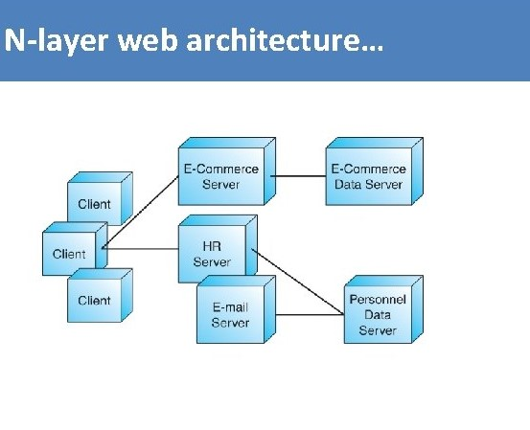

ARCHITECTURE
N-Layers
Micro Service

Slide 8
03
DATABASE PROJECT

Slide 9
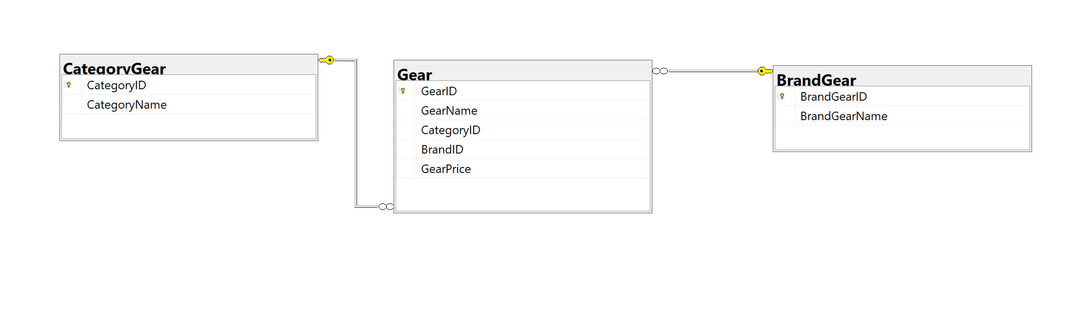
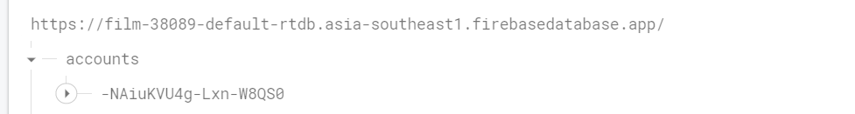
DATABASE

Slide 10
04
FEATURES OF PROJECT

Slide 11
LOG IN
01
REGISTER
02
FEARTURES
05
ADD NEW
06
UPDATE
VIEW DATA
03
SEARCH
04
07
DELETE

Slide 12
05
DEMO

Slide 13
THANKS
Does anyone have any questions?

