Slide 1
Generate Reports Use Case Presentation

Slide 2
Introduction
Significance:
Why "Generate Reports" Matters:
In the intricate world of retail management, data is king. The ability to distill meaningful information from our system's vast repository is what sets our B2B Information System apart. The "Generate Reports" use case empowers our agents by providing a lens into critical aspects of their retail stores.
Key Points
Data-Driven Decision Making
Operational Insights
Strategic Advantage

Slide 3
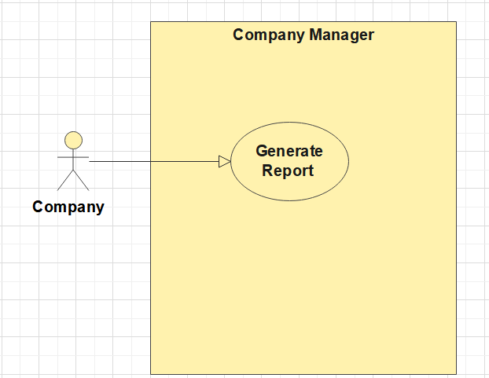
Use Case Overview

Slide 4
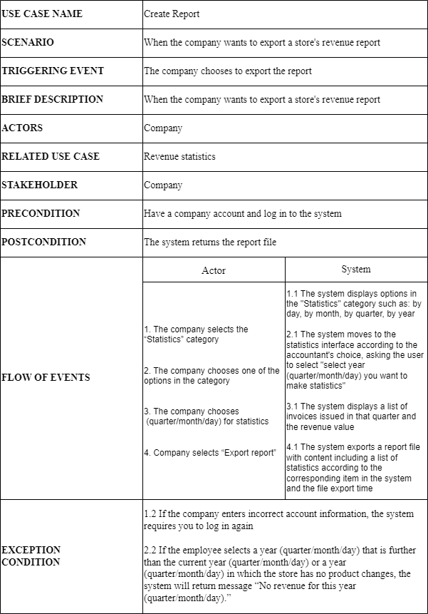
Use case description

Slide 5
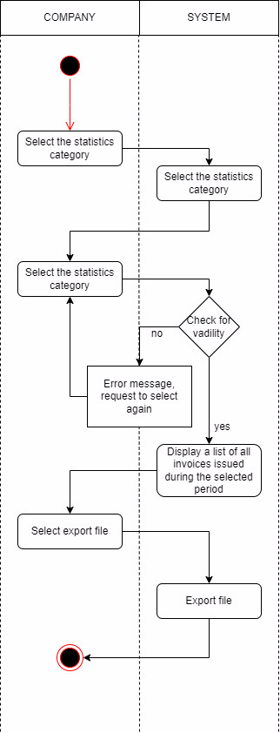
Activity diagram

Slide 6
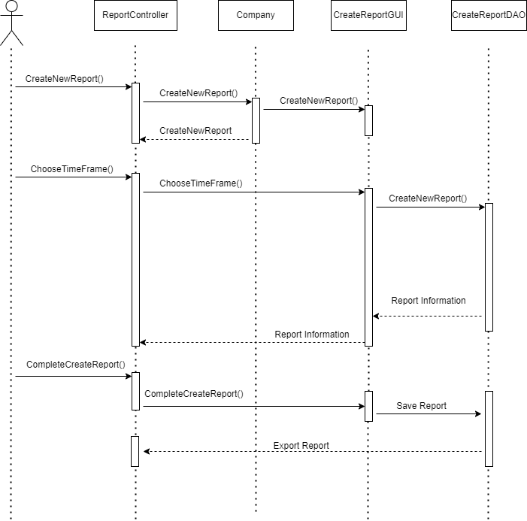
System sequence diagram

Slide 7
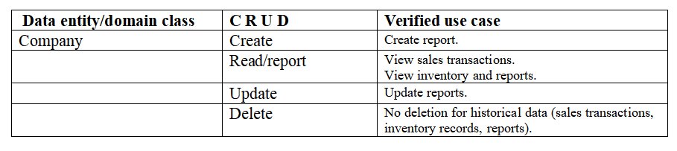
Verifying use cases for Actor

Slide 8
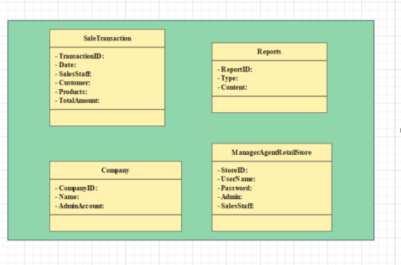
Domain class

Slide 9
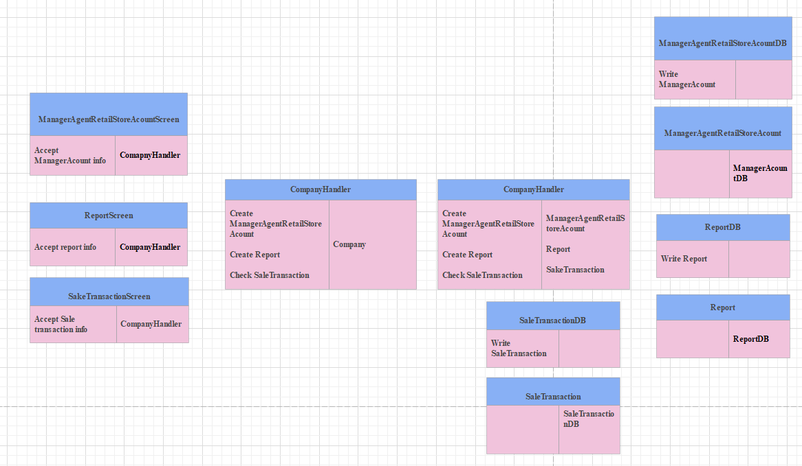
Data Access

Slide 10
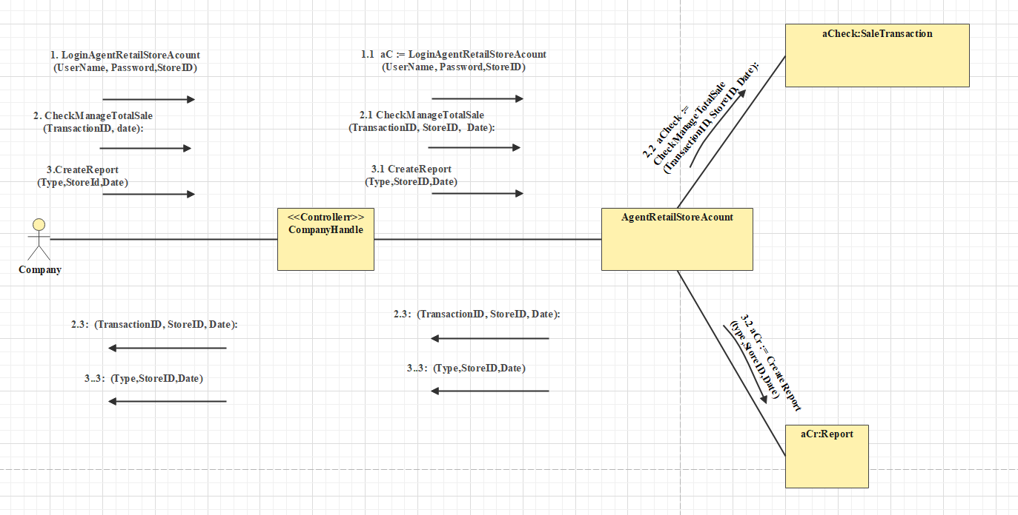
OOD with Communication

Slide 11
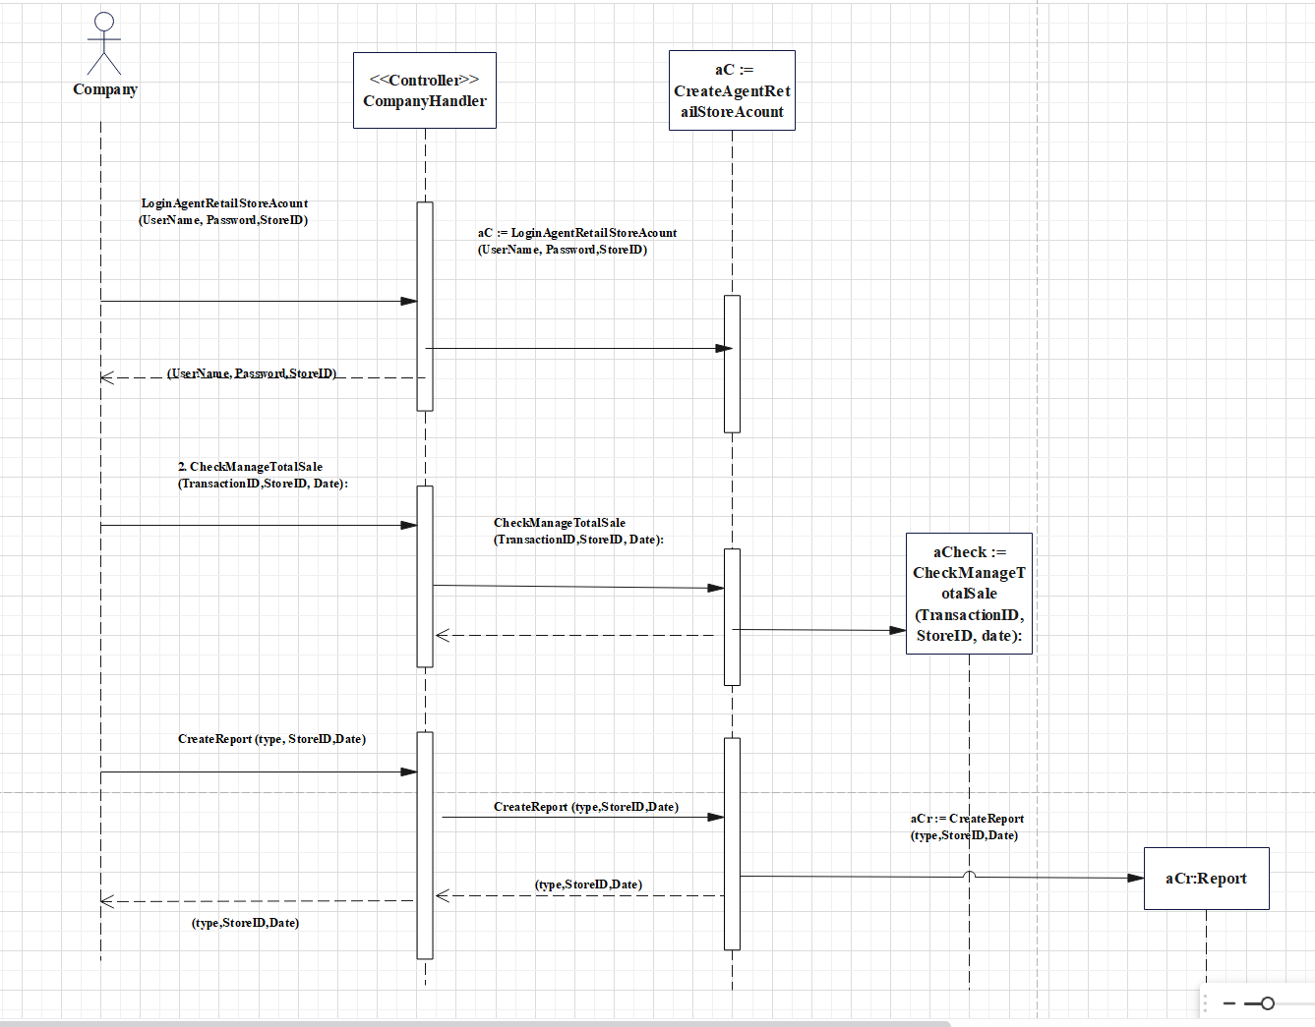
OOD with Sequence Diagram

Slide 12
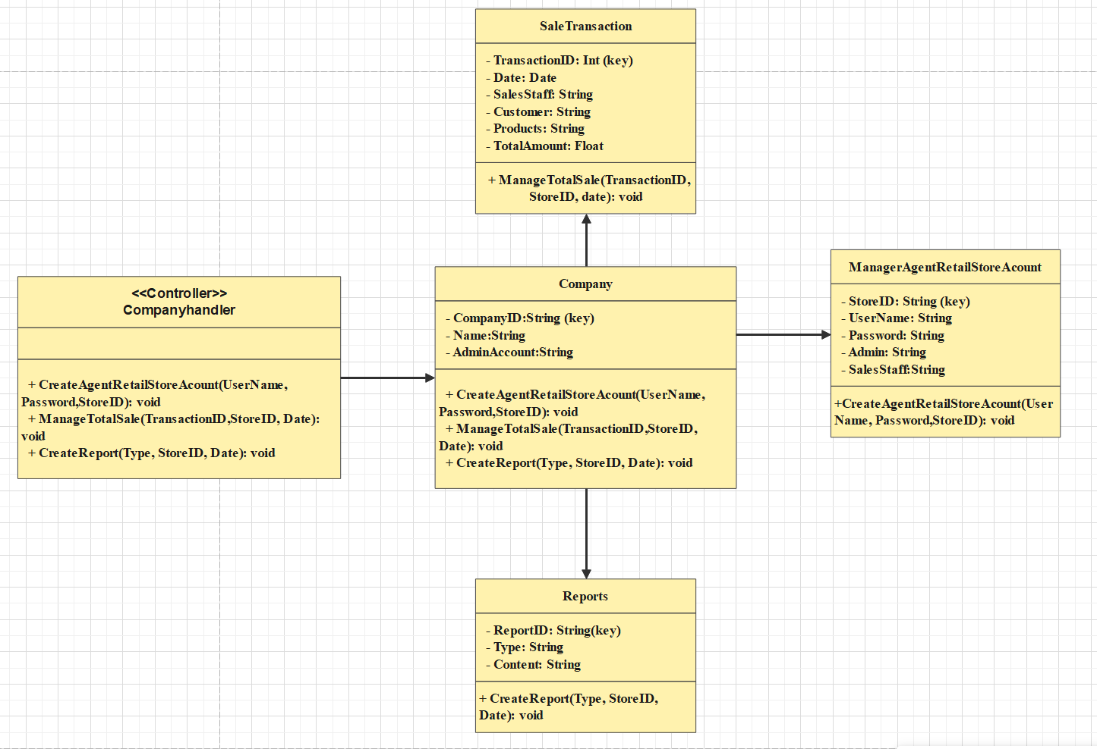
Final Design Class Diagram

Slide 13
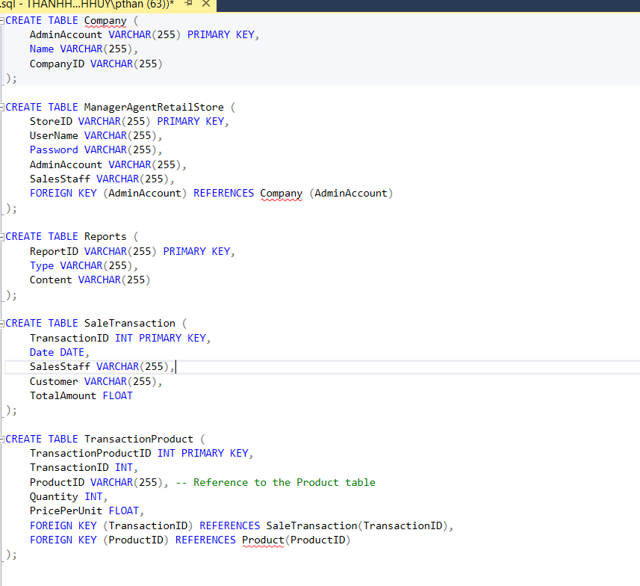
SQL Code

Slide 14
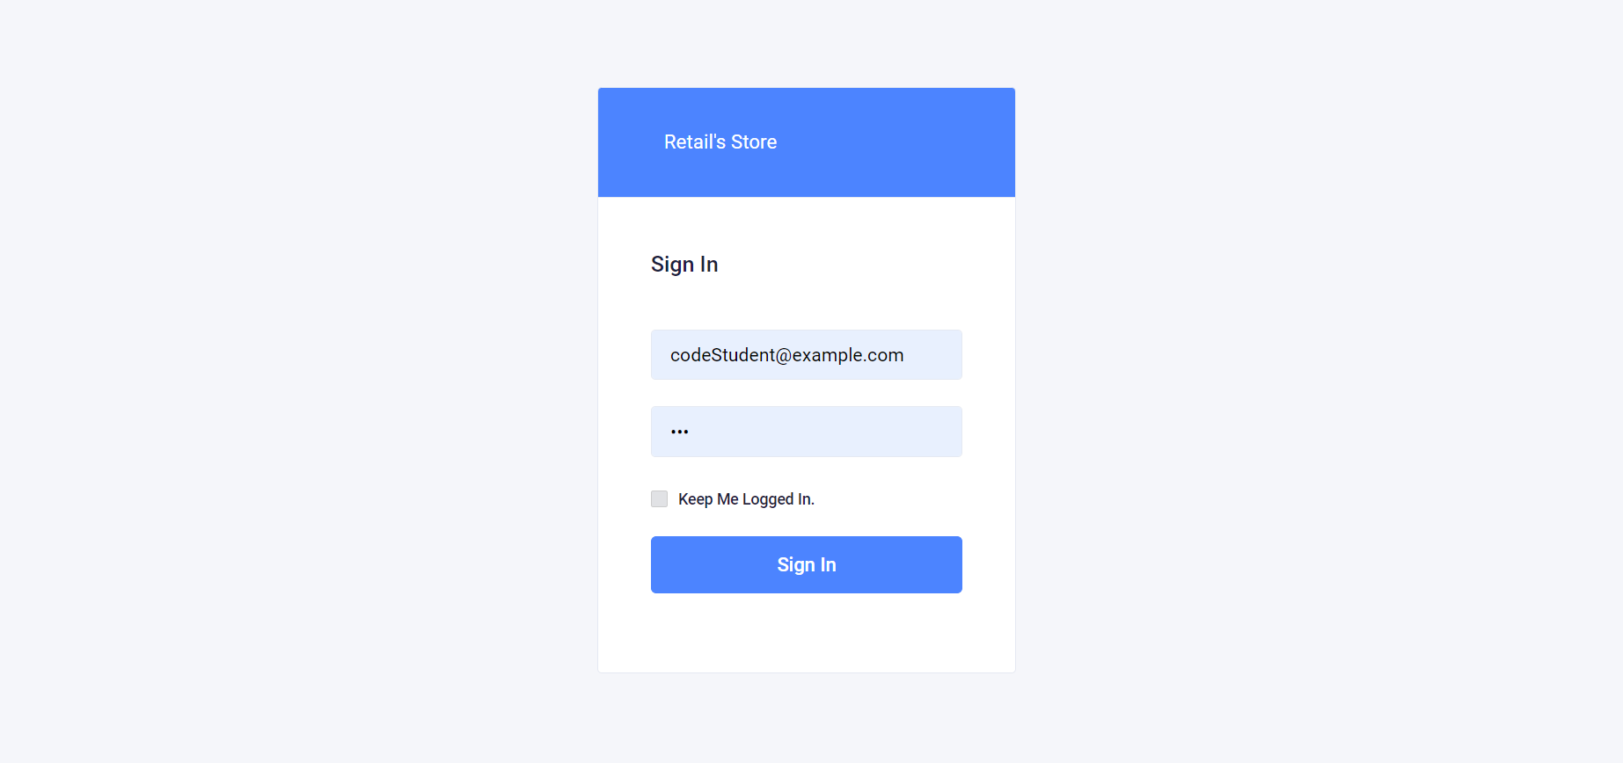
UI for Use Case

Slide 15
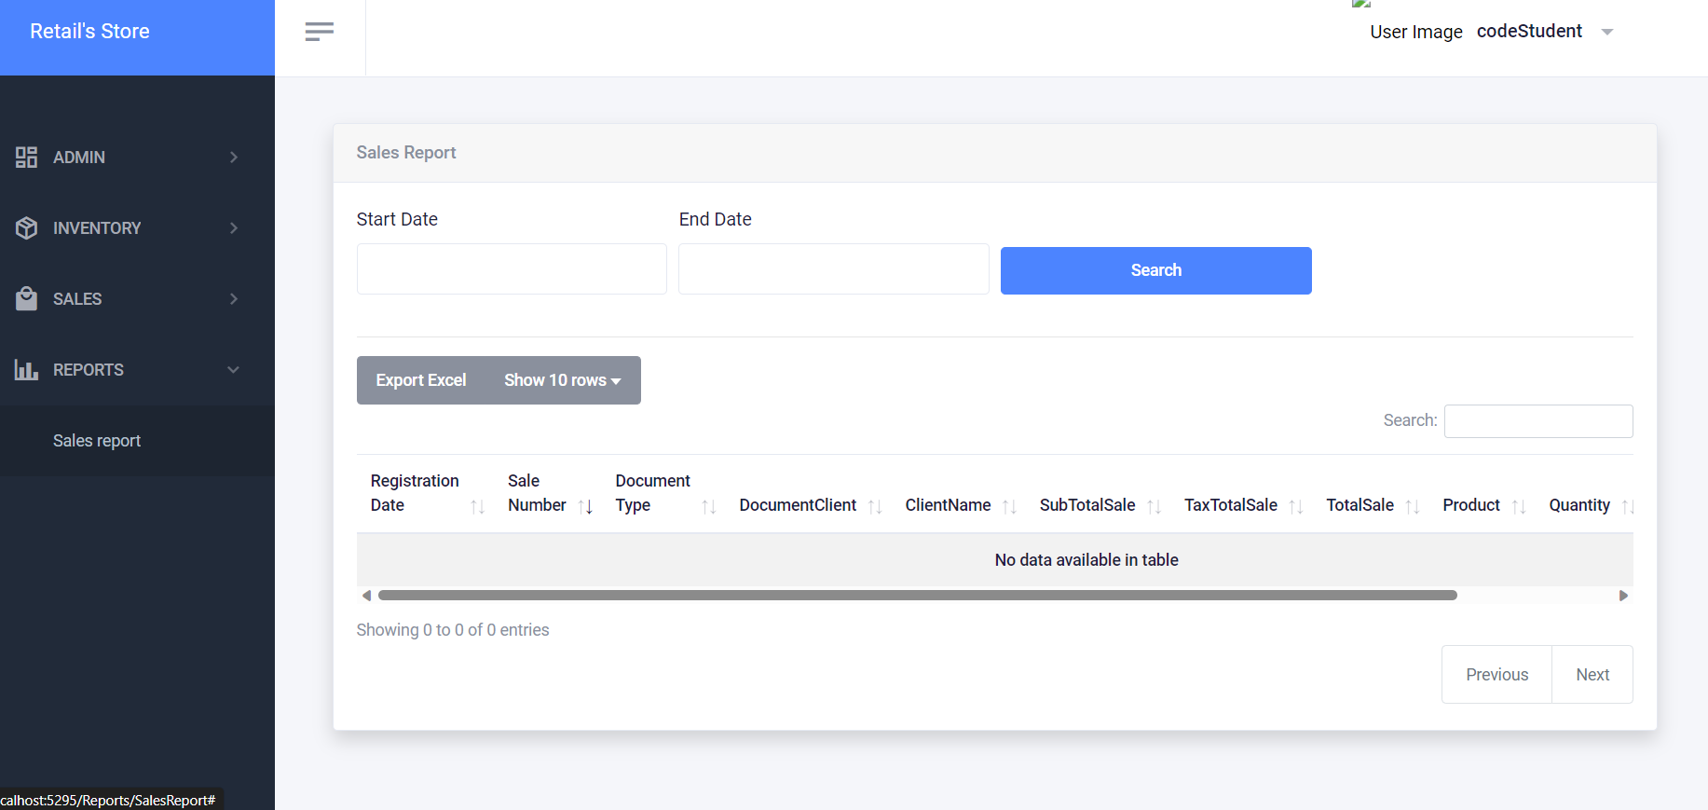

Slide 16
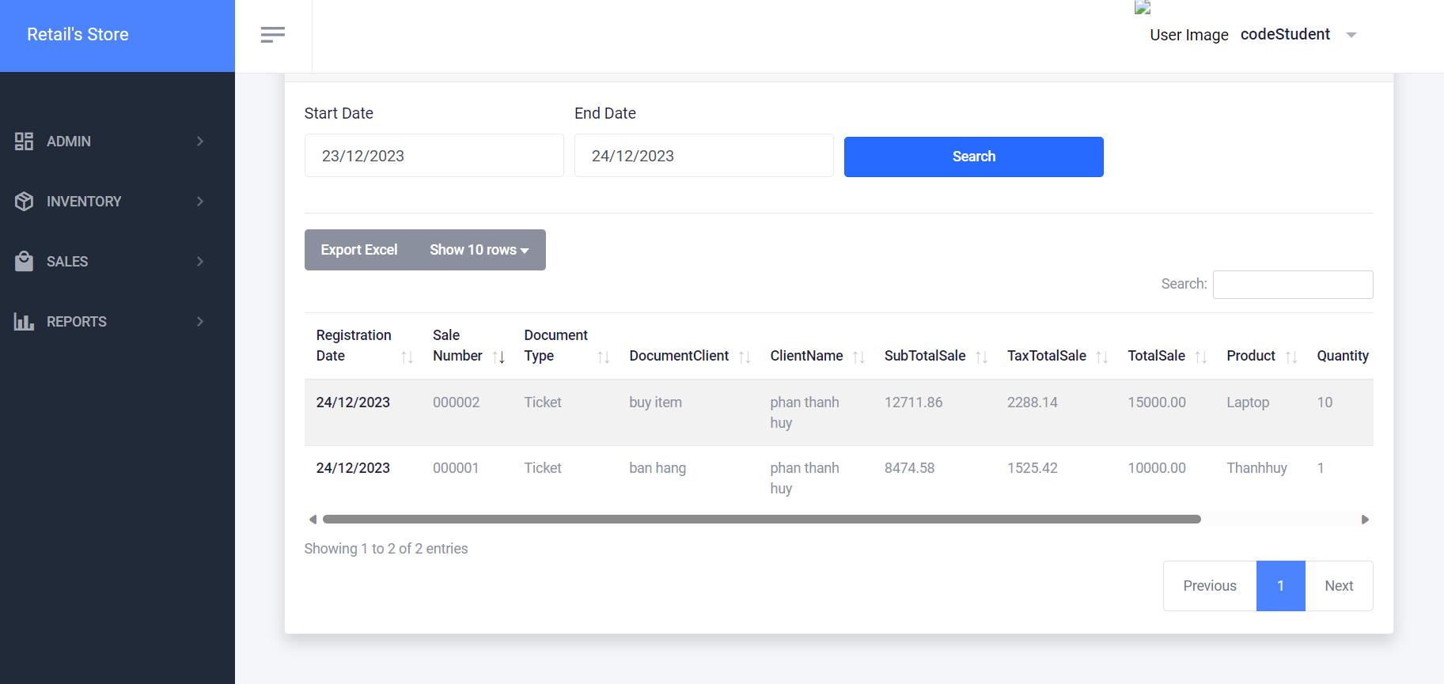

Slide 17
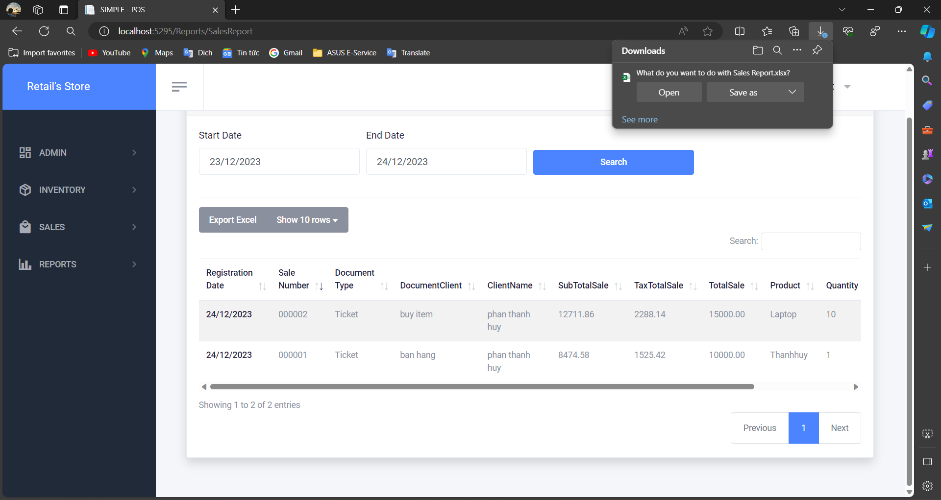

Slide 18
Test Case
Test Scenario:
Agent initiates the "Generate Reports" use case to create a Quarterly Income Report for the last quarter.
Test Steps:
a. Agent logs into the system.
b. Agent navigates to the "Generate Reports" section.
c. Agent selects "Income Report" as the report type.
d. Agent sets the date range for the last quarter.
e. Agent clicks "Generate Report."
Expected Outcomes:
a. The system processes the request without errors.
b. An income report is generated, displaying relevant data.
c. The report includes income details for the specified date range.
d. The UI presents the report in a clear and organized format.
e. Options to export or print the report are available.

Slide 19
Test Case
Importance of Testing:
a. Functionality: Ensure all features work as intended, from selecting parameters to report generation.
b. User Experience: Evaluate the clarity, usability, and responsiveness of the UI.
c. Error Handling: Verify that the system provides meaningful error messages in case of issues.
d. Data Accuracy: Confirm that the generated report accurately reflects the income for the specified period.
Conclusion:
Successful execution of this test case validates the functionality and user experience of the "Generate Reports" use case, ensuring that our agents can rely on accurate and accessible data for informed decision-making.

Slide 20
THANKS

