Slide 1
Norbert Wiener part II
Cybernetics in mid 20th century

Slide 2
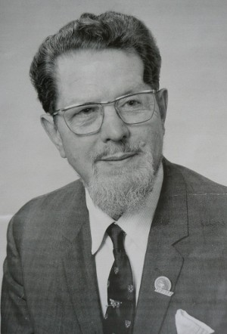
Computing Machines and Nervous Systems
W.Grey Walter in 1947 build the first autonomous
Robot as an aid to study animal behavior. He also
Invented EEG.
His first robots, which he used to call Machina
speculatrix and named Elmer and Elsie, were
constructed between 1948 and 1949 and were often
described as tortoises due to their shape and slow rate
of movement - and because they "taught us" about
the secrets of organisation and life. The three-wheeled
tortoise robots were capable of phototaxis, by which
they could find their way to a recharging station when they ran
low on battery power.

Slide 3
Biology and machines based on Analog principle
Walter stressed the importance of using purely analogue electronics to simulate brain processes at a time when his contemporaries such as Alan Turing and John von Neumann were all turning towards a view of mental processes in terms of digital computation.
BEAM robotics (from Biology, Electronics, Aesthetics and Mechanics) is a style of robotics that primarily uses simple analogue circuits, such as comparators, instead of a microprocessor in order to produce an unusually simple design. While not as flexible as microprocessor based robotics, BEAM robotics can be robust and efficient in performing the task for which it was designed.

Slide 4
NEW CYBERNETICS
In the 1970s, new cyberneticians emerged in multiple fields, but especially in biology. The ideas of Maturana, Varela and Atlan, according to Jean-Pierre Dupuy (1986) "realized that the cybernetic metaphors of the program upon which molecular biology had been based rendered a conception of the autonomy of the living being impossible. Consequently, these thinkers were led to invent a new cybernetics, one more suited to the organizations which mankind discovers in nature - organizations he has not himself invented.
A notable application to the biology world would be that, in 1955, the physicist George Gamow published a prescient article in Scientific American called "Information transfer in the living cell", and cybernetics gave biologists Jacques Monod and François Jacob a language for formulating their early theory of gene regulatory networks in the 1960s

Slide 5
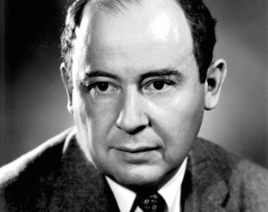
John Von Neuman 1940
von Neumann cellular automata, and their logical follow up, the von Neumann Universal Constructor.
The result of these deceptively simple thought-experiments was the concept of self replication, which cybernetics adopted as a core concept. The concept that the same properties of genetic reproduction applied to social memes, living cells, and even computer viruses is further proof of the somewhat surprising universality of cybernetic study.

Slide 6
MICRO-MACRO GAP
One characteristic of the emerging new cybernetics considered in that time by Felix Geyer and Hans van der Zouwen, according to Bailey (1994),^{[20]} was "that it views information as constructed and reconstructed by an individual interacting with the environment. This provides an epistemological foundation of science, by viewing it as observer-dependent. Another characteristic of the new cybernetics is its contribution towards bridging the micro-macro gap. That is, it links the individual with the society".^{[20]} Another characteristic noted was the "transition from classical cybernetics to the new cybernetics [that] involves a transition from classical problems to new problems. These shifts in thinking involve, among others, (a) a change from emphasis on the system being steered to the system doing the steering, and the factor which guides the steering decisions; and (b) new emphasis on communication between several systems which are trying to steer each other".[

Slide 7
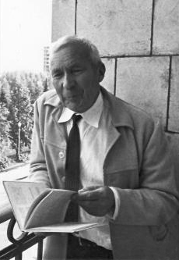
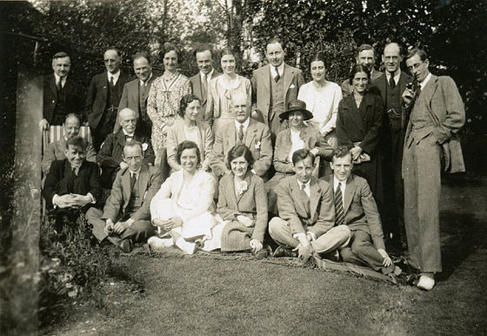
Andrej Nikolajevich Kolmogorov and George Gamow

Slide 8
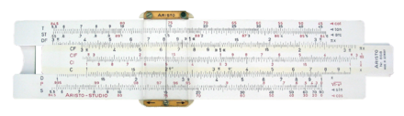
Digital principles
The abacus was initially used for arithmetic tasks. The Roman abacus was developed from devices used in Babylonia as early as 2400 BC. Since then, many other forms of reckoning boards or tables have been invented. In a medieval European counting house, a checkered cloth would be placed on a table, and markers moved around on it according to certain rules, as an aid to calculating sums of money.
Many mechanical aids to calculation and measurement were constructed for astronomical and navigation use.

Slide 9
Differential Analyser
The differential analyser, a mechanical analog computer designed to solve differential equations by integration, used wheel-and-disc mechanisms to perform the integration. In 1876 Lord Kelvin had already discussed the possible construction of such calculators, but he had been stymied by the limited output torque of the ball-and-disk integrators.^{[14]} In a differential analyzer, the output of one integrator drove the input of the next integrator, or a graphing output. The torque amplifier was the advance that allowed these machines to work. Starting in the 1920s, Vannevar Bush and others developed mechanical differential analyzers.

Slide 10
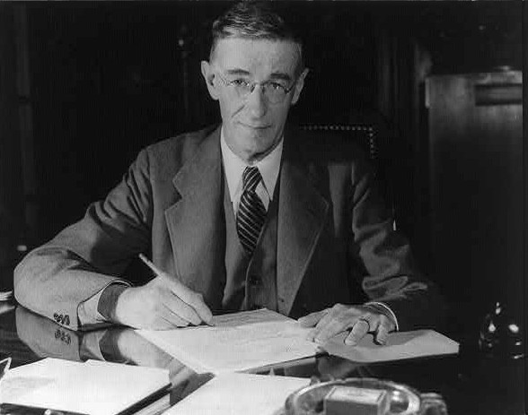
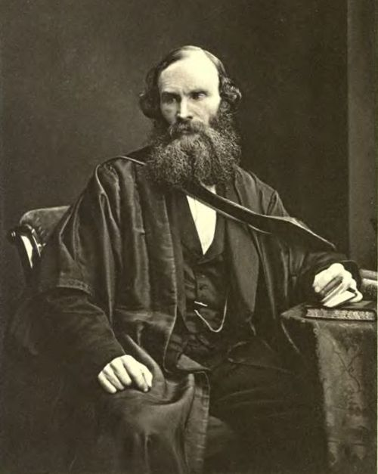
Lord kelvin and Vannavar Bush

Slide 11
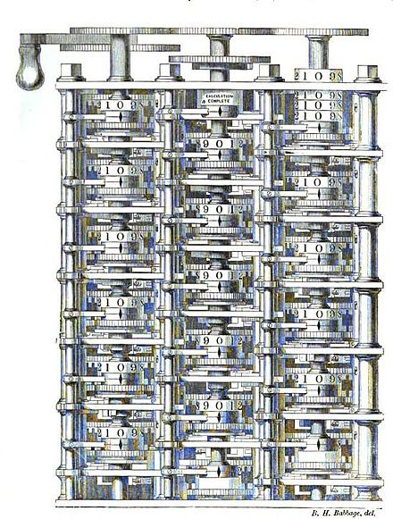
Charles Babbage an English mechanical engineer and polymath, originated the concept of a programmable computer. Considered the "father of the computer",^{[15]} he conceptualized and invented the first mechanical computer in the early 19th century.
The input of programs and data was
to be provided to the machine via punched
Cards a method being used at the time to
direct mechanical looms such as
the Jacquard loom

Slide 12
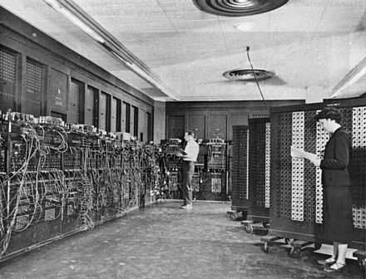

Slide 13
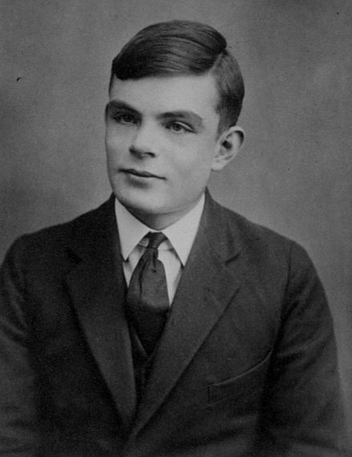
Alan Turing
Computer Scientist
Mathematician
Theoretical Biologist

Slide 14
Norbert Wiener recap and gestalt and Universals
Virtually all of the principles which Wiener enumerated as being desirable characteristics of calculating and data processing machines have been adopted in the design of digital computers, from the early mainframes of the 1950s to the latest microchips.
This brief chapter is a philosophical enquiry into the relationship between the physical events in the central nervous system and the subjective experiences of the individual. It concentrates principally on the processes whereby nervous signals from the retina are transformed into a representation of the visual field. It also explores the various feedback loops involved in the operation of the eyes: the homeostatic operation of the retina to control light levels, the adjustment of the lens to bring objects into focus, and the complex set of reflex movements to bring an object of attention into the detailed vision area of the fovea. The chapter concludes with an outline of the challenges presented by attempts to implement a reading machine for the blind.

Slide 15
Cybernetics and Sociology
It is remarckable that Wiener in 40s already thought about the influence of Cybernetics and Psychology, The language,Informrtion and Society.
In this regard we will touch upon the Action Theory –Theory of Sociological Scheme by Talcot Parsons around 1950-`1970. He espoused the Structure of Social Actions as a unified MAP of All action Systems and ultimately all Living Systems. He called it AGIL
Which stands for ADAPTATION (Capacity of the society adpt to its environment),ATTAINMENT (Capacity to set goals)INTEGRATION (Integrate its components:Values and Norms) LATENCY(maintain the integrative elements:schools, belief systems).

Slide 16
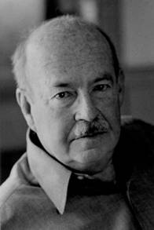
Talcot PARSONS

Slide 17
Wiener thought of LEARNING and Selfreproducing machines
Wiener expands the discussion to John von Neumann's theory of games, and the application to military situations. He then speculates about the manner in which a chess-playing computer could be programmed to analyse its past performances and improve its performance. This proceeds to a discussion of the evolution of conflict, as in the examples of matador and bull, or mongoose and cobra, or between opponents in a tennis game.

Slide 18
Brain Waves and self Organizing systems
This chapter opens with a discussion of the mechanism of evolution by Natural Selection, which he refers to as "phylogentic learning", since it is driven by a feedback mechanism caused by the success or otherwise in surviving and reproducing; and modifications of behaviour over a lifetime in response to experience, which he calls "ontogenetic learning". He suggests that both processes involve non-linear feedback, and speculates that the learning process is correlated with changes in patterns of the rhythms of the waves of electrical activity that can be observed on an electroencephalograph.

Slide 19
Conclusions
I hope I convinced you that development of science, build over the centuries by mathematicians and physicist, later by chemist. It is interesting to note that sometimes the mathematical models/tools were developed in abstract which eventually found their way to describe, explain the natural phenomena. Some other time the physical phenomena were observed before there were mathematically described.
It is also clear from this history that physical scientists were from the beginning intrigued by the living creatures, tried to analyze them, mimic their behavior.

Slide 20
The Message
We all (in science/engineering) are standing on the shoulders of the previous generations.
Scientific discoveries and their models for prediction depend on the scale (special and/or time) which is enabled by the instruments available at that time.
Science and scientists come from all over the world, it was true in BC and AD , hence Science is GLOBAL.
When you think what has changed during the centuries , the mathematical concepts given the right scale of abstraction do not change. What has changed are the instruments of available observations which then in turn they question the old theoretical concepts that were develop for the old at that time available scale.

