Slide 1
Robotics and Societal Impact
Ruzena Bajcsy
June 2017

Slide 2
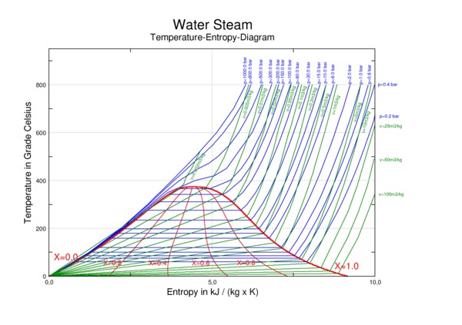
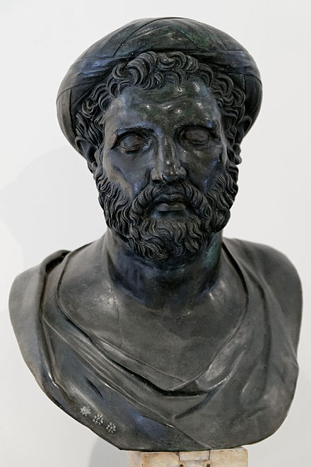
Short history (from Wikipedia)
History of Robots has its origin in the Ancient World. It goes back to the 4th Century BC with Greek Mathematician ARCHYTAS of TARENTUM who postulated a mechanical bird called :THE PIGEON
propelled by steam.

Slide 3
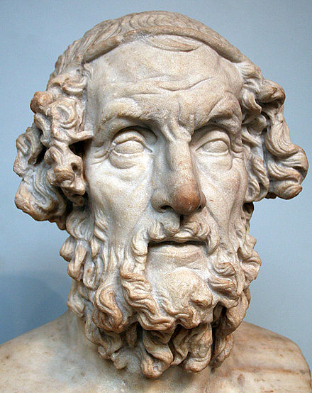
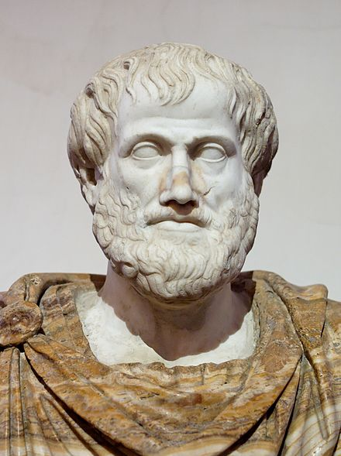
History ,cont.
Reference to HOMER’s ILLIAD and ARISTOTEL speculate in POLITICS (cc.322BC) that Autmaton could someday abolish Slavery.

Slide 4
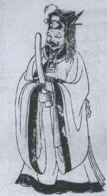
History, cont.
Similar ideas emerged in China by LIE ZI (3d century BC), in his text KING MU of ZHOU (1023-957 BC) is presented with a life size human shaped Mechanical Figure by Yan Shi the artificier. Su Song in 1088 featured mechanical manekins.
They chimed the hours, ringing
Gongs and bells.

Slide 5
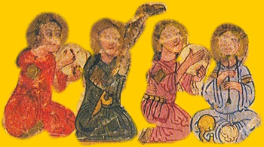
History
Al-Jazari (1136-1206) Muslim Inventor,contructed automatic machines, kitchen appliances,
Musical automata powered
By water.

Slide 6
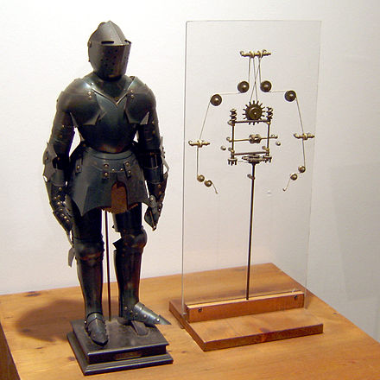
History
One of the FIRST recorded designs of Humanoid Robots was made by LEONARDO DA VINCI in 1495.
Around 1700 many Automatons
Were built,including once capable
Of acting, drawing, flying and
Playing music.

Slide 7
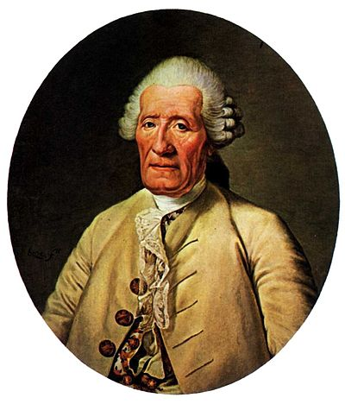
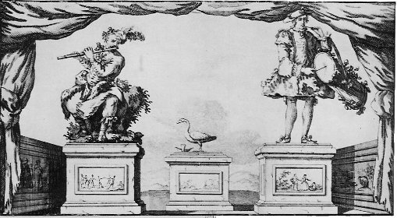
History
Jacques de Vaucanson in 1737 created a flute payer, a tambourine player, but the most famous is “DIGESTING DUCK”, powered by weights imitating a real duck, by flapping wings, eat grain, digest it and then defecate by exerting matter stored in hidden compartment.

Slide 8
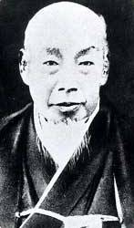
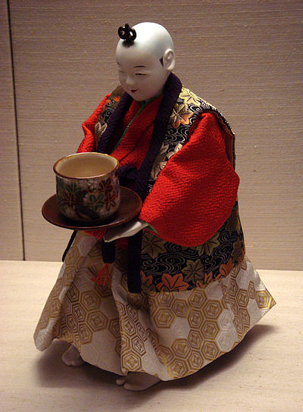
History
Japanese Craftsmen HISHASHIGE TANAKA known as Japanese EDISON, created an array of complex Mechanical Toyes.

Slide 9
Remote Controlled Systems
Remotely Controlled Vehicles were demonstrated in th elate 19th century- as remotely controlled TORPEDOS by John ERICSSON (pneumatic) , John Luis Lay (guided by electric wire) and Victor von Scheliha (guided by electric wire). Luis Brennan (1877) developed a torpedo powered by two contra-rotating propellers that were spun by Rapidly pulling out wires from drums inside of torpedo.

Slide 10
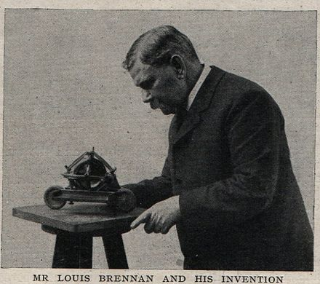
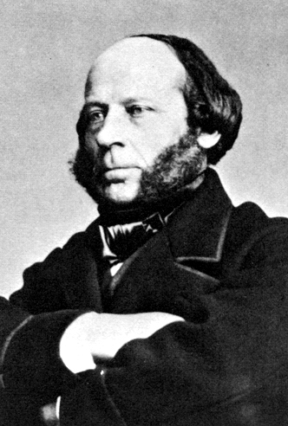
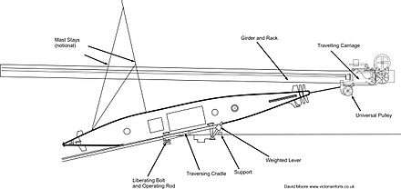
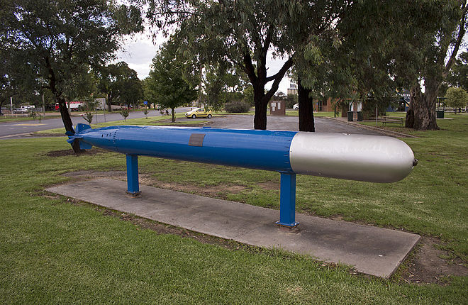

Slide 11
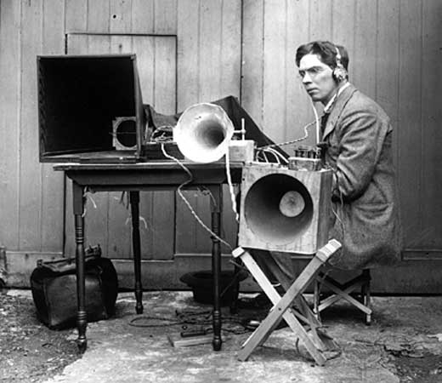
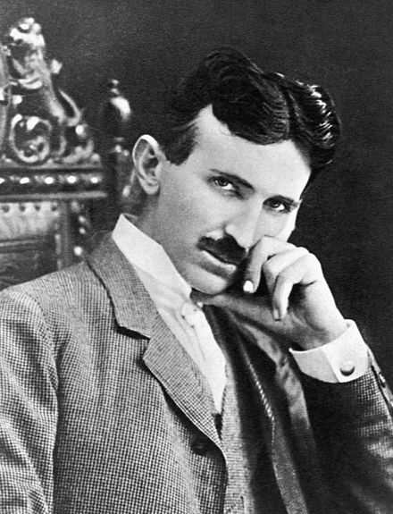
Wireless control
Nikola Tesla in 1898 demonstrated wireless radio controlled torpedo.
Archibald Low was known as father of radio guidance systems and for his pioneering work on guided rockets and planes during the WW1.

Slide 12
Humanoid Robots
The term ROBOT was first used to denote fictional AUTOMATA in 1921, in play RUR by Karel CAPEK. The word was created by his brother Josef for Czech “Robota” meaning Servitude.
The first humanoid robot was a soldier with a trumpet made in 1810 by Friedrich Kaufman in Dresden, Germany.
In 1928 W.H.Richard invented a robot, named ERIC, constructed of Aluminum body with 11 electromagnets and one motor powered by 12 V power source. It oculd move its hands, head controlled by Voice.

Slide 13
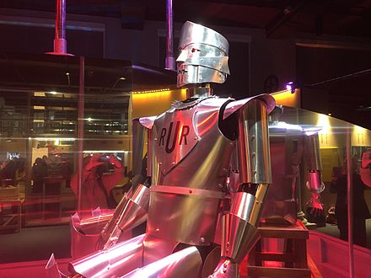
ERIC the robot, 1928.

Slide 14
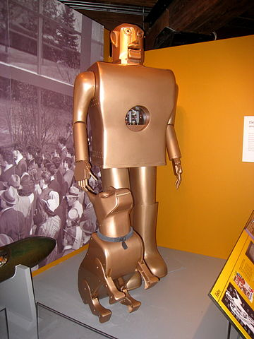
Westing House Corp.7feet high,can walk,move hands/head, weight 265pounds.
In 1926 build TELEVOX and then later Humanoid Robot ELEKTRO

Slide 15
Modern AutonomousRobots
In 1941,1942 Isaac Asimov formulated 3 laws of robotics, hence introduced the word ROBOTICS.
Norbert Wiener formulated the principles of CYBERNETICS.
Norbert Wiener in 1948 defined Cybernetics as the scientific study of CONTROL and Communication in the animal and machine.
Cybernetics is relevant to mechanical, Physical,Biological ,Cognitive and Social Systems.
Cybernetics include study of feedback, black boxes, control in living organisms and machines,organization and self-organization.

Slide 16
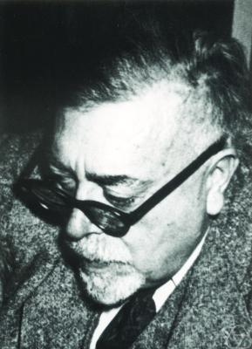
Norbert Wiener,born 1894,died 1964.

Slide 17
The roots of Cybernetics.
The word cybernetics was first used in the context of "the study of self-governance" by Plato in The Alcibiades to signify the governance of people.^{[14]} The word 'cybernétique' was also used in 1834 by the physicist André-Marie Ampère (1775–1836) to denote the sciences of government in his classification system of human knowledge.
The first artificial automatic regulatory system was a water clock, invented by the mechanician Ktesibios; based on a tank which poured water into a reservoir before using it to run the mechanism, it used a cone-shaped float to monitor the level of the water in its reservoir and adjust the rate of flow of the water accordingly to maintain a constant level of water in the reservoir.

Slide 18
Early 20th century
Contemporary cybernetics began as an interdisciplinary study connecting the fields of control systems, electrical network theory, mechanical engineering, logic modeling, evolutionary biology and neuroscience in the 1940s; the ideas are also related to the biological work of Ludwig von Bertalanffy in General Systems Theory. Electronic control systems originated with the 1927 work of Bell Telephone Laboratories engineer Harold S. Black on using negative feedback to control amplifiers.
The founder of System Dynamics, Jay Forrester, during WWII a graduate student at the Servomechanisms Laboratory at MIT, working with Gordon S. Brown to develop electronic control systems for the U.S

Slide 19
W. Edwards Deming, the Total Quality Management guru for whom Japan named its top post-WWII industrial prize, was an intern at Bell Telephone Labs in 1927 and may have been influenced by network theory; Deming made "Understanding Systems" one of the four pillars of what he described as "Profound Knowledge" in his book "The New Economics."
Numerous papers spearheaded the coalescing of the field. In 1935 Russian physiologist P. K. Anokhin published a book in which the concept of feedback ("back afferentation") was studied. The study and mathematical modelling of regulatory processes became a continuing research effort and two key articles were published in 1943: "Behavior, Purpose and Teleology" by Arturo Rosenblueth, Norbert Wiener, and Julian Bigelow; and the paper "A Logical Calculus of the Ideas Immanent in Nervous Activity" by Warren McCulloch and Walter Pitts.

Slide 20
Basics of Wiener’s theory
The Book of Wiener laid the theoretical Foundation for servo mechanisms (electrical, mechanical or hydrolic) Automatic Navigation ,Analog Computing, AI, Neuroscience and reliable Communictation.
Wiener traces the origins of Cybernetic Analysis to the philosophy of LIEBNITZ, citing his work on universal symbolism and calculus of reasoning.
Newtonian and Bergsonian Time:
This chapter explores the contrast between the time reversible processes governed by Newtonian mechanics and time IRREVERSIBLE processes in accordance with the second law of Thermodynamics.

Slide 21
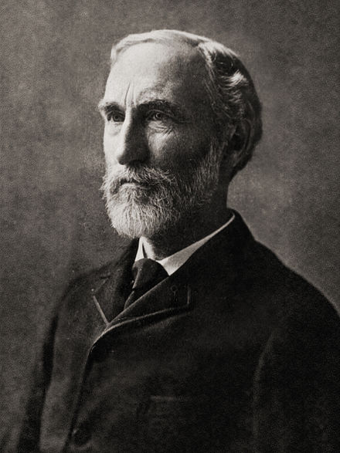
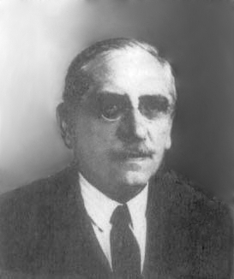
next chapter:Groups and Statistical Mechanics
In the early 20th century Willard Gibbs (a Physicist) worked on statistical Approach to Newtonian dynamics and thermodynamics and Lebeque (mathematician)worked on trigonometric series had deep influence on Wiener.

Slide 22
Important Result
Wiener claims the Lebesque integral had an unexpected /important implications in establishing the validity of Gibb’s work on foundation of Statistical Mechanics. The notion of average and measure in the sense established by lebesque were needed to prove Gibb’s ERGODIC HYPOTHESIS.
Thereis a difference between Rieman Integral and Lebesque Integral. While in Rieman Integral one fills the area under the graph with smaller and smaller rectangles and takes the limit of the sums of the areas. However for some functions the total area does not approach the single number.

Slide 23
Cont.
Lebesque Use the CODOMAIN for his discretization.
First, he defines a measure for both sets and functions on those sets. Then he builds integral for a simple function, then defines more complex function as the least upper bound of all integrals of simple functions.Now we are ready to examine the ERGODIC HYPOTHESIS.
In Physics and Thermodynamics the ERGODIC HYPOTHESIS says that over long period of time spent by the system in some region of phase space of microstate with the same energy is proportional to the volume of the region.

Slide 24
ERGODICITY and Statistical mechanics
Ergodicity of a Dynamical System is a certain IRREDUCIBILITY PROPERTY. IRREDUCIBLE Representation in Algebra are prime number sin Arithmetics.
In Signal processing, a stochastic process in ergodic if its statistical properties can be deduced from a single long random sample of the process.
STATISTICAL MECHANICS uses probability theory to study average behavior of a Mechanical system, where the state is uncertain.
Statistical mechanics connects thermodynamics (heat capacity) to microscopic behavior.

Slide 25
Second Law of Thermodynamics
States that ENTROPY of Isolated system cannot decrease.
It can remain constantin the ideal case where the system is in already in steady state (equilibrium) or underging a reversible process. The increase in entropy accounts for irreversibility of natural process and ASYMMETRY between future and present.
The First law states the rules of conservation of energy, while the second shows the directions of natural processes.
The father of thermodynamics was Nicloas Leonard Sadi Carnot.

Slide 26
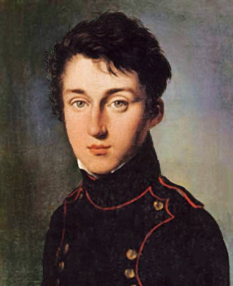

Slide 27
Chapter 3: Time series, Information and Communication
This is one of the more mathematically intensive chapters in the book. It deals with the transmission or recording of a varying analog signal as a sequence of numerical samples, and lays much of the groundwork for the development of digital audio and telemetry over the past six decades. It also examines the relationship between bandwidth, noise, and information capacity, as developed by Wiener in collaboration with Claude Shannon.

Slide 28
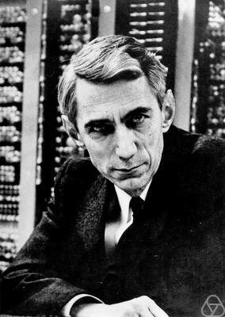
Claude Shannon 1916-2001

Slide 29
Chapter 4:Feedback and Oscilations
This chapter lays down the foundations for the mathematical treatment of negative feedback in automated control systems. The opening passage illustrates the effect of faulty feedback mechanisms by the example of patients suffering from various forms of ataxia. He then discusses railway signalling, the operation of a thermostat, and a steam engine centrifugal governor. The rest of the chapter is mostly taken up with the development of a mathematical formulation of the operation of the principles underlying all of these processes. More complex systems are then discussed such as automated navigation, and the control of non-linear situations such as steering on an icy road. He concludes with a reference to the homeostatic processes in living organisms.

Slide 30
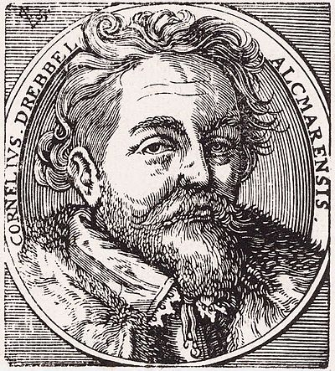
More on feedback history
Possibly the earliest recorded examples of thermostat control were built by the Dutch innovator Cornelis Drebbel1572–1633) around 1620 in England. He invented a mercury thermostat to regulate the temperature of a chicken incubator.^{[1]} This is one of the first recorded feedback-controlled devices.

Slide 31
Steam Engine
Is a HEAT engine that performs mechanical work, using steam as its working fluid.
In 1781 Scottish engineer James Watt patented a steam engine that produced continuous rotary motion.^{[4]} Watt's ten-horsepower engines enabled a wide range of manufacturing machinery to be powered. The stationary steam engine was a key component of the Industrial Revolution, allowing factories to locate where water power was unavailable. The atmospheric engines of Newcomen and Watt were large compared to the amount of power they produced, but high-pressure steam engines were light enough to be applied to vehicles such as traction engines and the railway locomotives.

Slide 32
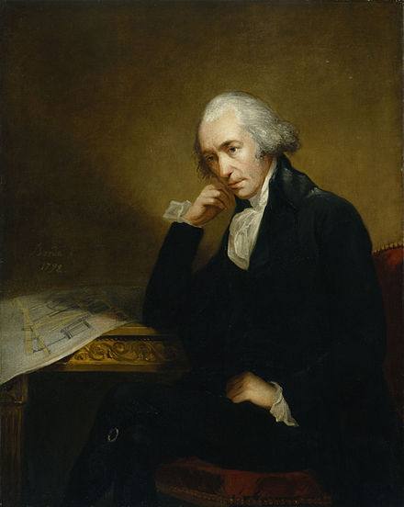
James Watt 1736-1819

Slide 33
Other applications of feedback systems
The first feedback position control device was the ship steering engine, used to position the rudder of large ships based on the position of the ship's wheel in 1866.
Electrical servomechanisms were used as early as 1888 in Elisha Gray’s Telautograph.
Next application was audio amplifiers, then Analog computing feedback and Operational amplifiers.
The simplest kind of servos use bang–bang control. More complex control systems use proportional control, PID control, and state space control, which are studied in modern control theory.
In organism ,feedback is in body temperature , blood sugar level and others called Homeostatic processes.

Slide 34
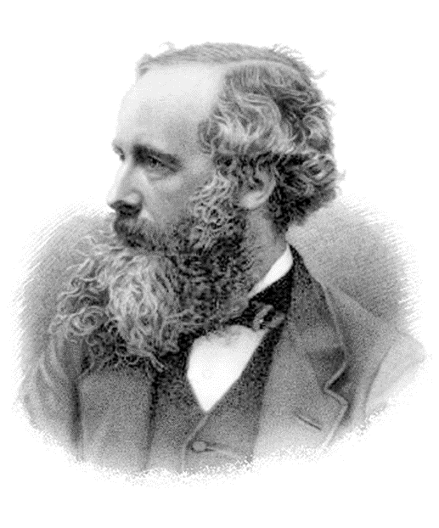
With feedback the question of stability
Of course his most notable achievement was to formulate the classical theory of electromagnetic radiation and unified electricity, magnetism and light. He also was the first who controlled oscilator (1868).
The term feedback however was established only in 1920
Boosting the Gain of amplifier. Harold Stephen BLOCK in
Bell Labs used negative feedback in electron amplifier,1927.
Niquist and Bode in Belllabs build on Block’s work and
Developed the Theory of amplifier stability.
In Biology ,using the ideas from engineering, modeled the homeostasis.

