Slide 1
Demostration of Sorting Algorithms
Bubble sort, Quick sort and Insertion sort

Slide 2
Member and Assigment
01
02
Dang Thanh Lam
Nguyen Quang Tung
20194442
Element, CreateArray, GeneralSort, BubbleSort class
Demostration screens and controller (bubbleSort.fxml, insertionSort.fxml, quickSort.fxml, SortController)
Write report
Make powerpoint presentation
20194462
InsertionSort, QuickSort class
Main menu screen and controller ( MainMenu.fxml, About.fxml, MainScreenController)
Main class
Write report
Record demo video

Slide 3
Problem description
Array is the most basic structure of computer science. Most operations as well as otherdata structures are built and performed on array. In this project, we will make an application inorder to explain three sorting algorithms on array: Bubble sort, Quicksort and Insertion sort

Slide 4
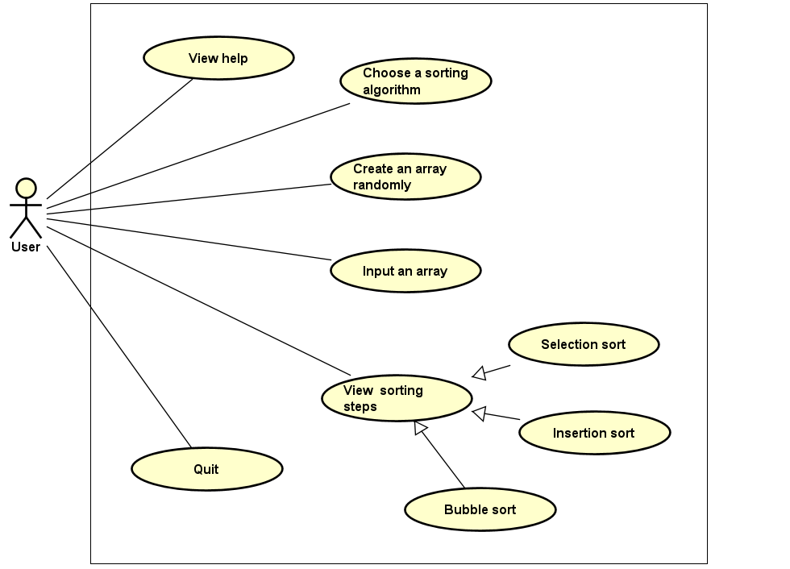
Usecase Diagram

Slide 5
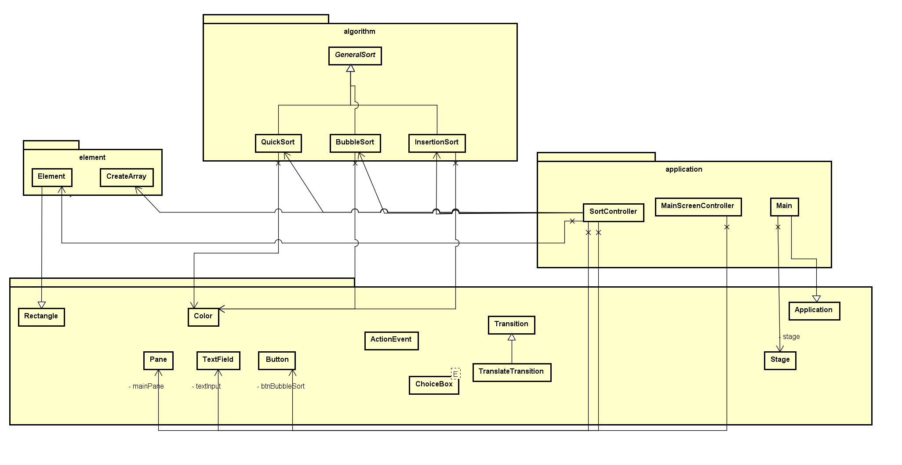
General Class Diagram

Slide 6
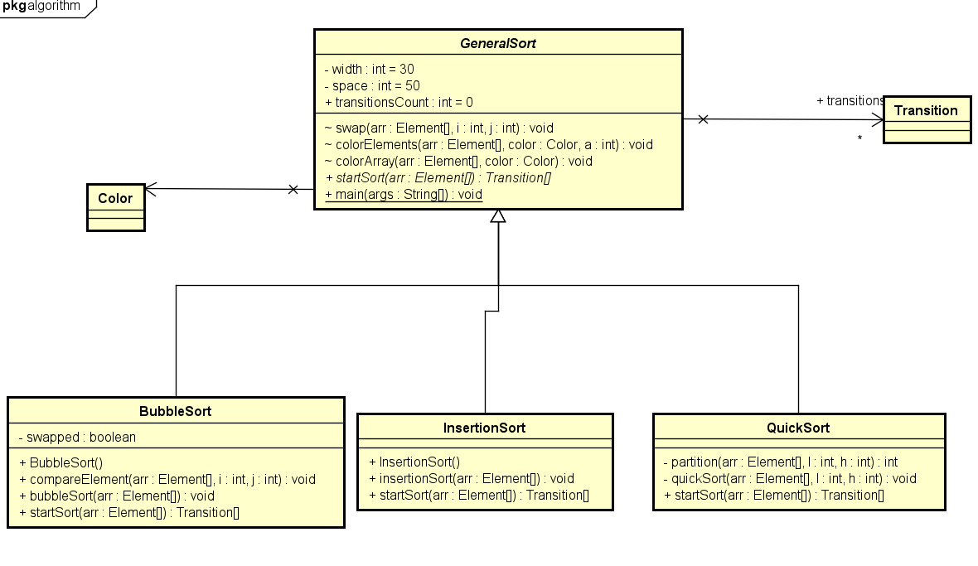
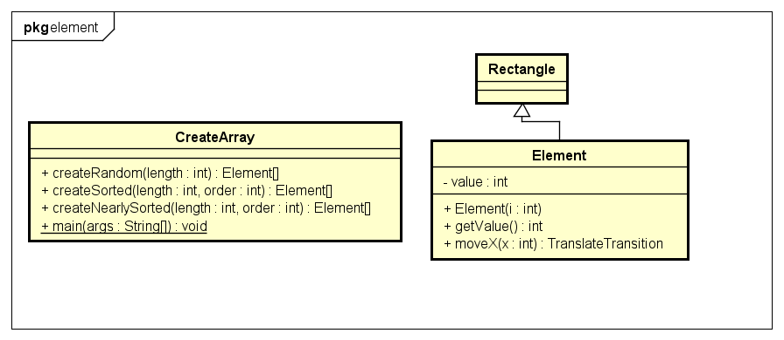
Detail Class Diagrams
Package Algorithm
Package Element

Slide 7
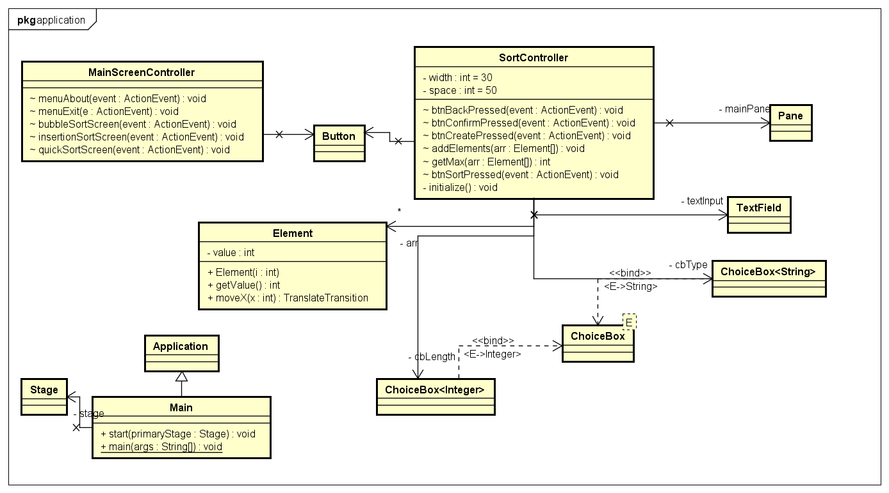
Detail Class Diagram
Package Application

Slide 8
OOP Techniques
Inheritance
Element class inherit from Rectangle class
QuickSort, BubbleSort and InsertionSort inherit from the abstract class GeneralSort
Main class inherit from the Application class
Abstraction
Abstract method startSort(Element[]) is defined in GeneralSort class and implemented in BubbleSort, QuickSort and InsertionSort class

Slide 9
OOP Techniques
Association
SortController class associates with CreateArray class, BubbleSort, QuickSort, InsertionSort class
Main class associate with Stage class.
SortController and MainScreenController associate with many elements from JavaFX to create the GUI.

Slide 10
Demostration Video Link
https://www.youtube.com/watch?v=4xfsTnZJx9g

