Slide 1

OOP Mini Project Presentation
Topic: 6.Ô Ăn Quan
Group: 16

Slide 2
Content
CONTENT
Member and Assignment
Problem Statement
Use Case Diagram
General Class Diagram
Package Class Diagram
OOP Technique Explanation
Project Demo

Slide 3
I. Member and Assignment
Dinh Ngoc Lap Thanh(Leader) – 20226000
Design Class Diagram and Use case Diagram
Write project Report
Write project source code
Design presentation
Exception in thread "main" java.lang.ArrayIndexOutOfBoundsException: Index 1 out of bounds for length 1

Slide 4
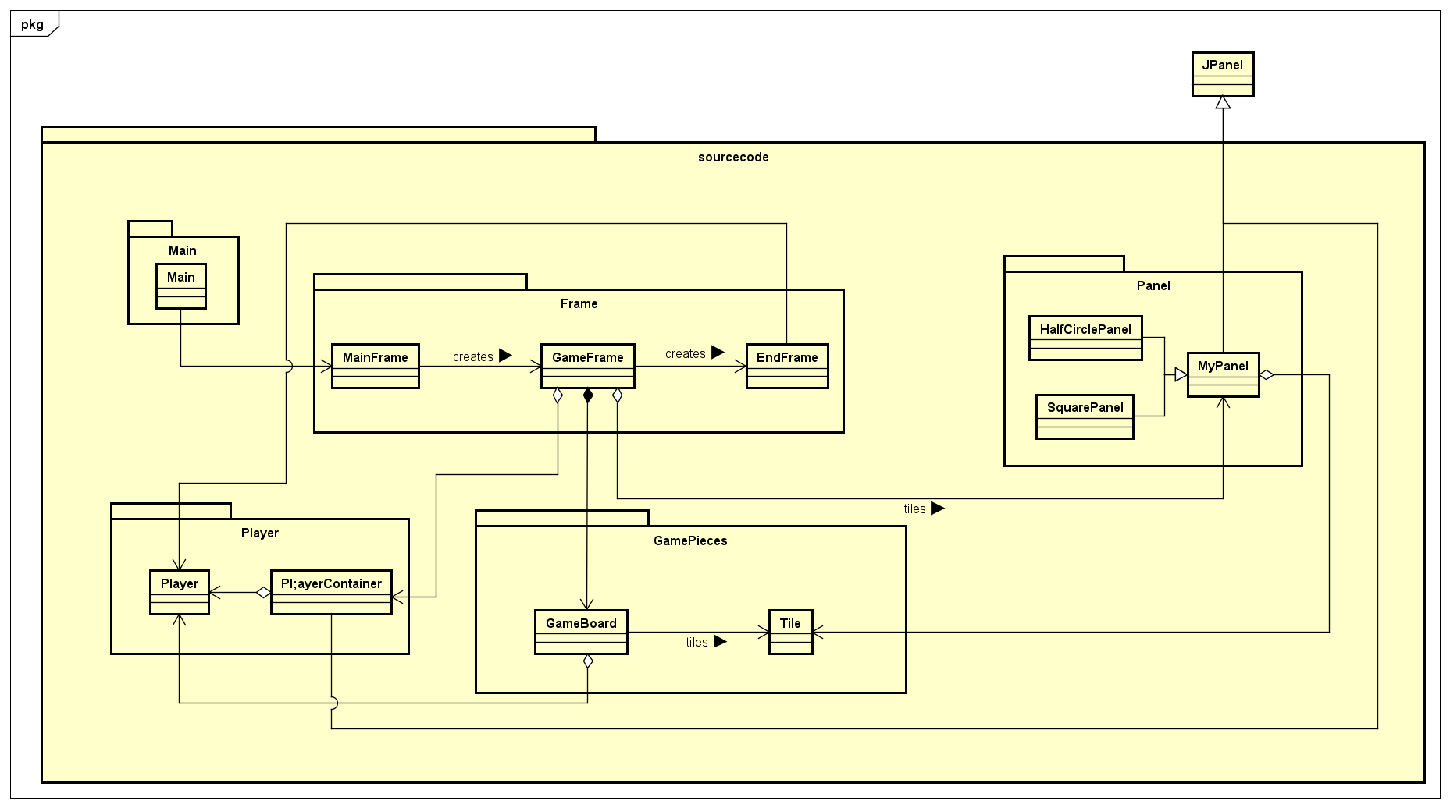
II. Problem Statement
Design a functioning game with main screen that include:
Start button: start the game
Exit button: exit the program with second confirmation from user
Help button: display game guideline
In the game screen:
A game board with 10 square tiles, each holding 5 “dan” and 2 half circles, each holding 1 “quan” each.
The application must notify players’ turn.
Players can select square and direction to spread gems. If condition meet, he/she will collect the gems in the consecutive squares according to the game’s instruction.
A notification of the winner when the game end and display players’ points.

Slide 5
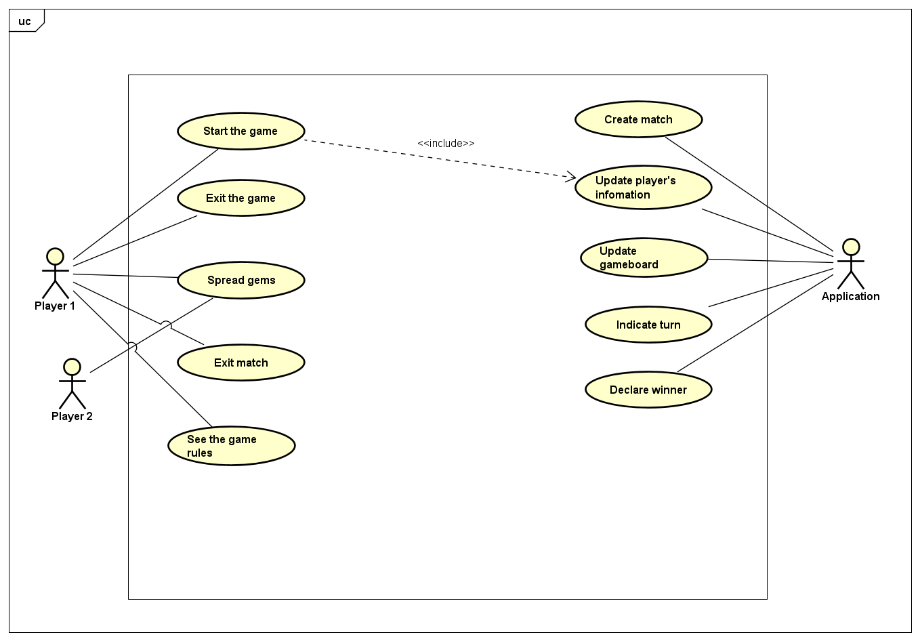
III. Use Case Diagram

Slide 6
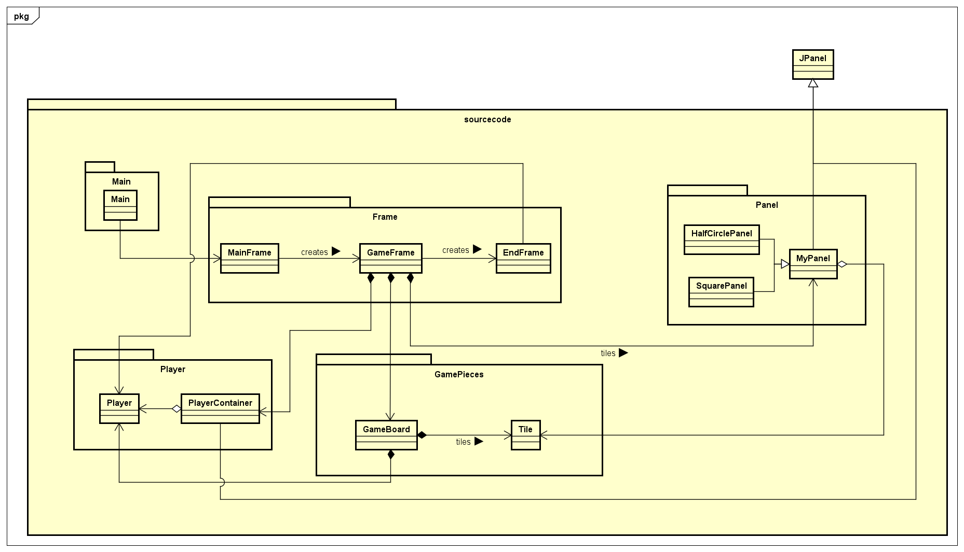
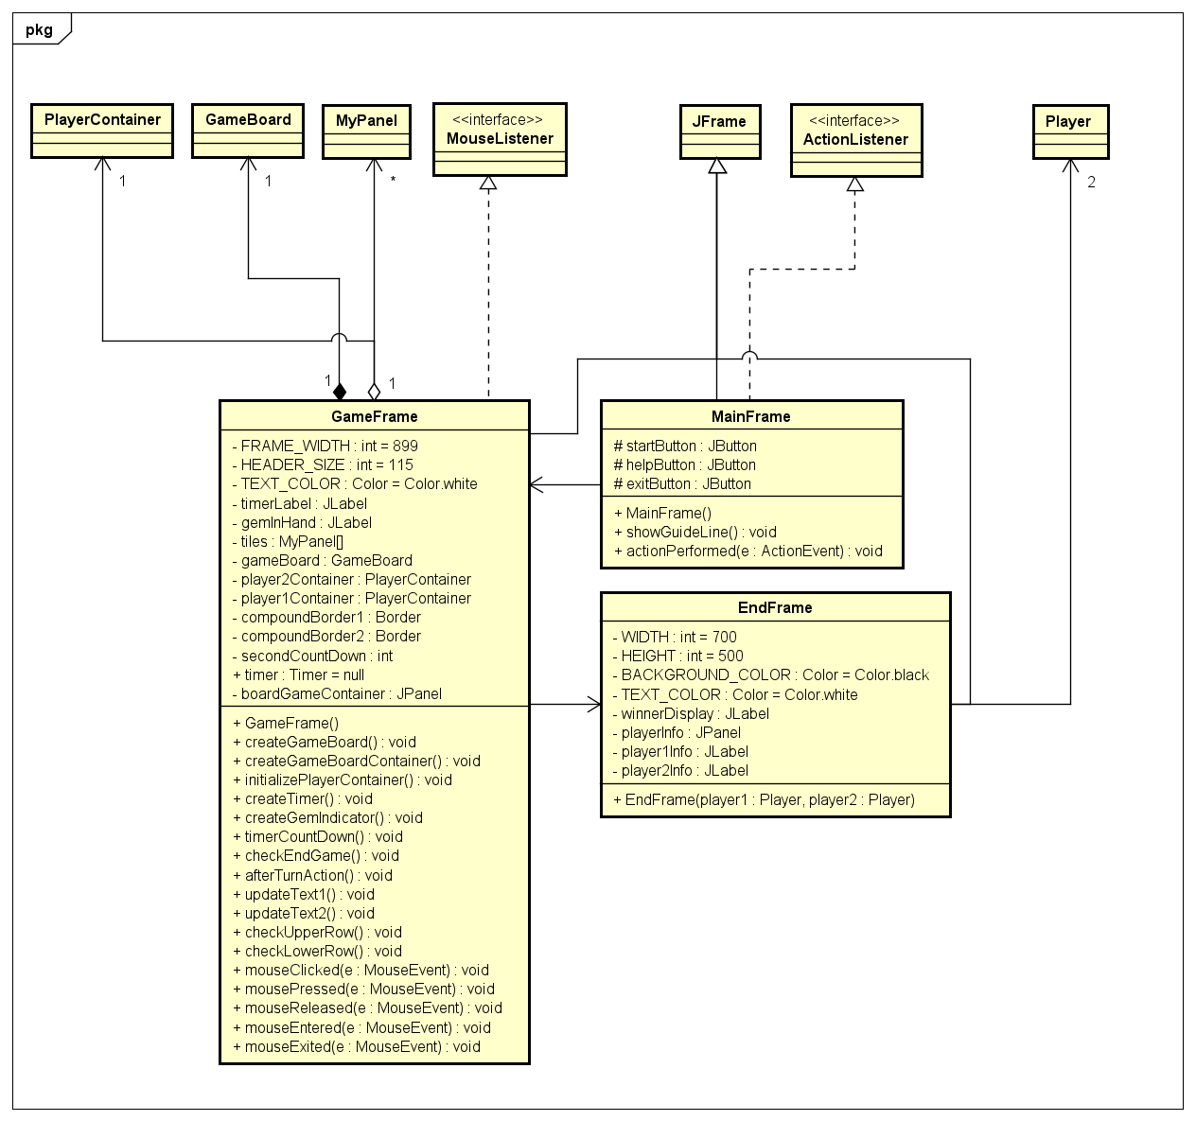
IV. General Class Diagram

Slide 7


V. Package Class Diagram
1. Frame Package

Slide 8
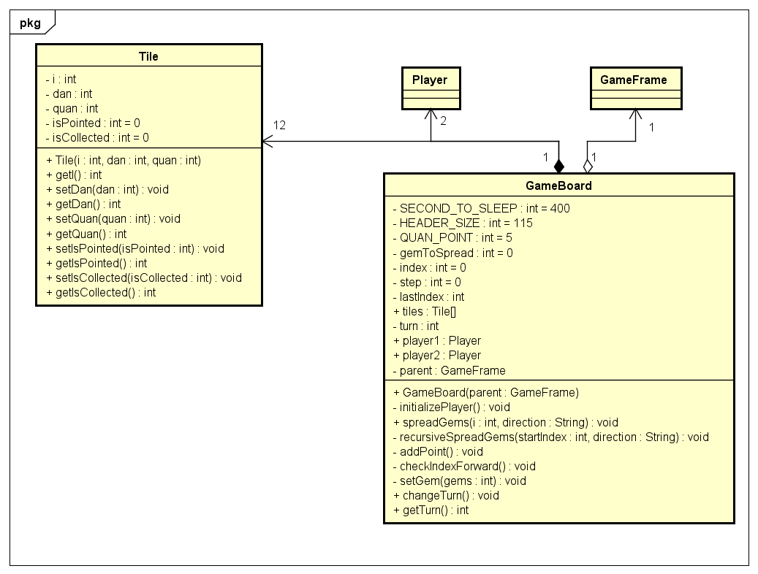
V. Package Class Diagram
2. GamePieces Package

Slide 9
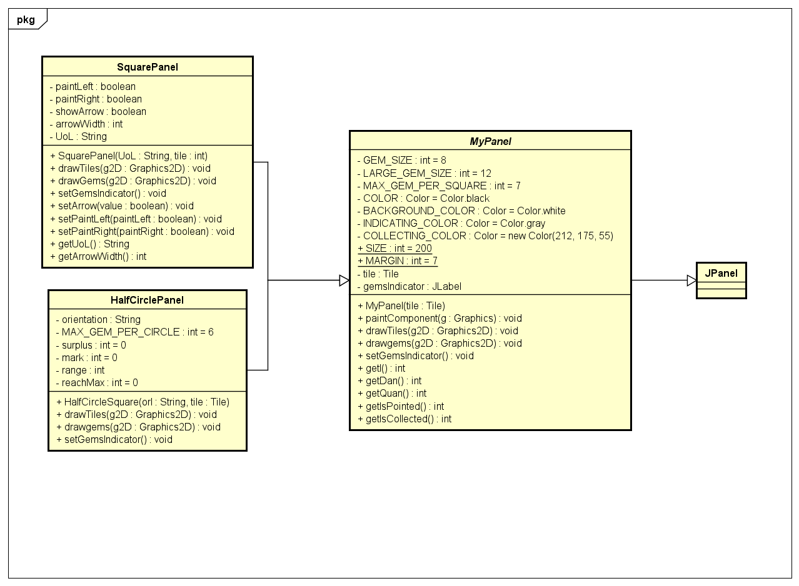
V. Package Class Diagram
3. Panel Package

Slide 10
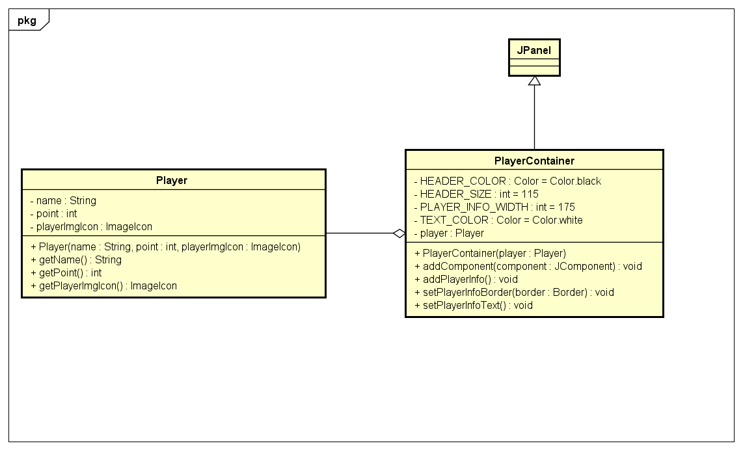
V. Package Class Diagram
4. Player Package

Slide 11
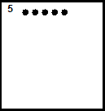
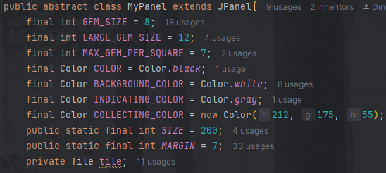




VI. OOP Technique Explanation
I. Inheritance/Abstraction

Slide 12
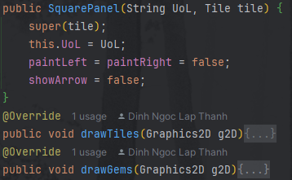
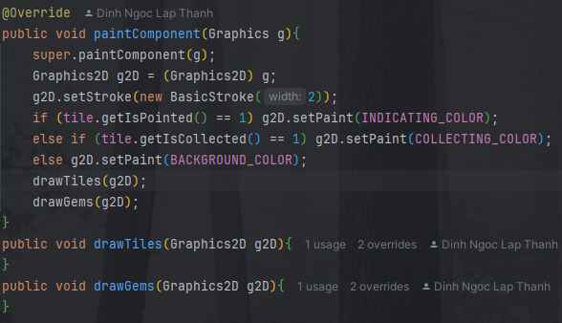
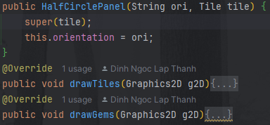
VI. OOP Technique Explanation
II. Polymorphism

Slide 13
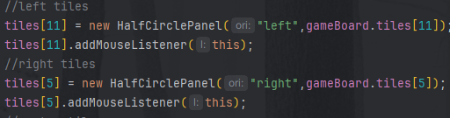


VI. OOP Technique Explanation
II. Polymorphism
(Downcasting)

Slide 14
VI. OOP Technique Explanation
III. Aggregation/Composition
MainFrame
GameFrame
EndFrame
creates
creates
creates/uses
creates/uses
creates/uses
uses
GameBoard
MyPanel[]
uses
PlayerContainer
uses
creates/uses
creates/uses
uses
Player[]
Tiles[]

Slide 15
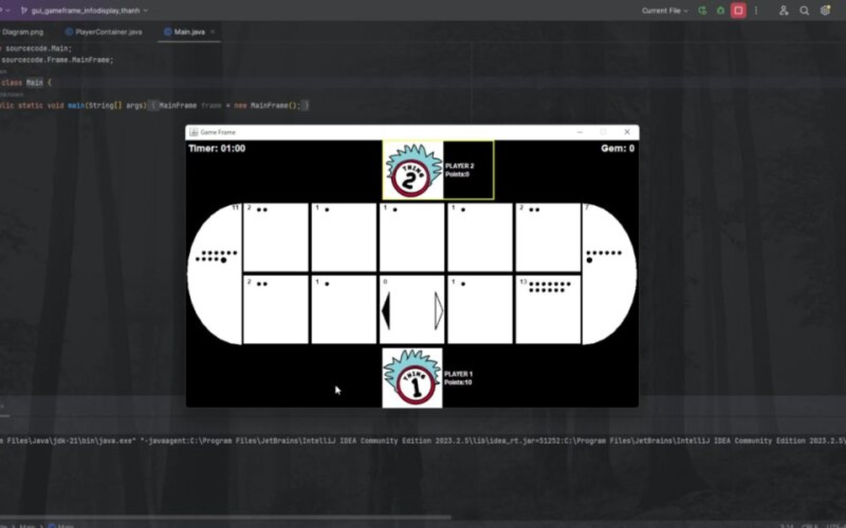
VII. Project Demo

