Slide 1

OOP Mini Project Presentation
Topic: 6.Ô Ăn Quan
Group: 16

Slide 2
Content
CONTENT
Member and Assignment
Problem Statement
Use Case Diagram
General Class Diagram
Package Class Diagram
OOP Technique Explanation
Project Demo

Slide 3
I. Member and Assignment
Dinh Ngoc Lap Thanh(Leader) – 20226000
Design Class Diagram and Use case Diagram
Write project Report
Write project source code
Design presentation
Exception in thread "main" java.lang.ArrayIndexOutOfBoundsException: Index 1 out of bounds for length 1

Slide 4
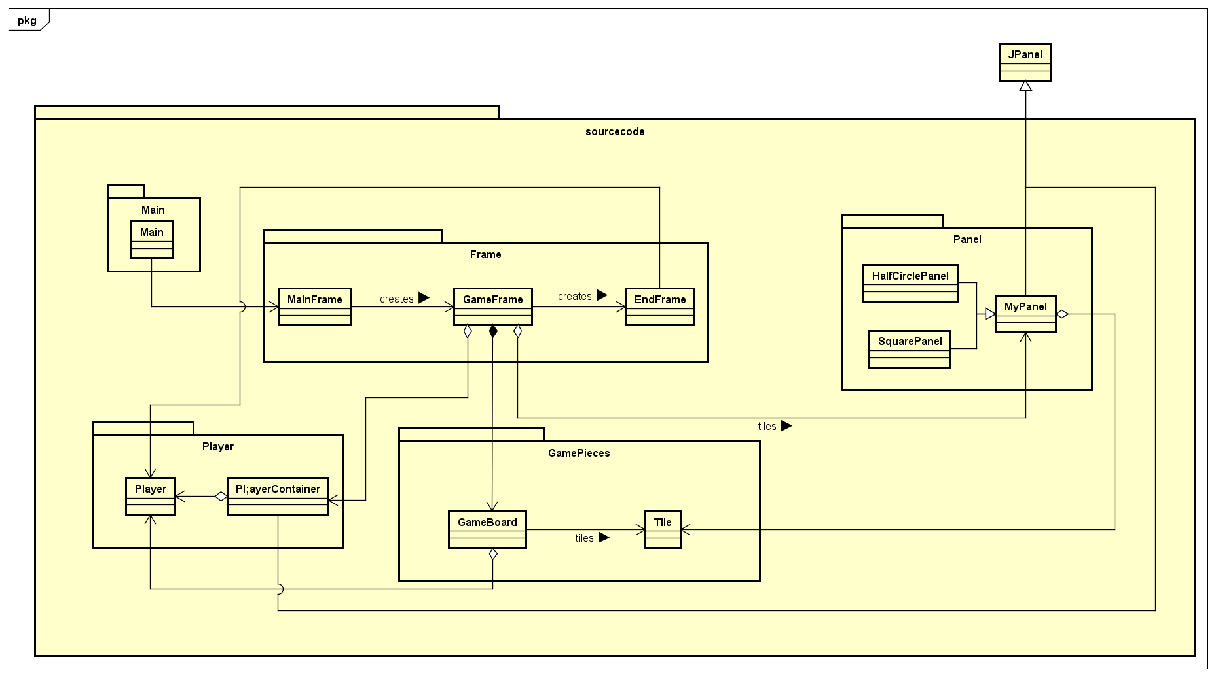
II. Problem Statement
Design a functioning game with main screen that include:
Start button: start the game
Exit button: exit the program with second confirmation from user
Help button: display game guideline
In the game screen:
A game board with 10 square tiles, each holding 5 “dan” and 2 half circles, each holding 1 “quan” each.
The application must notify players’ turn.
Players can select square and direction to spread gems. If condition meet, he/she will collect the gems in the consecutive squares according to the game’s instruction.
A notification of the winner when the game end and display players’ points.

Slide 5
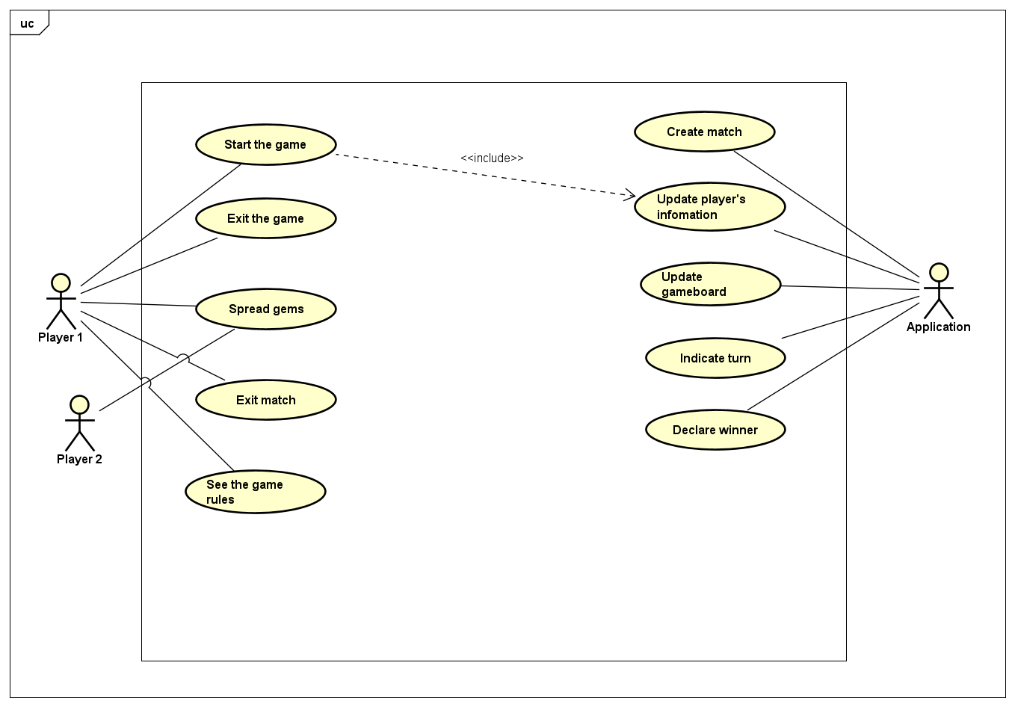
III. Use Case Diagram

Slide 6
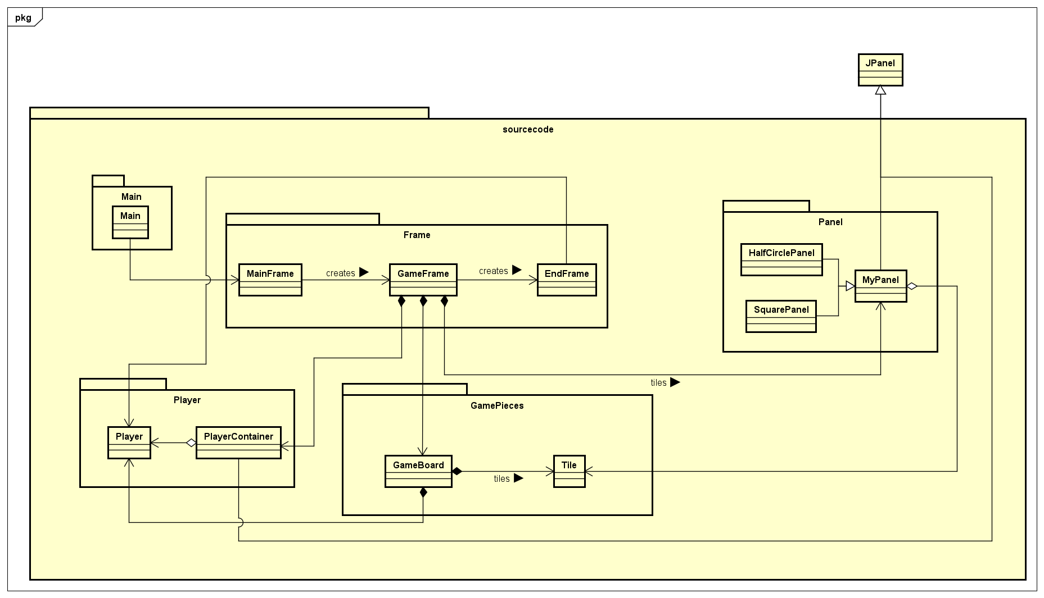
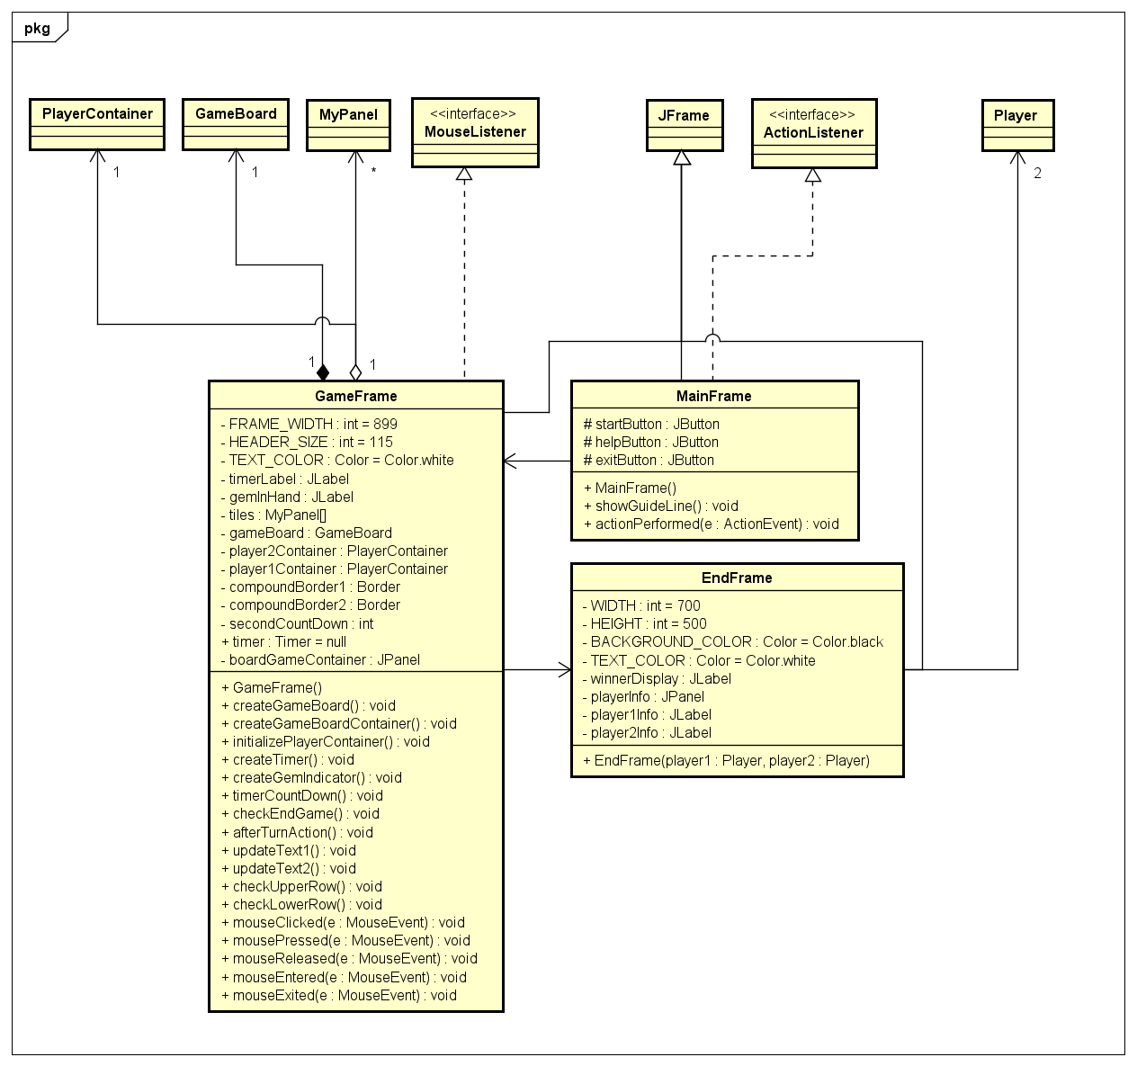
IV. General Class Diagram

Slide 7


V. Package Class Diagram
1. Frame Package

Slide 8
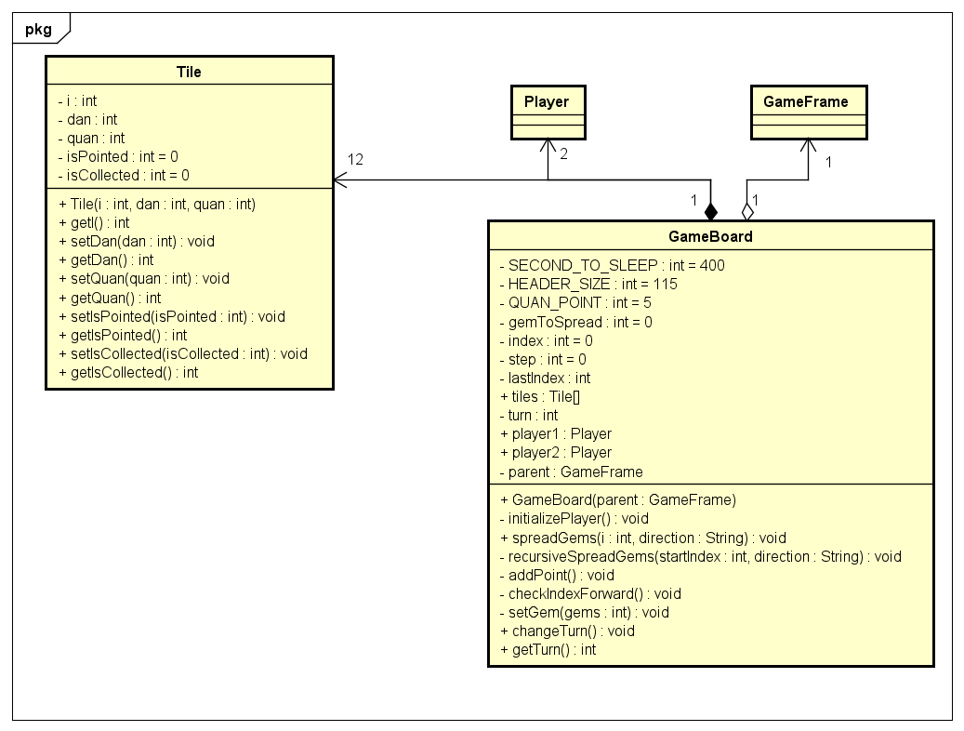
V. Package Class Diagram
2. GamePieces Package

Slide 9
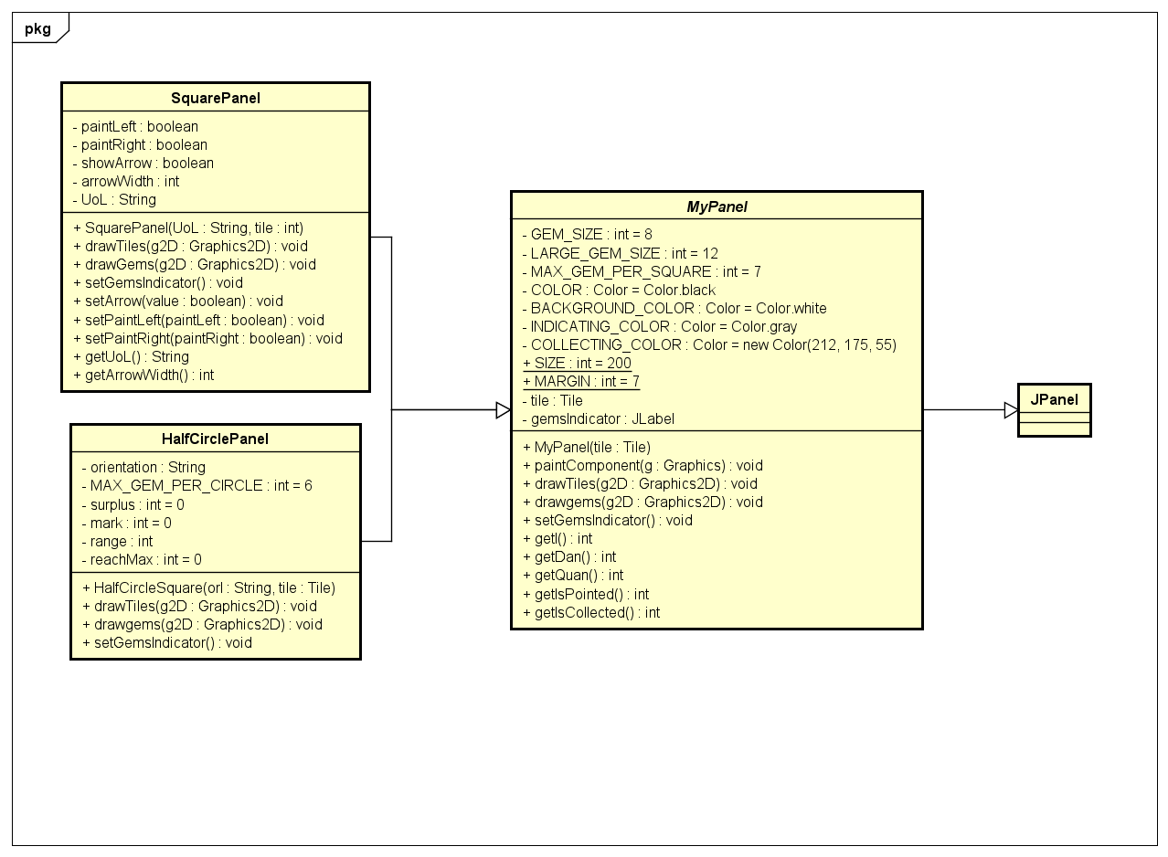
V. Package Class Diagram
3. Panel Package

Slide 10
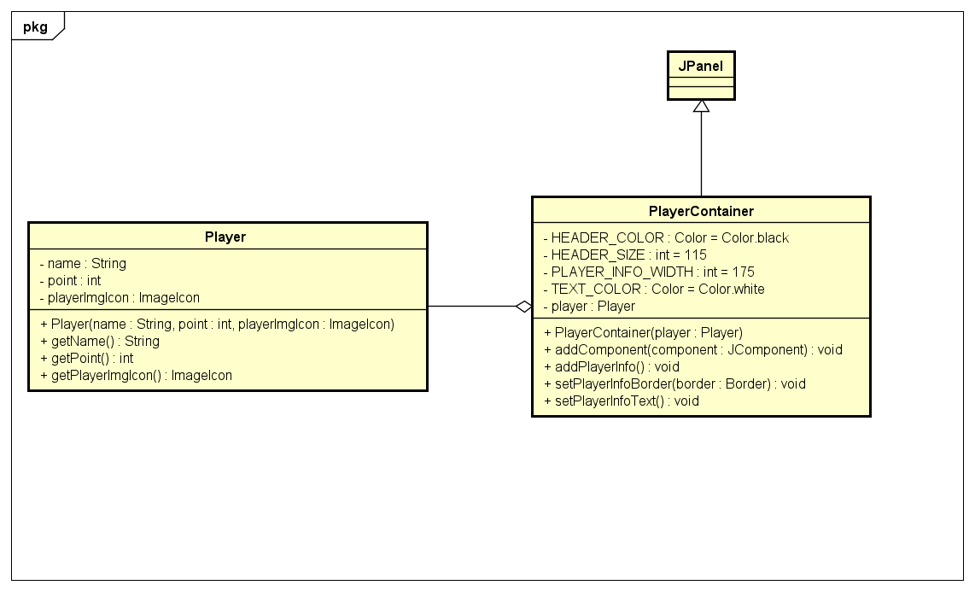
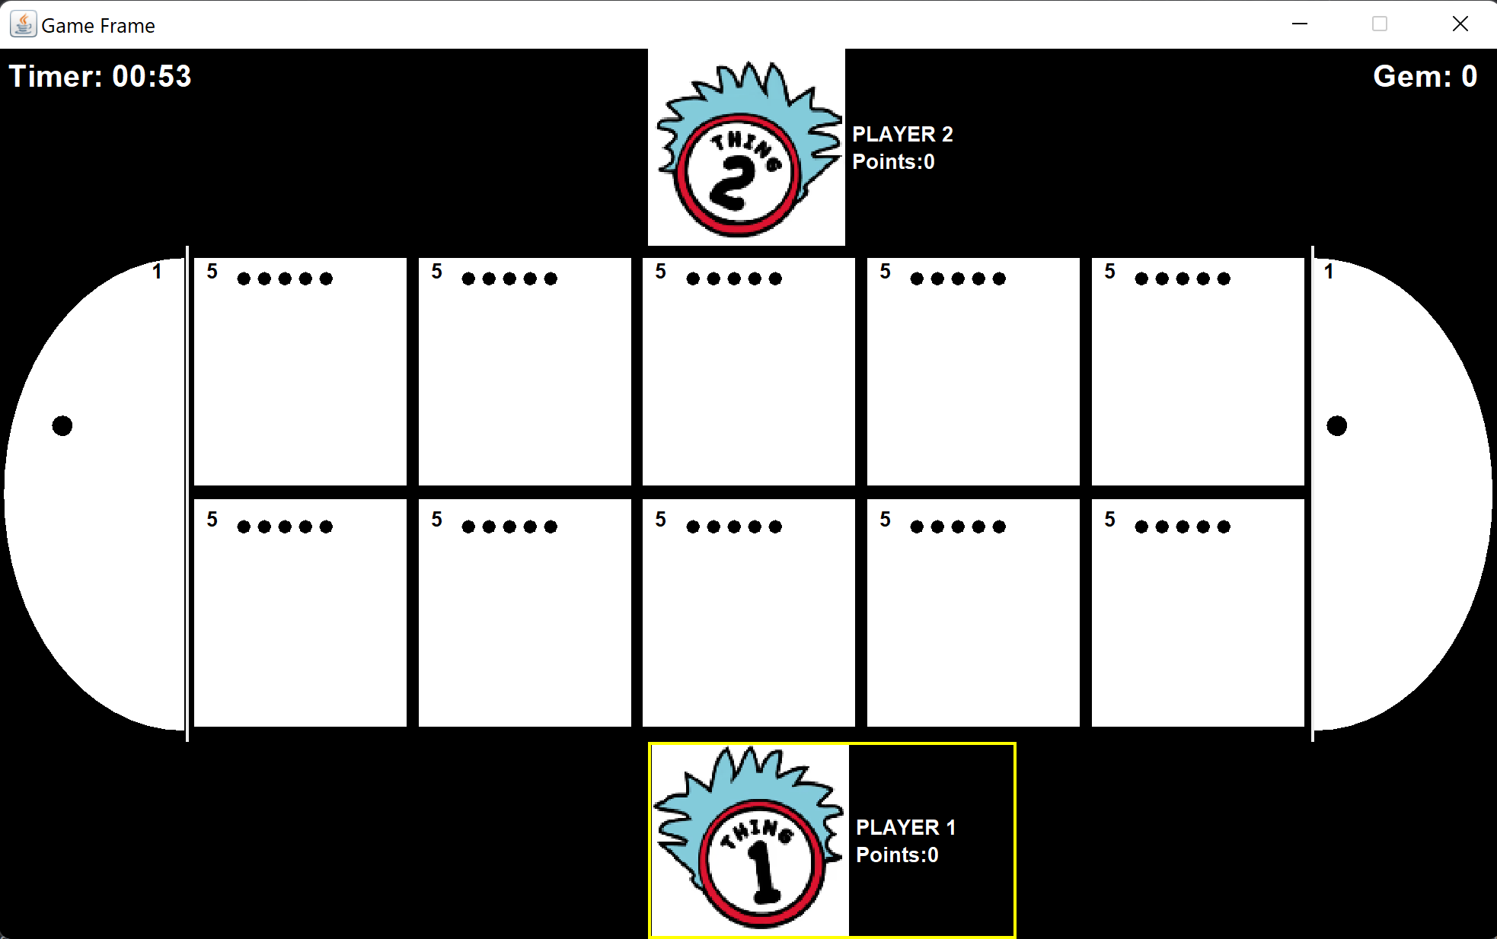
V. Package Class Diagram
4. Player Package

Slide 11
V. Package Class Diagram
PlayerContainer
GameBoard
MyPanel

Slide 12
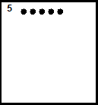
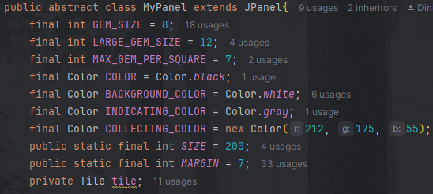




VI. OOP Technique Explanation
I. Inheritance/Abstraction

Slide 13
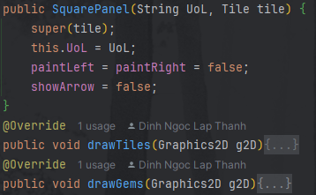
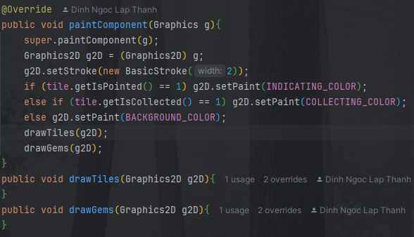
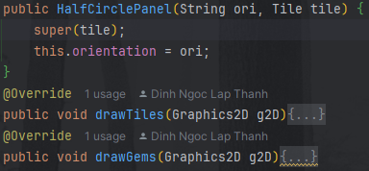
VI. OOP Technique Explanation
II. Polymorphism

Slide 14
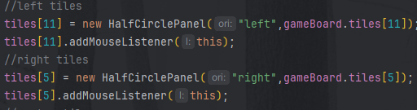


VI. OOP Technique Explanation
II. Polymorphism
(Downcasting)

Slide 15
VI. OOP Technique Explanation
III. Association/Aggregation/Composition
MainFrame
GameFrame
EndFrame
creates
creates
creates/uses
creates/uses
creates/uses
uses
GameBoard
MyPanel[]
uses
PlayerContainer
uses
creates/uses
creates/uses
uses
Player[]
Tiles[]

Slide 16
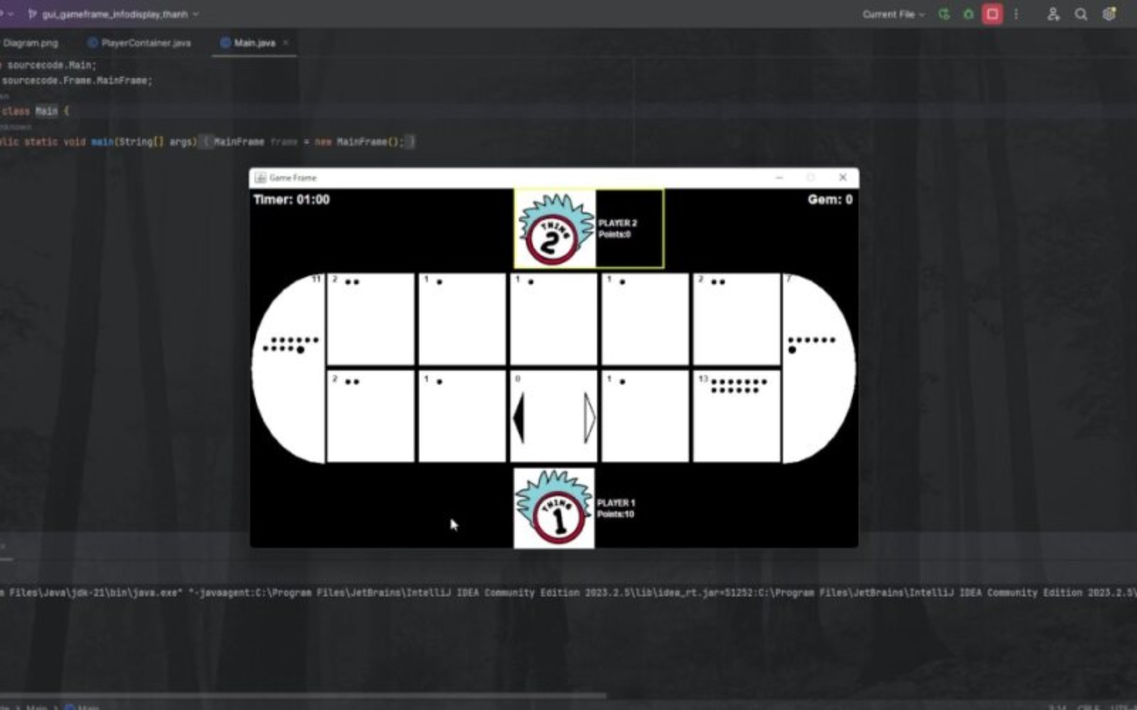
VII. Project Demo

