Slide 1
YAKINDU
is a modular toolkit
for model-based development
(of embedded systems)

Slide 2
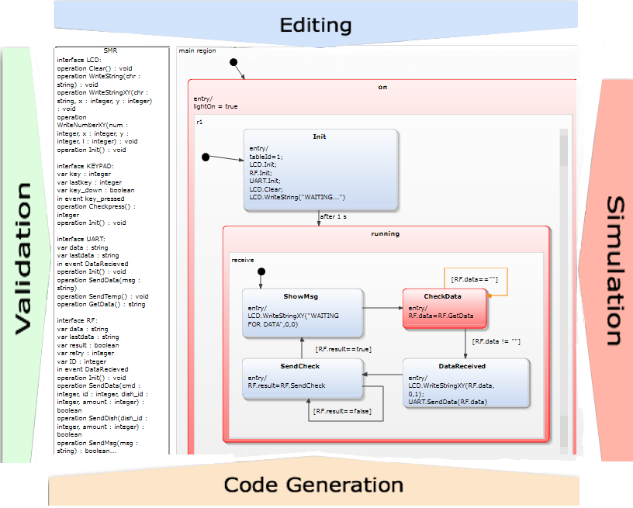
YAKINDU Statechart Tools (SCT)

Slide 3
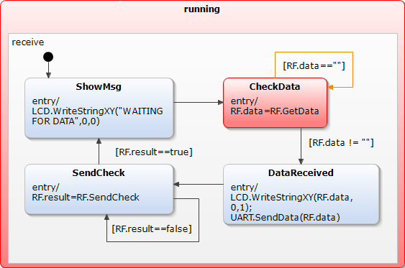
YAKINDU Statechart
Formalism similar to state machines as defined by David Harel, but:
self-contained with a well defined interface
with a cycle-based execution semantics
allows processing concurrent events
event-driven behavior can be defined on top
time control is delegated to the environment

Slide 4
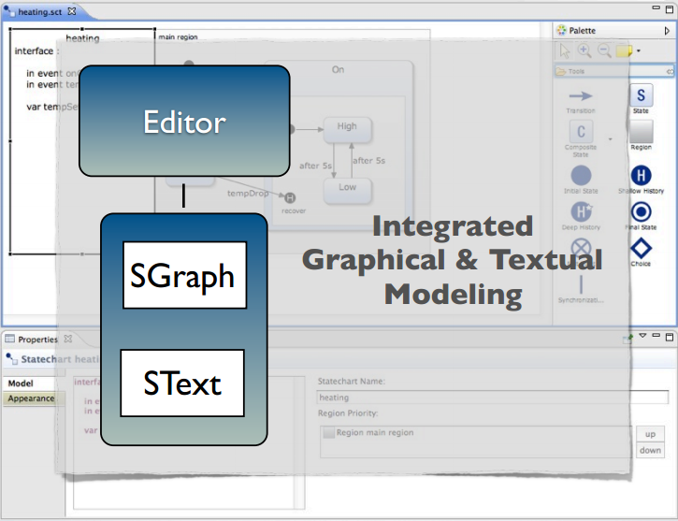
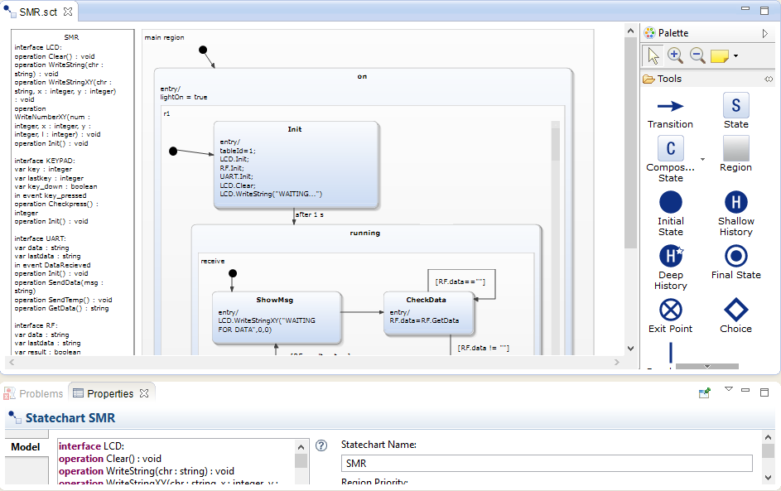
Yakindu SCT - Editing

Slide 5
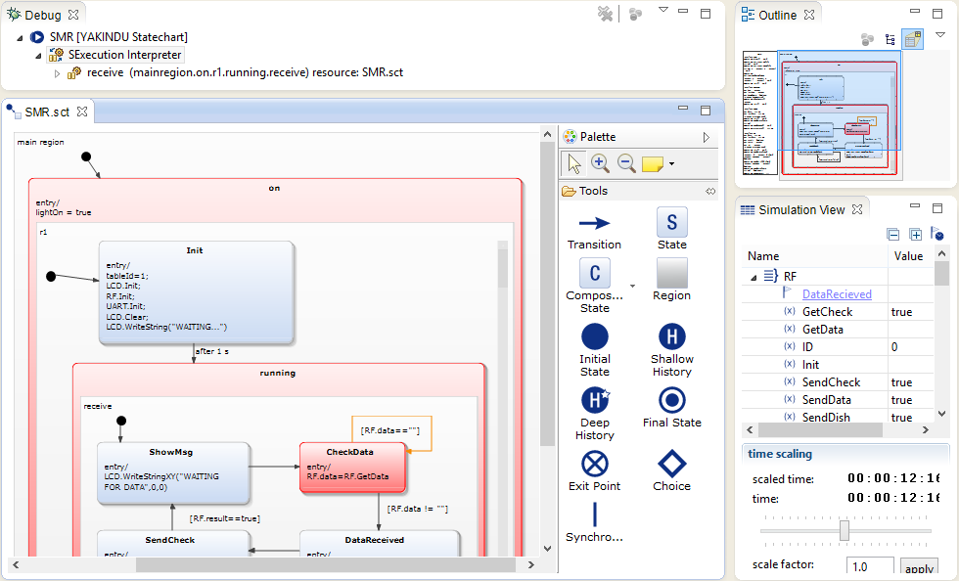
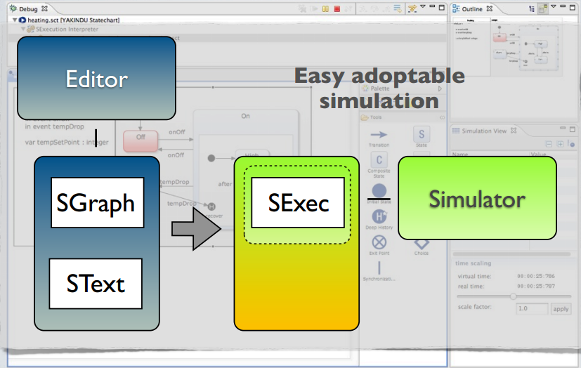
Yakindu SCT - Simulation

Slide 6
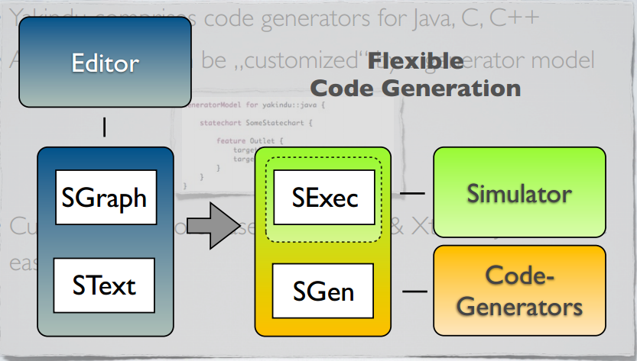
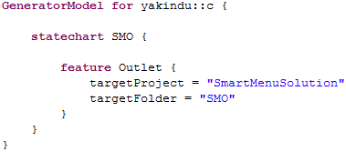
Yakindu SCT - Code Generation
Yakindu comprises code generators for Java, C, C++
All generators can be „customized“ by a generator model
Custom generators based on Xpand & Xtend2/Java can be easily integrated

Slide 7
DEMO

