Slide 1
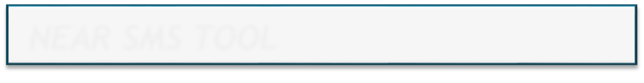
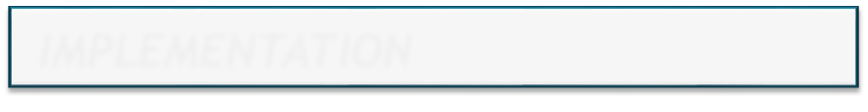
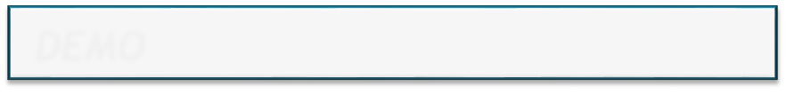
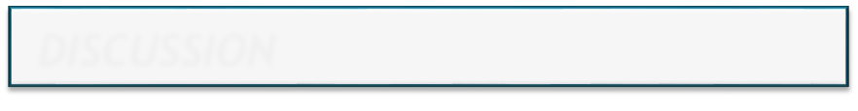
NEAR SMS TOOL
Presenter: daothang
Course: NEAR Certified Developer Level 1
1
NEAR SMS TOOL
2
IMPLEMENTATION
3
DEMO
4
DISCUSSION

Slide 2
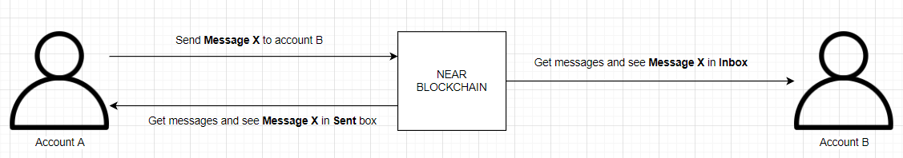
1. NEAR SMS TOOL
IDEA: NEAR SMS Tool
Description: The small tool to send short messages between NEAR accounts.
Source code: https://github.com/kiemtienonline360/near-sms-tool
Demo: https://near-sms-tool.kiemtienonline360.com/

Slide 3
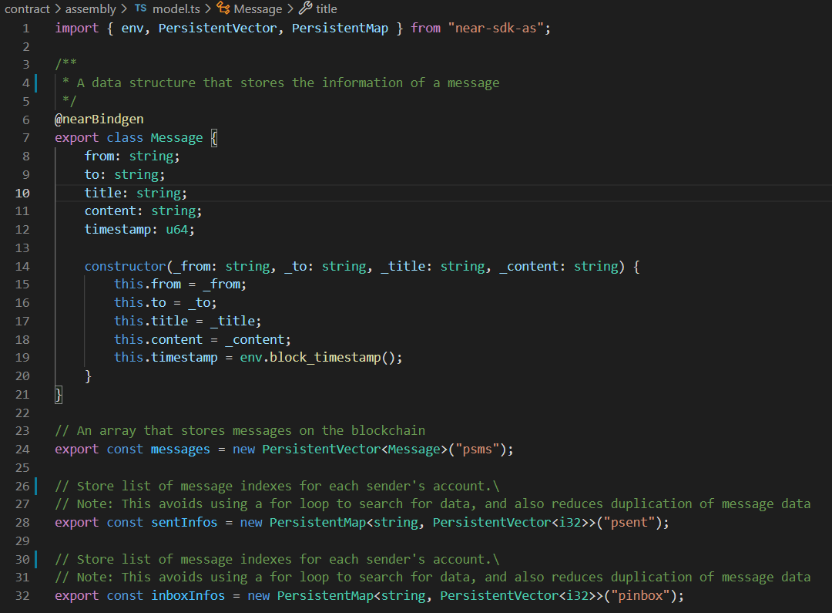
2. IMPLEMENTATION
MODEL.TS
Define Message data structure and declare variables to store data on NEAR blockchain.

Slide 4
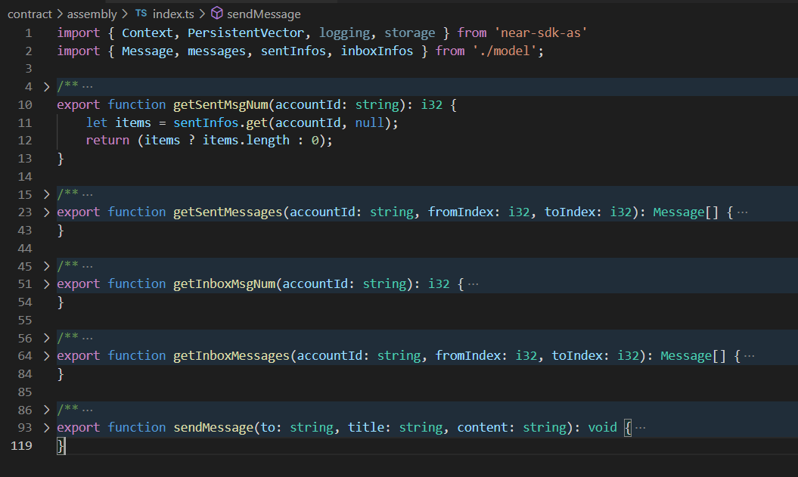
2. IMPLEMENTATION
INDEX.TS
Provide 5 functions to help clients manipulate data on Smart Contract

Slide 5
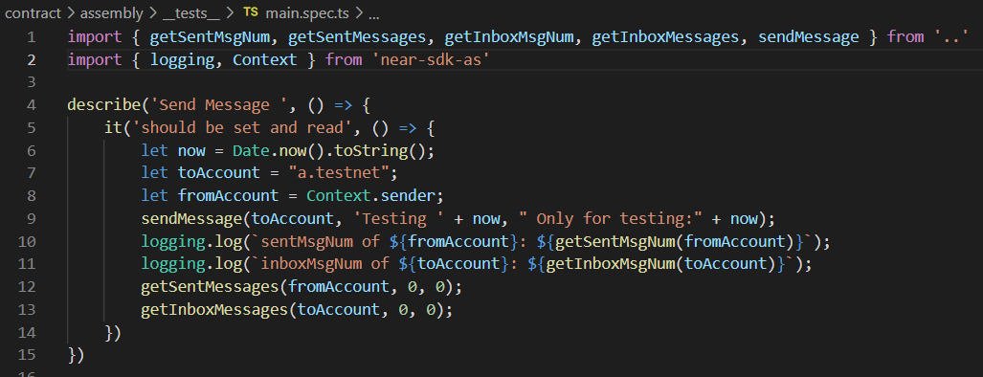
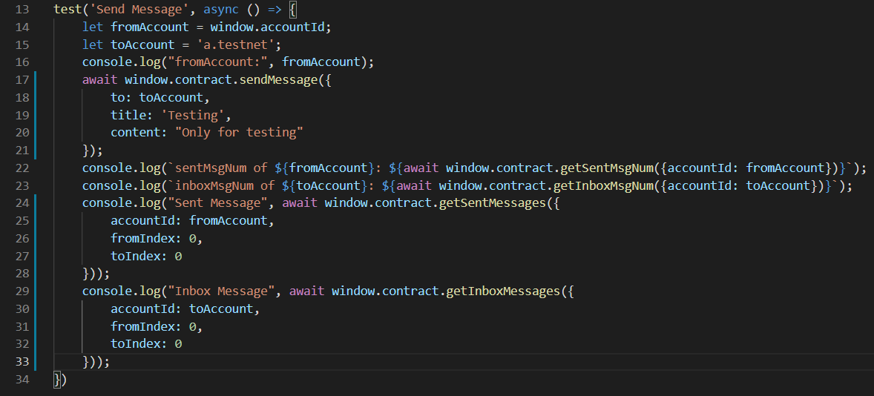
2. IMPLEMENTATION
TEST CASE

Slide 6
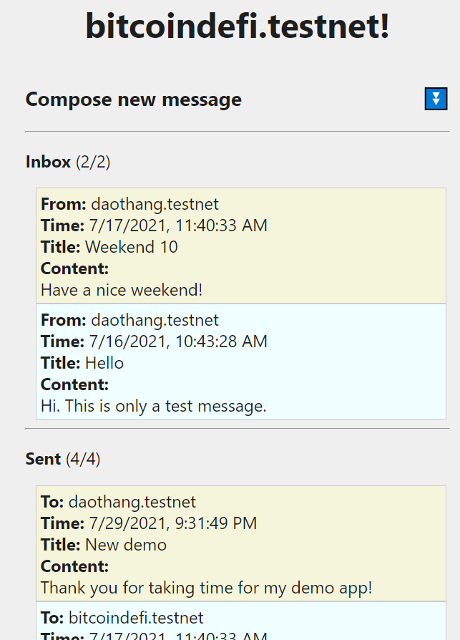
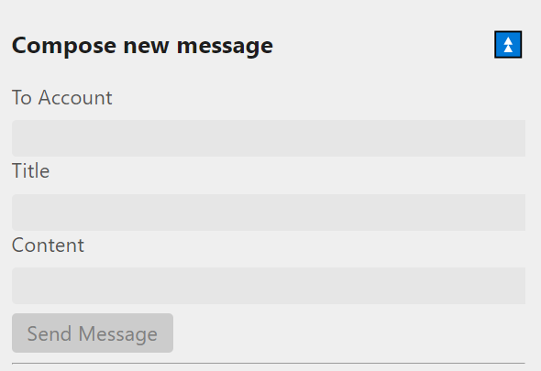
3. DEMO
Run Test
npm run test
Run Demo
npm run dev

Slide 7
4. DISCUSSION
WHAT NEEDS IMPROVEMENT?
  Need to encrypt content using public key of receiver to increase security
  Need to support more diverse data as HTML, Images,...
FUTURE EXPECTATIONS?
  Can create the app “Secured Email Tool“:
    Support multimedia content as HTML, Attachment files,…
    Support data size to several tens of MB of data
    Support reply, forward functions without duplicate data
  The solutions:
    Content is store on IPFS encrypted with a symmetric key
    NEAR blockchain only store header data and a symmetric key encrypted public key.

Slide 8
Thank you for listening

