Slide 1



Ambition
Project name:
Ambi social network
Members:
Pham Thanh Tam
Vu Thanh Long
Vu Manh Duc
Nguyen Van Truong
Chuc Kim Thien

Slide 2


Goals:
New social network for people connect together
Know how to use real-time feature
Approaching new knowledge(ajax, REST api,…)

Slide 3
Planning:
Design ERD, Sitemap
Preparing task
Coding (Back end)
Edit Front end
Test
Deploy

Slide 4
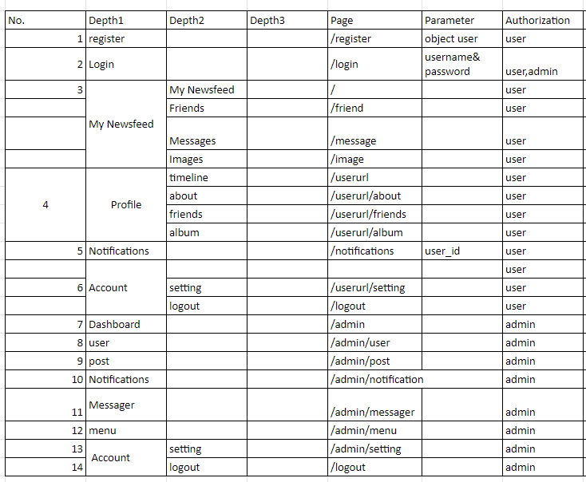
Done
Brief sitemap

Slide 5
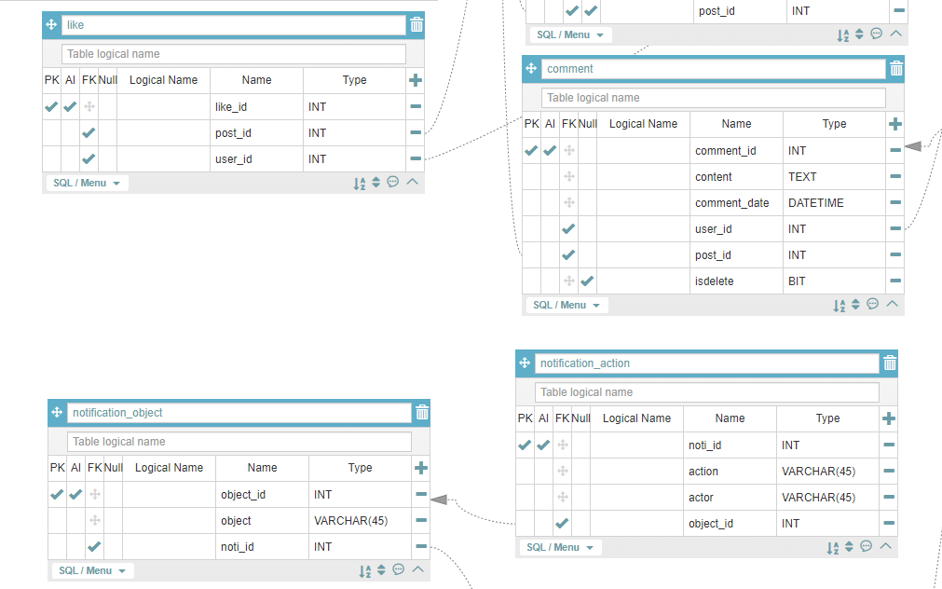
Done
A part of ERD

Slide 6
Scheduling
Basically function (3 days)
Main function (10 days)
Edit layout (3 days)
Testing (3 days)
Deploy (1 days)

Slide 7
Assignment
No | Member | Task
1 | Vũ Mạnh Đức | Notification, Registration
2 | Chúc Kim Thiên | Chatting, Personal information management
3 | Nguyễn Văn Trường | Admin management
4 | Phạm Thanh Tâm | Posting, Friends
5 | Vũ Thành Long | Authentication, Roles, Login

Slide 8
THANK YOU

