Slide 1
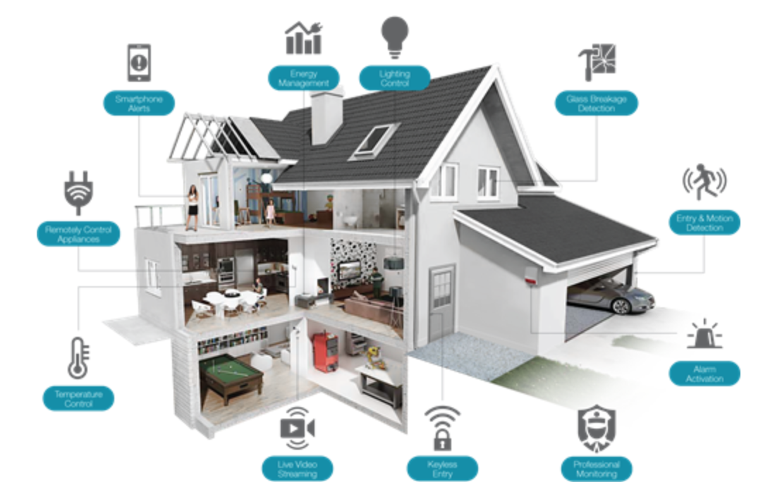


HOUSEHOLD DEVICES CONTROL AND MONITORING SYSTEM

Slide 2
Introduction
Monitoring and controlling light, fan (and other household devices) with android app with ease.

Slide 3
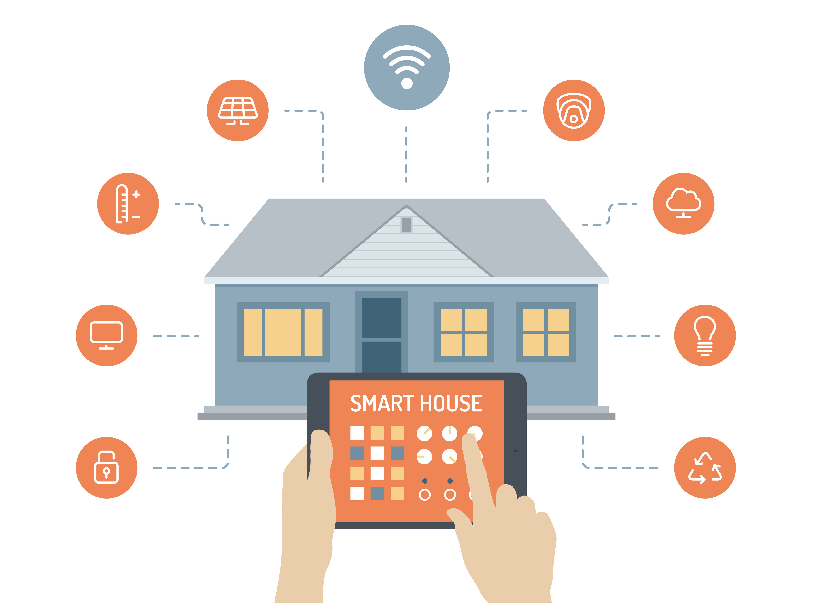
Target
Saving time for busy people. You don’t have to get to the device(s) to use them. Get your phone, connect to internet and control them remotely.
Possible to control even when away from home.
Feeling at ease even when forgetting to turn something off.

Slide 4

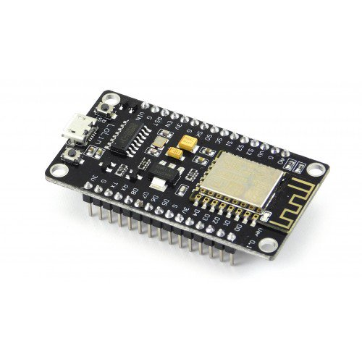

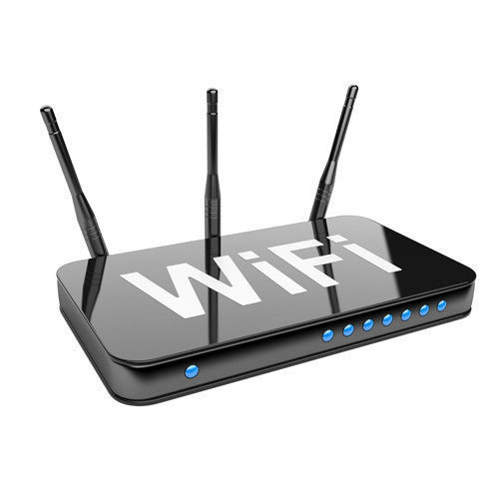



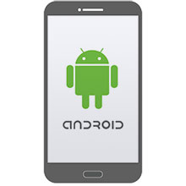
Design Idea
Sensor
DATABASE
MCU
CLOUD
MCU
ROUTER
RESTFULL API SERVER
MCU
PHONE APP

Slide 5
Assignment
Android app: Lê Huy Thịnh (ước tính 1 tháng)
Sensor-controller + MCU Dev: Lê Đào Minh Tuấn (ước tính 1.5 tháng)
Thingspeak + Server + Database: Nguyễn Thành Long (ước tính 1 tháng)
Khâu combine và testing cả nhóm sẽ làm chung ( ước tính 1 tuần )
Tổng thời thực hiện ước tính: 1.5 tháng và 1 tuần.

Slide 6
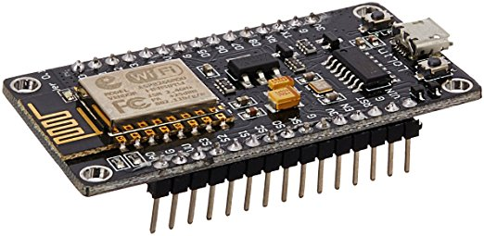
Sensor-Controller(NodeMCU+Sensors)
Functions:
Reading environment and device data(s) from sensor(s) & send them to IoT cloud
Receiving message from the cloud & controlling device(s)
Devices for test:
Light sensor
Temperature sensor (LM35)
NodeMCU
Relay module (SSR)
Battery (18650)

Slide 7
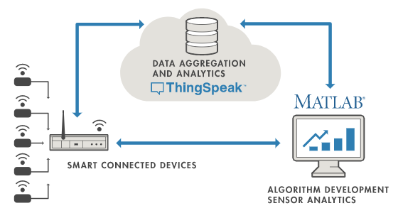
IoT Cloud(Thingspeak)
Functions:
Collecting datas from Sensor-Controller & Android device(s)
Analyzing datas
Sending datas to Sensor-Controller & Android device(s)
Alerting user when using the device can cause negative effect (e.g using fan when temperature is low, turning on the light when environment is too bright…)

Slide 8
Android app
Functions:
Having abilities to send controlling messages to the cloud & receive feedbacks.
Displaying room’s temperature when user request.
Buttons:
Button 1: Turning ON/OFF light(s)
Button 2: Turning ON/OFF fan
Button 3: Show environment data (this buttion will show room’s temperature, light intensify, device’s statuses)

Slide 9
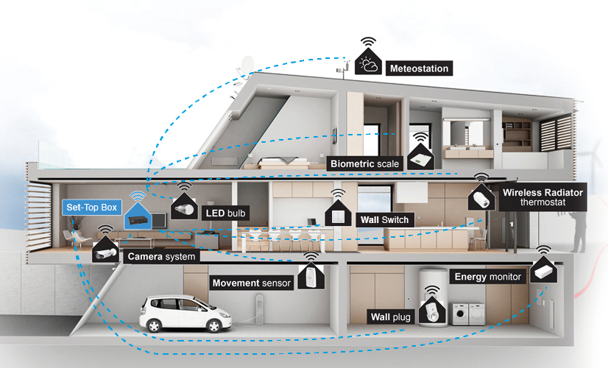
Future Development
Adding sensor to your front door. Notifying when you leave your house forgetting to turn something off.
Have voice regconigtion module. (Alexa)
Setting timer with your phone app.

Slide 10
Reference
http://tapchitaichinh.vn/tai-chinh-gia-dinh/tai-chinh-tieu-dung/xu-huong-smart-home-hien-dien-ro-net-tai-ifa-2017-121256.html
http://www.antiktech.com/en/digital-signagebr--smart-home/smart-home
https://www.amazon.com/Raspberry-Pi-RASPBERRYPI3-MODB-1GB-Model-Motherboard/dp/B01CD5VC92
https://www.cloudesire.com/
http://chittagongit.com/icon/icon-mobile-phone-18.html
https://www.amazon.in/ESP8266-NodeMcu-WiFi-Development-Board/dp/B00UY8C3N0
https://thingspeak.com/pages/commercial_learn_more

Slide 11
THANK YOU FOR LISTENING

