Slide 1
Free PPT Templates
Insert the Sub Title of Your Presentation
http://www.free-powerpoint-templates-design.com

Slide 2
Content
01
What is GraphQL?
02
GraphQL is the better REST
03
Component
04
Ecosystem

Slide 3
What is GraphQL?

Slide 4
What is GraphQL?
GraphQL is a query language for APIs
It makes it easier to aggregate data from multiple sources.
Enables declaratative data fetching
It uses a type system to describe data.
GraphQL server exposes single endpoint and respons to queries
Developed by Facebook and open source version published in July 2015
Industrial automation

Slide 5
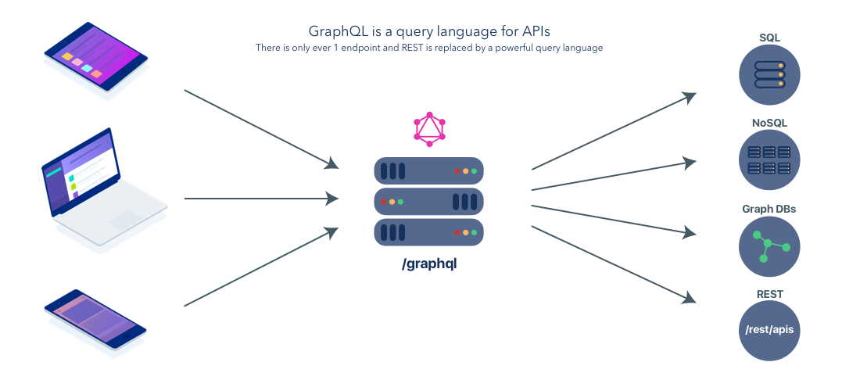
What is GraphQL?

Slide 6
GraphQL vs REST

Slide 7

GraphQL vs REST
Send data over HTTP request.
Core idea is resource.
The final output is JSON
Differentiate between write / read data.

Slide 8
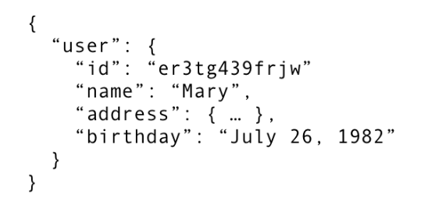
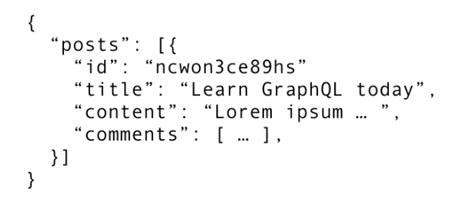
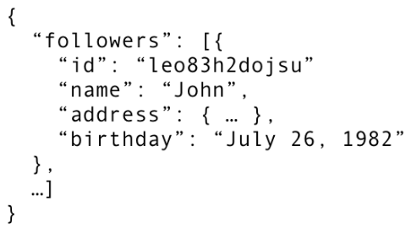
Fetching Data with REST
/api/user/<id>
/api/order/<id>/posts
REST
/api/order/<id>/followers

Slide 9
REST Drawbacks
The number of API endpoints is too much
Overfetching: Downloading unnecessary data
Underfetching: An endpoint doesn’t return enough of the required information; need to send multiple requests (n+1 problem)
Notes:
Overfetching: Downloading superfluous data
Overfetching means that a client downloads more information than is actually required in the app. Imagine for example a screen that needs to display a list of users only with their names. In a REST API, this app would usually hit the /users endpoint and receive a JSON array with user data. This response however might contain more info about the users that are returned, e.g. their birthdays or addresses - information that is useless for the client because it only needs to display the users’ names.
Underfetching and the n+1 problem
Another issue is underfetching and the n+1-requests problem. Underfetching generally means that a specific endpoint doesn’t provide enough of the required information. The client will have to make additional requests to fetch everything it needs. This can escalate to a situation where a client needs to first download a list of elements, but then needs to make one additional request per element to fetch the required data.
<number>

Slide 10
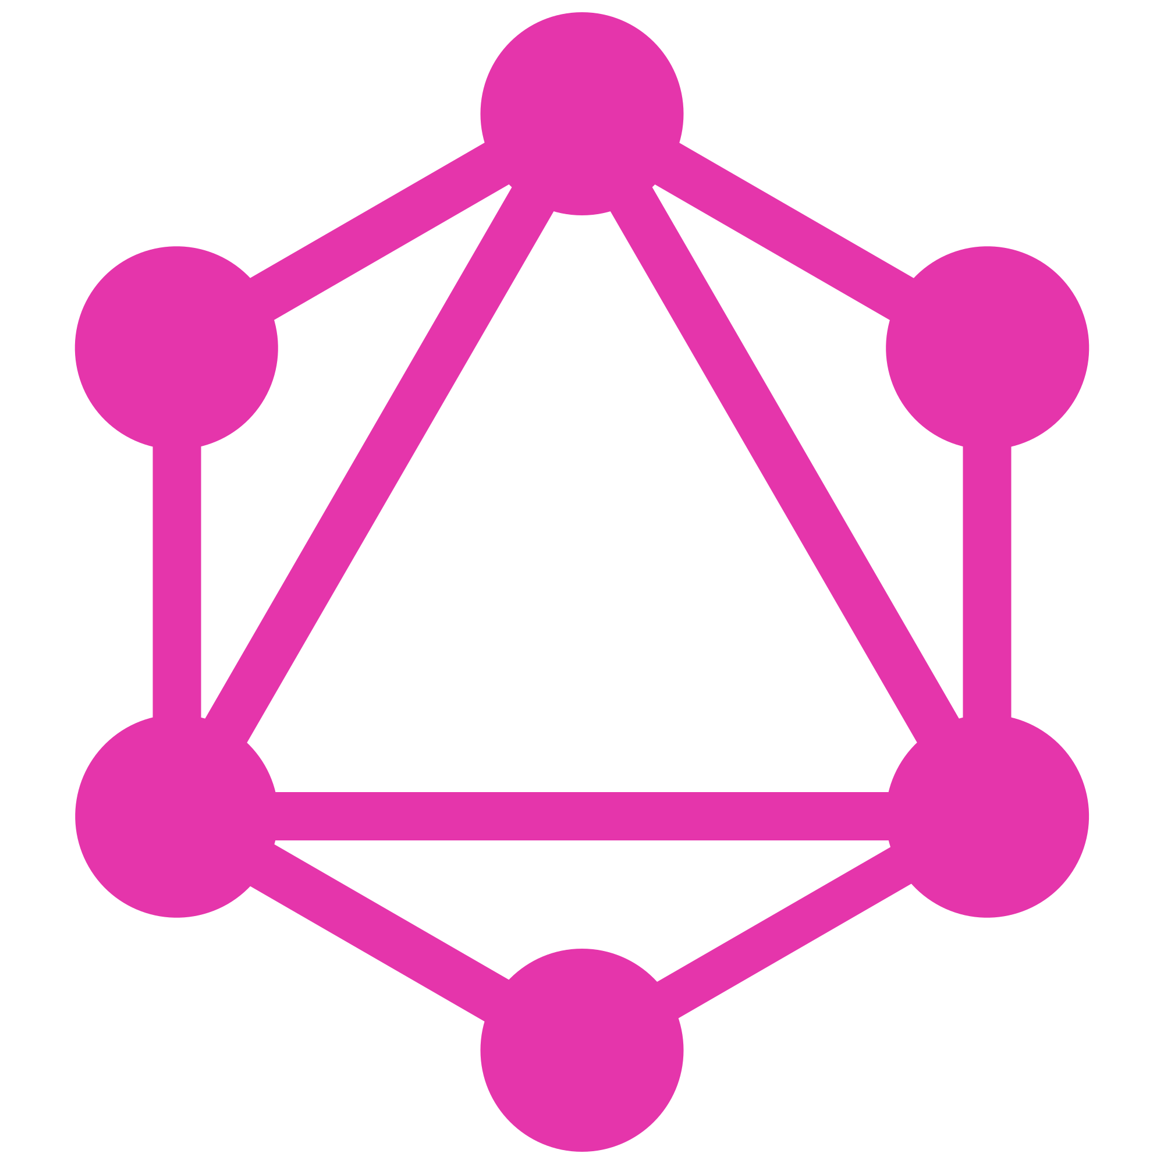
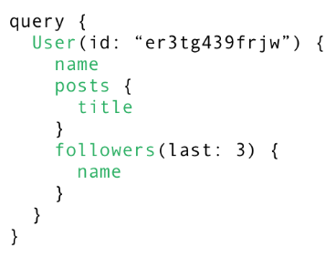
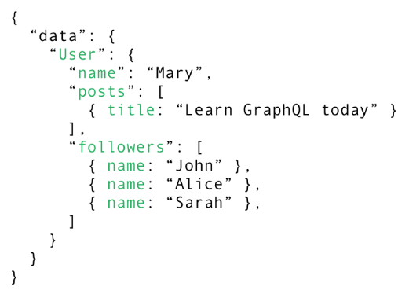
Fetching everything with a single request

Slide 11
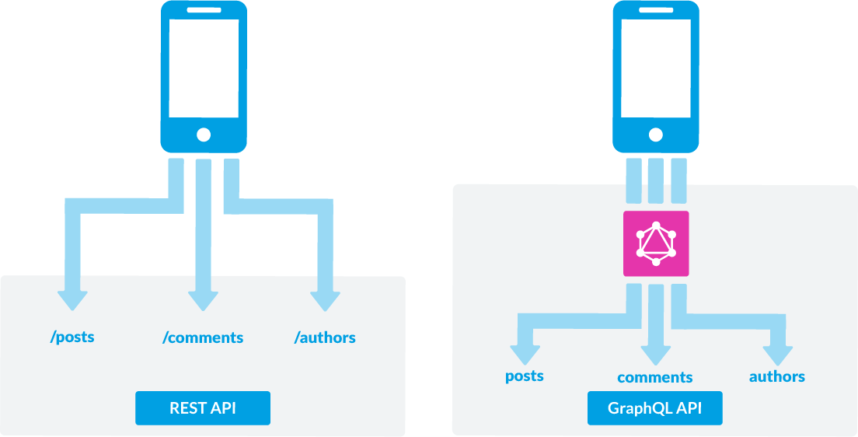
GraphQL is the better REST

Slide 12
Component

Slide 13
Component
Schema
Queries & Mutation
This Schema is used as a transaction between the client and server to determine how the client can access the data
The request you make to your GraphQL
Resolvers
Subscription
A resolver tells GraphQL how and where to fetch the data corresponding to a given field
Một yêu cầu quan trọng khác đối với nhiều ứng dụng đó chính là realtime, để có thể kết nối đến máy chủ để có được thông tin về các event ngay lập tức

Slide 14
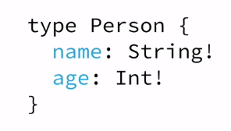
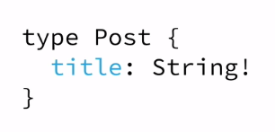
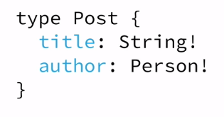
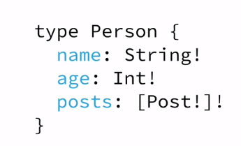
The Schema Definition Language (SDL)
GraphQL has its own type system that’s used to define the schema of an API. The syntax for writing schemas is called Schema Definition Language (SDL).

Slide 15
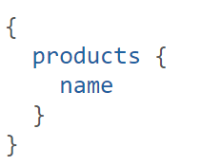

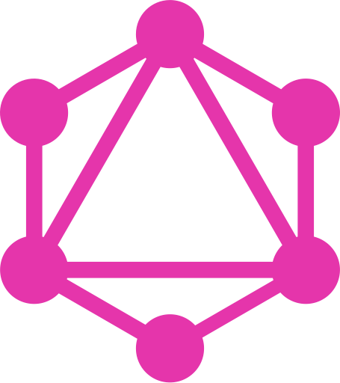
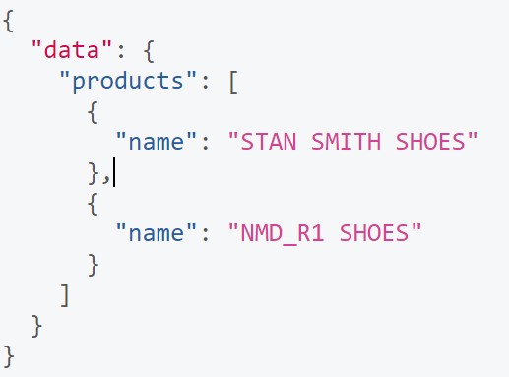
Fetching Data with Queries

Slide 16
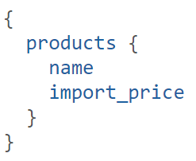
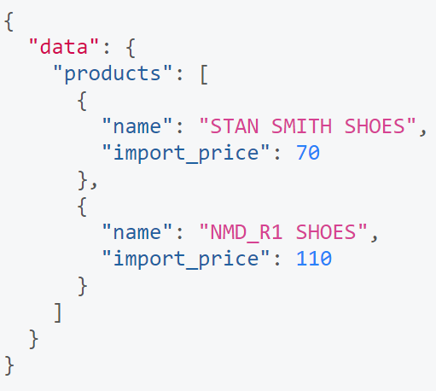
Fetching Data with Queries

Slide 17
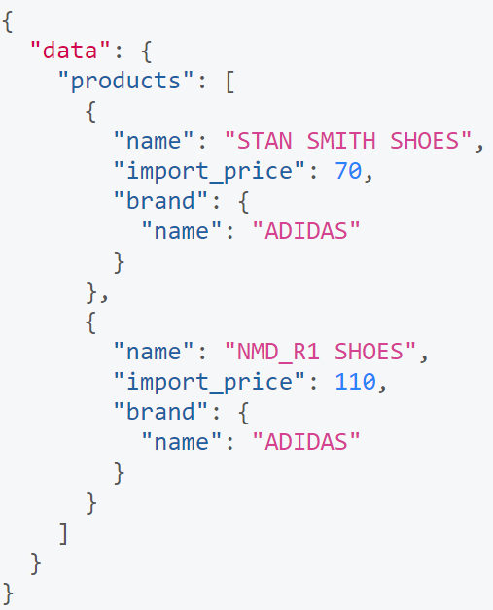
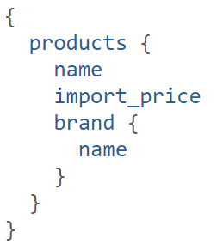
Fetching Data with Queries

Slide 18
Writing Data with Mutations
There generally are three kinds of mutations:
Creating new data
Updating existing data
Deleting existing data
Notes:
<number>

Slide 19
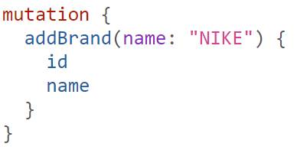
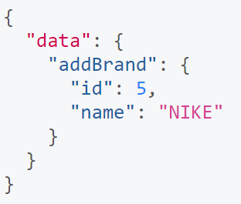
Writing Data with Mutations

Slide 20
The GraphQL Schema
Define capabilities of the API by specifying how a client and fetch and update data
Represents contract between client and server
Collection of GraphQL types with special root types

Slide 21
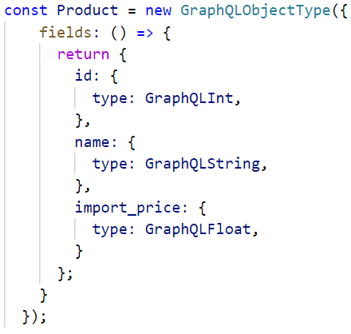
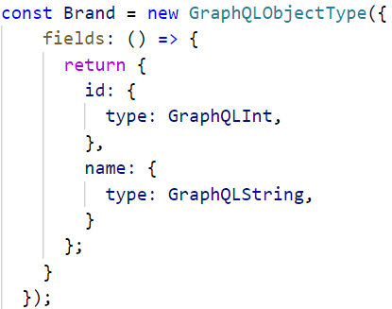
Object Type

Slide 22
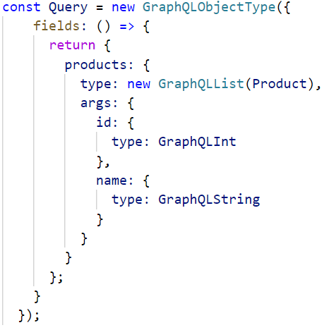
Query Type

Slide 23
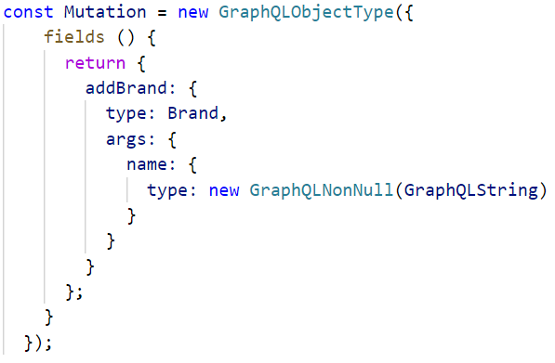
Mutation Type

Slide 24
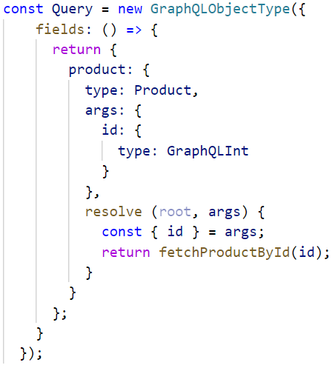
Resolvers implement the API
Each field in a GraphQL schema is backed by a resolver.
A resolver tells GraphQL how and where to fetch the data corresponding to a given field

Slide 25
Ecosystem

Slide 26
Ecosystem
GraphQL
GraphQL Server
GraphQL Client
The first brick you’ll need is a GraphQL server. GraphQL itself is just a specification after all, so this leaves the door open to a few competing implementations.
Although you can technically query your GraphQL API directly without the need for a dedicated client library, it can definely make your life easier.

Slide 27
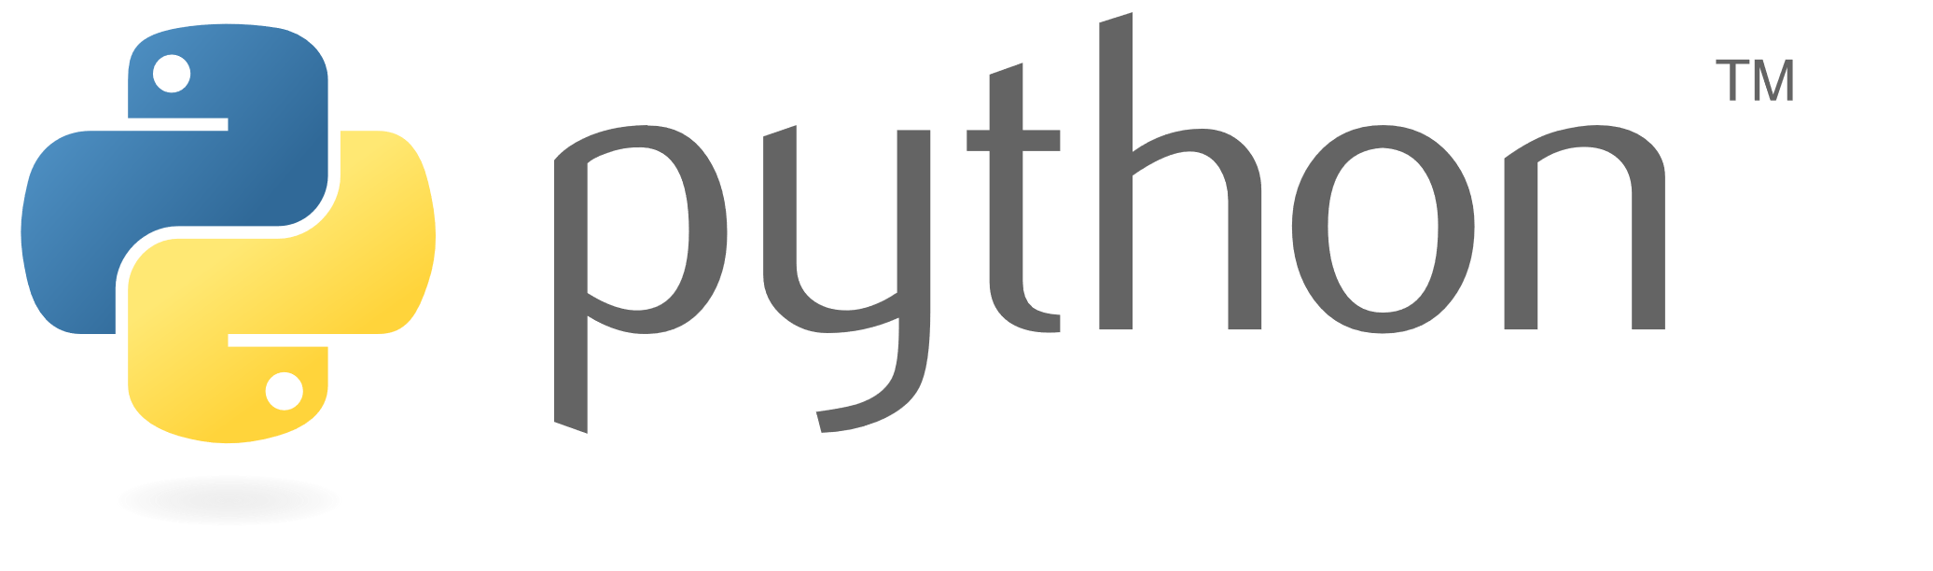
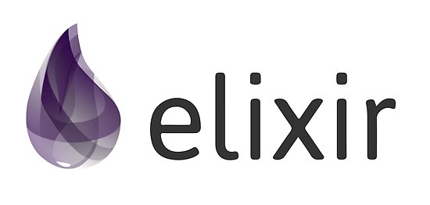
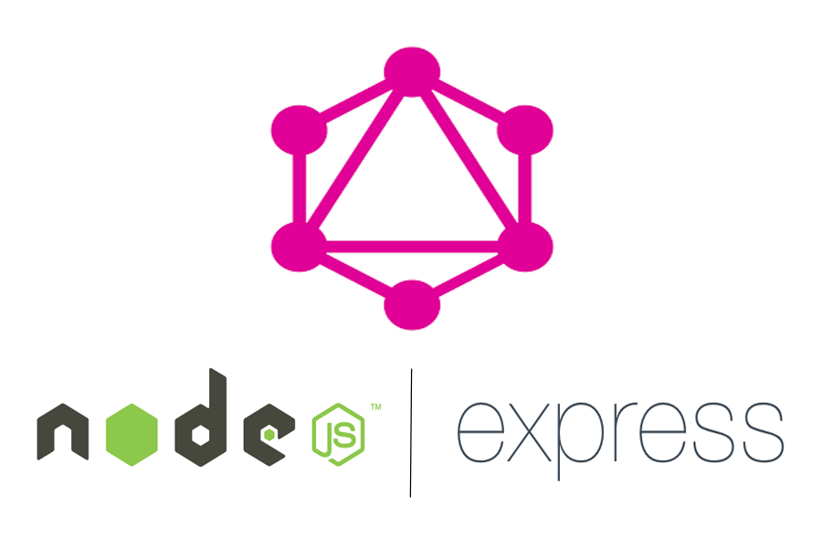
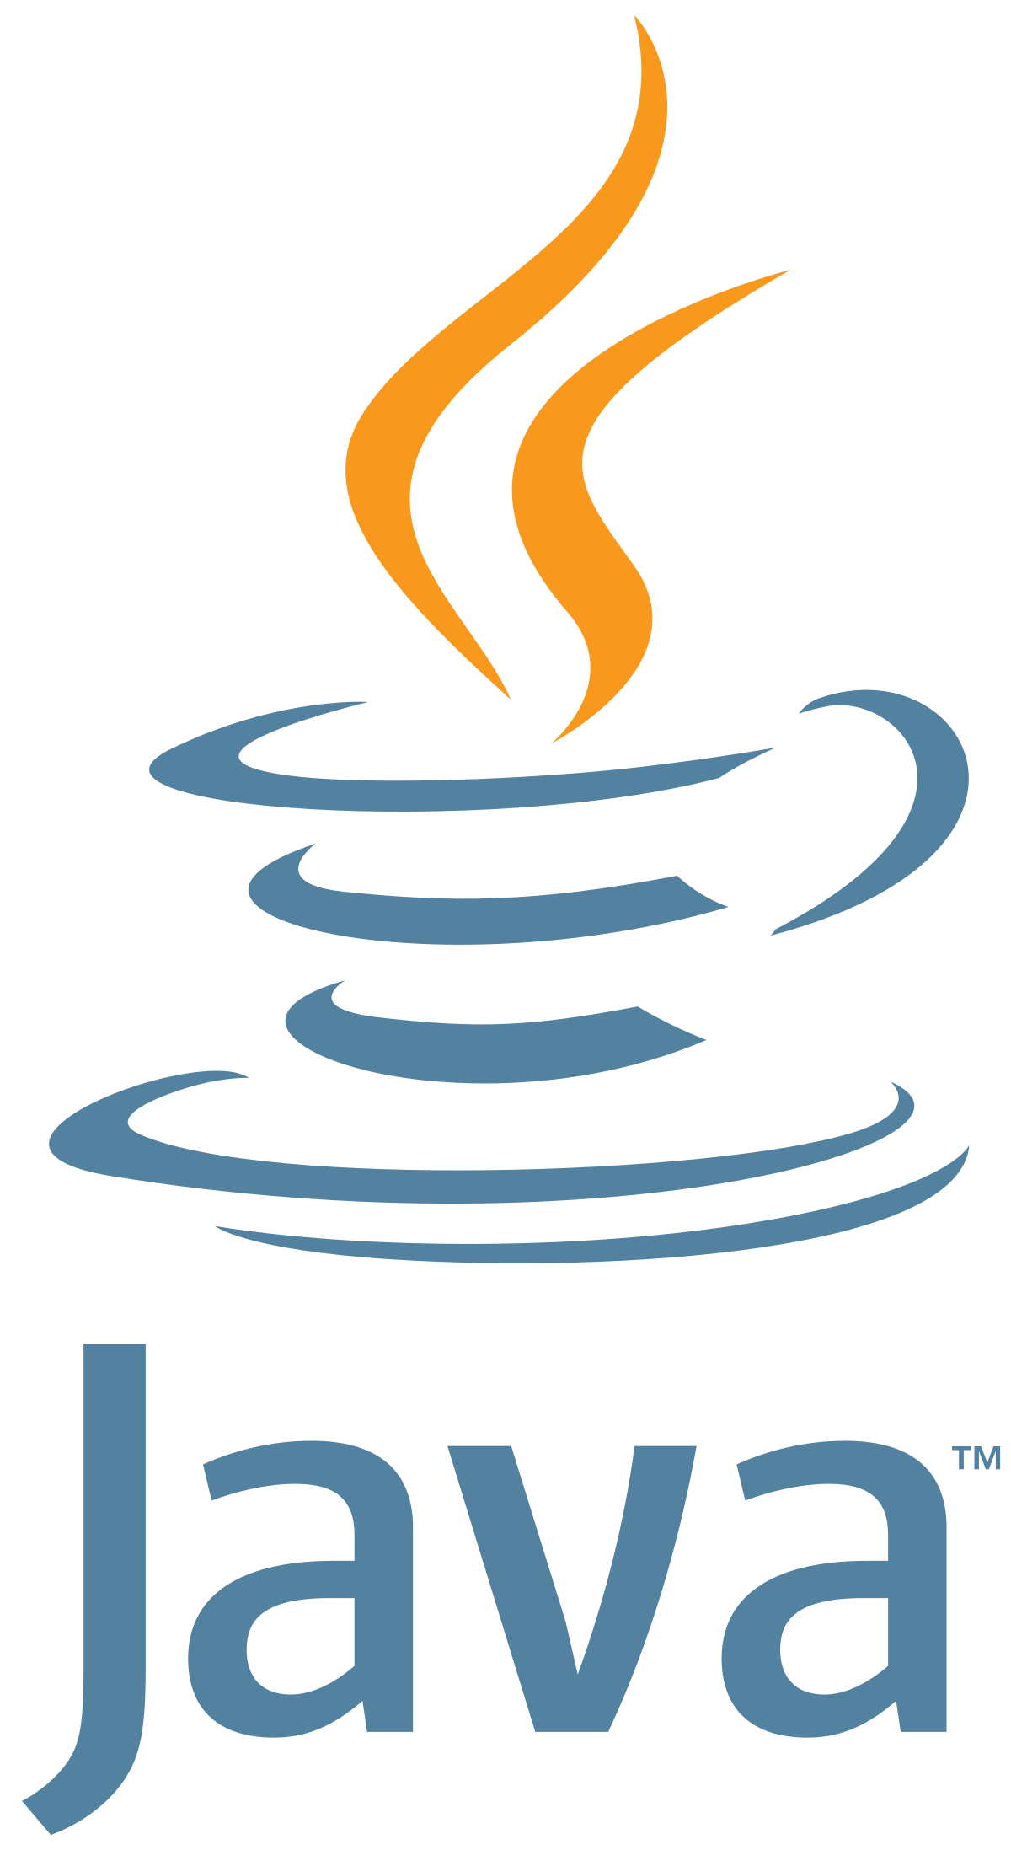
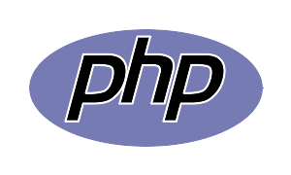
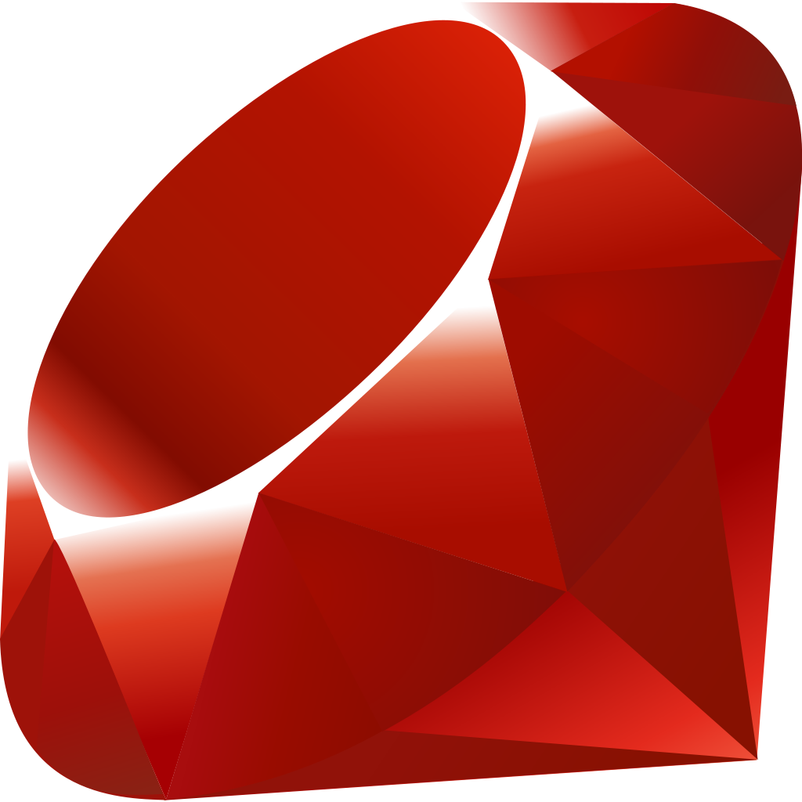

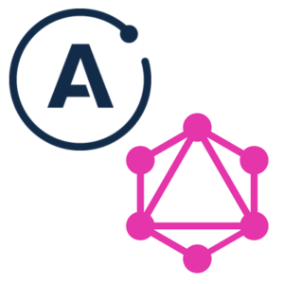
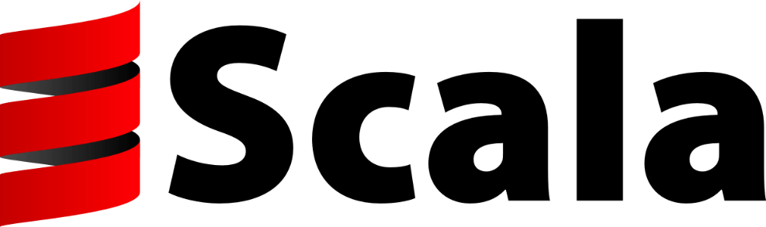
GraphQL Server
GraphQL – JS (Node)
This is the original reference implementation of GraphQL. You can use it together with express-graphql to create your API server.
GraphQL - JS
Other Platforms
GraphQL - Server
Other Platforms
GraphQL - Server (Node)
Beside, GraphQL implement for various other platform (PHP, Ruby, Python, etc.)
The Apollo team also has their own all-in-one GraphQL server implementation. It’s not as widespread as the original yet, but is very well documented and supported and quickly gaining ground.

Slide 28
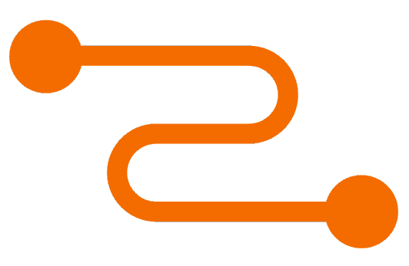

GraphQL Client
Relay is Facebook’s own GraphQL toolkit. I’ve heard it’s mainly tailored to Facebook’s own needs, and might be a bit over-engineered for most usages.
APOLLO CLIENT
RELAY
Which lets you run GraphQL queries in the browser and store their data. A connector for your front-end framework of choice
GraphQL Client
You can technically query your GraphQL API directly without the need for a dedicated client library.

Slide 29
Conclusion
GraphQL is a query language for APIs
It makes it easier to aggregate data from multiple sources.
S
W
STRENGTHS
OPPORTUNITIES
WEAKNESS
It lets the client specify exactly what data it needs.
O
T
GraphQL server exposes single endpoint and respons to queries
THREATS

Slide 30
Thank You
Insert the Sub Title of
Your Presentation

