Slide 1
GRAPHQL

Slide 2
Content
01
What is GraphQL?
02
GraphQL vs REST
03
Component
04
Ecosystem
Notes:
- In my presentation. I will go through 4 main parts
<number>

Slide 3
What is GraphQL?
Notes:
We will go to the first part
<number>

Slide 4
What is GraphQL?
GraphQL is a query language for APIs
It makes it easier to aggregate data from multiple sources.
Enables declaratative data fetching
It uses a type system to describe data.
GraphQL server exposes single endpoint and respons to queries
Developed by Facebook and open source version published in July 2015
Industrial automation
Notes:
GraphQL is a query language for APIs that provides a more efficient, powerful and flexible alternative to REST.
At its core, GraphQL enables declarative data fetching where a client can specify exactly what data it needs from an API. Send a GraphQL query to your API and get exactly what you need, nothing more and nothing less.
Instead of multiple endpoints that return fixed data structures, a GraphQL server only exposes a single endpoint and responds with precisely the data a client asked for.
It makes it easier to aggregate data from multiple sources.
It uses a type system to describe data. GraphQL APIs are organized in terms of types and fields, not endpoints. Access the full capabilities of your data from a single endpoint.
It was developed and open-sourced by Facebook and is now maintained by a large community of companies and individuals from all over the world.
So how did GraphQL get started? What does it look like in practice? And how do you start using it? Follow me to find out!
<number>

Slide 5
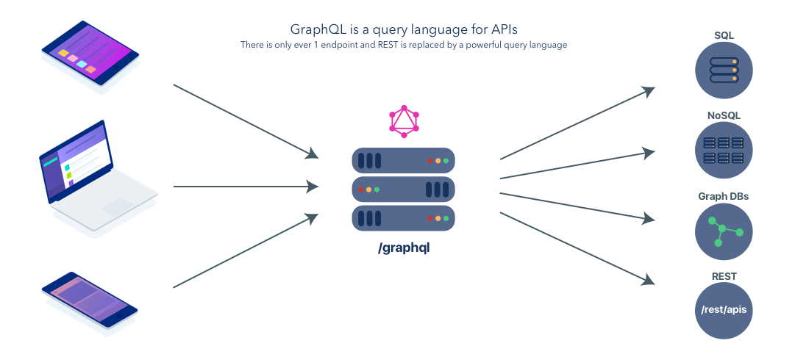
What is GraphQL?
Notes:
In the previous slide, I mentioned a feature of GraphQL that It makes it easier to aggregate data from multiple sources.
So as you see, When you have multiple clients requesting data from multiple services, a GraphQL layer in the middle can simplify and standardize this communication.
<number>

Slide 6
GraphQL vs REST
Notes:
We will go to next part
<number>

Slide 7

GraphQL vs REST
Send data over HTTP request.
Core idea is resource.
The final output is JSON
Differentiate between write/ read data.
Notes:
Graphql and rest have some similarities
<number>

Slide 8
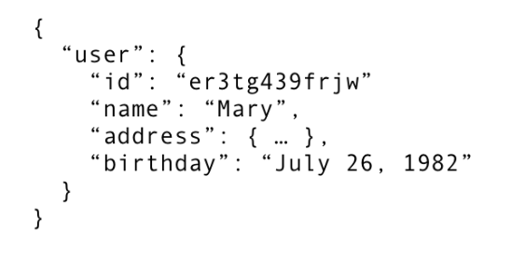
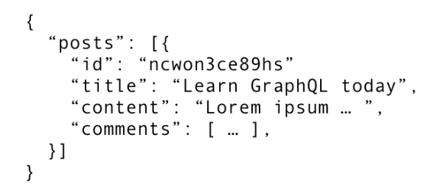
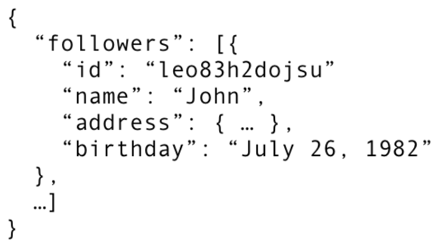
Fetching Data with REST
/api/user/<id>
/api/user/<id>/post
REST
/api/user/<id>/followers
Notes:
With a REST API, you would typically gather the data by accessing multiple endpoints.
In the example, these could be /users/<id> endpoint to fetch the initial user data.
Secondly, there’s likely to be a /users/<id>/posts endpoint that returns all the posts for a user.
The third endpoint will then be the /users/<id>/followers that returns a list of followers per user.
<number>

Slide 9
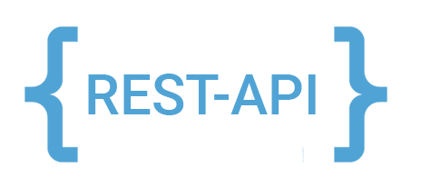
REST Drawbacks
The number of API endpoints is too much
Overfetching: Downloading unnecessary data
Underfetching: An endpoint doesn’t return enough of the required information; need to send multiple requests (n+1 problem)
Notes:
Overfetching: Downloading superfluous data
Overfetching means that a client downloads more information than is actually required in the app.
Underfetching and the n+1 problem
Another issue is underfetching and the n+1-requests problem.
Underfetching generally means that a specific endpoint doesn’t provide enough of the required information. The client will have to make additional requests to fetch everything it needs.
So it very trouble!!!
<number>

Slide 10
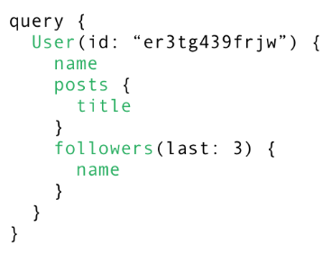
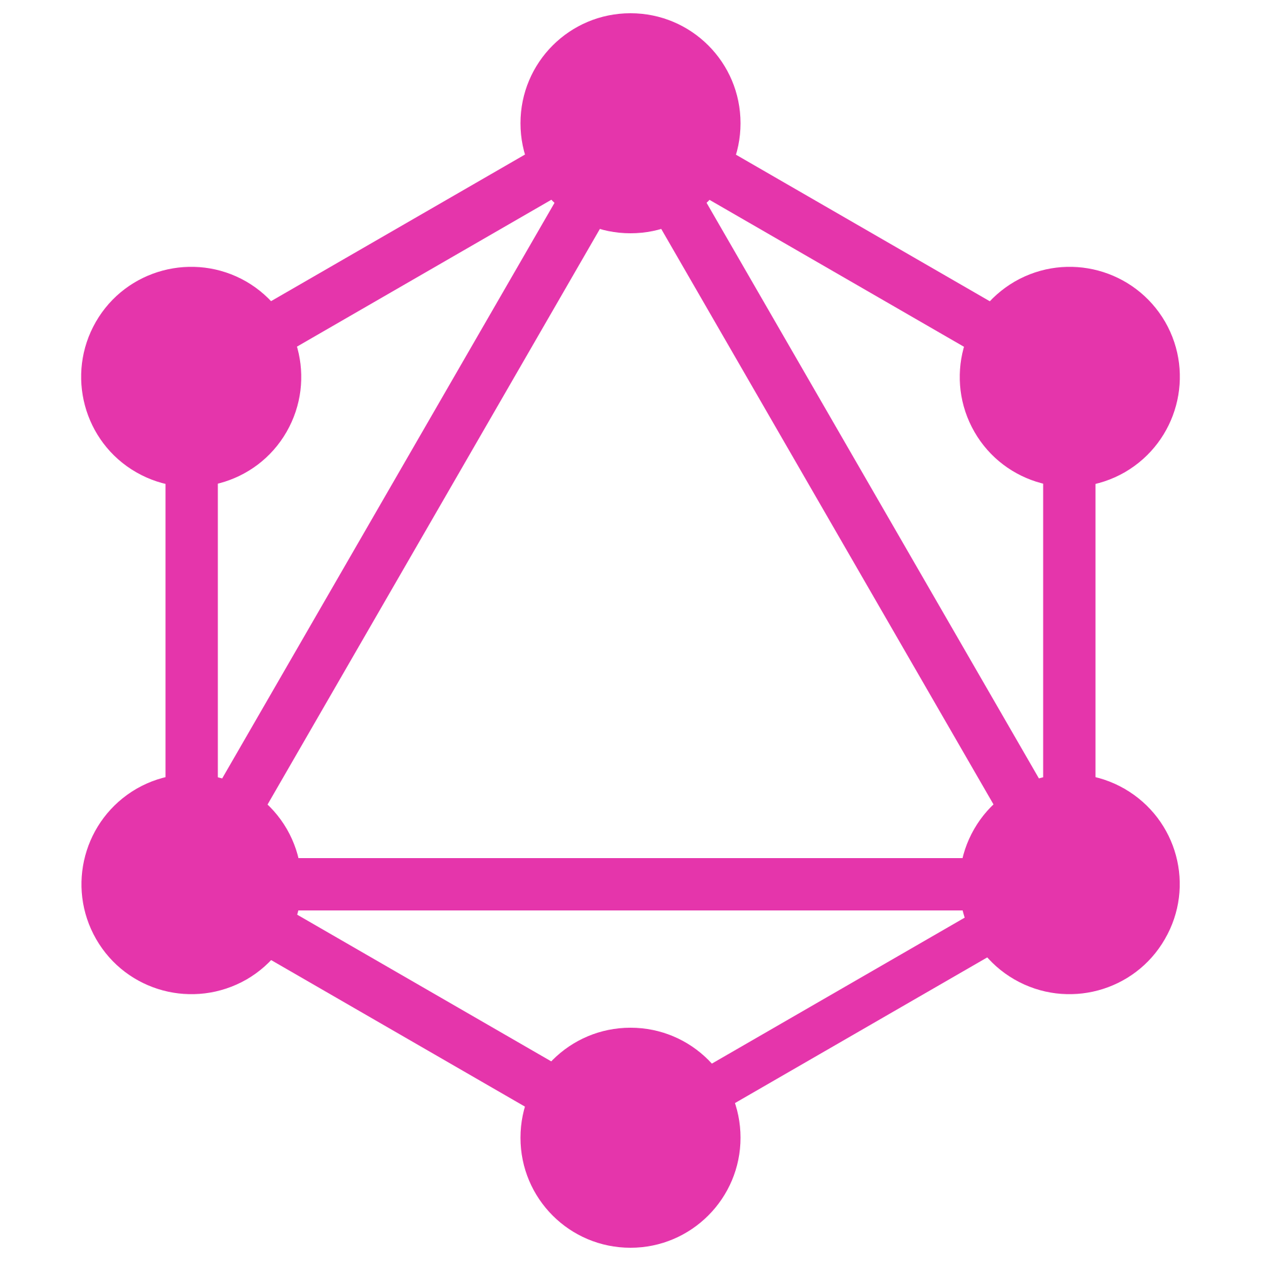
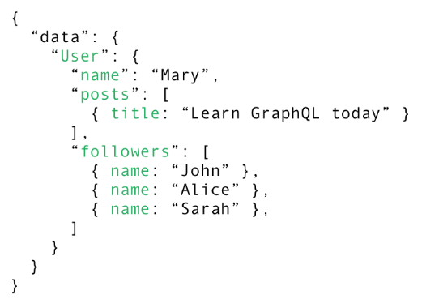
Fetching everything with a single request
Notes:
With graphql you would actually only send a single request to the server and the server would respond with all the information that you need.
The way how this works is by sending a post request to the server where you in the body of that request you include the query that describe all the data requirement of the client
So in this case we are asking for user with a particular ID and then we can specify all the data that we want from that user so we want name of user, we want to have the titles of the posts of the user, and we want to have the name of the last three followers
When the server receives that query. They will process and resolve it to fetch exactly the data that’ specified in the query and read it from the database. It will then package it up into a JSON object the it just return to the client.
<number>

Slide 11
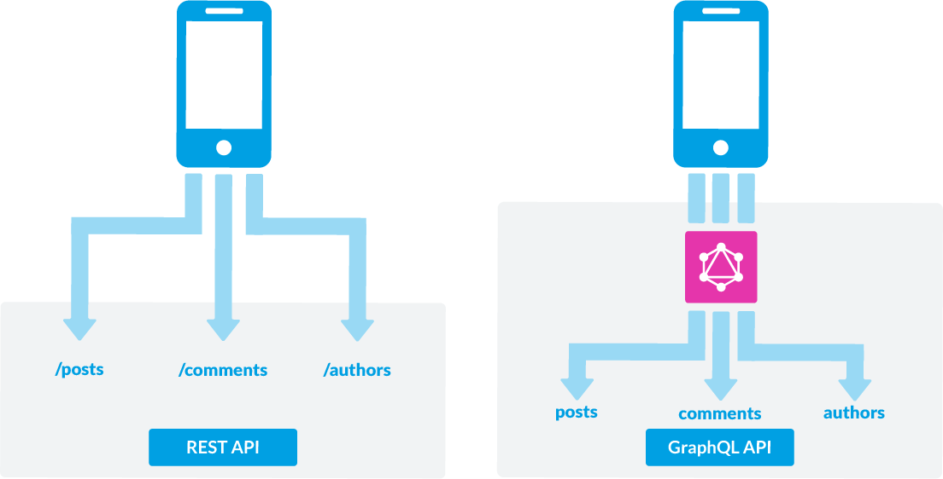
GraphQL is the better REST
Notes:
As you can see in the picture, for the rest api you will have to send many endpoints to the server to get the data.
As for graphql, you only need to send a single endpoint to the server to get the data you need, no more or missing data
<number>

Slide 12
Component
Notes:
So how did GraphQL get started? What does it look like in practice? And how do you start using it? Follow me to find out!
<number>

Slide 13
Component
Schema
Queries & Mutation
This Schema is used as a transaction between the client and server to determine how the client can access the data
The request you make to your GraphQL
Resolvers
Subcription
A resolver tells GraphQL how and where to fetch the data corresponding to a given field
Enable to connect to the server to get information about events immediately.
Notes:
Schema is used as a transaction between the client and server to determine how the client can access the data
The request you make to your GraphQL is the query and mutation.
A resolver tells GraphQL how and where to fetch the data corresponding to a given field
Another important requirement for many applications is realtime, to be able to connect to the server to get information about events immediately.
<number>

Slide 14
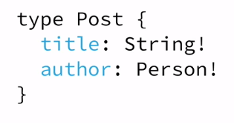
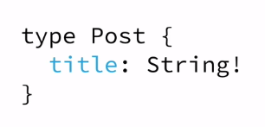
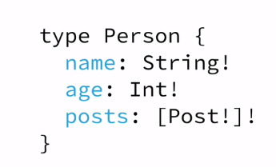
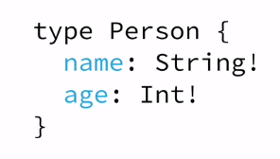
The Schema Definition Language (SDL)
GraphQL has its own type system that’s used to define the schema of an API. The syntax for writing schemas is called Schema Definition Language (SDL).
Notes:
GraphQL has its own type system that’s used to define the schema of an API. The syntax for writing schemas is called Schema Definition Language (SDL).
The most basic components of a GraphQL schema are object types, which just represent a kind of object you can fetch from your service, and what fields it has. In the GraphQL schema language, we might represent it like this:
Here is an example how we can use the SDL to define a simple type called Person:
This type has two fields, they’re called name and age and are respectively of type String and Int. The !following the type means that this field is required.
It’s also possible to express relationships between types. A Person could be associated with a Post:
Conversely, the other end of the relationship needs to be placed on the Person type:
Note that we just created a one-to-many-relationship between Person and Post since the posts field on Personis actually an array of posts.
<number>

Slide 15
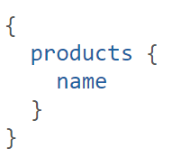
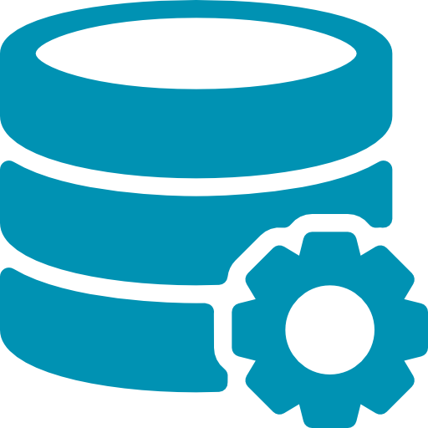
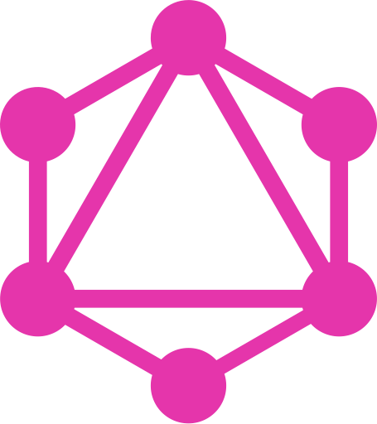
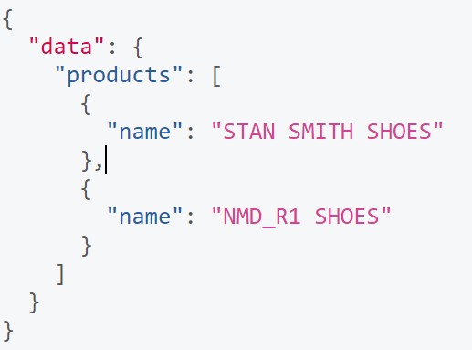
Fetching Data with Queries
Notes:
The request you make to your GraphQL is the query.
You can specify the fields you need to retrieve, then send to the server via queries. The server will return the correct fields that you have requested without redundancy
Let’s take a look at an example query that a client could send to a server:
The products field in this query is called the root field of the query. Everything that follows the root field, is called the payload of the query. The only field that’s specified in this query’s payload is name.
This query would return a list of all persons currently stored in the database. Here’s an example response:
<number>

Slide 16
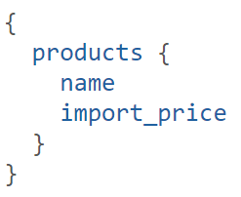
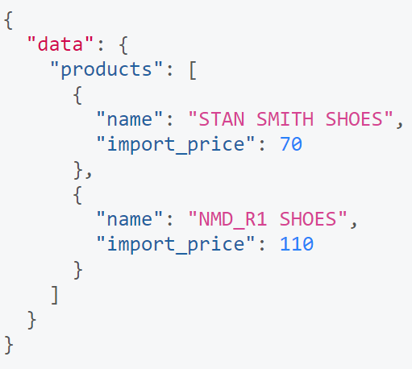
Fetching Data with Queries
Notes:
If the client also needed the products’ import_price, we can slightly adjust the query and include the new field in the query’s payload
So the result will reponse name and import_price in json.
<number>

Slide 17
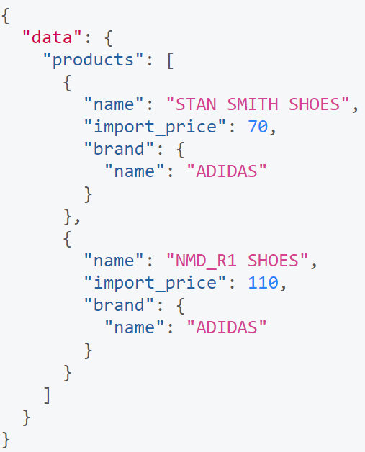
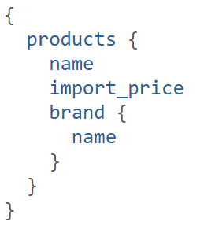
Fetching Data with Queries
Notes:
One of the major advantages of GraphQL is that it allows for naturally querying nested information.
For example, if you wanted to load a brand of product, you could simply follow the structure of your types to request this information:
<number>

Slide 18
Writing Data with Mutations
There generally are three kinds of mutations:
Creating new data
Updating existing data
Deleting existing data
Notes:
Next to requesting information from a server, the majority of applications also need some way of making changes to the data that’s currently stored in the backend.
With GraphQL, these changes are made using so-called mutations. There generally are three kinds of mutations:
creating new data
updating existing data
deleting existing data
<number>

Slide 19
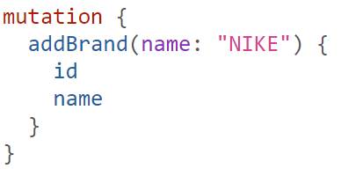
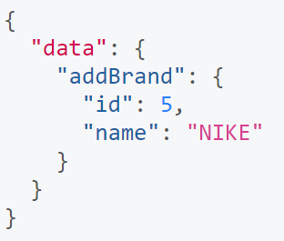
Writing Data with Mutations
Notes:
Mutations follow the same syntactical structure as queries, but they always need to start with the mutation keyword.
Here’s an example for how we might create a new Brand:
<number>

Slide 20
The GraphQL Schema
Define capabilities of the API by specifying how a client and fetch and update data
Represents contract between client and server
Collection of GraphQL types with special root types
Notes:
Now that you have a basic understanding of what queries, mutations.
Let’s put it all together and learn how you can write a schema that would allow you to execute the examples you’ve seen so far.
The schema is one of the most important concepts when working with a GraphQL API.
It specifies the capabilities of the API and defines how clients can request the data.
It is often seen as a contract between the server and client.
Generally, a schema is simply a collection of GraphQL types.
<number>

Slide 21
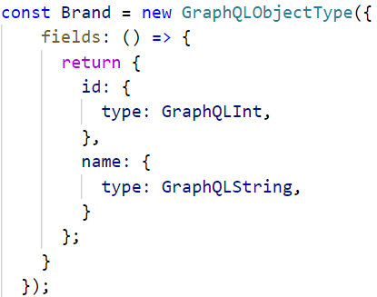
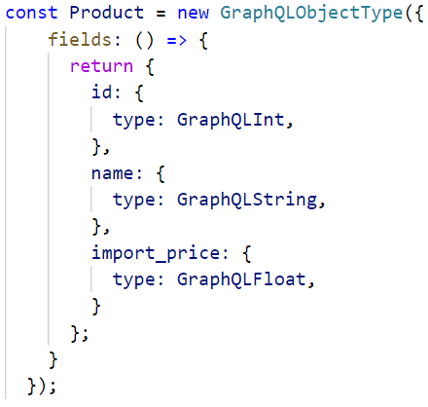
Object Type
Notes:
The object type is the most common type used in a schema and represents a group of fields.
<number>

Slide 22
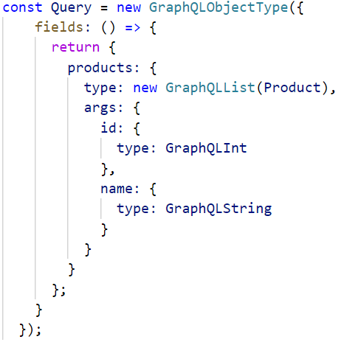

Query Type
Notes:
A GraphQL query is for fetching data.
In order to define what queries are possible on a server, the Query type is used within the SDL. The Query type is one of many root-level types which defines functionality for clients and acts as an entry-point to other more specific types within the schema.
In this Query type, we define two types of queries which are available on this GraphQL server:
getBooks: which returns a list of Book objects.
As mentioned in the previous section, the structure in which types are organized in the SDL is important because of the relationships it creates. When a client makes a query to the server, the server will return results in a shape that matches that of the query.
Based on the SDL defined above, a client could request a list of all products by sending a single query with exactly what it wishes to receive in return:
<number>

Slide 23
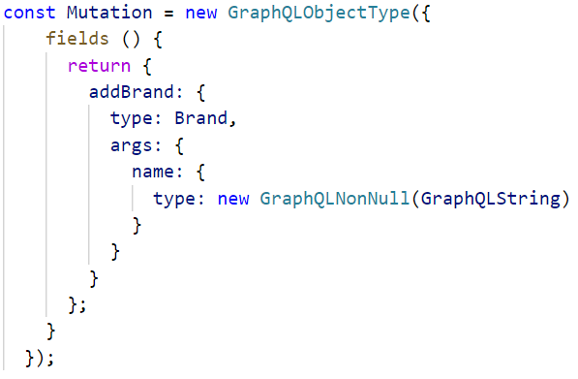
Mutation Type
Notes:
Much like how the Query type defines the entry-points for data-fetching operations on a GraphQL server, the root-level Mutation type specifies the entry points for data-manipulation operations.
For example, when imagining a situation where the API supported adding a new Brand, the SDL might implement the following Mutation type:
This implements a single addBrand mutation which accepts name as arguments, but the important thing to note here is that this mutation will return the newly-created Brandobject.
<number>

Slide 24
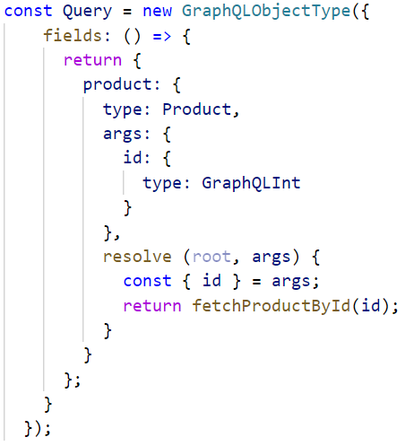
Resolvers implement the API
Each field in a GraphQL schema is backed by a resolver.
A resolver tells GraphQL how and where to fetch the data corresponding to a given field
Notes:
In its most basic form, a GraphQL server will have one resolver function per field in its schema. Each resolver knows how to fetch the data for its field. Since a GraphQL query at its essence is just a collection of fields, all a GraphQL server actually needs to do in order to gather the requested data is invoke all the resolver functions for the fields specified in the query.
When using GraphQL.js, each of the fields on a type in the GraphQLSchema object can have a resolve function attached to it. Let’s consider our example from above, in particular the user field on the Query type — here we can add a simple resolvefunction as follows:
Assuming a function fetchProductById is actually available and returns a User instance (a JS object with id and name fields), the resolve function now enables execution of the schema.
<number>

Slide 25
Ecosystem
Notes:
So, we will go to the final part in this presentaion
<number>

Slide 26
Ecosystem
GraphQL
GraphQL Server
GraphQL Client
The first brick you’ll need is a GraphQL server. GraphQL itself is just a specification after all, so this leaves the door open to a few competing implementations.
Although you can technically query your GraphQL API directly without the need for a dedicated client library, it can definely make your life easier.
Notes:
Ecosystem GraphQL composes of participants, programming languages, communities, platforms support for graphql
Here I devide into 2 main part
The first brick you’ll need is a GraphQL server. GraphQL itself is just a specification after all, so this leaves the door open to a few competing implementations.
Although you can technically query your GraphQL API directly without the need for a dedicated client library, it can definely make your life easier.
<number>

Slide 27
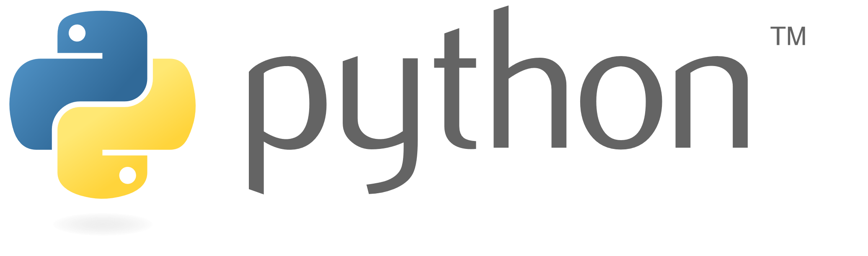
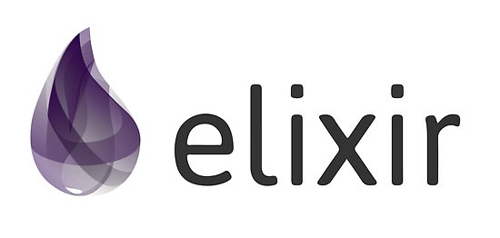
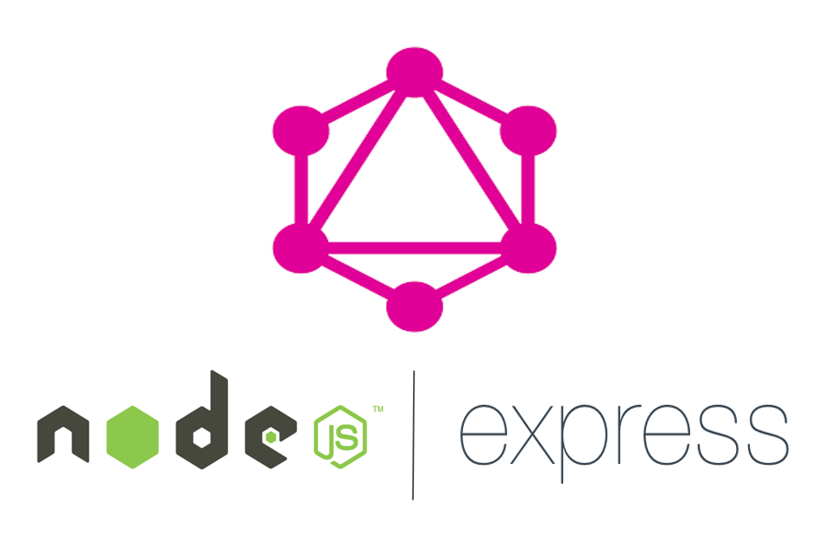
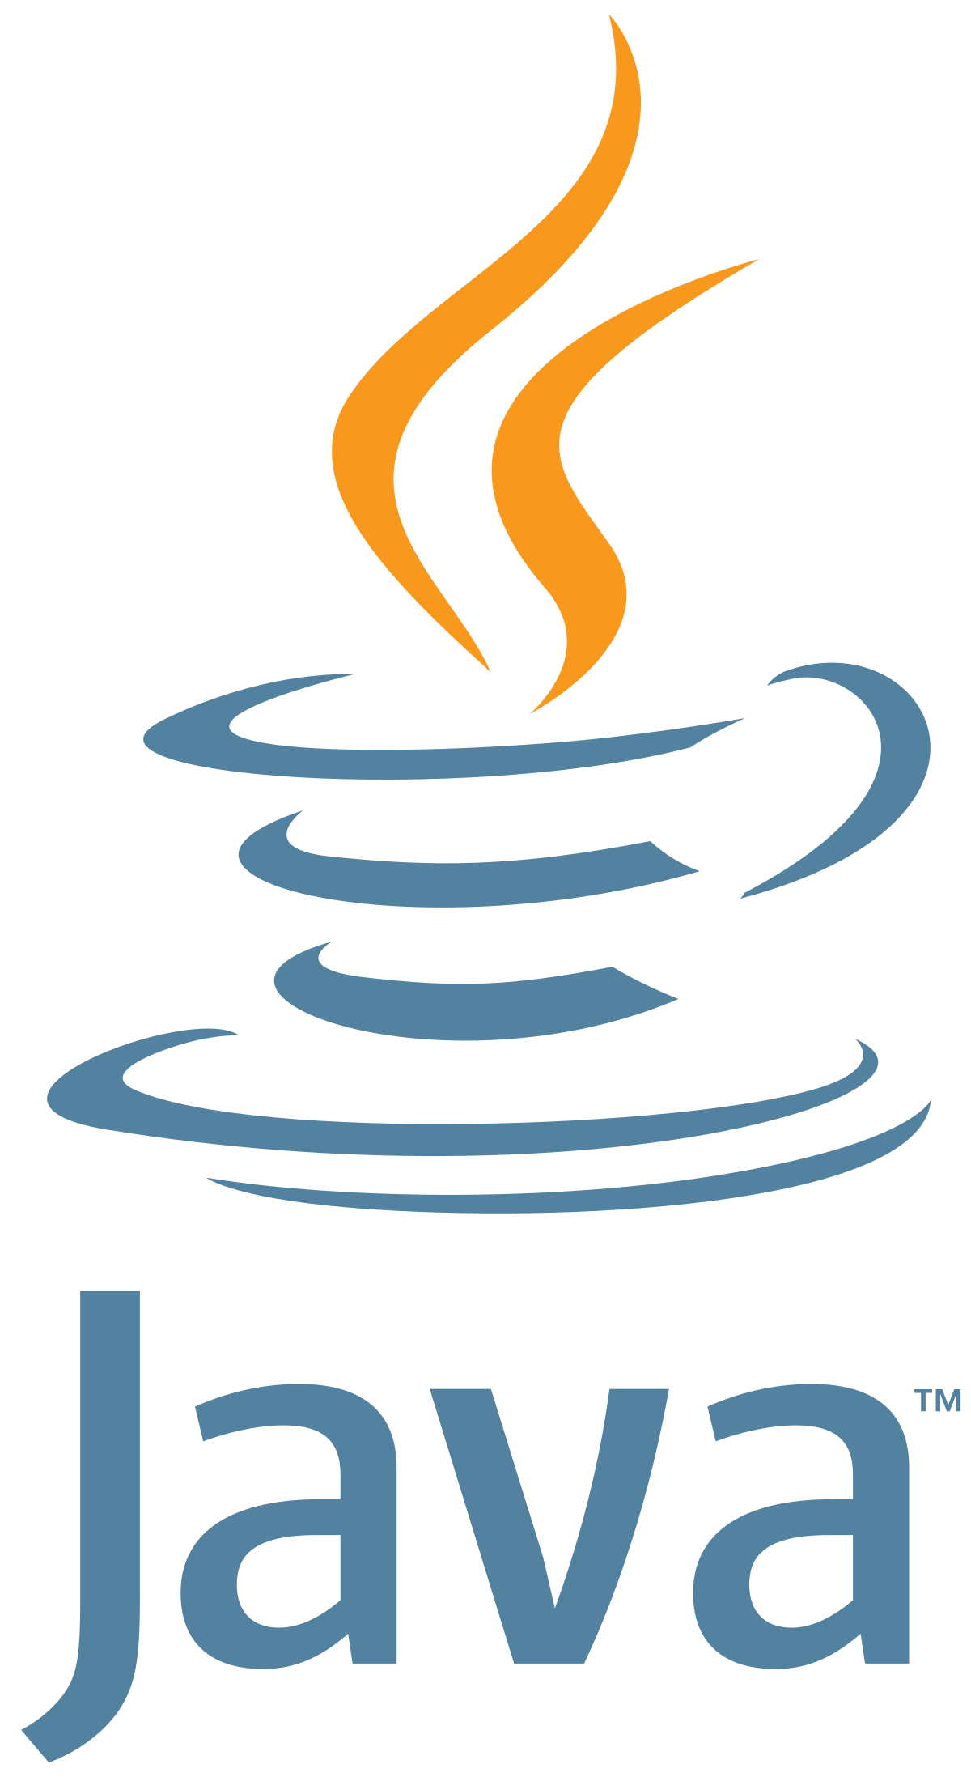
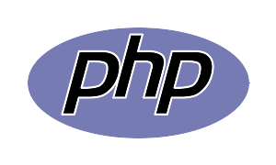
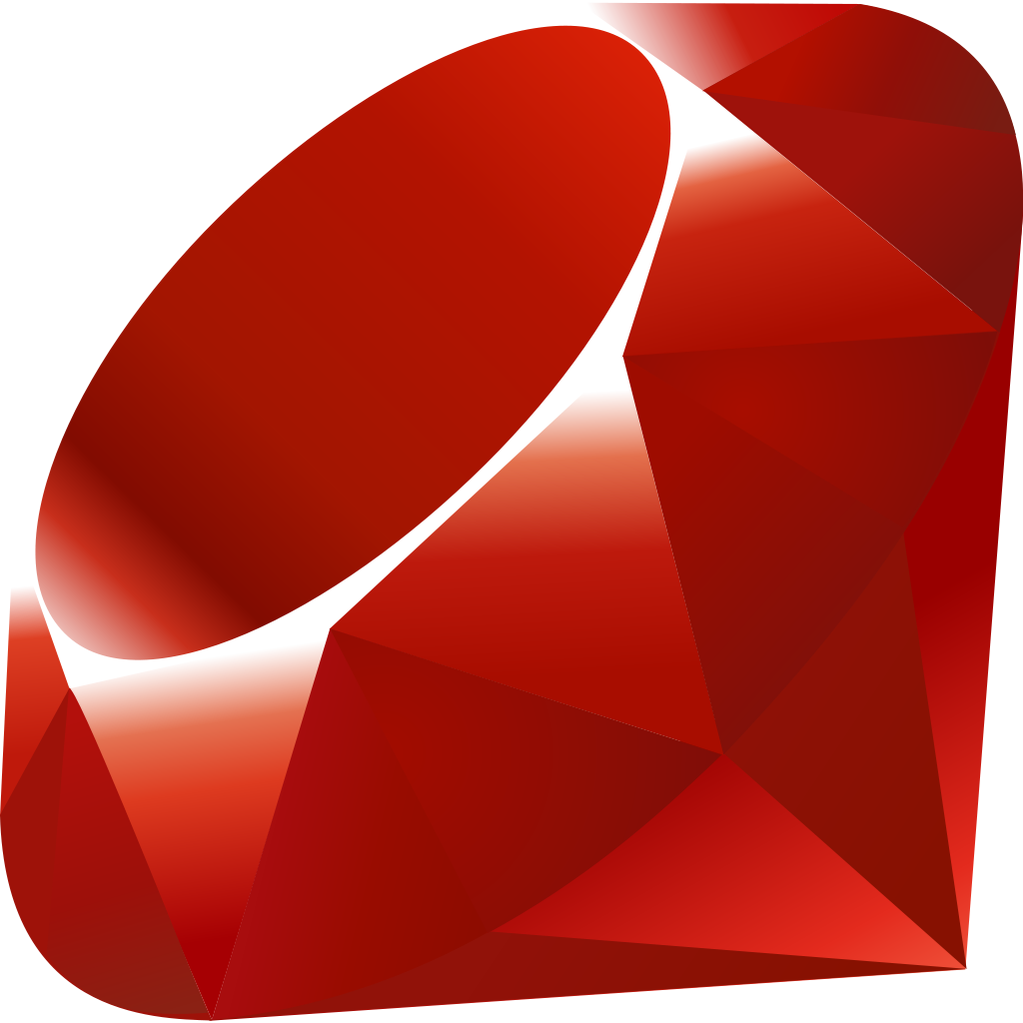
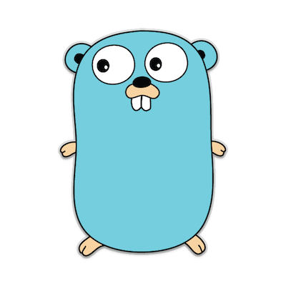
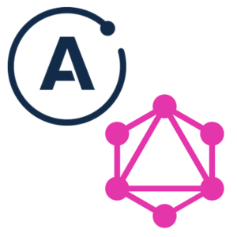
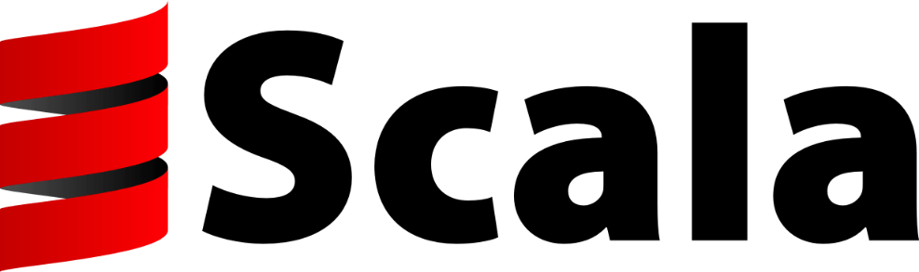
GraphQL Server
GraphQL – JS (Node)
This is the original reference implementation of GraphQL. You can use it together with express-graphql to create your API server.
GraphQL - JS
Other Platforms
GraphQL - Server
Other Platforms
GraphQL - Server (Node)
Beside, GraphQL implement for various other platform (PHP, Ruby, Python, etc.)
The Apollo team also has their own all-in-one GraphQL server implementation. It’s not as widespread as the original yet, but is very well documented and supported and quickly gaining ground.
Notes:
GraphQL – JS (Node): This is the original reference implementation of GraphQL. You can use it together with express-graphql to create your API server.
GraphQL - Server (Node): The Apollo team also has their own all-in-one GraphQL server implementation. It’s not as popular as the original yet, but is very well documentation and supported.
Beside, GraphQL implement for various other platform (PHP, Ruby, Python, etc.)
<number>

Slide 28
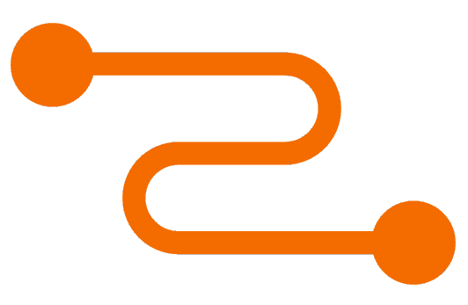

GraphQL Client
Relay is Facebook’s own GraphQL toolkit. I’ve heard it’s mainly tailored to Facebook’s own needs, and might be a bit over-engineered for most usages.
APOLLO CLIENT
RELAY
Which lets you run GraphQL queries in the browser and store their data. A connector for your front-end framework of choice
GraphQL Client
You can technically query your GraphQL API directly without the need for a dedicated client library.
Notes:
Normally, You can technically query your GraphQL API directly without the need for a dedicated client library.
But, Here I would like to introduce 2 popular GraphQL client and support you to easily connect to graphql.
Relay is Facebook’s own GraphQL toolkit. It support Facebook’s own needs, and might be a bit over-engineered for most usages.
Apollo Client is the best way to use GraphQL to build client applications. The client is designed to help you quickly build a UI that fetches data with GraphQL, and can be used with any JavaScript front-end.
<number>

Slide 29
Conclusion
GraphQL is a query language for APIs
It makes it easier to aggregate data from multiple sources.
S
W
STRENGTHS
OPPORTUNITIES
WEAKNESS
It lets the client specify exactly what data it needs.
GraphQL server exposes single endpoint and respons to queries
O
T
THREATS

Slide 30

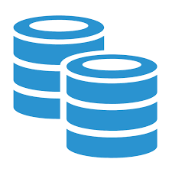
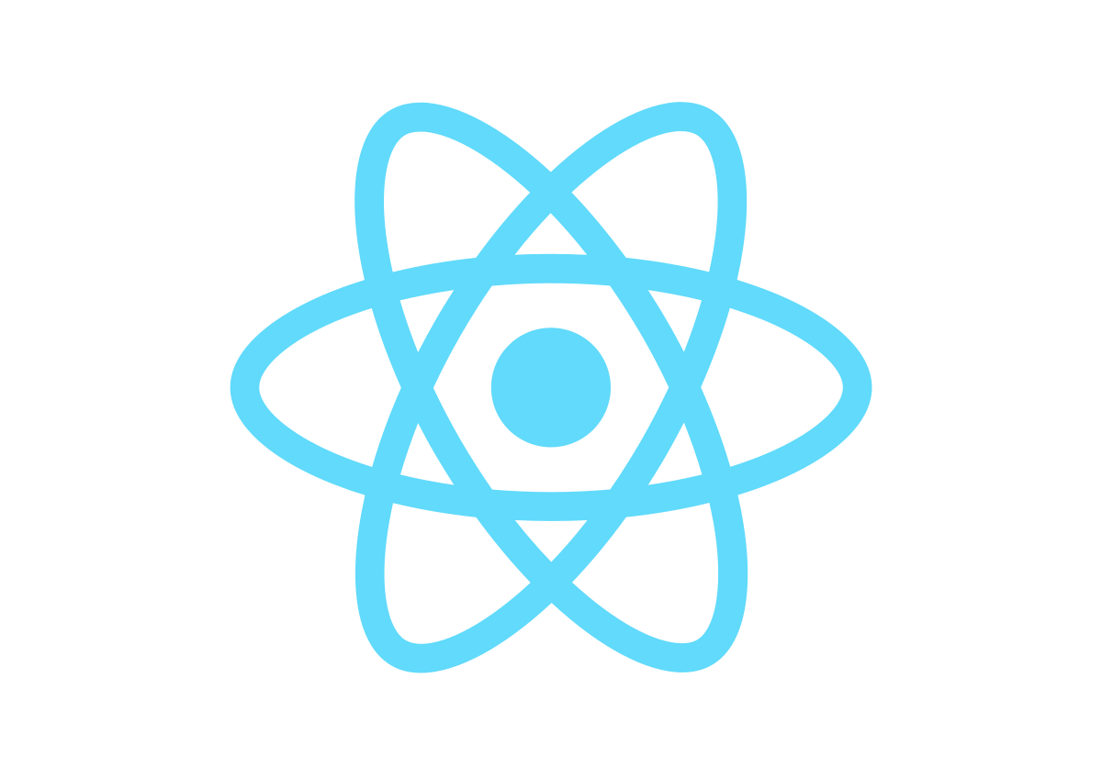
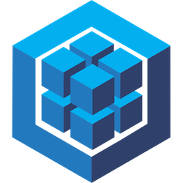
Client
Server
Database
Spring Boot
ReactJS
GraphQL
(Node.js & express)
Sequelize

Slide 31
Thank You

