Slide 1
Big Mountain Resort

Slide 2
Problem identification
$1.5 million increase in operating costs (new chair lift)
Can Resort’s facilities and features (number of runs, vertical drop, number of chairs…) support higher ticket price?
If increase/decrease number of facilities, what is the effect on supported price and revenue?

Slide 3
Recommendation and key findings
Four most important features that support price:
Number of fastQuads
Number of Runs
Area covered by Snow Making machines
Vertical drop
Recommendations:
Increase price to $85.
Add a run to increase the vertical drop by 150 feet.

Slide 4
Modeling results and analysis
Four most important features that support price:
Number of fastQuads
Number of Runs
Area covered by Snow Making machines
Vertical drop
Model price $95.87; mean absolute error $10.39
Fair price is in range $85.48 to $106.26
Resort’s facilities are superior to those of competitors
Recommendation1: Increase price to $85.
Still only at the lowest end of the range. Thus, a safe move.
$4 ticket increase lead to increase in revenue of 5 x 350000 x 4 = $7 millions.

Slide 5
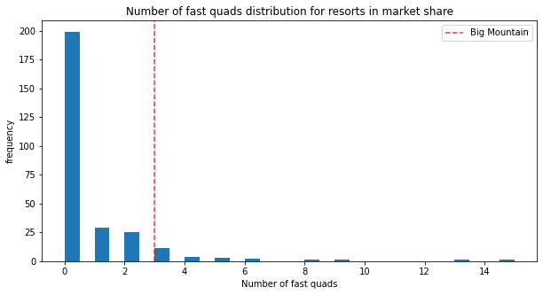
Modeling results and analysis

Slide 6
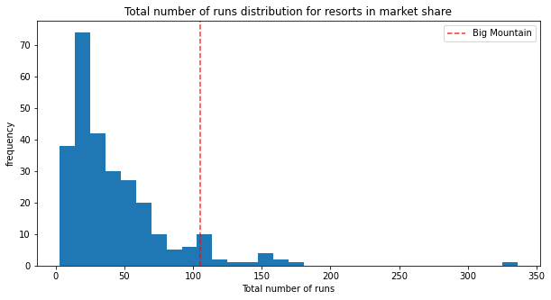
Modeling results and analysis

Slide 7
Modeling results and analysis
Add a run to increase the vertical drop by 150 feet.
Requires installing an additional chair lift.
The new features support price increase of $2 (revenue increase by $3.5 millions).
Questions remained: how much additional operating costs for having one more run and a chair lift?

Slide 8
Summary and conclusion
Resort’s superior facilities support ticket price increase from $81 to $85.
Resort can add a run to increase the vertical drop by 150 feet.

