Slide 1
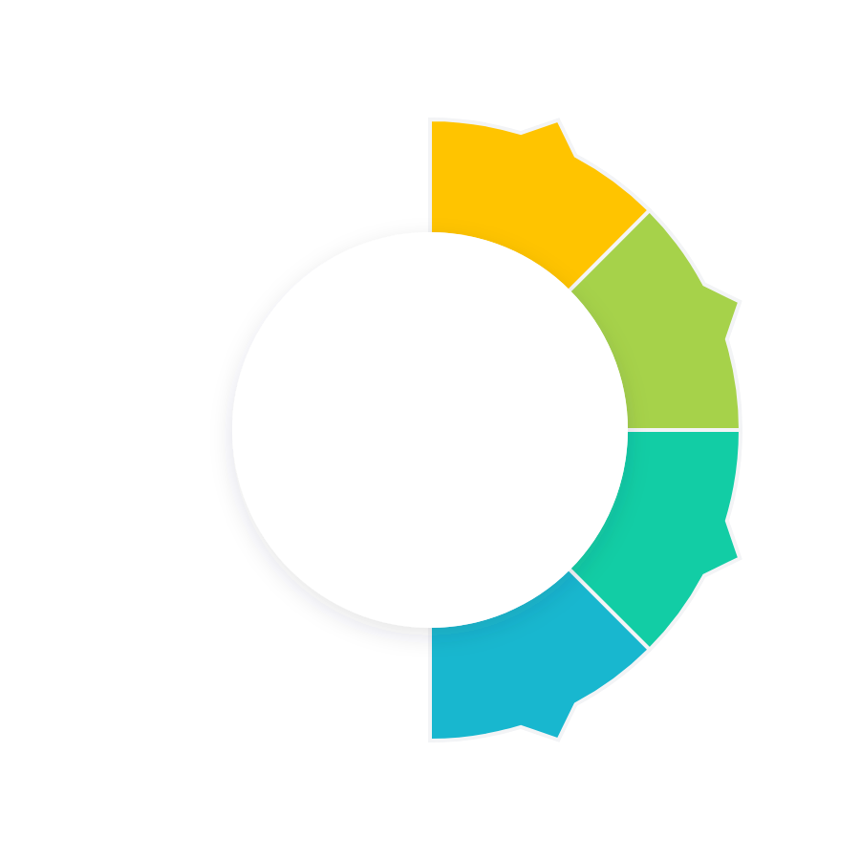




Discovery
Teams work with customers to understand their specific problems.
AGILE AND THE CUSTOMER JOURNEY AGILE AND THE CUSTOMER JOURNEY
Iteration
New features are developed in small, usable increments.
Feedback
Customer feedback is continuously integrated into the development.
Delivery
The team releases usable products frequently.

