Slide 1
Progress Report: 15/02 - 25/02
Dinh Vinh Thanh NGUYEN
Intern at Gepetto team
LAAS-CNRS
Toulouse

Slide 2
Outline
2 DOF robot model
Identification procedure
Dynamic model
Data generation
QR decomposition with column pivoting
Results

Slide 3
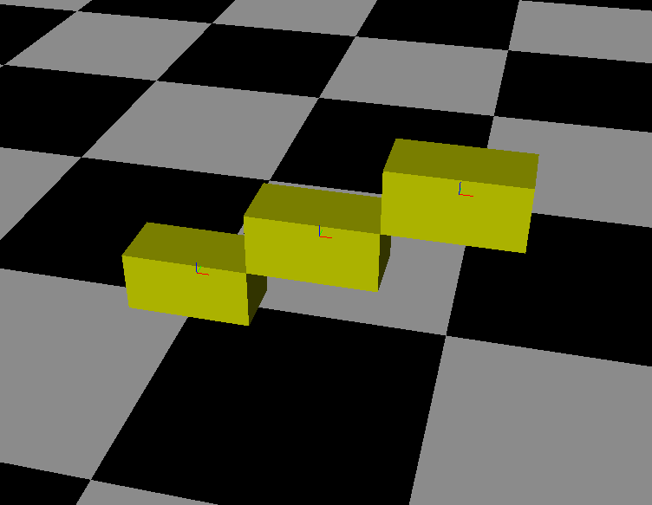
2 DOF robot
2 degree of freedom
Link: box-shaped,
size of 0.25x0.25x0.5
2 revolute joints
with direction along y axis
Link B2
Link B1
Base
link Bo
Global frame
Local reference frame

Slide 4
Animation

Slide 5
Identification procedure
URDF file
Joint Torques
Exciting
Trajectories
Robot model
Regressor
Matrix
Pinocchio
Identification
Algorithm
Validation

Slide 6
Dynamic model
For link i :
q2
O₂
z
q1
General:
x
O₁

Slide 7
Rearrange to identification model
10 standard inertia parameters:
W: regressor matrix, (2N x 20)
Φ: vector of parameters, (20 x 1)
τ: vector of joint torques, (2N x 1)
N = number of samples

Slide 8
Data generation
1. Generate a set of random samples (q, v, a)
2. Obtain from algorithms of Pinocchio:
Matrix W = computeJointTorqueRegressor(model, data, q, v, a’)
τ = rnea(model, data, q, v, a)
3. Calculate the norm of columns: W^{T}*W, eliminate corresponding columns that have
its value < tolerance (1e-6)
4. Obtain the reduced regressor matrix, W_{e} (2N x 7)

Slide 9
Solve linear least squares (LLS) by
QR decomposition with column pivoting (1)
Solving rank deficient LLS problem: W_{e}*Φ_{e} = τ,
with Φ_{e} = { mx₁, mz₁, I_{xx1}, m₂, mx₂, mz₂, I_{xx2} }
1. QR decomposition with column pivoting
W_{e}P = QR
where: P is a permutation matrix, (7x7)
Q is a orthogonal matrix Q^{T}Q = I, (2Nx2N)
R is an upper triangular matrix with absolute values of |R_{ii}| decreasing, (2Nx7)
2. Set tolerance to determine rank k of W_{e}
tole = N*max|R_{ii}|*epsilon (epsilon = precision of machine)
k is rank of W_{e} if max|R_{kk}| < tole
=> (7-k) paramters can be regrouped into the first k paramters.

Slide 10
Solve linear least squares (LLS) by
QR decomposition with column pivoting (2)
3. Regrouping parameters – Base parameters
Linearly dependent columns can be grouped as:
Solving full-rank LLS with base parameter Φ_{b}:

Slide 11
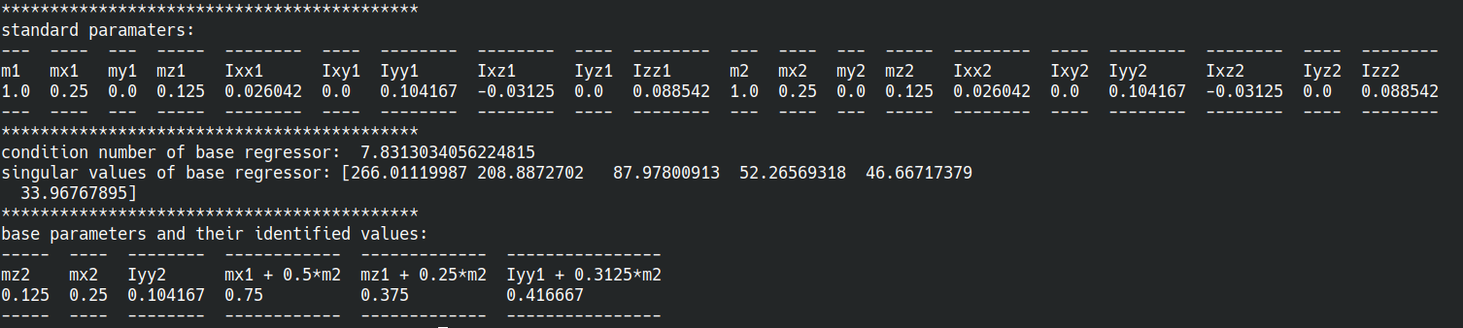
Results

