Slide 1
Library management system project
Course - CS401 Modern Programming Practices (MPP)
Professor - Renuka Mohanraj
Group 2 :
DUY THANH NGO - 986653
CHI TAM NGUYEN - 986693
THI MINH THUY DOAN - 986584

Slide 2
Summary
Overview:
Library Management System is the a desktop application system that is developed in Java which mainly focus on operations such as search book, check out books for library members, add new books(copy of book) to the collection, create new library members, and edit library member information.
Designing this system is elaborated using UML class diagram and Sequence Diagram while implementation of project has done with Java and uses object oriented concepts like polymorphism, Inheritance, Relationships, Singleton, Abstract classes, Interfaces and JavaFX for UI.
Notes:
Designing this system will be elaborated using UML class diagram and Sequence Diagram while implementation of library management system
the project will be done with Java and uses object oriented concepts like polymorphism, Inheritance, Relationships, Singleton, Abstract classes, Interfaces and JavaFX for UI.

Slide 3
Goal
Support for Administrators add library member, edit member info , search book and add books.
Support for Librarians check out books and search book
Support System Admins have both authorization levels as Librarian and Administrator

Slide 4
Technology
Front end development: JavaFX
Back end development: Java
Database: File Serialization

Slide 5
Functional Requirement
The Library Management System based on a real need of Librarian and administration. The system has the following functional requirements:
Search Book
Add Library Member
Edit Library Member
Add Book
Add Book Copy
Check out Book

Slide 6
Non – Functional Requirement:
Performance
Speed
Memorize
User friendly Interface

Slide 7
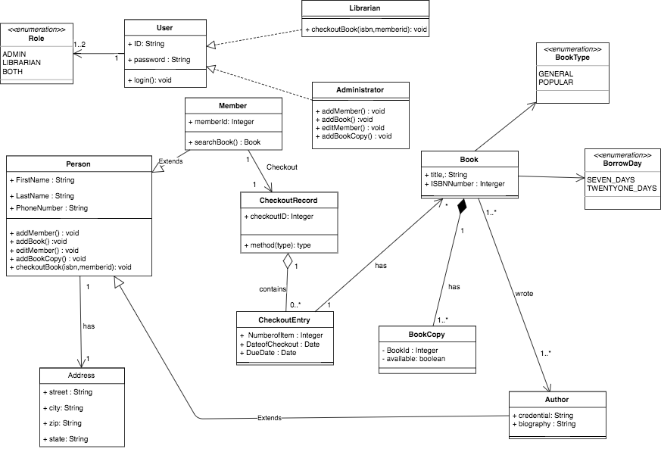
Design Approach

Slide 8
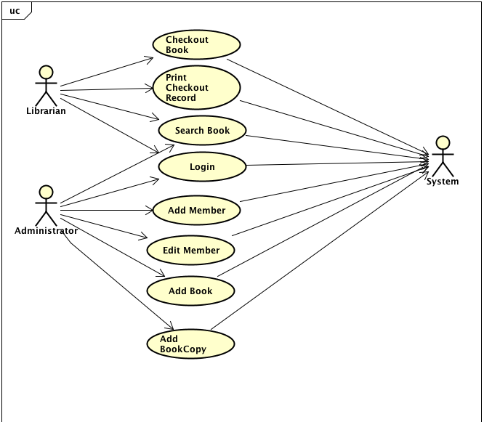
Use Case Diagram
Notes:
Optional Use cases :
1. Add book
2. Print CheckoutRecord(MemberID)
3. Search Book

Slide 9
Sequence Diagram
Add a new library member to the system.
Checkout a book (if available) for a library member.
Notes:
There are many sequence diagrams in this system, but we just show two sequences

Slide 10
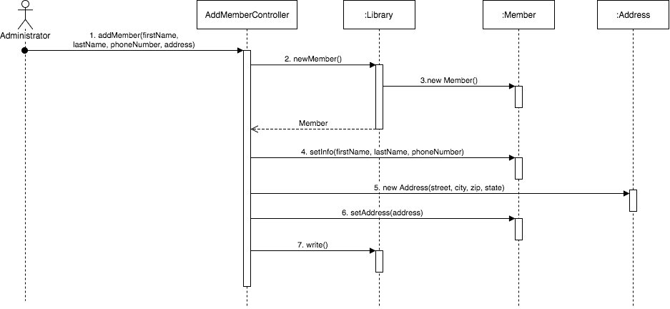
1. Add a new library member to the system.

Slide 11
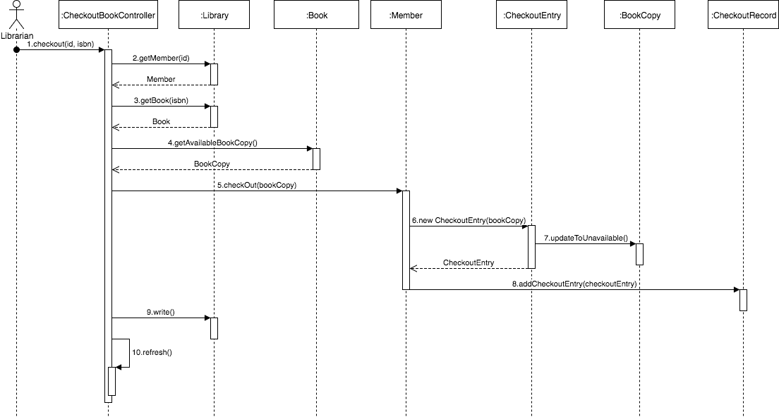
2. Checkout a book (if available) for a library member
Notes:
What UI features are involved in the use case
How the UI communicates with the controller
What the controller does in response to the request from the UI

Slide 12
UI Design decision, Components used from JavaFX.
1. Container: GridPane, Borderpane, Pane …
2. Controls: Label, Button, TextField, TableView, Table…

Slide 13
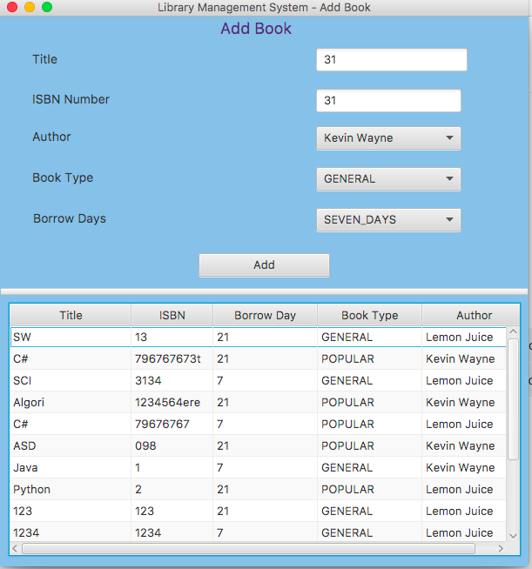
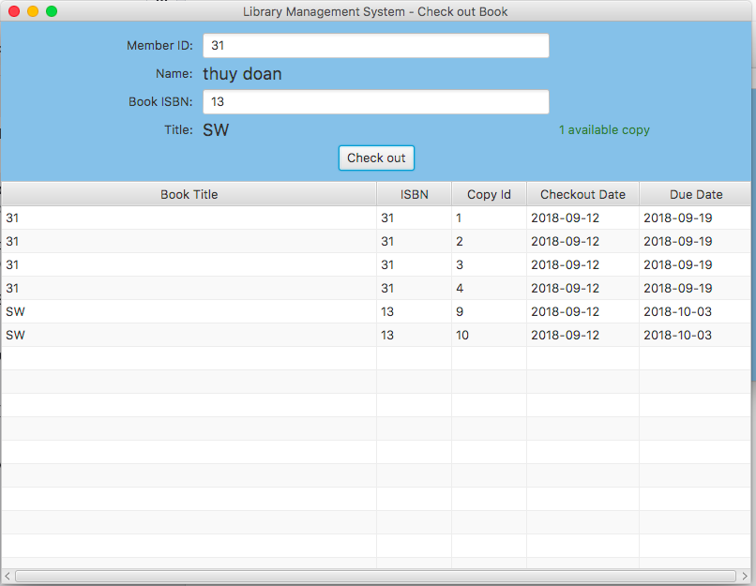
Some Examples OF Components used from JavaFX
Notes:
- Add some UI

Slide 14
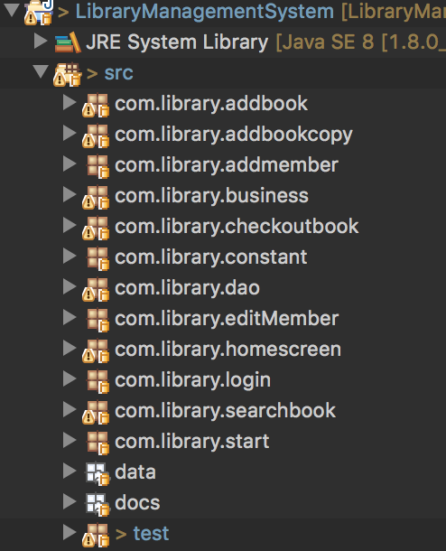
DeMO
Project Hierarchy
Execution starts from Login to end as
per the assigned role.

Slide 15
Conclusion with SCI Principle.
Overview
Library Management System is the system which has the intelligence functioning in its underlying class, which is the silent basis for the dynamic behavior of objects. Likewise, pure consciousness is the silent level of intelligence that underlies all expressions of intelligence in the form of thoughts and actions using SCI principles such as order is present everywhere, life is found in layers, outer depends on inter…
Notes:
Define is app desktop and develop it
We can find the layers in our system is Bussiness, DataBase Access and UI
To develop LMS requires a deep foundation like Class, Use Cases, Sequence that have to have the infinitely relationship
Library Management System is designed by using the simplest state of awareness, where the mind goes beyond thoughts and concepts to the most abstract level of awareness – the "abstract content" of awareness in Class Diagrams. Experiences that all objects in the universe arise from pure consciousness .
Sequence Diagrams and Object Diagrams both show how objects relate to each other because its very nature has the fundamental association of self-referral – the Self being aware of the Self. Collecting between sequence in Unity Consciousness one feels intimately associated with all other things in creation as a result of perceiving all things in terms of one’s Self.
Inheritance and Abstract classes in LMS displays the infinitely adaptable field of pure intelligence that can be ‘reused’ by every individual in all places, at all times. The individual is united with everything else, and inherits the total potential of natural for fulfillment of all desires spontaneously. To prevent the unexpected change, we have the concrete class embodies a set of concrete behaviors on a set of data whereas an abstract class embodies some concrete behaviors and at the same time gives expression to new unimplemented behaviors in the form of abstract methods.
Interfaces give expression to abstract “unmanifest behaviors, ”pure possibilities”, which can be realized in an endless number of ways by implementing classes
UML class diagram and Sequence Diagram while implementation of project has done with Java and uses object oriented concepts like polymorphism, Inheritance, Relationships, Singleton, Abstract classes, Interfaces and JavaFX for UI.

Slide 16

Notes:
Class diagrams is the simplest state of awareness, where the mind goes beyond thoughts and concepts to the most abstract level of awareness – the "abstract content" of awareness. Experiences that all objects in the universe arise from pure consciousness and are ultimately nothing but consciousness. Also Class diagrams are related to itself through its own self- referral dynamics.
Sequence Diagrams and Object Diagrams both show how objects relate to each other because its very nature has the fundamental association of self-referral – the Self being aware of the Self. Collecting between sequence in Unity Consciousness one feels intimately associated with all other things in creation as a result of perceiving all things in terms of one’s Self.
Inheritance: is the infinitely adaptable field of pure intelligence that can be ‘reused’ by every individual in all places, at all times. The individual is united with everything else, and inherits the total potential of natural for fulfillment of all desires spontaneously
Abstract classes : concrete class embodies a set of concrete behaviors on a set of data whereas an abstract class embodies some concrete behaviors and at the same time gives expression to new unimplemented behaviors in the form of abstract methods.
Interfaces : give expression to abstract “unmanifest behaviors, ”pure possibilities”, which can be realized in an endless number of ways by implementing classes
Designing this system is elaborated using UML class diagram and Sequence Diagram while implementation of project has done with Java and uses object oriented concepts like polymorphism, Inheritance, Relationships, Singleton, Abstract classes, Interfaces and JavaFX for UI.

