Slide 1
Jena

Slide 2
RDF Stores
Jena (jena.semanticweb.org)
  Popular RDF store
  RDF and RDFS querying
  Limited OWL reasoning
  Forward chaining and backward chaining rule engines
  Open source implementation in Java
  Command-line and Java API access
Sesame (sesame.semanticweb.org)
  Scalable RDF store
  Open source implementation in Java
  RDF and RDFS querying
  Limited OWL reasoning
  Forward chaining rules engine
  Java API and HTTP access
RDFStore
  C-based RDF store
  RDQL support

Slide 3
RDF and RDF API in Jena 2
Framework developed by HP Labs for manipulating with metadata in Java applications
Two versions:
  Jena 1
    Expressive support for RDF
    Limited reasoning facilities (RDQL)
  Jena 2
    Ontology API included
    Support for OWL included

Slide 4
Jena
Includes components:
  API for RDF (ARP: Another RDF parser)
  API for ontologies with support for OWL, DAML and RDF schema
  Reasoners
  Persistent storage support
  SPARQL: query language for RDF

Slide 5
Jena Installation
Step1: Download Jena version 2.5.5 (http://jena.sourceforge.net/downloads.html) to your home directory (say C:\Jena)
Step2: Unzip the file on the same folder, it will create the directory structure:
  C:\Jena\Jena-2.5.5
Step3: Set the classpath, put the lib of Jena to classpath:

Slide 6
Set up many classpaths
store setcp.bat in C:\Jena
C:\Jena>setcp.bat C:\Jena\Jena-2.5.5\lib
C:\Jena>echo %classpath%
@echo off
set CLASSPATH=
call :setall . %*
goto end
:setall
if .%1.==.. goto end
set dir=%1
set dir=%dir:"=%
if not "%CLASSPATH%"=="" set CLASSPATH=%CLASSPATH%;%dir%
if "%CLASSPATH%"=="" set CLASSPATH=%dir%
for %%i in ("%dir%\*.jar") do call :setone "%%i"
for %%i in ("%dir%\*.zip") do call :setone "%%i"
shift
goto setall
:setone
set file=%1
set file=%file:"=%
set CLASSPATH=%CLASSPATH%;%file%
:end
setcp.bat

Slide 7
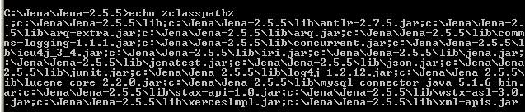
Jena classpaths

Slide 8

Jena Installation
Step4: test Jena by running the regression tests:
  test.bat (on windows)
  Regression testing is any type of software testing which seeks to uncover regression bugs.
    Regression bugs occur when software previously worked as desired, stops working or no longer works in the same way that was previously planned.

Slide 9
Jena RDF API
http://jena.sourceforge.net/tutorial/RDF_API/

Slide 10
Setting up
Properly install Jena at Jena_home
Go to Jena_home\doc\tutorial\RDF_API\index.html
All tutorial java files are located at:
  Jena_home\src-examples\jena\examples\rdf\
Create a new folders as:
  C:\Jena\Tutorial

Slide 11
Jena Tutorials
Jena is a Java API which can be used to create and manipulate RDF graphs.
Jena has object classes to represent graphs, resources, properties and literals.
The interfaces representing resources, properties and literals are called Resource, Property and Literal respectively.
In Jena, a graph is called a model and is represented by the model interface.

Slide 12
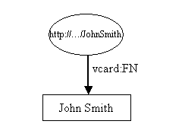
Tutorial01 –
Representing a RDF graph
// some definitions
static String personURI = "http://somewhere/JohnSmith";
static String fullName = "John Smith";
// create an empty Model
Model model = ModelFactory.createDefaultModel();
// create the resource
Resource johnSmith = model.createResource(personURI);
// add the property
johnSmith.addProperty(VCARD.FN, fullName);
Tutorial01.java

Slide 13
Representing a RDF graph
It begins with some constant definitions and then creates an empty Model or model, using the ModelFactory method createDefaultModel() to create a memory-based model.
Jena contains other implementations of the Model interface, e.g one which uses a relational database: these types of Model are also available from ModelFactory.
The John Smith resource is then created and a property added to it. The property is provided by a "constant" class VCARD which holds objects representing all the definitions in the VCARD schema.
Jena provides constant classes for other well known schemas, such as RDF and RDF schema themselves, Dublin Core and DAML, vCard.

Slide 14
package jena.examples.rdf ;
import com.hp.hpl.jena.rdf.model.*;
import com.hp.hpl.jena.vocabulary.*;
public class Tutorial01 extends Object {
// some definitions
static String personURI = "http://somewhere/JohnSmith";
static String fullName = "John Smith";
public static void main (String args[]) {
// create an empty model
Model model = ModelFactory.createDefaultModel();
// create the resource
Resource johnSmith = model.createResource(personURI);
// add the property
johnSmith.addProperty(VCARD.FN, fullName);
//write the model in XML form to a file
model.write(System.out);
}
}
Tutorial01.java

Slide 15
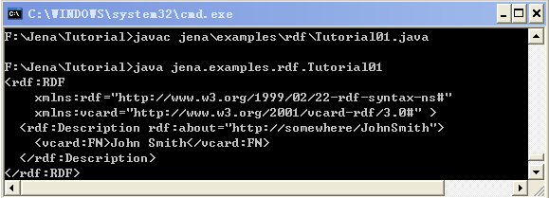
Compile and Run Tutorial01
Store Tutorial01.java in C:\Jena\Tutorial\jena\examples\rdf (because of the package stated in Tutorial01.java)
Compile and Run

Slide 16
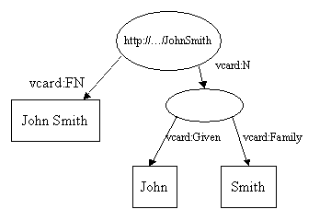
Tutorial02-
RDF Graph with blank node
// some definitions
String personURI = "http://somewhere/JohnSmith";
String givenName = "John";
String familyName = "Smith";
String fullName = givenName + " " + familyName;
// create an empty Model
Model model = ModelFactory.createDefaultModel();
// create the resource
// and add the properties cascading style
Resource johnSmith
= model.createResource(personURI)
.addProperty(VCARD.FN, fullName)
.addProperty(VCARD.N,
model.createResource()
.addProperty(VCARD.Given, givenName)
.addProperty(VCARD.Family, familyName));

Slide 17
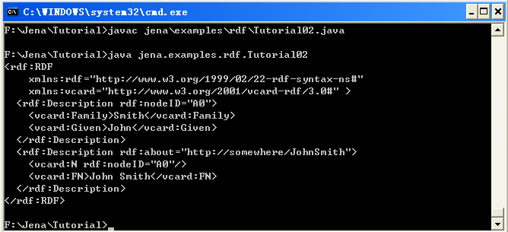
Compile and Run Tutorial02
Store Tutorial02.java in C:\Jena\Tutorial\jena\examples\rdf
Compile and Run

Slide 18
Tutorial03- Statement
// list the statements in the Model
StmtIterator iter = model.listStatements();
// print out the predicate, subject and object of each statement
while (iter.hasNext()) {
Statement stmt = iter.nextStatement(); // get next statement
Resource subject = stmt.getSubject(); // get the subject
Property predicate = stmt.getPredicate(); // get the predicate
RDFNode object = stmt.getObject(); // get the object
System.out.print(subject.toString());
System.out.print(" " + predicate.toString() + " ");
if (object instanceof Resource) {
System.out.print(object.toString());
} else {
// object is a literal
System.out.print(" \"" + object.toString() + "\"");
}
System.out.println(" .");
}

Slide 19
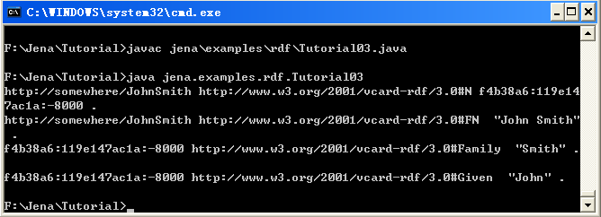
Compile and Run Tutorial03
Store Tutorial03.java in C:\Jena\Tutorial\jena\examples\rdf
Compile and Run

Slide 20
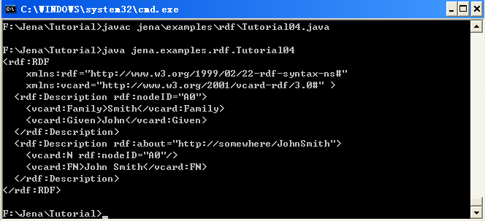
Tutorial04 – output in RDF/XML
Write the result of Tutorial03 in RDF/XML:
  model.write(System.out);
Store Tutorial04.java in C:\Jena\Tutorial\jena\examples\rdf
Compile and Run

Slide 21
Tutorial04 – output in other formats
Write the result of Tutorial03 in:
  XML: model.write(System.out, "RDF/XML-ABBREV");
  N-Triple: model.write(System.out, "N-TRIPLE");

Slide 22
Tutorial05 – Reading RDF
Read a RDF from a file and write it out
// create an empty model
Model model = ModelFactory.createDefaultModel();
// use the FileManager to find the input file
InputStream in = FileManager.get().open( inputFileName );
if (in == null) {
throw new IllegalArgumentException(
"File: " + inputFileName + " not found");
}
// read the RDF/XML file
model.read(in, "");
// write it to standard out
model.write(System.out);

Slide 23
Tutorial05 – Reading RDF
Source rdf (vc-db-1.rdf) to be read:
<rdf:RDF
xmlns:rdf='http://www.w3.org/1999/02/22-rdf-syntax-ns#'
xmlns:vCard='http://www.w3.org/2001/vcard-rdf/3.0#'
>
<rdf:Description rdf:about="http://somewhere/JohnSmith/">
<vCard:FN>John Smith</vCard:FN>
<vCard:N rdf:parseType="Resource">
<vCard:Family>Smith</vCard:Family>
<vCard:Given>John</vCard:Given>
</vCard:N>
</rdf:Description>
<rdf:Description rdf:about="http://somewhere/RebeccaSmith/">
<vCard:FN>Becky Smith</vCard:FN>
<vCard:N rdf:parseType="Resource">
<vCard:Family>Smith</vCard:Family>
<vCard:Given>Rebecca</vCard:Given>
</vCard:N>
</rdf:Description>
. . .
</rdf:RDF>
rdf:parseType=“Resource” is used to represent blank nodes.

Slide 24
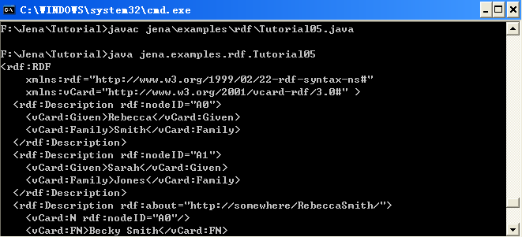
Tutorial05 – Reading RDF
Store Tutorial05.java in C:\Jena\Tutorial\jena\examples\rdf
Store vc-db-1.rdf in C:\Jena\Tutorial\ (it has to be in this folder)
Compile and Run

Slide 25
Tutorial06 – Navigating a Model
Deal with accessing information held in a Model
Given the URI of a resource, the resource object can be retrieved from a model using Model.getResource(String uri) method.
This method is defined to return a Resource object if one exists in the model, or otherwise to create a new one.
For example:
  // retrieve the John Smith vcard resource from the model Resource vcard = model.getResource(johnSmithURI);

Slide 26
Tutorial06 – Navigating a Model
Accessing properties of a resource
  Resource.getProperty(Property p)
  This method returns the whole statement.
  Then using getObject() to get the value of the property.
  Example
    // retrieve the value of the N property
      Resource name = (Resource) vcard.getProperty(VCARD.N)
      .getObject();

Slide 27
Tutorial06 – Navigating a Model
The object of a statement could be a resource or a literal
  Knowing the value to be a resource
    // retrieve the value of the FN property
      Resource name = vcard.getProperty(VCARD.N)
      .getResource();
  Knowing the value to be literal
    // retrieve the given name property
      String fullName = vcard.getProperty(VCARD.FN)
      .getString();

Slide 28
Tutorial06 – Navigating a Model
RDF permits a resource to repeat a property,
  e.g. // add two nickname properties to vcard vcard.addProperty(VCARD.NICKNAME, "Smithy")
    .addProperty(VCARD.NICKNAME, "Adman");
The result of calling vcard.getProperty(VCARD.NICKNAME) is indeterminate. Jena will return one of the values.
It is possible to list all the properties by using Resource.listProperties(Property p)
  StmtIterator iter = vcard.listProperties(VCARD.NICKNAME);
  while (iter.hasNext()) {
  System.out.println(" " + iter.nextStatement()
  .getObject()
  .toString());
  }

Slide 29
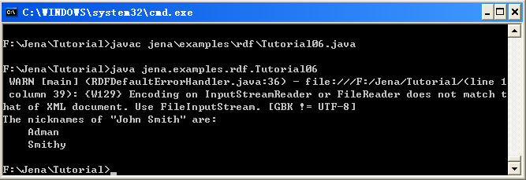
Tutorial06 – Navigating a Model
Store Tutorial06.java in C:\Jena\Tutorial\jena\examples\rdf
Store vc-db-1.rdf in C:\Jena\Tutorial\ (it has to be in this folder)
Compile and Run

Slide 30
Tutorial07-Query a Model I
Here introduces some limited query primitive
  model.listStatements(): lists all the statements in a model, not recommended on large models
    model.listStatements(Selector s): returns an iterator over all the statements in the model selected by s.
  model.listSubjects(): returns an iterator over all resources which are subjects of the statements
  model.listSubjectsWithProperty(Property p, RDFNode o): returns an iterator over all the resources which have property p with value o.
// list vcards
ResIterator iter = model.listSubjectsWithProperty(VCARD.FN);
while (iter.hasNext()) {
Resource r = iter.nextResource();
...
}

Slide 31
Tutorial07-Query a Model I
Select subject, predicate and object
  Selector selector = new SimpleSelector(subject, predicate, object):
  It will select all the statements with a subject that matches subject, a predicate that matches predicate and an object that matches object.
  If a null is supplied in any of the positions, it matches anything.
    Selector selector = new SimpleSelector(null, null, null)
  Example:
    Selector selector = new SimpleSelector(null, VCARD.FN, null): will select all the statements with VCARD.FN as their predicate, whatever the subject or object.

Slide 32
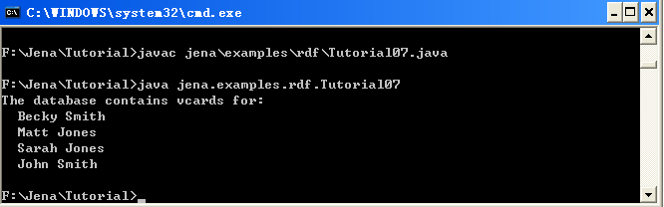
Tutorial07-Query a Model I
Store Tutorial07.java in C:\Jena\Tutorial\jena\examples\rdf
Store vc-db-1.rdf in C:\Jena\Tutorial\ (it has to be in this folder)
Compile and Run

Slide 33
Tutorial08-Query a Model II
Lets see some finer control over the selected statements
// select all the resources with a VCARD.FN property
// whose value ends with "Smith"
StmtIterator iter = model.listStatements(
new SimpleSelector(null, VCARD.FN, (RDFNode) null) {
public boolean selects(Statement s)
{return s.getString().endsWith("Smith");}
});

Slide 34
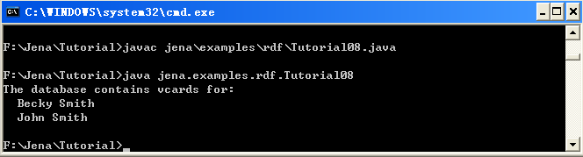
Tutorial08-Query a Model II
Store Tutorial08.java in C:\Jena\Tutorial\jena\examples\rdf
Store vc-db-1.rdf in C:\Jena\Tutorial\ (it has to be in this folder)
Compile and Run

Slide 35
Tutorial09-Operations on Models
Jena provides three operations for manipulating models:
  Union - .union(Model): creates a new model containing all the statements in this model together with all of those in another given model.
    It can merge data from different data sources
  Intersection - .intersection(Model): create a new model containing all the statements which are in both this model and another
  Difference - .difference(Model): create a new model containing all the statements in this model which are not in another.

Slide 36
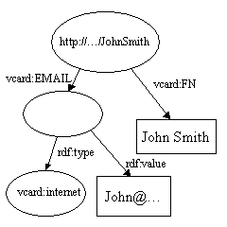
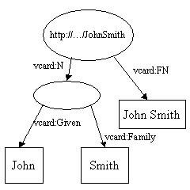
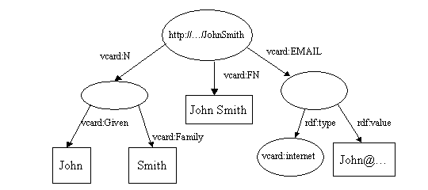
Tutorial09-Operations on Models
// read the RDF/XML files
model1.read(new InputStreamReader(in1), "");
model2.read(new InputStreamReader(in2), "");
// merge the Models
Model model = model1.union(model2);
// print the Model as RDF/XML
model.write(system.out, "RDF/XML-ABBREV");

Slide 37
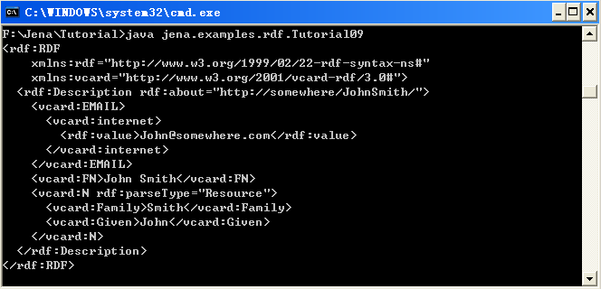
Tutorial09-Operations on Models
Store Tutorial09.java in C:\Jena\Tutorial\jena\examples\rdf
Store vc-db-3.rdf and vc-db-4.rdf in C:\Jena\Tutorial\
Compile and Run

Slide 38
Tutorial10 - Containers
RDF provides containers to represent collections of things. There are three kinds of containers:
  A BAG is an unordered collection
  An ALT is an unordered collection for which only one selection can be made.
  A SEQ is an ordered collection
A container is represented by a resource, which has an rdf:type property whose value can be: rdf:Bag, rdf:Alt or rdf:Seq.
The first number of the container is the value of the container’s rdf:_1 property, rdf:_2,…rdf:_nn

Slide 39
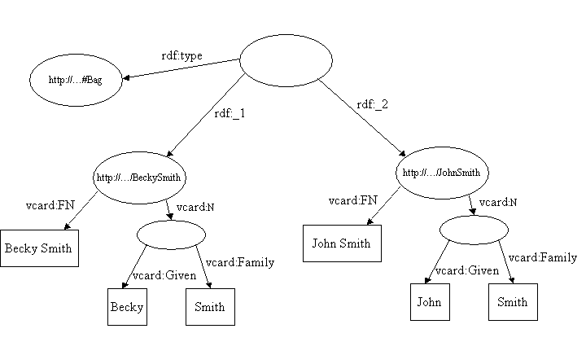
Tutorial10 - Containers

Slide 40
Tutorial10 - Containers
Lets create a bag container
// create a bag
Bag smiths = model.createBag();
// select all the resources with a VCARD.FN property
// whose value ends with "Smith"
StmtIterator iter = model.listStatements(
new SimpleSelector(null, VCARD.FN, (RDFNode) null) {
public boolean selects(Statement s) {
return s.getString().endsWith("Smith");
}
});
// add the Smith's to the bag
while (iter.hasNext()) {
smiths.add(iter.nextStatement().getSubject());
}

Slide 41
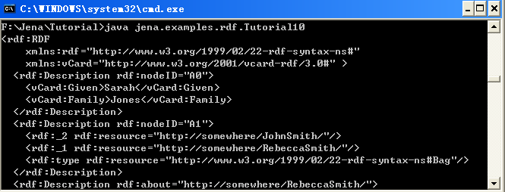
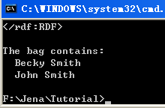
Tutorial10 - Containers
Store Tutorial10.java in C:\Jena\Tutorial\jena\examples\rdf
Store vc-db-3.rdf and vc-db-4.rdf in C:\Jena\Tutorial\
Compile and Run

Slide 42
Tutorial11-Literals and Datatypes
model.createLiteral(): create literal
// create the resource
Resource r = model.createResource();
// add the property
r.addProperty(RDFS.label, model.createLiteral("chat", "en"))
.addProperty(RDFS.label, model.createLiteral("chat", "fr"))
.addProperty(RDFS.label, model.createLiteral("<em>chat</em>", true));
// write out the Model
model.write(system.out);

Slide 43
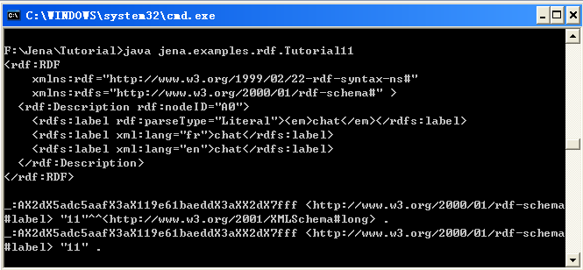
Tutorial11-Literals and Datatypes
Store Tutorial11.java in C:\Jena\Tutorial\jena\examples\rdf
Compile and Run

Slide 44
Jena 2 Ontology API
http://www.srdc.metu.edu.tr/webpage/documents/jena_doc/ontology/index.html

Slide 45
General concepts
Jena allows a programmer to specify, in an open, meaningful way the concepts and relationships that collectively characterise some domain.
  E.g. red wine, grape varieties, vintage years, wineries --- wine domain classes
  E.g. wineries produce wines, wines have a year of production – wine domain relationships
The advantage of an ontology is that it is an explicit, first-class description, it can be published and reused for different purposes.
  A winery may uses the wine ontology to link production schedule to the stock system
  A wine recommendation program may use the wine ontology to recommend wines for different menus.

Slide 46
Ontology languages and Jena Ontology API
Jena 1 tightly bound Java classes to the specific ontology languages,
While Jena 2 ontology API is language-neutral.
  Each language has its profile, which lists the permitted constructs and the URI’s of the classes and properties.
    URI object property for
      OWL →OWL:ObjectProperty
      RDFS →null (as RDFS does not define object properties)
        rdf:Property
      DAML →daml:ObjectProperty

Slide 47
Ontology Model
Ontology Model allows to access to the statements in a collection of RDF data.
The profile is bound to an ontology model, which extends this by adding supports to handle:
  Classes (in a class hierarchy): OntClass has listSuperClasses() method
  Properties (in a property hierarchy):
  Individuals:
Worth emphasizing:
  No information is stored in the OntClass object itself.
  When listSuperClass() method is called, the information is retrieved from the underlying RDF statements.

Slide 48
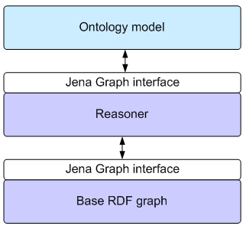
Ontology Model
The statements that the ontology Java objects see:
  The asserted statements in the underlying RDF graph
  The statement inferred by the reasoner being used.
Each module works with the Graph Interface which allows us:
  To build models with no or different reasoners without changing ontology model
  The RDF graph can be in memory store, persistent store without affecting the ontology model.

Slide 49
RDF-level polymorphism and Jena
An ontology class: (relative)URI#DigitalCamera
An OWL Restriction (subclass of rdfs:Class): #DigitalCamera
#DigitalCamera is a class and a property
<rdfs:Class rdf:ID=“DigitalCamera”></rdfs:Class>
<rdfs:Class rdf:ID=“DigitalCamera”>
<rdf:type owl:Restriction /> </rdfs:Class>
<rdfs:Class rdf:ID=“DigitalCamera”>
<rdf:type owl:ObjectProperty /> </rdfs:Class>
How to change them in run-time? Jena 2 provide solution – as()

Slide 50
RDF-level polymorphism and Jena
Jena 2 accepts this basic characteristic of polymorphism at the RDF level by considering that the Java abstraction (OntClass, Restriction, DatatypeProperty, etc.) is just a view or facet of the resource.
as() method
Resource r = myModel.getResource(myNS + “DigitalCamera” );
OntClass cls = (OntClass) r.as( OntClass.class );
Restriction rest = (Restriction) cls.as( Restriction.class );
This RDF-level polymorphism is used extensively in the Jena ontology API to allow maximum flexibility in handling ontology data

Slide 51
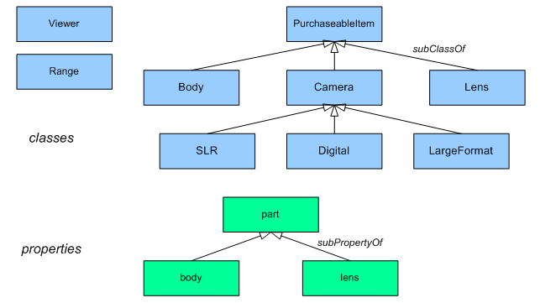
Example: the camera ontology
This is an example drawn from a Roger Costello’s camera ontology which deals with the domain of still-picture cameras.

Slide 52
Creating ontology models
An ontology model is an extension of the Jena RDF model that provides extra capabilities for handling ontology data sources.
Ontology models are created through the Jena ModelFactory.
OntModelSpec is used to configure a ontology model, such as:
  The ontology language in use, the reasoner, and the means of handling compound documents
  OntModelSpec.OWL_MEM: a ontology model using the OWL FULL profile, an in-memory storage model, and no reasoner.
  OntModelSpec.OWL_MEM_RDFS_INF: a ontology model same as above + using RDFS rule-based reasoner (which include entailments from subclass and sub-property hierarchies, and domain and range constraints, but not entailments from the disjointness of classes
OntModel m = ModelFactory.createOntologyModel();

Slide 53
Creating ontology models
To create a model with a given specification,
To create a custom model specification, try to copy the existing specification and then updates it as necessary:
OntModel m = ModelFactory.createOntologyModel( OntModelSpec.OWL_MEM, null );
OntModelSpec s = new OntModelSpec( OntModelSpec.OWL_MEM );
s.setDocumentManager( myDocMgr );
OntModel m = ModelFactory.createOntologyModel( s, null );

Slide 54
URI of the ontology language
Ontology language | URI
RDFS | http://www.w3.org/2000/01/rdf-schema#
DAML+OIL | http://www.daml.org/2001/03/daml+oil#
OWL Full | http://www.w3.org/2002/07/owl#
OWL DL | http://www.w3.org/TR/owl-features/#term_OWLDL
OWL Lite | http://www.w3.org/TR/owl-features/#term_OWLLite

Slide 55
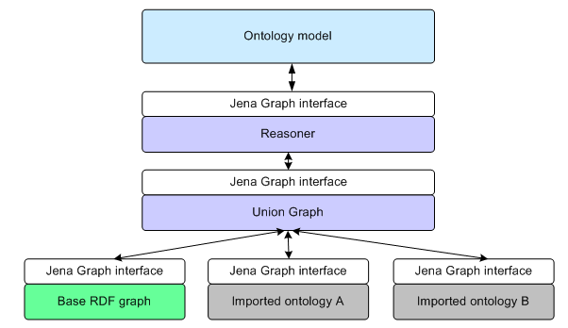
Handling ontology documents and imports
Using the “read” method to load an ontology document into an ontology model
The ontology “DocumentManager” assist to handle ontology import.
It is important to hold each import as a separate graph structure so that we can know where a statement came from.

Slide 56
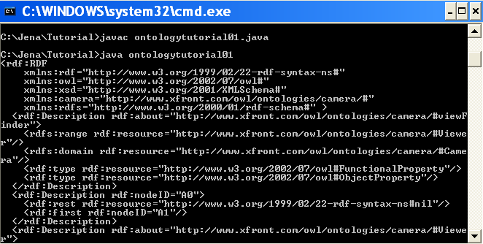
Ontology Tutorial 01
Read ontology and output ontology
  Read camera.owl and output it

Slide 57
Ontology Tutorial 01
import java.util.List;
import java.io.*;
import com.hp.hpl.jena.ontology.*;
import com.hp.hpl.jena.rdf.model.*;
import com.hp.hpl.jena.util.FileManager;
public class ontologytutorial01 extends Object {
static final String inputFileName = "camera.owl";
public static void main (String args[]) {
// Create an empty in-memory ontology model
OntDocumentManager mgr = new OntDocumentManager();
OntModelSpec s = new OntModelSpec( OntModelSpec.RDFS_MEM );
s.setDocumentManager( mgr );
OntModel m = ModelFactory.createOntologyModel( s, null );
// use the FileManager to open the ontology from the filesystem
InputStream in = FileManager.get().open(inputFileName);
if (in == null) {
throw new IllegalArgumentException( "File: " + inputFileName + " not found"); }
// read the ontology file
m.read( in, "" );
// write it to standard out (RDF/XML)
m.write(System.out); }
}
Ontologytutorial01.java

Slide 58
ontology document manager
Each ontology model has an associated document manager that assists with the processing and handling of ontology documents.
There is one global document manager that is used by default by ontology models.
OntDocumentManager mgr = new OntDocumentManager();
// set the mgr’s properties now ...
OntModelSpec s = new OntModelSpec( OntModelSpec.RDFS_MEM );
s.setDocumentManager( mgr );
OntModel m = ModelFactory.createOntologyModel( s, null );

Slide 59
Document manager policy
The document manager has a large number of configurable options. There are two ways to setting them:
  Using Java code to set them
  Using document manager to load values for the parameters from ont-policy.rdf
<DocumentManagerPolicy>
<!-- policy for controlling the document manager's behaviour -->
<processImports rdf:datatype="&xsd;boolean">true</processImports>
<cacheModels rdf:datatype="&xsd;Boolean">true</cacheModels>
</DocumentManagerPolicy>

Slide 60
ModelMaker
The ModelMaker is a simple interface that allows different kinds of models (in memory, from file, in persistent database, etc.)
For database, this may include passing the database user-name and password and other connection parameters.
New model makers can be created via ModelFactory.
The default specificaiton in OntModelSpec that begin MEM_ use in-memory model

Slide 61
Controlling imports processing
To load an ontology without building the imports closure, call the method setProcessImports( false)
To ignore certain URI’s when loading the imported documents, call the method addIgnoreImport( String uri )
To solve the firewall problem of importing online ontologies, the ontology manager allows a local copy of such imported ontologies
<OntologySpec>
<!-- local version of the RDFS vocabulary -->
<publicURI rdf:resource="http://www.w3.org/2000/01/rdf-schema" />
<altURL rdf:resource="file:vocabularies/rdf-schema.rdf" />
<language rdf:resource="http://www.w3.org/2000/01/rdf-schema" />
<prefix rdf:datatype="&xsd;string">rdfs</prefix>
</OntologySpec>
Notes:
The imports closure of an RDF graph is the union of the smallest import-closed set of RDF graphs containing the graph.

Slide 62
Specifying prefixes
A model keeps a table of URI prefixes that can be used to render relative URIs
The ontology model’s prefix table can be initialized by the document manger, to prevent such,
  use the property useDeclaredNsPrefixes in the policy file (with value “false”), or
  call the method setUseDeclaredPrefixes on the ontology object.

Slide 63
Caching models
Suppose two ontologies, A and B both import ontology C. It would be nice not to have to read C twice when loading A and B.
The document manager supports this use case by optionally caching C’s model.
To turn model catching on or off,
  use the policy property cacheModels, or
  call the method setCacheModels( Boolean caching ).
The default is caching on.
Model cache can be cleared at any time by calling clearCache().
OntModel m = ModelFactory.createOntologyModel();
OntDocumentManager dm = m.getDocumentManager();
dm.addAltEntry( "http://www.xfront.com/owl/ontologies/camera/",
"file:" + JENA + "doc/user-manual/ontology/data/camera.owl" );
m.read( "http://www.xfront.com/owl/ontologies/camera/" );

Slide 64
The generic ontology type: OntResource
All the classes in the ontology API that represent ontology values have OntResource as a common super-class.
This makes OntResource a good place to put shared functionality for all such classes.
The Java interface OntResource extends Jena’s RDF Resource interface.

Slide 65
Common Attributes of OntResource
Attribute | Meaning
versionInfo | A string documenting the version or history of this resource
comment | A general comment associated with this value
label | A human-readable label
seeAlso | Another web location to consult for more information about this resource
isDefinedBy | A specialisation of seeAlso that is intended to supply a definition of this resource
sameAs | Denotes another resource that this resource is equivalent to
differentFrom | Denotes another resource that is distinct from this resource (by definition)

Slide 66
Methods for Attributes of OntResource
Method | Effect
add<property> | Add an additional value for the given property
set<property> | Remove any existing values for the property, then add the given value
list<property> | Return an iterator ranging over the values of the property
get<property> | Return the value for the given property, if the resource has one. If not, return null. If it has more than one value, an arbitrary selection is made.
has<property> | Return true if there is at least one value for the given property. Depending on the name of the property, this is sometimes is<property>
remove<property> | Removes a given value from the values of the property on this resource. Has no effect if the resource does not have that value.

Slide 67
OntResource other methods
To find out how many values a resource has for a given property: getCardinality( Property p )
Delete a resource: remove()
Set the value of a given property: addPropertyValue( Property p, RDFNode value)
Get the value of a given property: getPropertyValue( Property p )
List the RDF types of a resource: listRDFTypes()
  E.g., class B is the subclass of class A, resource x rdf:type is B,
    Without reasoner, x’s RDF types is B
    Reasoners with subclass hierarchy, x’s RDF types are B and A,
    Complete reasoners, x’s RDF types are B, A, owl:Thing, rdf:Resource

Slide 68
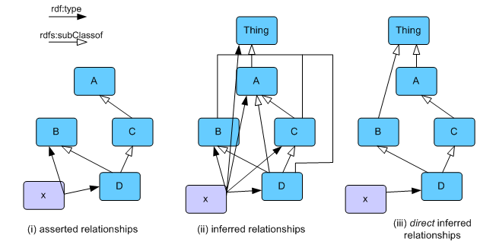
rdf:type inference
listRDFTypes() // assumes not-direct
listRDFTypes( Boolean direct ) //if true, show only direct relationships

Slide 69
Handling ontology components: basic class expressions
A simple class is represented in Jena as an OntClass object, which is the a facet of an RDF resource
Get an ontology class
Create a new ontology class
Create an anonymous class
String camNS = "http://www.xfront.com/owl/ontologies/camera/#";
Resource r = m.getResource( camNS + "Camera" );
OntClass camera = (OntClass) r.as( OntClass.class );
Or
OntClass camera = m.getOntClass( camNS + "Camera" );
OntClass pinCamera = m.createClass( camNS + "PinholeCamera" );
OntClass anonClass = m.createClass();

Slide 70
Handling ontology components: basic class expressions
The collection of methods for class are:
  set, add, get, test, list and remove values
Similar methods of class can be used to:
  subClass, superClass, equivalentClass, disjointWith

Slide 71
Ontology Tutorial 02
List the subclasses of class Camera
OntClass camera = m.getOntClass( camNS + "Camera" );
for (Iterator i = camera.listSubClasses(); i.hasNext(); ) {
OntClass c = (OntClass) i.next();
System.out.print( c.getLocalName() + " " );
}

Slide 72
Ontology Tutorial 02
import java.util.List;
import java.io.*;
import com.hp.hpl.jena.ontology.*;
import com.hp.hpl.jena.rdf.model.*;
import com.hp.hpl.jena.util.FileManager;
import com.hp.hpl.jena.util.*;
import com.hp.hpl.jena.util.iterator.ExtendedIterator;
public class ontologytutorial02 extends Object {
static final String inputFileName = "camera.owl";
static String camNS = "http://www.xfront.com/owl/ontologies/camera/#";
public static void main (String args[]) {
// Create an empty in-memory ontology model
OntDocumentManager mgr = new OntDocumentManager();
OntModelSpec s = new OntModelSpec( OntModelSpec.OWL_MEM );
s.setDocumentManager( mgr );
OntModel m = ModelFactory.createOntologyModel( s, null );

Slide 73
Ontology Tutorial 02
// use the FileManager to open the ontology from the filesystem
InputStream in = FileManager.get().open(inputFileName);
if (in == null) {
throw new IllegalArgumentException( "File: " + inputFileName + " not found");
}
// read the ontology file
m.read( in, "" );
// list the subclass of class Camera
OntClass camera = m.getOntClass( camNS + "Camera" );
for (ExtendedIterator i = camera.listSubClasses(); i.hasNext(); ) {
OntClass c = (OntClass) i.next();
System.out.println( c.getLocalName() + " subclass of class Camera " );
}
}
}
Ontologytutorial02.java

Slide 74

Ontology Tutorial 02
OntModelSpec s = new OntModelSpec( OntModelSpec.OWL_MEM );

Slide 75
Handling ontology components: properties
The class for representing ontology properties in Jena is OntProperty.
It can add, set, get, list, has and remove methods.

Slide 76
OntProperty
Attribute | Meaning
subProperty | A sub property of this property; i.e. a property which is declared to be a subPropertyOf this property. If p is a sub property of q, and we know that A p B is true, we can infer that A q B is also true.
superProperty | A super property of this property, i.e. a property that this property is a subPropertyOf
domain | Denotes the class or classes that form the domain of this property. Multiple domain values are interpreted as a conjunction. The domain denotes the class of value the property maps from.
range | Denotes the class or classes that form the range of this property. Multiple range values are interpreted as a conjunction. The range denotes the class of values the property maps to.
equivalentProperty | Denotes a property that is the same as this property.
inverse | Denotes a property that is the inverse of this property. Thus if q is the inverse of p, and we know that A q B, then we can infer that B p A.

Slide 77
Create property
In camera ontology, the property body is a sub-property of part, and has domain Camera and range Body. We can create such property as:
OntModel newM = ModelFactory.createOntologyModel();
OntClass Camera = newM.createClass( camNS + "Camera" );
OntClass Body = newM.createClass( camNS + "Body" );
ObjectProperty part = newM.createObjectProperty( camNS + "part" );
ObjectProperty body = newM.createObjectProperty( camNS + "body" );
body.addSuperProperty( part );
body.addDomain( Camera );
body.addRange( Body );

Slide 78
More properties
Use as() to change an object property facet to different kinds of property facet.
  FunctionalProperty: for a given individual in the domain, the range value is unique.
  InverseFunctionalProperty: for a given range element, the domain value is unique
  TransitiveProperty: if p is transitive, and we know A p B and also B p C, then A p C (e.g., hasBrother)
  SymmetricProperty: if p is symmetric, and we know A p B, then B p A
public TransitiveProperty asTransitiveProperty();
public FunctionalProperty asFunctionalProperty();
public SymmetricProperty asSymmetricPropery();
public InverseFunctionalProperty asInverseFunctionalProperty();

Slide 79
Handling ontology components: more complex class expressions
There are a number of additional class expressions that allow richer and more expressive descriptions of concepts, such as
  Restriction class expression:
    has value, all values from, some values from, cardinality, min cardinality, max cardinality,
  Boolean expression:
    and, or, not – intersection, union, and complement
  List expression
    Seq, Alt and Bag
  Enumerated classes

Slide 80
Examples
OntClass c = m.createClass( Ns + "C" );
ObjectProperty p = m.createObjectProperty( Ns + "p" );
// use a null URI to create an anonymous restriction
AllValuesFromRestriction rst = m.createAllValuesFromRestriction( null, p, c );
Restriction class
OntModel m = ModelFactory.createOntModel();
OntClass c0 = m.createClass( Ns + "c0" );
OntClass c1 = m.createClass( Ns + "c1" );
OntClass c2 = m.createClass( Ns + "c2" );
RDFList cs = m.createList( new RDFNode[] {c0, c1, c2} );
RDF List

Slide 81
Ontology Tutorial 03
Create Ontology Camera
  Here we show how to create the complex class “SLR”
<owl:Class rdf:ID="SLR">
<owl:intersectionOf rdf:parseType="Collection">
<owl:Class rdf:about="#Camera"/>
<owl:Restriction>
<owl:onProperty rdf:resource="#viewfinder"/>
<owl:hasValue rdf:resource="#ThroughTheLens"/>
</owl:Restriction>
</owl:intersectionOf>
</owl:Class>

Slide 82
Ontology Tutorial 03
import java.io.*;
import com.hp.hpl.jena.ontology.*;
import com.hp.hpl.jena.rdf.model.*;
import com.hp.hpl.jena.vocabulary.*;
public class CreateOntology extends Object {
public static void main (String args[]) throws Exception{
String camNS = "http://www.xfront.com/owl/ontologies/camera/#";
String xmlbase = "http://www.xfront.com/owl/ontologies/camera/";
// create an Ontology model
OntModel m = ModelFactory.createOntologyModel(OntModelSpec.OWL_MEM);
Resource NAMESPACE = m.createResource( camNS );
m.setNsPrefix( "camera", camNS);
RDFWriter rdfw=m.getWriter("RDF/XML-ABBREV");
rdfw.setProperty("xmlbase", xmlbase);
// class Camera
OntClass Camera = m.createClass( camNS + "Camera" );

Slide 83
Ontology Tutorial 03
// create the throughTheLens window instance
OntClass Window = m.createClass( camNS + "Window" );
Individual throughTheLens = m.createIndividual( camNS + "ThroughTheLens", Window );
// create the viewfinder property
ObjectProperty viewfinder = m.createObjectProperty( camNS + "viewfinder" );
// now the anonymous hasValue restriction
HasValueRestriction viewThroughLens =
m.createHasValueRestriction( null, viewfinder, throughTheLens );
// finally create the intersection class to define SLR
IntersectionClass SLR = m.createIntersectionClass( camNS + "SLR",
m.createList( new RDFNode[] {viewThroughLens, Camera} ) );
// now write the model in XML form to a file
FileOutputStream camera_File = new FileOutputStream("C:/Jena/Tutorial/camera1.owl");
//OutputStream out = (OutputStream) camera_File;
m.write(camera_File, "RDF/XML-ABBREV", xmlbase);
}
}
C:/Jena/Tutorial/CreateOntology.java

Slide 84
Ontology Tutorial 03
<rdf:RDF
xmlns:rdf="http://www.w3.org/1999/02/22-rdf-syntax-ns#"
xmlns:owl="http://www.w3.org/2002/07/owl#"
xmlns:xsd="http://www.w3.org/2001/XMLSchema#"
xmlns:camera="http://www.xfront.com/owl/ontologies/camera/#"
xmlns:rdfs="http://www.w3.org/2000/01/rdf-schema#">
<owl:Class rdf:ID="Window"/>
<owl:Class rdf:ID="SLR">
<owl:intersectionOf rdf:parseType="Collection">
<owl:Restriction>
<owl:hasValue>
<camera:Window rdf:ID="ThroughTheLens"/>
</owl:hasValue>
<owl:onProperty>
<owl:ObjectProperty rdf:ID="viewfinder"/>
</owl:onProperty>
</owl:Restriction>
<owl:Class rdf:ID="Camera"/>
</owl:intersectionOf>
</owl:Class>
</rdf:RDF>
C:/Jena/Tutorial/camera1.owl

Slide 85
Instances (individuals)
The method createIndividual( Resource cls ) creates an anonymous individual belonging to the given class.
OntClass c = m.createClass( Ns + "C" );
Individual inst = m.createIndividual( Ns + "foo", c );

Slide 86
Ontology meta-data
The metadata about the ontology itself is attached to an instance of class Ontology.
It normally contains:
  Version, Author, Comment, import
Ontology ont = m.getOntology( baseURI );
ont.addProperty( DC.creator, "John Smith" );

Slide 87
Ontology inference
Ontology inference by Jena is handled by Ontology Model.
Jena framework also aligns with other reasoners, such as Pellet.

Slide 88
Inference and storage for ontology model
OntModelSpec | Language | Storage | Reasoner
OWL_MEM | OWL full | in-memory | none
OWL_MEM_TRANS_INF | OWL full | in-memory | transitive class-hierarchy inference
OWL_MEM_RULE_INF | OWL full | in-memory | rule-based reasoner with OWL rules
OWL_MEM_MICRO_RULE_INF | OWL full | in-memory | optimised rule-based reasoner with OWL rules
OWL_MEM_MINI_RULE_INF | OWL full | in-memory | rule-based reasoner with subset of OWL rules
OWL_DL_MEM | OWL DL | in-memory | none
OWL_DL_MEM_RDFS_INF | OWL DL | in-memory | rule reasoner with RDFS-level entailment-rules
OWL_DL_MEM_TRANS_INF | OWL DL | in-memory | transitive class-hierarchy inference
OWL_DL_MEM_RULE_INF | OWL DL | in-memory | rule-based reasoner with OWL rules
OWL_LITE_MEM | OWL Lite | in-memory | none
OWL_LITE_MEM_TRANS_INF | OWL Lite | in-memory | transitive class-hierarchy inference
OWL_LITE_MEM_RDFS_INF | OWL Lite | in-memory | rule reasoner with RDFS-level entailment-rules
OWL_LITE_MEM_RULES_INF | OWL Lite | in-memory | rule-based reasoner with OWL rules
RDFS_MEM | RDFS | in-memory | none
RDFS_MEM_TRANS_INF | RDFS | in-memory | transitive class-hierarchy inference
RDFS_MEM_RDFS_INF | RDFS | in-memory | rule reasoner with RDFS-level entailment-rules

Slide 89

Ontology Tutorial 04
Test different inference models
Based on ontology tutorial 02: List the subclass of Camera
  OntModelSpec.OWL_MEM_RULE_INF
    SLR, Digital, Large-Format, null
  OntModelSpec.OWL_DL_MEM_RDFS_INF
    Digital, Large-Format
  OntModelSpec.RDFS_MEM_RDFS_INF
    Digital, Large-Format
Future versions of Jena will contain means of selectively ignoring such correct but unhelpful entailments
C:/Jena/Tutorial/ontologytutorial04.java

Slide 90
Jena schemagen
Convert .rdf or .owl to java class.
Command line:
  java jena.schemagen -i <input> [-a <namespaceURI>] [-o <output file>] [-c <config uri>] [-e <encoding>] ...
  Example: convert camera.owl to java class
    C:\Jena\Tutorial>java jena.schemagen -i camera.owl –a http://www.xfront.com/owl/ontologies/camera/# -o cameraclass

Slide 91
Jena schemagen
import java.io.*;
import com.hp.hpl.jena.ontology.*;
import com.hp.hpl.jena.rdf.model.*;
import com.hp.hpl.jena.vocabulary.*;
public class CreateOntology extends Object {
public static void main (String args[]) throws Exception{
String camNS = "http://localhost/owl/ontologies/camera/#";
String xmlbase = camNS;
// create an Ontology model
OntModel m = ModelFactory.createOntologyModel(ProfileRegistry.OWL_LANG);
Resource NAMESPACE = m.createResource( camNS );
RDFWriter rdfw=m.getWriter("RDF/XML-ABBREV");
rdfw.setProperty("xmlbase", xmlbase);
rdfw.setProperty("relativeURIs", "");
// class Camera
OntClass Camera = m.createClass( camNS + "Camera" );

Slide 92
Jena schemagen
// create the throughTheLens window instance
OntClass Window = m.createClass( camNS + "Window" );
Individual throughTheLens = m.createIndividual( camNS + "ThroughTheLens", Window );
// create the viewfinder property
ObjectProperty viewfinder = m.createObjectProperty( camNS + "viewfinder" );
// now the anonymous hasValue restriction
HasValueRestriction viewThroughLens =
m.createHasValueRestriction( null, viewfinder, throughTheLens );
// finally create the intersection class to define SLR
IntersectionClass SLR = m.createIntersectionClass( camNS + "SLR",
m.createList( new RDFNode[] {viewThroughLens, Camera} ) );
// now write the model in XML form to a file
FileOutputStream camera_File = new FileOutputStream("C:/camera.owl");
//OutputStream out = (OutputStream) camera_File;
m.write(camera_File, "RDF/XML-ABBREV", xmlbase);
}
}
CameraSchemagen.java

Slide 93
Working with persistent ontologies
A common way to work with ontology data is to load the ontology and instances at run-time for a set of source documents.
Limitation: it requires the documents to be parsed each time the application is run.
Jena provides an implementation of the RDF model interface to store the ontology and instances persistently in a database.
Suit for large size ontology

Slide 94
Importing and persisting models
Persistent model
  Java can persist its models on the filesystem (model.write() and model.read()), or in a relational database, the database engines currently supported are PostgreSQL, Oracle, and MySQL.
Persistent models are created in the same way for any database system:
  Load the JDBC driver, this enables Jena to communicate with the database instance.
  Create a database connection, this creates a Java object for a database connection.
  Create a ModelMaker for the database
  Create a Model for existing or new data

Slide 95
Connecting Jena with MySQL
Steps in Java code
String className = "com.mysql.jdbc.Driver"; // path of driver class
Class.forName (className); // Load the Driver
String DB_URL = "jdbc:mysql://localhost/jena"; // URL of database
String DB_USER = "????"; // database user id
String DB_PASSWD = "????"; // database password
String DB = "MySQL"; // database type
// Create database connection
IDBConnection conn = new DBConnection ( DB_URL, DB_USER, DB_PASSWD, DB );
ModelMaker maker = ModelFactory.createModelRDBMaker(conn) ;
// create or open the default model
Model model = maker.createDefaultModel();
// Close the database connection
conn.close();

Slide 96
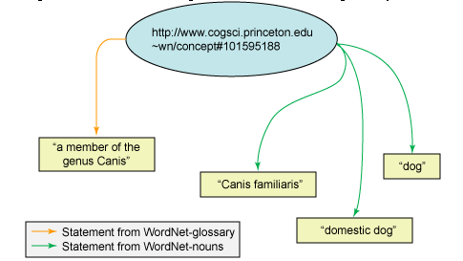
Ontology tutorial 05
Import WordNet 1.6 RDF database to MySQL
  Taking the form of several separate RDF documents, importing them into a single Jena model and merge their statements.
C:Jena/Tutorial/familytree/wordnet_glossary-20010201.rdf
C:Jena/Tutorial/familytree/wordnet_hyponyms-20010201.rdf
C:Jena/Tutorial/familytree/wordnet_nouns-20010201.rdf

Slide 97
Connecting Jena with MySQL
Set classpath for mysql connector (JDBC driver)
  set classpath=%classpath%;…\mysql-connector-java-5.1.6-bin.jar
  javac -cp ;…\mysql-connector-java-5.1.6-bin.jar Yourclass.java
  Or go to environmental variables to add the classpath.
Go to MySQL
  open and stop mysql server
    C:\mysql\bin>net start mysql
    C:\mysql\bin>net stop mysql
  open and stop mysql client
    C:\mysql\bin>mysql -uroot -p111
    mysql>exit
  Create an empty database
    create database wordnet; in mysql client →mysql>create database wordnet;
    Show existing mysql databases: mysql>show databases;

Slide 98
Loading Wordnet rdf files to MySQL
import java.io.*;
import com.hp.hpl.jena.db.*;
import com.hp.hpl.jena.rdf.model.*;
public class ImportWordnet {
/** MySQL driver classname */
private static final String mysqlDriver = "com.mysql.jdbc.Driver";
/** URL of database to use */
private static final String DB_URL = "jdbc:mysql://localhost/wordnet";
private static final String DB_TYPE = "MySQL";
/** User credentials */
private static final String DB_USER = "root";
private static final String DB_PASSWORD = "111";
/** Name of the Jena model to create */
private static final String MODEL_NAME = "wordnet";
/** Locations of wordnet graphs to load */
private static String WN_NOUNS = "wordnet_nouns-20010201.rdf";
private static String WN_GLOSSARY = "wordnet_glossary-20010201.rdf";
private static String WN_HYPONYMS = "wordnet_hyponyms-20010201.rdf";
public static void main(String args[]) {
try {
// Instantiate database driver
Class.forName(mysqlDriver);
} catch (ClassNotFoundException e) {
System.err.println("MySQL driver class not found");
System.exit(-1);}

Slide 99
Loading Wordnet rdf files to MySQL
// Get a connection to the db
DBConnection connection = new DBConnection(DB_URL, DB_USER, DB_PASSWORD, DB_TYPE);
// Get a ModelMaker for database-backend models
ModelMaker maker = ModelFactory.createModelRDBMaker(connection);
// Create a new model named "wordnet".
Model wordnetModel = maker.createModel(MODEL_NAME,true);
try {
wordnetModel.begin();
readFileIntoModel(WN_NOUNS, wordnetModel);
readFileIntoModel(WN_GLOSSARY, wordnetModel);
readFileIntoModel(WN_HYPONYMS, wordnetModel);
// Commit the transaction
wordnetModel.commit();
} catch (FileNotFoundException e) {System.err.println(e.toString());
} finally { try {
// Close the database connection
connection.close(); } catch (java.sql.SQLException e) {} }
}
private static void readFileIntoModel(String filename, Model model)
throws FileNotFoundException {
// Use the class loader to find the input file
InputStream in = ImportWordnet.class.getClassLoader().getResourceAsStream(filename);
if (in == null) {
throw new FileNotFoundException("File not found on classpath: "+ filename); }
// Read the triples from the file into the model
model.read(in,null); }
}
C:/Jena/Tutorial/familytree/ImportWordnet.java

Slide 100
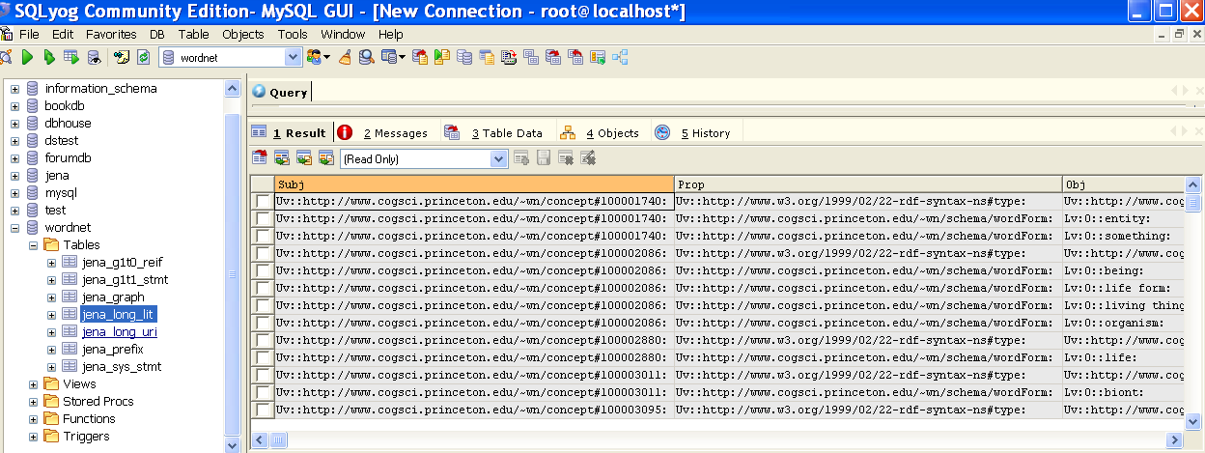
Ontology tutorial 05

Slide 101
Jena 2 Database Interface
The schema for storing RDF statements in a relational database is the triple store.
  Each RDF statement is stored as a single row in a three column ‘statement’ table with subject, predicate and object as the column, and a fourth column to indicate if the object is a literal or a URI.
Jena2 uses a denormalized triple store approach to achieve some efficiency:
  A statement table, two types:
    One for asserted statements
    One for reified statements
  a literal table
    short literal is stored in statement table and long literal is stored in literal table
  a resource table
    long URIs are stored in the resource table

Slide 102
Tables
Statement Tables
  Asserted Statement Table (Jena_GiTj_Stmt)
    Subj, Prop, Obj, GraphId (Identifier of graph (model) that contains the asserted statement)
  Reified Statement Table (Jena_GiTj_Stmt)
    Subj, Prop, Obj, GraphId, Stmt (identifier (URI) of reified statement), HasType (“true” if the graph contains the statement)
System table (Jena_Sys_Stmt)
  Subj, Prop, Obj, GraphId (always 0, representing the system graph)
Long Literals Table (Jena_Long_Lit)
  Id (ID for long literal, referenced from the statement tables), Head (first n characters of long literal), ChkSum (checksum of tail of long literal), Tail (remaining of long literal)

Slide 103
Tables
Long Resources Table (Jena_Long_URI)
  Id (identifier of long URI, referenced from the statement tables), Head (first n characters of long URI), ChkSum (Checksum of tail of long URI), Tail (remainder of long URI)
Prefixes Table (Jena_Prefix)
  Id (identifier for prefix, referenced from the statement tables), Head (first n characters of prefix), ChkSum (Checksum of tail of long prefix), Tail (remainder of long prefix)
Graph Table (Jena_Graph)
  Id (unique identifier for graph), Name (Graph name)

Slide 104
Jena Sparql
http://jena.sourceforge.net/ARQ/Tutorial/index.html

Slide 105
Jena SPARQL
SPARQL queries RDF graphs (a set of triples):
  RDF graphs – models (in Jena)
  RDF triples – statements (in Jena)
It is the triples that SPARQL cares, not the serialization.
  The serialization is just a way to write the triples down
  Here we use Turtle

Slide 106
vc-db-1.rdf in Turtle
@prefix vCard: <http://www.w3.org/2001/vcard-rdf/3.0#> .
@prefix rdf: <http://www.w3.org/1999/02/22-rdf-syntax-ns#> .
<http://somewhere/MattJones/> vCard:FN "Matt Jones" .
<http://somewhere/MattJones/> vCard:N _:b0 .
_:b0 vCard:Family "Jones" .
_:b0 vCard:Given "Matthew" .
<http://somewhere/RebeccaSmith/> vCard:FN "Becky Smith" .
<http://somewhere/RebeccaSmith/> vCard:N _:b1 .
_:b1 vCard:Family "Smith" .
_:b1 vCard:Given "Rebecca" .
<http://somewhere/JohnSmith/> vCard:FN "John Smith" .
<http://somewhere/JohnSmith/> vCard:N _:b2 .
_:b2 vCard:Family "Smith" .
_:b2 vCard:Given "John" .
<http://somewhere/SarahJones/> vCard:FN "Sarah Jones" .
<http://somewhere/SarahJones/> vCard:N _:b3 .
_:b3 vCard:Family "Jones" .
_:b3 vCard:Given "Sarah" .

Slide 107
ARQ
ARQ is a query engine for Jena that supports the SPARQL RDF Query language.
ARQ Features:
  Multiple query languages
    SPARQL (.rq – file extension)
    RDQL (.rdql)
    ARQ, the engine’s own language (.arq)
  Multiple query engines
    General purpose engine
    Remote access engines
    Rewriter to SQL

Slide 108
Install ARQ
Download ARQ from: http://jena.sourceforge.net/ARQ/download.html
Unpack the zip: it unpacks into a directory (e.g. C:\Jena\ARQ-2.2\ARQ-2.2)
Set classpath
  Put every file in \lib on your classpath.
    Using setcp.bat (e.g. the location of setcp.bat is C:\Jena)
    C:\Jena>setcp.bat C:\Jena\ARQ-2.2\ARQ-2.2\lib
    C:\Jena>echo %classpath%
Set ARQROOT environment variable to the path of the ARQ distribution
  Go to C:\Jena\ARQ-2.2\ARQ-2.2 (ARQ location)
  C:\Jena\ARQ-2.2\ARQ-2.2>set ARQROOT= C:\Jena\ARQ-2.2\ARQ-2.2

Slide 109
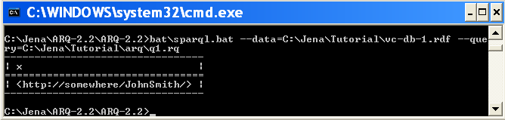
Query 1
Data file: C:\Jena\Tutorial\vc-db-1.rdf
Query file: C:\Jena\Tutorial\arq\q1.rq
Execute query q1.rq
  C:\Jena\ARQ-2.2\ARQ-2.2>bat\sparql.bat --data= C:\Jena\Tutorial\vc-db-1.rdf --query= C:\Jena\Tutorial\arq\q1.rq
SELECT ?x
WHERE
{ ?x <http://www.w3.org/2001/vcard-rdf/3.0#FN> "John Smith" }

Slide 110
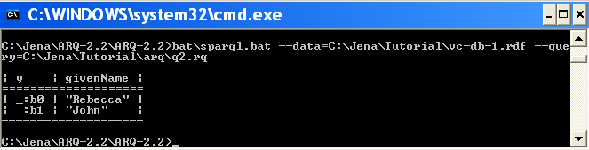
Query 2
Data file: C:\Jena\Tutorial\vc-db-1.rdf
Query file: C:\Jena\Tutorial\arq\q2.rq
PREFIX vcard: <http://www.w3.org/2001/vcard-rdf/3.0#>
SELECT ?y ?givenName
WHERE { ?y vcard:Family "Smith" .
?y vcard:Given ?givenName . }

Slide 111
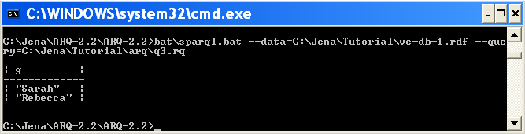
Query 3 - Filter
Data file: C:\Jena\Tutorial\vc-db-1.rdf
Query file: C:\Jena\Tutorial\arq\q3.rq
PREFIX vcard: <http://www.w3.org/2001/vcard-rdf/3.0#>
SELECT ?g
WHERE
{ ?y vcard:Given ?g .
FILTER regex(?g, "r", "i") }

Slide 112
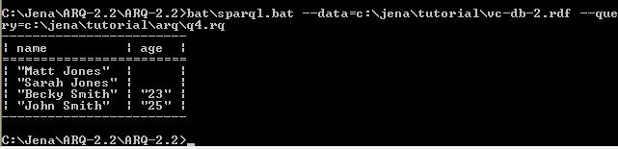
Query 4 - OPTIONAL
Data file: C:\Jena\Tutorial\vc-db-2.rdf
Query file: C:\Jena\Tutorial\arq\q4.rq
PREFIX info: <http://somewhere/peopleInfo#>
PREFIX vcard: <http://www.w3.org/2001/vcard-rdf/3.0#>
SELECT ?name ?age
WHERE
{ ?person vcard:FN ?name .
OPTIONAL { ?person info:age ?age } }

Slide 113
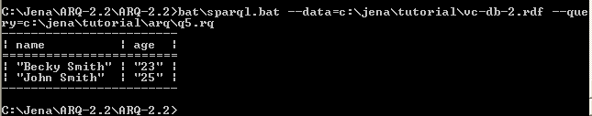
Query 5
Data file: C:\Jena\Tutorial\vc-db-2.rdf
Query file: C:\Jena\Tutorial\arq\q5.rq
PREFIX info: <http://somewhere/peopleInfo#>
PREFIX vcard: <http://www.w3.org/2001/vcard-rdf/3.0#>
SELECT ?name ?age
WHERE
{ ?person vcard:FN ?name .
?person info:age ?age . }

Slide 114
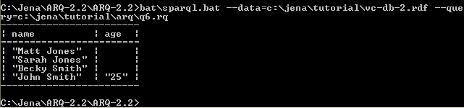
Query 6 – Optional and Filter
Data file: C:\Jena\Tutorial\vc-db-2.rdf
Query file: C:\Jena\Tutorial\arq\q6.rq
PREFIX info: <http://somewhere/peopleInfo#>
PREFIX vcard: <http://www.w3.org/2001/vcard-rdf/3.0#>
SELECT ?name ?age
WHERE
{
?person vcard:FN ?name .
OPTIONAL { ?person info:age ?age . FILTER ( ?age > “24” ) }
}

Slide 115
Query 7 - Union
Data: C:\Jena\Tutorial\name.rdf
@prefix foaf: <http://xmlns.com/foaf/0.1/> .
@prefix vcard: <http://www.w3.org/2001/vcard-rdf/3.0#> .
_:a foaf:name "Matt Jones" .
_:b foaf:name "Sarah Jones" .
_:c vcard:FN "Becky Smith" .
_:d vcard:FN "John Smith" .

Slide 116
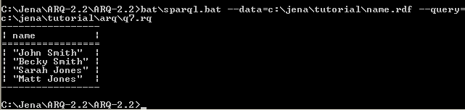
Query 7 - Union
Data file: C:\Jena\Tutorial\name.rdf
Query file: C:\Jena\Tutorial\arq\q7.rq
PREFIX foaf: <http://xmlns.com/foaf/0.1/>
PREFIX vCard: <http://www.w3.org/2001/vcard-rdf/3.0#>
SELECT ?name
WHERE
{
{ [] foaf:name ?name } UNION { [] vCard:FN ?name }
}

Slide 117
Query 8 – Named Graphs
@prefix dc: <http://purl.org/dc/elements/1.1/> .
@prefix xsd: <http://www.w3.org/2001/XMLSchema#> .
<ds-ng-1.ttl> dc:date "2005-07-14T03:18:56+0100"^^xsd:dateTime .
<ds-ng-2.ttl> dc:date "2005-09-22T05:53:05+0100"^^xsd:dateTime .
Default graph: ds-dft.ttl
Named graph: ds-ng-1.ttl
@prefix dc: <http://purl.org/dc/elements/1.1/> .
[] dc:title "Harry Potter and the Philospher's Stone" .
[] dc:title "Harry Potter and the Chamber of Secrets" .
Named graph: ds-ng-2.ttl
@prefix dc: <http://purl.org/dc/elements/1.1/> .
[] dc:title "Harry Potter and the Sorcerer's Stone" .
[] dc:title "Harry Potter and the Chamber of Secrets" .

Slide 118
Query 8 – Named Graphs
Data file: C:\Jena\Tutorial\
Query file: C:\Jena\Tutorial\arq\q8.rq
PREFIX xsd: <http://www.w3.org/2001/XMLSchema#>
PREFIX dc: <http://purl.org/dc/elements/1.1/>
PREFIX : <.>
SELECT ?title ?graph
FROM <ds-dft.ttl>
FROM NAMED <ds-ng-1.ttl>
FROM NAMED <ds-ng-2.ttl>
WHERE {
GRAPH ?graph {
?x dc:title ?title . }
}

Slide 119
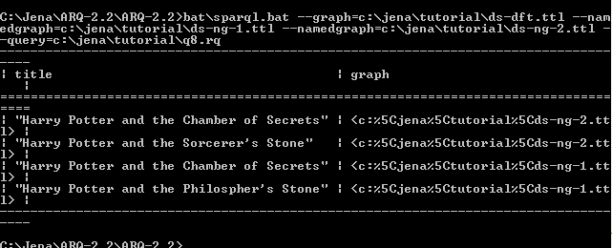
Query 8 – Named Graphs

Slide 120
Executing SPARQL queries via Jena API
SPARQL queries are created and executed with Jena via classes in the com.hp.hpl.jena.query package.
Using QueryFactory is the simplest approach.
  Create() methods are used to read a textual query from a file or from a String.
  Create() returns a query object with a parsed query
Create an instance of QueryExecution to perform a different type of query
  Call QueryExecutionFactory.create(query, model)
  Because the data for the query is provided programmatically, the query does not need a FROM clause.
ResultSet allows you to iterate over QuerySolution providing access to each bound variable’s value.

Slide 121
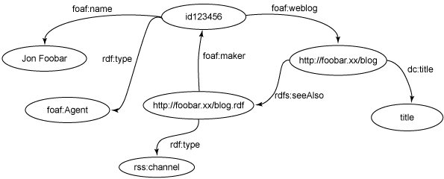
Bloggers.rdf

Slide 122
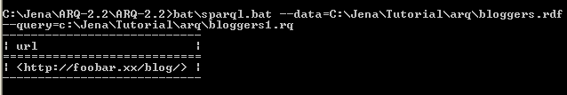
Query bloggers
Data file: C:\Jena\Tutorial\arq\bloggers.rdf
Query file: C:\Jena\Tutorial\arq\bloggers1.rq
Execute query bloggers1.rq
  C:\Jena\ARQ-2.2\ARQ-2.2>bat\sparql.bat --data= C:\Jena\Tutorial\arq\bloggers.rdf - -query= C:\Jena\Tutorial\arq\bloggers1.rq
PREFIX foaf: <http://xmlns.com/foaf/0.1/>
SELECT ?url
FROM <bloggers.rdf>
WHERE {
?contributor foaf:name "Jon Foobar" .
?contributor foaf:weblog ?url .
}

Slide 123
import com.hp.hpl.jena.rdf.model.*;
import com.hp.hpl.jena.util.FileManager;
import com.hp.hpl.jena.query.* ;
import com.hp.hpl.jena.query.ARQ;
import com.hp.hpl.jena.sparql.*;
import java.io.*;
public class Bloggers extends Object {
static final String inputFileName = "bloggers.rdf";
public static void main (String args[]) {
// Create an empty in-memory model
Model model = ModelFactory.createDefaultModel();
// use the FileManager to open the bloggers RDF graph from the filesystem
InputStream in = FileManager.get().open(inputFileName);
if (in == null) {
throw new IllegalArgumentException( "File: " + inputFileName + " not found");
}
// read the RDF/XML file
model.read( in, "" );
Bloggers.java

Slide 124
// Create a new query
String queryString =
"PREFIX foaf: <http://xmlns.com/foaf/0.1/> " +
"SELECT ?url " +
"WHERE {" +
" ?contributor foaf:name \"Jon Foobar\" . " +
" ?contributor foaf:weblog ?url . " +
" }";
Query query = QueryFactory.create(queryString);
// Execute the query and obtain results
QueryExecution qe = QueryExecutionFactory.create(query, model);
ResultSet results = qe.execSelect();
// Output query results
ResultSetFormatter.out(System.out, results, query);
// Important - free up resources used running the query
qe.close();
}
}
Bloggers.java

Slide 125
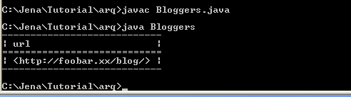
Executing SPARQL queries via Jena API
Store bloggers.java in C:\Jena\Tutorial\arq
Compile
Run

Slide 126
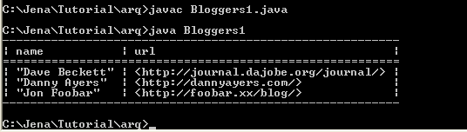
Executing SPARQL queries via Jena API
PREFIX foaf: <http://xmlns.com/foaf/0.1/>
SELECT ?name ?url
FROM <bloggers.rdf>
WHERE {
?x foaf:name ?name .
?x foaf:weblog ?url .
}
Bloggers1.java
Store bloggers1.java in C:\Jena\Tutorial\arq
Compile and run

Slide 127
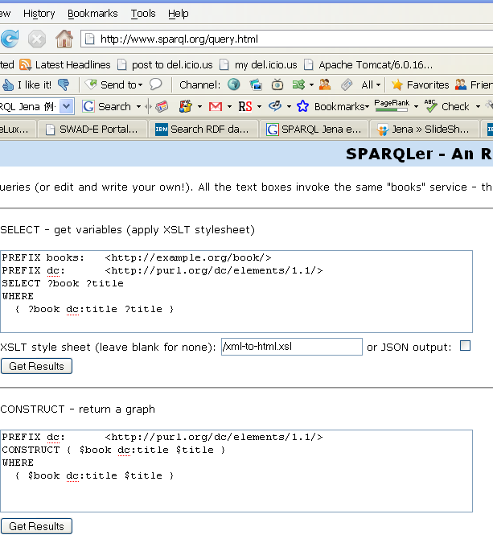
SPARQLer – An RDF Query Demo
http://www.sparql.org/query.html

Slide 128
Jena Examples
Expert
FamilyTree

Slide 129
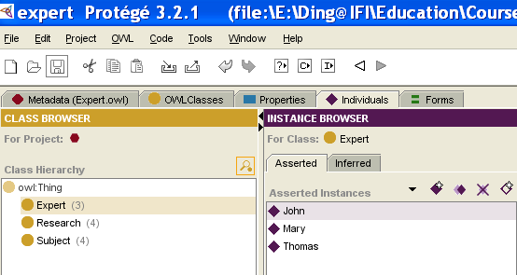
Expert
Using Protege to build up expert.owl:
  Three classes: Expert, Research, Subject
  Properties: hasResearch: expert can have many researches; research is associated with many subjects
  Create some instances.
  Output this ontology as expert.owl (for example: C:\Jena\Tutorial\expert\expert.owl)

Slide 130
ontologyDB
Introduce some methods to handle store, read ontology in/from persistent database (here takes MySQL as example):
  connectDB
  createDBModelFromFile
  getModelFromDB
  getModelSpec

Slide 131
ontologyDB
import java.util.*;
import com.hp.hpl.jena.db.*;
import com.hp.hpl.jena.ontology.*;
import com.hp.hpl.jena.rdf.model.*;
public class ontologyDB {
/* link database */
public static IDBConnection connectDB(String DB_URL, String DB_USER, String DB_PASSWD, String DB_NAME) {
return new DBConnection(DB_URL, DB_USER, DB_PASSWD, DB_NAME);}
/* Read ontology from filesystem and store it into database */
public static OntModel createDBModelFromFile(IDBConnection con, String name, String filePath) {
ModelMaker maker = ModelFactory.createModelRDBMaker(con);
Model base = maker.createModel(name);
OntModel newmodel = ModelFactory.createOntologyModel( getModelSpec(maker), base );
newmodel.read(filePath);
return newmodel; }

Slide 132
ontologyDB
/* Get ontology from database */
public static OntModel getModelFromDB(IDBConnection con, String name) {
ModelMaker maker = ModelFactory.createModelRDBMaker(con);
Model base = maker.getModel(name);
OntModel newmodel = ModelFactory.createOntologyModel( getModelSpec(maker), base);
return newmodel; }
public static OntModelSpec getModelSpec(ModelMaker maker) {
OntModelSpec spec = new OntModelSpec(OntModelSpec.OWL_MEM);
spec.setImportModelMaker(maker);
return spec;}
}
C:\Jena\Tutorial\expert\ontologyDB.java

Slide 133
Main.java
Store expert.owl into MySQL database,
Read expert.owl from MySQL database,
List the classes of expert.owl

Slide 134
import com.hp.hpl.jena.ontology.*;
import com.hp.hpl.jena.rdf.model.ModelMaker;
import com.hp.hpl.jena.util.FileManager;
import com.hp.hpl.jena.util.*;
import com.hp.hpl.jena.util.iterator.ExtendedIterator;
import com.hp.hpl.jena.db.*;
public class Main {
public static final String DB_URL = "jdbc:mysql://localhost/expert";
public static final String DB_USER = "root";
public static final String DB_PASSWD = "111";
public static final String DB = "MySQL";
public static final String DB_DRIVER = "com.mysql.jdbc.Driver";
public static void main (String args[]) {
try {
Class.forName("com.mysql.jdbc.Driver");
} catch (ClassNotFoundException e) {
e.printStackTrace(); }
String filePath = "file:C://Jena//Tutorial//expert//expert.owl";
IDBConnection con = ontologyDB.connectDB(DB_URL,DB_USER, DB_PASSWD, DB);
System.out.println(con);
ontologyDB.createDBModelFromFile(con, "expert", filePath);
OntModel model = ontologyDB.getModelFromDB(con, "expert");
for (ExtendedIterator i = model.listClasses(); i.hasNext();) {
OntClass c = (OntClass) i.next();
System.out.println(c.getLocalName()); } }
}
C:\Jena\Tutorial\expert\Main.java

Slide 135
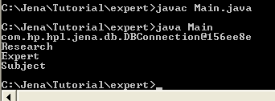
Expert
Create expert database in MySQL
  Mysql>create database expert;
Parse ontologyDB.java and Main.java
Run Main.java
Notes:
Make sure all classes are owl classes because OWL_MEM:
<owl:Class rdf:ID="Research"/>
<owl:Class rdf:ID="Expert"/>
<owl:Class rdf:ID="Subject"/>
Notes:
OntModelSpec OWL_MEM, then in expert.owl, three classes should use owl:class; otherwise, it will not list the classes here.
<owl:Class rdf:ID="Research"/>
<owl:Class rdf:ID="Expert"/>
<owl:Class rdf:ID="Subject"/>

Slide 136
Expert - Class
Main.java
  Not using method to output class of the ontology
Main1.java
  Using defined SimpleReadOntology method to output class of the ontology
public static void SimpleReadOntology(OntModel model) {
for (ExtendedIterator i = model.listClasses(); i.hasNext();) {
OntClass c = (OntClass) i.next();
System.out.println(c.getLocalName());
}
}

Slide 137
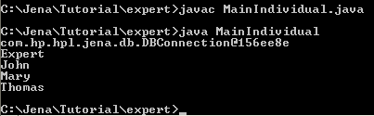
Expert - individual
MainIndividual.java
  C:\Jena\Tutorial\expert\MainIndividual.java, defined prix is default namespace from expert.owl, using getInstance method.
  But you have to compile ontologyDB.java, as all the Main* files are calling the methods defined in ontologyDB.class
public static void getInstance(OntModel model){
String prix = "http://www.owl-ontologies.com/Expert.owl#";
/*get Expert class from the onotlogy*/
OntClass expert = model.getOntClass(prix + "Expert");
//print out the name of the Expert class
System.out.println(expert.getLocalName());
//get instances of the Expert class
ExtendedIterator it = expert.listInstances();
//print out the instances of the Expert class
while(it.hasNext()){
Individual oi = (Individual)it.next();
System.out.println(oi.getLocalName());
}
}

Slide 138
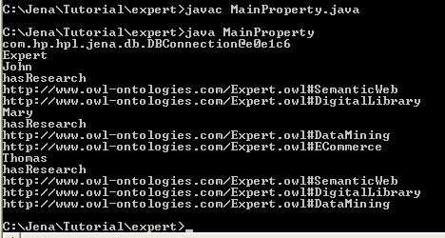
Expert - property
MainProperty.java
  C:\Jena\Tutorial\expert\MainProperty.java
  Using getProperty method
  Compile ontologyDB.java first

Slide 139
Expert – getProperty method
public static void getProperty(OntModel model) {
String NS = "http://www.owl-ontologies.com/Expert.owl#";
/* get the Expert class */
OntClass expert = model.getOntClass(NS + "Expert");
// print out the name of the Expert class
System.out.println(expert.getLocalName());
// get the instances of the Expert class
ExtendedIterator it = expert.listInstances();
// print out the instances of the Expert class
while (it.hasNext()) {
Individual oi = (Individual) it.next();
System.out.println(oi.getLocalName());
//get the properties of the instances of the Expert class
for (ExtendedIterator ipp = expert.listDeclaredProperties(); ipp.hasNext();) {
OntProperty p = (OntProperty) ipp.next();
//print out property name and its values
System.out.println( p.getLocalName());
for (ExtendedIterator ivv = oi.listPropertyValues(p); ivv.hasNext();) {
String valuename = ivv.next().toString();
System.out.println(valuename); } }
}
}

Slide 140
Query Expert
Using SPARQL and Jena Reasoner
Add familiar_with property (domain: Expert, range: Subject) to expert.owl.
  There is no instance for this property.
  We will use reasoner to find its inferred instances
Query: list the experts and their familiar_with subjects.
Setting up rules for the reasoner:
  ExpertA hasResearch ResearchB, ResearchB is associated with SubjectC → ExpertA is familiar_with SubjectC
Using Sparql to query ExpertX (is familir_with) SubjectY
  Select ?expert ?subject
  Where { ?expert faimilar_with ?subject }

Slide 141
MainQuery.java
import com.hp.hpl.jena.ontology.*;
import com.hp.hpl.jena.rdf.model.*;
import com.hp.hpl.jena.util.*;
import com.hp.hpl.jena.query.* ;
import com.hp.hpl.jena.sparql.*;
import com.hp.hpl.jena.reasoner.*;
import com.hp.hpl.jena.reasoner.rulesys.*;
import com.hp.hpl.jena.db.*;
public class MainQuery {
public static final String DB_URL = "jdbc:mysql://localhost/expert";
public static final String DB_USER = "root";
public static final String DB_PASSWD = "111";
public static final String DB = "MySQL";
public static final String DB_DRIVER = "com.mysql.jdbc.Driver";
public static void main (String args[]) {
try {
Class.forName("com.mysql.jdbc.Driver");
} catch (ClassNotFoundException e) {
e.printStackTrace(); }
String filePath = "file:C://Jena//Tutorial//expert//expert.owl";
IDBConnection con = ontologyDB.connectDB(DB_URL,DB_USER, DB_PASSWD, DB);
System.out.println(con);
ontologyDB.createDBModelFromFile(con, "expert", filePath);
OntModel model = ontologyDB.getModelFromDB(con, "expert");
searchOnto(model); }

Slide 142
MainQuery.java
public static void searchOnto(OntModel model){
/*Setting up rules*/
String rule = "[rule1:(?x http://www.owl-ontologies.com/Expert.owl#hasResearch ?y) " +
"(?y http://www.owl-ontologies.com/Expert.owl#associate ?z) " +
"->(?x http://www.owl-ontologies.com/Expert.owl#familiar_with ?z)]";
/*query String*/
String queryString = "PREFIX Expert:<http://www.owl-ontologies.com/Expert.owl#> " +
"SELECT ?expert ?subject " +
"WHERE {?expert Expert:familiar_with ?subject} ";
/*set up reasoner*/
Reasoner reasoner2 = new GenericRuleReasoner(Rule.parseRules(rule));
InfModel inf = ModelFactory.createInfModel(reasoner2, model);
Query query = QueryFactory.create(queryString);
QueryExecution qe = QueryExecutionFactory.create(query, inf);
ResultSet results = qe.execSelect();
/*output result*/
ResultSetFormatter.out(System.out, results, query);
qe.close(); }
}
C:C:\Jena\Tutorial\expert\MainQuery.java

Slide 143
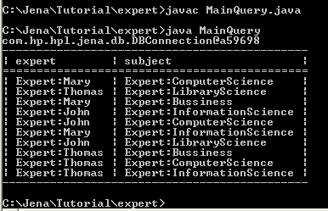
Query Expert
MainQuery.java
  C:\Jena\Tutorial\expert\MainQuery.java
  Using searchOnto method
  Compile ontologyDB.java first

Slide 144
MainQuery1.java
Actually you do not need to insert any new relations to the ontology before (like familiar_as)
You can define any rules with the new relationships, such as
  ExpertA hasResearch ResearchB, ResearchB is associated with SubjectC → ExpertA is isExpertOf SubjectC

Slide 145
MainQuery1.java
public static void searchOnto(OntModel model){
/*Setting up rules*/
String rule = "[rule1:(?x http://www.owl-ontologies.com/Expert.owl#hasResearch ?y) " +
"(?y http://www.owl-ontologies.com/Expert.owl#associate ?z) " +
"->(?x http://www.owl-ontologies.com/Expert.owl#isExpertOf ?z)]";
/*query String*/
String queryString = "PREFIX Expert:<http://www.owl-ontologies.com/Expert.owl#> " +
"SELECT ?expert ?subject " +
"WHERE {?expert Expert:isExpertOf ?subject} ";
/*set up reasoner*/
Reasoner reasoner2 = new GenericRuleReasoner(Rule.parseRules(rule));
InfModel inf = ModelFactory.createInfModel(reasoner2, model);
Query query = QueryFactory.create(queryString);
QueryExecution qe = QueryExecutionFactory.create(query, inf);
ResultSet results = qe.execSelect();
/*output result*/
ResultSetFormatter.out(System.out, results, query);
qe.close();
C:C:\Jena\Tutorial\expert\MainQuery1.java

Slide 146
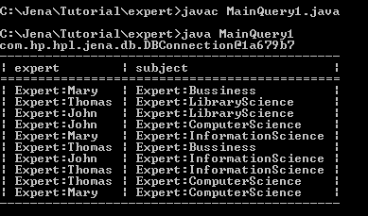
Query Expert
MainQuery1.java
  C:\Jena\Tutorial\expert\MainQuery1.java
  Using searchOnto method
  Compile ontologyDB.java first

Slide 147
Family Tree

Slide 148
Family Tree
The example shows:
  How to create and populate RDF models
  How to persist them to a database,
  How to query them programmatically using SPARQL query language
  How to show Jena reasoning capabilities which can be used to infer knowledge about models from an ontology
URL: http://www-128.ibm.com/developerworks/xml/library/j-jena/

Slide 149
Creating a simple RDF model
Create a model from scratch and add RDF statements to it.
Create a model to represent the relationships in a family using different relationship types, such as siblingOf, spouseOf, parentOf, childOf (more details about relationship ontology: http://vocab.org/relationship/)
Define family members using URIs from a made-up namespace: http://family/. It is useful to declare them as Java constants.

Slide 150
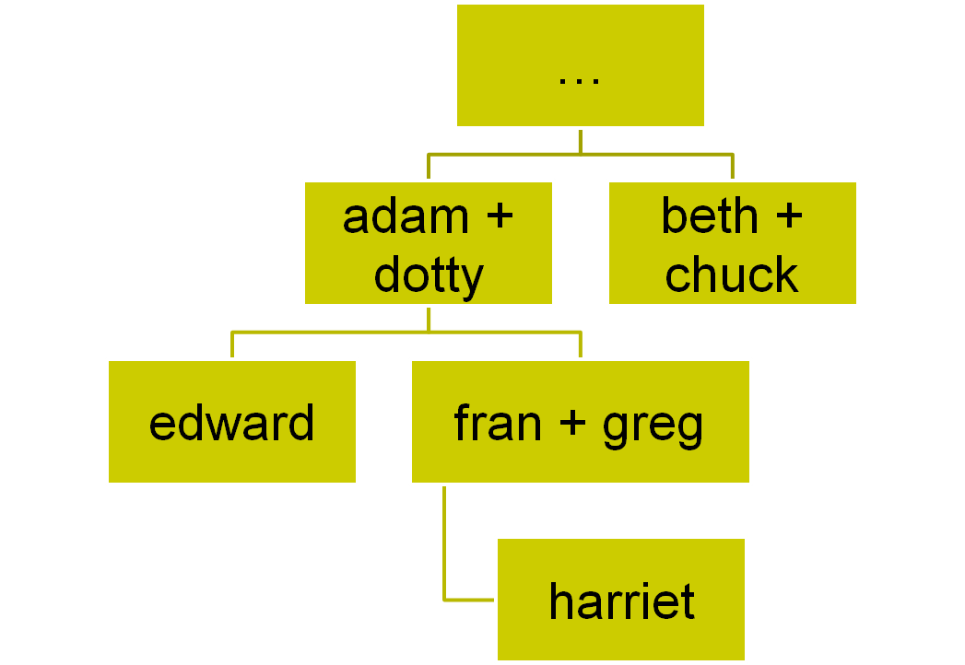
Family Tree

Slide 151
Creating a simple RDF model
import java.util.*;
import java.io.*;
import com.hp.hpl.jena.rdf.model.*;
import com.hp.hpl.jena.util.FileManager;
//A small family tree held in a Jena Model
public class FamilyModel {
// Namespace declarations
static final String familyUri = "http://family/";
static final String relationshipUri = "http://purl.org/vocab/relationship/";
public static void main(String args[]) {
// Create an empty Model
Model model = ModelFactory.createDefaultModel(); . . .
//set namespace
Resource NAMESPACE = model.createResource( relationshipUri );
model.setNsPrefix( "rela", relationshipUri);
// Create the types of Property we need to describe relationships in the model
Property childOf = model.createProperty(relationshipUri,"childOf"); . . .
// Create resources representing the people in our model
Resource adam = model.createResource(familyUri+"adam");. . .

Slide 152
Creating a simple RDF model
// Add properties to describing the relationships between them
adam.addProperty(siblingOf,beth); . . .
// Statements can also be directly created ...
Statement statement1 = model.createStatement(edward,childOf,adam); . . .
// ... then added to the model:
model.add(statement1); . . .
// Arrays of Statements can also be added to a Model:
Statement statements[] = new Statement[5];
statements[0] = model.createStatement(fran,childOf,adam); . . .
// A List of Statements can also be added
List list = new ArrayList(); . . .
list.add(model.createStatement(greg,spouseOf,fran)); . . .
model.add(list);
model.write(System.out, "RDF/XML-ABBREV");
}
}
C:\Jena\Tutorial\familytree\FamilyModel.java

Slide 153
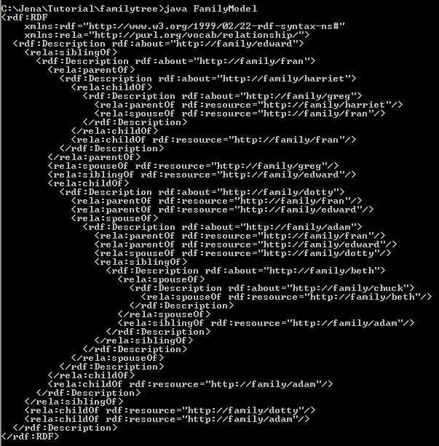
Creating a simple RDF model
Store FamilyModel.java in C:\Jena\Tutorial\familytree
Compile and Run

Slide 154
Store this RDF model in file
Store the RDF model in to C:\Jena\Tutorial\familytree\family.rdf
Add following codes to FamilyModel.java
try{
File file=new File("C:\\Jena\\Tutorial\\familytree\\family.rdf");
FileOutputStream f1=new FileOutputStream(file);
RDFWriter d = model.getWriter("RDF/XML-ABBREV");
d.write(model,f1,null);
}catch(Exception e) {}
C:\Jena\Tutorial\familytree\FamilyModel01.java

Slide 155
Query family tree - listStatement
Query : Show me who has which-kind-of relation with whom.
  listStatement (Subject s, Property p, RDFNode o)
import com.hp.hpl.jena.rdf.model.*;
import com.hp.hpl.jena.util.FileManager;
import com.hp.hpl.jena.vocabulary.*;
import java.io.*;
public class FamilyQuery {
static final String inputFileName = "family.rdf";
public static void main (String args[]) {
// create an empty model
Model model = ModelFactory.createDefaultModel();
// use the FileManager to find the input file
InputStream in = FileManager.get().open(inputFileName);
if (in == null) {
throw new IllegalArgumentException( "File: " + inputFileName + " not found"); }
model.read( in, "");
//query the statement:subject, property and object
StmtIterator iter = model.listStatements(null, null, (RDFNode) null);
if (iter.hasNext()) {System.out.println("They are:");
while (iter.hasNext()) {System.out.println(" " + iter.nextStatement()); }
} else {System.out.println("They are not in the database"); }
}
}
C:\Jena\Tutorial\familytree\FamilyQuery.java

Slide 156
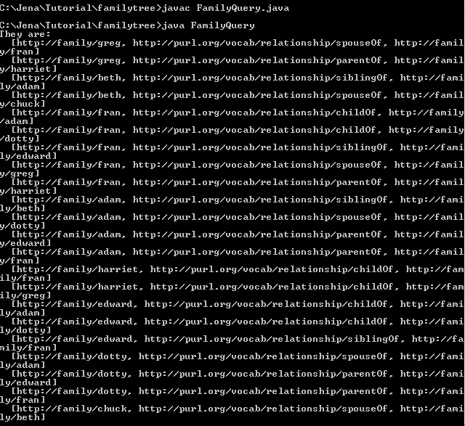
Run FamilyQuery.java

Slide 157
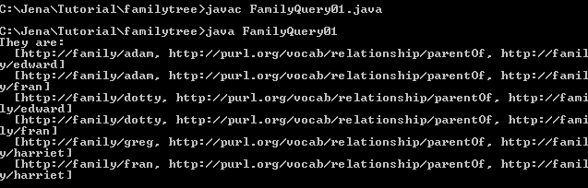
Query family tree - listStatement
Query01: show me who are the parent of whom
  listStatements(null, model.getProperty("http://purl.org/vocab/relationship/parentOf"), (RDFNode) null)
  C:\Jena\Tutorial\familytree\FamilyQuery01.java

Slide 158
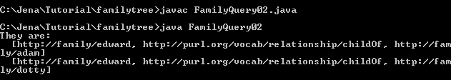
Query family tree - listStatement
Query02: who are parent of edward
  model.listStatements(model.getResource("http://family/edward"), model.getProperty("http://purl.org/vocab/relationship/childOf"), (RDFNode) null)
  C:\Jena\Tutorial\familytree\FamilyQuery02.java

Slide 159
Query family tree - Sparql
Find grandparent?
import com.hp.hpl.jena.rdf.model.*;
import com.hp.hpl.jena.util.FileManager;
import com.hp.hpl.jena.query.* ;
import com.hp.hpl.jena.sparql.*;
import java.io.*;
public class FamilyQuery03 {
static final String inputFileName = "family.rdf";
public static void main (String args[]) {
// create an empty model
Model model = ModelFactory.createDefaultModel();
// use the FileManager to find the input file
InputStream in = FileManager.get().open(inputFileName);
if (in == null) {
throw new IllegalArgumentException( "File: " + inputFileName + " not found"); }
model.read( in, "");

Slide 160

Query family tree - Sparql
String queryString = "PREFIX rela: <http://purl.org/vocab/relationship/> " +
"SELECT ?person ?grandparent " +
"WHERE {" +
" ?grandparent rela:parentOf ?y . " +
" ?y rela:parentOf ?person . " +
" }";
Query query = QueryFactory.create(queryString);
// Execute the query and obtain results
QueryExecution qe = QueryExecutionFactory.create(query, model);
ResultSet results = qe.execSelect();
// Output query results
ResultSetFormatter.out(System.out, results, query);
// Important - free up resources used running the query
qe.close();
}
}
C:\Jena\Tutorial\familytree\FamilyQuery03.java

Slide 161

Query family tree - Sparql
Who is uncle of harriet?
C:\Jena\Tutorial\familytree\FamilyQuery04.java
String queryString =
"PREFIX rela: <http://purl.org/vocab/relationship/> " +
"SELECT ?uncleoraunt " +
"WHERE {" +
" <http://family/harriet> rela:childOf ?x . " +
" ?x rela:siblingOf ?uncleoraunt . " +
" }";

Slide 162
Reasoning family tree
Who are niece or nephew of edwar?
import java.io.*;
import java.util.Iterator;
import com.hp.hpl.jena.util.*;
import com.hp.hpl.jena.rdf.model.*;
import com.hp.hpl.jena.reasoner.*;
import com.hp.hpl.jena.reasoner.rulesys.*;
public class FamilyReason {
private static String fname = "family.rdf";
private static String NS = "http://family/";
public static void main(String args[]) {
Model rawData = FileManager.get().loadModel(fname);
String rules = "[r1: (?x http://purl.org/vocab/relationship/siblingOf ?y), (?y http://purl.org/vocab/relationship/parentOf ?z)" + "-> (?x uncleorauntOf ?z)]";
Reasoner reasoner = new GenericRuleReasoner(Rule.parseRules(rules));
InfModel inf = ModelFactory.createInfModel(reasoner, rawData);
Resource A = inf.getResource(NS + "edward");
System.out.println("A * * =>");
Iterator list = inf.listStatements(A, null, (RDFNode)null);
while (list.hasNext()) {
System.out.println(" - " + list.next()); }
}
}
C:\Jena\Tutorial\familytree\FamilyReason.java

Slide 163

Reasoning family tree

Slide 164
Reasoning family tree
Using FamilyModel02.java to delete some statements (siblingOf, childOf, spouseOf,…) and store it in N-Triple in family1.nt.
Who are the children of dotty?
Using generic rule reasoning
Using sparql to query
C:\Jena\Tutorial\familytree\FamilyReason01.java

Slide 165
FamilyReason01.java
import java.io.*;
import java.util.Iterator;
import com.hp.hpl.jena.util.*;
import com.hp.hpl.jena.rdf.model.*;
import com.hp.hpl.jena.reasoner.*;
import com.hp.hpl.jena.reasoner.rulesys.*;
import com.hp.hpl.jena.query.* ;
import com.hp.hpl.jena.sparql.*;
public class FamilyReason01 {
private static String fname = "family1.nt";
public static void main(String args[]) {
Model rawData = FileManager.get().loadModel(fname);
//setting up rules
String rules = "[r1: (?x http://purl.org/vocab/relationship/parentOf ?y), (?x http://purl.org/vocab/relationship/spouseOf ?z)" +
"-> (?z http://purl.org/vocab/relationship/parentOf ?y)]";

Slide 166

FamilyReason01.java
/*query String*/
String queryString = "SELECT ?dottychild " +
"WHERE { <http://family/dotty> <http://purl.org/vocab/relationship/parentOf> ?dottychild} ";
Reasoner reasoner = new GenericRuleReasoner(Rule.parseRules(rules));
InfModel inf = ModelFactory.createInfModel(reasoner, rawData);
Query query = QueryFactory.create(queryString);
QueryExecution qe = QueryExecutionFactory.create(query, inf);
ResultSet results = qe.execSelect();
/*output result*/
ResultSetFormatter.out(System.out, results, query);
qe.close();
}
}
C:\Jena\Tutorial\familytree\FamilyReason01.java

Slide 167
Reasoning family tree
Using multiple rules to do complex reasoning.
Dataset: C:\Jena\Tutorial\familytree\family2.nt
<http://family/harriet> <http://purl.org/vocab/relationship/childOf> <http://family/fran> .
<http://family/fran> <http://purl.org/vocab/relationship/spouseOf> <http://family/greg> .
<http://family/fran> <http://purl.org/vocab/relationship/childOf> <http://family/adam> .
<http://family/adam> <http://purl.org/vocab/relationship/spouseOf> <http://family/dotty> .
<http://family/adam> <http://purl.org/vocab/relationship/siblingOf> <http://family/beth> .
<http://family/beth> <http://purl.org/vocab/relationship/spouseOf> <http://family/chuck> .
<http://family/edward> <http://purl.org/vocab/relationship/siblingOf> <http://family/fran> .
<http://family/edward> <http://purl.org/vocab/relationship/childOf> <http://family/adam> .

Slide 168
FamilyReason02.java
Multiple rules:
  R1: ?x parentOf ?y, ?y parentOf ?z ->?x grandparentOf ?z
  R2: ?x parentOf ?y, ?x spouseOf ?z ->?z parentOf ?y
  R3: ?x childOf ?y -> ?y parentOf ?x
Query: who can be grandparents?

Slide 169
FamilyReason02.java
import java.io.*;
import java.util.Iterator;
import com.hp.hpl.jena.util.*;
import com.hp.hpl.jena.rdf.model.*;
import com.hp.hpl.jena.reasoner.*;
import com.hp.hpl.jena.reasoner.rulesys.*;
import com.hp.hpl.jena.query.* ;
import com.hp.hpl.jena.sparql.*;
public class FamilyReason02 {
private static String fname = "family2.nt";
public static void main(String args[]) {
Model rawData = FileManager.get().loadModel(fname);
//setting up rules
String rules = "[r1: (?x http://purl.org/vocab/relationship/parentOf ?y),
(?y http://purl.org/vocab/relationship/parentOf ?z)" +
"-> (?x grandparentOf ?z)]" +
"[r2: (?x http://purl.org/vocab/relationship/parentOf ?y),
(?x http://purl.org/vocab/relationship/spouseOf ?z)" +
"-> (?z http://purl.org/vocab/relationship/parentOf ?y)]" +
"[r3: (?x http://purl.org/vocab/relationship/childOf ?y)" +
"-> (?y http://purl.org/vocab/relationship/parentOf ?x)]";

Slide 170

FamilyReason02.java
/*query String*/
String queryString = "SELECT ?grandparent " +
"WHERE { ?grandparent <http://purl.org/vocab/relationship/parentOf> ?x ." +
" ?x <http://purl.org/vocab/relationship/parentOf> ?y . } ";
Reasoner reasoner = new GenericRuleReasoner(Rule.parseRules(rules));
InfModel inf = ModelFactory.createInfModel(reasoner, rawData);
Query query = QueryFactory.create(queryString);
QueryExecution qe = QueryExecutionFactory.create(query, inf);
ResultSet results = qe.execSelect();
/*output result*/
ResultSetFormatter.out(System.out, results, query);
qe.close();
}
}
C:\Jena\Tutorial\familytree\FamilyReason02.java

