Slide 1
Python Learning
A comprehensive guide to mastering Python

Slide 2
Table of Contents
1. Basic Data Types
2. Variables and Operators
3. Control Flow
4. Functions
5. Basic Data Structures
6. String and File Handling
7. Exception Handling
8. Modules and Packages
9. Object-Oriented Programming (OOP)
10. Comprehensions
11. Lambda, Map, Filter, Reduce
12. Decorators and Generators
13. Advanced OOP
14. Working with Libraries
15. Regular Expressions
16. Multithreading and Multiprocessing
17. File Formats and Data Handling

Slide 3
Basic Data Types
Objectives
Understand the basic data types in Python.
Declare and use variables with different data types.
Distinguish between mutable and immutable data types.

Slide 4
Basic Data Types
Data type defines the kind of value a variable can hold.
Don’t need to declare the data type explicitly

Slide 5
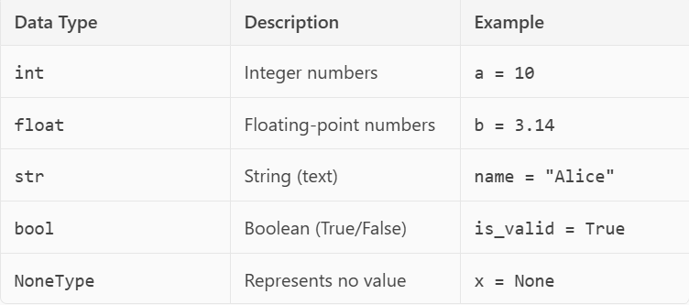
Basic Data Types

Slide 6
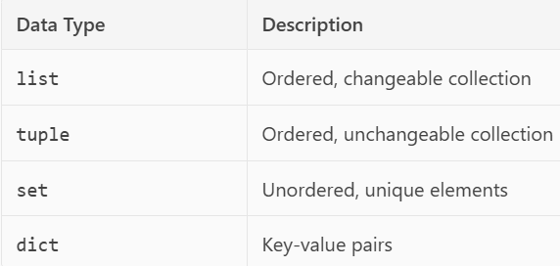
Basic Data Types

Slide 7
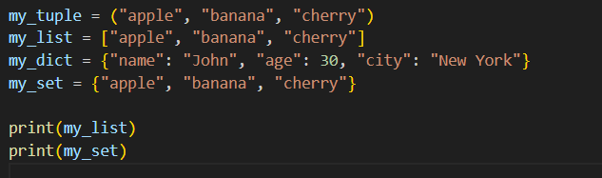

Basic Data Types

Slide 8
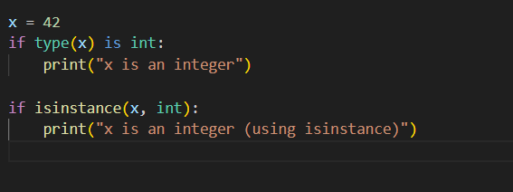
Basic Data Types
Checking Data Types:
Use the type() function to check a variable’s data type

Slide 9
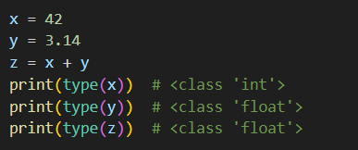
Basic Data Types
Type conversion:
Implicit Type Conversion (Automatic)
Explicit Type Conversion (Type Casting)
Manually convert a value from one type to another using built-in functions

Slide 10
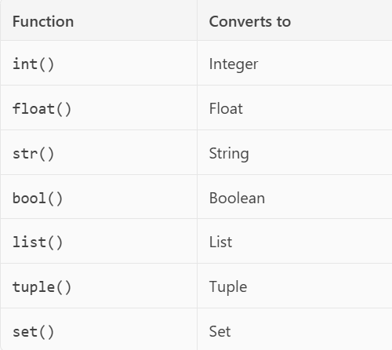
Basic Data Types

Slide 11
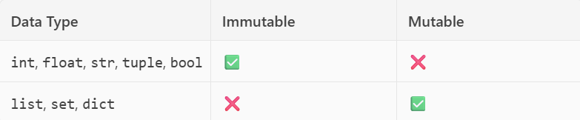
Basic Data Types
Mutable vs Immutable

Slide 12
Mutable vs Immutable
Mutable objects: Can be changed after they are created.
Immutable objects: Cannot be changed after they are created.

Slide 13
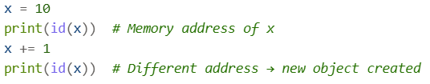
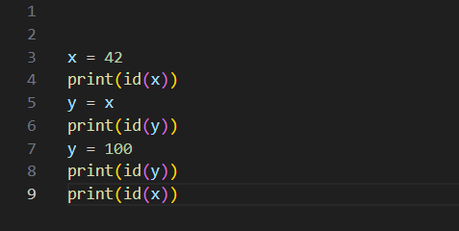
Mutable vs Immutable
Immutable example

Slide 14
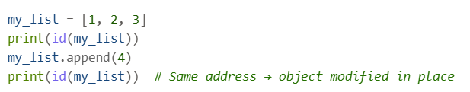
Mutable vs Immutable
Mutable example

Slide 15
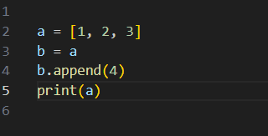
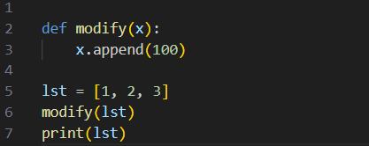
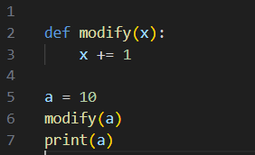
Mutable vs Immutable
Assignment behavior
Function argument

Slide 16
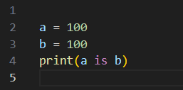
Interning and Memory Optimization
Python optimizes memory by reusing immutable objects (like small integers and strings)

Slide 17
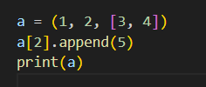
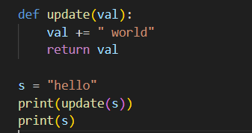
Practice Questions

Slide 18
Variables and Operators
Variable assignment
Arithmetic, comparison, logical, and assignment operators

Slide 19
Control Flow
if, elif, else statements
while and for loops
break, continue, pass

Slide 20
Functions
Defining and calling functions
Parameters and return values
Scope and lifetime of variables

Slide 21
Basic Data Structures
Lists, tuples, sets, dictionaries
Indexing, slicing, and basic operations

Slide 22
File Handling
What is a File
A file is a collection of data stored on a computer's memory
Files allow us to store data permanently, even after a program has finished running
Can interact with files to either read data from them or write data to them.

Slide 23
File Modes
Need to specify the mode in which you want to interact with it

Slide 24
File Modes
‘r’ (read): This is the default mode. It's used for reading data from a file. If the file doesn't exist, the program will raise an error
‘w’ (write): Used for writing data to a file. If the file already exists, all its old content will be deleted and replaced with the new content. If the file doesn't exist, a new one will be created
‘a’ (append): Used for appending (adding) data to the end of a file. If the file doesn't exist, a new one will be created.
‘x’ (exclusive creation): Used to create a new file. If the file already exists, the program will raise an error
‘t’ (text): The default mode for working with text files.
‘b’ (binary): Used for working with binary files like images, videos, or audio

Slide 25
Basic Steps for File Handling
Open the file: Use built-in open() function
Perform an operation: read/write
Close the file: Use close() method

Slide 26
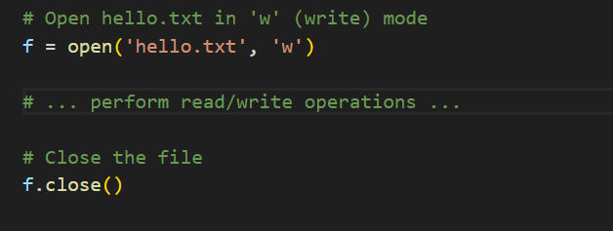
Opening/Closing File
file_variable = open('filename', 'mode')

Slide 27
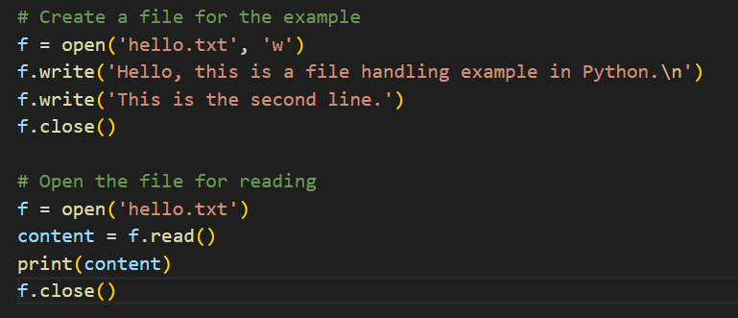
Reading File

Slide 28
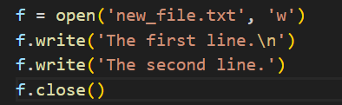
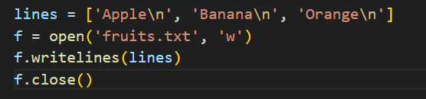
Writing File
Writing a single string
Writing a list of string

Slide 29
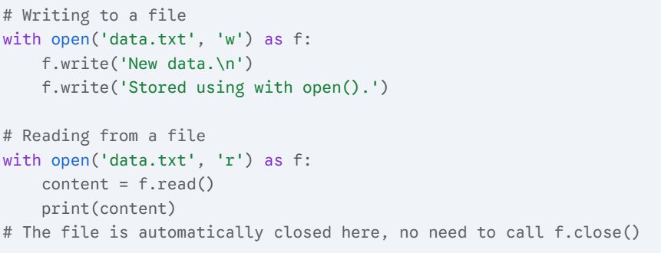
Best Practice
Using “with open()” when working with files in Python
Syntax : with open('filename', 'mode') as file_variable:

Slide 30
Handle CSV file
Using csv module

Slide 31
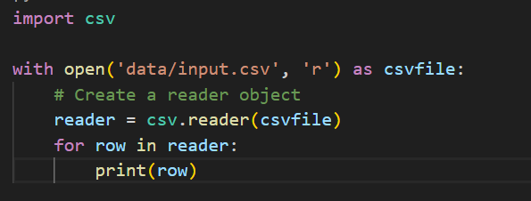
Reading csv

Slide 32
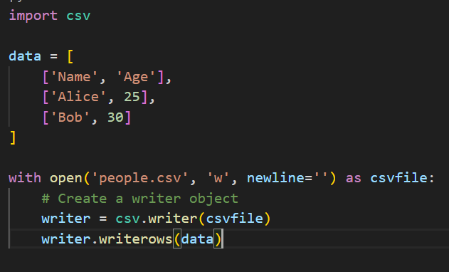
Writing csv

Slide 33
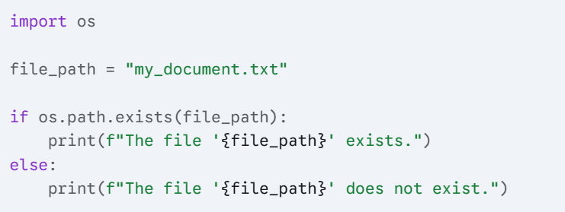
Checking File existing
Using os.path.exists() function from the os module

Slide 34
Handle JSON file
Using json module
Serialization (Python to JSON):
Python dict -> JSON Object
Python list -> JSON Array
Python string -> JSON String
Python int/float -> JSON Number
True/False/None -> true/false/null

Slide 35
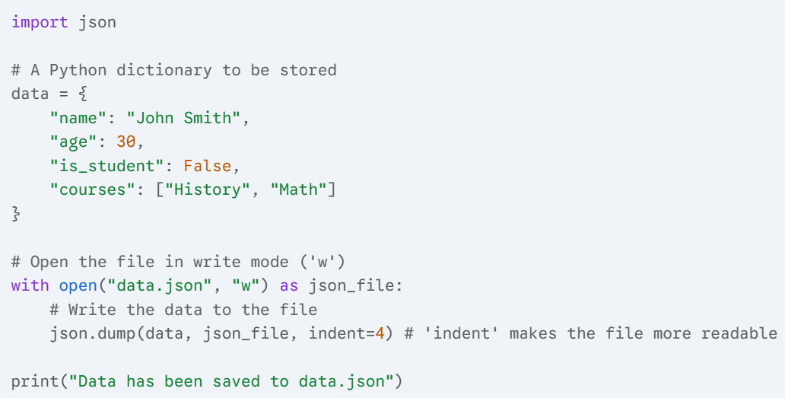
Writing Data to a JSON File

Slide 36
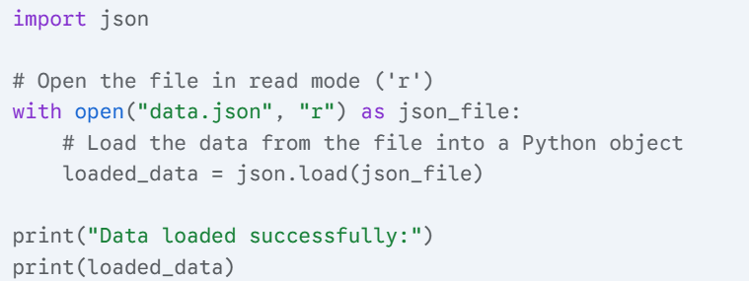
Reading Data from a JSON File

Slide 37
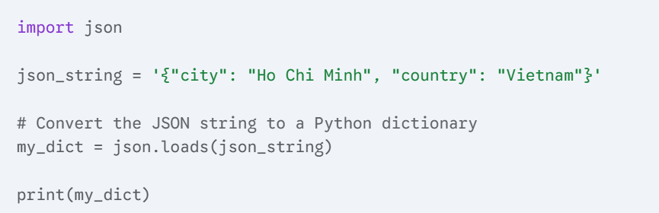
Handling JSON Strings
From string to python (Deserialization)
Use json.loads

Slide 38
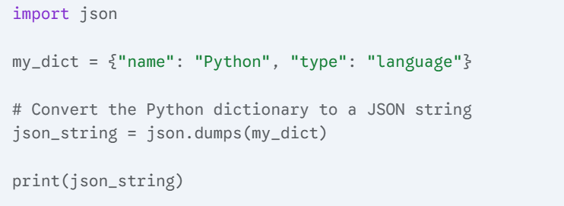
Handling JSON Strings
From python to json (Serialization)
Use json.dumps()

Slide 39
Exception Handling
try, except, finally
Custom exceptions

Slide 40
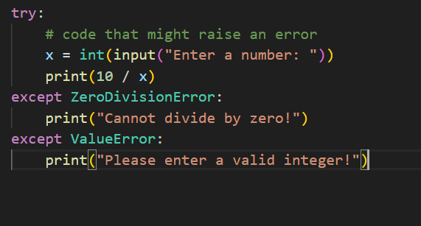
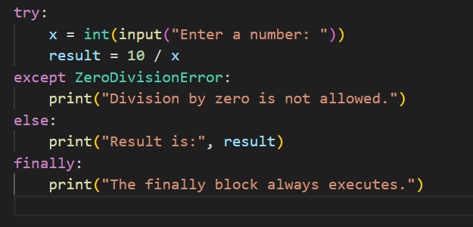
Exception

Slide 41
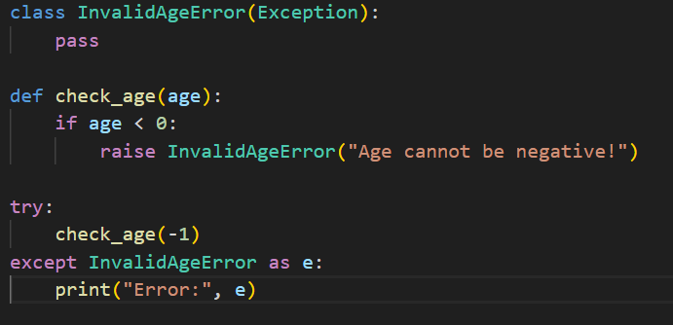
Custom Exception

Slide 42
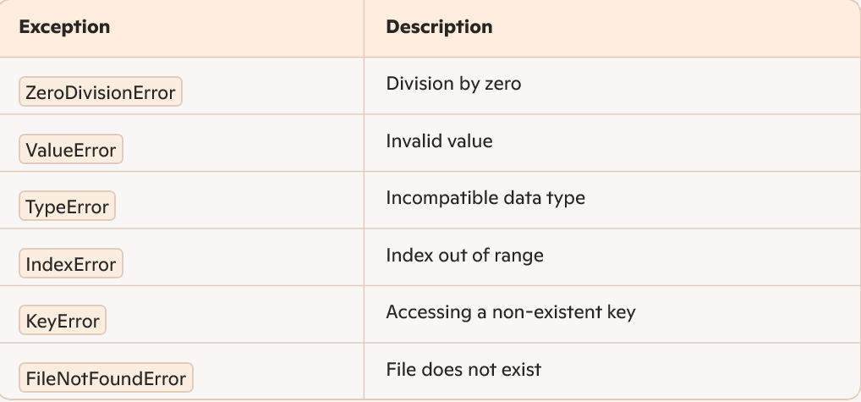
Common Exception Type

Slide 43
Modules and Packages
A module is a single Python file (.py) that contains definitions of functions, classes, and variables.
A package is a directory that contains a special file __init__.py and can contain multiple modules or sub-packages.

Slide 44
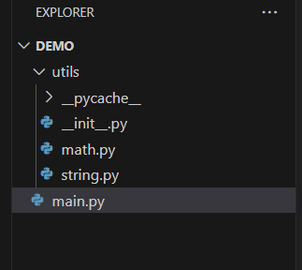
Modules and Packages

Slide 45
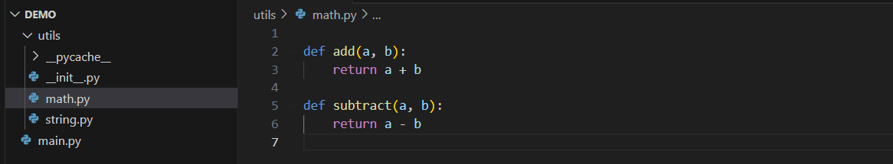
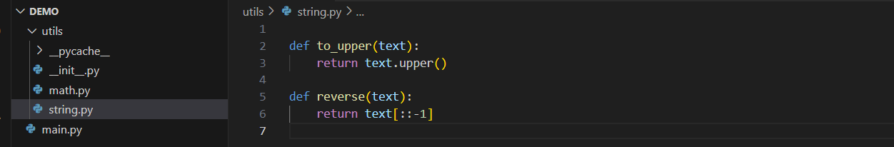
Modules and Packages
Using module

Slide 46
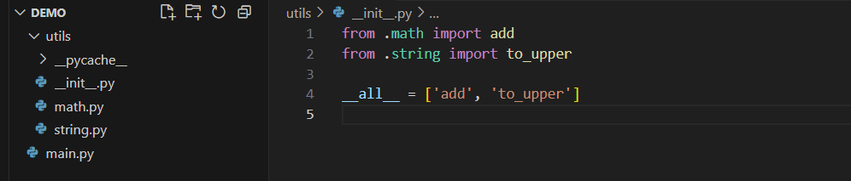
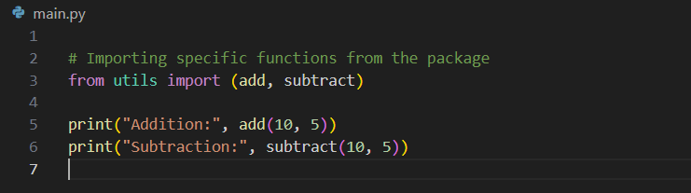
Modules and Packages
Using module

Slide 47
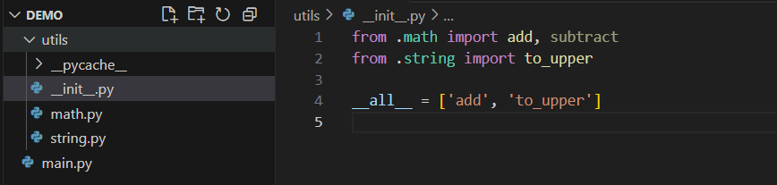
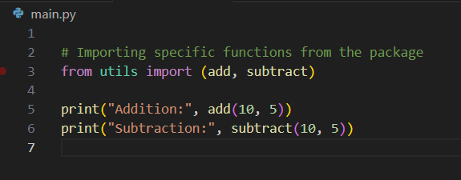
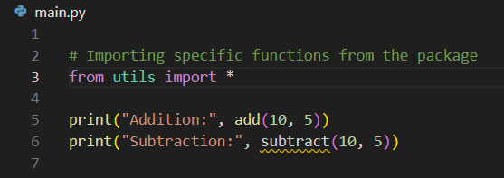
Modules and Packages
Using module

Slide 48
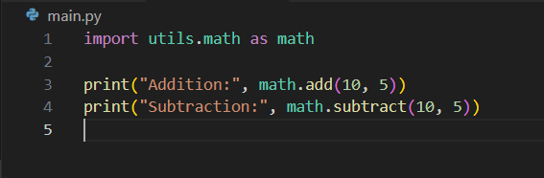
Modules and Packages
Using module

Slide 49
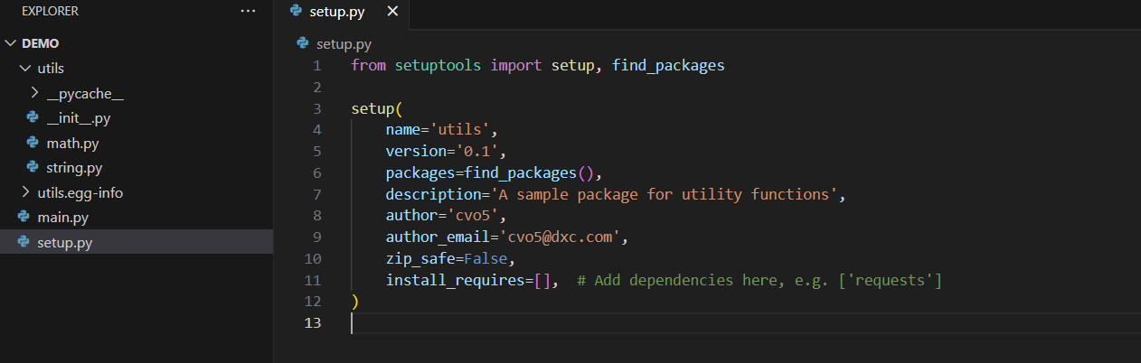
Modules and Packages

Slide 50
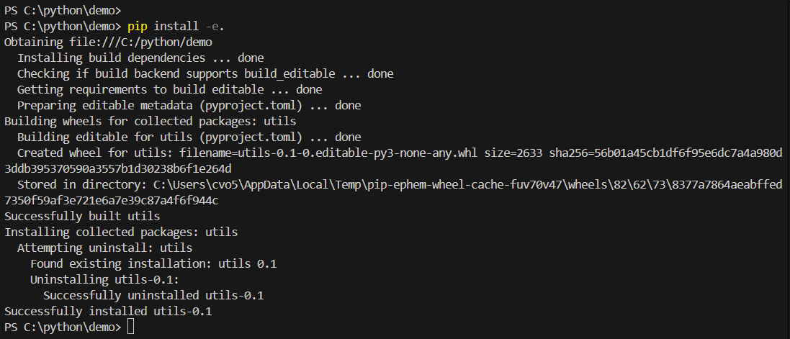
Modules and Packages

Slide 51
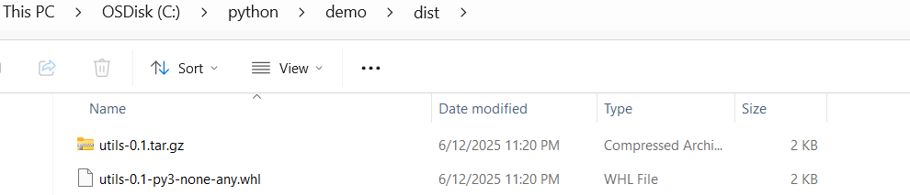
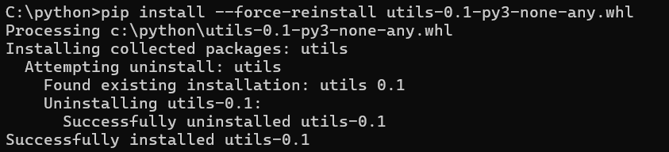
Modules and Packages

Slide 52
Object-Oriented Programming (OOP)
Class in Python
Definition:
- A class is a blueprint that defines the properties and behaviors of an object.
- In Python, it's declared using the class keyword.

Slide 53
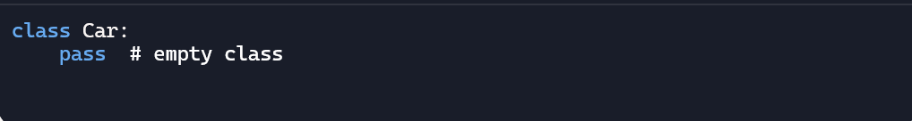
Object-Oriented Programming (OOP)
Class in Python
Definition:
- A class is a blueprint that defines the properties and behaviors of an object.
- In Python, it's declared using the class keyword.

Slide 54
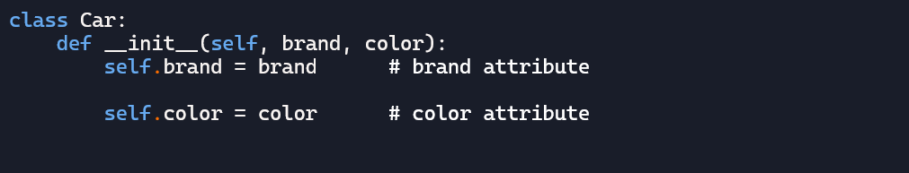
Attributes
What are Attributes?
- Data attached to an object, usually declared inside the constructor __init__.

Slide 55
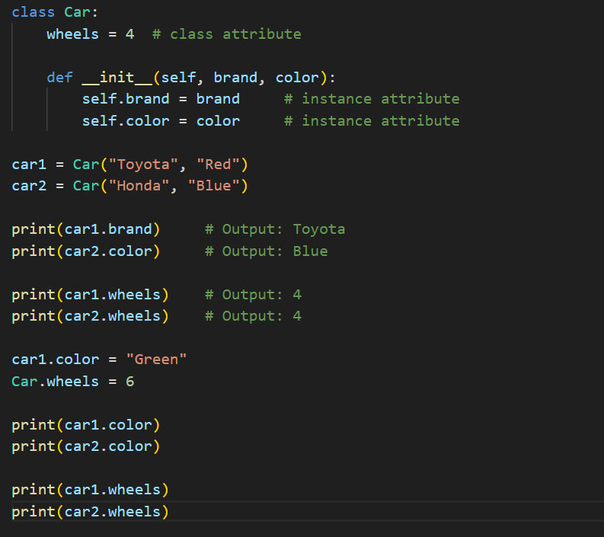
Attributes

Slide 56
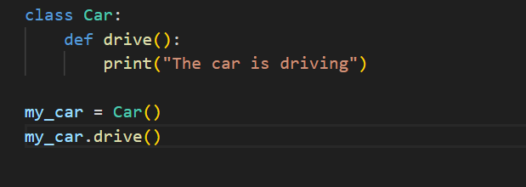
Method
What is a Method?
- A function defined inside a class that describes an object's behavior.
- Defined with def, and always takes self as the first parameter.

Slide 57
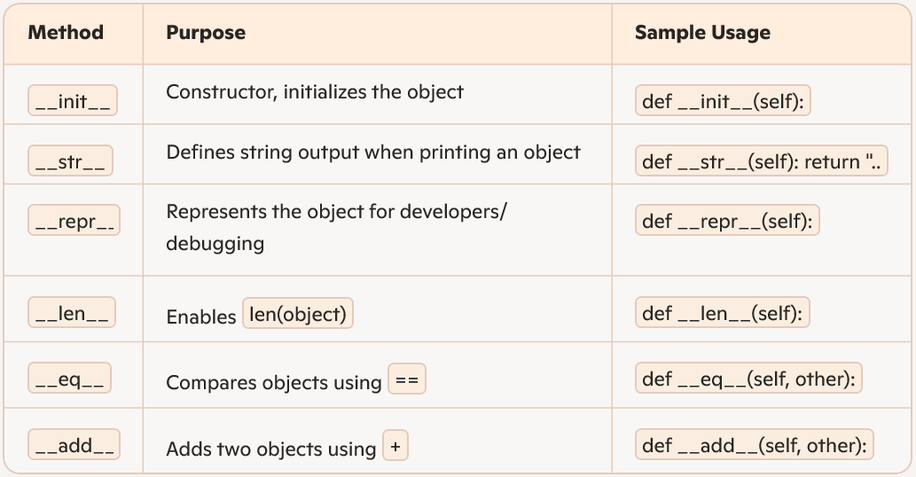
Dunder Methods

Slide 58

Dunder Methods

Slide 59
OOP in Python
Encapsulation
Inheritance
Polymorphism
Abstraction

Slide 60
Encapsulation
Protect the internal state of an object from being accessed or changed directly from the outside
We achieve encapsulation through naming conventions and a technique called name mangling.

Slide 61

Encapsulation
Public: By default, all class members (attributes and methods) in Python are public. Can access and modify them from anywhere.

Slide 62

Encapsulation
Protected: should only be accessed by the class itself and its subclasses
Signal this by prefixing the name with a single underscore -> this is just a convention

Slide 63
Encapsulation
Private: intended to be accessible only from within the class
Define them with a double underscore prefix
Python performs name mangling on these attributes, changing their name to _ClassName__attributeName

Slide 64

Encapsulation

Slide 65

Inheritance
Mechanism for a new class (the child class) to inherit properties and behaviors from an existing class (the parent class)

Slide 66

Inheritance

Slide 67
Polymorphism
means "many forms." It's the ability of different objects to respond to the same method call in their own way.
There are two common ways to demonstrate polymorphism:
Method Overriding
Duck Typing

Slide 68
Method Overriding
A child class provides a specific implementation for a method that is already defined in its parent class

Slide 69

Method Overriding

Slide 70

Duck Typing
This is a more informal form of polymorphism where an object's suitability is determined by the presence of a certain method or attribute, rather than by its explicit class type.

Slide 71
Abstraction
focus on hiding the complex implementation details and showing only the essential features of an object.
we achieve abstraction using Abstract Base Classes (ABCs) and Abstract Methods from the abc module

Slide 72
Abstraction
An abstract class cannot be instantiated directly. Its sole purpose is to serve as a blueprint for other classes
To declare a class as abstract, you must inherit from ABC and use the @abstractmethod decorator on at least one method

Slide 73

Abstraction

Slide 74
Pandas-DataFrame
A DataFrame is a 2-dimensional data structure in the pandas library, similar to a table in Excel or SQL
It consists of rows and columns, and each column can hold different data types

Slide 75
Creating a DataFrame
From a dictionary
From a csv file

Slide 76


Creating a DataFrame

Slide 77


Creating a DataFrame
df.head() -> display the first 5 rows
df.tail() -> display the last 5 rows

Slide 78




Accessing Data
Accessing Column:

Slide 79
Accessing Data
Acessing Row
df.loc[]
df.iloc[]

Slide 80





Accessing Row

Slide 81



Transforming Data
Filter

Slide 82



Transforming Data
Add a new column

Slide 83


Transforming Data
Drop column (row)

Slide 84


Exporting Data

Slide 85
Comprehensions
List, dictionary, and set comprehensions

Slide 86
Lambda, Map, Filter, Reduce
Anonymous functions
Functional programming basics

Slide 87
Lambda
A Lambda function, also known as an anonymous function
It can only contain a single expression
Syntax: lambda arguments: expression
arguments: The input parameters for the function
expression: The expression to be executed, and its result is the return value

Slide 88


Lambda

Slide 89
Advantages of Lambda
Concise: Used to write simple, single-line functions.
Often used as an argument to higher-order functions like map(), filter(), and reduce().

Slide 90
Map
The map() function applies a given function to all items in an iterable (e.g., a list, a tuple) and returns a new map object
Syntax: map(function, iterable)
function: The function you want to apply to each element.
iterable: The sequence of input elements.

Slide 91


Map

Slide 92
Filter
The filter() function filters elements from an iterable based on a test function (which returns True or False). It returns only the elements for which the function returns True
Syntax: filter(function, iterable)
function: The test function. It must return a boolean value (True or False).
iterable: The sequence of input elements.

Slide 93


Filter

Slide 94
Reduce
The reduce() function applies a function to the elements of an iterable cumulatively (from left to right) to reduce the sequence to a single value. Note: reduce() is not built-in in Python; you must import it from the functools module.
Syntax: reduce(function, iterable[, initializer])
function: A function that takes two arguments.
iterable: The sequence of input elements.
initializer (optional): An initial value.

Slide 95


Reduce

Slide 96

Summary

Slide 97
Functional Programming
Functional Programming (FP) is a programming paradigm that treats computation as the evaluation of mathematical functions.
It emphasizes using functions to build programs.
The core principle is to avoid changing state and mutable data.

Slide 98


Pure Functions

Slide 99
Core FP Concept
First-Class Functions
Assign a function to a variable.
Store a function in a data structure (like a list or a dictionary).
Pass a function as an argument to another function.
Return a function from another function.
Immutability: FP strongly encourages the use of immutable data structures

Slide 100

First-Class Functions
Assign a function to a variable

Slide 101

First-Class Functions
Store a function in a data structure

Slide 102

First-Class Functions
Pass a function as an argument to another function

Slide 103

First-Class Functions
Return a function from another function

Slide 104
Decorators and Generators
Writing and using decorators
Creating and using generators with yield

Slide 105
Decorator
A decorator is a function that takes another function as input and returns a modified version of it — without changing the original function’s code.
Why Use Decorators
Add logging, timing, or access control
Retry failed operations
Cache results
Validate inputs
Clean, reusable code

Slide 106


Decorator
Syntax

Slide 107

Decorator

Slide 108
Generator
Generators are a powerful and memory-efficient way to create iterators in Python.
A generator function can yield a sequence of values, pausing its execution and saving its state after each yield.

Slide 109
Generator
Key Concepts
The yield Keyword
return: Terminates the function and returns a single value. The function's state is lost.
yield: Pauses the function, yields a value, and saves its state. When the generator is called again (e.g., via next()), execution resumes from the exact point of the last yield.

Slide 110

Generator
Why Use Generators?
The primary reason to use generators is memory efficiency

Slide 111


Generator
How to Use Generators
The for loop
The next() function

Slide 112

Generator Expressions
Similar to list comprehensions

Slide 113
Advanced OOP
Class methods and static methods
Abstract base classes
Multiple inheritance and MRO (Method Resolution Order)

Slide 114
Working with Libraries
requests, datetime, math, random, etc.
Virtual environments and pip

Slide 115
Regular Expressions
What is Regex?
Regex is a language for describing search patterns. It allows you to search for, match, and manipulate text based on a predefined set of rules.

Slide 116
Regular Expressions
Basic Components of Regex
Metacharacters
.: Matches any single character (except the newline character \n).
[]: Character set. Matches one character from within the set.
|: OR. Matches one of the expressions. (a|b) matches 'a' or 'b’.
(): Group. Used to group expressions and capture the matched text.

Slide 117
Regular Expressions
Basic Components of Regex
Shorthand Character Classes
\d: Matches a digit (equivalent to [0-9]).
\D: Matches a non-digit character.
\w: Matches a word character (letter, digit, or underscore) (equivalent to [a-zA-Z0-9_]).
\W: Matches a non-word character.
\s: Matches a whitespace character (space, tab, newline, etc.).
\S: Matches a non-whitespace character.

Slide 118
Regular Expressions
Basic Components of Regex
Quantifiers
*: Matches 0 or more repetitions.
+: Matches 1 or more repetitions.
?: Matches 0 or 1 repetition.
{n}: Matches exactly n repetitions.
{n,}: Matches at least n repetitions.
{n,m}: Matches from n to m repetitions.

Slide 119
Regular Expressions
Basic Components of Regex
Anchors
^: Matches the beginning of the string.
$: Matches the end of the string.

Slide 120


Regular Expressions
Python has a built-in re module for working with Regex.
The most common functions include:
re.search(pattern, string)
re.findall(pattern, string)

Slide 121

Regular Expressions
The most common functions include:
re.finditer(pattern, text)

Slide 122


Regular Expressions
The most common functions include:
re.sub(pattern, repl, string): Replaces all substrings that match the pattern with the repl string.
re.split(pattern, string): Splits the string into a list based on the pattern as a delimiter

Slide 123

Regular Expressions
Group capturing
(?P<name>...)

Slide 124
Multithreading and Multiprocessing
Threading basics
Parallel processing

Slide 125
Multithreading
Multithreading is a technique that allows a program to execute multiple tasks concurrently.
Thread: A thread is the smallest unit of execution within a process. Threads within the same process share resources like memory
Process: A process is a running instance of a program. Each process has its own separate memory space.

Slide 126
Multithreading
Python’s built-in threading module is the standard way to create and manage threads.
Syntax
thread_name = threading.Thread(target=function_name, args=(argument1, argument2))

Slide 127
Multithreading
To start the thread -> call the .start() method
.join() method is used to wait for a thread to complete its work before the main program continues.

Slide 128

Multithreading

Slide 129

Multithreading

Slide 130

Multithreading

Slide 131

Race condition

Slide 132

Lock

Slide 133

Lock

Slide 134
Multiprocessing
Multiprocessing is a technique that enables a program to use multiple independent processes to execute tasks simultaneously.
Each process can run on a different CPU core.
The key advantage of multiprocessing is that it overcomes the Global Interpreter Lock (GIL) in Python

Slide 135
When to Use Multiprocessing?
Multiprocessing is the best choice for CPU-bound tasks
For I/O-bound tasks (like downloading files from the web or reading/writing to a database), multithreading is often more efficient

Slide 136

Multiprocessing
Syntax
process_name = Process(target=function_name, args=(argument1, argument2))

Slide 137

Pool

Slide 138

Queue

Slide 139
File Formats and Data Handling
Working with JSON, CSV, XML
Using pandas for data analysis

