Slide 1

Tìm hiểu kiến thức về ReactJS

Slide 2
1. JSX 2. Component + Class Component (Stateful Component) + Function Component (Stateless Component) 3. Props 4. State 5. Handling Events 6. Form

Slide 3
7. Styled Component 8. Redux + mapStateToProps() + mapDispatchToProps() 9. Lifecycle

Slide 4
10. Hook + useState() + useEffect() + useMemo() + useCallback() + useSelector() + useDispatch() 11. Router 12. API Axios 13. Redux thunk

Slide 5
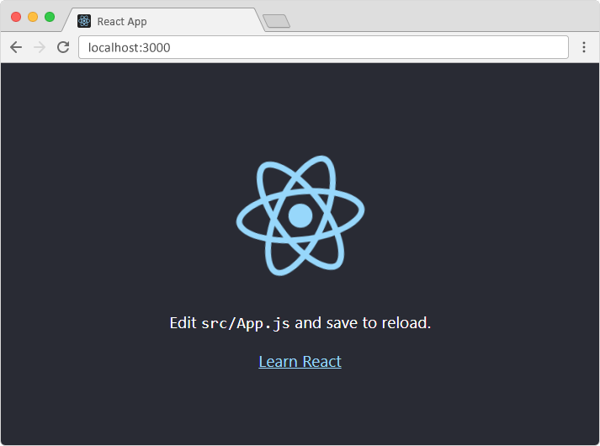
WEBSITE REACT

Slide 6
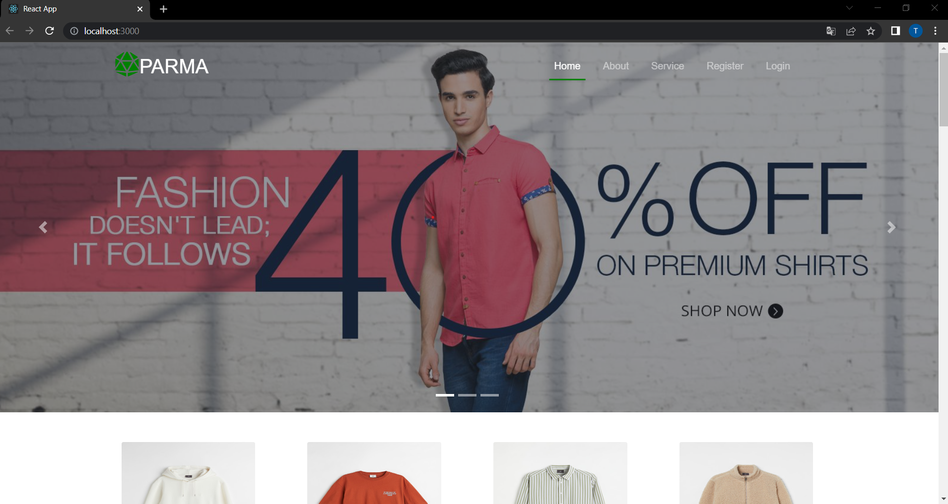
HOME

Slide 7
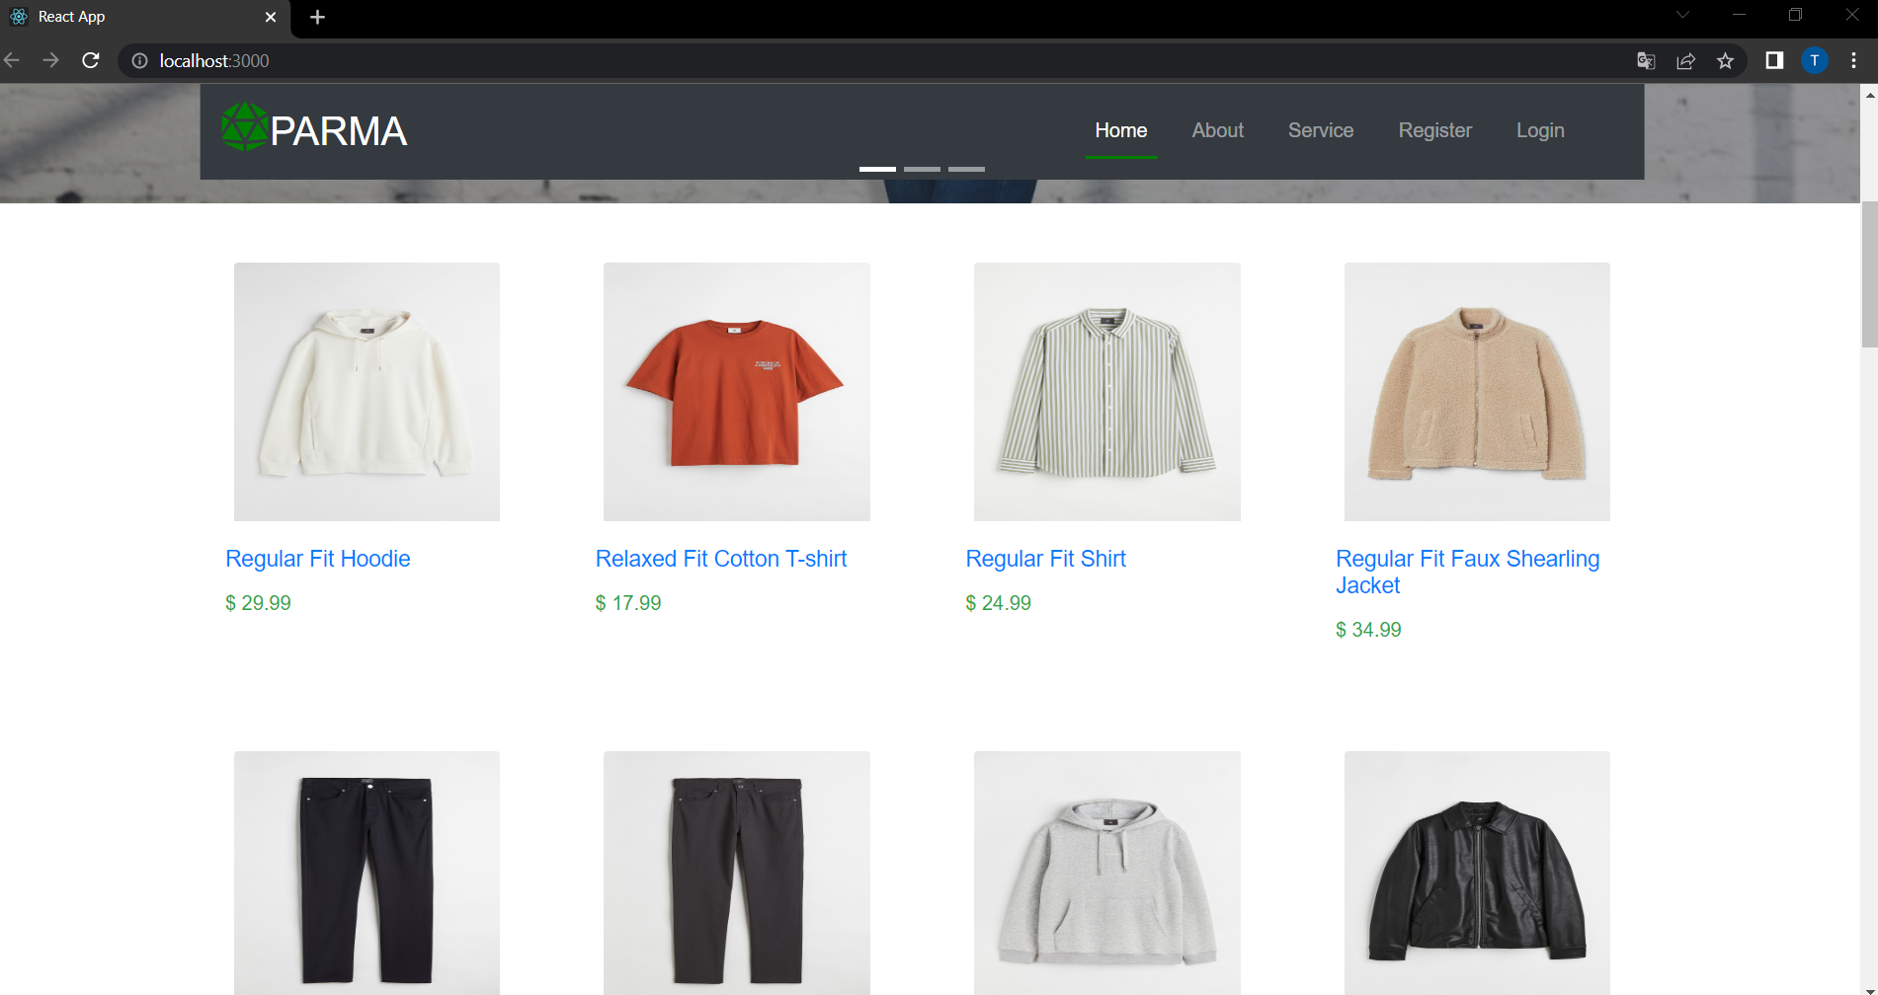

Slide 8
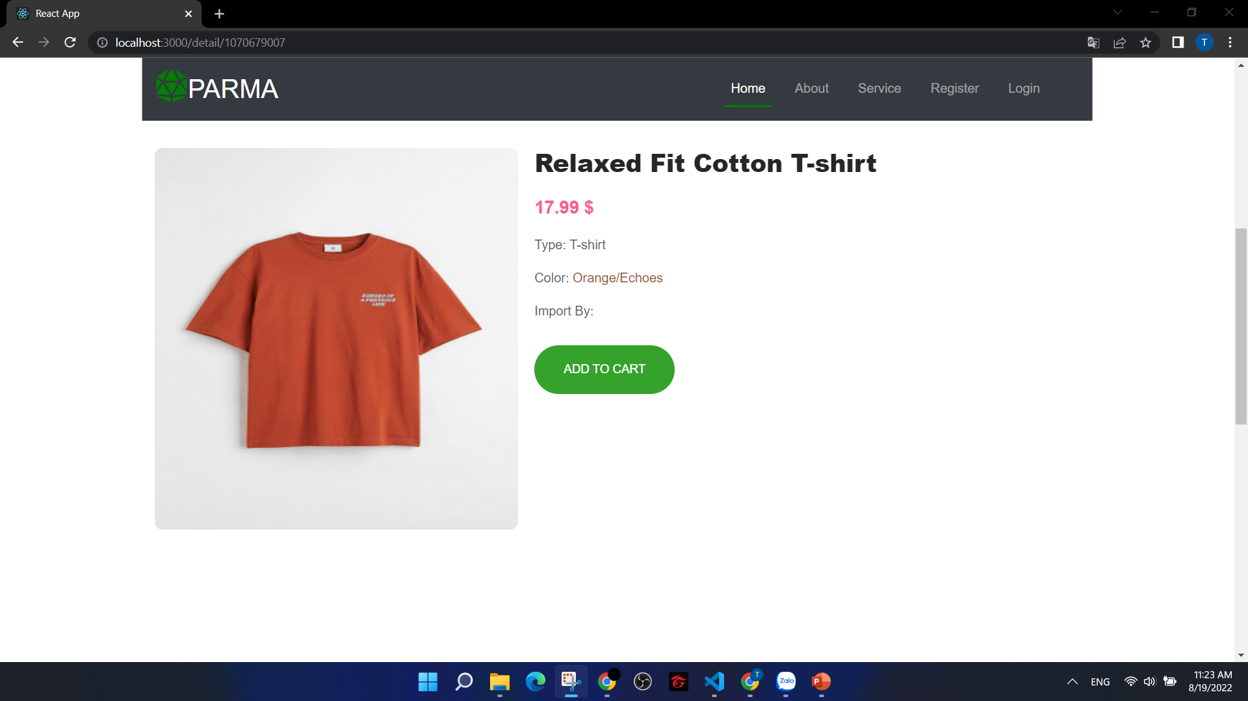
DETAILS

Slide 9
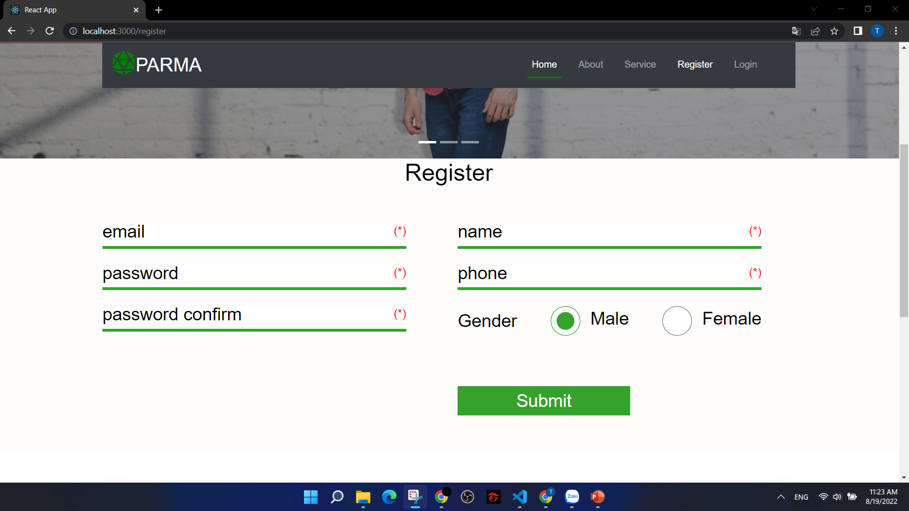
REGISTER

Slide 10
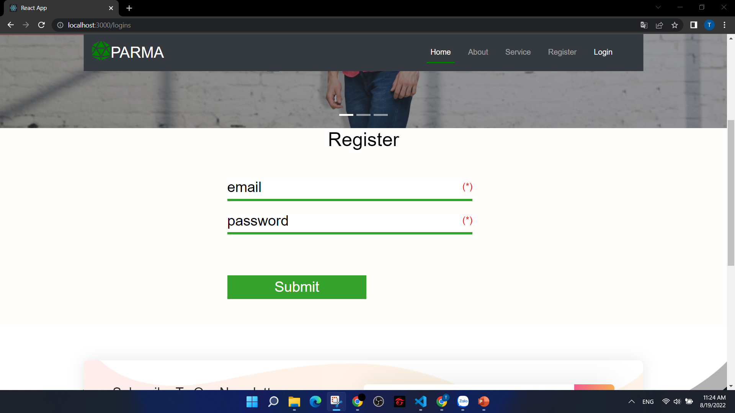
LOGIN

