Slide 1


Progressive Web App

Slide 2
Contents
What is the PWA?
The three PWA pillars
Why use PWA?
Required of a PWA
Demo create a PWA sample site

Slide 3
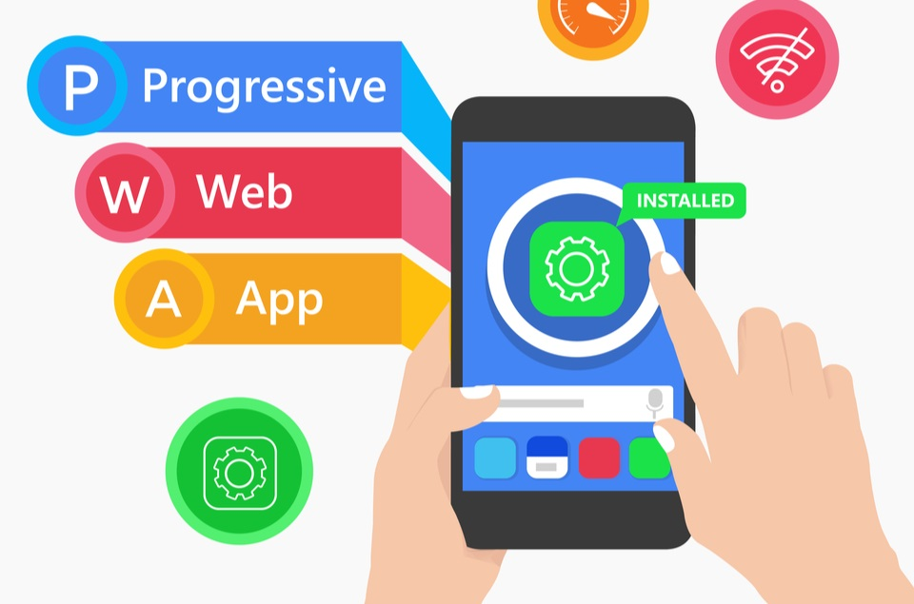
What is the PWA?
In 2015, designer Frances Berriman and Google Chrome engineer Alex Russell coined the term "progressive web apps“ to describe apps taking advantage of new features supported by modern browsers, including service workers and web app manifests.
This is an app built from the web technologies we all know and love, like HTML, CSS, and JavaScript.
Progressive Web Apps bring native app features through the web to all platforms and devices using web standards running in a secure context.

Slide 4
Browser support
Browser | Support |  |  |  |  | Comment
 | Windows | Linux | macOS | Android | iOS
Chromium-based | Yes | Yes | Yes | Yes | No | Includes Google Chrome, Microsoft Edge
Firefox | No | No | No | Partial | No
Safari | N/A | N/A | Yes | N/A | Yes (iOS 11.3+)
According to: wiki

Slide 5
The three PWA pillars
Capable
Reliable
Installable
A reliable Progressive Web App feels fast (use cached) and dependable regardless of the network(online/offline/lag network). A Website with HTTPs ensure more security.
PWAs can do most things that native apps can do, such as operate offline, access your camera and microphone if necessary, GPS, and more.
Installed Progressive Web Apps run in a standalone window instead of a browser tab. They're launchable from on the user's home screen, dock, taskbar.

Slide 6
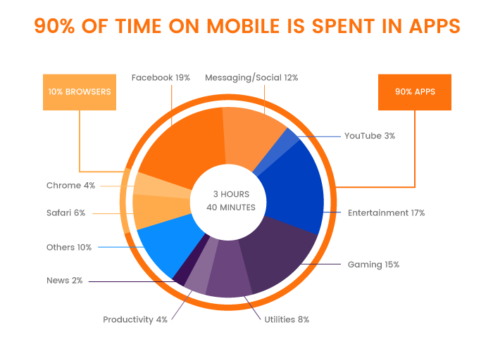
Why use PWA?
According to: comScore 2016

Slide 7
Required of a PWA
The web app manifest provides information about a web application in a JSON text file.
Web app manifests are part of a collection of web technologies called progressive web apps (PWAs).
A service worker is a script that your browser runs in the background, separate from a web page.
Things to note about a service worker:
It's a JavaScript Worker, so it can't access the DOM directly.
Service worker is a programmable network proxy.
Website with an HTTPS web address uses SSL/TLS.
SSL, more commonly called TLS, is a protocol for encrypting Internet traffic and verifying server identity
Web App Manifest
Service Worker
HTTPS certificate

Slide 8
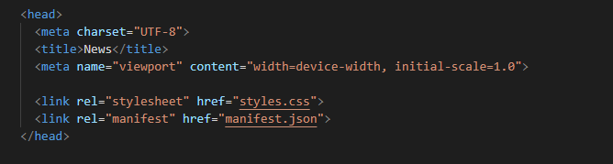
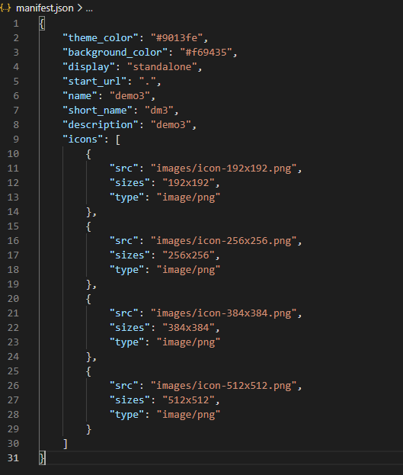
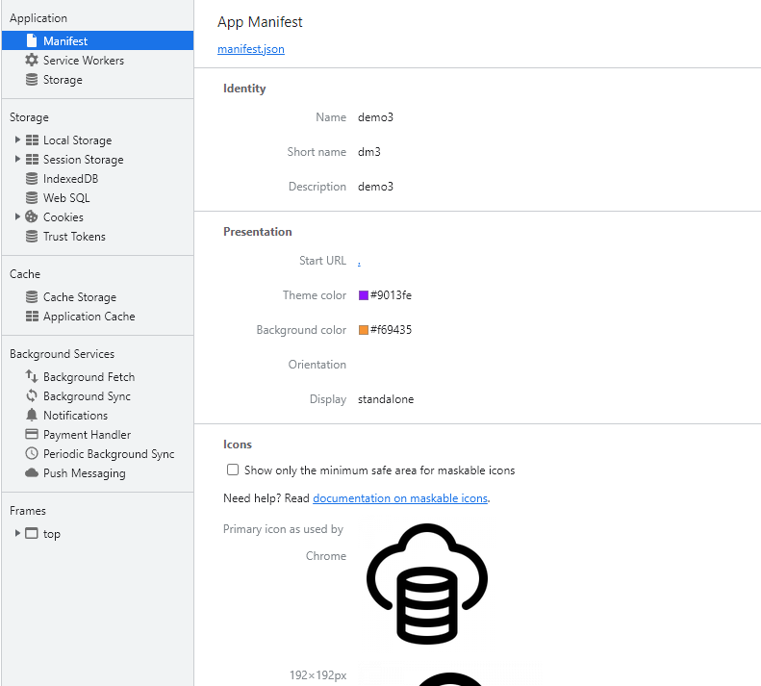
Install Web App Manifest

Slide 9
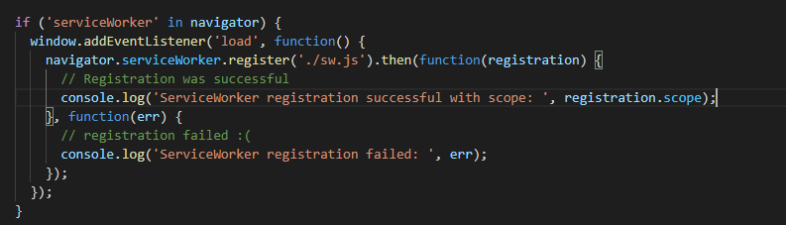
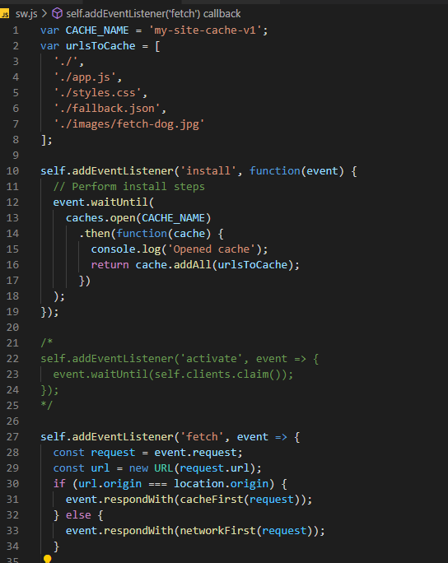
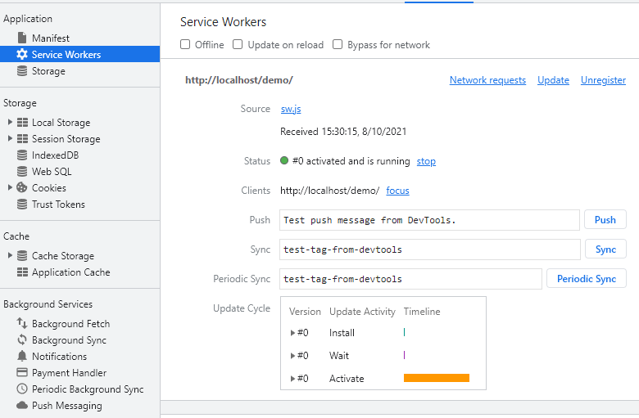
Install Service Worker

Slide 10
Service Work Lifecycle
No Service Worker
Installing
Activated
Error
Idle
Terminated
Fetch / Message / …

Slide 11
Service Worker Events
install
active
fetch
push
notificationclick

Slide 12
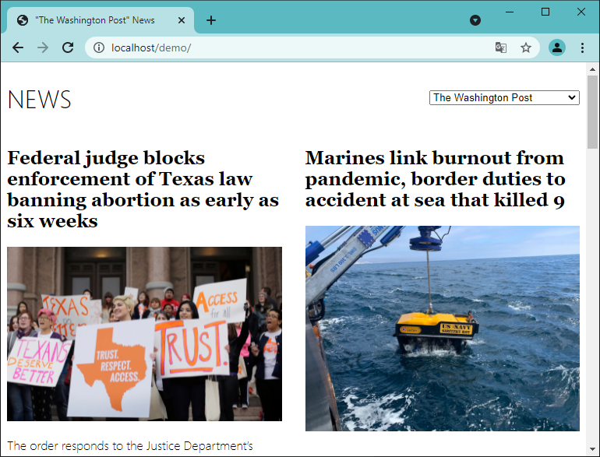
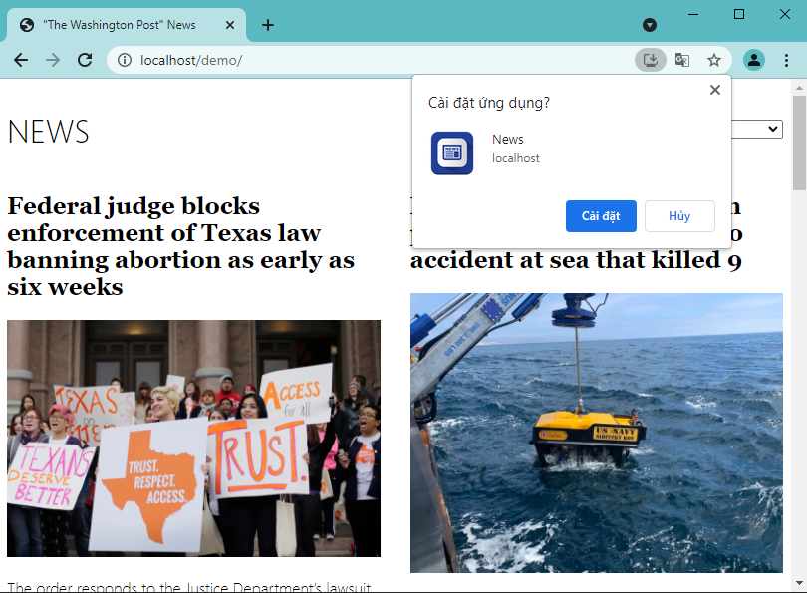
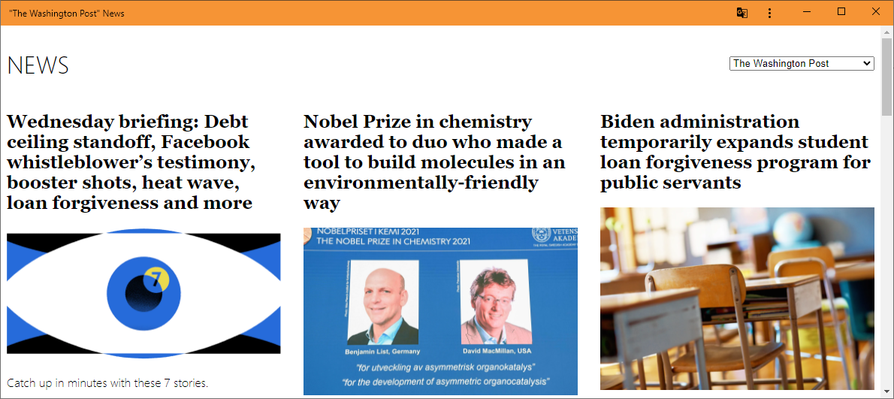

Demo a PWA sample site
Apply PWA
Install
Open by shortcut

Slide 13
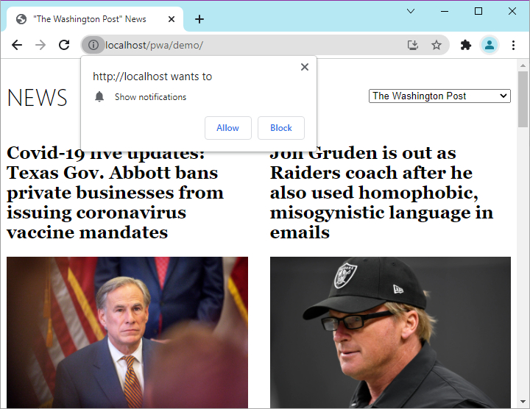

Web push notification
Receive notify although the tab was closed

Slide 14
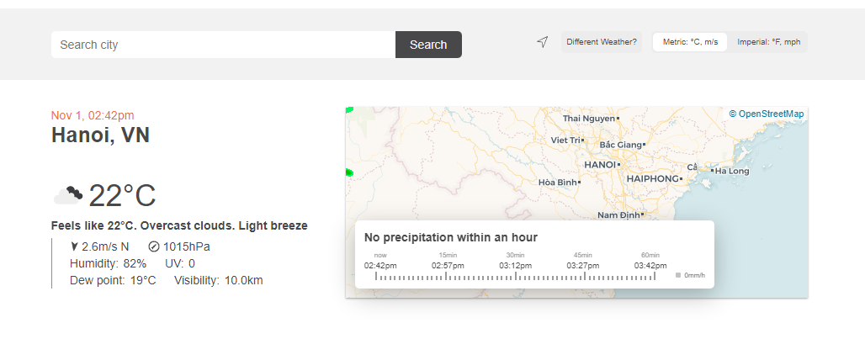
Exercise
Use api from https://openweathermap.org/current, create a weather page with search box is city name.
Display weather information base CurrentPosition.
Apply PWA:
Install (PC desktop) or Add to Home Screen(A2HS mobile).
Run offline (with the previous result).
Notification and display weather information for a new city name that is input from web-push server.

Slide 15



THANK YOU!
nvthanh@tma.com.vn
Skype:
0963219426
Email:

Slide 16
Refs
https://web.dev/what-are-pwas/
https://developers.google.com/web/fundamentals/primers/service-workers/
https://developer.mozilla.org/en-US/docs/Web/Manifest
https://developer.mozilla.org/en-US/docs/Web/API/ServiceWorkerGlobalScope
https://developers.google.com/web/fundamentals/push-notifications
https://en.wikipedia.org/wiki/Progressive_web_application
https://developer.mozilla.org/en-US/docs/Web/Progressive_web_apps/Add_to_home_screen
https://gravitec.net/blog/can-you-receive-push-notifications-when-browser-not-running/

