Slide 1
Memory Management
Why is memory management such a big deal?
Because memory management plays a huge role in allocating memory so that the program can perform at the request of the user and could be free for reuse when no longer needed.
1. The task will stop performing meaning you won’t be able to execute any of your task.
2. The task probably will not progress but continue running and running until it hits the limit and the program crashed.
3. You probably don’t want the user to use a buggy program.
What could really happen if you exhaust the memory?

Slide 2
What is Automatic Reference Counting (ARC)?
Swift uses Automatic Reference Counting (ARC) to keep tracking and managing all the objects created by the application. This signifies that it handles Memory Management itself and we do not need to take care of it.
But there are few situations where we as a developer need to provide few other information, in particularly, the relationship between objects, to avoid Memory Leaks.
Reference Counting applies only to the instances of Reference Type.

Slide 3
How does ARC work?
Each time you create a class instance through init(), ARC automatically allocates some memory to store the information.
To be more specific, that chunk of memory holds the instance, together with the values of the properties. When the instance is no longer needed, deinit()

Slide 4
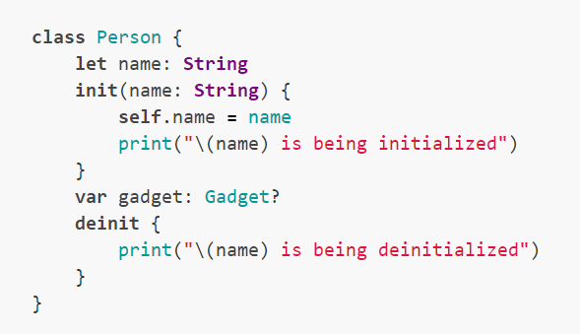
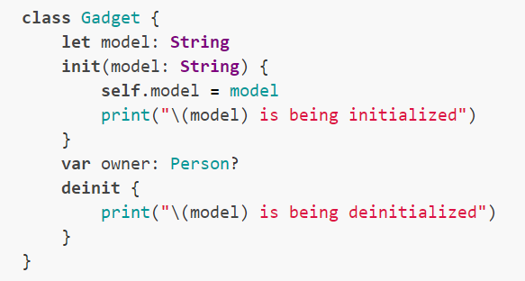

Slide 5
Strong vs Weak vs Unowned
Usually, when a property is being created, the reference is strong unless they are declared weak or unowned.
With the property labelled as weak, it will not increment the reference count
An unowned reference falls in between, they are neither strong nor or type optional. Compiler will assume that object is not deallocated as the reference itself remain allocated.

Slide 6
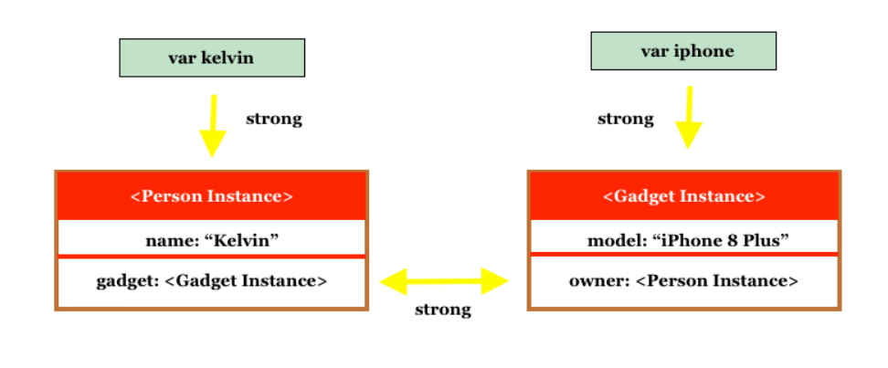
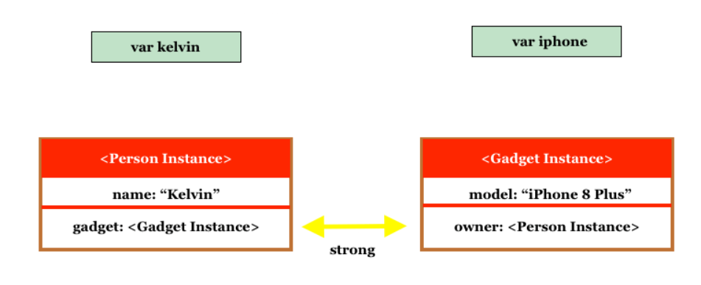
Strong reference
Kelvin = nil
Iphone = nil

Slide 7
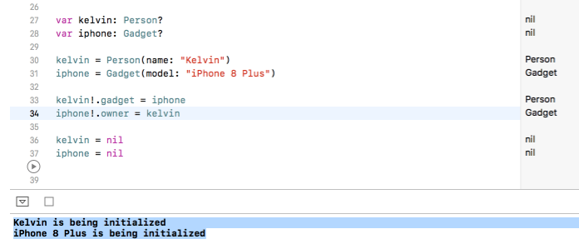
This is what call strong reference cycle, leading to memory leaks in your apps. To break the strong reference cycle and prevent memory leaks, you will need to use weak and unowned references.

Slide 8
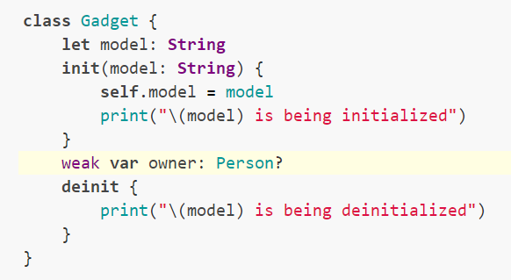
Weak reference
1. Weak reference are always declared as optional types because the value of the variable can be set to nil
2. ARC automatically sets weak reference to nil when the instance is deallocated. And because of the change of value, we know that variable will need to be used here as constants will not let you change the value.

Slide 9
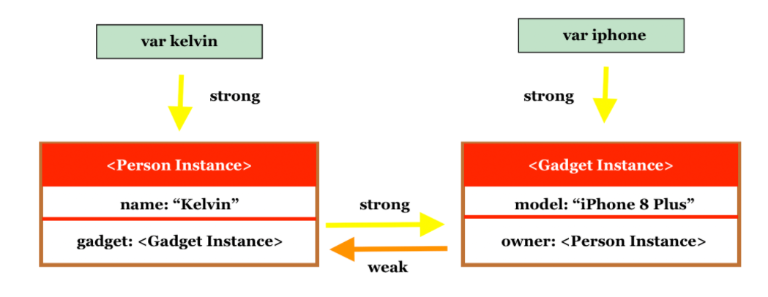
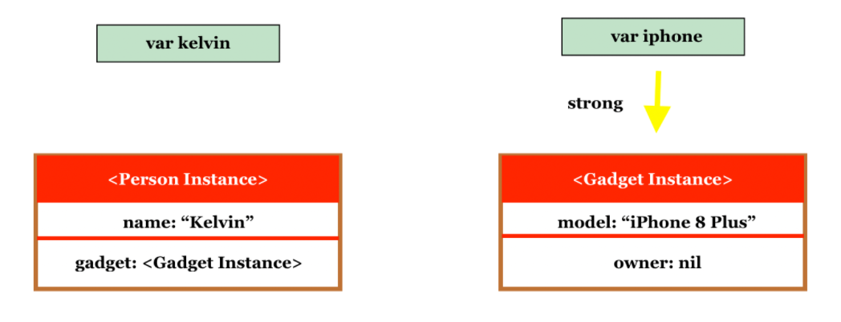
Kelvin = nil

Slide 10
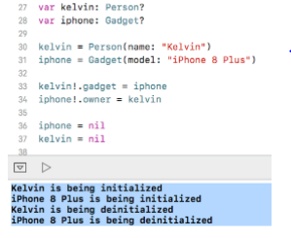

Slide 11
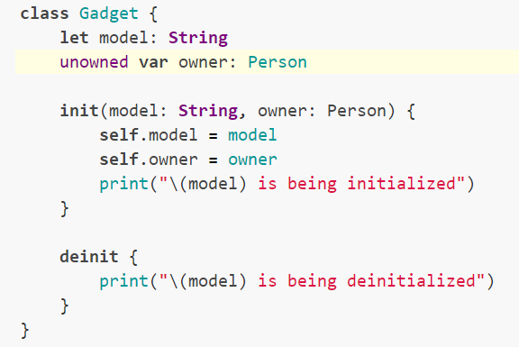
Unowned reference
An unowned reference is very similar to a weak reference that it can be used to resolve the strong reference cycle and the big difference is that an unowned reference always have a value.
ARC will not set unowned reference’s value to nil. In other words, the reference is declared as non-optional types.

Slide 12

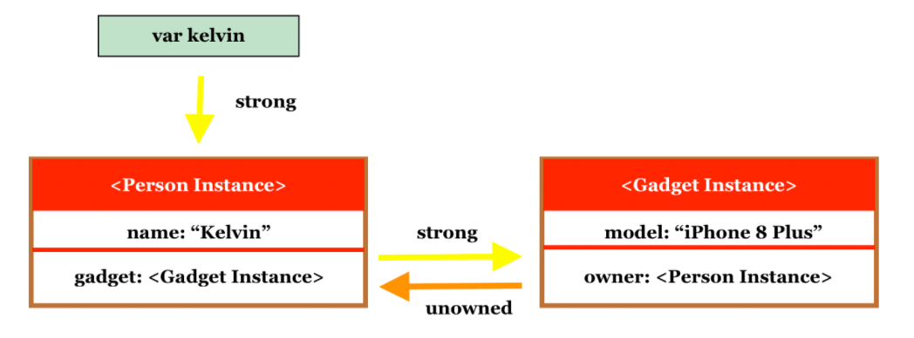

Slide 13
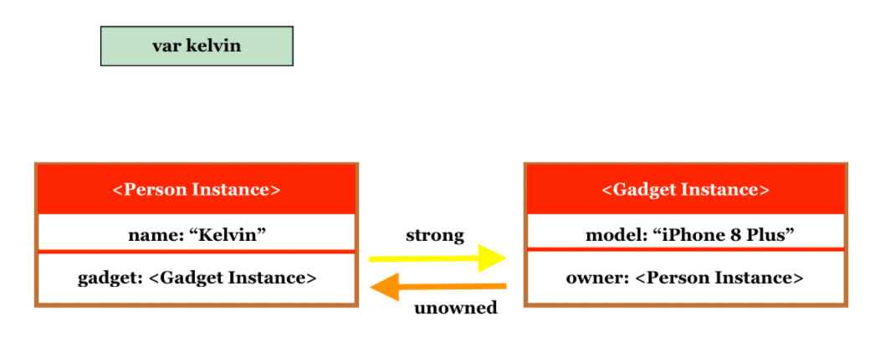


Slide 14
Structures and Classes

Slide 15
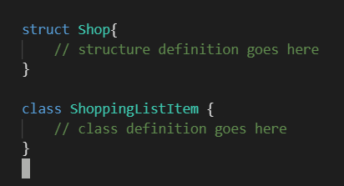
1. Definition Syntax
Structures with the “struct” keyword and Classes with the “class” keyword.

Slide 16
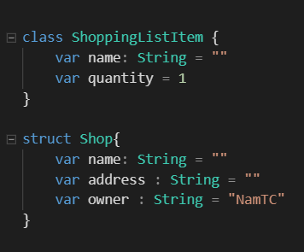
Example of a structure definition and a class definition

Slide 17

2. Structure and Class Instances

Slide 18
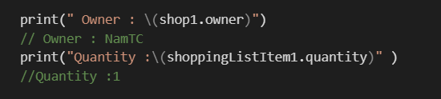
3. Accessing Properties
Access the properties of an instance using dot syntax. In dot syntax, write the property name immediately after the instance name, separated by a period (.), without any spaces

Slide 19

4. Memberwise Initializers for Structure Types and Init for Class
All structures have an automatically generated memberwise initializer, which can use to initialize the member properties of new structure instances. Initial values for the properties of the new instance can be passed to the memberwise initializer by name:

Slide 20
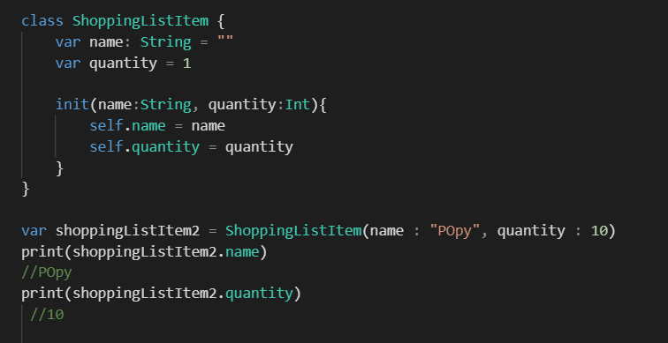
Unlike structures, class instances don’t receive a default memberwise initializer, so need to use Initializers with keyword “init”.

Slide 21
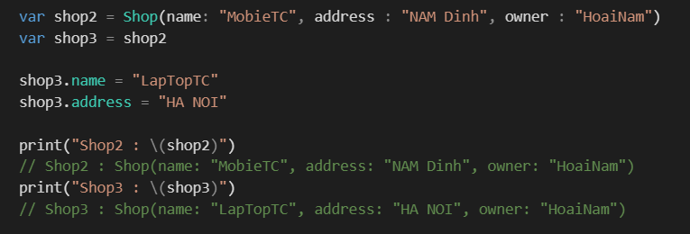
5. Structures Are Value Types, Mutating Func trong Struct
A value type is a type whose value is copied when it’s assigned to a variable or constant, or when it’s passed to a function. Changing the value of copy thereafter doesn’t affect the original value.

Slide 22
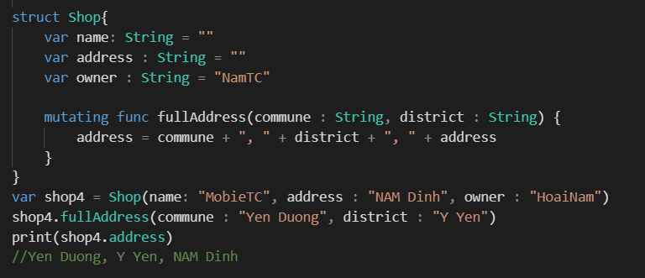
Mutating Func trong Struct
when the function has the ability to change the value variable in the struct, I will add the keyword "mutating" to that function.

Slide 23
6. Classes Are Reference Types, Inheritance, Overriding, Deinit in Class

Slide 24
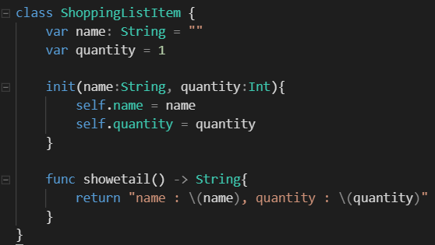
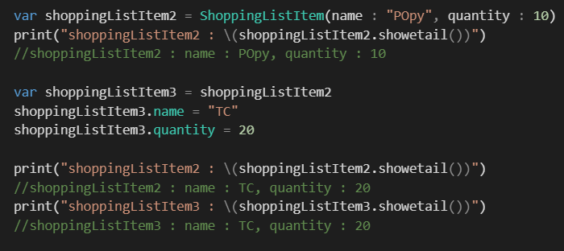
Classes Are Reference Types
Unlike value types, reference types are not copied when they’re assigned to a variable or constant, or when they’re passed to a function. Rather than a copy, a reference to the same existing instance is used.
Because classes are reference types, shoppingListItem2 and shoppingListItem3
actually both refer to the same ShoppingListItem instance. Effectively, they’re just two different names for the same single instance

Slide 25
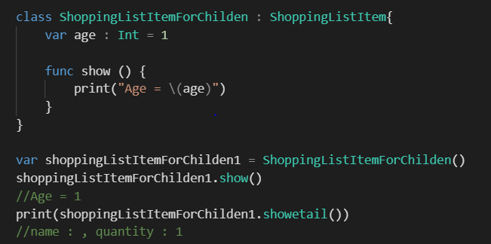
Inheritance
Class in swift is built in and allows inheritance. That means building a new class that inherits the properties and methods of another class.

Slide 26
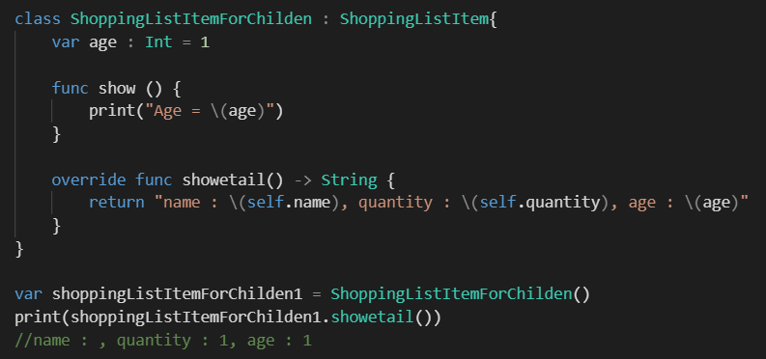
Overriding
Overriding is the process where the subclass is solely responsible for changing or reimplementing the instance methods, instance properties, and type properties defined in the superclass or superclass. To override the method on the parent class, you need to add the prefix override before the func in the method you want to override.

Slide 27
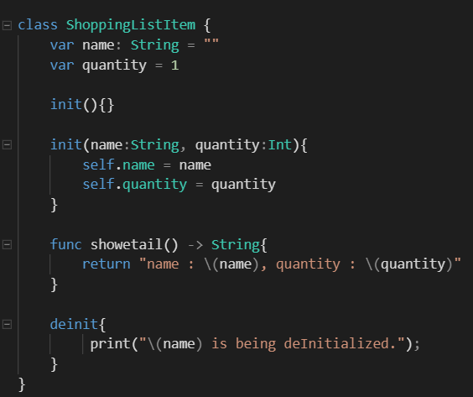
Deinit
when you work with your own resources, you need to perform some additional cleanup before deallocating the object.

Slide 28
7. Comparing Structures and Classes
 |  | Struct | Class
Init |  | Optional | Required
Inheritance |  | NO | YES
Override |  | NO | YES
Destruction function |  | NO | Deinit
Change variable | let | NO | NO
 | var | YES (mutating) | YES
 |  | Value Types | Reference Types

Slide 29
When to use Struct?
- Use Struct when creating objects with many properties of simple data types, usually of value type (like Int, Float, String, ...)
- When working multi-threaded. For example, the database connection is made on a thread parallel to the Main thread, using Struct is safer because it can copy values ​​from one thread to another.
- Struct does not need to inherit properties or behavior from any other type.
- Using Struct will ensure that no part of the code gets a reference to our objects unless we directly access them. Therefore, it is easy to manage, and it becomes simpler to control the object value when it is changed.

Slide 30


