Slide 1
Convolution Neural Network
Thanh Pham Trung
Aug 18
This material is based on Coursera Deep Learning Specialization and Stanford CS231n Course

Slide 2
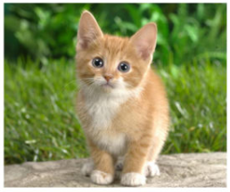
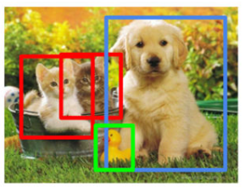
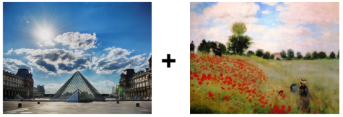
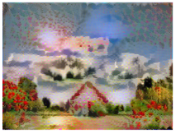
Computer vision
Computer vision problem
Image Classification
Object detection
Neural Style Transfer
Cat? (0/1)
Object (What, Where)

Slide 3
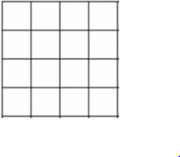
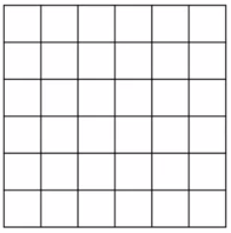
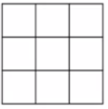
Padding
Valid and same convolution
Valid convolution (No padding)
4x4
*
3x3
Same convolution (Padding = 1)
6x6
Output size = (n+2p-f+1, n+2p-f+1)
6x6

Slide 4
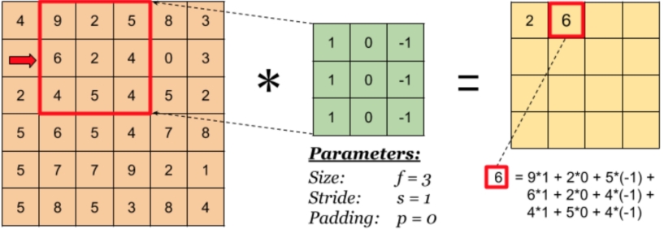
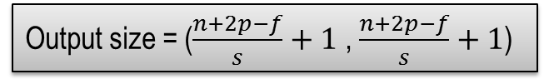
Stride
Input
Filter
Output
6x6
3x3
4x4
Output size = ($\frac{n+2p−f}{s}+1$ , $\frac{n+2p−f}{s}+1$)
http://www.dames.org.uk/courses/msc/projects/PastProjects/exemplars/abbas.pdf

Slide 5
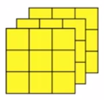
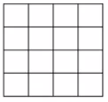
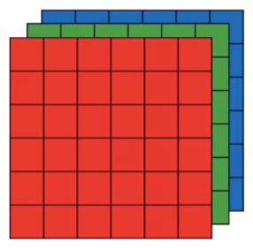
Convolution over volumes
Convolution on RGB image
Filter 1
*
3x3x3
4x4
Filter 2
*
4x4x2
6x6x3
3x3x3
4x4

Slide 6
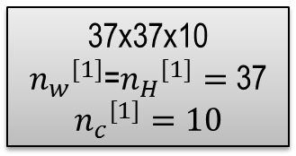

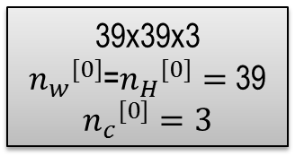


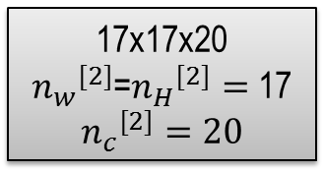
A simple convolution network
$$f^{[1]}=3$$
$$s^{[1]}=1$$
$$p^{[1]}=0$$
10 filter
?
$$f^{[3]}=5$$
$$s^{[3]}=2$$
$$p^{[3]}=0$$
40 filter
$$f^{[2]}=5$$
$$s^{[2]}=2$$
$$p^{[2]}=0$$
20 filter
39x39x3
${n_{w}}^{[0]}$=${n_{H}}^{[0]}=$ 39
$${n_{c}}^{[0]}=3$$
37x37x10
${n_{w}}^{[1]}$=${n_{H}}^{[1]}=$ 37
$${n_{c}}^{[1]}=10$$
17x17x20
${n_{w}}^{[2]}$=${n_{H}}^{[2]}=$ 17
$${n_{c}}^{[2]}=20$$
7x7x40

Slide 7
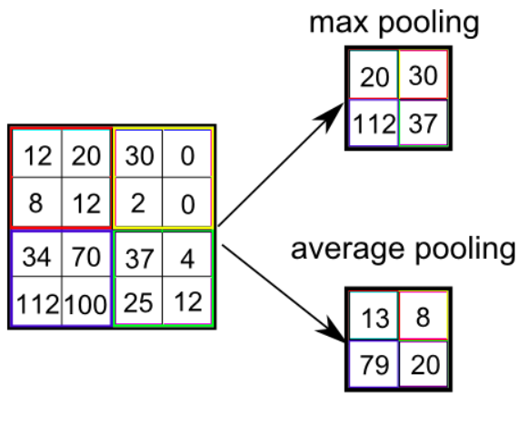
Pooling layer
Max pooling and Average pooling
Pooling ≠ Convolution: No use parameter

Slide 8



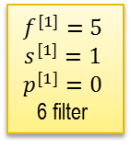

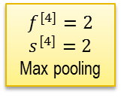

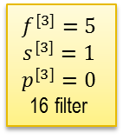

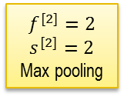

Convolution neural network sample
Input layer
CONV1
POOL1
CONV2
POOL2
$$f^{[1]}=5$$
$$s^{[1]}=1$$
$$p^{[1]}=0$$
6 filter
$$f^{[3]}=5$$
$$s^{[3]}=1$$
$$p^{[3]}=0$$
16 filter
$$f^{[4]}=2$$
$$s^{[4]}=2$$
Max pooling
9
$$f^{[2]}=2$$
$$s^{[2]}=2$$
Max pooling
32x32x3
28x28x6
14x14x6
10x10x16
5x5x16
Hidden Layer 1
Hidden Layer 2
FC3
FC4
Output layer
Softmax function
$$\hat{y}$$
$$n_{x}=400$$
unit$=200$
unit$=84$
$$unit=class=10$$

Slide 9
Why convolution?
Parameter sharing
A feature detector that’s useful in one part of image is probably useful in another part of the image.
Sparsity of connections

Slide 10
Thank you for watching

