Slide 1
DLSG Week 3: Shallow neural networks
Thanh Pham Trung
July 2019
This material is based on Coursera Deep Learning Specialization and Stanford CS231n Course

Slide 2












Neural network overview
Overview
Neural Neural Network
$x_{1}$
$x_{1}$
$x_{2}$
$$\hat{y}$$
$$\hat{y}$$
$x_{2}$
$x_{3}$
$x_{3}$
$x$
$$ω$$
z =$ω^{T}x+b$
$\hat{y}$=$σ\left(ω^{T}x+b\right)$
Input Layer
Hidden Layer
Output Layer
$$b$$

Slide 3
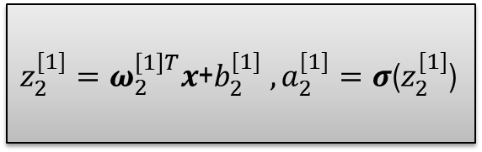

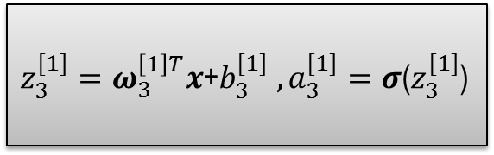




Compute neural network output
Compute output
$z_{1}^{[1]}=ω_{1}^{\left[1\right]T}x$+$b_{1}^{[1]} ,a_{1}^{[1]}=σ$($z_{1}^{[1]}$)
$x_{1}$
$$\hat{y}$$
$z_{2}^{[1]}=ω_{2}^{\left[1\right]T}x$+$b_{2}^{[1]} ,a_{2}^{[1]}=σ$($z_{2}^{[1]}$)
$x_{2}$
$x_{3}$
$z_{3}^{[1]}=ω_{3}^{\left[1\right]T}x$+$b_{3}^{[1]} ,a_{3}^{[1]}=σ$($z_{3}^{[1]}$)

Slide 4










Compute neural network output
Matrix form
$\left[\begin{matrix}z_{1}^{[1]} \\ z_{2}^{[1]} \\ z_{3}^{[1]}\end{matrix}\right]$=$\left[\begin{matrix}ω_{1}^{\left[1\right]T} \\ ω_{2}^{\left[1\right]T} \\ ω_{3}^{\left[1\right]T}\end{matrix}\right]\left[\begin{matrix}x_{1} \\ x_{2} \\ x_{3} \end{matrix}\right]$+$\left[\begin{matrix}b_{1}^{[1]} \\ b_{2}^{[1]} \\ b_{3}^{[1]}\end{matrix}\right]$
Layer 1
(Hidden layer)
$z^{[1]}=w^{[1]}$ $x$+$b^{[1]}$
$a^{[1]}=$ $σ$($z^{[1]}$)
$$z^{[1]}$$
$$w^{[1]}$$
$$b^{[1]}$$
$z^{[2]}=ω^{\left[2\right]T}\left[\begin{matrix}a_{1}^{[1]} \\ a_{2}^{[1]} \\ a_{3}^{[1]}\end{matrix}\right]$+$b^{[2]}$
Layer 2
(Output layer)
$z^{[2]}=w^{[2]}a^{[1]}$+$b^{[2]}$
$a^{[2]}=$ $σ$($z^{[2]}$)
$$a^{[1]}$$

Slide 5


















Vectorization
Training pairs
$$\left\{\left(x^{(1)},y^{(1)}\right), …,\left(x^{(m)},y^{(m)}\right)\right\}$$
$$X =\left[\begin{aligned} \\ \\ \\ \\ \end{aligned}\right]$$
$$x^{(1)}$$
$$x^{(2)}$$
$$⋯$$
$$x^{(m)}$$
$$x^{(1)}$$
$$a^{[1](1)}$$
$${\hat{y}}^{(1)}{=a}^{[2](1)}$$
$$A^{\left[1\right]}=\left[\begin{aligned} \\ \\ \\ \\ \end{aligned} \right]$$
$$a_{1}^{[1]}$$
$$a^{\left[1\right](1)}$$
$$a^{\left[1\right](2)}$$
$$a^{\left[1\right](m)}$$
$$⋯$$
$x_{1}$
$$\hat{y}$$
$x_{2}$
$$a_{2}^{[1]}$$
$$a^{[2]}$$
$Z^{[1]}=W^{[1]}$ $X$+$b^{[1]}$
$x_{3}$
$A^{[1]}=$ $σ$($Z^{[1]}$)
$$a_{3}^{[1]}$$
$Z^{[2]}=W^{[1]}A^{[1]}$+$b^{[2]}$
$A^{[2]}=$ $σ$($Z^{[2]}$)

Slide 6


Activation Function
Activation function
Linear activation function
(y = ax+b)
Non-linear activation function
(Sigmoid, Tanh, ReLu,…)
Function | Advantages | Disadvantages
Linear | Suitable with linear regression, data is linear | All neural of network is linear active function -> network become linear model
Sigmoid,Tanh | Compute derivative easy | Input is big value -> slop of gradient ≈ const -> parameter not update ->Training time slow
ReLu, Leaky ReLu | Compute derivative easy and fast | Derivative ≈0 -> parameter not update

Slide 7


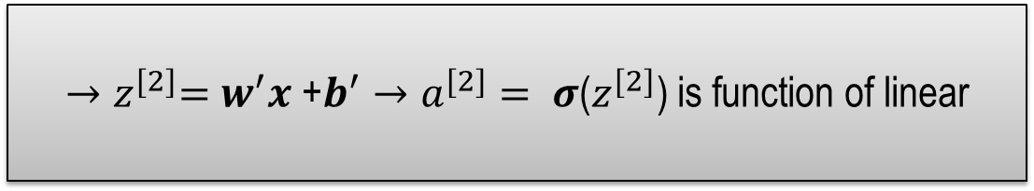

Activation Function(2)
Explain about linear function
If activation function is linear: $z^{[1]}=w^{[1]}$ $x$+$b^{[1]}→a^{[1]}= σ\text{(}z^{[1]}\text{)}\text{ = }z^{[1]}$
Layer output: $z^{[2]}=w^{[2]}a^{[1]}$+$b^{[2]}→z^{[2]}=w^{[2]}(w^{[1]} x \text{+}b^{[1]})\text{+}b^{[2]}$
$→z^{[2]}=w^{[2]}w^{[1]} x \text{+} w^{[2]}b^{[1]}\text{+}b^{[2]}$
$$w^{′}$$
$$b^{′}$$
$${→z}^{[2]}=w^{′}x \text{+}b^{′}→a^{[2]}= σ\text{(}z^{[2]}\text{)} \text{is} \text{function} \text{of} \text{linear}$$

Slide 8
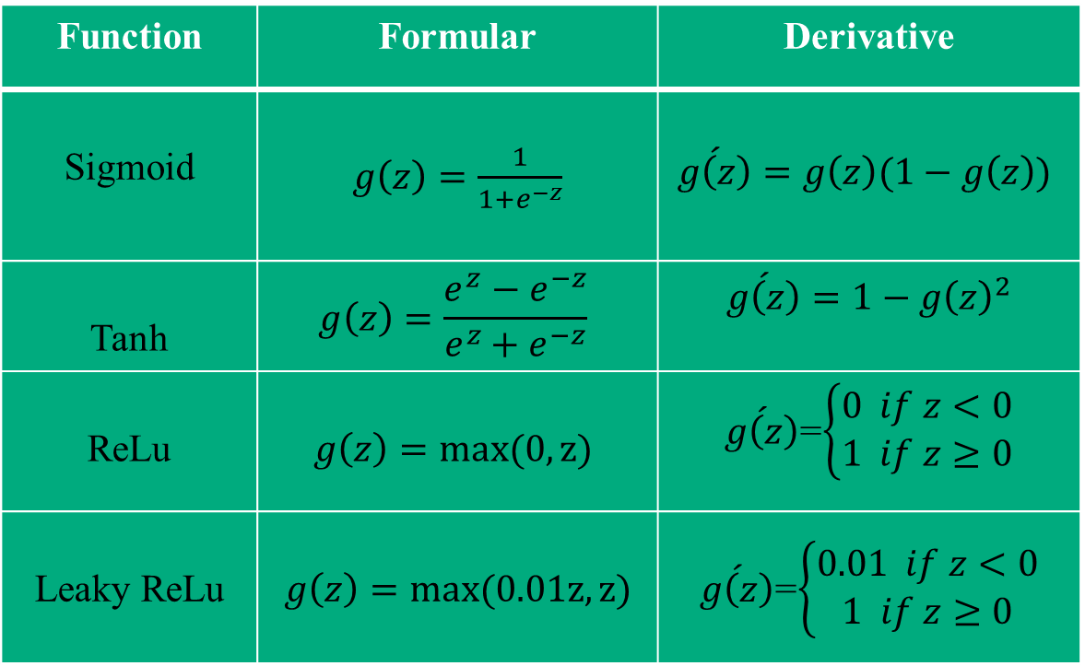
Derivative Activation Function
Function | Formular | Derivative
Sigmoid | $g\left(z\right)=\frac{1}{1+e^{−z}}$ | $$\acute{g\left(z\right)}=g\left(z\right)(1−g\left(z\right))$$
Tanh | $$g\left(z\right)=\frac{e^{z}−e^{−z}}{e^{z}+e^{−z}}$$ | $$\acute{g\left(z\right)}=1−{g\left(z\right)}^{2}$$
ReLu | $$g\left(z\right)=max(0,z)$$ | $\acute{g\left(z\right)}$=$\left\{\begin{aligned}0 if z<0 \\ 1 if z≥0\end{aligned}\right.$
Leaky ReLu | $$g\left(z\right)=max(0.01z,z)$$ | $\acute{g\left(z\right)}$=$\left\{\begin{aligned}0.01 if z<0 \\ 1 if z≥0\end{aligned}\right.$

Slide 9
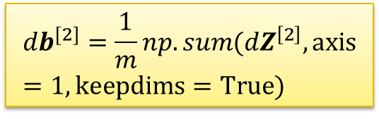




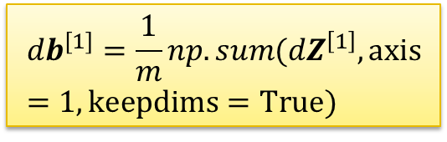



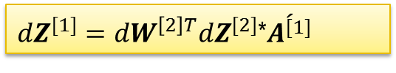
Gradient descent for NN
Forward propagation step
Backward propagation step
$${dZ}^{[2]}=A^{[2]}−Y$$
${dW}^{[2]}=$ $\frac{1}{m}{dZ}^{[2]}A^{\left[1\right]T}$
$Z^{[1]}=W^{[1]}$ $X$+$b^{[1]}$
$${db}^{[2]}=\frac{1}{m}np.sum({dZ}^{\left[2\right]},axis=1,keepdims=True)$$
$A^{[1]}=$ $σ$($Z^{[1]}$)
$Z^{[2]}=W^{[1]}A^{[1]}$+$b^{[2]}$
${dZ}^{[1]}={dW}^{\left[2\right]T}{dZ}^{[2]}$*$\acute{A^{[1]}}$
$A^{[2]}=$ $σ$($Z^{[2]}$)
${dW}^{[1]}=$ $\frac{1}{m}{dZ}^{[1]}X^{T}$
$${db}^{[1]}=\frac{1}{m}np.sum({dZ}^{\left[1\right]},axis=1,keepdims=True)$$

Slide 10
Thank you for watching

