Slide 1
BOOST LIBRARY
GROUP 7’S PRESENTATION

Slide 2
boost::Utility
a conglomeration of miscellaneous, useful classes and functions.

Slide 3
BOOST_CURRENT_FUNCTION
Uses the macro BOOST_CURRENT_FUNCTION, defined in boost/current_function.hpp, to return the name of the surrounding function as a string.

Slide 4
BOOST_CURRENT_FUNCTION
BOOST_CURRENT_FUNCTION provides a platform-independent way to retrieve the name of a function. Starting with C++11, you can do the same thing with the standardized macro __func__. Before C++11, compilers like Visual C++ and GCC supported the macro __FUNCTION__ as an extension. BOOST_CURRENT_FUNCTION uses whatever macro is supported by the compiler.

Slide 5
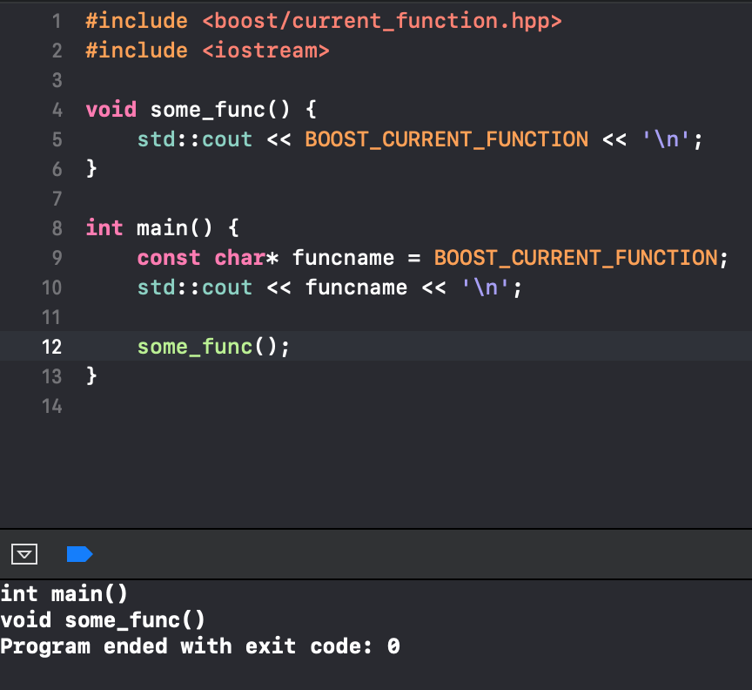
BOOST_CURRENT_FUNCTION

Slide 6
Next / prior
boost::prior() and boost::next() return an iterator relative to another iterator.

Slide 7
Next / prior
In addition to the iterator, both functions accept a second parameter that indicates the number of steps to move forward or backward.

Slide 8
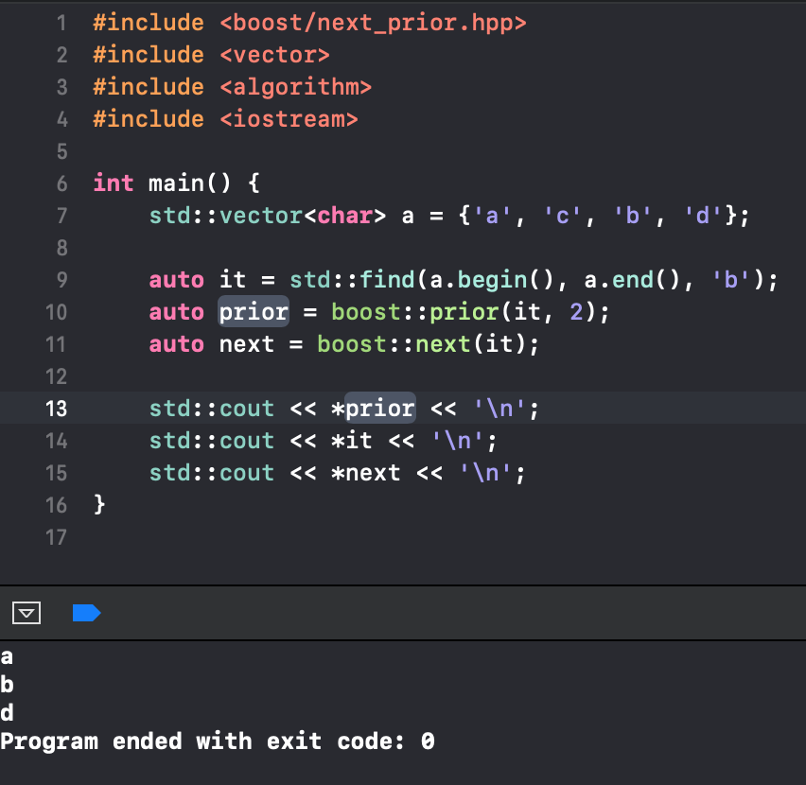
Next / prior

Slide 9
Next / prior
Both functions were added to the standard library in C++11, where they are called std::prev() and std::next(). They are defined in the header file iterator.

Slide 10
Noncopyable
Boost.Utility provides the class boost::noncopyable, which is defined in boost/noncopyable.hpp. This class makes it impossible to copy (and move) objects.

Slide 11
Noncopyable
The same effect can be achieved by defining the copy constructor and assignment operator as private member functions or – since C++11 – by removing the copy constructor and assignment operator with delete.

Slide 12
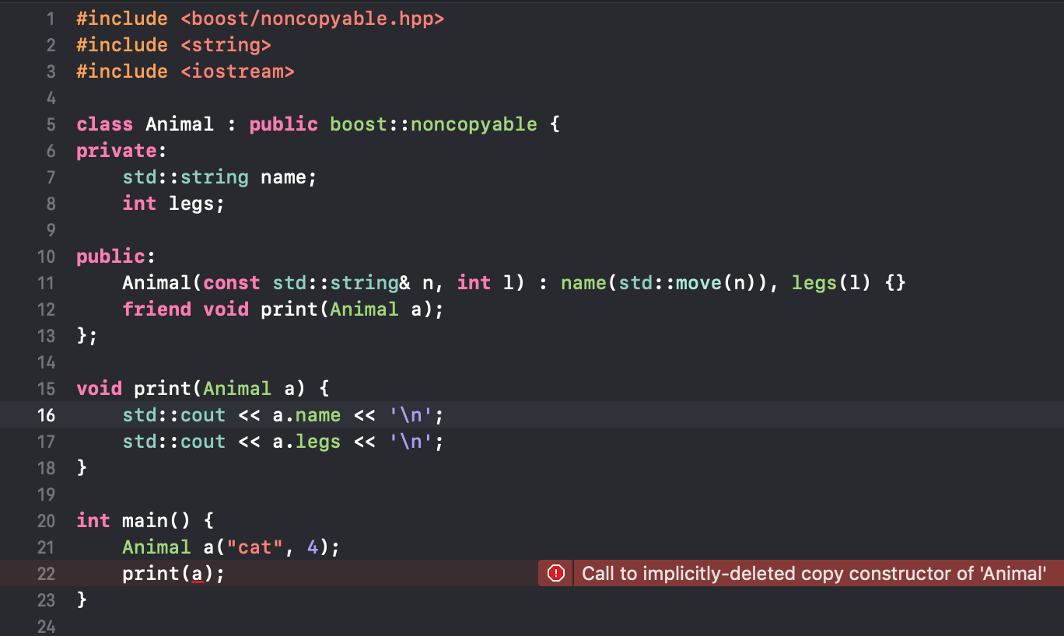
Noncopyable

Slide 13
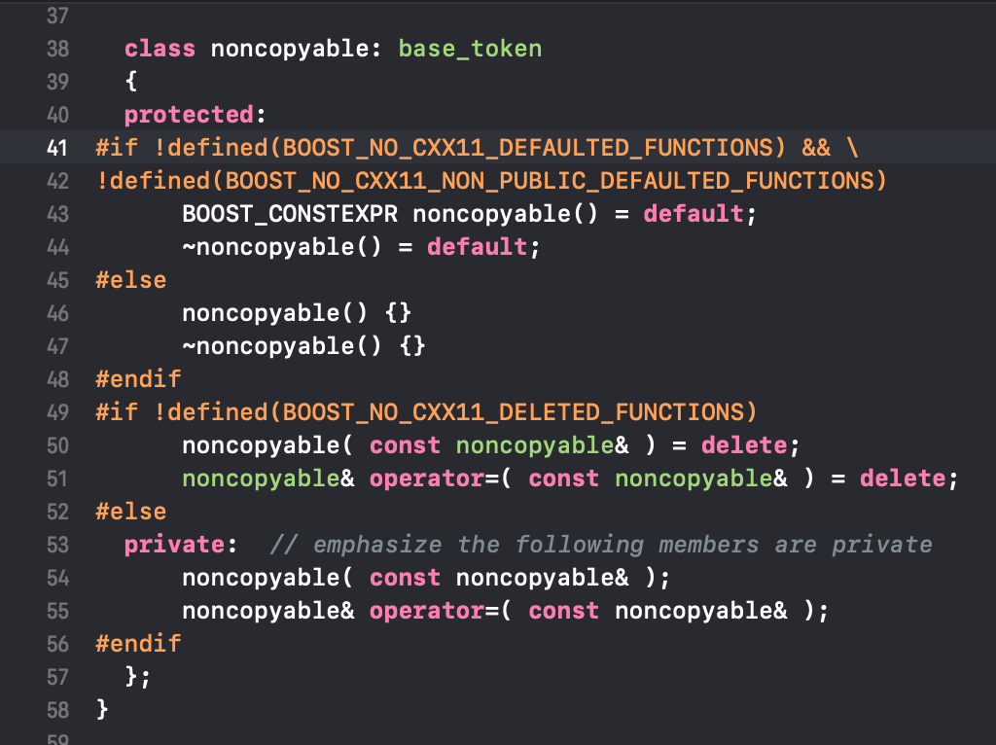
Noncopyable

Slide 14
Addressof
To retrieve the address of a particular object, even if operator& has been overloaded, Boost.Utility provides the function boost::addressof(), which is defined in boost/utility/addressof.hpp.

Slide 15
Addressof
With C++11, this function became part of the standard library and is available as std::addressof() in the header file memory.

Slide 16
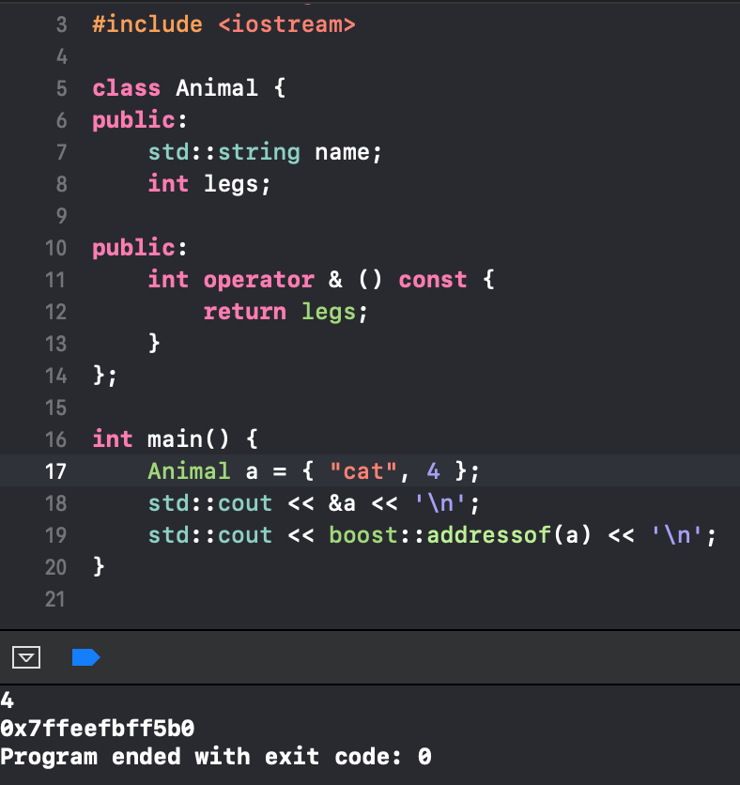
Addressof

Slide 17
binary
The macro BOOST_BINARY lets you create numbers in binary form. Standard C++ only supports hexadecimal and octal forms, using the prefixes 0x and 0.

Slide 18
binary
BOOST_BINARY simply offers another option to write numbers. Because, in C++, the default type for numbers is int, BOOST_BINARY also uses int.

Slide 19
binary
To define a number of type long, use the macro BOOST_BINARY_L, which generates the equivalent of a number suffixed with the letter L.

Slide 20
binary
Boost.Utility includes additional macros such as BOOST_BINARY_U, which initializes a variable without a sign bit. All of these macros are defined in the header file boost/utility/binary.hpp.

Slide 21
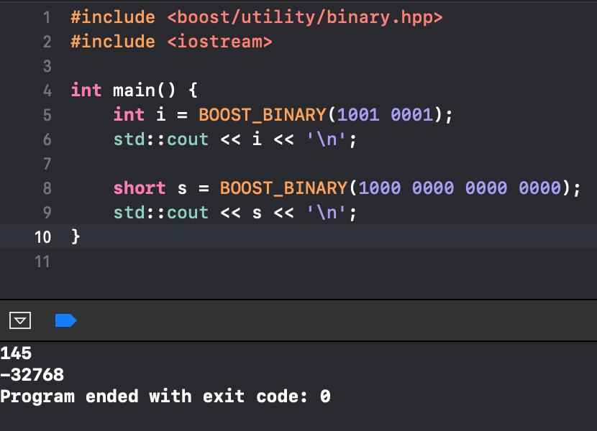
binary

Slide 22
boost::tokenizer
iterate over partial expressions in a string by interpreting certain characters as separators.

Slide 23
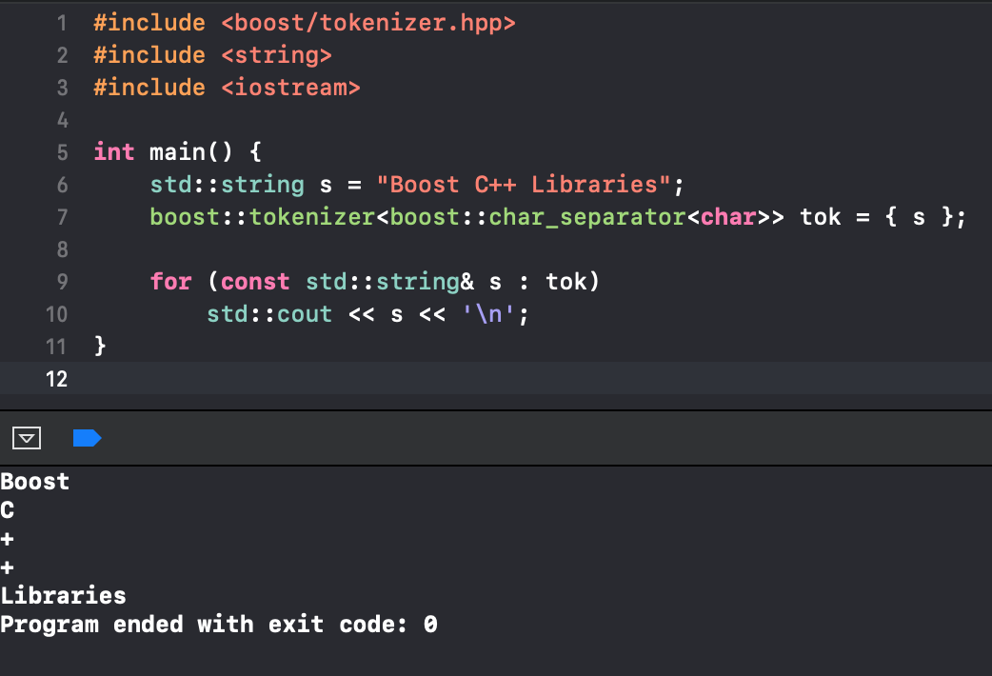
Boost.Tokenizer is a class template called boost::tokenizer in boost/tokenizer.hpp. It expects as a template parameter a class that identifies coherent expressions.

Slide 24
boost::char_separator
To keep punctuation marks from being interpreted as separators, initialize the boost::char_separator object before passing it to the tokenizer.

Slide 25
boost::char_separator
The constructor of boost::char_separator accepts a total of three parameters, but only the first one is required. The first parameter describes the individual separators that are suppressed.

Slide 26
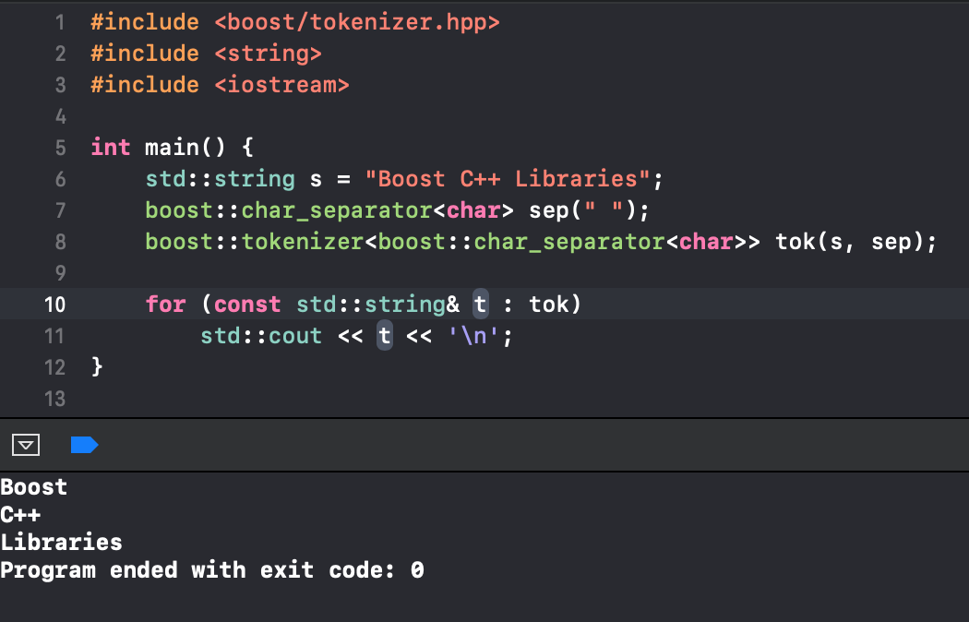
boost::char_separator

Slide 27
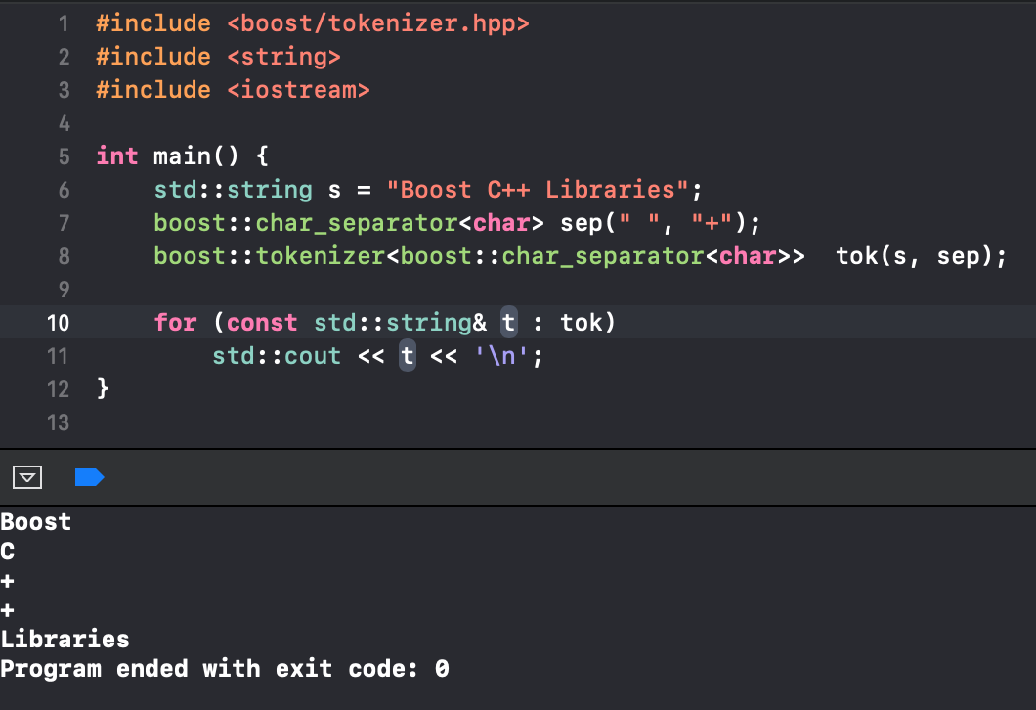
boost::char_separator

Slide 28
boost::char_separator
The third parameter determines whether or not empty partial expressions are displayed. If two separators are found back-to-back, the corresponding partial expression is empty. By default, these empty expressions are not displayed.

Slide 29
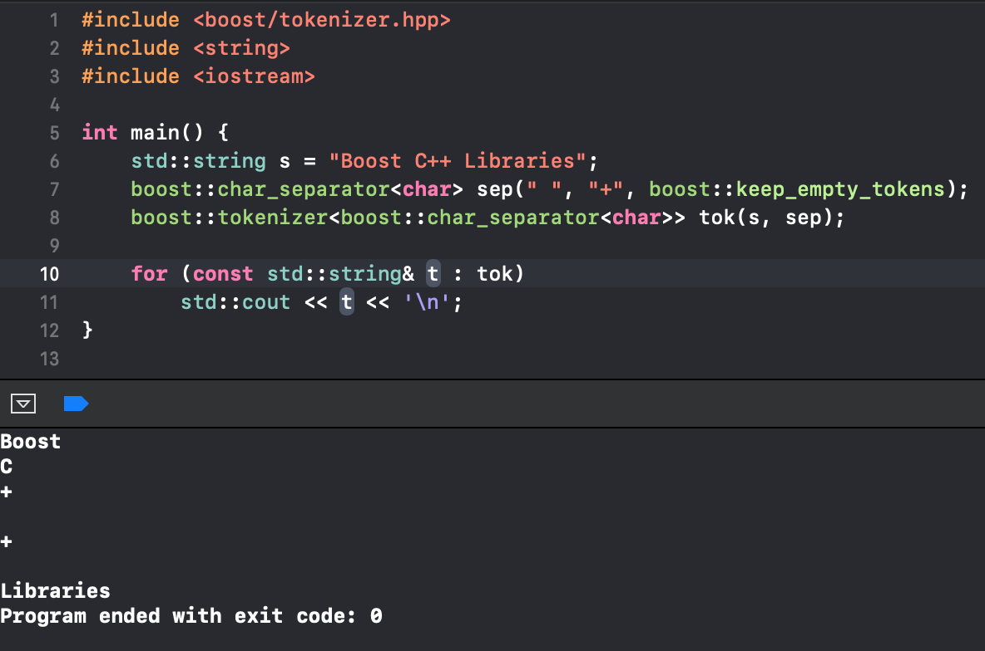
boost::char_separator

Slide 30
boost::escaped_list_separator
boost::escaped_list_separator is used to read multiple values separated by commas. This format is commonly known as CSV (Comma Separated Values).
boost::escaped_list_separator also handles double quotes and escape sequences.

Slide 31
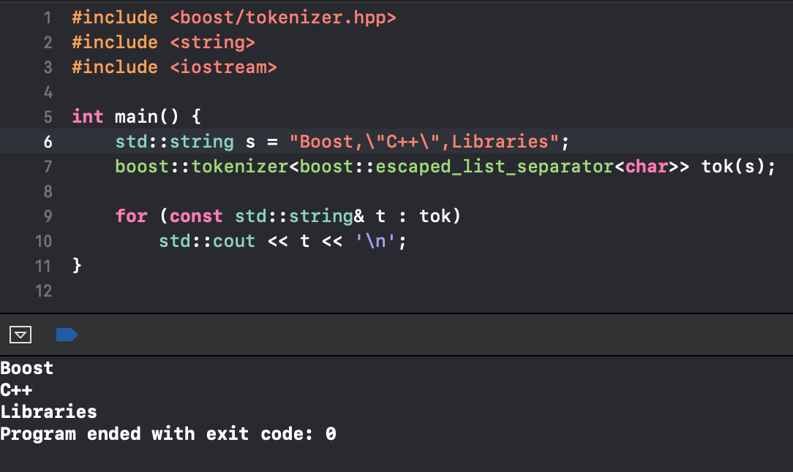
boost::escaped_list_separator

Slide 32
boost::offset_separator
boost::offset_separator specifies the locations within the string where individual partial expressions end.

Slide 33
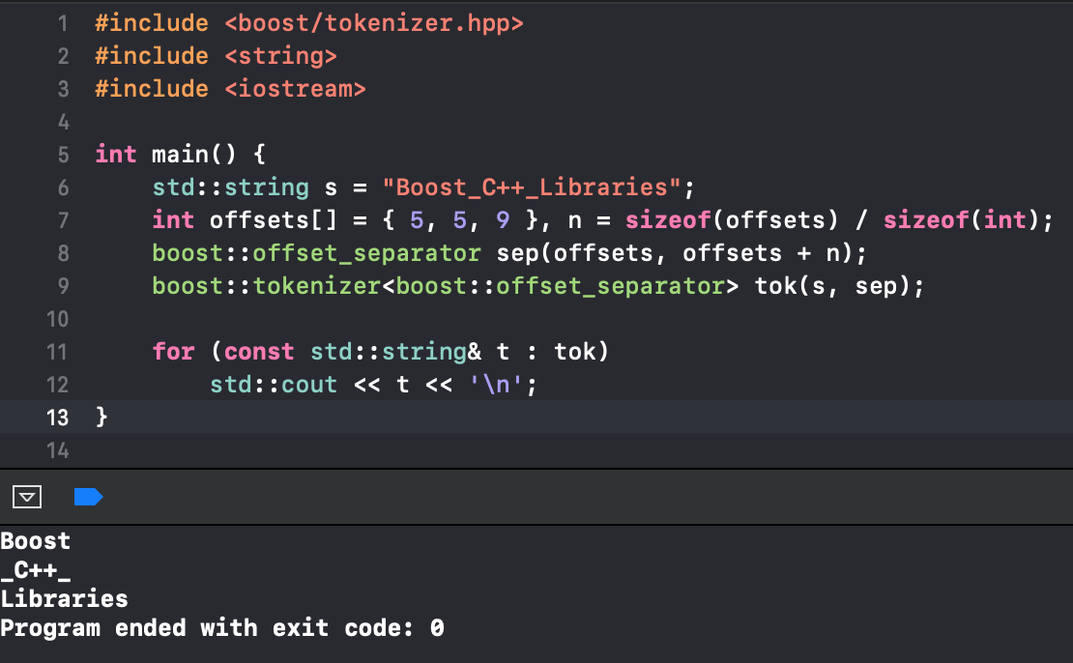
boost::offset_separator

Slide 34
boost::lambda
implements a form of lambda abstractions for C++, defines an unnamed function.

Slide 35
• Lambda is a function object. Lambda can be used instead of std::function. Lambda in C ++ can capture local variables. The return value of lambda can be deduced type (meaning the keyword auto is used).

Slide 36
[ capture-list ] ( params ) mutable ( optional ) exception attribute -> return-type { body } (1)
[ capture-list ] ( params ) -> return-type { body } (2)
[ capture-list ] ( params ) { body } (3)
[ capture-list ] { body } (4)

Slide 37
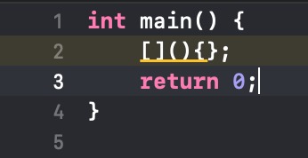
simple lambda

Slide 38
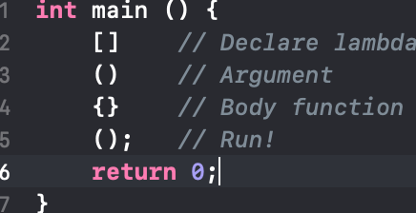
The meaning of each parenthesis

Slide 39
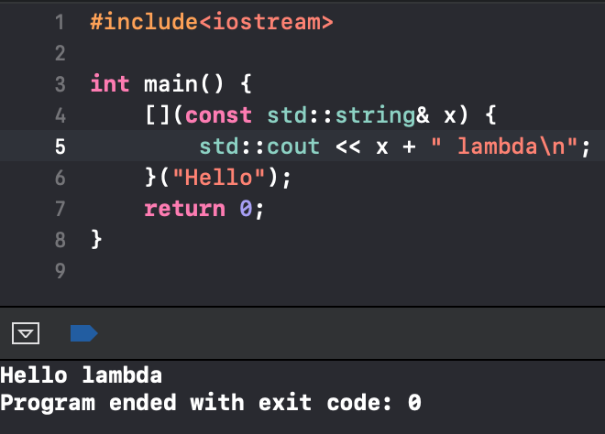
Transmission of arguments

Slide 40
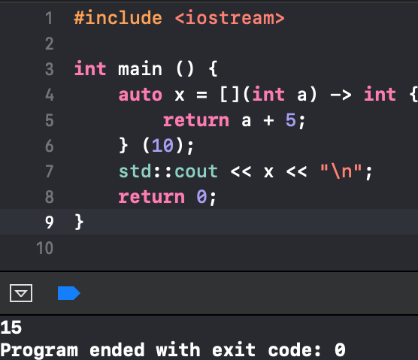
Return value

Slide 41
Return value
The result is 15. Here -> int is the expressive spelling that this function will return an int. auto will deduce the type of x by itself.

Slide 42
capture
Lambda features it as a Function Object and can accesses a variable outside the scope ( scope created by its {} ). Accessing a captured variable has two ways:
Access by reference.
Access by copying (by value).

Slide 43
capture
In Lambda, to capture by reference, write [&]. To capture by value, write [=]. To not capture anything, leave [] blank.

Slide 44
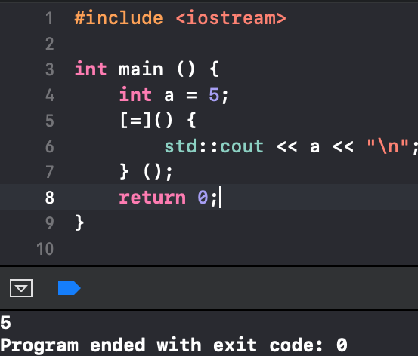
capture

Slide 45
mutable
You can not modify captured by value variable. If you want to change the value ? -> Use mutable keyword.

Slide 46
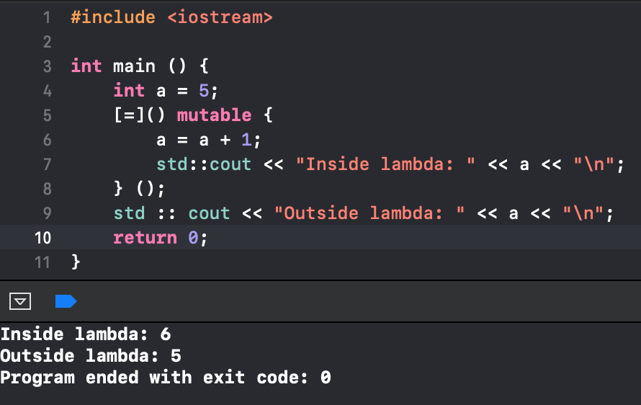
mutable

Slide 47
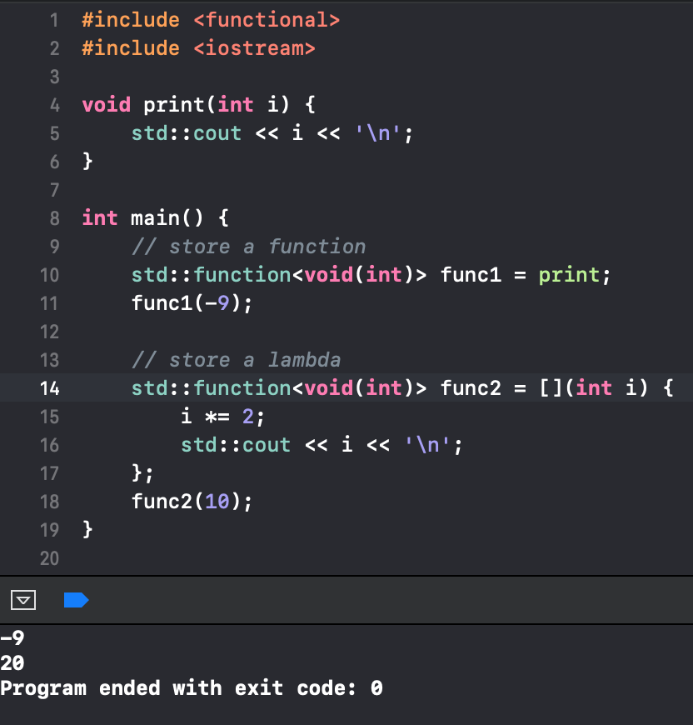
using lambda with std::function

Slide 48
Boost::Algorithm

Slide 49
boost::algorithm::all_of_equal()
boost::algorithm::one_of()
boost::algorithm::is_sorted()
boost::algorithm::all_of()
boost::algorithm::one_of_equal()
boost::algorithm::none_of_equal()

Slide 50
boost::algorithm::clamp()
boost::algorithm::is_partitioned()
boost::algorithm::none_of()
boost::algorithm::any_of()
boost::algorithm::any_of_equal()
C++ Boost String Algorithms

Slide 51
boost::algorithm::all_of_equal()
returns true if the all the elements are same in the sequence.
vector<int> c(5, 1);
bool ans =boost::algorithm::all_of_equal(c, 1);
if (ans == 1) cout << "ALl elements are 1";
else cout << "All elements are not 1";
return 0;
int a[] = { 1, 2, 5, 6 };
bool ans = boost::algorithm::all_of_equal(a, a + 4, 4);
if (ans == 1) cout << "ALl elements are 4";
else cout << "All elements are not 4";
return 0;

Slide 52
boost::algorithm::one_of()
returns true if the predicate returns true for exactly one given element in the sequence.
int c[] = { 1, 2, 3 };
bool ans = boost::algorithm::one_of(c, isOdd);
if (ans == 1) cout << "Exactly one element is odd";
else cout << "Exactly one element is not odd";
return 0;
int a[] = { 1, 9, 10, 8 };
bool ans = boost::algorithm::one_of(a, a + 4, LessThanSeven);
if (ans == 1) cout << "Exactly one element is less than 7";
else cout << "Exactly one element is not less than 7";
return 0;

Slide 53
boost::algorithm::is_sorted()
tests if the given sequence is sorted or not.
int c[] = { 1, 2, 6, 8 };
bool ans = boost::algorithm::is_sorted(c);
if (ans == 1) cout << "sorted";
else cout << "not sorted";
return 0;
int c[] = { 1, 2, 10, 8 };
bool ans = boost::algorithm::is_sorted(c, c + 3);
if (ans == 1) cout << "sorted till 3rd index";
else cout << "not sorted till 3rd index";
return 0;

Slide 54
boost::algorithm::all_of()
returns true if the predicate returns true when applied to every element in the sequence.
vector<int> c(5, 1);
bool ans = boost::algorithm::all_of(c, isOdd);
if (ans == 1) cout << "ALl elements are odd";
else cout << "All elements are even";
int a[] = { 1, 2, 5, 6 };
bool ans = boost::algorithm::all_of(a, a + 4, LessThanSeven);
if (ans == 1) cout << "ALl elements are less than 7";
elsecout << "All elements are not less than 7";

Slide 55
boost::algorithm::one_of_equal()
returns true if the exactly one of the elements are same in the sequence to the value passed.
int c[] = { 1, 2, 3 };
bool ans = boost::algorithm::one_of_equal(c, 1);
if (ans == 1) cout << "exactly one element is 1";
else cout << "exactly one element is not 1";
int a[] = { 1, 2, 3, 6 };
bool ans = boost::algorithm::one_of_equal(a, a + 4, 4);
if (ans == 1) cout << "exactly one element is 4";
else cout << "exactly one element is not 4";

Slide 56
boost::algorithm::none_of_equal()
returns true if none of the elements are equal to the value in the sequence.
vector<int> c(5, 1);
bool ans = boost::algorithm::none_of_equal(c, 1);
if (ans == 1) cout << "all not equal to 1";
else cout << "all equals to 1";
int a[] = { 1, 2, 5, 6 };
bool ans = boost::algorithm::none_of_equal(a, a + 4, 4);
if (ans == 1) cout << "all not equal to 4";
else cout << "all equal to 4";

Slide 57
boost::algorithm::clamp()
const T& clamp ( const T& val, const T& lo, const T& hi )
Return Value: The function returns three values as described below:
It returns low if value is less than low.
It returns high if high is greater than value.
In all other cases, it returns value.
int ans = boost::algorithm::clamp(5, 10, 20);
int ans = boost::algorithm::clamp(25, 10, 20);
int ans = boost::algorithm::clamp(15, 10, 20);

Slide 58
boost::algorithm::is_partitioned()
which tests if the given sequence is partioned according to the given predicate or not. Partition here means that all the items in the sequence that satisfy the predicate are at the beginning of the sequence.
returns true if the all the elements are same in the sequence.
int c[] = { 1, 2, 5, 6, 8 };
bool ans = boost::algorithm::is_partitioned(c, isOdd);
if (ans == 1) cout << "Sequence is partitioned";
else cout << "Sequence is not partitioned";
int c[] = { 4, 2, 5, 6, 8 };
bool ans = boost::algorithm::is_partitioned(c, c + 2, isEven);
if (ans == 1) cout << "Sequence is partitioned";
else cout << "Sequence is not partitioned";

Slide 59
boost::algorithm::none_of()
returns true if the given predicate is false for all the elements of the sequence, else it returns false.
vector<int> c(5, 1);
bool ans = boost::algorithm::none_of(c, isOdd);
if (ans == 1) cout << "all are not odd";
else cout << "all are odd";
int a[] = { 1, 2, 5, 6 };
bool ans = boost::algorithm::none_of(a, a + 4, LessThanSeven);
if (ans == 1) cout << "all greater than 7";
else cout << "all smaller than 7";

Slide 60
boost::algorithm::any_of()
returns true if the given predicate is true on any of the element of the sequence, else it returns false.
int c[] = { 1, 2, 3 };
bool ans = boost::algorithm::any_of(c, isOdd);
if (ans == 1) cout << "at least one element is odd";
else cout << "all elements are even";
int a[] = { 1, 2, 10, 8 };
bool ans = boost::algorithm::any_of(a, a + 4, LessThanSeven);
if (ans == 1) cout << "at least one element is less than 7";
else cout << "all elements are not less than 7";

Slide 61
boost::algorithm::any_of_equal()
returns true if any of the elements of the sequence is equal to value, else it returns false.
int c[] = { 1, 2, 3 };
bool ans = boost::algorithm::any_of_equal(c, 1);
if (ans == 1) cout << "at least one elements is 1";
else cout << "all elements are not 1";
int a[] = { 1, 2, 3, 6 };
bool ans = boost::algorithm::any_of_equal(a, a + 4, 4);
if (ans == 1) cout << "at least one element is 4";
else cout << "all elements are not 4";

Slide 62
C++ Boost String Algorithms
Converting a string to uppercase and lowercase.
string str("Hello"); string upper_s; string lower_s;
to_upper(str);
cout << "Actual string converted to uppercase: " << str << endl;
to_lower(str);
cout << "Actual string converted to lowercase: "<< str << endl;
str = "Hello";
upper_s = to_upper_copy(str);
lower_s = to_lower_copy(str);
cout << "Converted Uppercase string: " << upper_s << endl;
cout << "Converted Lowercase string: " lower_s << endl;

Slide 63
C++ Boost String Algorithms
To remove characters from a string
string s = "geeksforgeeks";
cout << erase_first_copy(s, "g")
cout << erase_nth_copy(s, "g", 0 )
cout << erase_last_copy(s, "g )
cout << erase_all_copy(s, "g")
cout << erase_head_copy(s, 5)
cout << erase_tail_copy(s, 1)

Slide 64
C++ Boost String Algorithms
To replace characters from a string
string s = "geeks_for_geeks";
cout << replace_first_copy(s, "_", "-")
cout << replace_last_copy(s, "_", "-")
cout << replace_all_copy(s, "_", "-")

Slide 65
The End the source code and example are collected on geeksforgeeks.org by Nguyễn Tấn Thiện Tks to geeksforgeeks.org and viewers

