Slide 1



[ ADD THE DATE HERE ] <- TO DO
Using Bootstrap and AI
in a Thymeleaf Project
CRUD
DEMO
Spring Boot 3.4.2 · Thymeleaf · Bootstrap 5.3.3 · built with an AI agent
PRESENTED TO
PRESENTED BY — OUR TEAM
[ Lecturer name ]
[ Member 1 · Student ID ]
[ Member 2 · Student ID ]
[ Member 3 · Student ID ]
[ Member 4 · Student ID ]
Product inventory CRUD · github.com/thanhsu263/hsfAssignment
Notes:
Hello everyone. We are [team name], and today we show how we built a web application with
Thymeleaf and Bootstrap, and how we used an AI coding agent to help us build it. We will
explain the setup, show the code, and finish with a live demo.
Introduce each member and the part they will present.

Slide 2

Agenda
1 | The project and Thymeleaf
2 | Bootstrap: CDN or WebJars
3 | One layout, four pages
4 | A real page
5 | Which AI tool we used
6 | Prompts that worked
7 | What we had to fix
8 | Demo and lessons learned
Notes:
This is our plan. First the project and the template engine. Then the two ways to add
Bootstrap, and why we chose one of them. Then the shared layout and a real page. After that
the AI part: how we set the tool up and what we actually asked it for. At the end, the two
bugs we had to fix, and a live demo.

Slide 3
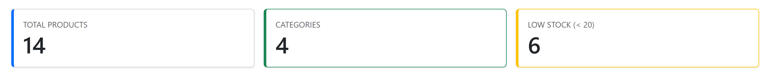
BOOTSTRAP + AI IN A THYMELEAF PROJECT
Project overview
A product inventory CRUD with sign-in, two roles, search and pagination.
• Spring Boot 3.4.2 on Java 17 · H2 in memory, nothing to install
• Bootstrap 5.3.3 served from WebJars
• Session + interceptor for sign-in and roles
Back to Agenda
Notes:
Our app manages a product inventory. After signing in, an administrator can create, read,
update and delete products; a staff account can only view and search. The controller handles
the request, the service holds the logic, the repository talks to the database, and Thymeleaf
builds the HTML page. The default database is H2 and it lives in memory, so the app starts on
any machine without installing anything.

Slide 4
BOOTSTRAP + AI IN A THYMELEAF PROJECT
What is Thymeleaf?
A template engine: it fills plain HTML with data from the controller.
• Normal HTML attributes — th:text, th:each, th:href
• The controller puts named values in the Model
• One starter dependency, and Spring Boot does the rest
the Model goes in, the page comes out
// DashboardController.java
model.addAttribute("totalProducts", products.count());
<!-- templates/dashboard.html -> renders 14 -->
<div class="display-6" th:text="${totalProducts}">0</div>
Back to Agenda
Notes:
Thymeleaf takes an HTML file and fills it with data. We write th:text or th:each inside
normal HTML tags, so the file is still valid HTML. Spring Boot looks for templates in
src/main/resources/templates. The controller never builds HTML itself — it puts named values
in the Model and the template decides how they are shown. One dependency is enough, and it
carries no version number, because the Spring Boot parent manages that for us.

Slide 5
BOOTSTRAP + AI IN A THYMELEAF PROJECT
Why Bootstrap?
Ready-made components, and a responsive grid we did not have to write.
• Buttons, tables, forms, navbars, modals, badges
• The same page works on a phone and on a desktop
• The whole project needs only 5 lines of our own CSS
static/css/app.css — the entire file
body { min-height: 100vh; display: flex; flex-direction: column; }
main { flex: 1; }
.login-page { background: linear-gradient(135deg, ...); }
.stat-card { border-left: .3rem solid var(--bs-primary); }
.table td, .table th { vertical-align: middle; }
Back to Agenda
Notes:
Bootstrap gives us ready-made classes. btn btn-primary makes a blue button, and
table table-striped makes a striped table. The whole project has only five lines of our own
CSS, and three of them exist just to pin the footer to the bottom of the page. Because
Bootstrap and Thymeleaf both work on plain HTML attributes, they never get in each other's
way.

Slide 6
BOOTSTRAP + AI IN A THYMELEAF PROJECT
Option A: the CDN
A public server hosts the library for you: one link, one script.
• Pro: nothing to download, the fastest way to start
• Con: the page needs internet every time it loads
• Use the bundle file — it includes Popper, which modals need
still in our layout.html, kept as a comment
<!-- in <head> -->
<link rel="stylesheet"
href="https://cdn.jsdelivr.net/npm/bootstrap@5.3.3/dist/css/bootstrap.min.css">
We kept both CDN lines as comments, so we can show the two approaches side by side.
Back to Agenda
Notes:
The CDN is the fastest way to start: paste one CSS link and one script tag. The bundle file
is the important one, because it includes Popper, which dropdowns, tooltips and modals need.
We left both CDN lines in our layout file as comments on purpose, so we can show the two
approaches side by side. The drawback is that the app stops looking right as soon as there
is no internet.

Slide 7
BOOTSTRAP + AI IN A THYMELEAF PROJECT
Option B: WebJars
The library arrives as a Maven dependency and Spring Boot serves it.
• Declared in pom.xml — Maven downloads it once
• Served automatically under /webjars/
• Works offline, version pinned — this is the one we used
the version in the URL must match pom.xml
<!-- pom.xml -->
<dependency><groupId>org.webjars</groupId>
<artifactId>bootstrap</artifactId><version>5.3.3</version></dependency>
<!-- fragments/layout.html -->
<link rel="stylesheet" th:href="@{/webjars/bootstrap/5.3.3/css/bootstrap.min.css}">
Back to Agenda
Notes:
This is the option we chose. Maven downloads Bootstrap for us and Spring Boot serves it
straight out of the jar, so we never copy a CSS file by hand. One thing to watch: the version
in the URL must match the version in pom.xml. If we bump the dependency and forget the
template, the page loads with no styling at all. We pulled in Bootstrap Icons the same way,
and that is where every icon on our pages comes from.

Slide 8
BOOTSTRAP + AI IN A THYMELEAF PROJECT
One layout, four pages
A fragment is a named, reusable piece of HTML — and it takes parameters.
• layout.html holds five: head, navbar, flash, footer, scripts
• navbar('products') marks the right tab as active
• Change the navbar once and all four pages follow
define once, use everywhere
<!-- fragments/layout.html -->
<nav th:fragment="navbar(activePage)"> ... </nav>
<!-- products.html, dashboard.html, login.html, product-form.html -->
<div th:replace="~{fragments/layout :: navbar('products')}"></div>
Back to Agenda
Notes:
Without fragments we would copy the same head and the same navbar into four files. With
fragments we write each one once. th:fragment names the piece and th:replace drops it into
the page. The useful part is the parameter: navbar('products') tells the fragment which link
to mark as active, so one navbar serves every page and still highlights the right tab.

Slide 9
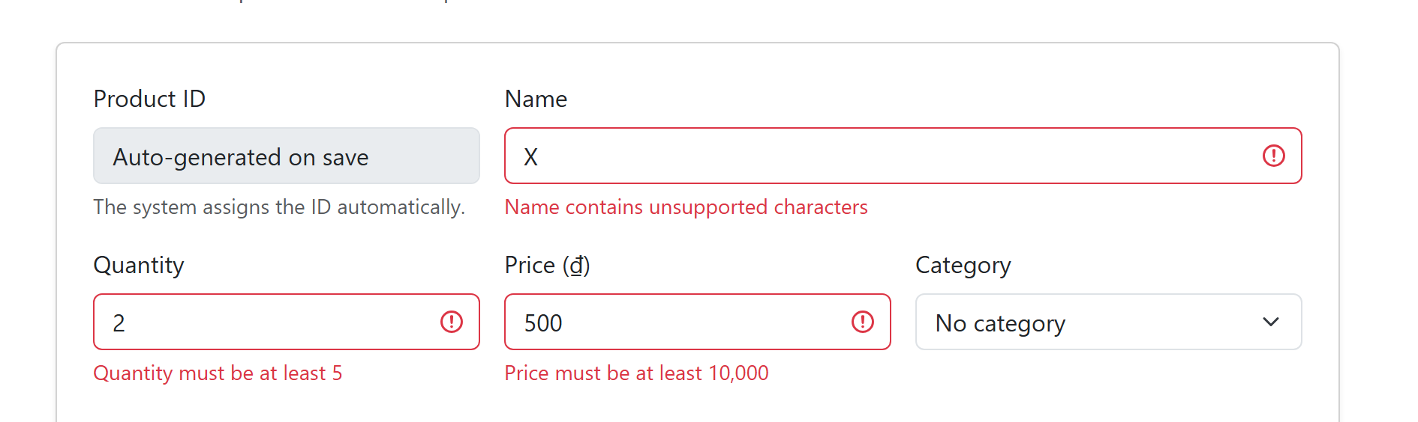
BOOTSTRAP + AI IN A THYMELEAF PROJECT
A real page
Straight out of product-form.html — nothing invented for the slide.
one field, bound and validated
<input th:field="*{quantity}"
th:classappend="${#fields.hasErrors('quantity')} ? 'is-invalid'">
<div class="invalid-feedback" th:errors="*{quantity}"></div>
Back to Agenda
Notes:
This is a real page from our project. th:object says which Java object the fields belong to,
and th:field sets the input's name, id and value in one attribute. When validation fails,
fields.hasErrors appends Bootstrap's is-invalid class, which is what turns the border red,
and th:errors prints the message from the entity underneath. We wrote the rule once on the
entity and the form shows it — we never repeat the rule in the template.

Slide 10
BOOTSTRAP + AI IN A THYMELEAF PROJECT
Which AI tool we used
An agent reads the whole project, edits many files, and runs commands itself.
Tool | Where it runs | Good for | Limit
* Claude Code | Terminal, IDE | Whole-project tasks, runs commands | Paid; review it
GitHub Copilot | VS Code, IntelliJ | Completion while you type | Sees less at once
Cursor | Its own editor | Chat with the codebase | Changing editor
* the one we used — the only one that could change pom.xml, the Java classes and the templates in a single task.
Back to Agenda
Notes:
We used Claude Code. The difference between an agent and ordinary autocomplete is scope:
autocomplete finishes the line we are typing, while an agent reads the project, changes
several files, and runs Maven to check its own work. That mattered here, because adding
Bootstrap touched pom.xml and every template at the same time. It is a paid tool, and it is
not always right — we will show that in two slides.

Slide 11
BOOTSTRAP + AI IN A THYMELEAF PROJECT
Setting the agent up
Four steps — and the third is the one that actually matters.
1
2
3
4
Install it and sign in
Open it in the project folder
Write the rules down
Start small, check the result
the rules we worked to
# Project rules
- Spring Boot 3.4.2, Java 17, Thymeleaf, Spring Data JPA.
- Use jakarta.* imports, never javax.*. Bootstrap 5.3.3 from WebJars.
- Every link uses th:href="@{...}", never a hard-coded path.
- Controller -> Service -> Repository. No logic in a controller.
Back to Agenda
Notes:
Setup takes a few minutes. The important step is the third one. If we do not state the stack
and the conventions, the agent guesses, and its guess is usually the most common pattern on
the internet, which for Spring is often the older one. Writing the rules down once saved us
from correcting the same thing over and over.
Note for the team: this rules file is an example of how to record them. It is not committed
in the repository, so do not claim that it is.

Slide 12
BOOTSTRAP + AI IN A THYMELEAF PROJECT
Prompting for the UI
Name three things: the file path, the fields, and the conventions.
“Create templates/product-form.html for Product — id, name, quantity, price, category. Bootstrap 5.3, th:object and th:field, errors with is-invalid. Reuse the fragments from fragments/layout.html.”
[ replace with the prompt we actually typed ] <- TO DO
• The exact file path, so it did not invent a new folder
• Reuse our fragments — or it writes a fresh <head> into every file
Back to Agenda
Notes:
A vague prompt gives a generic page. A good prompt names three things: the file path, the
fields with their types, and the conventions to follow. Notice that we asked it to reuse our
existing fragments — otherwise it writes a fresh head into every file and the layout drifts
apart. It produced this in seconds; we changed a few labels and the order of the buttons.

Slide 13
BOOTSTRAP + AI IN A THYMELEAF PROJECT
Prompting the back end
The agent cannot guess that quantity must be 5 to 100 — so we said it.
Product.java — every rule stated in the prompt
@Entity public class Product {
@Id @Size(min = 4, max = 5) private String id;
@NotBlank @Nationalized private String name;
@NotNull @Min(5) @Max(100) private Integer quantity;
@NotNull @DecimalMin("10000") private BigDecimal price;
}
• Say the layers out loud: Controller → Service → Repository
• No Lombok, constructor injection — we had to say both
Back to Agenda
Notes:
For the back end the prompt has to carry the rules, because the agent cannot guess that
quantity must be between 5 and 100. The nice part is the repository: we describe the query in
the method name and Spring Data writes the SQL — findByNameContainingIgnoreCaseOrIdContaining
IgnoreCase is the whole search feature, with no implementation behind it. One detail we asked
for specifically is Nationalized, so that Vietnamese product names survive the trip to SQL
Server.

Slide 14
BOOTSTRAP + AI IN A THYMELEAF PROJECT
What we had to fix
Both looked completely correct in the browser. Only testing found them.
1 — HIDING A BUTTON IS NOT SECURITY
We hid the buttons from staff with th:if. Typing the URL went straight through.
the fix — a server-side check in LoginInterceptor.java
if (protectedAction && !user.isAdmin()) { response.sendRedirect("/products"); }
2 — VIETNAMESE NAMES CAME BACK AS ?????
It only showed up with real data: the column was not Unicode.
the fix — Product.java
@Nationalized @Column(nullable = false, length = 100) private String name;
Back to Agenda
Notes:
The first version hid the create and delete buttons from staff with th:if on currentUser
admin. That looks correct on screen, but the page is only a view: typing /products/new in the
address bar went straight through. The fix was a server-side interceptor that checks the role
on every protected URL and sends staff back to the list.
The second one only appeared with real data. Vietnamese product names came back as question
marks, because the column was not Unicode. Both are the same lesson: AI output that looks
right still has to be tested with real data and real users.
Each member can take one bug here. If the team remembers a third mistake of its own,
add it as a block 3 — there is room if one of the code lines is dropped.

Slide 15
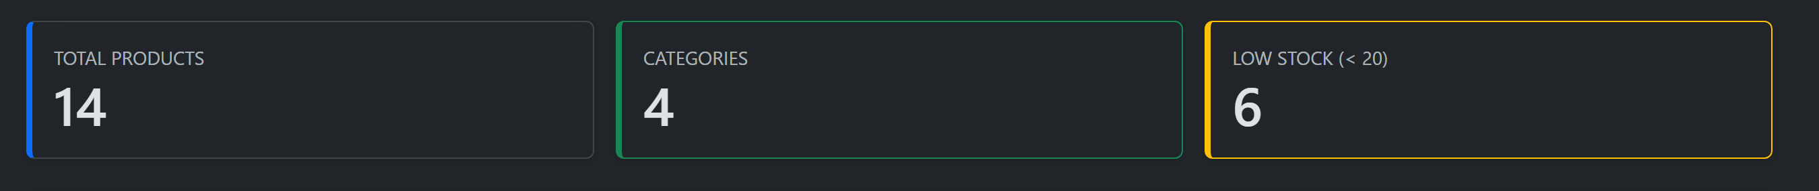
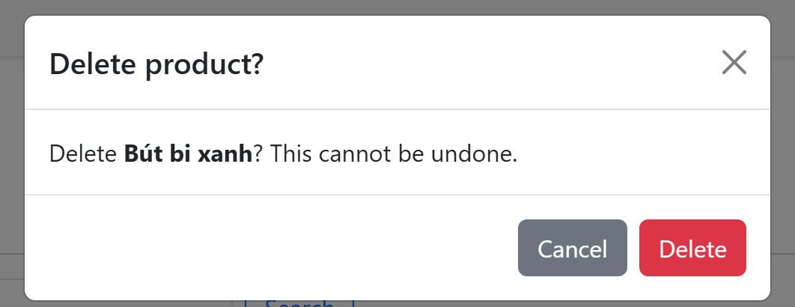
BOOTSTRAP + AI IN A THYMELEAF PROJECT
Demo
Live, in the running app at localhost:6969.
• mb@a.com — blocked, cannot sign in
• ad@a.com — dashboard, then dark mode
• Search Sách, page 2 — keyword survives
• Quantity 2 — validation stops the save
• st@a.com — no buttons, URL blocked too
Back to Agenda
Notes:
Now the running application. We start with the blocked account to show that the check is
real. Then the dashboard, and the dark mode toggle, which is just Bootstrap's data-bs-theme
attribute saved in localStorage. In the product list we search, move to the next page, and
the keyword survives. Then we create a product with an invalid quantity to show Bean
Validation. Finally we sign in as staff and try the URL we showed on the last slide.

Slide 16
BOOTSTRAP + AI IN A THYMELEAF PROJECT
What we take away
5
5
2
lines of our own CSS in the whole project
fragments serving all four pages
real bugs that looked fine on screen
Bootstrap for the look, fragments for the structure, the agent for the first draft — and us for the review.
Thank you · Questions?
Back to Agenda
Notes:
To summarise: Bootstrap made the interface fast, Thymeleaf fragments kept it from being
copied four times, and the AI agent wrote most of the first draft. But the two bugs we showed
are the real point of this talk — both looked correct in the browser, and only testing found
them. The AI writes the code; we are still the ones who have to understand it. Thank you for
listening, and we are happy to take questions.

