Slide 1
FOOD
What is your favorite food?
How healthy is your diet?
Do you ever eat unhealthy food?
What do you often have for breakfast/ lunch/ dinner?
Do you prefer eating out to cooking?
Can you cook? What is your best dish?

Slide 2
Food
Breakfast
Lunch
dinner

Slide 3
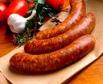

sausage
meat

Slide 4
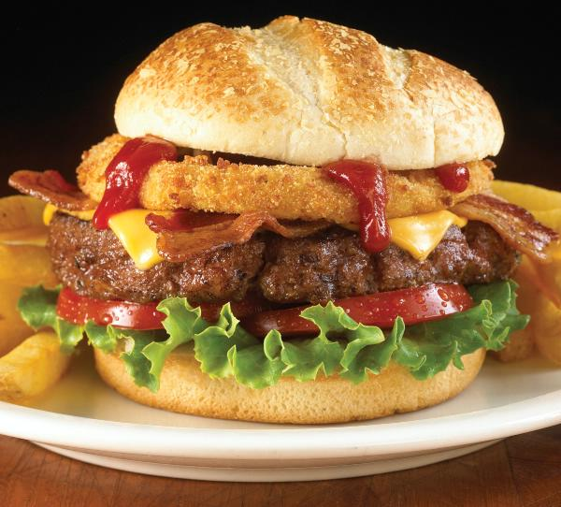
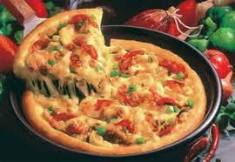
pizza
hamburger

Slide 5
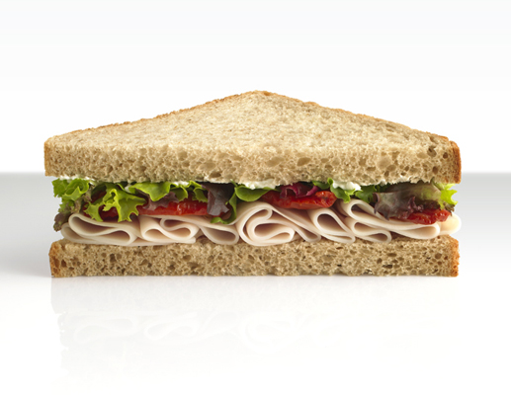
SANDWICH

Slide 6
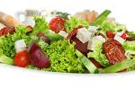
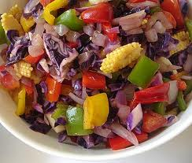
SALAD
MIXED SALAD

Slide 7
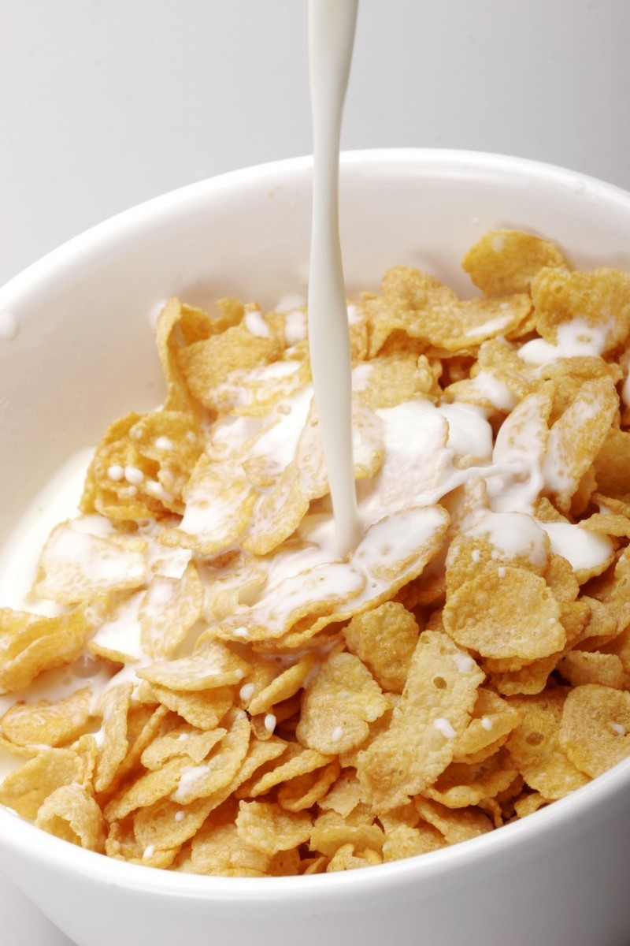
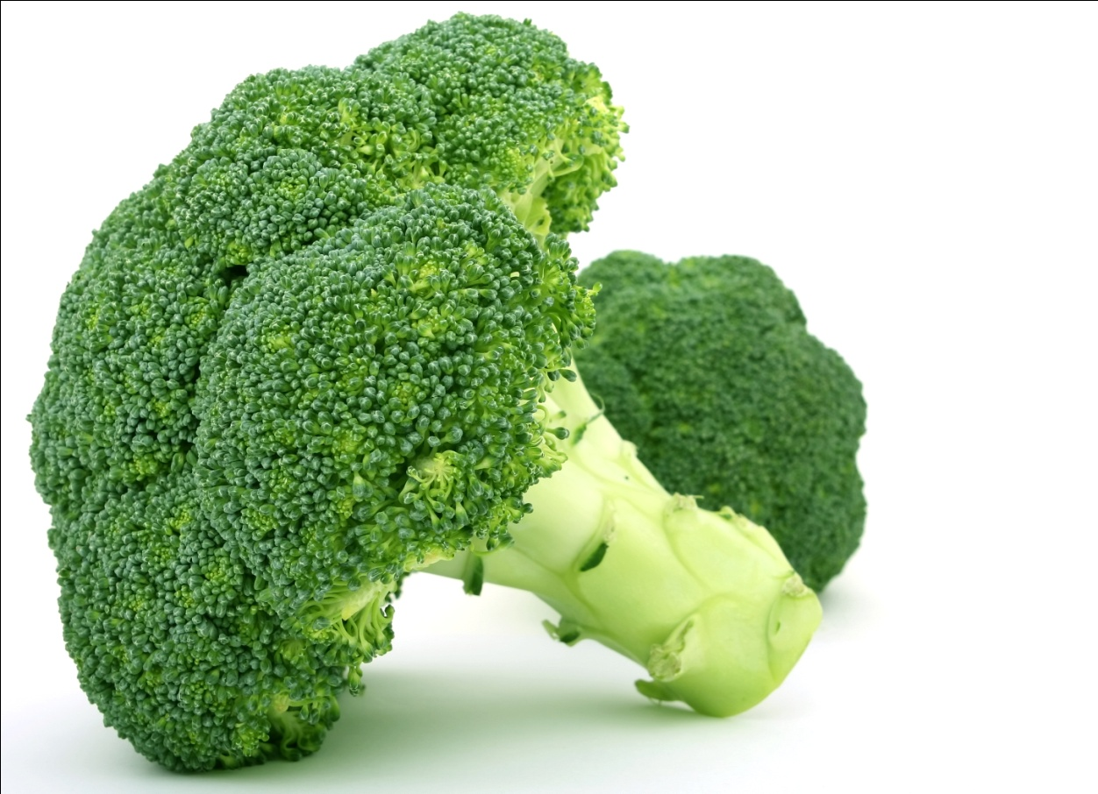
BROCCOLI
CEREAL

Slide 8
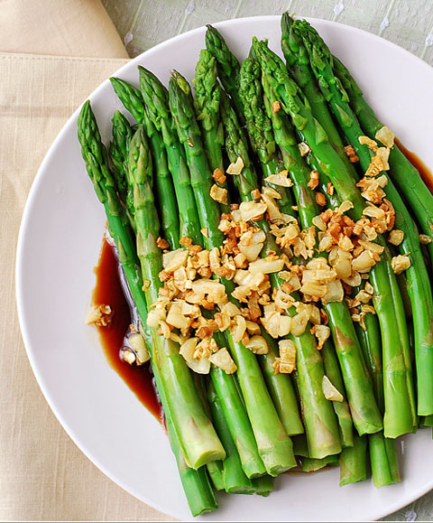
asparagus

Slide 9
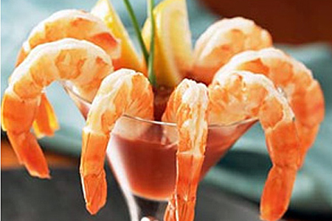
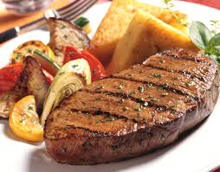
SHRIMP COCKTAIL
STEAK

Slide 10
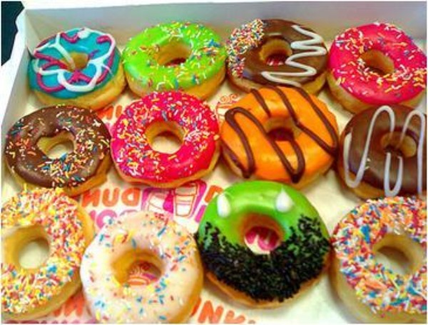
Donuts

Slide 11

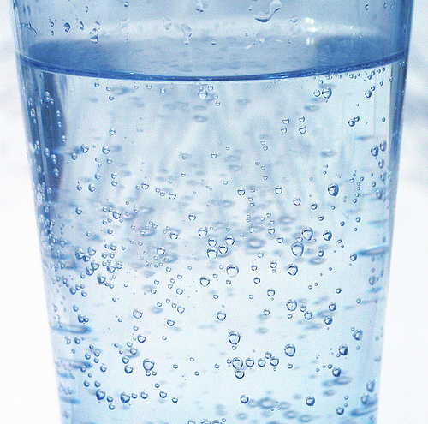
STILL WATER
SPARKLING WATER

Slide 12
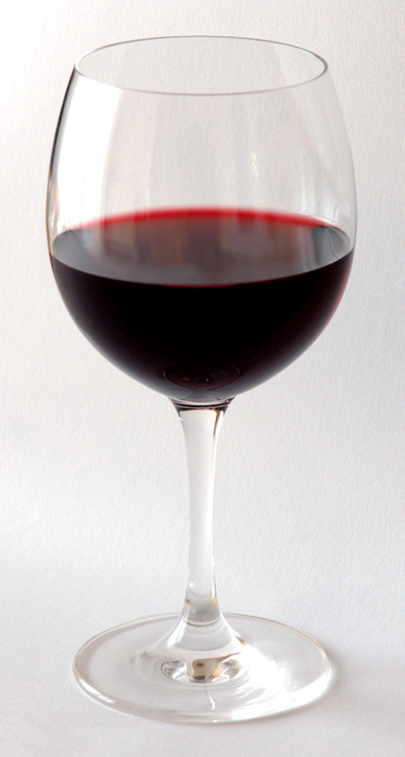
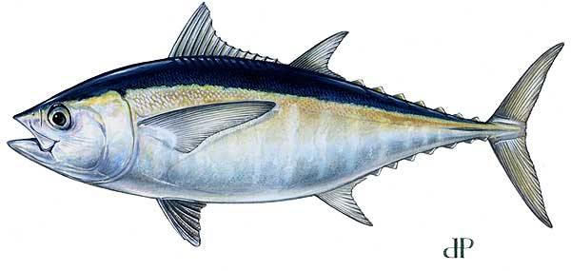
TUNA
RED WINE

Slide 13
NEW WORDS:
Basket: cái rổ, cái sọt
Shopping cart: xe đẩy siêu thị
A carton of milk: hộp sữa
Meat ball: thịt viên
Burger: bánh mì tròn
Bacon: thit nguoi
Steam: hấp
Fry: chiên, xào
boil: luộc

Slide 14
Vegetarian: người ăn chay
Tuna: cá ngừ
Mixed: thực cẩm
Sandwiches: bánh mị kẹp thịt
Drink:
wine: rượu
Beer: bia
Mineral water: nước khoáng
Natural water: nước lọc

Slide 15
REAL WORLD:
REQUEST AND OFFERS:
REQUEST:
Ex: I’d like a bottle of water, please
can I/ We have the bill, please?
I’ D LIKE ……..
CAN I/ WE ………..?

Slide 16
OFFERS:
Ex: Would you like to order now?
What would you like to drink?
Would you like some coffee?
WHAT WOULD YOU LIKE TO……?
WOULD YOU LIKE TO ……?
WOULD YOU LIKE SOME ……..?

Slide 17
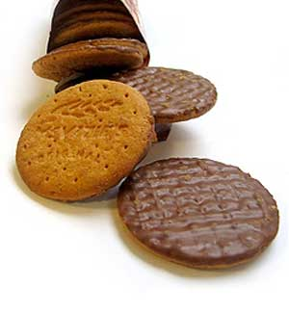
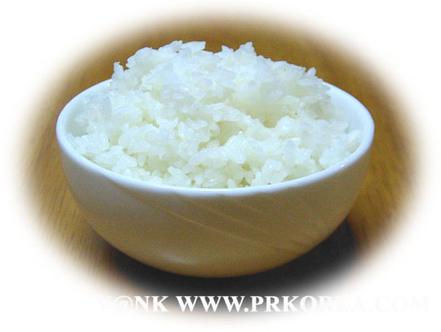
BISCUITS
RICE

Slide 18
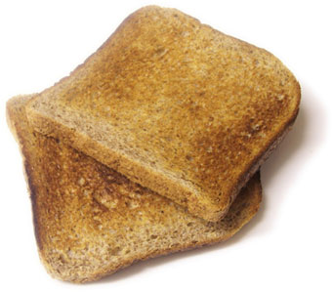
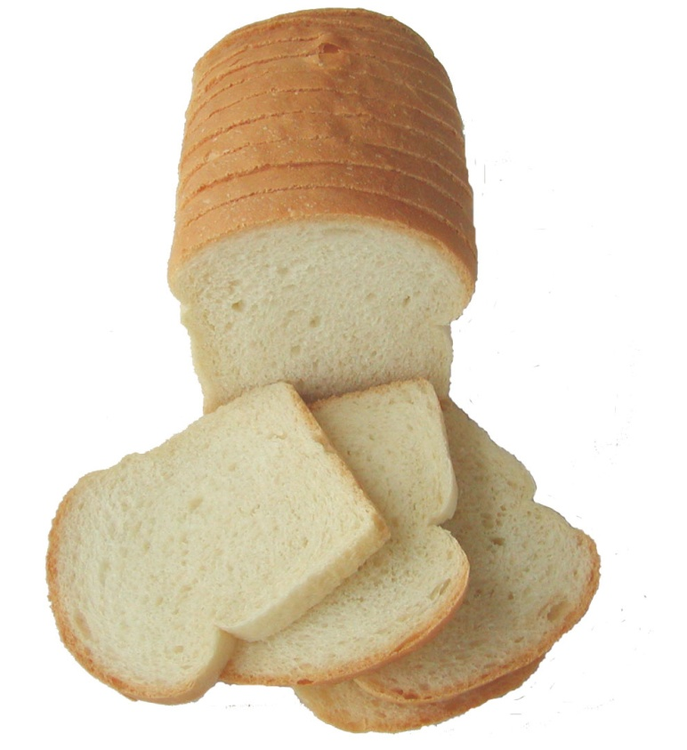
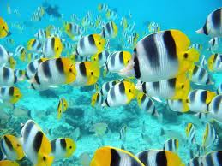
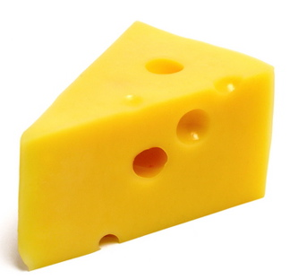
FISH
CHEESE

Slide 19
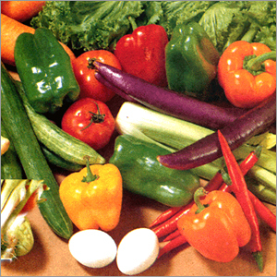
VEGETABLES

Slide 20
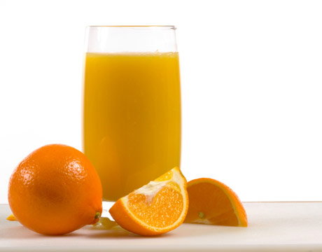
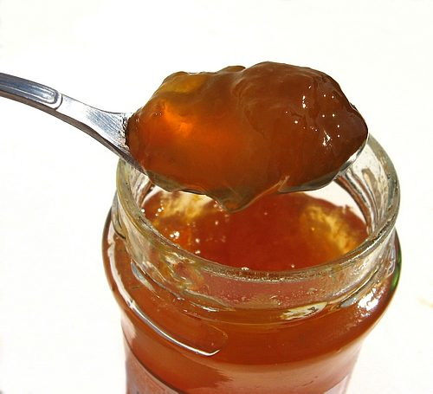
ORANGE JUICE
JAM

Slide 21
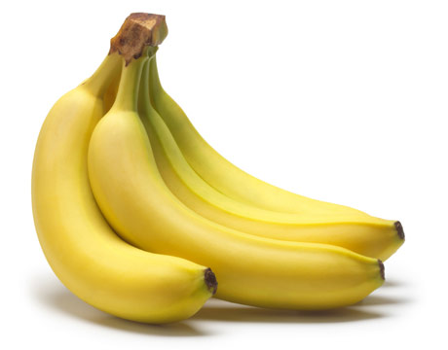
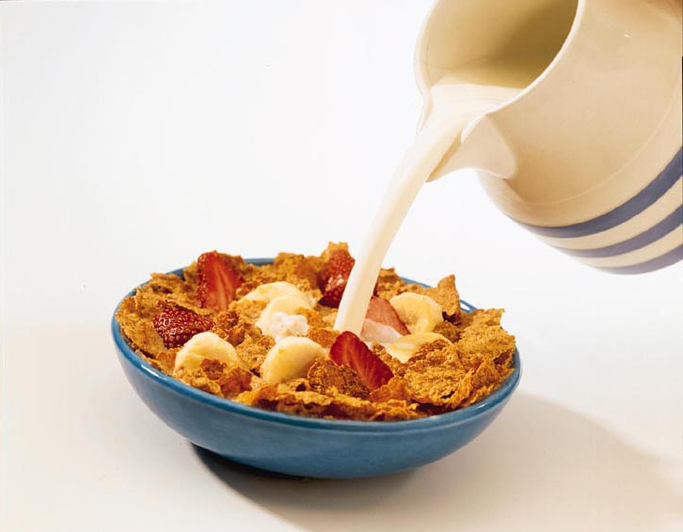
BANANA
CEREAL

Slide 22
4D. BREAKFAST TIME
NEW WORDS:
Biscuits: bánh quy
Toast: banh mi nướng
Sausages: xuc xích
Jam: mứt
Cereal: bột ngũ cốc
Vegetables: rau
Fruit: trái cây
Bread: bánh mì

Slide 23
Healthy food | Unhealthy food

Slide 24
COUNTABLE AND UNCOUNTABLE NOUNS
COUNTABLE NOUNS | UNCOUNTABLE NOUNS
- BISCUITS APPLES - BANANAS - BURGERS CHIPS EGGS | RICE MILK BEER WINE SUGAR JAM BREAD

Slide 25





THANK YOU!

