Slide 1
Introduction to Machine Learning
Classification Problem
Dr. Nguyen Thi Ngoc Anh
University of Science and Education- The University of Danang

Slide 2
Classification: Definition
Given a collection of records (training set )
  Each record is by characterized by a tuple (x,y), where x is the attribute set and y is the class label
    x: attribute, predictor, independent variable, input
    y: class, response, dependent variable, output
Task:
  Learn a model that maps each attribute set x into one of the predefined class labels y

Slide 3
Examples of Classification Task
Task | Attribute set, x | Class label, y
Categorizing email messages | Features extracted from email message header and content | spam or non-spam
Identifying tumor cells | Features extracted from MRI scans | malignant or benign cells
Cataloging galaxies | Features extracted from telescope images | Elliptical, spiral, or irregular-shaped galaxies

Slide 4

General Approach for Building Classification Model
Introduction to Data Mining, 2nd Edition

Slide 5
Classification Techniques
Base Classifiers
  Decision Tree based Methods
  Rule-based Methods
  Nearest-neighbor
  Neural Networks
  Deep Learning
  Naïve Bayes and Bayesian Belief Networks
  Support Vector Machines
Ensemble Classifiers
  Boosting, Bagging, Random Forests

Slide 6
Classification vs. Prediction
Classification:
  predicts categorical class labels (discrete or nominal)
  classifies data (constructs a model) based on the training set and the values (class labels) in a classifying attribute and uses it in classifying new data
Prediction:
  models continuous-valued functions, i.e., predicts unknown or missing values
Typical Applications
  credit approval
  target marketing
  medical diagnosis
  treatment effectiveness analysis

Slide 7
Classification—A Two-Step Process
Model construction: describing a set of predetermined classes
  Each tuple/sample is assumed to belong to a predefined class, as determined by the class label attribute
  The set of tuples used for model construction is training set
  The model is represented as classification rules, decision trees, or mathematical formulae
Model usage: for classifying future or unknown objects
  Estimate accuracy of the model
    The known label of test sample is compared with the classified result from the model
    Accuracy rate is the percentage of test set samples that are correctly classified by the model
    Test set is independent of training set, otherwise over-fitting will occur
  If the accuracy is acceptable, use the model to classify data tuples whose class labels are not known

Slide 8



Classification Process (1): Model Construction
Classification
Algorithms
Training
Data
Classifier
(Model)
IF rank = ‘professor’
OR years > 6
THEN tenured = ‘yes’

Slide 9




Classification Process (2): Use the Model in Prediction
Classifier
Testing
Data
Unseen Data
(Jeff, Professor, 4)
Tenured?

Slide 10
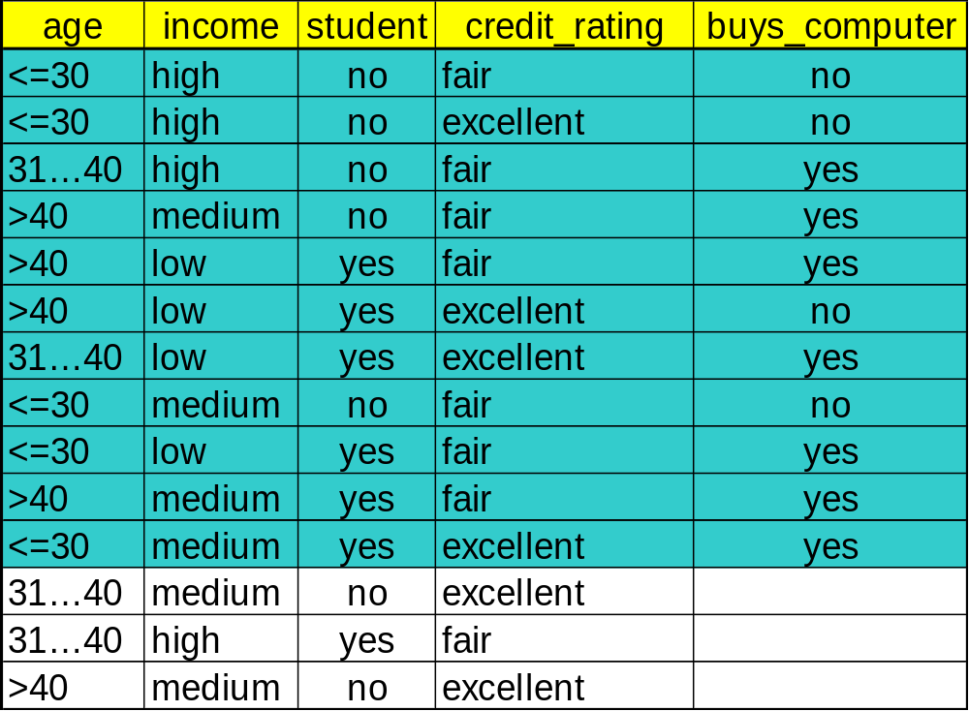
Dataset

Slide 11
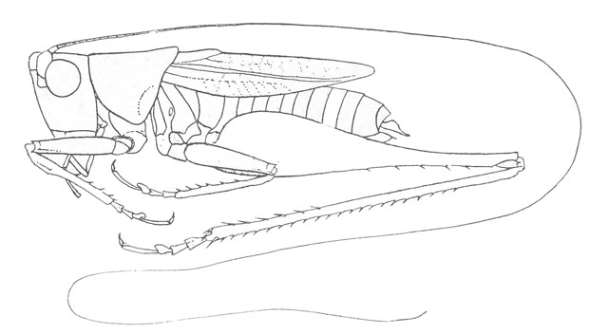
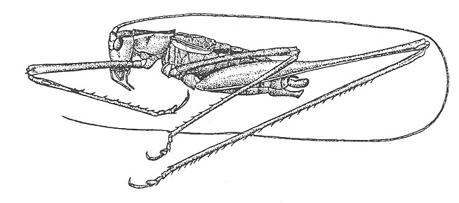
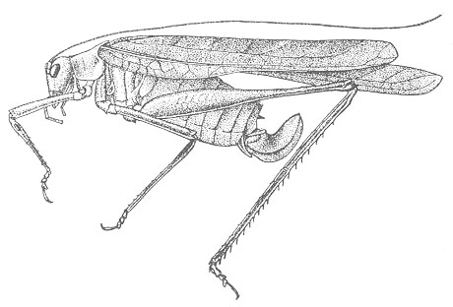
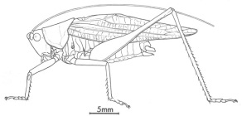
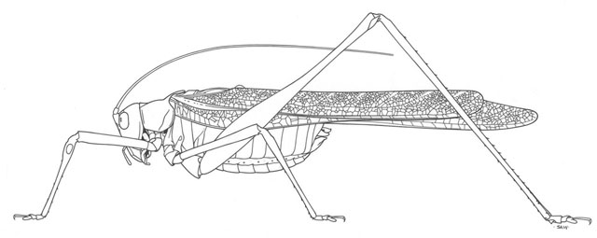
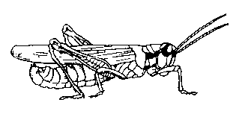
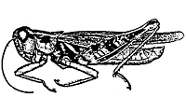
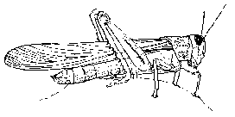
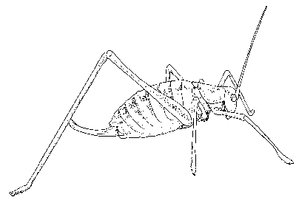
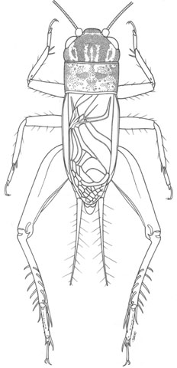
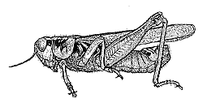
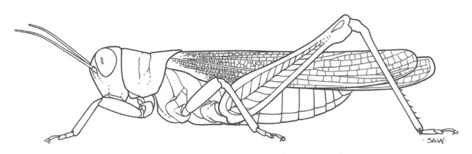
The Classification Problem
(informal definition)
Katydids
Given a collection of annotated data. In this case 5 instances Katydids of and six of Grasshoppers, decide what type of insect the unlabeled example is.
Grasshoppers
Katydid or Grasshopper?

Slide 12
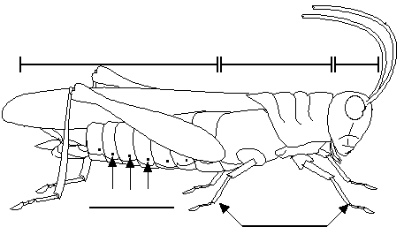
For any domain of interest, we can measure features
Color {Green, Brown, Gray, Other}
Has Wings?
Abdomen
Length
Thorax Length
Antennae
Length
Mandible
Size
Spiracle
Diameter
Leg Length

Slide 13
We can store features in a database.
My_Collection
Insect ID | Abdomen Length | Antennae Length | Insect Class
1 | 2.7 | 5.5 | Grasshopper
2 | 8.0 | 9.1 | Katydid
3 | 0.9 | 4.7 | Grasshopper
4 | 1.1 | 3.1 | Grasshopper
5 | 5.4 | 8.5 | Katydid
6 | 2.9 | 1.9 | Grasshopper
7 | 6.1 | 6.6 | Katydid
8 | 0.5 | 1.0 | Grasshopper
9 | 8.3 | 6.6 | Katydid
10 | 8.1 | 4.7 | Katydids
The classification problem can now be expressed as:
Given a training database (My_Collection), predict the class label of a previously unseen instance
previously unseen instance =
11 | 5.1 | 7.0 | ???????

Slide 14

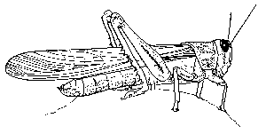

Grasshoppers
Katydids
10
9
8
7
6
Antenna Length
5
4
3
2
1
1
2
3
4
5
6
7
8
9
10
Abdomen Length

Slide 15
Grasshoppers
Katydids
We will also use this lager dataset as a motivating example…
10
9
8
7
6
Antenna Length
5
Each of these data objects are called…
exemplars
(training) examples
instances
tuples
4
3
2
1
1
2
3
4
5
6
7
8
9
10
Abdomen Length

Slide 16

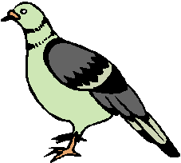
We will return to the previous slide in two minutes. In the meantime, we are going to play a quick game.
I am going to show you some classification problems which were shown to pigeons!
Let us see if you are as smart as a pigeon!

Slide 17
Pigeon Problem 1
Examples of class A
Examples of class B
3 4
5 2.5
1.5 5
5 2
6 8
8 3
2.5 5
4.5 3

Slide 18


Pigeon Problem 1
What class is this object?
Examples of class A
Examples of class B
3 4
5 2.5
8 1.5
What about this one, A or B?
1.5 5
5 2
6 8
8 3
4.5 7
2.5 5
4.5 3

Slide 19

Pigeon Problem 1
This is a B!
Examples of class A
Examples of class B
3 4
5 2.5
8 1.5
1.5 5
5 2
Here is the rule.
If the left bar is smaller than the right bar, it is an A, otherwise it is a B.
6 8
8 3
2.5 5
4.5 3

Slide 20


Pigeon Problem 2
Oh! This ones hard!
Examples of class A
Examples of class B
4 4
5 2.5
8 1.5
Even I know this one
5 5
2 5
6 6
5 3
7 7
3 3
2.5 3

Slide 21

Pigeon Problem 2
Examples of class A
Examples of class B
The rule is as follows, if the two bars are equal sizes, it is an A. Otherwise it is a B.
4 4
5 2.5
5 5
2 5
So this one is an A.
6 6
5 3
7 7
3 3
2.5 3

Slide 22

Pigeon Problem 3
Examples of class A
Examples of class B
6 6
4 4
5 6
This one is really hard!
What is this, A or B?
1 5
7 5
6 3
4 8
3 7
7 7

Slide 23

Pigeon Problem 3
It is a B!
Examples of class A
Examples of class B
6 6
4 4
5 6
The rule is as follows, if the square of the sum of the two bars is less than or equal to 100, it is an A. Otherwise it is a B.
1 5
7 5
6 3
4 8
3 7
7 7

Slide 24
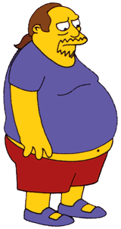

Why did we spend so much time with this game?
Because we wanted to show that almost all classification problems have a geometric interpretation, check out the next 3 slides…

Slide 25
Pigeon Problem 1
10
9
8
Examples of class A
Examples of class B
7
6
Left Bar
5
4
3
2
3 4
5 2.5
1
1
2
3
4
5
6
7
8
9
10
Right Bar
1.5 5
5 2
Here is the rule again.
If the left bar is smaller than the right bar, it is an A, otherwise it is a B.
6 8
8 3
2.5 5
4.5 3

Slide 26

Pigeon Problem 2
10
9
8
Examples of class A
Examples of class B
7
6
Left Bar
5
4
3
2
4 4
5 2.5
1
1
2
3
4
5
6
7
8
9
10
Right Bar
5 5
2 5
Let me look it up… here it is.. the rule is, if the two bars are equal sizes, it is an A. Otherwise it is a B.
6 6
5 3
3 3
2.5 3

Slide 27

Pigeon Problem 3
100
90
80
Examples of class A
Examples of class B
70
60
Left Bar
50
40
30
20
4 4
5 6
10
10
20
30
40
50
60
70
80
90
100
Right Bar
1 5
7 5
6 3
4 8
The rule again:
if the square of the sum of the two bars is less than or equal to 100, it is an A. Otherwise it is a B.
3 7
7 7

Slide 28
Grasshoppers
Katydids
10
9
8
7
6
Antenna Length
5
4
3
2
1
1
2
3
4
5
6
7
8
9
10
Abdomen Length

Slide 29
previously unseen instance =
11 | 5.1 | 7.0 | ???????
We can “project” the previously unseen instance into the same space as the database.
We have now abstracted away the details of our particular problem. It will be much easier to talk about points in space.
10
9
8
7
6
Antenna Length
5
4
3
2
1
Katydids
Grasshoppers
1
2
3
4
5
6
7
8
9
10
Abdomen Length

Slide 30
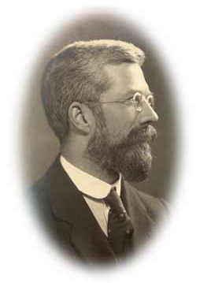
Simple Linear Classifier
10
9
8
7
R.A. Fisher
1890-1962
6
5
If previously unseen instance above the line
then
class is Katydid
else
class is Grasshopper
4
3
2
1
Katydids
Grasshoppers
1
2
3
4
5
6
7
8
9
10

Slide 31


The simple linear classifier is defined for higher dimensional spaces…

Slide 32
… we can visualize it as being an n-dimensional hyperplane

Slide 33
It is interesting to think about what would happen in this example if we did not have the 3rd dimension…

Slide 34
We can no longer get perfect accuracy with the simple linear classifier…
We could try to solve this problem by user a simple quadratic classifier or a simple cubic classifier..
However, as we will later see, this is probably a bad idea…

Slide 35
Which of the “Pigeon Problems” can be solved by the Simple Linear Classifier?
10
9
8
7
6
Perfect
Useless
Pretty Good
5
4
3
2
1
1
2
3
4
5
6
7
8
9
10
100
10
90
9
Problems that can be solved by a linear classifier are call linearly separable.
80
8
70
7
60
6
50
5
40
4
30
3
20
2
10
1
10
20
30
40
50
60
70
80
90
100
1
2
3
4
5
6
7
8
9
10

Slide 36
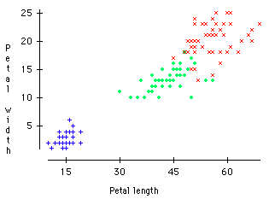
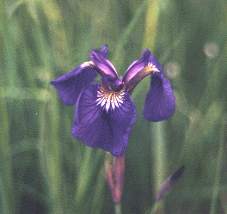

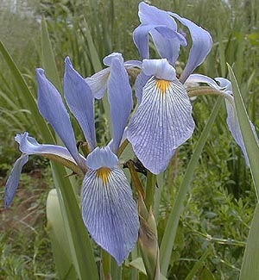
Virginica
A Famous Problem
R. A. Fisher’s Iris Dataset.
3 classes
50 of each class
The task is to classify Iris plants into one of 3 varieties using the Petal Length and Petal Width.
Setosa
Versicolor
Iris Setosa
Iris Versicolor
Iris Virginica

Slide 37
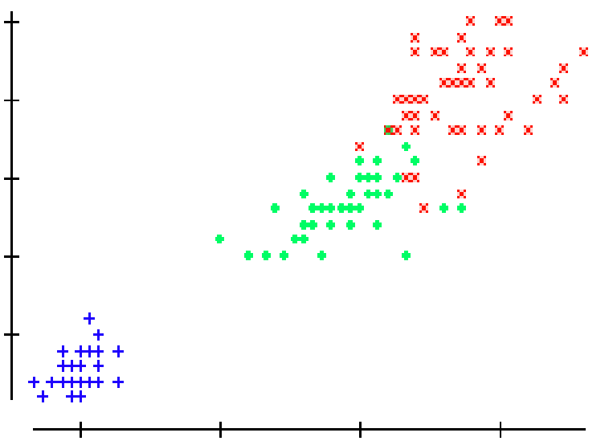
We can generalize the piecewise linear classifier to N classes, by fitting N-1 lines. In this case we first learned the line to (perfectly) discriminate between Setosa and Virginica/Versicolor, then we learned to approximately discriminate between Virginica and Versicolor.
Virginica
Setosa
Versicolor
If petal width > 3.272 – (0.325 * petal length) then class = Virginica
Elseif petal width…

Slide 38
We have now seen one classification algorithm, and we are about to see more. How should we compare them?
Predictive accuracy
Speed and scalability
  time to construct the model
  time to use the model
  efficiency in disk-resident databases
Robustness
  handling noise, missing values and irrelevant features, streaming data
Interpretability:
  understanding and insight provided by the model

Slide 39
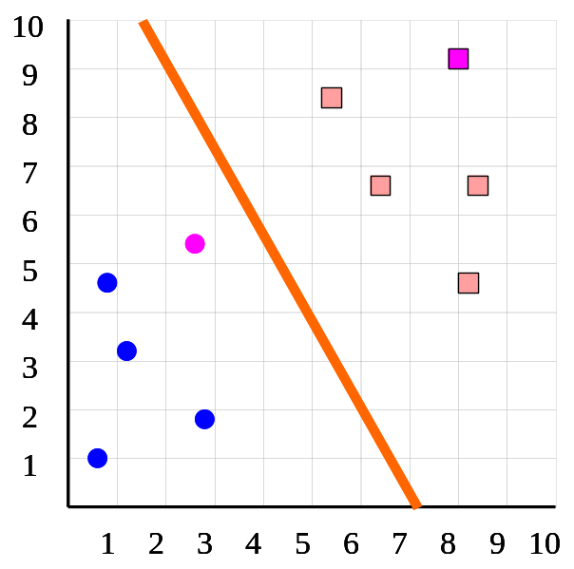
Predictive Accuracy I
How do we estimate the accuracy of our classifier?
  We can use K-fold cross validation
We divide the dataset into K equal sized sections. The algorithm is tested K times, each time leaving out one of the K section from building the classifier, but using it to test the classifier instead
Number of correct classifications
Number of instances in our database
Accuracy =
K = 5
Insect ID | Abdomen Length | Antennae Length | Insect Class
1 | 2.7 | 5.5 | Grasshopper
2 | 8.0 | 9.1 | Katydid
3 | 0.9 | 4.7 | Grasshopper
4 | 1.1 | 3.1 | Grasshopper
5 | 5.4 | 8.5 | Katydid
6 | 2.9 | 1.9 | Grasshopper
7 | 6.1 | 6.6 | Katydid
8 | 0.5 | 1.0 | Grasshopper
9 | 8.3 | 6.6 | Katydid
10 | 8.1 | 4.7 | Katydids

Slide 40
Predictive Accuracy II
Using K-fold cross validation is a good way to set any parameters we may need to adjust in (any) classifier.
We can do K-fold cross validation for each possible setting, and choose the model with the highest accuracy. Where there is a tie, we choose the simpler model.
Actually, we should probably penalize the more complex models, even if they are more accurate, since more complex models are more likely to overfit (discussed later).
Accuracy = 94%
Accuracy = 100%
Accuracy = 100%
10
10
10
9
9
9
8
8
8
7
7
7
6
6
6
5
5
5
4
4
4
3
3
3
2
2
2
1
1
1
1
2
3
4
5
6
7
8
9
10
1
2
3
4
5
6
7
8
9
10
1
2
3
4
5
6
7
8
9
10

Slide 41
Predictive Accuracy III
Number of correct classifications
Number of instances in our database
Accuracy =
Accuracy is a single number, we may be better off looking at a confusion matrix. This gives us additional useful information…
True label is...
 | Cat | Dog | Pig
Cat | 100 | 0 | 0
Dog | 9 | 90 | 1
Pig | 45 | 45 | 10
Classified as a…

Slide 42
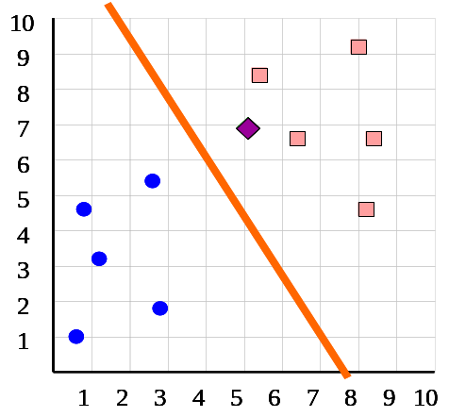
Speed and Scalability I
We need to consider the time and space requirements for the two distinct phases of classification:
  Time to construct the classifier
    In the case of the simpler linear classifier, the time taken to fit the line, this is linear in the number of instances.
  Time to use the model
    In the case of the simpler linear classifier, the time taken to test which side of the line the unlabeled instance is. This can be done in constant time.
As we shall see, some classification algorithms are very efficient in one aspect, and very poor in the other.

Slide 43
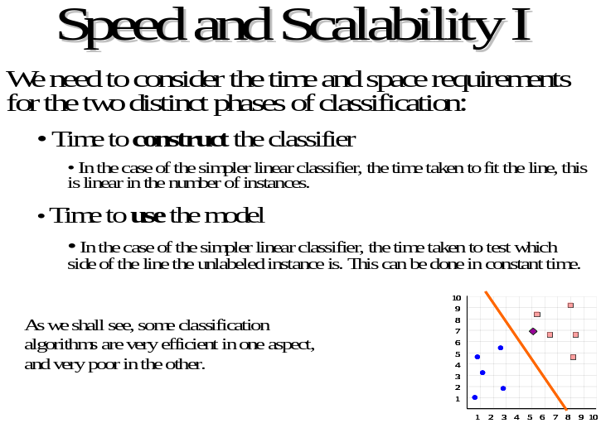
Speed and Scalability II
For learning with small datasets, this is the whole picture
However, for data mining with massive datasets, it is not so much the (main memory) time complexity that matters, rather it is how many times we have to scan the database.
This is because for most data mining operations, disk access times completely dominate the CPU times.
For data mining, researchers often report the number of times you must scan the database.

Slide 44
Robustness I
We need to consider what happens when we have:
Noise
  For example, a persons age could have been mistyped as 650 instead of 65, how does this effect our classifier? (This is important only for building the classifier, if the instance to be classified is noisy we can do nothing).
Missing values
For example suppose we want to classify an insect, but we only know the abdomen length (X-axis), and not the antennae length (Y-axis), can we still classify the instance?
10
10
10
10
9
9
9
9
8
8
8
8
7
7
7
7
6
6
6
6
5
5
5
5
4
4
4
4
3
3
3
3
2
2
2
2
1
1
1
1
1
1
1
1
2
2
2
2
3
3
3
3
4
4
4
4
5
5
5
5
6
6
6
6
7
7
7
7
8
8
8
8
9
9
9
9
10
10
10
10

Slide 45
Robustness II
We need to consider what happens when we have:
Irrelevant features
For example, suppose we want to classify people as either
  Suitable_Grad_Student
  Unsuitable_Grad_Student
And it happens that scoring more than 5 on a particular test is a perfect indicator for this problem…
10
If we also use “hair_length” as a feature, how will this effect our classifier?
9
8
7
6
5
4
3
2
1
1
2
3
4
5
6
7
8
9
10
1
2
3
4
5
6
7
8
9
10

Slide 46
Robustness III
We need to consider what happens when we have:
Streaming data
For many real world problems, we don’t have a single fixed dataset. Instead, the data continuously arrives, potentially forever… (stock market, weather data, sensor data etc)
Can our classifier handle streaming data?
10
9
8
7
6
5
4
3
2
1
1
2
3
4
5
6
7
8
9
10

Slide 47
Interpretability
Some classifiers offer a bonus feature. The structure of the learned classifier tells use something about the domain.
As a trivial example, if we try to classify peoples health risks based on just their height and weight, we could gain the following insight (Based of the observation that a single linear classifier does not work well, but two linear classifiers do).
There are two ways to be unhealthy, being obese and being too skinny.
Weight
Height

Slide 48
Summary of Classification
We have seen 4 major classification techniques:
Simple linear classifier, Decision tree, Neural Networks
There are other techniques:
Nearest neighbor, Support Vector Machines, Genetic algorithms..
In general, there is no one best classifier for all problems. You have to consider what you hope to achieve, and the data itself…

