Slide 1
ENVIROMENT

Slide 2
BEFORE WE GET STARTED
Using Windows 10 or Ubuntu 16.04.
Installed Git.
Installed Visual Studio Code – with extensions with extensions : Live server, Prettier, HTML CSS Support, IntelliSense for CSS classes, Auto Close Tag, HTML Snippets, Bootstrap 4 Snippets, Material Theme, Material Icons …
Chrome Web Browser – with extensions : Ddict Translate.
* Note it on your paper then we move on to next slide, install it immediately.

Slide 3
BEFORE WE GET STARTED
Using Windows 10 or Ubuntu 16.04.
Installed Git.
Installed Visual Studio Code – with extensions with extensions : Live server, Prettier, HTML CSS Support, IntelliSense for CSS classes, Auto Close Tag, HTML Snippets, Bootstrap 4 Snippets, Material Theme, Material Icons …
Chrome Web Browser – with extensions : Ddict Translate.
* Note it on your paper then we move on to next slide, install it immediately.

Slide 4
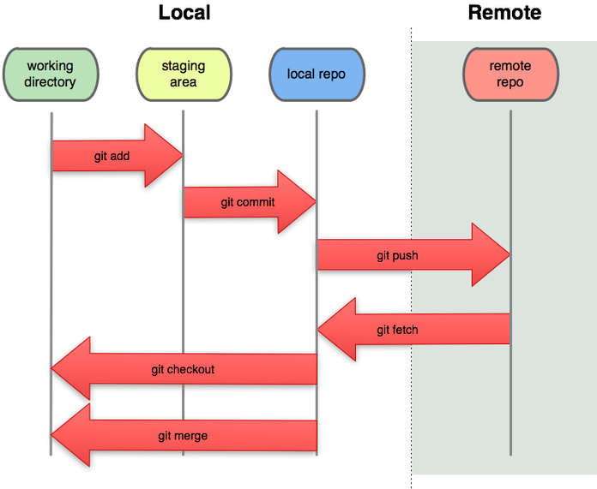
USING GIT & GITHUB REPOSITORY
Install Git & register an account at Github.com.
Git is a software tool that we use to track the changes made to our software over time.
GitHub is a code hosting platform for version control and collaboration. It lets you and others work together on projects from anywhere.

Slide 5
GIT BASH & COMMAND LINE
Have to install Git and using Git Bash during this course.
Learn some of command line to using like : cd, ls, rm, mv, cp.
Using Tab (in keyboard) to complete your command line.
Try to access into your disk by Git Bash.
Try this one : cd C:/ and mkdir my-folder, then using cd to go to that folder.

Slide 6
TRY GITHUB REPOSITORY
Git pull origin master https://github.com/namnh06/aptech-php-course.
Then create new Repository at Github.com with name convention : Aptech-php-13-your-name, then ADD, COMMIT and PUSH into your repository.
Remember to config your account at local (your computer) :
git config --global user.name "[name]“
git config --global user.email "[email address]"

Slide 7
USING SOME RESOURCE
https://git-scm.com/doc
https://services.github.com/on-demand/downloads/github-git-cheat-sheet.pdf
https://try.github.io/levels/1/challenges/1
https://guides.github.com/activities/hello-world/
https://backlog.com/git-tutorial/vn/stepup/stepup1_1.html
https://viblo.asia/p/co-ban-ve-git-Eb85oXROK2G
https://viblo.asia/p/tim-hieu-ve-mot-so-khai-niem-trong-git-RQqKLgVN57z

Slide 8
LET’S DO IT TOGETHER !!!

