Slide 1
HTML

Slide 2
BEFORE WE GET STARTED
Using Windows 10 or Ubuntu 16.04.
Installed Git.
Installed Visual Studio Code – with extensions with extensions : Live server, Prettier, HTML CSS Support, IntelliSense for CSS classes, Auto Close Tag, HTML Snippets, Bootstrap 4 Snippets, Material Theme, Material Icons …
Chrome Web Browser – with extensions : Ddict Translate.
Register & create your Repository on GitHub.com with convention: Aptech-php-13-your-name
* Note it on your paper then we move on to next slide, install it immediately.

Slide 3
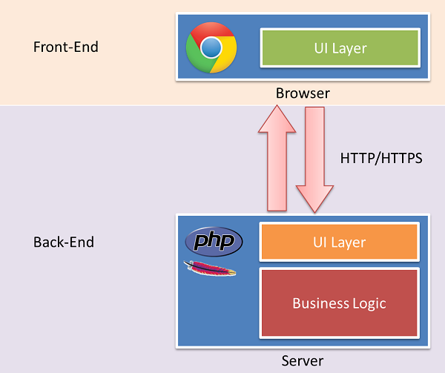
HOW THE WEBSITE WORKS ?

Slide 4
WHAT IS HTML ?
HTML is the standard markup language for creating Web pages – Web Page is a document which can be display in a web browser such as Firefox, Google Chrome and Website is a collection of webpages.
HTML stands for Hyper Text Markup Language. Extension file HTML is .html.
HTML elements are the building blocks of HTML pages and represented by tags.
Browsers do not display the HTML tags, but use them to render the content of the page.

Slide 5
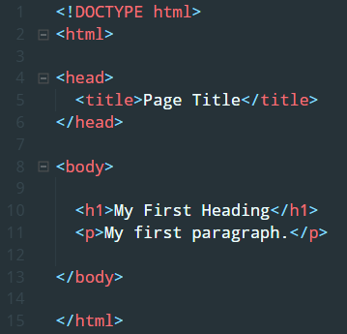
HTML DOCUMENT
HTML documents must start with a document type declaration : <!DOCTYPE html> , represented for HTML5.
The <html> element is the root element of an HTML page and end with </html>.
The <head> element contains meta information about the document.
The <body> element contains the visible page content.
Do not care about another element. Will be learned it later.

Slide 6

HTML ELEMENT
HTML tags are element names surrounded by angle brackets :
HTML tags normally come in pairs, but sometime go alone.
The first tag is the opening tag and the other one is closing tag. Carefully with forward slash of closing tag.
Some of special tag do not have the close tag, it is called empty elements.
HTML elements can be nested : <tag1> <tag2> </tag2> </tag1>.

Slide 7
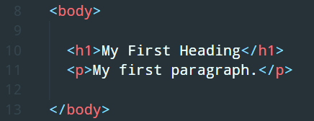

HEADING & PARAGRAPHS
Heading are defined with <h1>, it is a element of HTML and a tag.
Headings are important in the web page, it is using for title of article or something like that.
There are <h1> to <h6> represented for the important of your content.
The <p> element defines a paragraph, use it for the normal content of web page.

Slide 8

HTML ATTRIBUTES & STYLES
Attributes provide additional information about HTML elements.
All HTML elements can have attributes.
Attributes are always specified in the start tag.
Attributes usually come in name/value pairs like : name=“value”.
Using style attribute to setting the style of an HTML element.
Style attribute has syn tax : <tagname style="property:value;">, property is a CSS property, value is a CSS value.
Will be learned CSS later.

Slide 9
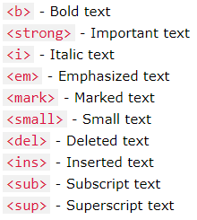
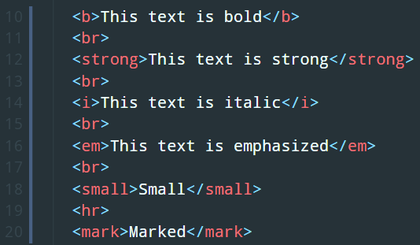
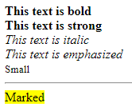
HTML FORMATTING
There are some special HTML elements for defining text with a special meaning.
The <br> tag breaks line and the <hr> tag separate content with a horizontal rule.
HTML uses elements like <b> and <i> for formatting output, like bold or italic text.

Slide 10
HTML LINKS
HTML Links element are hyperlinks and allow users to click their way from page to page.
Links are defined with the <a> tag.
The href attribute specifies the destination address. Href is stand for HyperText Reference.
The target=“_blank” attribute specifies open new window in browser.

Slide 11

HTML IMAGES
IN HTML, images are defined with the <img> tag.
The <img> tag is empty, it contains attributes and does not have a closing tag.
The src attribute specifies URL of the image.
The alt attribute provides an alternate text for an image.

Slide 12
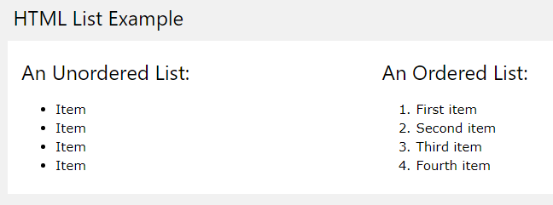
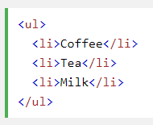
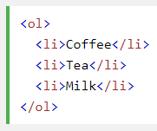
HTML LISTS
There are 2 types of HTML List element : Unordered List and Ordered List.
An unordered list is using the <ul> </ul> tag and an ordered list use the <ol> </ol> tag.
Each list item inside them is using the <li> </li> tag.

Slide 13
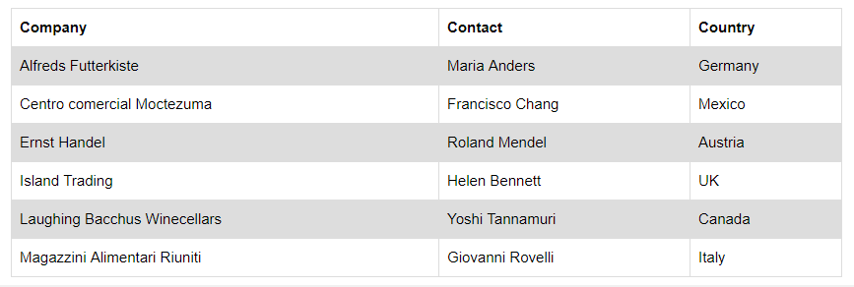
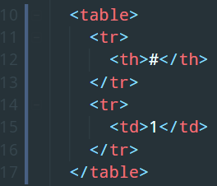
HTML TABLE
An HTML Table is defined with the <table> </table> tag.
Table Row is defined with the <tr> </tr> tag.
Table Header is defined with the <th> </th> tag and data/cell is defined with the <td> </td> tag.

Slide 14
HTML BLOCKS & INLINE
Every HTML element has a default display value depending on what type of element it is.
A block-level element always start on a new line a takes up the full width available.
An inline element does not start on a new line only takes up as much width as necessary.
The <div> </div> tag is often used as a container for other elements and the <span> </spam> often for some text.

Slide 15
TIME TO PRACTICE

