Slide 1
JAVASCRIPT

Slide 2
BEFORE WE GET STARTED
MAKE SURE YOU READ THROUGH THE GREETING, ENVIROMENT, HTML SECTION AND CSS SECTION

Slide 3
WHAT IS JAVASCRIPT ?
JavaScript is a scripting language that enables you to create dynamically to updating content, control multimedia, animate images, ... in Web pages. JavaScript is the programming language, interpreted by the browser.
JavaScript is used in desktop, server and database either.
JavaScript is not Java.
JavaScript was invented by Brendan Eich in 1995, and became an ECMA standard in 1997.

Slide 4
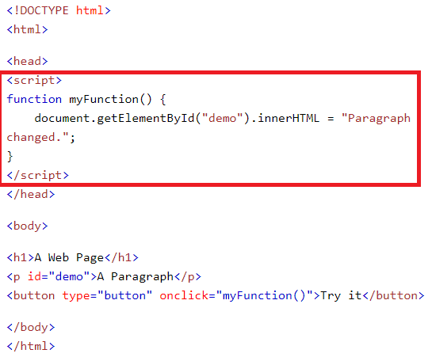
HOW TO USE AND SYNTAX
JavaScript can be used in HTML by using script element or external file like CSS with .js file’s extension.
The <script> </script> tag can be used in <head> or <body> section of HTML page, or both of them.
In external file Javascript, no need to declare script tag, have to declare script link to file.

Slide 5
JAVASCRIPT OUTPUT
First, JavaScript can be used by the element, id or class of HTML to manipulate the content of web pages.
Using document.getElementById(‘id-name’) to get the “point” on HTML DOM by ID.
Writing into an HTML element, using innerHTML to defines the HTML content.
Writing into the HTML output, using document.write() to rewrite into DOM.
Writing into an alert box, using window.alert() to call a modal display data.
Writing into the browser console, using console.log() to display data in console tab of Dev Tools.

Slide 6
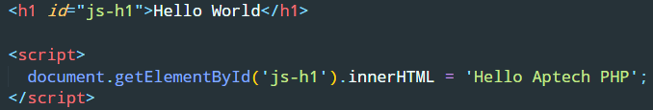

EXERCISE 1
Using inner HTML to change content of h1 element below to “Hello Aptech PHP”:
Using window.alert and console.log to display your name :

Slide 7

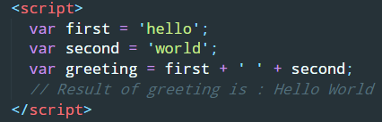
JAVASCRIPT VARIABLES & OPERATORS
Variables are containers for storing data values.
Using var keyword to declare variables, then assign value to that variable or just declare it with none value.
JavaScript Arithmetic Operators are used to perform arithmetic on numbers, using : addition (+), subtraction (-), multiplication (*), division (/), …
JavaScript String Operators use + operator to add (concatenate) strings.

Slide 8
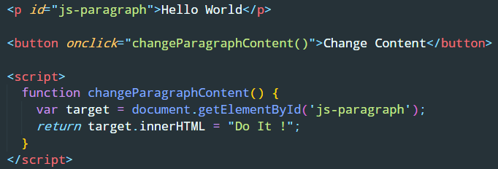
JAVASCRIPT FUNCTIONS
A JavaScript function is a block of code designed to perform a particular task.
A JavaScript function is executed when “something” invokes it (calls it).
Function will execute when an event occurs (user clicks a button), invoked (call) from JavaScript code or automatically.

Slide 9
JAVASCRIPT EVENTS
HTML events are “things” that happen to HTML elements.
When JavaScript is used in HTML pages, JavaScript can “react” on these events.
There are some HTML events : onchange, onclick, onmouseover, onmouseout, onkeydown, onload.
Event handlers can be used to handle, and verify, user input, user actions and browser actions.
Many different methods can be used to let JavaScript with events.

Slide 10
TIME TO PRACTICE

