Slide 1
PHP BASIC

Slide 2
BEFORE WE GET STARTED
Using Windows 10 or Ubuntu 16.04.
Installed Git.
Installed Chrome Web Browser.
Installed VS Code.
Installed XAMPP for Windows PHP 7.0.
Checkout : https://github.com/namnh06/aptech-php-course

Slide 3
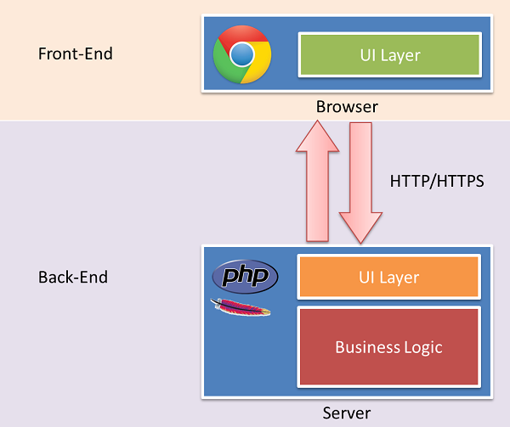
HOW THE WEBSITE WORKS ?

Slide 4
SET UP ENVIROMENT
Turn on Git Bash (on Windows).
Move to C:/xampp/htdocs/ by command line : cd /c/xampp/htdocs -> Enter.
Clone Repository by Git Hub, using this command line : git clone https://github.com/namnh06/aptech-php-course.git -> Enter.
Using this repository to learn and get homework, exercise from there.
Create your repository with convention code : Aptech-php-*-your-name. E.G : Aptech-php-12-nam-nh.
Push your repository to Git Hub and do your home work.

Slide 5
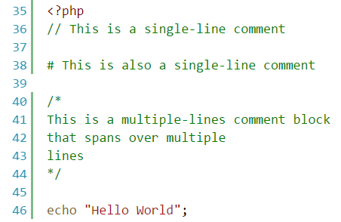
SYNTAX, ECHO, COMMENT
PHP files have “.php” extension.
PHP script always starts with <?php and end with ?>, in some case no need to close ?> in file .php. The end of statement of code always need “;”.
Comment starts with “//”, “#” or “/* */”.
Output into HTML Dom by using “echo”, “print”, “print_r” or “var_dump”.
Can write HTML, CSS, Javascript inside “.php” file.

Slide 6
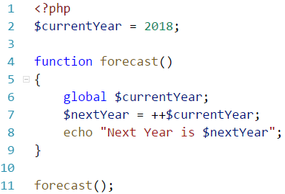
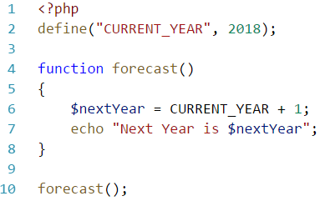
VARIABLE, CONSTANT
Variable starts with “$” (dollar sign), no need to declare type of variable.
Variable name must start with a letter or underscore character “_” and can not start with number.
Variable name can only contain alpha-numeric characters and underscores (A-z, 0-9 and _ ).
Using “global”, “static” keyword to make variable “special”.
Using function “define” to create a constant.

Slide 7
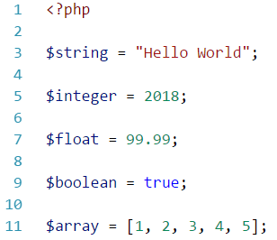
DATA TYPES
String : a sequence of characters.
Integer : non-decimal number between -2,147,483,648 and 2,147,483,647.
Float : decimal number.
Boolean : TRUE/FALSE.
Array : stores multiple values.
Object : stores data and information or properties and function.
NULL : is NULL.

Slide 8
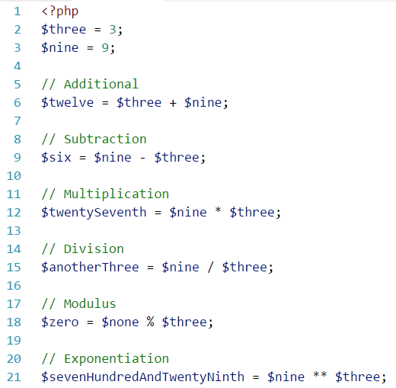
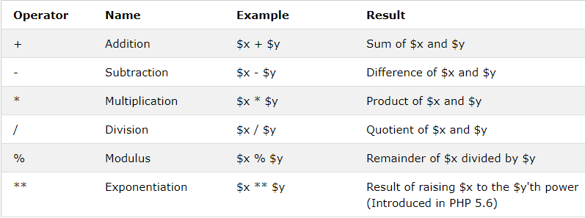
OPERATORS
Arithmetic Operators

Slide 9
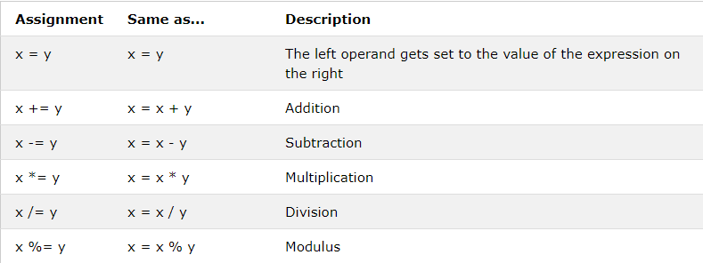
OPERATORS (cont. 1)
Assignment Operators

Slide 10
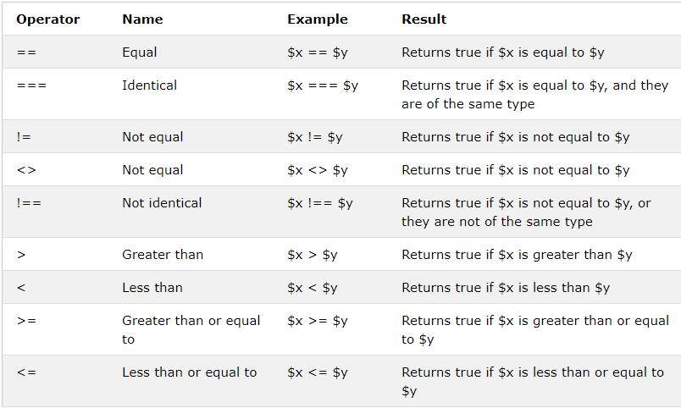
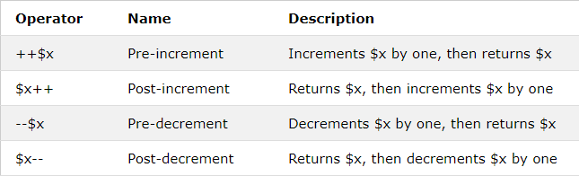
OPERATORS (cont. 2)
Comparison Operators
Increment/Decrement Operators

Slide 11
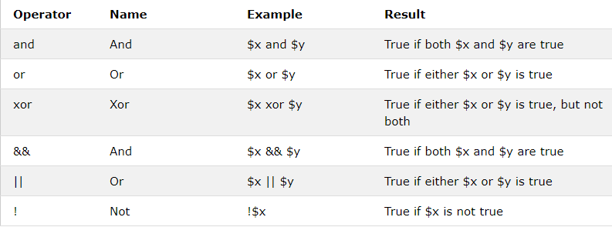
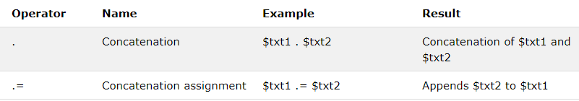
OPERATORS (cont. 3)
Logical Operators
String Operators

Slide 12
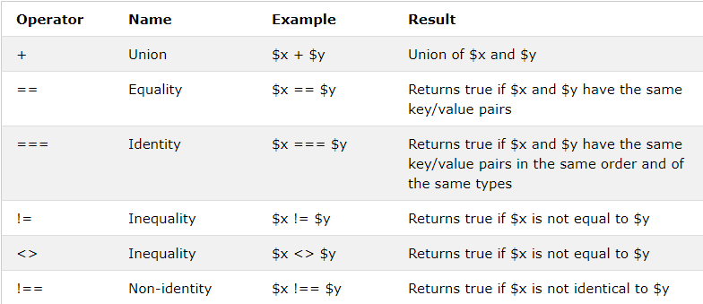
OPERATORS (cont. 4)
Array Operators

Slide 13
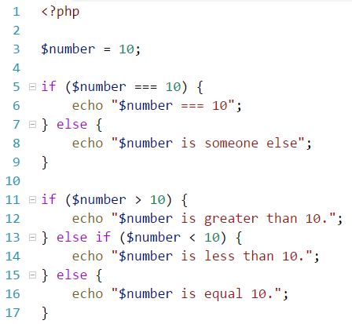
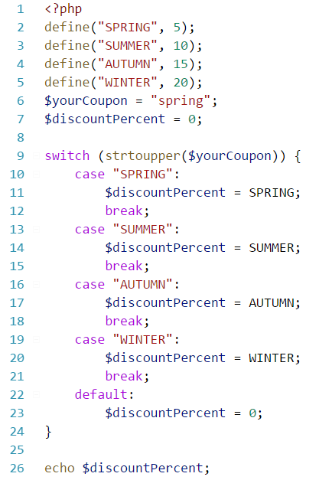
CONDITION STATMENTS
If
If … else
If … else if … else
Switch case

Slide 14
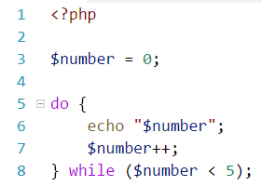
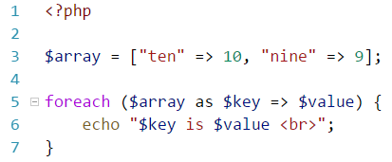
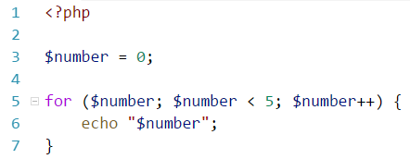
LOOPS
While
Do ... While
Foreach
For

Slide 15
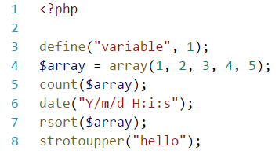
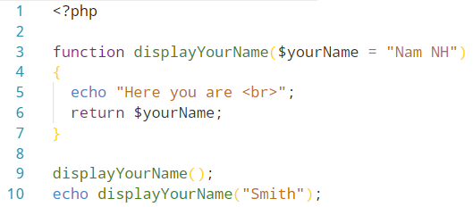
FUNCTIONS
A function name can start with a letter or underscore (not a number).
Give the function a name that reflects what the function does!
PHP has more than 1000 built-in functions.

Slide 16
SUPERGLOBALS
Built-in variables that are always available in all scopes.
Always accessible, regardless of scope, can access from any function or file.
$GLOBALS
$_SERVER
$_REQUEST
$_POST
$_GET
$_FILES
$_ENV
$_COOKIE
$_SESSION

Slide 17
TIME TO PRACTICE.

Slide 18
EXERCISE
Write a PHP script to get the PHP version and configuration information.
Write a PHP script to display the following strings. E.g : ‘My name is Nam’.
$var = 'PHP Tutorial'. Put this variable into the title section, h3 tag and as an anchor text within an HTML document.
Do the operator : 10/5 and print the result.
Create a variable and use it into an string. E.g : ‘hello ’ + $var + ‘ world’.

