Slide 1
Java Technology
GV:TS. Nguyễn Hà Giang

Slide 2
Group 6
Nguyễn Trà Thanh Trí (C)
Trần Thị Thanh Trang
Nguyễn Vinh Hiển
Trần Thanh Linh

Slide 3
Part A: The Theory section
CHAPTER 2. Introduction to Java Applications
Introduction
Your first program in Java: Printing a Line of text
Modifying your first java program
Displaying text with printf
Another Application: Adding integers
Memory Concepts
Arithmetic
Decision Making: Equality and relational operators

Slide 4
Introduction
This chapter introduces Java application programming.
We then present a program that obtains two numbers from a user, calculates their sum and displays the result.
The last example demonstrates how to make decisions.

Slide 5
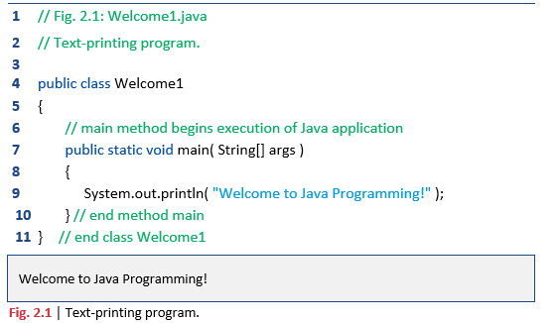
Your first program in Java: Printing a Line of text
A Java application is a computer program that executes when you use the java command to launch the Java Virtual Machine.
Later in this section we’ll discuss how to compile and run a Java application.
Figure 2.1 shows the program followed by a box that displays its output.

Slide 6
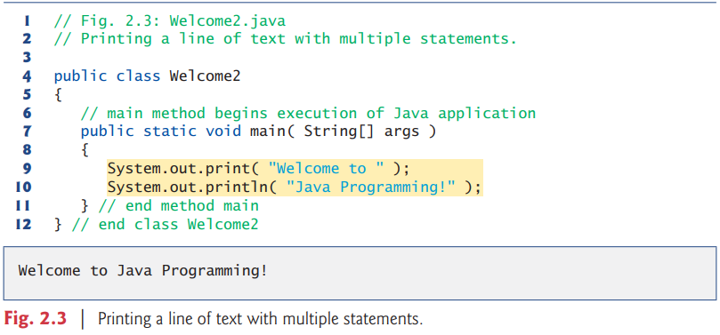
Modifying your first java program
Class Welcome2, shown in Fig. 2.3, uses two statements to produce the output shown in Fig. 2.1
The program is similar to Fig. 2.1, so we discuss only the changes here.
Line 4 begins the Welcome2 class declaration.
Lines 9–10 of method main display one line of text.

Slide 7
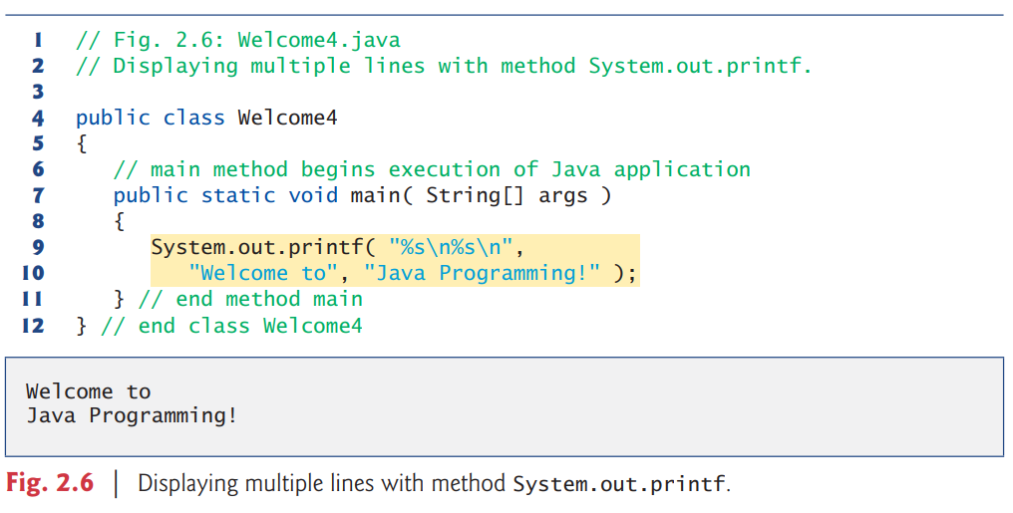
Displaying text with printf
The System.out.printf method displays formatted data.
Lines 9–10 call method System.out.printf to display the program’s output.
When a method requires multiple arguments, they’re placed in a comma-separated list.

Slide 8
Another Application: Adding integers
Our next application reads two integers typed by a user at the keyboard, computes their sum and displays it.
This program must keep track of the numbers supplied by the user for the calculation later in the program.
Programs remember numbers and other data in the computer’s memory and access that data through program elements called variables.
The program of Fig. 2.7 demonstrates these concepts. In the sample output, we use bold text to identify the user’s input .

Slide 9
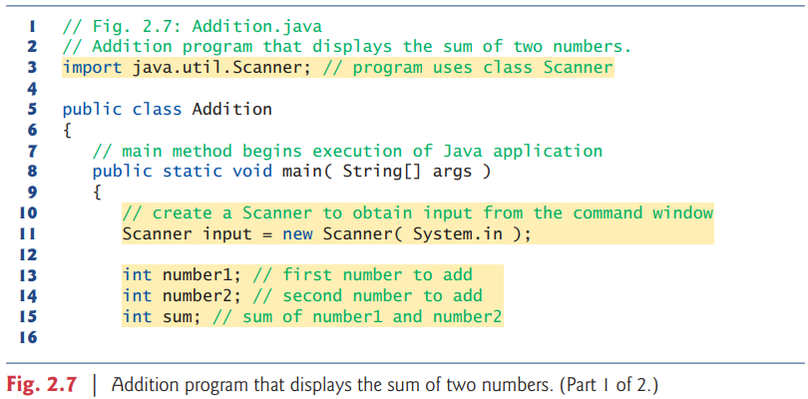
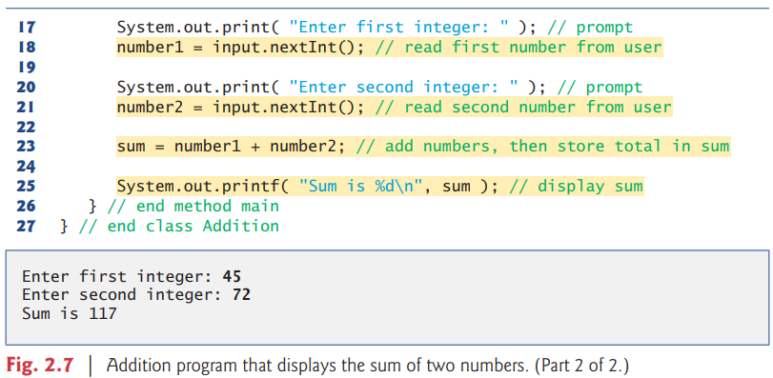

Slide 10
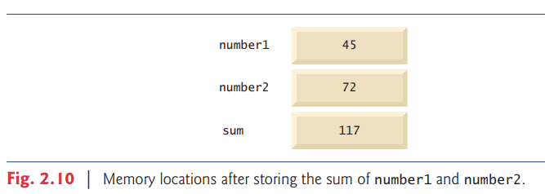
Memory Concepts
After the program of Fig. 2.7 obtains values for number1 and number2, it adds the values and places the total into variable sum.
After sum has been calculated, memory appears as shown in Fig. 2.10.
These values were used, but not destroyed, as the computer performed the calculation.

Slide 11
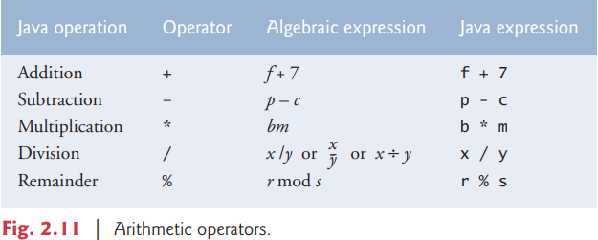
Arithmetic
Most programs perform arithmetic calculations.
The arithmetic operators are summarized in Fig.
Note the use of various special symbols not used in algebra.
The asterisk indicates multiplication, and the percent sign is the remainder operator, which we’ll discuss shortly.
Fig 2.11 are binary operators, because each operates on two operands.

Slide 12
Decision Making: Equality and relational operators
A condition is an expression that can be true or false. This section introduces Java’s if selection statement, which allows a program to make a decision based on a condition’s value.
If the condition is false, the body does not execute.
Both equality operators have the same level of precedence, which is lower than that of the relational operators.
The relational operators all have the same level of precedence and also associate from left to right.

Slide 13
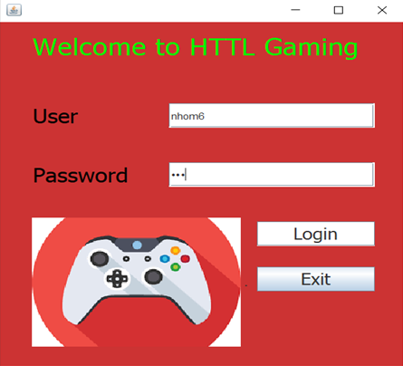
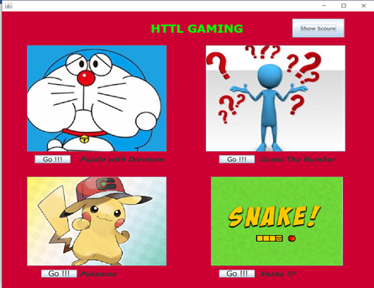
Part B: Java Swing Application
The game's main interface:
Login Interface

Slide 14
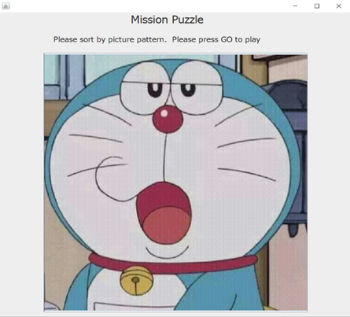
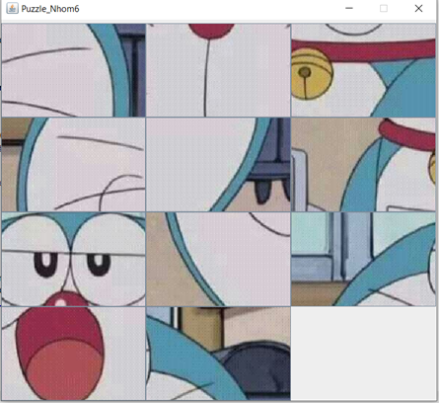
Game puzzle:
Mission of game
Interface game

Slide 15
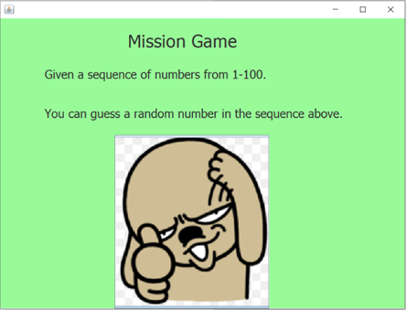
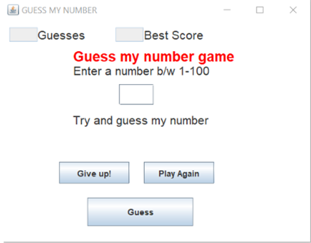
Game guess the number:
Mission of game
Interface game

Slide 16
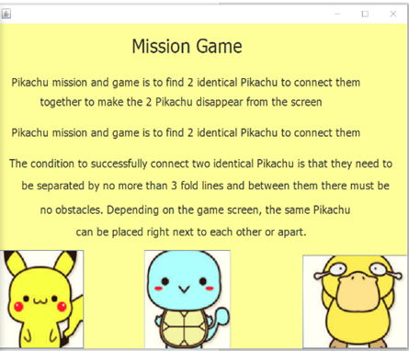
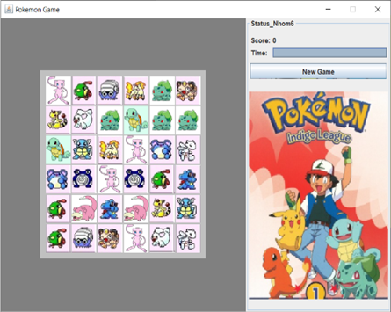
Game pokemon:
Mission of game
Interface game

Slide 17
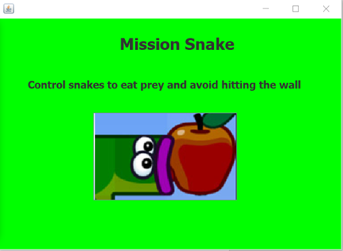
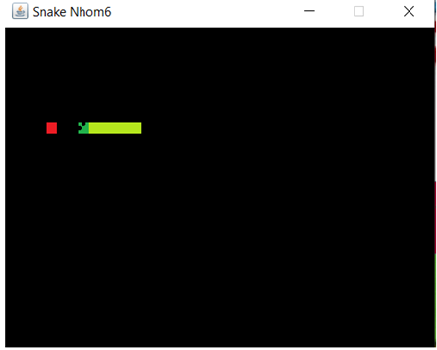
Game snake of prey:
Mission of game
Interface game

Slide 18
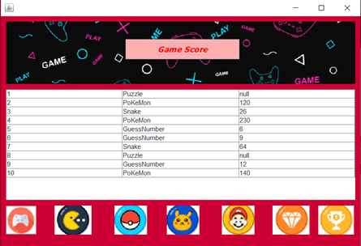
Associated with Table:

Slide 19
THANKS
FOR
LISTEN!
Any questions?

