Slide 1

William Stallings, Computer Organization and Architecture, 9th Edition
Chapter 5
Internal Memory
Notes:
Lecture slides prepared for “Computer Organization and Architecture”, 9/e, by William Stallings, Chapter 5 “Internal Memory”.
Adapted by Thân Văn Sử

Slide 2
Objectives
CLO4: Describe in detail the essential elements of computer organisation including internal bus, memory, Input/Output ( I/O) organizations and interfacing standards and discuss how these elements function;
Notes:
The term location in Table 4.1 refers to whether memory is internal and external
to the computer. Internal memory is often equated with main memory. But there
are other forms of internal memory. The processor requires its own local memory, in
the form of registers (e.g., see Figure 2.3). Further, as we shall see, the control unit
portion of the processor may also require its own internal memory. We will defer
discussion of these latter two types of internal memory to later chapters. Cache is
another form of internal memory. External memory consists of peripheral storage
devices, such as disk and tape, that are accessible to the processor via I/O controllers.
An obvious characteristic of memory is its capacity. For internal memory, this is
typically expressed in terms of bytes (1 byte = 8 bits) or words. Common word lengths
are 8, 16, and 32 bits. External memory capacity is typically expressed in terms of bytes.
A related concept is the unit of transfer. For internal memory, the unit
of transfer is equal to the number of electrical lines into and out of the memory
module. This may be equal to the word length, but is often larger, such as 64, 128, or
256 bits. To clarify this point, consider three related concepts for internal memory:
• Word: The “natural” unit of organization of memory. The size of a word is typically
equal to the number of bits used to represent an integer and to the instruction
length. Unfortunately, there are many exceptions. For example, the CRAY
C90 (an older model CRAY supercomputer) has a 64-bit word length but uses
a 46-bit integer representation. The Intel x86 architecture has a wide variety of
instruction lengths, expressed as multiples of bytes, and a word size of 32 bits.
• Addressable units: In some systems, the addressable unit is the word. However,
many systems allow addressing at the byte level. In any case, the relationship
between the length in bits A of an address and the number N of addressable
units is 2A = N.
• Unit of transfer: For main memory, this is the number of bits read out of or
written into memory at a time. The unit of transfer need not equal a word or
an addressable unit. For external memory, data are often transferred in much
larger units than a word, and these are referred to as blocks

Slide 3
Objectives
How are main memory structured?
Whether main memory may cause errors?
How many types of memory?
After studying this chapter, you should be able to:
Present an overview of the principle types of semiconductor main memory.
Understand the operation of a basic code that can detect and correct singlebit errors in 8-bit words.
Summarize the properties of contemporary advanced DRAM organizations.

Slide 4
Contents
5.1 Semiconductor Main Memory
5.2 Error Correction
5.3 Advanced Dram Organization
Semiconductor- Chất bán dẫn (silic, germanium) là vật liệu trung gian giữa chất dẫn điện và chất cách điện. Chất bán dẫn chỉ hoạt động như một chất dẫn điện ở một điều kiện nào đó. Chất bán dẫn được dùng để tạo ra các transistor (transfer-resistor).

Slide 5
10 Questions must be answered
5.1 What are the key properties of semiconductor memory?
5.2 What are two interpretations of the term random-access memory?
5.3 What is the difference between DRAM and SRAM in terms of application?
5.4 What is the difference between DRAM and SRAM in terms of characteristics such as speed, size, and cost?
5.5 Explain why one type of RAM is considered to be analog and the other digital.
5.6 What are some applications for ROM?
5.7 What are the differences among EPROM, EEPROM, and flash memory?
5.8 What is a parity bit?
5.9 How is the syndrome for the Hamming code interpreted?
5.10 How does SDRAM differ from ordinary DRAM?

Slide 6
5.1- Semiconductor Main Memory
Organization
Semiconductor Memory Types
Dynamic RAM and Static RAM
Types of ROM
Chip Logic
Chip Packaging
Module Organization
Interleaved Memory

Slide 7
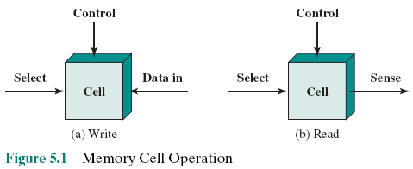
Organization
Basic element of a semiconductor memory is the memory cell.
Cell properties:
1-They exhibit two stable (or semistable) states, which can be used to represent binary 1 and 0.
2- They are capable of being written into (at least once), to set the state.
3- They are capable of being read to sense (nội dung bên trong) the state

Slide 8
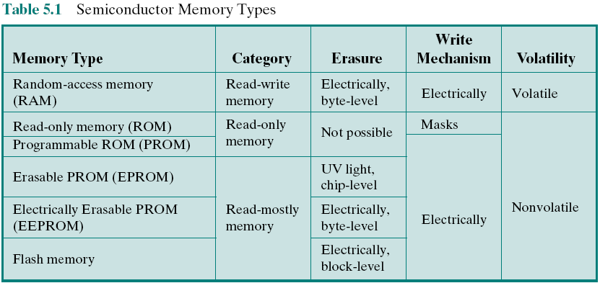
Semiconductor Memory Types
Read NOTE for more information
All of the memory types that we will explore in this chapter are random access. That is, individual words of memory are directly accessed through wired-in addressing logic.
Notes:
ROM chứa các code và dữ liệu quan trong nhất của hệ thống giúp điều khiển sự vận hành của hệ thống nên không cho sửa xóa.
ROM được chế tạo bằng một lưới các cầu chì , chỗ nào còn cầu chì (cho điện chạy qua) mang bit 1. Chỗ cầu chì đứt là bit 0.
Ban đầu các cầu chì đều tồn tại. Một thiết bị ghi ROM sẽ đánh đứt một số cầu chì. Để một cầu chì không đứt thì dùng một mặt nạ (mask) che nó trong quá trình ghi ROM.
PROM: là chip nhớ có thể xóa nội dung bằng tia tử ngoại (tia cực tím/ ultra violet light). PROM thường được dùng làm chip ROM trong máy tính ở chip này có một miếng nhựa trong cho việc ghi data sau đó người ta che đi (tránh tiếp xúc tia UV) bằng một miếng nhôm. Chip ROM của máy tính thường nằm cạnh cục pin trên mainboard.
Volatile MEM : Bộ nhớ bốc hơi – Data trong bộ nhớ cần có điện cung cấp để bảo tồn các bit. Khi cúp điện, các điện tích bị xóa → data bị mất
Non-Volatile MEM : Bộ nhớ KHÔNG bốc hơi – Data trong bộ nhớ được bảo tồn dù máy tính cúp điện.
Khi có điện, trạng thái các cầu chì mô tả 1/0 không đổi. Với bộ nhớ flash (ổ USB chúng ta thường dùng) data được bảo tồn nhờ khả năng bảo tồn điện tích của vật liệu chế tạo.
All of the memory types that we will explore in this chapter are random access. That is,
individual words of memory are directly accessed through wired-in addressing logic.
Table 5.1 lists the major types of semiconductor memory. The most common
is referred to as random-access memory (RAM). This is, in fact, a misuse of the
term, because all of the types listed in the table are random access. One distinguishing
characteristic of memory that is designated as RAM is that it is possible
both to read data from the memory and to write new data into the memory easily
and rapidly. Both the reading and writing are accomplished through the use of
electrical signals.
The other distinguishing characteristic of RAM is that it is volatile. A RAM
must be provided with a constant power supply. If the power is interrupted, then
the data are lost. Thus, RAM can be used only as temporary storage. The two traditional
forms of RAM used in computers are DRAM and SRAM.

Slide 9
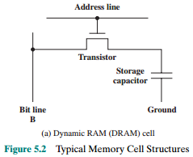
Dynamic RAM (DRAM)
RAM :Two technologies:
Dynamic RAM (DRAM) | Static RAM (SRAM)
DRAM
Made with cells that store data as charge on capacitors (tụ điện)
Presence or absence of charge in a capacitor is interpreted as a binary 1 or 0
Requires periodic charge refreshing to maintain data storage due to tendency of the stored charge to leak away, even with power continuously applied
The term dynamic refers to changing voltage of this capacity.
Read NOTE for more information
Notes:
Capacitor: Tụ điện được chế tạo bằng 2 lá (bản cực nhôm/đồng) dẫn điện ở giữa là lớp cách điện (không khí/giấy/…) được cuộn thật nhỏ lại.
Khi áp đặt 2 đầu +- của điện một chiều (thí dụ điện DC 5 volt) vào 2 bản cực, tụ điện sẽ tích điện.
Tụ điện tích điện: 1 (3.8v – 5v), tụ điện không tích điện: 0
Vì tấm cách điện rất mỏng, một số electron vẫn có thể rò rỉ (LEAK) qua lớp cách điện (không có vật liệu nào tuyệt đối cách điện) sẽ làm cho điện áp của tụ điện giảm theo thời gian.
Khi điện áp giảm nhiều (dưới 3.8 V), điện áp này không thể kích hoạt các mạch điện của máy tính sau đó nền cần phải được phục hồi (làm tươi/ refresh). Khi tụ điện đang được làm tươi, mọi truy xuất phải chờ. → Hiệu suất kém → Điểm yếu của DRAM
Ưu điểm của DRAM: Một tế bào DRAM có kích cỡ rất nhỏ (ít linh kiện, công nghệ nano) nên DRAM có thể được chế tạo có dung lượng rất lớn và được dùng làm RAM của máy tính hiện nay.
RAM technology is divided into two technologies: dynamic and
static. A dynamic RAM (DRAM) is made with cells that store data as charge on
capacitors. The presence or absence of charge in a capacitor is interpreted as a
binary 1 or 0. Because capacitors have a natural tendency to discharge, dynamic
RAMs require periodic charge refreshing to maintain data storage. The term
dynamic refers to this tendency of the stored charge to leak away, even with power
continuously applied.

Slide 10
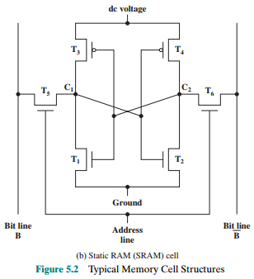
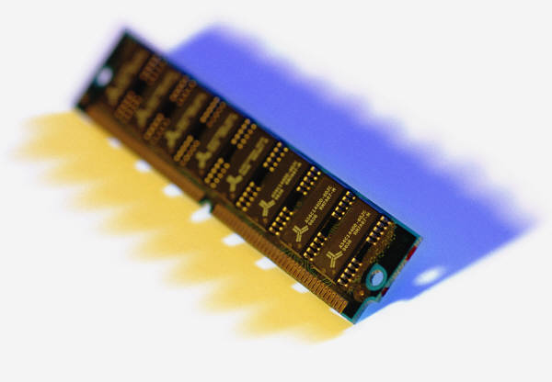
Static RAM (SRAM)
Digital device that uses the same logic elements used in the processor
Binary values are stored using traditional flip-flop logic gate configurations
Will hold its data as long as power is supplied to it
Read NOTE for more information
Notes:
Static RAM : RAM tĩnh, điện áp bền vững (tĩnh, không đổi nên không cần làm tươi), một tế bào SRAM cần 6 transistor nên có kích cỡ lớn hơn tế bào DRAM nhiều → Khó chế tạo các SRAM có kích thước lớn, mắc tiền nhưng không cần làm tười → Hiện suất cao
SRAM thường được dùng làm thanh ghi của CPU, bộ nhớ cache, bộ nhớ của những mạch cao cấp như card màn hình…
In contrast, a static RAM (SRAM) is a digital device that uses the
same logic elements used in the processor. In a SRAM, binary values are stored
using traditional flip-flop logic-gate configurations (see Chapter 11 for a description
of flip-flops). A static RAM will hold its data as long as power is supplied to it.
Figure 5.2b is a typical SRAM structure for an individual cell. Four transistors
(T₁, T₂, T₃, T₄) are cross connected in an arrangement that produces a stable logic
state. In logic state 1, point C₁ is high and point C₂ is low; in this state, T₁ and T₄ are off
and T₂ and T₃ are on. In logic state 0, point C₁ is low and point C₂ is high; in this state,
T₁ and T₄ are on and T₂ and T₃ are off. Both states are stable as long as the direct
current (dc) voltage is applied. Unlike the DRAM, no refresh is needed to retain data.
As in the DRAM, the SRAM address line is used to open or close a switch.
The address line controls two transistors (T₅ and T₆). When a signal is applied to
this line, the two transistors are switched on, allowing a read or write operation. For
a write operation, the desired bit value is applied to line B, while its complement
is applied to line B. This forces the four transistors (T₁, T₂, T₃, T₄) into the proper
state. For a read operation, the bit value is read from line B.

Slide 11
SRAM versus DRAM
SRAM
Both volatile: Power must be continuously supplied to the memory to preserve the bit values
Dynamic cell
Simpler to build, smaller
(smaller cells = more cells per unit area)
Less expensive
Requires the supporting refresh circuitry
Tend to be favored for large memory requirements
Used for main memory
Static
Faster
Used for cache memory (both on and off chip)
DRAM
Notes:
Both static and dynamic RAMs are volatile; that is,
power must be continuously supplied to the memory to preserve the bit values.
A dynamic memory cell is simpler and smaller than a static memory cell. Thus, a
DRAM is more dense (smaller cells = more cells per unit area) and less expensive
than a corresponding SRAM. On the other hand, a DRAM requires the supporting
refresh circuitry. For larger memories, the fixed cost of the refresh circuitry is more
than compensated for by the smaller variable cost of DRAM cells. Thus, DRAMs
tend to be favored for large memory requirements. A final point is that SRAMs are
somewhat faster than DRAMs. Because of these relative characteristics, SRAM is
used for cache memory (both on and off chip), and DRAM is used for main memory.

Slide 12
Read Only Memory (ROM)
Contains a permanent pattern of data that cannot be changed or added to.
No power source is required to maintain the bit values in memory
Data or program is permanently in main memory and never needs to be loaded from a secondary storage device
Data is actually wired into the chip as part of the fabrication process
Disadvantages of this:
No room for error, if one bit is wrong the whole batch of ROMs must be thrown out
Data insertion step includes a relatively large fixed cost
Read NOTE for more information
Notes:
Trong máy tính, ROM được gọi là ROM bios trong đó chứa:
Một số dữ liệu về cấu hình máy mà user có thể sửa.
Các Interrupt handler (trình điều khiển ngoại vi) user không thể sửa.
ROM có mạch đồng hồ thời gian thực nên cần pin điể nuôi → ROM bios thường được đặt cạnh cục pin
Nhiện diện: ROM bios có miếng nhốm dán (PROM)
As the name suggests, a read-only memory (ROM) contains a permanent pattern
of data that cannot be changed. A ROM is nonvolatile; that is, no power source is
required to maintain the bit values in memory. While it is possible to read a ROM,
it is not possible to write new data into it. An important application of ROMs is
microprogramming, discussed in Part Four. Other potential applications include
• Library subroutines for frequently wanted functions
• System programs
• Function tables
For a modest-sized requirement, the advantage of ROM is that the data or program
is permanently in main memory and need never be loaded from a secondary storage
device.
A ROM is created like any other integrated circuit chip, with the data actually
wired into the chip as part of the fabrication process. This presents two problems:
• The data insertion step includes a relatively large fixed cost, whether one or
thousands of copies of a particular ROM are fabricated.
• There is no room for error. If one bit is wrong, the whole batch of ROMs must
be thrown out.

Slide 13
Programmable ROM (PROM)
Read by yourself
Less expensive alternative
Nonvolatile and may be written into only once
Writing process is performed electrically and may be performed by supplier or customer at a time later than the original chip fabrication
Special equipment is required for the writing process
Provides flexibility and convenience
Attractive for high volume production runs
Notes:
When only a small number of ROMs with a particular memory content is
needed, a less expensive alternative is the programmable ROM (PROM). Like the
ROM, the PROM is nonvolatile and may be written into only once. For the PROM,
the writing process is performed electrically and may be performed by a supplier
or customer at a time later than the original chip fabrication. Special equipment is
required for the writing or “programming” process. PROMs provide flexibility and
convenience. The ROM remains attractive for high-volume production runs.

Slide 14
Read-Mostly Memory
Read by yourself
EPROM
Erasable programmable read-only memory
Erasure process can be performed repeatedly
More expensive than PROM but it has the advantage of the multiple update capability
EEPROM
Electrically erasable programmable read-only memory
Can be written into at any time without erasing prior contents
Combines the advantage of non-volatility with the flexibility of being updatable in place
More expensive than EPROM
Flash Memory
Intermediate between EPROM and EEPROM in both cost and functionality
Uses an electrical erasing technology, does not provide byte-level erasure
Microchip is organized so that a section of memory cells are erased in a single action or “flash”
Notes:
Another variation on read-only memory is the read-mostly memory, which is
useful for applications in which read operations are far more frequent than write
operations but for which nonvolatile storage is required. There are three common
forms of read-mostly memory: EPROM, EEPROM, and flash memory.
The optically erasable programmable read-only memory (EPROM) is read
and written electrically, as with PROM. However, before a write operation, all the
storage cells must be erased to the same initial state by exposure of the packaged
chip to ultraviolet radiation. Erasure is performed by shining an intense ultraviolet
light through a window that is designed into the memory chip. This erasure process
can be performed repeatedly; each erasure can take as much as 20 minutes to
perform. Thus, the EPROM can be altered multiple times and, like the ROM and
PROM, holds its data virtually indefinitely. For comparable amounts of storage, the
EPROM is more expensive than PROM, but it has the advantage of the multiple
update capability.
A more attractive form of read-mostly memory is electrically erasable programmable
read-only memory (EEPROM). This is a read-mostly memory that can
be written into at any time without erasing prior contents; only the byte or bytes
addressed are updated. The write operation takes considerably longer than the read
operation, on the order of several hundred microseconds per byte. The EEPROM
combines the advantage of non-volatility with the flexibility of being updatable in
place, using ordinary bus control, address, and data lines. EEPROM is more expensive
than EPROM and also is less dense, supporting fewer bits per chip.
Another form of semiconductor memory is flash memory (so named because
of the speed with which it can be reprogrammed). First introduced in the mid-1980s,
flash memory is intermediate between EPROM and EEPROM in both cost and
functionality. Like EEPROM, flash memory uses an electrical erasing technology.
An entire flash memory can be erased in one or a few seconds, which is much faster
than EPROM. In addition, it is possible to erase just blocks of memory rather than
an entire chip. Flash memory gets its name because the microchip is organized so
that a section of memory cells are erased in a single action or “flash.” However,
flash memory does not provide byte-level erasure. Like EPROM, flash memory
uses only one transistor per bit, and so achieves the high density (compared with
EEPROM) of EPROM.

Slide 15
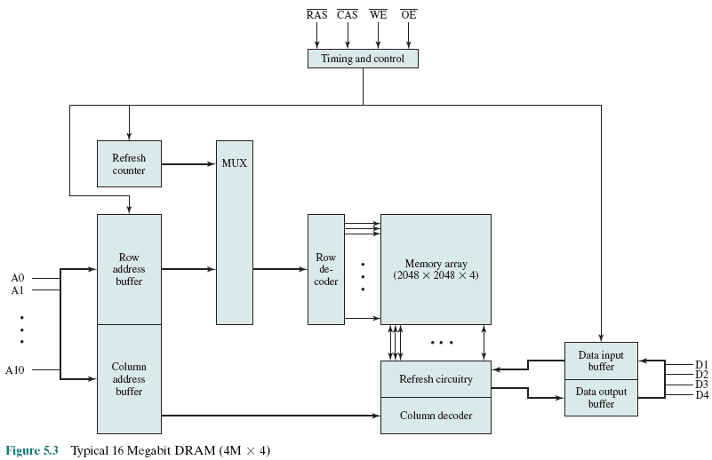
Typical 16 Mb DRAM (4M x 4)
Read by yourself
MUltipleXer is a device that selects one of several input signals and forwards the selected input into a single line
Address lines
Data lines
Notes:
Figure 5.3 shows a typical organization of a 16-Mbit DRAM. In this case, 4 bits
are read or written at a time. Logically, the memory array is organized as four square
arrays of 2048 by 2048 elements. Various physical arrangements are possible. In any
case, the elements of the array are connected by both horizontal (row) and vertical
(column) lines. Each horizontal line connects to the Select terminal of each cell in its
row; each vertical line connects to the Data-In/Sense terminal of each cell in its column.
Address lines supply the address of the word to be selected. A total of log₂W
lines are needed. In our example, 11 address lines are needed to select one of 2048
rows. These 11 lines are fed into a row decoder, which has 11 lines of input and 2048
lines for output. The logic of the decoder activates a single one of the 2048 outputs
depending on the bit pattern on the 11 input lines (2¹¹ = 2048).
An additional 11 address lines select one of 2048 columns of 4 bits per column.
Four data lines are used for the input and output of 4 bits to and from a data buffer.
On input (write), the bit driver of each bit line is activated for a 1 or 0 according to
the value of the corresponding data line. On output (read), the value of each bit line
is passed through a sense amplifier and presented to the data lines. The row line
selects which row of cells is used for reading or writing.
Because only 4 bits are read/written to this DRAM, there must be multiple
DRAMs connected to the memory controller to read/write a word of data to the bus.
Note that there are only 11 address lines (A0–A10), half the number you
would expect for a 2048 * 2048 array. This is done to save on the number of pins.
The 22 required address lines are passed through select logic external to the chip
and multiplexed onto the 11 address lines. First, 11 address signals are passed to the
chip to define the row address of the array, and then the other 11 address signals are
presented for the column address.
As an aside, multiplexed addressing plus the use of square arrays result in a
quadrupling of memory size with each new generation of memory chips. One more
pin devoted to addressing doubles the number of rows and columns, and so the size
of the chip memory grows by a factor of 4.
Figure 5.3 also indicates the inclusion of refresh circuitry. All DRAMs require
a refresh operation. A simple technique for refreshing is, in effect, to disable the
DRAM chip while all data cells are refreshed. The refresh counter steps through all
of the row values. For each row, the output lines from the refresh counter are supplied
to the row decoder and the RAS line is activated. The data are read out and
written back into the same location. This causes each cell in the row to be refreshed.

Slide 16
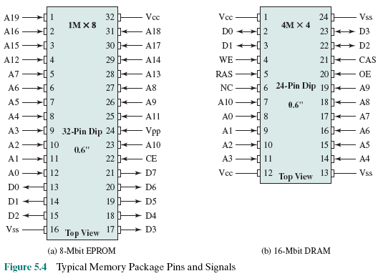
Chip Packaging
Read by yourself
Notes:
As was mentioned in Chapter 2, an integrated circuit is mounted on a package that
contains pins for connection to the outside world.
Figure 5.4a shows an example EPROM package, which is an 8-Mbit chip
organized as 1M * 8. In this case, the organization is treated as a one-word-per-chip
package. The package includes 32 pins, which is one of the standard chip package
sizes. The pins support the following signal lines:
• The address of the word being accessed. For 1M words, a total of 20 (2²⁰ = 1M)
pins are needed (A0–A19).
• The data to be read out, consisting of 8 lines (D0–D7).
• The power supply to the chip (V_{cc}).
• A ground pin (V_{ss}).
• A chip enable (CE) pin. Because there may be more than one memory chip,
each of which is connected to the same address bus, the CE pin is used to indicate
whether or not the address is valid for this chip. The CE pin is activated
by logic connected to the higher-order bits of the address bus (i.e., address bits
above A19). The use of this signal is illustrated presently.
• A program voltage (V_{pp}) that is supplied during programming (write operations).
A typical DRAM pin configuration is shown in Figure 5.4b, for a 16-Mbit chip
organized as 4M * 4. There are several differences from a ROM chip. Because
a RAM can be updated, the data pins are input/output. The write enable (WE)
and output enable (OE) pins indicate whether this is a write or read operation.
Because the DRAM is accessed by row and column, and the address is multiplexed,
only 11 address pins are needed to specify the 4M row/column combinations
(2¹¹ * 2¹¹ = 2²² = 4M). The functions of the row address select (RAS) and column
address select (CAS) pins were discussed previously. Finally, the no connect (NC)
pin is provided so that there are an even number of pins.

Slide 17
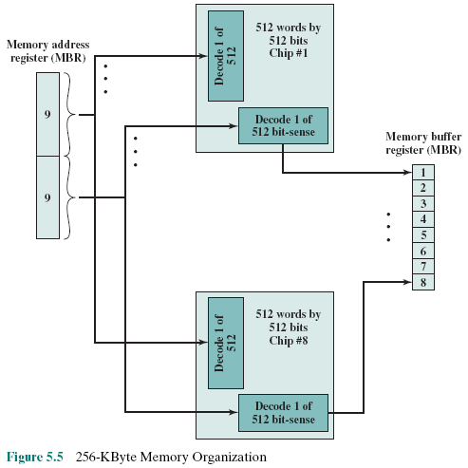
MAR
Figure 5.5
256-KByte
Memory
Organization
Read by yourself
1chip: 512*512= 2¹⁸ bits
=256kb
8 chips → 256KB
( 8bits/word)
Notes:
If a RAM chip contains only 1 bit per word, then clearly we will need at least a
number of chips equal to the number of bits per word. As an example, Figure 5.5
shows how a memory module consisting of 256K 8-bit words could be organized. For
256K words, an 18-bit address is needed and is supplied to the module from some
external source (e.g., the address lines of a bus to which the module is attached).
The address is presented to 8 256K * 1-bit chips, each of which provides the input/
output of 1 bit.

Slide 18
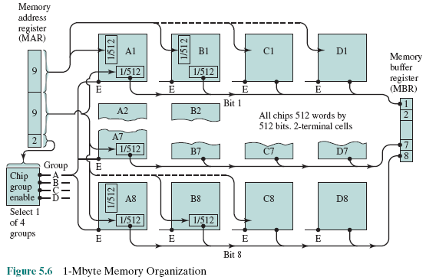
1MByte Module Organization
Read by yourself
Select column
Select row
Data buffer
Enable
E: enable, signal permits the chip operating or not
Notes:
This organization works as long as the size of memory equals the number of
bits per chip. In the case in which larger memory is required, an array of chips is
needed. Figure 5.6 shows the possible organization of a memory consisting of 1M
word by 8 bits per word. In this case, we have four columns of chips, each column
containing 256K words arranged as in Figure 5.5. For 1M word, 20 address lines are
needed. The 18 least significant bits are routed to all 32 modules. The high-order
2 bits are input to a group select logic module that sends a chip enable signal to one
of the four columns of modules.

Slide 19
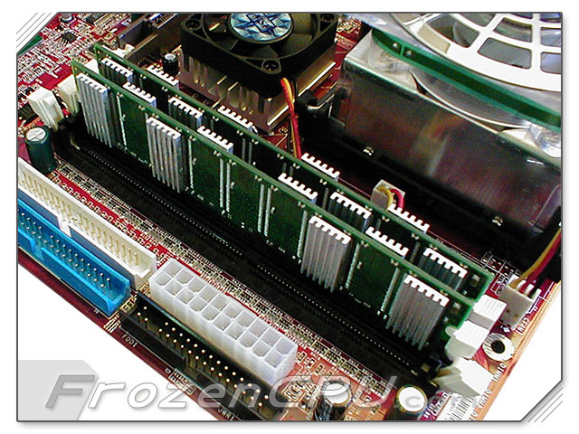
Interleaved Memory – Bộ nhớ đan xen
Composed of a collection of DRAM chips
Grouped together to form a memory bank
Each bank is independently able to service a memory read or write request
K banks can service K requests simultaneously, increasing memory read or write rates by a factor of K
If consecutive words of memory are stored in different banks, the transfer of a block of memory is speeded up
Notes:
Bộ nhớ đan xen (được dùng trong các máy tính)
Dùng số thanh DRAM ram chẵn (2/4 thanh)
Các thanh ram có thể được truy xuất độc lập hoặc đồng thời (xen kẽ).
Hai dữ liệu cạnh nhau thì để trong hai thanh nên hiệu suất truy cập nhanh hơn.
Nếu dùng 1 thanh DRAM: Ưu điểm của kỹ thuật đan xen không còn
Nếu dùng 3 thanh DRAM: Ưu điểm của kỹ thuật đan xen bị giảm
Main memory is composed of a collection of DRAM memory chips. A number of
chips can be grouped together to form a memory bank. It is possible to organize
the memory banks in a way known as interleaved memory. Each bank is independently
able to service a memory read or write request, so that a system with
K banks can service K requests simultaneously, increasing memory read or write
rates by a factor of K. If consecutive words of memory are stored in different
banks, then the transfer of a block of memory is speeded up. Appendix E explores
the topic of interleaved memory.

Slide 20
5.2- Error Correction
Hard Failure
Permanent physical defect (khuyết tật).
Memory cell or cells affected cannot reliably store data but become stuck at 0 or 1 or switch erratically between 0 and 1
Can be caused by:
Harsh (khắc nghiệt) environmental abuse(sự ngược đãi)
Manufacturing defects
Wear (hao mòn)
Soft Error
Random, non-destructive event that alters the contents of one or more memory cells
No permanent damage to memory
Can be caused by:
Power supply problems
Alpha particles
Mọi hệ thống đều tồn tại lỗi.
Làm sao kiểm tra được data trong bộ nhớ có lỗi hay không?
Đọc NOTE để biết về hạt Alpha
Notes:
Hạt Alpha: Hiện tượng 2 protons and 2 neutrons liên kết với nhau tạo ra một nguyên tử helium rất bền
Dòng điện được hình thành do dòng chảy của các electron đẩy nhau.
Khi các electron di chuyển, một khả năng dù rất hiếm xẩy ra là 2 electron và 2 proton kết dính với nhau đề tạo ra hạt alpha (helium).
Đặc điểm của helium là chỉ có 2 electron (vòng 2 rất rất bền) nên các electron của hạt alpha rất khó bị thay thế bởi electron khác. Điều này nếu xẩy thì hạt alpha chính là nguyên nhân cản trở dòng điện
A semiconductor memory system is subject to errors. These can be categorized as
hard failures and soft errors. A hard failure is a permanent physical defect so that
the memory cell or cells affected cannot reliably store data but become stuck at
0 or 1 or switch erratically between 0 and 1. Hard errors can be caused by harsh
environmental abuse, manufacturing defects, and wear. A soft error is a random,
nondestructive event that alters the contents of one or more memory cells without
damaging the memory. Soft errors can be caused by power supply problems
or alpha particles. These particles result from radioactive decay and are distressingly
common because radioactive nuclei are found in small quantities in nearly all
materials. Both hard and soft errors are clearly undesirable, and most modern main
memory systems include logic for both detecting and correcting errors.

Slide 21
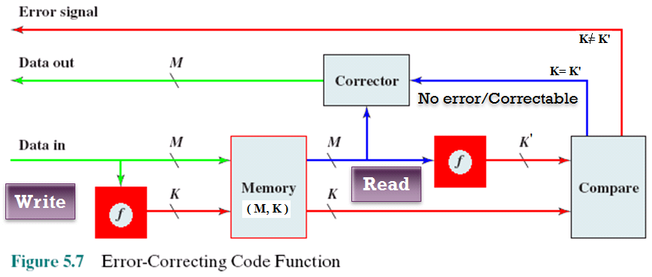
Error Correcting Code (ECC) Function
Làm sao biết được data trong bộ nhớ đáng tin?
Phép toán f tiến hành thế nào?
Slide sau.
Đọc NOTE để hiểu hơn nếu cần
Notes:
Cơ chế ghi vào bộ nhớn và đọc bộ nhớ có kiểm tra lỗi:
-Ghi: M bit data qua phép toán f cho ra K bit kiểm tra (mã ECC). Mang cả M và K ghi vào bộ nhớ
-Đọc:
Đọc bộ nhớ lấy ra cả M và K.
Thực thi lại cùng phép toán f để cho ra K’ bit
Nếu K=K’ thì M đáng tin
Ngược lại data M đã sai.
Figure 5.7 illustrates in general terms how the process is carried out. When
data are to be written into memory, a calculation, depicted as a function f, is performed
on the data to produce a code. Both the code and the data are stored. Thus,
if an M-bit word of data is to be stored and the code is of length K bits, then the
actual size of the stored word is M + K bits.
When the previously stored word is read out, the code is used to detect and possibly
correct errors. A new set of K code bits is generated from the M data bits and
compared with the fetched code bits. The comparison yields one of three results:
• No errors are detected. The fetched data bits are sent out.
• An error is detected, and it is possible to correct the error. The data bits plus
error correction bits are fed into a corrector, which produces a corrected set of
M bits to be sent out.
• An error is detected, but it is not possible to correct it. This condition is reported.
Codes that operate in this fashion are referred to as error-correcting codes. A
code is characterized by the number of bit errors in a word that it can correct and detect.

Slide 22

ECC Function: Examples
• The XOR operation is ussually used in ECC functions
The most simple data for checking is the original data → A copy of original data is written to memory . 8-bit data: 00001111, ECC data: 00001111 → Memory must be increased to double size
XORs some bits of M-bit original data to K-bit ECC will decrease memory size.
Examples:
8 bits → 3 bits: 01010110 → 101
8 bits → 2 bits: 01010110 → 00
8 bits → 1 bits: 01010110 → 0
- Main memory bank usually includes 9 chips. Why?
Notes:
Hàm f tính ECC được quyết định bởi nhà thiết kế bộ nhớ vì hàm này được hiện thực bằng phần cứng.
Trong phần cứng ECC, phép toán XOR nhị phân thường được dùng.
Với 8 bít data, ECC có bao nhiêu bit (3, 2, 1 bit) , bit nào XOR với bit nào đều do nhà thiết kế quyết định.
Trong slide là các thí dụ minh họa, các nhóm bit được XOR và kết quả được phân biệt bằng mầu sắc.
Dựa trên điều cơ bản là data trong bộ nhớ hiếm hiếm khi sai nên để tiết kiệm, 8 bit data chỉ có 1 bit ECC.
Đó chính là lý do bộ nhớ thường có 9 chip, 8 chip cho 8 bit data, 1 chip chứa các bit ECC.
Phép toán XOR thao tác lần lượt trên một nhóm bit cho ra 1 bit còn được gọi là phép toán PARITY;
ODD PARITY : Số số bit 1 trong data là số lẻ sẽ cho parity 1
00111001 → 4 bit 1 → PARITY = 0
01011101 → 5 bit 1 → PARITY = 1
(Bạn có thể kiểm tra bằng cách XOR lần lượt từ trái sang phải)
EVEN PARITY : Đảo lại kết quả của ODD PARITY
00111001 → 4 bit 1 → PARITY = 1
01011101 → 5 bit 1 → PARITY = 0

Slide 23
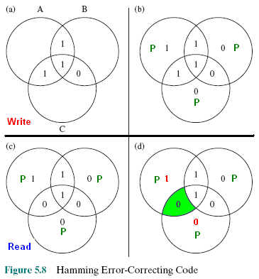
Hamming Error Correcting Code
Data: 4 bits
1 XOR 1 XOR 1 = 1
Richard Hamming at Bell Laboratories
Parity bit (P) =1 if number of 1s is odd. Based on parity bit, data can be corrected.
Làm sao biết bit nào sai trong data và sửa chúng
0 → 1
Notes:
NHóm 4 bit data thành 3 nhóm 3 bit
Quá trình ghi: Thực thi parity lẻ trên các nhóm 3 bit. Ghi cả data + các parity vào bộ nhớ
Quá trình đọc:
Đọc ra cả data và các bit parity,
Thực thi lại parity lẻ trên các nhóm 3 bit data.
Bit sai là phần chung của 2 nhóm có parity sai
The simplest of the error-correcting codes is the Hamming code devised by
Richard Hamming at Bell Laboratories. Figure 5.8 uses Venn diagrams to illustrate
the use of this code on 4-bit words (M = 4). With three intersecting circles,
there are seven compartments. We assign the 4 data bits to the inner compartments
(Figure5.8a). The remaining compartments are filled with what are called parity
bits. Each parity bit is chosen so that the total number of 1s in its circle is even
(Figure5.8b). Thus, because circle A includes three data 1s, the parity bit in that
circle is set to 1. Now, if an error changes one of the data bits (Figure 5.8c), it is easily
found. By checking the parity bits, discrepancies are found in circle A and circle
C but not in circle B. Only one of the seven compartments is in A and C but not B.
The error can therefore be corrected by changing that bit.

Slide 24
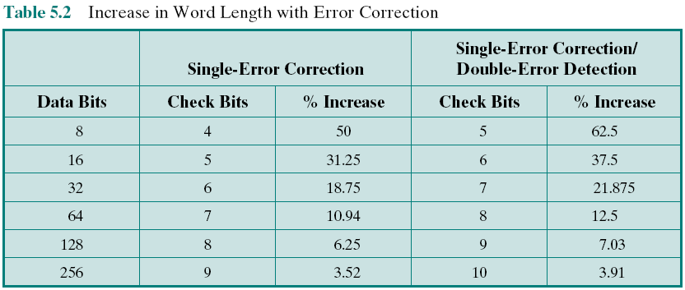
Increase in Word Length with ECC
Để phát hiện lỗi, tốn chi phí (thêm bit). Để có thể sửa bit lỗi thì phải chấp nhận tốn kém hơn nữa
Data 4 bits (2²) → At least 3 bit ECC (2+1)
Data 8 bits (2³) → At least 4 bit ECC (3+1)

Slide 25
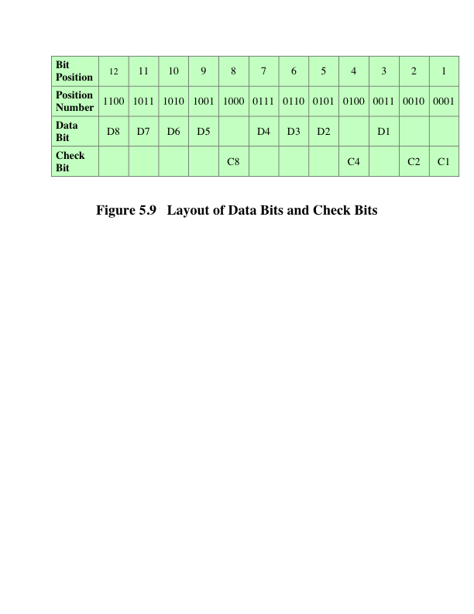
Layout of Data Bits and Check Bits
Một thí dụ về việc bố trí các bit data và ECC.
Check positions: 2³ 2² 2¹ 2⁰
(Algorithm for computing Ci bit is pre-defined)
(Example: 110011010110 → ECC: 1010, DATA: 11001011
Notes:
To achieve these characteristics, the data and check bits are arranged into a
12-bit word as depicted in Figure 5.9. The bit positions are numbered from 1 to 12.
Those bit positions whose position numbers are powers of 2 are designated as check
bits.

Slide 26
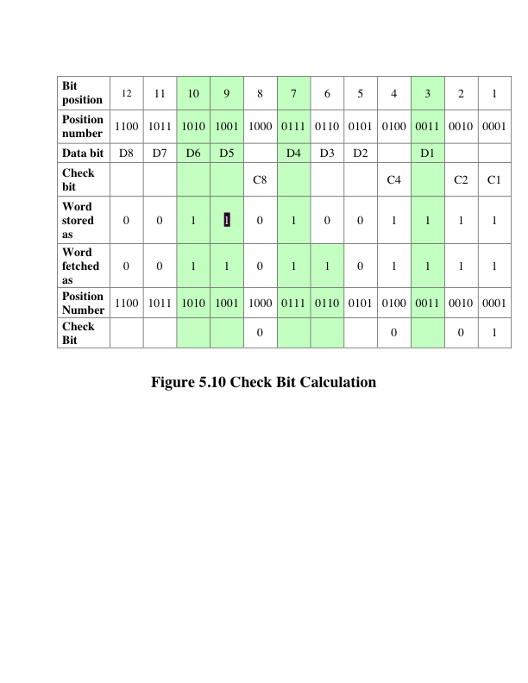
Check Bit Calculation
Error
ECC write: 0111
ECC read: 0001
0111 XOR 0001 != 0 → Error
Notes:
Figure 5.10 illustrates the calculation. The data and check bits are
positioned properly in the 12-bit word. Four of the data bits have a value 1 (shaded
in the table), and their bit position values are XORed to produce the Hamming
code 0111, which forms the four check digits. The entire block that is stored is
001101001111. Suppose now that data bit 3, in bit position 6, sustains an error and is
changed from 0 to 1. The resulting block is 001101101111, with a Hamming code of
0111. An XOR of the Hamming code and all of the bit position values for nonzero
data bits results in 0110. The nonzero result detects an error and indicates that the
error is in bit position 6.

Slide 27
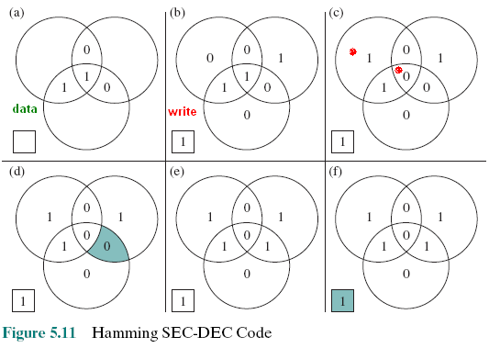
Hamming SEC-DED Code Single-Error Correcting/Double-Error Detecting
The sequence shows that if two errors occur (Figure 5.11c), the checking procedure
goes astray – chệch hướng (d) and worsens the problem by creating a third error (e).
To overcome the problem, an eighth bit is added that is set so that the total number of 1s in the diagram is even. The extra parity bit catches the error (f).
Notes:
The code just described is known as a single-error-correcting (SEC) code.
More commonly, semiconductor memory is equipped with a single-error-correcting,
double-error-detecting (SEC-DED) code. As Table 5.2 shows, such codes require
one additional bit compared with SEC codes.
Figure 5.11 illustrates how such a code works, again with a 4-bit data word.
The sequence shows that if two errors occur (Figure 5.11c), the checking procedure
goes astray – chệch hướng (d) and worsens the problem by creating a third error (e). To overcome
the problem, an eighth bit is added that is set so that the total number of 1s in the
diagram is even. The extra parity bit catches the error (f).
An error-correcting code enhances the reliability of the memory at the cost of
added complexity. With a 1-bit-per-chip organization, an SEC-DED code is generally
considered adequate. For example, the IBM 30xx implementations used an 8-bit SECDED
code for each 64 bits of data in main memory. Thus, the size of main memory is
actually about 12% larger than is apparent to the user. The VAX computers used a 7-bit
SEC-DED for each 32 bits of memory, for a 22% overhead. A number of contemporary
DRAMs use 9 check bits for each 128 bits of data, for a 7% overhead [SHAR97].

Slide 28

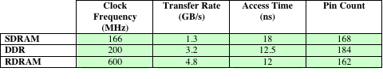
Performance Comparison
DRAM Alternatives
Table 5.3
Các dạng DRAM trên thị trường máy tính
Chú ý mối quan hệ giữa tần số làm việc với hiệu năng làm việc của RAM
Được giải thích ở các slide sau
Table 5.3 Performance Comparison of Some DRAM Alternatives
Notes:
The first three columns of Table 5.2
lists the number of check bits required for various data word lengths.
For convenience, we would like to generate a 4-bit syndrome for an 8-bit data
word with the following characteristics:
• If the syndrome contains all 0s, no error has been detected.
• If the syndrome contains one and only one bit set to 1, then an error has
occurred in one of the 4 check bits. No correction is needed.
• If the syndrome contains more than one bit set to 1, then the numerical value
of the syndrome indicates the position of the data bit in error. This data bit is
inverted for correction.

Slide 29
5.3- Advanced DRAM Organization
SDRAM
One of the most critical system bottlenecks when using high-performance processors is the interface to main internal memory
The traditional DRAM chip is constrained both by its internal architecture and by its interface to the processor’s memory bus
A number of enhancements to the basic DRAM architecture have been explored:
DDR-DRAM
RDRAM
Được giải thích ở các slide sau
Table 5.3 Performance Comparison of Some DRAM Alternatives
Notes:
RAM là nút thắt chính trong hệ nhống nhiều bộ xử lý vì RAM được dùng chung giữa nhiều bộ xử lý
Các bộ xử lý tranh giành truy xuất RAM. Do vậy, việc tuần tự hóa truy xuất phải được áp dùng để tại một thời điểm
chỉ có một bộ xử lý được quyền truy xuất RAM.
Một giải pháp cải tiến là mỗi bộ xử lý được gắn sẵn cache riêng.
Khi bộ xử lý được quyền truy xuất RAM thì truy xuất cả một khối khá lớn
RAM có thể ví như là máy nước nóng lạnh, ai lấy nước thì lấy luôn một chai để uống dần.
As discussed in Chapter 2, one of the most critical system bottlenecks when using
high-performance processors is the interface to main internal memory. This interface
is the most important pathway in the entire computer system. The basic building
block of main memory remains the DRAM chip, as it has for decades; until
recently, there had been no significant changes in DRAM architecture since the
early 1970s. The traditional DRAM chip is constrained both by its internal architecture
and by its interface to the processor’s memory bus.
We have seen that one attack on the performance problem of DRAM
main memory has been to insert one or more levels of high-speed SRAM cache
between the DRAM main memory and the processor. But SRAM is much costlier
than DRAM, and expanding cache size beyond a certain point yields diminishing
returns.
In recent years, a number of enhancements to the basic DRAM architecture
have been explored, and some of these are now on the market. The schemes that currently
dominate the market are SDRAM, DDR-DRAM, and RDRAM. Table 5.3
provides a performance comparison. CDRAM has also received considerable attention.
We examine each of these approaches in this section.

Slide 30
Synchronous DRAM (SDRAM)
DRAM đồng bộ
One of the most widely used forms of DRAM
Exchanges data with the processor synchronized to an external clock signal and running at the full speed of the processor/memory bus without imposing (long while) wait states
With synchronous access the DRAM moves data in and out under control of the system clock
The processor or other master issues the instruction and address information which is latched by the DRAM
The DRAM then responds after a set number of clock cycles
Meanwhile the master can safely do other tasks while the SDRAM is processing
Notes:
Internal Clock: Xung điều khiển vận hành các thành phần điện tử bên trong bộ xử lý
External Clock: Xung điều khiển vận hành các thành phần điện tử bên ngoài bộ xử lý (tức mainboard – mạch điện chính)
Trên mainboard, mạch điện lớn nhất trong máy tính, có bộ phận tạo xung chung (system clock) giúp điều khiển các thành phần điện tử kể cả hệ thống bus giao tiếp giữa bộ xử lý với bộ nhớ.
One of the most widely used forms of DRAM is the synchronous DRAM
(SDRAM) [VOGL94]. Unlike the traditional DRAM, which is asynchronous, the
SDRAM exchanges data with the processor synchronized to an external clock signal
and running at the full speed of the processor/memory bus without imposing
wait states.
In a typical DRAM, the processor presents addresses and control levels to
the memory, indicating that a set of data at a particular location in memory should
be either read from or written into the DRAM. After a delay, the access time, the
DRAM either writes or reads the data. During the access-time delay, the DRAM
performs various internal functions, such as activating the high capacitance of the
row and column lines, sensing the data, and routing the data out through the output
buffers. The processor must simply wait through this delay, slowing system
performance.
With synchronous access, the DRAM moves data in and out under control of
the system clock. The processor or other master issues the instruction and address
information, which is latched by the DRAM. The DRAM then responds after a set
number of clock cycles. Meanwhile, the master can safely do other tasks while the
SDRAM is processing the request.

Slide 31
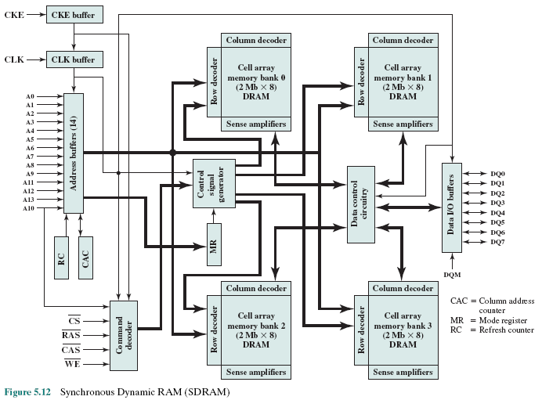
SDRAM
Read by yourself
Notes:
Figure 5.12 shows the internal logic of IBM’s 64-Mb SDRAM [IBM01], which
is typical of SDRAM organization.

Slide 32
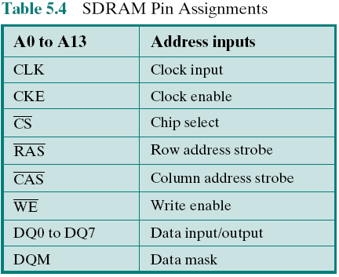
SDRAM Pin Assignments
Read by yourself
Notes:
Table 5.4 defines the various pin assignments.
The SDRAM employs a burst mode to eliminate the address setup time and
row and column line pre-charge time after the first access. In burst mode, a series of
data bits can be clocked out rapidly after the first bit has been accessed. This mode
is useful when all the bits to be accessed are in sequence and in the same row of the
array as the initial access. In addition, the SDRAM has a multiple-bank internal
architecture that improves opportunities for on-chip parallelism.
The mode register and associated control logic is another key feature differentiating
SDRAMs from conventional DRAMs. It provides a mechanism to
customize the SDRAM to suit specific system needs. The mode register specifies
the burst length, which is the number of separate units of data synchronously fed
onto the bus. The register also allows the programmer to adjust the latency between
receipt of a read request and the beginning of data transfer.
The SDRAM performs best when it is transferring large blocks of data serially,
such as for applications like word processing, spreadsheets, and multimedia.

Slide 33
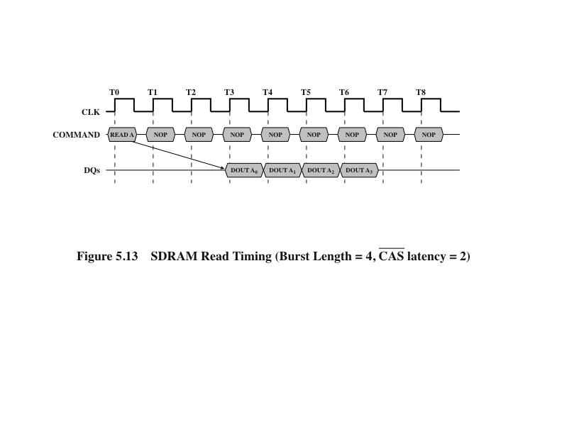
SDRAM Read Timing
Read by yourself
3 xung chờ các thành phần sẵn sàng
Mỗi xung đọc được 1 bit data
Hình minh họa tác vụ đọc bộ nhớ DRAM đồng bộ 4 bit.
Notes:
Figure 5.13 shows an example of SDRAM operation.

Slide 34
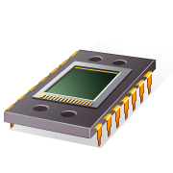
RDRAM
Developed by Rambus
Rambus Dynamic Random Access Memory
Asynchronous block-oriented protocol (Addr, read/write/ numBytes)
high-speed bus
Adopted by Intel for its Pentium and Itanium processors
Has become the main competitor to SDRAM
Bus can address up to 320 RDRAM chips and is rated at 1.6 GBps
Chips are vertical packages with all pins on one side. Exchanges data with the processor over 28 wires no more than 12 centimeters long
Notes:
Protocal:giao thức = tập quy tắc giúp giao tiếp
RDRAM, developed by Rambus [FARM92, CRIS97], has been adopted by Intel
for its Pentium and Itanium processors. It has become the main competitor to
SDRAM. RDRAM chips are vertical packages, with all pins on one side. The chip
exchanges data with the processor over 28 wires no more than 12 centimeters long.
The bus can address up to 320 RDRAM chips and is rated at 1.6 GBps.
The special RDRAM bus delivers address and control information using
an asynchronous block-oriented protocol. After an initial 480 ns access time,
this produces the 1.6 GBps data rate. What makes this speed possible is the bus
itself, which defines impedances, clocking, and signals very precisely. Rather than
being controlled by the explicit RAS, CAS, R/W, and CE signals used in conventional
DRAMs, an RDRAM gets a memory request over the high-speed bus. This
request contains the desired address, the type of operation, and the number of
bytes in the operation.

Slide 35
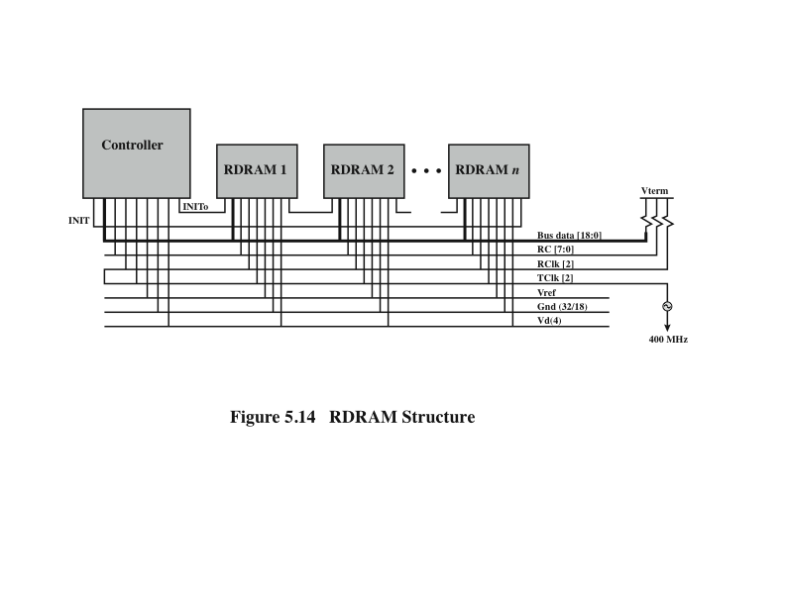
RDRAM Structure
Notes:
Figure 5.14 illustrates the RDRAM layout. The configuration consists of
a controller and a number of RDRAM modules connected via a common bus.
The controller is at one end of the configuration, and the far end of the bus is
a parallel termination of the bus lines. The bus includes 18 data lines (16 actual
data, two parity) cycling at twice the clock rate; that is, 1 bit is sent at the leading
and following edge of each clock signal. This results in a signal rate on each
data line of 800 Mbps. There is a separate set of 8 lines (RC) used for address
and control signals. There is also a clock signal that starts at the far end from
the controller propagates to the controller end and then loops back. A RDRAM
module sends data to the controller synchronously to the clock to master, and the
controller sends data to an RDRAM synchronously with the clock signal in the
opposite direction. The remaining bus lines include a reference voltage, ground,
and power source.

Slide 36

Double Data Rate SDRAM (DDR SDRAM)
SDRAM can only send data once per bus clock cycle
Double-data-rate SDRAM can send data twice per clock cycle, once on the rising edge of the clock pulse and once on the falling edge
Developed by the JEDEC Solid State Technology Association (Electronic Industries Alliance’s semiconductor-engineering-standardization body)
Các linh kiện kỹ thuật số cần 1 xung kích để xử lý tín hiệu đầu vào rồi cho tín hiệu đầu ra. Có linh kiện chỉ làm việc khi tín hiệu xung tăng, có linh kiện chỉ hoạt động khi tín hiệu xung giảm
Notes:
SDRAM is limited by the fact that it can only send data to the processor once per
bus clock cycle. A new version of SDRAM, referred to as double-data-rate SDRAM
can send data twice per clock cycle, once on the rising edge of the clock pulse and
once on the falling edge.
DDR DRAM was developed by the JEDEC Solid State Technology
Association, the Electronic Industries Alliance’s semiconductor-engineering-standardization
body. Numerous companies make DDR chips, which are widely used in
desktop computers and servers.

Slide 37
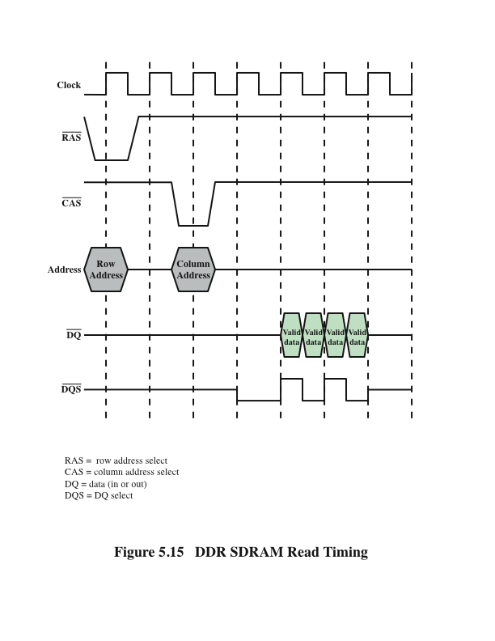
DDR SDRAM Read Timing
4 pulses for ready
2 bits/ pulse
Hình minh họa tác vụ đọc bộ nhớ DDRAM đồng bộ 4 bit.
Notes:
Figure 5.15 shows the basic timing for a DDR read. The data transfer is synchronized
to both the rising and falling edge of the clock. It is also synchronized to
a bidirectional data strobe (DQS) signal that is provided by the memory controller
during a read and by the DRAM during a write. In typical implementations the
DQS is ignored during the read. An explanation of the use of DQS on writes is
beyond our scope; see [JACO08] for details.
There have been two generations of improvement to the DDR technology.
DDR2 increases the data transfer rate by increasing the operational frequency
of the RAM chip and by increasing the prefetch buffer from 2 bits to 4 bits
per chip. The prefetch buffer is a memory cache located on the RAM chip. The
buffer enables the RAM chip to preposition bits to be placed on the data bus as
rapidly as possible. DDR3, introduced in 2007, increases the prefetch buffer size
to 8 bits.
Theoretically, a DDR module can transfer data at a clock rate in the range of
200 to 600 MHz; a DDR2 module transfers at a clock rate of 400 to 1066 MHz; and
a DDR3 module transfers at a clock rate of 800 to 1600 MHz. In practice, somewhat
smaller rates are achieved.
Appendix K provides more detail on DDR technology.

Slide 38
Cache DRAM (CDRAM)
Developed by Mitsubishi
Integrates a small SRAM cache onto a generic DRAM chip → increasing performance
SRAM on the CDRAM can be used in two ways:
It can be used as a true cache consisting of a number of 64-bit lines
Cache mode of the CDRAM is effective for ordinary random access to memory
Can also be used as a buffer to support the serial access of a block of data
Notes:
Cache DRAM (CDRAM), developed by Mitsubishi [HIDA90, ZHAN01], integrates
a small SRAM cache (16 Kb) onto a generic DRAM chip.
The SRAM on the CDRAM can be used in two ways. First, it can be used as a
true cache, consisting of a number of 64-bit lines. The cache mode of the CDRAM
is effective for ordinary random access to memory.
The SRAM on the CDRAM can also be used as a buffer to support the serial
access of a block of data. For example, to refresh a bit-mapped screen, the CDRAM
can prefetch the data from the DRAM into the SRAM buffer. Subsequent accesses
to the chip result in accesses solely to the SRAM.

Slide 39
Summary
Internal
Memory
Chapter 5
Semiconductor main memory
Organization
DRAM and SRAM
Types of ROM
Chip logic
Chip packaging
Module organization
Interleaved memory
Error correction
Hard failure
Soft error
Hamming code
Advanced DRAM organization
Synchronous DRAM
Rambus DRAM
DDR SDRAM
Cache DRAM
Notes:
Chapter 5 summary.

