Slide 1

To pay more attention to gain better result
ASSEMLY LANGUAGE 01
Notes:
Prepared by Thân Văn Sử
These slides are prepared using step-by-step approach, students can study by themselves.
All needed concepts are presented on each slide
Teachers should explain sample code, memory map of programs

Slide 2
Objectives
After studying this part, you should be able to:
Familiarize yourself with the assembly language, a low level language
Understand how a program is compiled
Develop some basic console applications

Slide 3
Contents
1- Install 32/64-bit MASM – MS Macro Assembly
2- MASM Integrated Development Environment(IDE)
3- Introduction to Microsoft Macro Assembly Language
Some sample programs

Slide 4
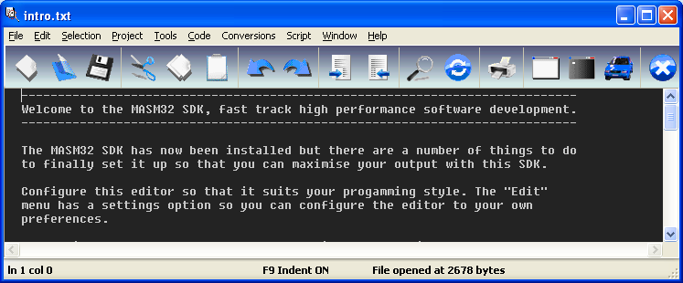
1- Install 32-bit MSAM
Microsoft Macro Assembler: an x86 assembler that uses the Intel syntax for MS-DOS and Microsoft Windows. Beginning with MASM 8.0 there are two versions of the assembler - one for 16-bit and 32-bit assembly sources, and another (ML64) for 64-bit sources only (Wiki)
Unzip: masm32v11r.zip → Install.exe → Run for installation
Interface after installation:

Slide 5
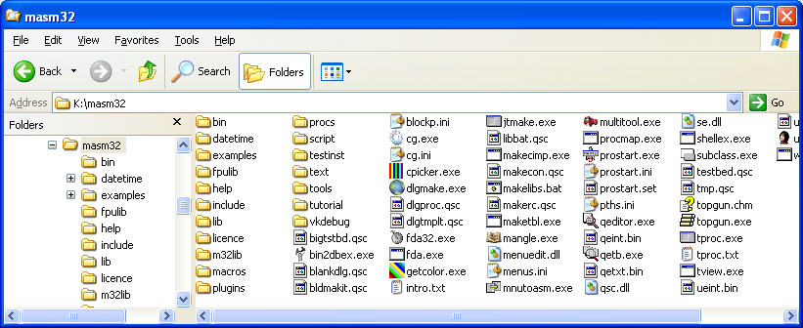

Install 32-bit MSAM…
Installed Contents:
Desktop Icon of MASM, executable file: qeditor.exe
Compiler: bin/ml.exe (32 bit), ml64.exe (64 bit)
You should create a folder as a storage of your exercises

Slide 6
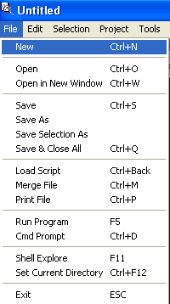
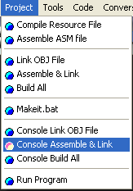
2- MASM Integrated Development Environment
Menu file allows user working with files, run program,…
Menu Project allows user compiling program,…

Slide 7
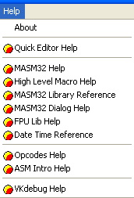
2- MASM Integrated Development Environment
Menu Help allows user referencing to relative topics:
Using editor
Build-in Libraries in MASM
Opcodes of Intel CPU
Syntaxes of MASM language

Slide 8
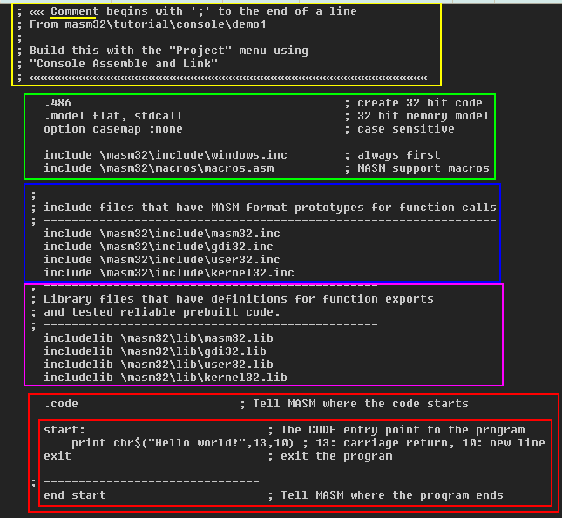
3- Introduction to MS Assembly
Demo 1: Write an Assembly program that displays the string 'Hello World' on the screen:
The flat memory model is a non-segmented configuration available in 32-bit operating systems.
Directives helps the program will conform to Windows
How to create it? NEXT SLIDE
Form of a MASM program

Slide 9
EX01_Hello.asm
Step 1: Open MASM/ Menu File/ New
Step 2: Copy and paste the code in the next slide to it’s editor
Step 3: Save file/EX1_Hello.asm
Step 4: Menu Project/ Console Assemble&Link
Step 5: View results in containing folder
Step 6: Run the program: Click the EX01_Hello.exe
A black window will show then disappear because
there is no code to block it.
An Assembly source code is a file whose extension MUST BE .ASM
What is the result of compilation?
You can see them in the folder containing you ASM files

Slide 10


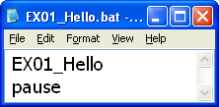
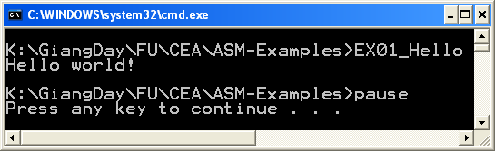
EX01_Hello.asm - Code
; «« Comment begins with ';' to the end of a line
; From masm32\tutorial\console\demo1
;
; Build this with the "Project" menu using
; "Console Assemble and Link"
; «««««««««««««««««««««««««««««««««««««««««««««««««««««««««
.486 ; create 32 bit code
.model flat, stdcall ; 32 bit memory model
option casemap :none ; case sensitive
include \masm32\include\windows.inc ; always first
include \masm32\macros\macros.asm ; MASM support macros
; -----------------------------------------------------------------
; include files that have MASM format prototypes for function calls
; -----------------------------------------------------------------
include \masm32\include\masm32.inc
include \masm32\include\gdi32.inc
include \masm32\include\user32.inc
include \masm32\include\kernel32.inc
; ------------------------------------------------
; Library files that have definitions for function exports
; and tested reliable prebuilt code.
; ------------------------------------------------
includelib \masm32\lib\masm32.lib
includelib \masm32\lib\gdi32.lib
includelib \masm32\lib\user32.lib
includelib \masm32\lib\kernel32.lib
.code ; Tell MASM where the code starts
start: ; The CODE entry point to the program
print chr$("Hello world!",13,10) ; 13: carriage return, 10: new line
exit ; exit the program
; -------------------------------
end start ; Tell MASM where the program ends
Results
How to run the program and we can see it? ➔ Create EX01_Hello.bat file the run it.

Slide 11
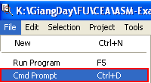
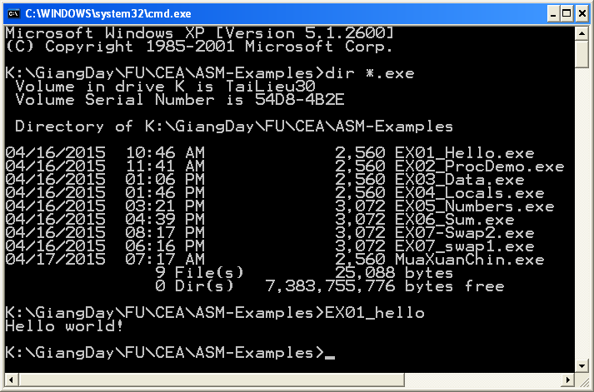
Run a program using the Menu File/Cmd Prompt
The command dir *.exe will show all exe files stored in the current folder.
Run an application by it’s file name (.exe can be ignored)

Slide 12
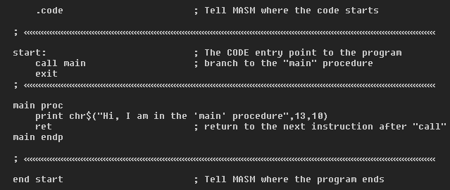
EX02_ProcDemo.asm
Procedures are a fundamental building block of programs that are
build directly into the processor using CALL and RET instructions. This shows how simple it is to do in MASM.
This code is in the directory masm32\tutorial\console\demo2\Proc.asm
Procedure syntax

Slide 13

EX02_ProcDemo.asm- Source/Run
; From masm32\tutorial\console\demo2
; Build this with the "Project" menu using
; "Console Assemble and Link"
; ««««««««««««««««««««««««««««««««««
.486 ; create 32 bit code
.model flat, stdcall ; 32 bit memory model
option casemap :none ; case sensitive
include \masm32\include\windows.inc ; always first
include \masm32\macros\macros.asm
; -----------------------------------------------------------------
; include files for function calls
; -----------------------------------------------------------------
include \masm32\include\masm32.inc
include \masm32\include\gdi32.inc
include \masm32\include\user32.inc
include \masm32\include\kernel32.inc
; ------------------------------------------------
; Library files that have definitions for function
; exports and tested reliable prebuilt code.
; ------------------------------------------------
includelib \masm32\lib\masm32.lib
includelib \masm32\lib\gdi32.lib
includelib \masm32\lib\user32.lib
includelib \masm32\lib\kernel32.lib
.code ; Tell MASM where the code starts
; ««««««««««««««««««««««««««
start: ; The CODE entry point to the program
call main ; branch to the "main" procedure
exit
; «««««««««««««««««««««««««««««
main proc
print chr$("Hi, I am in the 'main' procedure",13,10)
ret ; return to the next instruction after "call"
main endp
; «««««««««««««««««««««««««
end start ; Tell MASM where the program ends

Slide 14
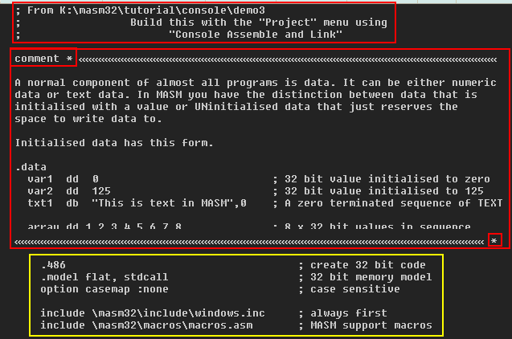
Comments in MASM
Comments are ignored by the assembler
; Comment line
COMMENT delimiter
[Comment block, extending to the closing delimiter] delimiter
Code

Slide 15
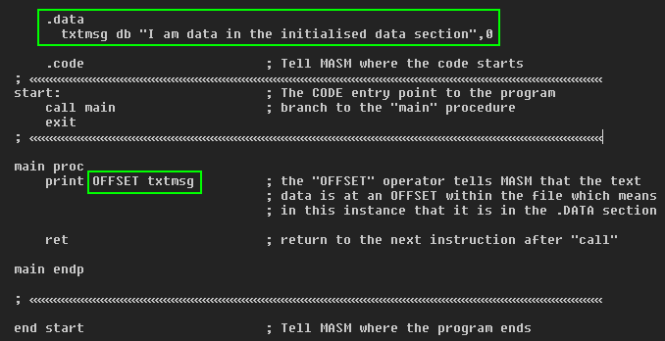
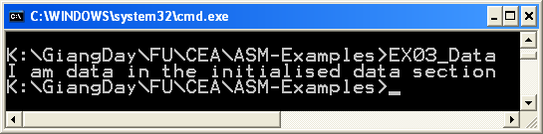
EX03_Data.asm
Print a string declared in the program using the operator OFFSET.
The OFFSET operator tells MASM that the text data is at an OFFSET within the file which means in this instance that it is in the .DATA section.
Data are declared in the .data are called as global data

Slide 16
Basic Data Types in MASM32
Type | Abbr | Size (bytes) | Integer range | Types Allowed
BYTE | DB | 1 | -128.. 127 | Character, string
WORD | DW | 2 | -32768..32767 | 16-bit near ptr, 2 characters, double-byte character
DWORD | DD | 4 | -2Gig..(4Gig-1) | 16-bit far per, 32-bit near ptr, 32-bit long word
FWORD | DF | 6 | -- | 32-bit far ptr
QWORD | DQ | 8 | -- | 64-bit long word
TBYTE | DT | 10 | -- | BCD, 10-byte binary number
REAL4 | DD | 4 | -- | Single-precision floating number
REAL8 | DQ | 8 | -- | Double-precision floating number
REAL10 | DT | 10 | -- | 10-byte floating point
D: Defined
Initialized data has this form:
.data
var1 dd 0 ; 32 bit value initialized to zero
var2 dd 125 ; 32 bit value initialized to 125
txt1 db "This is text in MASM",0 ; Initialize a NULL string
array dd 1,2,3,4,5,6,7,8 ; array of 8 initialized elements
Uninitialized data has this form:
.data?
udat1 dd ? ; Uninitialized single 32 bit space
buffa db 128 dup (?) ; buffer 128 bytes

Slide 17
EX03_Data.asm - Source
; From K:\masm32\tutorial\console\demo3
; Build this with the "Project" menu using
; "Console Assemble and Link"
.486 ; create 32 bit code
.model flat, stdcall ; 32 bit memory model
option casemap :none ; case sensitive
include \masm32\include\windows.inc ; always first
include \masm32\macros\macros.asm ; MASM support macros
include \masm32\include\masm32.inc
include \masm32\include\gdi32.inc
include \masm32\include\user32.inc
include \masm32\include\kernel32.inc
includelib \masm32\lib\masm32.lib
includelib \masm32\lib\gdi32.lib
includelib \masm32\lib\user32.lib
includelib \masm32\lib\kernel32.lib
.data
txtmsg db "I am data in the initialised data section",0
.code ; Tell MASM where the code starts
; ««««««««««««««««««««««««««««««««««««««««««««««
start: ; The CODE entry point to the program
call main ; branch to the "main" procedure
exit
; ««««««««««««««««««««««««««««««««««««««««««««««««««
main proc
print OFFSET txtmsg
ret ; return to the next instruction after "call“
main endp
; ««««««««««««««««««««««««««««««««««««««««««««««««««
end start ; Tell MASM where the program ends

Slide 18
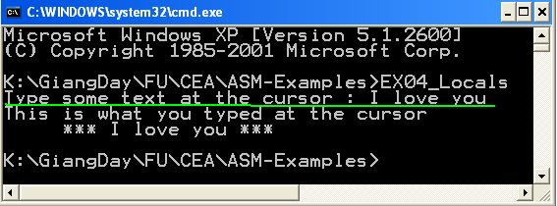
EX04_Locals.asm
How to use of LOCAL variables declared in a procedure?
When the procedure is called, these variables are allocated in program’s stack
DECLARE LOCAL VARIABLES
LOCAL MyVar:DWORD ; allocate a 32 bit space on the stack
LOCAL Buffer[128]:BYTE ; allocate 128 BYTEs of space for TEXT data.
How to PROTOTYPE and implement a procedure along with it’s parameters?
How to call user-defined procedure?
How can program receive input from user? → Build-in function: input(“warning:”)

Slide 19
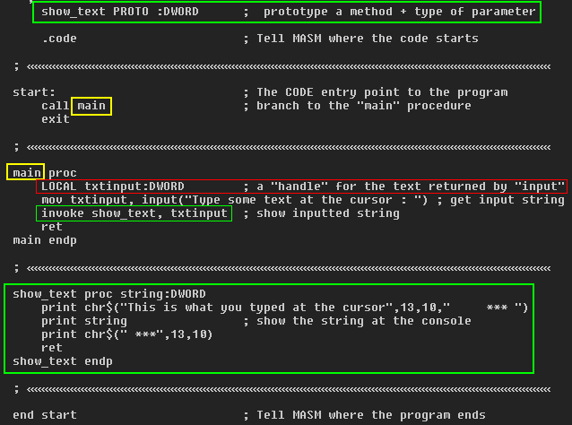
EX04_Locals.asm (Source code)
; Source code From masm32\tutorial\console\demo4\locals.asm
.486 ; create 32 bit code
.model flat, stdcall ; 32 bit memory model
option casemap :none ; case sensitive
include \masm32\include\windows.inc ; always first
include \masm32\macros\macros.asm ; MASM support macros
include \masm32\include\masm32.inc
include \masm32\include\gdi32.inc
include \masm32\include\user32.inc
include \masm32\include\kernel32.inc
includelib \masm32\lib\masm32.lib
includelib \masm32\lib\gdi32.lib
includelib \masm32\lib\user32.lib
includelib \masm32\lib\kernel32.lib
show_text PROTO :DWORD ; prototype a method + type of parameter
.code ; Tell MASM where the code starts
start: ; The CODE entry point to the program
call main ; branch to the "main" procedure
exit
; «««««««««««««««««««««««««««««««««««««««««««««««««««««««««««««««««««««««««
main proc
LOCAL txtinput:DWORD ; a "handle" for the text returned by "input"
mov txtinput, input("Type some text at the cursor : ") ; get input string
invoke show_text, txtinput ; show inputted string
ret
main endp
; «««««««««««««««««««««««««««««««««««««««««««««««««««««««««««««««««««««««««
show_text proc string:DWORD
print chr$("This is what you typed at the cursor",13,10," *** ")
print string ; show the string at the console
print chr$(" ***",13,10)
ret
show_text endp
; «««««««««««««««««««««««««««««««««««««««««««««««««««««««««««««««««««««««««
end start ; Tell MASM where the program ends

Slide 20

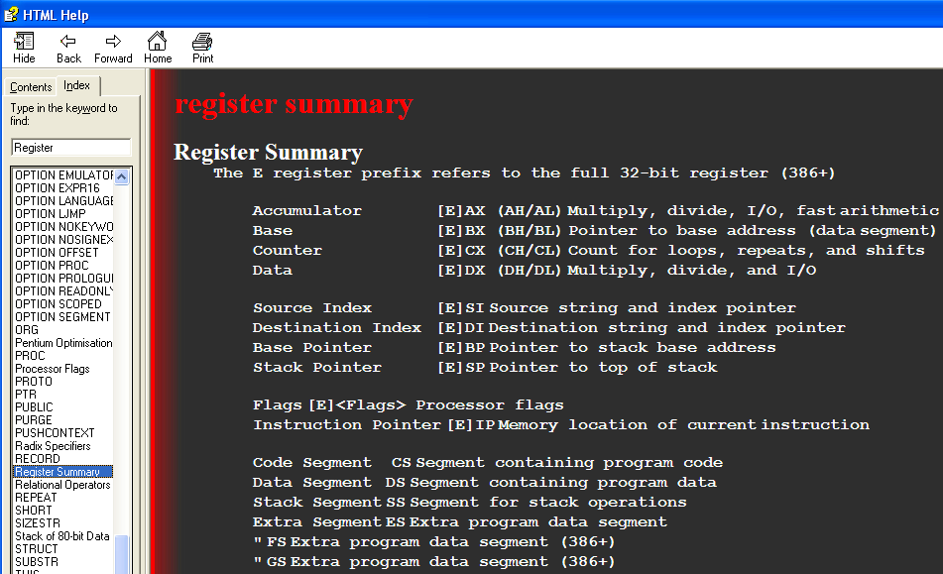
Intel CPU 32-bit Registers

Slide 21
Intel CPU Registers
64-bit register | Lower 32 bits | Lower 16 bits | Lower 8 bits
rax | eax | ax | al
rbx | ebx | bx | bl
rcx | ecx | cx | cl
rdx | edx | dx | dl
rsi | esi | si | sil
rdi | edi | di | dil
rbp | ebp | bp | bpl
rsp | esp | sp | spl
r8 | r8d | r8w | r8b
r9 | r9d | r9w | r9b
r10 | r10d | r10w | r10b
r11 | r11d | r11w | r11b
r12 | r12d | r12w | r12b
r13 | r13d | r13w | r13b
r14 | r14d | r14w | r14b
r15 | r15d | r15w | r15b
CS Code Segment
DS: Data Segment SS: Stack Segment
https://msdn.microsoft.com/en-us/library/windows/hardware/ff561499(v=vs.85).aspx

Slide 22
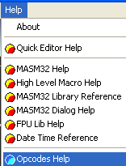
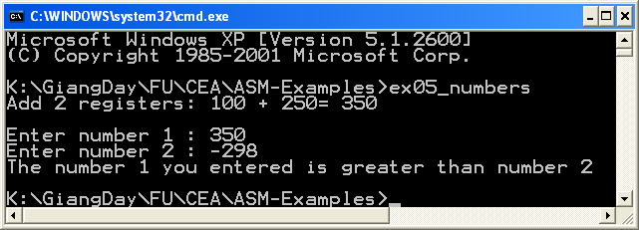
EX05-Numbers.asm
(1) How to receive numbers from user?
Raw data from keyboard are string. The function sval(string) will convert num-string to signed number.
(2) How to perform a simple addition using registers
add reg1, reg2 will accumulate value in reg2 to reg1
(3) How to print value in a register/variable to screen
Function str$(number) → num-string
(4) How to compare a memory variable to an immediate number
Use the instruction CMP reg, reg/ CMP reg, var/ CMP var, reg/ CMP mem, immed/ CMP reg, immed (immed= immediate value)
(5) How to branching to different labels after camparation?
Use jumps: JE (equal), JG (greater than), JL (less than)
Instruction Syntax

Slide 23
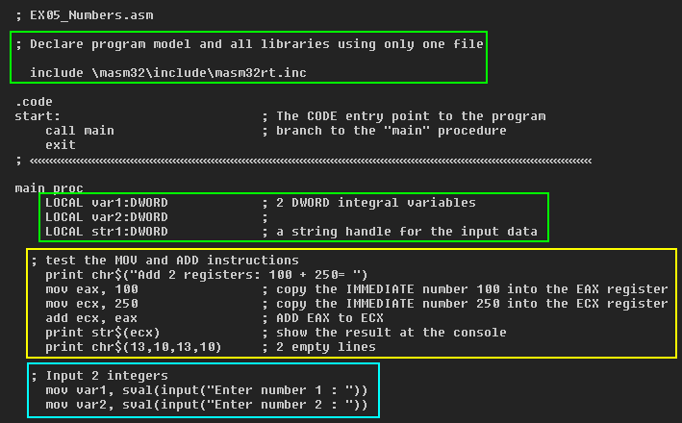
EX05-Numbrers.asm Variables Declarations, Input data, Converting data types

Slide 24
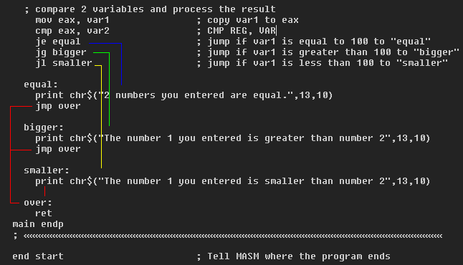
EX05-Numbers.asm Comparing and Branching

Slide 25
EX05-Numbers.asm Source code
; EX05_Numbers.asm
; Declare program model and all libraries using only one file
include \masm32\include\masm32rt.inc
.code
start: ; The CODE entry point to the program
call main ; branch to the "main" procedure
exit
; «««««««««««««««««««««««««««««««««««««««««««««««««««««««««««««
main proc
LOCAL var1:DWORD ; 2 DWORD integral variables
LOCAL var2:DWORD ;
LOCAL str1:DWORD ; a string handle for the input data
; test the MOV and ADD instructions
print chr$("Add 2 registers: 100 + 250= ")
mov eax, 100 ; copy the IMMEDIATE number 100 into the EAX register
mov ecx, 250 ; copy the IMMEDIATE number 250 into the ECX register
add ecx, eax ; ADD EAX to ECX
print str$(ecx) ; show the result at the console
print chr$(13,10,13,10) ; 2 empty lines
; Input 2 integers
mov var1, sval(input("Enter number 1 : "))
mov var2, sval(input("Enter number 2 : "))
; compare 2 variables and process the result
mov eax, var1 ; copy var1 to eax
cmp eax, var2 ; CMP REG, VAR
je equal ; jump if var1 is equal to 100 to "equal"
jg bigger ; jump if var1 is greater than 100 to "bigger"
jl smaller ; jump if var1 is less than 100 to "smaller"
equal:
print chr$("2 numbers you entered are equal.",13,10)
jmp over
bigger:
print chr$("The number 1 you entered is greater than number 2",13,10)
jmp over
smaller:
print chr$("The number 1 you entered is smaller than number 2",13,10)
over:
ret
main endp
; «««««««««««««««««««««««««««««««««««««««««««««
end start ; Tell MASM where the program ends

Slide 26
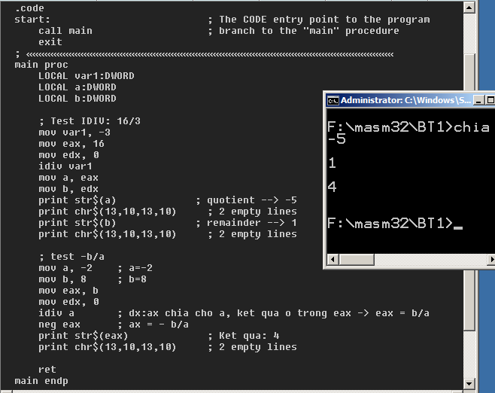
Signed Integer Division

Slide 27
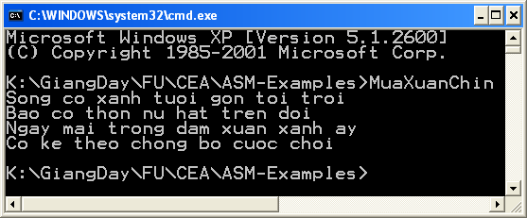
Exercises
Ex1: Use the Opcodes help of the menu Help, describe syntaxes of following MASM instructions
ADD
SUB
MUL, IMUL
DIV, IDIV. Which register will store the remainder ?
Ex2:
Write a MASM program that will print the following cantor of Hàn Mặc Tử

Slide 28
Exercises
Ex3: Write a program that will accept 3 positive integers, then sum of them and their integral average will be printed out.
Example: Input: 3 5 9 , Output: 17 5
Ex4: Write a MASM program that will solve the equation ax+b=0, a, b, x are integers.
Example: a= 3, b= 7, x = -2
Ex5: Write a MASM program that will accept 2 numbers, v1, v2 then print out v1+v2, v1-v2, v1*v2, v1/v2.
Attention: The case in which v2=0 must be managed.

Slide 29
Summary
Form of a MASM program
Variable declarations: DB, DD, DW, …
Basic input, output operations: print, chr$(…), str$(…)
Data type conversion: sval(..),
Procedure with parameters: CALL, INVOKE
Instructions: MOV, ADD, CMP, JE, JG, JL
Notes:
Chapter 13 summary.

