Slide 1

William Stallings, Computer Organization and Architecture, 9th Edition
Reduced Instruction Set Computers (RISC)
Chapter 15
Notes:
Lecture slides prepared for “Computer Organization and Architecture”, 9/e, by William Stallings, Chapter 15 “Reduced Instruction Set Computers”.
Adapted by Thân Văn Sử
Since the development of the stored-program computer around 1950, there have been remarkably few true innovations in the areas of computer organization and architecture. The following are some of the major advances since the birth of the computer:
The family concept: Introduced by IBM with its System/360 in 1964, followed shortly thereafter by DEC, with its PDP-8. The family concept decouples the architecture of a machine from its implementation. A set of computers is offered, with different price/performance characteristics, that presents the same architecture to the user. The differences in price and performance are due to different implementations of the same architecture.
Microprogrammed control unit: Suggested by Wilkes in 1951 and introduced by IBM on the S/360 line in 1964. Microprogramming eases the task of designing and implementing the control unit and provides support for the family concept.
Cache memory: First introduced commercially on IBM S/360 Model 85 in 1968. The insertion of this element into the memory hierarchy dramatically improves performance.
Pipelining: A means of introducing parallelism into the essentially sequential nature of a machine-instruction program. Examples are instruction pipelining and vector processing.
Multiple processors: This category covers a number of different organizations and objectives.
Reduced instruction set computer (RISC) architecture: This is the focus of this chapter.
When it appeared, RISC architecture was a dramatic departure from the historical trend in processor architecture. An analysis of the RISC architecture brings into focus many of the important issues in computer organization and architecture.
Although RISC architectures have been defined and designed in a variety of
ways by different groups, the key elements shared by most designs are these:
A large number of general-purpose registers, and/or the use of compiler technology to optimize register usage
A limited and simple instruction set
An emphasis on optimizing the instruction pipeline
We begin this chapter with a brief survey of some results on instruction sets, and then examine each of the three topics just listed. This is followed by a description of two of the best-documented RISC designs.

Slide 2
Introduction
CLO8: Explain processor structure and function in details, the operations of Reduced Instruction Set Computers
Two trends in CPU architecture:
CISC: Complex Instruction Set Computing/Computer such as IBM System/360, PDP-11, Motorola 6809, 68000, Intel 8080, x86,… CPU is set up to execute many instructions.
RISC: Reduced Instruction Set Computing/Computer: Idea: All complex instruction is association of some basic instructions. So, a smaller set of basic instructions is needed. Examples: Sun UltraSPARC microprocessor
More details:
http://en.wikipedia.org/wiki/Complex_instruction_set_computing
http://en.wikipedia.org/wiki/Reduced_instruction_set_computing

Slide 3
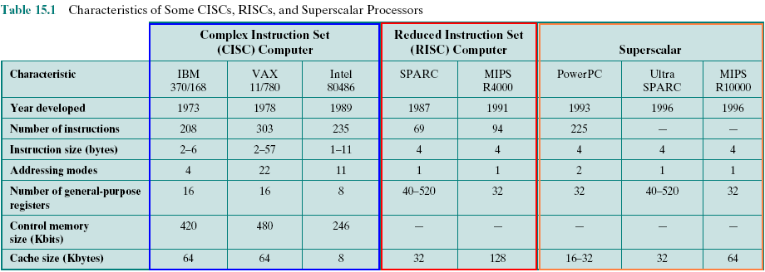
Comparing several RISC and Non-RISC Systems
Scalar processor: CPU processes one datum at a time
Vector processor: CPU processes multiple data items at a time
Superscalar processor: Architecture implements a form of parallelism called
instruction-level parallelism within a single processor.
(Wiki)
Notes:
Vector được mô tả bằng nhóm trị. Thí dụ: trong hệ tọa độ 3 chiều vector V = {dx=1, dy=2, dz=3}
Data có hướng = vector = nhóm trị
Data/biến vô hướng (scalar value, scalar data, scalar variable): Biến mang trị đơn (1 trị duy nhất)
Scalar processor: Bộ xử lý vô hướng, CPU truy xuất từng trị đơn → Các thanh ghi phân biệt nhau và chỉ chứa trị đơn
Vector processor: Bộ xử lý có hướng, CPU có thể truy xuất cả nhóm trị (khối) → Các thanh ghi được phân chia thành từng nhóm, mỗi nhóm được đặt tên.
Superscalar processor: Bộ xử lý siêu vô hướng, CPU vô hướng được nâng cấp (làm thêm phần cứng) để cho phép nhiều lệnh thực thi đồng thời.
CISC: Tập lệnh phức tạp → Phần cứng nhiều + phức tạp → Nhiều lệnh phức tạp được hiện thực bằng phần cứng → chạy nhanh
RISC: Tập lệnh đơn giản hơn → Phần cứng ít hơn + đơn giản hơn → User phải tự tách việc phức tạp thành dãy lệnh đơn giản → thực thi chậm hơn.
Giải pháp để RISC cạnh tranh với CISC
Trong RISC, đẩ tăng hiệu suất thực thi, người ta làm nhiều thanh ghi để hạn chế việc truy xuất bộ nhớ, xem bảng 15.1

Slide 4
Objectives
After studying this chapter, you should be able to:
Provide an overview research results on instruction execution characteristics that motivated the development of the RISC approach.
Summarize the key characteristics of RISC machines.
Understand the design and performance implications of using a large register file. Understand the use of compiler-based register optimization to improve performance.
Discuss the implication of a RISC architecture for pipeline design and performance.
List and explain key approaches to pipeline optimization on a RISC machine.

Slide 5
Contents
15.1- Instruction Execution Characteristics
15.2- The Use of a Large Register File
15.3- Compiler-Based Register Optimization
15.4- Reduced Instruction Set Architecture
15.5- RISC Pipelining
15.8- RISC Versus CISC Controversy
Notes:
Controversy: sự tranh luận, to controvert

Slide 6
5 Exercises
15.1 What are some typical distinguishing characteristics of RISC organization? (Refer to “Implication”)
15.2 Briefly explain the two basic approaches used to minimize register-memory operations on RISC machines (Refer to “The Use of a Large Register File”).
15.3 If a circular register buffer is used to handle local variables for nested procedures, describe two approaches for handling global variables. (Refer to “RISC: Global Variables”)
15.4 What are some typical characteristics of a RISC instruction set architecture? (Refer to “RISC: Pipelining”)
15.5 What is a delayed branch?

Slide 7
15.1- Instruction Execution Characteristics
High-level languages (HLLs)
Allow the programmer to express algorithms more concisely
Allow the compiler to take care of details that are not important in the programmer’s expression of algorithms
Often support naturally the use of structured programming and/or object-oriented design
Semantic gap
The difference between the operations provided in HLLs and those provided in computer architecture
Operations performed
Determine the functions to be performed by the processor and its interaction with memory
Operands used
The types of operands and the frequency of their use determine the memory organization for storing them and the addressing modes for accessing them
Execution sequencing
Determines the control and pipeline organization
Requirements
Responses from architecture
Notes:
Khoảng hở (gap) giữa diễn đạt code trong chương trình và cách thực thi chương trình
Programmer dùng ngôn ngữ cấp cao (gần như ngôn ngữ người) để diễn đạt cách giải một bài toán nhưng khi máy tính thực thi lại phải làm từng bước rất nhỏ. Do vậy, việc chuyển đổi từ code cấp cao sang code cấp thấp thực sự rất khó khăn và trình biên dịch phải gánh vác khó khăn này. Một code cấp cao nhiều khi phải dịch thành nhiều code cập thấp.
Thí dụ:
Code cấp cao: x = y;
Code cấp thấp: mov ax, y
mov x, ax
Đã thế, cơ chế thực thi lại là cơ chế tuần tự (execution sequencing), số tác vụ hỗ trợ (operation) và dạng mô tả toán hạng (operand) có hạn chế.
One of the most visible forms of evolution associated with computers is that of programming languages. As the cost of hardware has dropped, the relative cost of soft- ware has risen. Along with that, a chronic shortage of programmers has driven up software costs in absolute terms. Thus, the major cost in the life cycle of a system is software, not hardware. Adding to the cost, and to the inconvenience, is the element of unreliability: it is common for programs, both system and application, to continue to exhibit new bugs after years of operation.
The response from researchers and industry has been to develop ever more powerful and complex high-level programming languages. These high-level languages (HLLs): (1) allow the programmer to express algorithms more concisely, (2) allow the compiler to take care of details that are not important in the programmer’s expression of algorithms, and (3) often support naturally the use of structured programming and/or object-oriented design.
Alas, this solution gave rise to a perceived problem, known as the semantic gap, the difference between the operations provided in HLLs and those provided in computer architecture. Symptoms of this gap are alleged to include execution inefficiency, excessive machine program size, and compiler complexity. Designers responded with architectures intended to close this gap. Key features include large instruction sets, dozens of addressing modes, and various HLL statements implemented in hardware. An example of the latter is the CASE machine instruction on the VAX. Such complex instruction sets are intended to
Ease the task of the compiler writer.
Improve execution efficiency, because complex sequences of operations can
be implemented in microcode.
Provide support for even more complex and sophisticated HLLs.
Meanwhile, a number of studies have been done over the years to determine the characteristics and patterns of execution of machine instructions generated from HLL programs. The results of these studies inspired some researchers to look for a different approach: namely, to make the architecture that supports the HLL simpler, rather than more complex.
To understand the line of reasoning of the RISC advocates, we begin with a brief review of instruction execution characteristics. The aspects of computation of interest are as follows:
Operations performed: These determine the functions to be performed by the processor and its interaction with memory.
Operands used: The types of operands and the frequency of their use deter- mine the memory organization for storing them and the addressing modes for accessing them.
Execution sequencing: This determines the control and pipeline organization.
In the remainder of this section, we summarize the results of a number of studies of high-level-language programs. All of the results are based on dynamic measurements. That is, measurements are collected by executing the program and counting the number of times some feature has appeared or a particular property has held true. In contrast, static measurements merely perform these counts on the source text of a program. They give no useful information on performance, because they are not weighted relative to the number of times each statement is executed.

Slide 8
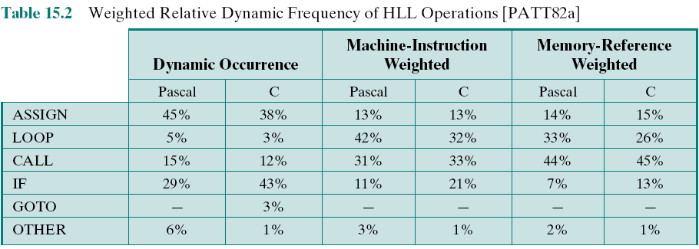
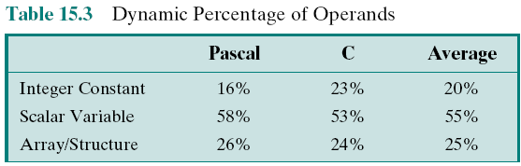
Operations and Operands are used:
Statistic
Statement
Notes:
Bảng 15.2 và 15.3 thống kê thói quen của người lập trình về việc sử dụng các phát biểu, các dạng khai báo hằng, biến
To get at this underlying phenomenon, the Patterson programs [PATT82a], described in Appendix 4A, were compiled on the VAX, PDP-11, and Motorola 68000 to determine the average number of machine instructions and memory references per statement type. The second and third columns in Table 15.2 show the relative frequency of occurrence of various HLL statements in a variety of programs; the data were obtained by observing the occurrences in running programs rather than just the number of times that statements occur in the source code. Hence these metrics capture dynamic behavior. To obtain the data in columns four and five (machine-instruction weighted), each value in the second and third columns is multiplied by the number of machine instructions produced by the compiler. These results are then normalized so that columns four and five show the relative frequency of occurrence, weighted by the number of machine instructions per HLL statement. Similarly, the sixth and seventh columns are obtained by multiplying the frequency of occurrence of each statement type by the relative number of memory references caused by each statement. The data in columns four through seven pro- vide surrogate measures of the actual time spent executing the various statement types. The results suggest that the procedure call/return is the most time-consuming operation in typical HLL programs.
The reader should be clear on the significance of Table 15.2. This table indicates the relative performance impact of various statement types in an HLL, when that HLL is compiled for a typical contemporary instruction set architecture. Some other architecture could conceivably produce different results. However, this study produces results that are representative for contemporary complex instruction set computer (CISC) architectures. Thus, they can provide guidance to those looking for more efficient ways to support HLLs.

Slide 9
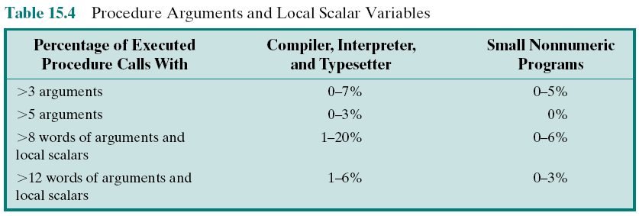
Procedure Call: Arguments and Local Scalar Variables
Statistic
Scalar variable: Simple variable storing only one value
Notes:
Bảng 15.4 thống kê thói quen của người lập trình về việc hiện thực hàm với số lượng tham số khác nhau.
We have seen that procedure calls and returns are an important aspect of HLL programs. The evidence (Table 15.2) suggests that these are the most time-consuming operations in compiled HLL programs. Thus, it will be profitable to consider ways of implementing these operations efficiently. Two aspects are significant: the number of parameters and variables that a procedure deals with, and the depth of nesting.
Tanenbaum’s study [TANE78] found that 98% of dynamically called procedures were passed fewer than six arguments and that 92% of them used fewer than six local scalar variables. Similar results were reported by the Berkeley RISC team [KATE83], as shown in Table 15.4. These results show that the number of words required per procedure activation is not large. The studies reported earlier indicated that a high proportion of operand references is to local scalar variables. These studies show that those references are in fact confined to relatively few variables.
The same Berkeley group also looked at the pattern of procedure calls and returns in HLL programs. They found that it is rare to have a long uninterrupted sequence of procedure calls followed by the corresponding sequence of returns. Rather, they found that a program remains confined to a rather narrow window of procedure-invocation depth. This is illustrated in Figure 4.21, which was discussed in Chapter 4. These results reinforce the conclusion that operand references are highly localized.

Slide 10
Implications
HLLs can best be supported by optimizing performance of the most time-consuming features of typical HLL programs
Three elements characterize RISC architectures:
Use a large number of registers or use a compiler to optimize register usage
Careful attention needs to be paid to the design of instruction pipelines
Instructions should have predictable costs and be consistent with a high-performance implementation
Notes:
Implication: hệ quả
User muốn chương trình phải chạy nhanh và một số trình biên dịch cũng hỗ trợ khả năng tối tưu hóa code.
Thế mà, RISC lại không cung cấp khả năng chạy lệnh phức tạp nhằm đáp ứng nhu cầu chạy nhanh chương trình.
Giải pháp mà RISC chọn đó là:
Dùng nhiều thanh ghi để tối thiểu hóa việc truy xuất bộ nhớ. Dùng thanh ghi thay cho biến bộ nhớ.
Trình biên dịch chịu trách nhiệm tính toán việc sử dụng hiệu quả tập thanh ghi này để tối ưu chương trình
Về phía nhà sản xuất CPU: Cung cấp chi phí từng lệnh máy (lệnh này chạy cần máy xung) và CPU chạy lệnh với hiệu suất cao nhất.
A number of groups have looked at results such as those just reported and have concluded that the attempt to make the instruction set architecture close to HLLs is not the most effective design strategy. Rather, the HLLs can best be supported by optimizing performance of the most time-consuming features of typical HLL programs.
Generalizing from the work of a number of researchers, three elements emerge that, by and large, characterize RISC architectures. First, use a large number of registers or use a compiler to optimize register usage. This is intended to optimize operand referencing. The studies just discussed show that there are several references per HLL statement and that there is a high proportion of move (assignment) statements. This, coupled with the locality and predominance of scalar references, suggests that performance can be improved by reducing memory references at the expense of more register references. Because of the locality of these references, an expanded register set seems practical.
Second, careful attention needs to be paid to the design of instruction pipe- lines. Because of the high proportion of conditional branch and procedure call instructions, a straightforward instruction pipeline will be inefficient. This manifests itself as a high proportion of instructions that are prefetched but never executed.
Finally, an instruction set consisting of high-performance primitives is indicated. Instructions should have predictable costs (measured in execution time and code size, and increasingly, in energy dissipation) and be consistent with a high-performance implementation (which harmonizes with predictable execution-time cost).

Slide 11
15.2- The Use of a Large Register File
Registers are accessed faster than cache or memory
➔ More registers are used
Software Solution
Hardware Solution
Requires compiler to allocate registers
Allocates based on most used variables in a given time
Requires sophisticated (complex) program analysis
More registers
Thus more variables will be in registers
Notes:
Trách nhiệm của trình biên dịch
Phân tích thật kỹ chương trình để chuyển nhiều biến nhất thanh thanh ghi một cách hiệu quả nhất.
The reason that register storage is indicated is that it is the fastest available storage device, faster than both main memory and cache. The register file is physically small, on the same chip as the ALU and control unit, and employs much shorter addresses than addresses for cache and memory. Thus, a strategy is needed that will allow the most frequently accessed operands to be kept in registers and to minimize register-memory operations.
Two basic approaches are possible, one based on software and the other on hardware. The software approach is to rely on the compiler to maximize register usage. The compiler will attempt to assign registers to those variables that will be used the most in a given time period. This approach requires the use of sophisticated program-analysis algorithms. The hardware approach is simply to use more registers so that more variables can be held in registers for longer periods of time.

Slide 12
RISC: Large Register File...
Some Issues
How are parameters transferred in procedure calls?
How are global data behave?
Whether number of registers is enough for large program?
How are instruction pipeline organized?
Using registers
Notes:
Trách nhiệm của trình biên dịch
Phân tích thật kỹ chương trình để chuyển nhiều biến nhất thanh thanh ghi một cách hiệu quả nhất.
The reason that register storage is indicated is that it is the fastest available storage device, faster than both main memory and cache. The register file is physically small, on the same chip as the ALU and control unit, and employs much shorter addresses than addresses for cache and memory. Thus, a strategy is needed that will allow the most frequently accessed operands to be kept in registers and to minimize register-memory operations.
Two basic approaches are possible, one based on software and the other on hardware. The software approach is to rely on the compiler to maximize register usage. The compiler will attempt to assign registers to those variables that will be used the most in a given time period. This approach requires the use of sophisticated program-analysis algorithms. The hardware approach is simply to use more registers so that more variables can be held in registers for longer periods of time.

Slide 13
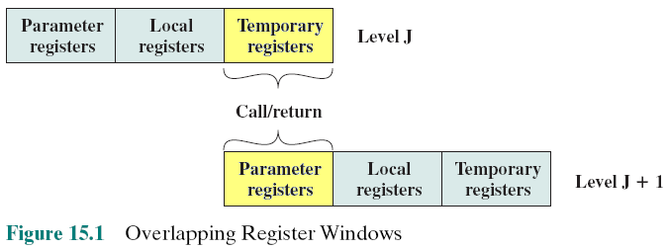
15.3- Compiler-Based Register Optimization
Transferring parameters in calling functions RISC: Overlapping Register Windows
Register windows is a group of registers which are used to pass arguments between procedure calls.
Notes:
Trong RISC, truyền tham số khi gọi chương trình con bằng thanh ghi. Nhóm thanh ghi được dùng trong việc này được gọi là cửa số thanh ghi (register window). Window này là nhóm thanh ghi dùng chung giữa hàm gọi và hàm được gọi.
Bên hàm gọi (caller): Temporary registers
Bên hàm được gọi (callee): Parameter registers
Hàm được gọi sẽ thao tác trực tiếp lên window dùng chung này.
Như vậy, mỗi hàm khi thực thi dữ liệu nằm trong các thanh ghi bao gồm:
- Dữ liệu tham số khi hàm được gọi (Parameter registes)
Dữ liệu cục bộ (riêng) của hàm (local registers)
Dữ liệu phục vụ cho việc gọi hàm sau đó (temporary registers)
Mức của hàm (Function Level)
Một số nguyên mô tả độ sâu của quá trình gọi hàm
Hàm main (mức 0). Main gọi f1 (mức 1), f1 gọi f2 (mức 2) ,….
On the face of it, the use of a large set of registers should decrease the need to access memory. The design task is to organize the registers in such a fashion that this goal is realized.
Because most operand references are to local scalars, the obvious approach is to store these in registers, with perhaps a few registers reserved for global variables. The problem is that the definition of local changes with each procedure call and return, operations that occur frequently. On every call, local variables must be saved from the registers into memory, so that the registers can be reused by the called procedure. Furthermore, parameters must be passed. On return, the variables of the calling procedure must be restored (loaded back into registers) and results must be passed back to the calling procedure.
The solution is based on two other results reported in Section 15.1. First, a typical procedure employs only a few passed parameters and local variables (Table 15.4). Second, the depth of procedure activation fluctuates within a relatively narrow range (Figure 4.21). To exploit these properties, multiple small sets of registers are used, each assigned to a different procedure. A procedure call automatically switches the processor to use a different fixed-size window of registers, rather than saving registers in memory. Windows for adjacent procedures are overlapped to allow parameter passing.
The concept is illustrated in Figure 15.1. At any time, only one window of registers is visible and is addressable as if it were the only set of registers (e.g., addresses 0 through N - 1). The window is divided into three fixed-size areas. Parameter registers hold parameters passed down from the procedure that called the current procedure and hold results to be passed back up. Local registers are used for local variables, as assigned by the compiler. Temporary registers are used to exchange parameters and results with the next lower level (procedure called by current procedure). The temporary registers at one level are physically the same as the parameter registers at the next lower level. This overlap permits parameters to be passed without the actual movement of data. Keep in mind that, except for the overlap, the registers at two different levels are physically distinct. That is, the parameter and local registers at level J are disjoint from the local and temporary registers at level J + 1.
To handle any possible pattern of calls and returns, the number of register windows would have to be unbounded. Instead, the register windows can be used to hold the few most recent procedure activations. Older activations must be saved
in memory and later restored when the nesting depth decreases. Thus, the actual organization of the register file is as a circular buffer of overlapping windows. Two notable examples of this approach are Sun’s SPARC architecture, described in Section 15.7, and the IA-64 architecture used in Intel’s Itanium processor.

Slide 14
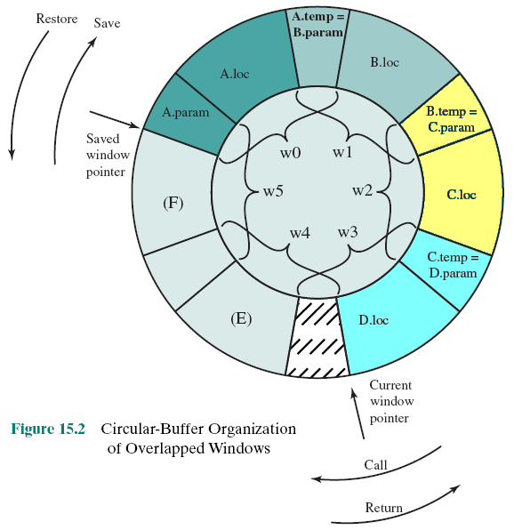
Circular Buffer Organization of Overlapped Windows
A called B; B called C; C called D
The procedure D is active
Overlapped registers are used between callings.
A curcular chain of register references is created
If the procedure F makes preparation to call another procedure, registers of A are conflicted and an interrupt must be thrown ➔ N windows permits N-1 calls only
Notes:
Hình 15.2 minh họa cơ chế gọi hàm A → B → C → D → D
The circular organization is shown in Figure 15.2, which depicts a circular buffer of six windows. The buffer is filled to a depth of 4 (A called B; B called C; C called D) with procedure D active. The current-window pointer (CWP) points to the window of the currently active procedure. Register references by a machine instruction are offset by this pointer to determine the actual physical register. The saved-window pointer (SWP) identifies the window most recently saved in memory. If procedure D now calls procedure E, arguments for E are placed in D’s temporary registers (the overlap between w3 and w4) and the CWP is advanced by one window.
If procedure E then makes a call to procedure F, the call cannot be made with the current status of the buffer. This is because F’s window overlaps A’s window. If F begins to load its temporary registers, preparatory to a call, it will overwrite the parameter registers of A (A.in). Thus, when CWP is incremented (modulo 6) so that it becomes equal to SWP, an interrupt occurs, and A’s window is saved. Only the first two portions (A.in and A.loc) need be saved. Then, the SWP is incremented and the call to F proceeds. A similar interrupt can occur on returns. For example, subsequent to the activation of F, when B returns to A, CWP is decremented and becomes equal to SWP. This causes an interrupt that results in the restoration of A’s window.
From the preceding, it can be seen that an N-window register file can hold only N - 1 procedure activations. The value of N need not be large. As was mentioned in Appendix 4A, one study [TAMI83] found that, with 8 windows, a save or restore is needed on only 1% of the calls or returns. The Berkeley RISC computers use 8 windows of 16 registers each. The Pyramid computer employs 16 windows of 32 registers each.

Slide 15
Compiler-Based Register Optimization:RISC: Global Variables
Variables declared as global in an HLL can be assigned memory locations by the compiler and all machine instructions that reference these variables will use memory reference operands
However, for frequently accessed global variables this scheme is inefficient
Alternative is to incorporate a set of global registers in the processor
These registers would be fixed in number and available to all procedures
A unified numbering scheme can be used to simplify the instruction format
There is an increased hardware burden (gánh nặng) to accommodate (supply) the split in register addressing
In addition, the linker (a part of compiler) must decide which global variables should be assigned to registers
Notes:
Hằng sẽ được đưa thẳng vào câu lệnh nên không cần thanh ghi để chứa.
Với biến toàn cục dùng chung giữa nhiều hàm: Trình biên dịch tính toán để chuyển biến toán cục vào thanh gi (global registers).
Linker – Trình liên kết
Quá trình biên dịch một chương trình gớm 2 bước:
Bước 1: Dịch (translator)
Kiểm tra các code thư viện có hợp lệ không (khai báo chưa? Gọi hàm thư viện có đúng tham số không?.
Dịch code của chương trình.
Bước 2: Liên kết (linker)
Copy code thư viện vào chương trình, bổ xung địa chỉ những chỗ gọi hàm thư viện
Có thể trong thư viện cũng có khai báo các biến toàn cục. Linker phải xem xét những dữ liệu toàn cục của thư viện cần đến trong chương trình để cấp phát thanh ghi phù hợp.
The window scheme just described provides an efficient organization for storing local scalar variables in registers. However, this scheme does not address the need to store global variables, those accessed by more than one procedure. Two options suggest themselves. First, variables declared as global in an HLL can be assigned memory locations by the compiler, and all machine instructions that reference these variables will use memory-reference operands. This is straightforward, from both the hardware and software (compiler) points of view. However, for frequently accessed global variables, this scheme is inefficient.
An alternative is to incorporate a set of global registers in the processor. These registers would be fixed in number and available to all procedures. A unified numbering scheme can be used to simplify the instruction format. For example, references to registers 0 through 7 could refer to unique global registers, and references to registers 8 through 31 could be offset to refer to physical registers in the current window. There is an increased hardware burden to accommodate the split in register addressing. In addition, the linker must decide which global variables should be assigned to registers.

Slide 16
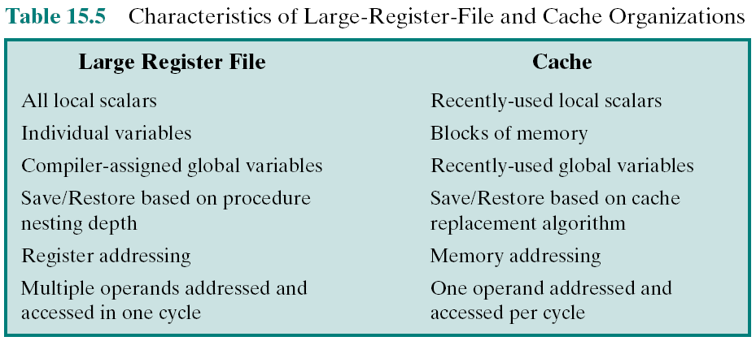
Large-Register-File vs. Cache
Why RISC uses register file but cache?
Notes:
The register file, organized into windows, acts as a small, fast buffer for holding a subset of all variables that are likely to be used the most heavily. From this point of view, the register file acts much like a cache memory, although a much faster memory. The question therefore arises as to whether it would be simpler and better to use a cache and a small traditional register file.
Table 15.5 compares characteristics of the two approaches. The window-based register file holds all the local scalar variables (except in the rare case of window overflow) of the most recent N - 1 procedure activations. The cache holds a selection of recently used scalar variables. The register file should save time, because all local scalar variables are retained. On the other hand, the cache may make more efficient use of space, because it is reacting to the situation dynamically. Furthermore, caches generally treat all memory references alike, including instructions and other types of data. Thus, savings in these other areas are possible with a cache and not a register file.
A register file may make inefficient use of space, because not all procedures will need the full window space allotted to them. On the other hand, the cache suffers from another sort of inefficiency: Data are read into the cache in blocks. Whereas the register file contains only those variables in use, the cache reads in a block of data, some or much of which will not be used.
The cache is capable of handling global as well as local variables. There are usually many global scalars, but only a few of them are heavily used [KATE83]. A cache will dynamically discover these variables and hold them. If the window- based register file is supplemented with global registers, it too can hold some global scalars. However, when program modules are separately compiled, it is impossible for the compiler to assign global values to registers; the linker must perform this task.
With the register file, the movement of data between registers and memory is determined by the procedure nesting depth. Because this depth usually fluctuates within a narrow range, the use of memory is relatively infrequent. Most cache memories are set associative with a small set size. Thus, there is the danger that other data or instructions will compete for cache residency.

Slide 17
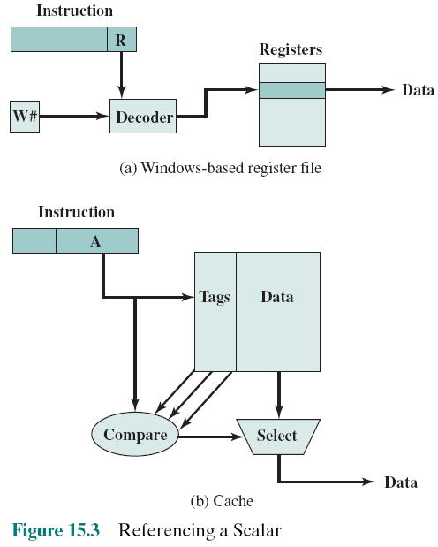
Referencing a Scalar
Very fast
Comparing performance in accessing data between RISC and CISC
slower
Notes:
So sánh hiệu suất trong việc truy xuất dữ liệu
Máy tính RISC: dữ liệu để trong thanh ghi nên toán hạng trong lệnh là thanh ghi. Tại 1 thời điểm có một hàm đang chạy, window chứa thanh ghi của hàm được ghi nhận(W#) nên việc xác định thanh ghi chứa dữ liệu sẽ tham gia vào tác vụ rất nhanh.
Máy tính CISC: dữ liệu để trong cache nên toán hạng là địa chỉ A trong cache (toán hạng trực triếp).phải được đó với thành phần tag nếu đúng (cache hit) rồi mới truy xuất được dữ liệu. Dù cache vận hành ở tốc độ cao hơn RAM nhưng vẫn chậm hơn truy xuất thanh ghi.
Based on the discussion so far, the choice between a large window-based register file and a cache is not clear-cut. There is one characteristic, however, in which the register approach is clearly superior and which suggests that a cache-based sys- tem will be noticeably slower. This distinction shows up in the amount of addressing overhead experienced by the two approaches.
Figure 15.3 illustrates the difference. To reference a local scalar in a window- based register file, a “virtual” register number and a window number are used. These can pass through a relatively simple decoder to select one of the physical registers. To reference a memory location in cache, a full-width memory address must be generated. The complexity of this operation depends on the addressing mode. In a set associative cache, a portion of the address is used to read a number of words and tags equal to the set size. Another portion of the address is compared with the tags, and one of the words that were read is selected. It should be clear that even if the cache is as fast as the register file, the access time will be considerably longer. Thus, from the point of view of performance, the window-based register file is superior for local scalars. Further performance improvement could be achieved by the addition of a cache for instructions only.
The essence of the optimization task is to decide which quantities are to be assigned to registers at any given point in the program. The technique most commonly used in RISC compilers is known as graph coloring, which is a technique borrowed from the discipline of topology [CHAI82, CHOW86, COUT86, CHOW90].
The graph coloring problem is this. Given a graph consisting of nodes and edges, assign colors to nodes such that adjacent nodes have different colors, and do this in such a way as to minimize the number of different colors. This problem is adapted to the compiler problem in the following way. First, the program is ana;yzed to build a register interference graph. The nodes of the graph are the symbolic registers. If two symbolic registers are “live” during the same program fragment, then they are joined by an edge to depict interference. An attempt is then made to color the graph with n colors, where n is the number of registers. Nodes that share the same color can be assigned to the same register. If this process does not fully succeed, then those nodes that cannot be colored must be placed in memory, and loads and stores must be used to make space for the affected quantities when they are needed.

Slide 18
15.4- Reduced Instruction Set Architecture
Why CISC?
-The trend to richer instruction sets, which include a larger number of instructions and more complex instructions.
Two principal reasons have motivated this trend:
A desire to simplify compilers and
A desire to improve performance.
Underlying both of these reasons was the shift to HLLs on the part of programmers; architects attempted to design machines that provided better support for HLLs.
Notes:
The register file, organized into windows, acts as a small, fast buffer for holding a subset of all variables that are likely to be used the most heavily. From this point of view, the register file acts much like a cache memory, although a much faster memory. The question therefore arises as to whether it would be simpler and better to use a cache and a small traditional register file.
Table 15.5 compares characteristics of the two approaches. The window-based register file holds all the local scalar variables (except in the rare case of window overflow) of the most recent N - 1 procedure activations. The cache holds a selection of recently used scalar variables. The register file should save time, because all local scalar variables are retained. On the other hand, the cache may make more efficient use of space, because it is reacting to the situation dynamically. Furthermore, caches generally treat all memory references alike, including instructions and other types of data. Thus, savings in these other areas are possible with a cache and not a register file.
A register file may make inefficient use of space, because not all procedures will need the full window space allotted to them. On the other hand, the cache suffers from another sort of inefficiency: Data are read into the cache in blocks. Whereas the register file contains only those variables in use, the cache reads in a block of data, some or much of which will not be used.
The cache is capable of handling global as well as local variables. There are usually many global scalars, but only a few of them are heavily used [KATE83]. A cache will dynamically discover these variables and hold them. If the window- based register file is supplemented with global registers, it too can hold some global scalars. However, when program modules are separately compiled, it is impossible for the compiler to assign global values to registers; the linker must perform this task.
With the register file, the movement of data between registers and memory is determined by the procedure nesting depth. Because this depth usually fluctuates within a narrow range, the use of memory is relatively infrequent. Most cache memories are set associative with a small set size. Thus, there is the danger that other data or instructions will compete for cache residency.

Slide 19
Reduced Instruction Set Architecture
Characteristics of Reduced Instruction Set Architectures
Although a variety of different approaches to reduced instruction set architecture have been taken, certain characteristics are common to all of them:
• One instruction per cycle
• Register-to-register operations
• Simple addressing modes
• Simple instruction formats
Notes:
The register file, organized into windows, acts as a small, fast buffer for holding a subset of all variables that are likely to be used the most heavily. From this point of view, the register file acts much like a cache memory, although a much faster memory. The question therefore arises as to whether it would be simpler and better to use a cache and a small traditional register file.
Table 15.5 compares characteristics of the two approaches. The window-based register file holds all the local scalar variables (except in the rare case of window overflow) of the most recent N - 1 procedure activations. The cache holds a selection of recently used scalar variables. The register file should save time, because all local scalar variables are retained. On the other hand, the cache may make more efficient use of space, because it is reacting to the situation dynamically. Furthermore, caches generally treat all memory references alike, including instructions and other types of data. Thus, savings in these other areas are possible with a cache and not a register file.
A register file may make inefficient use of space, because not all procedures will need the full window space allotted to them. On the other hand, the cache suffers from another sort of inefficiency: Data are read into the cache in blocks. Whereas the register file contains only those variables in use, the cache reads in a block of data, some or much of which will not be used.
The cache is capable of handling global as well as local variables. There are usually many global scalars, but only a few of them are heavily used [KATE83]. A cache will dynamically discover these variables and hold them. If the window- based register file is supplemented with global registers, it too can hold some global scalars. However, when program modules are separately compiled, it is impossible for the compiler to assign global values to registers; the linker must perform this task.
With the register file, the movement of data between registers and memory is determined by the procedure nesting depth. Because this depth usually fluctuates within a narrow range, the use of memory is relatively infrequent. Most cache memories are set associative with a small set size. Thus, there is the danger that other data or instructions will compete for cache residency.

Slide 20
Reduced Instruction Set Architecture
Typical of a classic RISC:
A single instruction size.
That size is typically 4 bytes.
A small number of data addressing modes, typically less than five. This parameter is difficult to pin down. In the table, register and literal modes are not counted and different formats with different offset sizes are counted separately.
No indirect addressing that requires you to make one memory access to get the address of another operand in memory.
No operations that combine load/store with arithmetic (e.g., add from memory, add to memory).
Notes:
The register file, organized into windows, acts as a small, fast buffer for holding a subset of all variables that are likely to be used the most heavily. From this point of view, the register file acts much like a cache memory, although a much faster memory. The question therefore arises as to whether it would be simpler and better to use a cache and a small traditional register file.
Table 15.5 compares characteristics of the two approaches. The window-based register file holds all the local scalar variables (except in the rare case of window overflow) of the most recent N - 1 procedure activations. The cache holds a selection of recently used scalar variables. The register file should save time, because all local scalar variables are retained. On the other hand, the cache may make more efficient use of space, because it is reacting to the situation dynamically. Furthermore, caches generally treat all memory references alike, including instructions and other types of data. Thus, savings in these other areas are possible with a cache and not a register file.
A register file may make inefficient use of space, because not all procedures will need the full window space allotted to them. On the other hand, the cache suffers from another sort of inefficiency: Data are read into the cache in blocks. Whereas the register file contains only those variables in use, the cache reads in a block of data, some or much of which will not be used.
The cache is capable of handling global as well as local variables. There are usually many global scalars, but only a few of them are heavily used [KATE83]. A cache will dynamically discover these variables and hold them. If the window- based register file is supplemented with global registers, it too can hold some global scalars. However, when program modules are separately compiled, it is impossible for the compiler to assign global values to registers; the linker must perform this task.
With the register file, the movement of data between registers and memory is determined by the procedure nesting depth. Because this depth usually fluctuates within a narrow range, the use of memory is relatively infrequent. Most cache memories are set associative with a small set size. Thus, there is the danger that other data or instructions will compete for cache residency.

Slide 21
Reduced Instruction Set Architecture
Typical of a classic RISC:
6- No more than one memory-addressed operand per instruction.
7. Does not support arbitrary alignment of data for load/store operations.
8. Maximum number of uses of the memory management unit (MMU) for a data address in an instruction.
9. Number of bits for integer register specifier equal to five or more. This means that at least 32 integer registers can be explicitly referenced at a time.
10. Number of bits for floating-point register specifier equal to four or more. This means that at least 16 floating-point registers can be explicitly referenced at a time.
Notes:
The register file, organized into windows, acts as a small, fast buffer for holding a subset of all variables that are likely to be used the most heavily. From this point of view, the register file acts much like a cache memory, although a much faster memory. The question therefore arises as to whether it would be simpler and better to use a cache and a small traditional register file.
Table 15.5 compares characteristics of the two approaches. The window-based register file holds all the local scalar variables (except in the rare case of window overflow) of the most recent N - 1 procedure activations. The cache holds a selection of recently used scalar variables. The register file should save time, because all local scalar variables are retained. On the other hand, the cache may make more efficient use of space, because it is reacting to the situation dynamically. Furthermore, caches generally treat all memory references alike, including instructions and other types of data. Thus, savings in these other areas are possible with a cache and not a register file.
A register file may make inefficient use of space, because not all procedures will need the full window space allotted to them. On the other hand, the cache suffers from another sort of inefficiency: Data are read into the cache in blocks. Whereas the register file contains only those variables in use, the cache reads in a block of data, some or much of which will not be used.
The cache is capable of handling global as well as local variables. There are usually many global scalars, but only a few of them are heavily used [KATE83]. A cache will dynamically discover these variables and hold them. If the window- based register file is supplemented with global registers, it too can hold some global scalars. However, when program modules are separately compiled, it is impossible for the compiler to assign global values to registers; the linker must perform this task.
With the register file, the movement of data between registers and memory is determined by the procedure nesting depth. Because this depth usually fluctuates within a narrow range, the use of memory is relatively infrequent. Most cache memories are set associative with a small set size. Thus, there is the danger that other data or instructions will compete for cache residency.

Slide 22
12.5- RISC Pipelining
Syllabus đã bỏ phần này
Instruction pipelining is often used to enhance performance. Most instructions in RISC are register to register.
Instruction cycle: two stages:
• I: Instruction fetch.
• E: Execute, ALU operation, Input and output are registers.
Load and store operations, three stages:
I: Instruction fetch.
E: Execute. Calculates memory address.
D: (direction) Memory. Register-to-memory or memory-to-register operation.
Notes:
Instruction Pipeline: Đường ống lệnh
Đường ống lệnh là một nhóm các mạch điện tử (modules). Mỗi mạch điện đảm nhiệm một bước (stage/ tầng) trong quá trình thực thi lệnh. Các tầng chạy đồng thời. Đầu ra của tầng này được đưa thẳng vào tầng sau nhằm tăng hiệu suất của phần cứng.
Vì RISC cố gắng đơn giản hoá tập lệnh nên đường ống lệnh có thể chỉ cần:
2 tầng trong trường hợp lý tưởng ở đó bộ nhớ không được dùng 3 tầng trong trường hợp CÓ dùng bộ nhớ.
Tầng I : Instaction fetch: giúp lấy lệnh
Tầng E: Execute giúp thực thi lệnh
Tầng D: Rirection giúp truy cập bộ nhớ trogn giao tiếp memory ←→ register
As we discussed in Section 12.4, instruction pipelining is often used to enhance performance. Let us reconsider this in the context of a RISC architecture. Most instructions are register to register, and an instruction cycle has the following two stages:
• I: Instruction fetch.
• E: Execute. Performs an ALU operation with register input and output.
For load and store operations, three stages are required:
I: Instruction fetch.
E: Execute. Calculates memory address.
D: Memory. Register-to-memory or memory-to-register operation.
Figure 15.6a depicts the timing of a sequence of instructions using no pipelining. Clearly, this is a wasteful process. Even very simple pipelining can substantially improve performance. Figure 15.6b shows a two-stage pipelining scheme, in which the I and E stages of two different instructions are performed simultaneously. The two stages of the pipeline are an instruction fetch stage, and an exe- cute/memory stage that executes the instruction, including register-to-memory and memory-to-register operations. Thus we see that the instruction fetch stage of the second instruction can be performed in parallel with the first part of the execute/ memory stage. However, the execute/memory stage of the second instruction must be delayed until the first instruction clears the second stage of the pipeline. This scheme can yield up to twice the execution rate of a serial scheme. Two problems prevent the maximum speedup from being achieved. First, we assume that a single- port memory is used and that only one memory access is possible per stage. This requires the insertion of a wait state in some instructions. Second, a branch instruction interrupts the sequential flow of execution. To accommodate this with mini- mum circuitry, a NOOP instruction can be inserted into the instruction stream by the compiler or assembler.
Pipelining can be improved further by permitting two memory accesses per stage. This yields the sequence shown in Figure 15.6c. Now, up to three instructions can be overlapped, and the improvement is as much as a factor of 3. Again, branch instructions cause the speedup to fall short of the maximum possible. Also, note that data dependencies have an effect. If an instruction needs an operand that is altered by the preceding instruction, a delay is required. Again, this can be accomplished by a NOOP.
The pipelining discussed so far works best if the three stages are of approximately equal duration. Because the E stage usually involves an ALU operation, it may be longer. In this case, we can divide into two substages:
• E₁: Register file read
• E₂: ALU operation and register write
Because of the simplicity and regularity of a RISC instruction set, the design of the phasing into three or four stages is easily accomplished. Figure 15.6d shows the result with a four-stage pipeline. Up to four instructions at a time can be under way, and the maximum potential speedup is a factor of 4. Note again the use of NOOPs to account for data and branch delays.

Slide 23
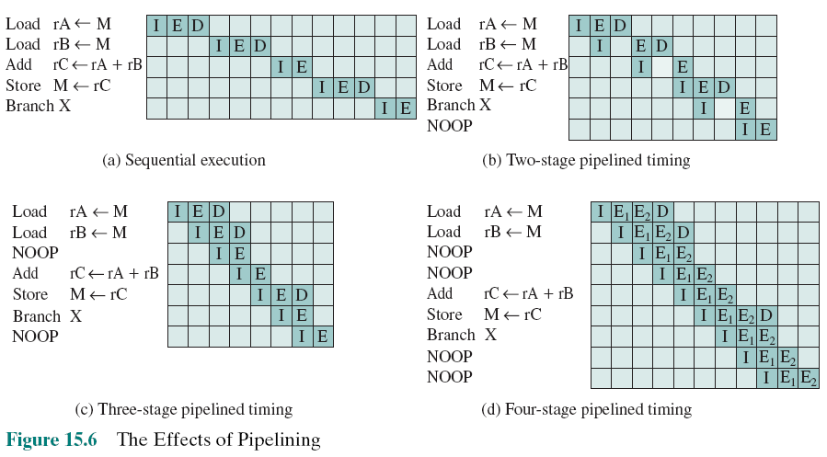
The Effects of Pipelining: An Example
(I), (E+D)
(I), (E), (D)
(I), (E1), (E2), D
NOOP: No operation → Wait
Notes:
Slide này minh họa hiệu quả của việc sử dụng đường ống lệnh để tăng hiệu suất của cùng một đoạn lệnh.
Hình a:
Không dùng kỹ thuật đường ống, các lệnh được chạy tuần tự. Tốn 13 đơn vị thời gian (bảng có 13 cột. Dòng số 3 không có sự tham gia của tầng D vì lệnh không truy xuất bộ nhớ.
Hình b: Dĩ nhiên chương trình có hiệu chỉnh bằng lệnh NOOP
Dùng kỹ thuật đường ống 2 tầng: tầng 1 lấy lệnh (I), tầng 2 làm 2 việc thực thi lệnh và ghi bộ nhớ (I+D).
Chương trình cần hiệu chỉnh phù hợp nên có lệnh NOOP – No operation. Đây là 1 lệnh máy nhưng không có gì để thực thi. Mục tiêu của lệnh NOOP là tạm dừng CPU một nhịp. Lệnh NOOP sẽ được giời thiệu kỹ hơn ở slide sau.
Ở thời điểm t=3 (cột 3), lệnh 1 đang ở bước ghi bộ nhớ (D) nên lệnh 2 phải chờ (biểu thị bằng ô trống dở dòng 2
Tốn 10 đơn vị thời gian → Chu7o78ng trình chạy nhanh hơn
Hình c: Dĩ nhiên chương trình có hiệu chỉnh bằng lệnh NOOP
Dùng kỹ thuật đường ống 3 tầng: tầng 1 lấy lệnh (I), tầng 2 thực thi (E), tầng 3 ghi bộ nhớ (D).
Chạy nhanh hơn nữa, 8 đơn vị thời gian. Lệnh 2 không bị chờ (xem cột 3).
Hình d: Dĩ nhiên chương trình có hiệu chỉnh bằng lệnh NOOP
Dùng kỹ thuật đường ống 4 tầng. Tầng E chia thành 2 tầng tách biệt E1 và E2 ← 11 đơn vị thời gian.
Nhận xét: Đường ống lệnh làm tăng hiệu suất nhưng không phải cứ nhiều tầng là hiệu suất càng cao
As we discussed in Section 12.4, instruction pipelining is often used to enhance performance. Let us reconsider this in the context of a RISC architecture. Most instructions are register to register, and an instruction cycle has the following two stages:
• I: Instruction fetch.
• E: Execute. Performs an ALU operation with register input and output.
For load and store operations, three stages are required:
I: Instruction fetch.
E: Execute. Calculates memory address.
D: Memory. Register-to-memory or memory-to-register operation.
Figure 15.6a depicts the timing of a sequence of instructions using no pipelining. Clearly, this is a wasteful process. Even very simple pipelining can substantially improve performance. Figure 15.6b shows a two-stage pipelining scheme, in which the I and E stages of two different instructions are performed simultaneously. The two stages of the pipeline are an instruction fetch stage, and an exe- cute/memory stage that executes the instruction, including register-to-memory and memory-to-register operations. Thus we see that the instruction fetch stage of the second instruction can be performed in parallel with the first part of the execute/ memory stage. However, the execute/memory stage of the second instruction must be delayed until the first instruction clears the second stage of the pipeline. This scheme can yield up to twice the execution rate of a serial scheme. Two problems prevent the maximum speedup from being achieved. First, we assume that a single- port memory is used and that only one memory access is possible per stage. This requires the insertion of a wait state in some instructions. Second, a branch instruction interrupts the sequential flow of execution. To accommodate this with mini- mum circuitry, a NOOP instruction can be inserted into the instruction stream by the compiler or assembler.
Pipelining can be improved further by permitting two memory accesses per stage. This yields the sequence shown in Figure 15.6c. Now, up to three instructions can be overlapped, and the improvement is as much as a factor of 3. Again, branch instructions cause the speedup to fall short of the maximum possible. Also, note that data dependencies have an effect. If an instruction needs an operand that is altered by the preceding instruction, a delay is required. Again, this can be accomplished by a NOOP.
The pipelining discussed so far works best if the three stages are of approximately equal duration. Because the E stage usually involves an ALU operation, it may be longer. In this case, we can divide into two substages:
• E₁: Register file read
• E₂: ALU operation and register write
Because of the simplicity and regularity of a RISC instruction set, the design of the phasing into three or four stages is easily accomplished. Figure 15.6d shows the result with a four-stage pipeline. Up to four instructions at a time can be under way, and the maximum potential speedup is a factor of 4. Note again the use of NOOPs to account for data and branch delays.

Slide 24
Optimization of Pipelining
Delayed branch
Does not take effect until after execution of following instruction
This location immediately following the branch is the delay slot → Insert the instruction NOOP
Delayed Load
Register to be target is locked by processor
Continue execution of instruction stream until register required
Idle until load is complete
Re-arranging instructions can allow useful work while loading
Loop Unrolling (mở rộng vòng lặp)
Replicate body of loop a number of times
Iterate loop fewer times
Reduces loop overhead
Increases instruction parallelism
Improved register, data cache, or TLB locality
Notes:
Một số tình huống làm giảm hiệu suất của đường ống lệnh:
1- Lệnh rẽ nhánh (branch/ lệnh nhẩy sang địa chỉ khác – lệnh if else trong ngôn ngữ cấp cao)
Vài lệnh ngay sau if (điều kiện đúng) đã được xử lý qua một số tầng mà điều kiện sai. Những xử lý này bị phí bỏ để nạp cách lệnh của khối else.
Giải pháp: Trình biên dịch chèn lệnh NOOP để tạm nhưng một nhịp phần cứng- Slide sau sẽ làm rõ.
2- Lệnh sau phụ thuộc thanh ghi của lệnh trước (delayed register)
Thí dụ: Mov R1, R2; // phải ghi hoàn tất R1 trước → Lệnh này sẽ khóa R1 và chỉ nhả ra sau khi ghi R1 xong.
Add R1, 3 // mới cho đọc rồi ghi R1
Giải pháp: Trình biên dịch sắp xếp lại các lệnh để giảm sự phụ thuộc lẫn nhau.
Nếu không sắp xếp được thì đây là chi phí phải chấp nhận.
3- Lệnh lặp- Trong lệnh lặp có lệnh nhẩy từ dưới lên trên
Giải pháp: Giảm bớt số lệnh nhẩy bằng cách tăng tính toán bên trong vòng lặp. Xem slide sau
Because of the simple and regular nature of RISC instructions, it is easier for a hardware designer to implement a simple, fast pipeline. There are few variations in instruction execution duration, and the pipeline can be tailored to reflect this. However, we have seen that data and branch dependencies reduce the overall execution rate.
To compensate for these dependencies, code reorganization techniques have been developed.

Slide 25
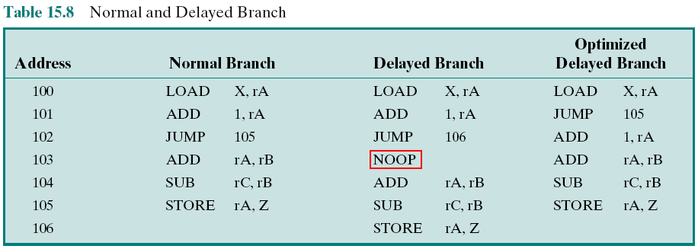
Table 15.8: Normal and Delayed Branch
Target of JUMP is delayed → ADD is executed before STORE
After 102 is executed, the next instruction to be executed is 105
To regularize the pipeline, a NOOP is inserted after this branch
(previous slide)
Increased performance is achieved only if the instructions at 101 and 102 are interchanged.
Notes:
NOOP/ No operation là một lệnh máy nên vẫn phải qua các bước lấy lệnh, giải mã nhưng không có gì để thực thi.
Lệnh này được đưa ra nhằm tăng hiệu suất của đường ống lệnh
Các cách trình biên dịch xử lý lệnh rẽ nhánh (branch/ JUMP) – Xem các khung mầu đỏ trong bảng
Kỹ thuật Delay Branch – Làm chậm lại lệnh rẽ nhánh bằng cách thêm lệnh NOOP ngay sau lệnh rẽ nhánh.
Kỹ thuật Optimized Delay Branch: Không chèn thêm lệnh NOOP mà hoán vị thứ tự lệnh JUMP với lệnh trước đó.
Minh họa bằng đường ống lệnh ở slide sau.
First, let us consider branching instructions. Delayed branch, a way of increasing the efficiency of the pipeline, makes use of a branch that does not take effect until after execution of the following instruction (hence the term delayed). The instruction location immediately following the branch is referred to as the delay slot. This strange procedure is illustrated in Table 15.8. In the column labeled “normal branch,” we see a normal symbolic instruction machine-language program. After 102 is executed, the next instruction to be executed is 105. To regularize the pipeline, a NOOP is inserted after this branch. However, increased performance is achieved if the instructions at 101 and 102 are interchanged.

Slide 26
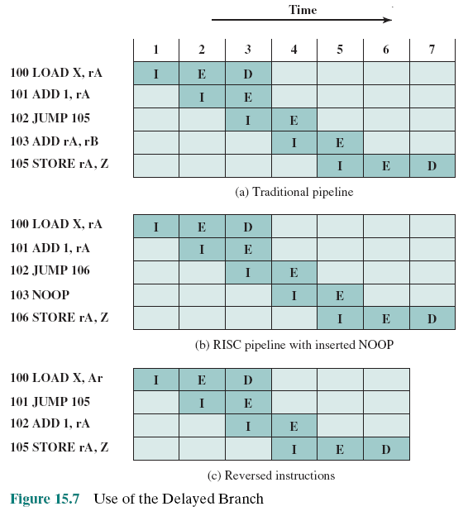
Use of the Delayed Branch
26
Program in the table 15.6
Notes:
Nhìn sơ qua các bảng:
Kỹ thuật Delayed Branch không cải tiến đường ống lệnh khi gặp lệnh rẽ nhánh (vẫn cần 7 đơn vị thời gian)
Kỹ thuật Delayed Branch cải tiến đường ống lệnh khi gặp lệnh rẽ nhánh (chỉ cần 6 đơn vị thời gian)
Figure 15.7 shows the result. Figure 15.7a shows the traditional approach to pipelining, of the type discussed in Chapter 14 (e.g., see Figures 14.11 and 14.12). The JUMP instruction is fetched at time 3. At time 4, the JUMP instruction is executed at the same time that instruction 103 (ADD instruction) is fetched. Because a JUMP occurs, which updates the program counter, the pipeline must be cleared of instruction 103; at time 5, instruction 105, which is the target of the JUMP, is loaded. Figure 15.7b shows the same pipeline handled by a typical RISC organization. The timing is the same. However, because of the insertion of the NOOP instruction, we do not need special circuitry to clear the pipeline; the NOOP simply executes with no effect. Figure 15.7c shows the use of the delayed branch. The JUMP instruction is fetched at time 2, before the ADD instruction, which is fetched at time 3. Note, however, that the ADD instruction is fetched before the execution of the JUMP instruction has a chance to alter the program counter. Therefore, during time 4, the ADD instruction is executed at the same time that instruction 105 is fetched.
Thus, the original semantics of the program are retained but one less clock cycle is required for execution.
This interchange of instructions will work successfully for unconditional branches, calls, and returns. For conditional branches, this procedure cannot be blindly applied. If the condition that is tested for the branch can be altered by the immediately preceding instruction, then the compiler must refrain from doing the interchange and instead insert a NOOP. Otherwise, the compiler can seek to insert a useful instruction after the branch. The experience with both the Berkeley RISC and IBM 801 systems is that the majority of conditional branch instructions can be optimized in this fashion ([PATT82a], [RADI83]).
A similar sort of tactic, called the delayed load, can be used on LOAD instructions. On LOAD instructions, the register that is to be the target of the load is locked by the processor. The processor then continues execution of the instruction stream until it reaches an instruction requiring that register, at which point it idles until the load is complete. If the compiler can rearrange instructions
so that useful work can be done while the load is in the pipeline, efficiency is
increased.

Slide 27
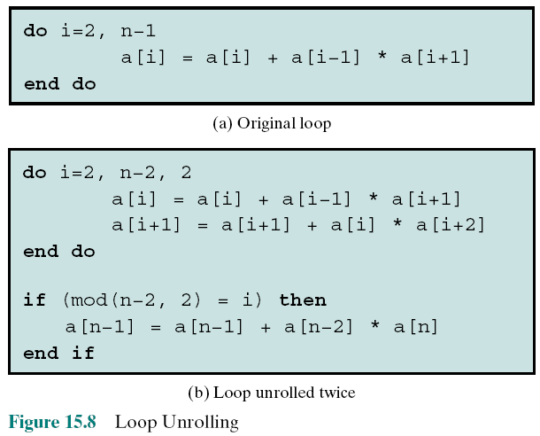
Loop Unrolling Twice Example
Compiler technique to improve instruction parallelism is loop unrolling .
Unrolling can improve the performance by:
Reducing loop overhead,
increasing instruction parallelism by improving pipeline performance, improving register, data cache, or TLB locality
Number of loops decreases 2 times
Notes:
Loop Unrolling – mở rộng vòng lặp giúp giảm số lần nhẩy
Trong lệnh lặp có lệnh nhẩy từ dưới lên trên. Xem thí dụ:
for (I = 0; I<100; I++) { → Nhẩy 100 lần
a[I] = 10;
}
for (I = 0; I<100; I+=2) { // → Nhẩy 50 lần
a[I] = 10;
a{I+1] = 10;
}
Another compiler technique to improve instruction parallelism is loop unrolling [BACO94]. Unrolling replicates the body of a loop some number of times called the unrolling factor (u) and iterates by step u instead of step 1.
Unrolling can improve the performance by
Reducing loop overhead
Increasing instruction parallelism by improving pipeline performance
Improving register, data cache, or TLB locality
Figure 15.8 illustrates all three of these improvements in an example. Loop overhead is cut in half because two iterations are performed before the test and branch at the end of the loop. Instruction parallelism is increased because the second assignment can be performed while the results of the first are being stored and the loop variables are being updated. If array elements are assigned to registers, register locality will improve because a[i] and a[i + 1] are used twice in the loop body, reducing the number of loads per iteration from three to two.

Slide 28
15.8-RISC versus CISC Controversy
Quantitative – So sánh định lượng
Compare program sizes and execution speeds of programs on RISC and CISC machines that use comparable technology
Qualitative – so sánh chất lượng
Examine issues of high level language support and use of VLSI real estate (very large scale integration chip)
Problems with comparisons:
No pair of RISC and CISC machines that are comparable in life-cycle cost, level of technology, gate complexity, sophistication of compiler, operating system support, etc.
No definitive set of test programs exists
Difficult to separate hardware effects from complier effects
Most comparisons done on “toy” rather than commercial products
Most commercial devices advertised as RISC possess a mixture of RISC and CISC characteristics
Chưa biết mèo nào cắn mèo nào!
The battle has no end!
Controversy: tranh luận
Notes:
For many years, the general trend in computer architecture and organization has been toward increasing processor complexity: more instructions, more addressing modes, more specialized registers, and so on. The RISC movement represents a fundamental break with the philosophy behind that trend. Naturally, the appearance of RISC systems, and the publication of papers by its proponents extolling RISC virtues, led to a reaction from those involved in the design of CISC architectures.
The work that has been done on assessing merits of the RISC approach can be grouped into two categories:
Quantitative: Attempts to compare program size and execution speed of pro- grams on RISC and CISC machines that use comparable technology
Qualitative: Examines issues such as high-level language support and optimum use of VLSI real estate
Most of the work on quantitative assessment has been done by those working on RISC systems [PATT82b, HEAT84, PATT84], and it has been, by and large, favorable to the RISC approach. Others have examined the issue and come away unconvinced [COLW85a, FLYN87, DAVI87]. There are several problems with attempting such comparisons [SERL86]:
There is no pair of RISC and CISC machines that are comparable in life-cycle cost, level of technology, gate complexity, sophistication of compiler, operating system support, and so on.
No definitive test set of programs exists. Performance varies with the program.
It is difficult to sort out hardware effects from effects due to skill in compiler
writing.
Most of the comparative analysis on RISC has been done on “toy” machines rather than commercial products. Furthermore, most commercially available machines advertised as RISC possess a mixture of RISC and CISC characteristics. Thus, a fair comparison with a commercial, “pure-play” CISC machine (e.g., VAX, Pentium) is difficult.
The qualitative assessment is, almost by definition, subjective. Several researchers have turned their attention to such an assessment [COLW85a, WALL85], but the results are, at best, ambiguous, and certainly subject to rebuttal [PATT85b] and, of course, counterrebuttal [COLW85b].

Slide 29
Summary
Reduced Instruction Set Computers
(RISC)
Chapter 15
Instruction execution characteristics
Operations
Operands
Procedure calls
Implications
The use of a large register file
Register windows
Global variables
Large register file versus cache
RISC pipelining
Pipelining with regular instructions
Optimization of pipelining
Compiler-based register optimization
RISC versus CISC controversy
Notes:
Chapter 15 summary.

