Slide 1

William Stallings, Computer Organization and Architecture, 9th Edition
Instruction-Level Parallelism and Superscalar Processors
Chapter 16
Notes:
Lecture slides prepared for “Computer Organization and Architecture”, 9/e, by William Stallings, Chapter 16 “Instruction-Level Parallelism and Superscalar Processors”.
Adapted by Thân Văn Sử
A superscalar implementation of a processor architecture is one in which common instructions—integer and floating-point arithmetic, loads, stores, and conditional branches—can be initiated simultaneously and executed independently. Such implementations raise a number of complex design issues related to the instruction pipeline.
Superscalar design arrived on the scene hard on the heels (điểm yêu) of RISC architecture. Although the simplified instruction set architecture of a RISC machine lends itself readily to superscalar techniques, the superscalar approach can be used on either a RISC or CISC architecture.
Whereas the gestation period for the arrival of commercial RISC machines from the beginning of true RISC research with the IBM 801 and the Berkeley RISC I was seven or eight years, the first superscalar machines became commercially available within just a year or two of the coining of the term superscalar. The superscalar approach has now become the standard method for implementing high- performance microprocessors.
In this chapter, we begin with an overview of the superscalar approach, contrasting it with super pipelining. Next, we present the key design issues associated with superscalar implementation. Then we look at several important examples of superscalar architecture.

Slide 2
Objectives
CLO9: Investigate, evaluate and communicate general trends in computing technologies such as Instruction-Level Parallelism and Superscalar Processors

Slide 3
Objectives
Parallel execution → High performance
After studying this chapter, you should be able to:
Explain the difference between superscalar and super pipelined approaches.
Define instruction-level parallelism.
Discuss dependencies and resource conflicts as limitations to instruction level parallelism
Present an overview of the design issues involved in instruction-level parallelism.
Compare and contrast techniques of improving pipeline performance in RISC machines and superscalar machines.

Slide 4
Contents
16.1 Overview
16.2 Design Issues

Slide 5
9 Exercises
16.1 What is the essential characteristic of the superscalar approach to processor design? (Refer to ”Overview”)
16.2 What is the difference between the superscalar and super pipelined approaches? (Refer to the figure 16.2)
16.3 What is instruction-level parallelism?
16.4 Briefly define the following terms: • True data dependency • Procedural dependency • Resource conflicts • Output dependency • Antidependency
16.5 What is the distinction between instruction-level parallelism and machine parallelism?
16.6 List and briefly define three types of superscalar instruction issue policies.
16.7 What is the purpose of an instruction window?
16.8 What is register renaming and what is its purpose?
16.9 What are the key elements of a superscalar processor organization? (Refer to “Superscalar Implementation”)

Slide 6
16.1- Superscalar
Overview
Term first coined in 1987
Refers to a machine that is designed to improve the performance of the execution of scalar instructions
In most applications the bulk (almost) of the operations are on scalar quantities
Represents the next step in the evolution of high-performance general-purpose processors
Essence of the approach is the ability to execute instructions independently and concurrently in different pipelines
Concept can be further exploited by allowing instructions to be executed in an order different from the program order
Notes:
Superscalar processor
Đọc 6 nội dung trong slide rồi trả lời các câu hỏi sau:
Bộ xử lý siêu vô hướng được giới thiệu khi nào?
Bộ xử lý siêu vô hướng được tạo ra để làm gì?
Tại sao lại chọn dữ liệu vô hướng để xử lý?
Bộ xử lý này đa tạo ra điểm nhấn gì trong công nghệ chế tạo bộ xử lý?
Bằng cách nào bộ xử lý này cải thiện hiệu suất xử lý so với các thế hệ trước?
(6) Xử lý song song có đặc điểm gì?
The term superscalar, first coined in 1987 [AGER87], refers to a machine that is designed to improve the performance of the execution of scalar instructions. In most applications, the bulk of the operations are on scalar quantities. Accordingly, the superscalar approach represents the next step in the evolution of high-performance general-purpose processors.
The essence of the superscalar approach is the ability to execute instructions independently and concurrently in different pipelines. The concept can be further exploited by allowing instructions to be executed in an order different from the program order.

Slide 7
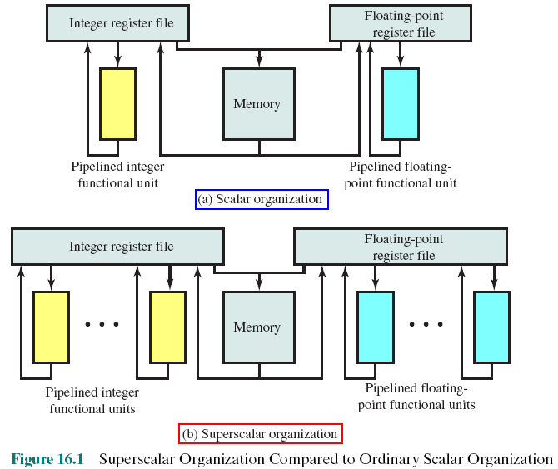
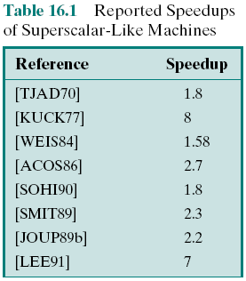
Compare : Scalar vs Superscalar Processors
Some results
Notes:
Về mặt kỹ thuật, CPU siêu vô hướng có gì khác biệt? → Có nhiều đường ống lệnh (phần cứng phải nhiều hơn)
Figure 16.1 compares, in general terms, the scalar and superscalar approaches. In a traditional scalar organization, there is a single pipelined functional unit for integer operations and one for floating-point operations. Parallelism is achieved by enabling multiple instructions to be at different stages of the pipeline at one time. In the superscalar organization, there are multiple functional units, each of which is implemented as a pipeline. Each individual functional unit provides a degree of parallelism by virtue of its pipelined structure. The use of multiple functional units enables the processor to execute streams of instructions in parallel, one stream for each pipeline. It is the responsibility of the hardware, in conjunction with the compiler, to assure that the parallel execution does not violate the intent of the program.
Many researchers have investigated superscalar-like processors, and their research indicates that some degree of performance improvement is possible. Table 16.1 presents the reported performance advantages. The differences in the results arise from differences both in the hardware of the simulated machine and in the applications being simulated.

Slide 8
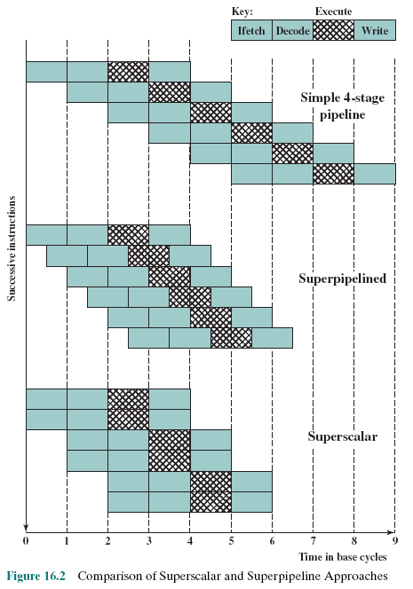
Comparison of Superscalar and Superpipeline Approaches
USING 4-STAGE PIPELINES:
I, D, E, W
Notes:
Hình trong slide này minh họa sự khác biệt giũa kiến trúc siêu đường ống/superpipeline và siêu vô hướng/superscalar
Ôn tập (nếu cần thì xem lại chương Digital Logic)
Xung một chiều có hai bán kỳ 1 bán kỳ dương/ điện áp tăng, 1 bán kỳ âm/ điện áp giảm (xem hình xung trong slide)
Nếu bán kỳ âm được đưa vào cổng NOT thì lại sinh ra điện áp tăng
Như vậy người ta có thể tăng năng suất một mạch số lên gấp đôi bằng cách làm cho mạch vận hành cả 2 bán kỳ.
Kiến trúc super-pipeline:
Chỉ dùng một đường ống lệnh nhưng khai thác đặc điểm của xung để mỗi tầng hoàn thành nhiệm vụ chỉ trong 1 bán kỳ.
Do vậy, hiệu suất đường ống lệnh sẽ tăng. Khi thể hiện mô hình vận hành, chúng ta thấy có sự phủ lấp nhau nửa xung (1 bán kỳ).
Hiện suất đường ống lệnh tăng.
Kiến trúc super-scalar:
Dùng nhiều đường ống lệnh độc lập (trong hình minh họa 2 đường ống lệnh).
Có sự phủ lấp cả xung ở 2 đường ống lệnh → song song thực sự ở 2 đường ống lệnh
Hiệu suất cao hơn so với super-pipeline
An alternative approach to achieving greater performance is referred to as super- pipelining, a term first coined in 1988 [JOUP88]. Superpipelining exploits the fact that many pipeline stages perform tasks that require less than half a clock cycle. Thus, a doubled internal clock speed allows the performance of two tasks in one external clock cycle. We have seen one example of this approach with the MIPS R4000.
Figure 16.2 compares the two approaches. The upper part of the diagram illustrates an ordinary pipeline, used as a base for comparison. The base pipeline issues one instruction per clock cycle and can perform one pipeline stage per clock cycle. The pipeline has four stages: instruction fetch, operation decode, operation execution, and result write back. The execution stage is crosshatched for clarity. Note that although several instructions are executing concurrently, only one instruction is in its execution stage at any one time.
The next part of the diagram shows a superpipelined implementation that is capable of performing two pipeline stages per clock cycle. An alternative way of looking at this is that the functions performed in each stage can be split into two non-overlapping parts and each can execute in half a clock cycle. A superpipeline implementation that behaves in this fashion is said to be of degree 2. Finally, the lowest part of the diagram shows a superscalar implementation capable of executing two instances of each stage in parallel. Higher-degree superpipeline and super- scalar implementations are of course possible.
Both the superpipeline and the superscalar implementations depicted in Figure 16.2 have the same number of instructions executing at the same time in the steady state. The superpipelined processor falls behind the superscalar processor at the start of the program and at each branch target.

Slide 9
Constraints
Instruction level parallelism
Refers to the degree to which the instructions of a program can be executed in parallel
A combination of compiler based optimization and hardware techniques can be used to maximize instruction level parallelism
Limitations:
True data dependency
Procedural dependency
Resource conflicts
Output dependency
Anti-dependency
Input of the next instruction is the output of the previous (RAW)
Previous instruction is a branch, code of the target can cause affects on input of the next
2 instructions access the same resource (bus, registers,…)
2 instructions write values to the same output (Write-after-write - WAW)
Situations in which parallel executions can not be used
Write-after-read situation (WAR)
Notes:
Bằng cách nào để song song hóa một chương trình?
Phần cứng: có các thành phần giúp tối ưu hóa
Phần mềm: Trình biên dịch (compiler) sẽ phân tích code nhằm tìm ra các lệnh độc lập nhau, các lệnh phụ thuộc
để khai thác thế mạnh của CPU siêu vô hướng.
Những rủi ro (hazard,ràng buộc/ constraints) nào có thể kềm hãm khả năng chạy song song
Khi những tình huống này xẩy ra, bắt buộc một số lệnh phải thực thi tuần tự → Chập nhận giảm hiệu suất
Các slide sau sẽ minh họa các tình huống này.
Các tình huống làm giảm hiệu suất là những tình huống nào? Đọc phần limitations.
True data dependency – Phụ thuộc vào dữ liệu
Procedural dependency – Phụ thuộc xử lý. Hàm P2 có dữ liệu đầu vào là đầu ra của hàm P1. Như vậy, P1 phải chạy xong thì P2 mới được chạy.
Resource dependency – Phụ thuộc tài nguyên. Không cho phép 2 tầng của đường ống lệnh cùng truy xuất bus
Output Dependency – Phụ thuộc dữ liệu xuất – Lệnh trước ghi data xong thì lệnh sau mới được chạy.
Anti- dependency – Kháng phụ thuộc: Lệnh trước ghi xong thì lệnh sau mới được ghi tiếp
The superscalar approach depends on the ability to execute multiple instructions in parallel. The term instruction-level parallelism refers to the degree to which, on average, the instructions of a program can be executed in parallel. A combination of compiler-based optimization and hardware techniques can be used to maximize instruction-level parallelism. Before examining the design techniques used in super- scalar machines to increase instruction-level parallelism, we need to look at the fundamental limitations to parallelism with which the system must cope. [JOHN91] lists five limitations:
• True data dependency
• Procedural dependency
• Resource conflicts
• Output dependency
• Antidependency

Slide 10
Constraints - Examples
A = 3
B = A
C = B
Data dependency → Order of instructions can not be changed → They can not be parallelized
MOV EAX, eff ; /* copy variable eff to the register
MOV EBX, EAX ; /* copy EAX to EBX → Data dependency
B = 3
A = B + 1
B = 7
Instruction 1, 3 can not be parallelized be cause they are Write-after-write (WAW) → Output dependency
B = 3
A = B + 1
B = 7
Instruction 2 is anti-dependent → Order of instructions can not be changed → They can not be parallelized , instruction 3: Write after read (WAR)
Notes:
The superscalar approach depends on the ability to execute multiple instructions in parallel. The term instruction-level parallelism refers to the degree to which, on average, the instructions of a program can be executed in parallel. A combination of compiler-based optimization and hardware techniques can be used to maximize instruction-level parallelism. Before examining the design techniques used in super- scalar machines to increase instruction-level parallelism, we need to look at the fundamental limitations to parallelism with which the system must cope. [JOHN91] lists five limitations:
• True data dependency
• Procedural dependency
• Resource conflicts
• Output dependency
• Antidependency

Slide 11
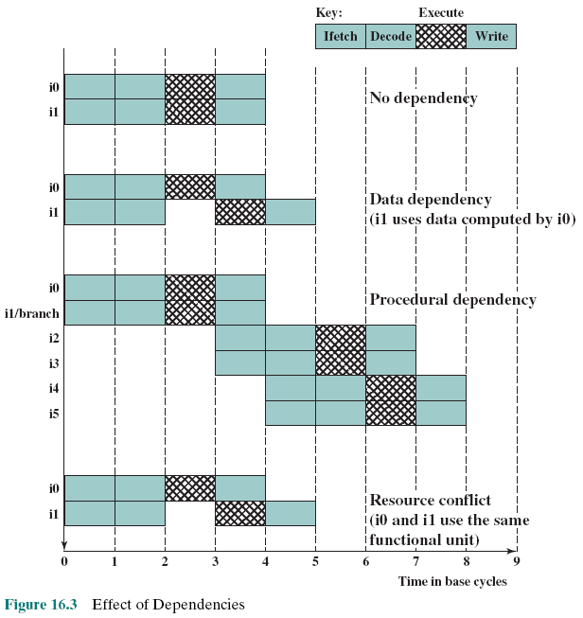
Effect of Dependencies
i1 and i2 are executed concurrently
Input of i2 depends on i1 → i2 waits
i2 must be waited due to a branch
i2 waits resources which are being accessed by i1
Notes:
As was discussed in Chapter 14, the presence of branches in an instruction sequence complicates the pipeline operation. The instructions following a branch (taken or not taken) have a procedural dependency on the branch and cannot be executed until the branch is executed. Figure 16.3 illustrates the effect of a branch on a superscalar pipeline of degree 2.
As we have seen, this type of procedural dependency also affects a scalar pipe- line. The consequence for a superscalar pipeline is more severe, because a greater magnitude of opportunity is lost with each delay.
If variable-length instructions are used, then another sort of procedural dependency arises. Because the length of any particular instruction is not known, it must be at least partially decoded before the following instruction can be fetched. This prevents the simultaneous fetching required in a superscalar pipeline. This is one of the reasons that superscalar techniques are more readily applicable to a RISC or RISC-like architecture, with its fixed instruction length.
A resource conflict is a competition of two or more instructions for the same resource at the same time. Examples of resources include memories, caches, buses, register-file ports, and functional units (e.g., ALU adder).
In terms of the pipeline, a resource conflict exhibits similar behavior to a data dependency (Figure 16.3). There are some differences, however. For one thing, re- source conflicts can be overcome by duplication of resources, whereas a true data dependency cannot be eliminated. Also, when an operation takes a long time to complete, resource conflicts can be minimized by pipelining the appropriate functional unit.

Slide 12
Definitions
Instruction-Level Parallelism
and Machine Parallelism
Instruction level parallelism
Instructions in a sequence are independent
Execution can be overlapped
Governed by data and procedural dependency
Machine Parallelism
Ability to take advantage of instruction level parallelism
Governed by number of parallel pipelines
Notes:
Song song mức lệnh là gì: → Có nhiều lệnh được thực thi đồng thời
Song song mức máy là gì? Máy tính có khả năng xử lý nhiều lệnh đồng thời → Khai thác được song song mức lệnh Làm sao để có máy tính chạy song song mức lệnh? → CPU có nhiều đường ống lệnh.
[JOUP89a] makes an important distinction between the two related concepts of instruction-level parallelism and machine parallelism. Instruction-level parallelism exists when instructions in a sequence are independent and thus can be executed in parallel by overlapping.
The degree of instruction-level parallelism is determined by the frequency of true data dependencies and procedural dependencies in the code. These factors, in turn, are dependent on the instruction set architecture and on the application. Instruction-level parallelism is also determined by what [JOUP89a] refers to as operation latency: the time until the result of an instruction is available for use as an operand in a subsequent instruction. The latency determines how much of a delay a data or procedural dependency will cause.
Machine parallelism is a measure of the ability of the processor to take advantage of instruction-level parallelism. Machine parallelism is determined by the number of instructions that can be fetched and executed at the same time (the number of parallel pipelines) and by the speed and sophistication of the mechanisms that the processor uses to find independent instructions.
Both instruction-level and machine parallelism are important factors in enhancing performance. A program may not have enough instruction-level parallel- ism to take full advantage of machine parallelism. The use of a fixed-length instruction set architecture, as in a RISC, enhances instruction-level parallelism. On the other hand, limited machine parallelism will limit performance no matter what the nature of the program.

Slide 13
Instruction Issue Policy Chiến lược phát lệnh
Instruction issue
Refers to the process of initiating instruction execution in the processor’s functional units
Instruction issue policy
Refers to the protocol used to issue instructions
Instruction issue occurs when instruction moves from the decode stage of the pipeline to the first execute stage of the pipeline
Three types of orderings are important:
The order in which instructions are fetched – Thứ tự lấy lệnh
The order in which instructions are executed - Thứ tự thực thi lệnh
The order in which instructions update the contents of register and memory locations - Thứ tự cập nhật data
Superscalar instruction issue policies can be grouped into the following categories:
In-order issue with in-order completion
In-order issue with out-of-order completion
Out-of-order issue with out-of-order completion
Notes:
Chiến lược phát lệnh
Trong một chương trình,
Có nhiều lệnh độc lập nhau → chúng có thể được thực thi song song. Lệnh nào làm trước cũng được Thí dụ:
p=5;
m=6;
t=7;
k = 9;
Có nhiều lệnh không thể chạy đồng thời vì chúng phụ thuộc nhau bắt buộc phải thực thi tuần tư. Thí dụ:
m = 7;
n = 2*m -9;
k = 2* n – m;
Lệnh sau phụ thuộc lệnh trước thì dù cơ chế song song đã làm xong phần giải mã lệnh thì lệnh sau cũng phải chờ lệnh trước thực thi xong thì lệnh sau mới được thực thi.
Do vậy, cần một cơ chế kiểm soát thứ tự thực thi (cơ chế phát lệnh thực thi/ instruction issue policy).
Tóm lại có một số thứ tự cần xem xét mà superscalar CPU phải đồi diện. Xem phần Types of orderings
Các lệnh phụ thuộc cần phải được cho phép mới thực thi để bảo đảm tính phụ thuộc của dữ liệu. Như vậy, có một thứ tự phát lệnh cho các lệnh trong các đường ống thực thi nhưng vẫn phải kiểm tra thứ tự hoàn tất lệnh bảo đảm đúng giải thuật.
Tình huống lý tưởng là: Out-of-Order issue với outr-of-order completion nghĩa là phát lệnh thế nào cũng được, lệnh nào kết thúc trước cũng được. Đây là tình huống các lệnh độc lập nhau → Hiệu suất song song cao nhất.
As was mentioned, machine parallelism is not simply a matter of having multiple instances of each pipeline stage. The processor must also be able to identify instruction-level parallelism and orchestrate the fetching, decoding, and execution of instructions in parallel. [JOHN91] uses the term instruction issue to refer to the process of initiating instruction execution in the processor’s functional units and the term instruction issue policy to refer to the protocol used to issue instructions. In general, we can say that instruction issue occurs when instruction moves from the decode stage of the pipeline to the first execute stage of the pipeline.
In general terms, we can group superscalar instruction issue policies into the
following categories:
• In-order issue with in-order completion
• In-order issue with out-of-order completion
• Out-of-order issue with out-of-order completion
In essence, the processor is trying to look ahead of the current point of execution to locate instructions that can be brought into the pipeline and executed. Three types of orderings are important in this regard:
The order in which instructions are fetched
The order in which instructions are executed
The order in which instructions update the contents of register and memory locations
The more sophisticated the processor, the less it is bound by a strict relation- ship between these orderings. To optimize utilization of the various pipeline elements, the processor will need to alter one or more of these orderings with respect to the ordering to be found in a strict sequential execution. The one constraint on the processor is that the result must be correct. Thus, the processor must accommodate the various dependencies and conflicts discussed earlier.

Slide 14
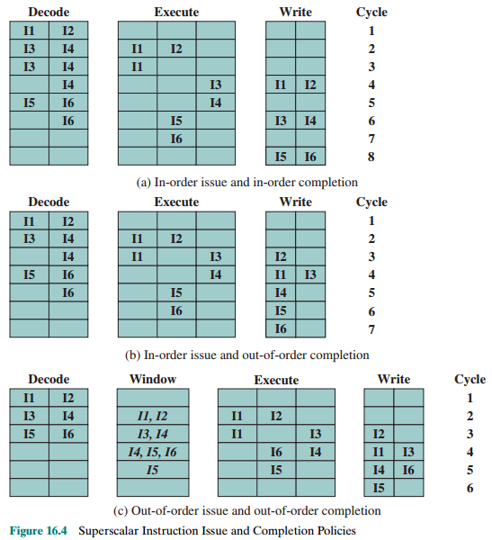
Superscalar Instruction Issue and Completion Policies
14
Notes:
Slide này minh họa 3 tình huống về thứ tự phát lệnh và thứ tự hoàn tất lệnh.
Chú ý:
- Số thứ tự như I1, I2 là thứ tự lệnh được viết trong chương trình.
Các tầng D, E, I, W có nhiều phần cứng giống nhau nên được trình bầy dạng bảng.
Các lệnh ở tầng W là các lệnh đã hoàn tất.
Các bạn xem thứ tự các lệnh để phân biệt đặc điểm của 3 tình huống.
The simplest instruction issue policy is to issue instructions in the exact order that would be achieved by sequential execution (in-order issue) and to write results in that same order (in-order completion). Not even scalar pipelines follow such a simple-minded policy. However, it is useful to consider this policy as a baseline for comparing more sophisticated approaches.
Figure 16.4a gives an example of this policy. We assume a superscalar pipeline capable of fetching and decoding two instructions at a time, having three separate functional units (e.g., two integer arithmetic and one floating-point arithmetic), and having two instances of the write-back pipeline stage. The example assumes the fol- lowing constraints on a six-instruction code fragment:
I1 requires two cycles to execute.
I3 and I4 conflict for the same functional unit.
I5 depends on the value produced by I4.
I5 and I6 conflict for a functional unit.
Instructions are fetched two at a time and passed to the decode unit. Because instructions are fetched in pairs, the next two instructions must wait until the pair of decode pipeline stages has cleared. To guarantee in-order completion, when there is a conflict for a functional unit or when a functional unit requires more than one cycle to generate a result, the issuing of instructions temporarily stalls.
In this example, the elapsed time from decoding the first instruction to writing the last results is eight cycles.
Out-of-order completion is used in scalar RISC processors to improve the performance of instructions that require multiple cycles. Figure 16.4b illustrates its use on a superscalar processor. Instruction I2 is allowed to run to completion prior to I1. This allows I3 to be completed earlier, with the net result of a savings of one cycle.
With out-of-order completion, any number of instructions may be in the execution stage at any one time, up to the maximum degree of machine parallelism across all functional units. Instruction issuing is stalled by a resource conflict, a data dependency, or a procedural dependency.
In addition to the aforementioned limitations, a new dependency, which we referred to earlier as an output dependency (also called write after write [WAW] dependency), arises.
Instruction I2 cannot execute before instruction I1, because it needs the result in register R3 produced in I1; this is an example of a true data dependency, as described in Section 16.1. Similarly, I4 must wait for I3, because it uses a result produced by I3. What about the relationship between I1 and I3? There is no data dependency here, as we have defined it. However, if I3 executes to completion prior to I1, then the wrong value of the contents of R3 will be fetched for the execution of I4. Consequently, I3 must complete after I1 to produce the correct output values. To ensure this, the issuing of the third instruction must be stalled if its result might later be overwritten by an older instruction that takes longer to complete.
Out-of-order completion requires more complex instruction issue logic than in-order completion. In addition, it is more difficult to deal with instruction interrupts and exceptions. When an interrupt occurs, instruction execution at the current point is suspended, to be resumed later. The processor must assure that the resumption takes into account that, at the time of interruption, instructions ahead of the instruction that caused the interrupt may already have completed.

Slide 15
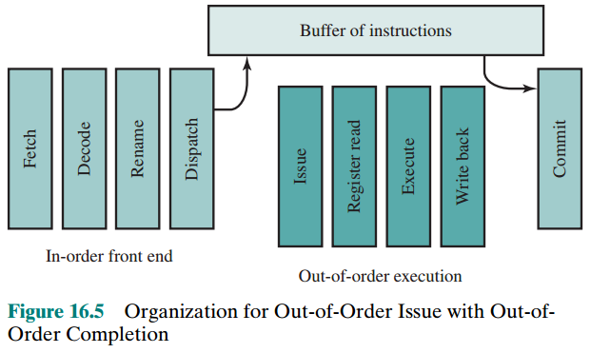
Organization for Out-of-Order Issue with Out-of-Order Completion
An instruction buffer (instruction window) is used to store instructions which are ready for executing. After a processor has finished decoding an instruction, it is placed in it. As long as this buffer is not full, the processor can continue to fetch and decode new instructions.
Any instruction in the buffer will be issued out-of-order if
(1) It needs the particular functional unit that is available, and
(2) No conflicts or dependencies block this instruction.
Another buffer (reorder buffer) can be used as a temporary storage for results completed out of order that are then committed to the register file in program order
Notes:
Slide này minh họa việc cơ chế phát lệnh (cho phép lệnh thực thi)
Những tầng được bổ sung thêm vào đường ống lệnh
- Tầng rename : Giúp đổi tên thanh ghi – sẽ được giải thích ở slide sau.
Tầng Dispatch chuyển giao lệnh đã sẵn sàng thực thi vào bộ đệm (buffer/ instruction window).
Buffer/ instruction window: một bộ nhớ cache chứa các lệnh sẵn sàng thực thi hiện hành. Mỗi lệnh có thông tin lệnh này phụ thuộc lệnh nào.
Tầng Issue: Chọn và phát tín hiệu cho phép lệnh thực thi theo một thứ tự phù hợp đối với các lệnh có phụ thuộc. - Tầng Register read : Đọc trị thanh ghi đang chứa toán hạng của lệnh
Tầng Execute: Thực thi lệnh
Tầng Write back: Ghi kết quả
Tầng Commit: kiểm tra trạng thái thực thi của lệnh rồi xóa lệnh khỏi buffer.
With in-order issue, the processor will only decode instructions up to the point of a dependency or conflict. No additional instructions are decoded until the conflict is resolved. As a result, the processor cannot look ahead of the point of conflict to subsequent instructions that may be independent of those already in the pipeline and that may be usefully introduced into the pipeline.
To allow out-of-order issue, it is necessary to decouple the decode and exe- cute stages of the pipeline. This is done with a buffer referred to as an instruction window. With this organization, after a processor has finished decoding an instruction, it is placed in the instruction window. As long as this buffer is not full, the processor can continue to fetch and decode new instructions. When a functional unit becomes available in the execute stage, an instruction from the instruction window may be issued to the execute stage. Any instruction may be issued, provided that (1) it needs the particular functional unit that is available, and (2) no conflicts or dependencies block this instruction. Figure 16.5 suggests this organization.
The result of this organization is that the processor has a lookahead capability, allowing it to identify independent instructions that can be brought into the execute stage. Instructions are issued from the instruction window with little regard for their original program order. As before, the only constraint is that the program execution behaves correctly.
Figures 16.4c illustrates this policy. During each of the first three cycles, two instructions are fetched into the decode stage. During each cycle, subject to the constraint of the buffer size, two instructions move from the decode stage to the instruction window. In this example, it is possible to issue instruction I6 ahead of I5 (recall that I5 depends on I4, but I6 does not). Thus, one cycle is saved in both the execute and write-back stages, and the end-to-end savings, compared with Figure 16.4b, is one cycle.
The instruction window is depicted in Figure 16.4c to illustrate its role. However, this window is not an additional pipeline stage. An instruction being in the window simply implies that the processor has sufficient information about that instruction to decide when it can be issued.
The out-of-order issue, out-of-order completion policy is subject to the same constraints described earlier. An instruction cannot be issued if it violates a dependency or conflict. The difference is that more instructions are available for issuing, reducing the probability that a pipeline stage will have to stall. In addition, a new dependency, which we referred to earlier as an antidependency (also called write after read [WAR] dependency), arises.
Instruction I3 cannot complete execution before instruction I2 begins execution and has fetched its operands. This is so because I3 updates register R3, which is a source operand for I2. The term antidependency is used because the constraint is similar to that of a true data dependency, but reversed: Instead of the first instruction producing a value that the second instruction uses, the second instruction destroys a value that the first instruction uses.

Slide 16
Register Renaming
Output and antidependencies occur because register contents may not reflect the correct ordering from the program
May result in a pipeline stall (nghẽn)
Registers allocated dynamically
Compiler techniques attempt to maximize the use of registers → maximizing the number of storage conflicts if parallel execution is applied. Register renaming is a technique of duplication of resources (more registers are added). Registers are allocated dynamically by the processor hardware, and they are associated with the values needed by instructions at various points in time. Thus, the same original register reference in several different instructions may refer to different actual registers.
Notes:
Kỹ thuật đổi tên thanh ghi
Superscalar CPU có nhiều phần cứng nên hiển nhiên phải có nhiều thanh ghi nên thanh ghi được dùng trong việc lưu trữ toán hạng của lệnh.
Một thanh ghi cụ thể cũng có thể gây sự phụ thuộc liệu. Xem thí dụ:
Code: x= y;
k = t;
Code assembly tương ứng: Hai lệnh cuối phụ thuộc hai lệnh trên vì dùng chung thanh ghi Ax.
Nếu thay AX bằng thanh ghi khác thì chúng có thể thực thi độc lập theo từng nhóm 2 lệnh.
Mov Ax, y Mov Ax, y
Mov x, Ax Mov x, Ax
Mov Ax, t Mov Bx, t
Mov k, Ax Mov k, Bx
Ở phần cứng, tầng Rename register sẽ xem xét thanh ghi nào rảnh để thay thế bthanh ghi trong lệnh do trình biên dịch đã dùng trong lúc biên dịch chương trình. Minh họa ở slide sau.
When out-of-order instruction issuing and/or out-of-order instruction completion are allowed, we have seen that this gives rise to the possibility of WAW dependencies and WAR dependencies. These dependencies differ from RAW data dependencies and resource conflicts, which reflect the flow of data through a program and the sequence of execution. WAW dependencies and WAR dependencies, on the other hand, arise because the values in registers may no longer reflect the sequence of values dictated by the program flow.
When instructions are issued in sequence and complete in sequence, it is possible to specify the contents of each register at each point in the execution. When out-of-order techniques are used, the values in registers cannot be fully known at each point in time just from a consideration of the sequence of instructions dictated by the program. In effect, values are in conflict for the use of registers, and the processor must resolve those conflicts by occasionally stalling a pipeline stage.
Antidependencies and output dependencies are both examples of storage conflicts. Multiple instructions are competing for the use of the same register locations, generating pipeline constraints that retard performance. The problem is made more acute when register optimization techniques are used (as discussed in Chapter 15), because these compiler techniques attempt to maximize the use of registers, hence maximizing the number of storage conflicts.
One method for coping with these types of storage conflicts is based on a traditional resource-conflict solution: duplication of resources. In this context, the technique is referred to as register renaming. In essence, registers are allocated dynamically by the processor hardware, and they are associated with the values needed by instructions at various points in time. When a new register value is created (i.e., when an instruction executes that has a register as a destination operand), a new register is allocated for that value. Subsequent instructions that access that value as a source operand in that register must go through a renaming process: the register references in those instructions must be revised to refer to the register containing the needed value. Thus, the same original register reference in several different instructions may refer to different actual registers, if different values are intended.
The register reference without the subscript refers to the logical register reference found in the instruction. The register reference with the subscript refers to a hardware register allocated to hold a new value. When a new allocation is made for a particular logical register, subsequent instruction references to that logical register as a source operand are made to refer to the most recently allocated hardware register (recent in terms of the program sequence of instructions).

Slide 17
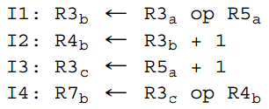
Register Renaming- Example
R3: logical register
R3_{a} :a hardware register allocated dynamically
When a new allocation is made for a particular logical register, subsequent instruction references to that logical register as a source operand are made to refer to the most recently allocated hardware register (recent in terms of the program sequence of instructions). In this example, the creation of register R3_{c} in instruction I3 avoids the WAR dependency on the second instruction and the WAW on the first instruction, and it does not interfere with the correct value being accessed by I4. The result is that I3 can be issued immediately; without renaming, I3 cannot be issued until the first instruction is complete and the second instruction is issued.
Notes:
Đối với trình biên dịch, CPU có thanh ghi R3 nên trình biên dịch sử dụng R3.
Trong phần cứng, R3 là một nhóm thanh ghi tương đương nhau. Khi lệnh thực thi, tầng Rename Register sẽ xem xét thanh ghi nào rảnh trong nhóm R3 rồi dùng.
Như vậy, R3 được xem là thanh ghi logic (mang tính biểu tượng) để trình biên dịch dùng (vẫn bảo tồn tính vô hướng – scalar).

Slide 18
Machine Parallelism
3 hardware techniques that can be used in a superscalar processor to enhance performance:
Duplication of resources,
Out-of-order issue,
Renaming registers.
Figure 16.6 (next slide) shows the results in mean speedup of the superscalar machine over the scalar machine (without procedural dependencies).
base: processor organization does not duplicate any of the functional units, but it can issue instructions out of order.
+ld/st: duplicates the load/store functional unit that accesses a data cache.
+alu: duplicates the ALU,
+both: duplicates both load/store and ALU.

Slide 19
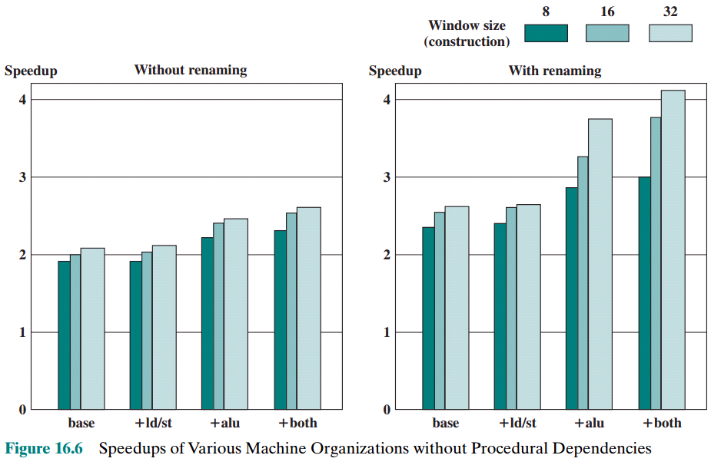
Speedups of Various Machine Organizations Without Procedural Dependencies
Notes:
Hình 16.6 minh họa hiểu quả về khả năng tăng hiệu suất (speedup) của CPU khi chương trình không có phụ thuộc xử lý (phụ thuộc hàm).
Base: CPU cơ bản không thêm phần cứng
+ld/st: Thêm phần cứng truy xuất bộ nhớ (load/store)
+alu: Thêm phần cứng ALU
+both: Thêm cả ld/st và ALU
Without renaming: Không dùng kỹ thuật đổi tên thanh ghi
With renaming: Có dùng kỹ thuật đổi tên thanh ghi
Window size: Kích cỡ lưu trữ của instruction window.
In the preceding discussion, we have looked at three hardware techniques that can be used in a superscalar processor to enhance performance: duplication of resources, out-of-order issue, and renaming. One study that illuminates the relationship among these techniques was reported in [SMIT89]. The study made use of a simulation that modeled a machine with the characteristics of the MIPS R2000, augmented with various superscalar features. A number of different program sequences were simulated.
Figure 16.6 shows the results. In each of the graphs, the vertical axis corresponds to the mean speedup of the superscalar machine over the scalar machine. The horizontal axis shows the results for four alternative processor organizations. The base machine does not duplicate any of the functional units, but it can issue instructions out of order. The second configuration duplicates the load/store functional unit that accesses a data cache. The third configuration duplicates the ALU, and the fourth configuration duplicates both load/store and ALU. In each graph, results are shown for instruction window sizes of 8, 16, and 32 instructions, which dictates the amount of lookahead the processor can do. The difference between the two graphs is that, in the second, register renaming is allowed. This is equivalent to saying that the first graph reflects a machine that is limited by all dependencies, whereas the second graph corresponds to a machine that is limited only by true dependencies.
The two graphs, combined, yield some important conclusions. The first is that it is probably not worthwhile to add functional units without register renaming.
There is some slight improvement in performance, but at the cost of increased hard- ware complexity. With register renaming, which eliminates antidependencies and output dependencies, noticeable gains are achieved by adding more functional units. Note, however, that there is a significant difference in the amount of gain achievable between using an instruction window of 8 versus a larger instruction window. This indicates that if the instruction window is too small, data dependencies will prevent effective utilization of the extra functional units; the processor must be able to look quite far ahead to find independent instructions to utilize the hardware more fully.

Slide 20
Superscalar: Branch Prediction
Any high-performance pipelined machine must address the issue of dealing with branches
Intel 80486 addressed the problem by fetching both the next sequential instruction after a branch and speculatively fetching the branch target instruction
RISC machines:
Delayed branch strategy was explored
Processor always executes the single instruction that immediately follows the branch
Keeps the pipeline full while the processor fetches a new instruction stream
Superscalar machines:
Delayed branch strategy has less appeal (không là yêu cầu)
Have returned to pre-RISC techniques of branch prediction
Reasons: multiple instructions need to execute in the delay slot, instruction dependencies are major interest
Notes:
Superscalar CPU có phải giải quyết bài toán tối ưu hóa lệnh rẽ nhánh hay không?
Không cần vì phần cứng đã quá nhiều (less appeal).
Any high-performance pipelined machine must address the issue of dealing with branches. For example, the Intel 80486 addressed the problem by fetching both the next sequential instruction after a branch and speculatively fetching the branch tar- get instruction. However, because there are two pipeline stages between prefetch and execution, this strategy incurs a two-cycle delay when the branch gets taken.
With the advent of RISC machines, the delayed branch strategy was explored. This allows the processor to calculate the result of conditional branch instructions before any unusable instructions have been prefetched. With this method, the processor always executes the single instruction that immediately follows the branch. This keeps the pipeline full while the processor fetches a new instruction stream.
With the development of superscalar machines, the delayed branch strategy has less appeal. The reason is that multiple instructions need to execute in the delay slot, raising several problems relating to instruction dependencies. Thus, superscalar machines have returned to pre-RISC techniques of branch prediction. Some, like the PowerPC 601, use a simple static branch prediction technique. More sophisticated processors, such as the PowerPC 620 and the Pentium 4, use dynamic branch prediction based on branch history analysis.

Slide 21
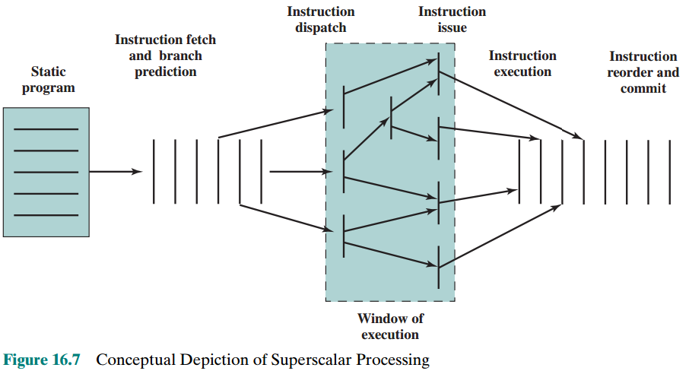
Superscalar Execution
Notes:
We are now in a position to provide an overview of superscalar execution of pro- grams; this is illustrated in Figure 16.7. The program to be executed consists of a linear sequence of instructions. This is the static program as written by the programmer or generated by the compiler. The instruction fetch stage, which includes branch prediction, is used to form a dynamic stream of instructions. This stream is examined for dependencies, and the processor may remove artificial dependencies. The processor then dispatches the instructions into a window of execution. In this window, instructions no longer form a sequential stream but are structured according to their true data dependencies. The processor executes each instruction in an order determined by the true data dependencies and hardware resource availability. Finally, instructions are conceptually put back into sequential order and their results are recorded.
The final step mentioned in the preceding paragraph is referred to as committing, or retiring, the instruction. This step is needed for the following reason. Because of the use of parallel, multiple pipelines, instructions may complete in an order different from that shown in the static program. Further, the use of branch prediction and speculative execution means that some instructions may complete execution and then must be abandoned because the branch they represent is not taken. Therefore, permanent storage and program-visible registers cannot be updated immediately when instructions complete execution. Results must be held in some sort of temporary storage that is usable by dependent instructions and then made permanent when it is determined that the sequential model would have executed the instruction.

Slide 22
Superscalar Implementation
Key elements:
Instruction fetch strategies that simultaneously fetch multiple instruction
Logic for determining true dependencies involving register values, and mechanisms for communicating these values to where they are needed during execution
Mechanisms for initiating, or issuing, multiple instructions in parallel
Resources for parallel execution of multiple instructions, including multiple pipelined functional units and memory hierarchies capable of simultaneously servicing multiple memory references
Mechanisms for committing the process state in correct order
Notes:
Slide này giới thiệu những yêu cầu cần được xem xét khi chế tạo CPU siêu vô hướng
Làm sao có thể lấy lệnh đồng thời?
Làm sao phát hiện các lệnh phụ thuộc
Làm sao khởi tạo và phát lệnh
Làm sao theo dõi nhiều ống lệnh cùng lúc cũng như việc truy cập bộ nhớ phân cấp (các cache/ RAM)
Làm sao bảo đảm việc ghi nhận trạng thái thực thi không có sai để loại lệnh đã thực thi ra khỏi cửa sổ lệnh mà vẫn bảo đảm đúng thứ tự lệnh do user quy định.
Based on our discussion so far, we can make some general comments about the processor hardware required for the superscalar approach. [SMIT95] lists the following key elements:
• Instruction fetch strategies that simultaneously fetch multiple instructions, often by predicting the outcomes of, and fetching beyond, conditional branch instructions. These functions require the use of multiple pipeline fetch and decode stages, and branch prediction logic.
Logic for determining true dependencies involving register valuesand mechanisms for communicating these values to where they are needed during execution.
Mechanisms for initiating, or issuing, multiple instructions in parallel.
Resources for parallel execution of multiple instructions, including multiple pipelined functional units and memory hierarchies capable of simultaneously servicing multiple memory references.
Mechanisms for committing the process state in correct order.

Slide 23
Summary
Instruction-Level Parallelism and Superscalar Processors
Chapter 16
Superscalar versus Superpipelined
Design issues
Instruction-level parallelism
Machine parallelism
Instruction issue policy
Register renaming
Branch prediction
Superscalar execution
Superscalar implementation
Notes:
Chapter 16 summary.

