Slide 1

Multicore Computers
Chapter 18
Notes:
Lecture slides prepared for “Computer Organization and Architecture”, 9/e, by William Stallings, Chapter 18 “Multicore Computers”.
Adapted by Thân Văn Sử
A multicore computer, also known as a chip multiprocessor, combines two or more processors (called cores) on a single piece of silicon (called a die). Typically, each core consists of all of the components of an independent processor, such as registers, ALU, pipeline hardware, and control unit, plus L1 instruction and data caches. In addition to the multiple cores, contemporary multicore chips also include L2 cache and, increasingly, L3 cache.
This chapter provides an overview of multicore systems. We begin with a look at the hardware performance factors that led to the development of multicore computers and the software challenges of exploiting the power of a multicore system. Next, we look at multicore organization. Finally, we examine three examples of multicore products, covering personal computer and workstation systems (Intel), embedded systems (ARM), and mainframes (IBM).

Slide 2
Objectives
CLO9: Investigate, evaluate and communicate general trends in computing technologies such as Instruction-Level Parallelism and Superscalar Processors.
A multicore computer, also known as a chip multiprocessor, combines two or more processors (called cores) on a single piece of silicon (called a die- khuôn mẫu). Typically, each core consists of all of the components of an independent processor, such as registers, ALU, pipeline hardware, and control unit, plus L1 instruction and data caches. In addition to the multiple cores, contemporary multicore chips also include L2 cache and, increasingly, L3 cache.
Your computer is a multicore computer. Do you want to know about it?

Slide 3
Objectives
After studying this chapter, you should be able to:
Understand the hardware performance issues that have driven the move to multicore computers.
Understand the software performance issues posed by the use of multithreaded multicore computers.
Have an appreciation of the use of multicore organization on embedded systems, PCs and servers, and mainframes.

Slide 4
Contents
18.1 Hardware Performance Issues
18.2 Software Performance Issues
18.3 Multicore Organization
18.4- Introduction to Intel x86 Multicore Organization

Slide 5
5 Exercises
18.1 Summarize the differences among simple instruction pipelining, superscalar, and simultaneous multithreading.
18.2 Give several reasons for the choice by designers to move to a multicore organization rather than increase parallelism within a single processor.
18.3 Why is there a trend toward giving an increasing fraction of chip area to cache memory?
18.4 At a top level, what are the main design variables in a multicore organization?
18.5 List some advantages of a shared L2 cache among cores compared to separate dedicated L2 caches for each core.

Slide 6
18.1- Hardware Performance Issues
These changes include, in chronological order
Pipelining: Individual instructions are executed through a pipeline of stages so that while one instruction is executing in one stage of the pipeline, another instruction is executing in another stage of the pipeline. •
Superscalar: Multiple pipelines are constructed by replicating execution resources. This enables parallel execution of instructions in parallel pipelines, so long as hazards are avoided.
Simultaneous multithreading (SMT): Register banks are replicated so that multiple threads can share the use of pipeline resources.
For each of these innovations, designers have over the years attempted to increase the performance of the system by adding complexity
More efficient
Notes:
Chronologoc: theo thứ tự thời gian
Slide này tóm tắt các kỹ thuật phần cứng nhằm cải tiến hiệu suất thực thi của phần cứng.

Slide 7
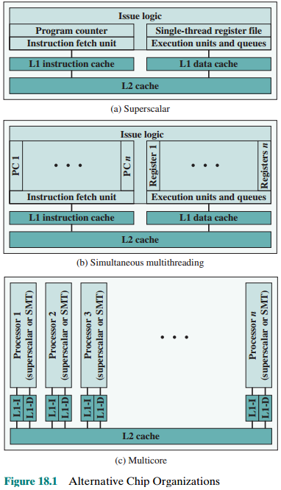
Alternative Chip Organization
There is a practical limit to how far this trend can be taken, because with more stages, there is the need for more logic, more interconnections, and more control signals
SMT: Simultaneous multithreading
Notes:
Slide này minh họa các dạng tổ chức trong chip CPU
Ôn tập về cache tách biệt (Split cache): Lệnh để torng 1 cache, data để trong cache khác
L1-I: Level 1 Instruction cache
L1-D: Level 1 Data cache
The organizational changes in processor design have primarily been focused on increasing instruction-level parallelism, so that more work could be done in each clock cycle. These changes include, in chronological order (Figure 18.1):
* Pipelining: Individual instructions are executed through a pipeline of stages so that while one instruction is executing in one stage of the pipeline, another instruction is executing in another stage of the pipeline.
* Superscalar: Multiple pipelines are constructed by replicating execution resources. This enables parallel execution of instructions in parallel pipelines, so long as hazards are avoided.
* Simultaneous multithreading (SMT): Register banks are replicated so that multiple threads can share the use of pipeline resources.
For each of these innovations, designers have over the years attempted to increase the performance of the system by adding complexity. In the case of pipelining, simple three-stage pipelines were replaced by pipelines with five stages, and then many more stages, with some implementations having over a dozen stages. There is a practical limit to how far this trend can be taken, because with more stages, there is the need for more logic, more interconnections, and more control signals. With superscalar organization, increased performance can be achieved by increasing the number of parallel pipelines. Again, there are diminishing returns as the number of pipelines increases. More logic is required to manage hazards and to stage instruction resources. Eventually, a single thread of execution reaches the point where hazards and resource dependencies prevent the full use of the multiple pipelines available. This same point of diminishing returns is reached with SMT, as the complexity of managing multiple threads over a set of pipelines limits the number of threads and number of pipelines that can be effectively utilized.

Slide 8
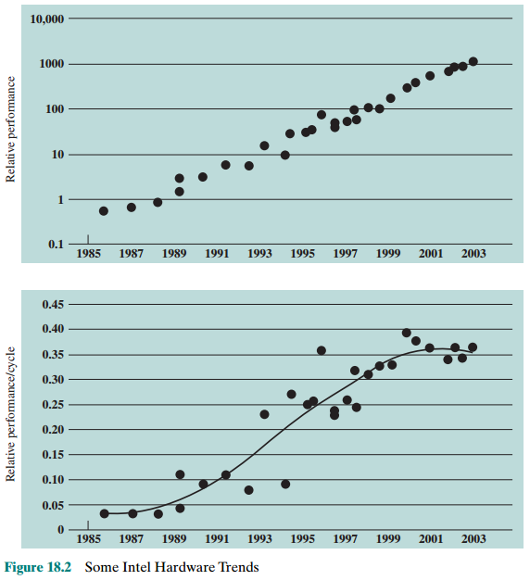
Intel Hardware Trends
Beginning about 2000, a new flat region of the curve appears, as the limits of effective exploitation of instruction-level parallelism are reached.
Notes:
Các biểu đồ minh họa sự tăng trưởng hiệu suất tính theo hiệu suất tương đối (relative performance) theo năm của hãng Intel.
Figure 18.2, from [OLUK05], is instructive in this context. The upper graph shows the exponential increase in Intel processor performance over the years. The lower graph is calculated by combining Intel’s published SPEC CPU figures and processor clock frequencies to give a measure of the extent to which performance improvement is due to increased exploitation of instruction-level parallelism. There is a flat region in the late 1980s before parallelism was exploited extensively. This is followed by a steep rise as designers were able to increasingly exploit pipelining, superscalar techniques, and SMT. But, beginning about 2000, a new flat region of the curve appears, as the limits of effective exploitation of instruction-level parallelism are reached.
There is a related set of problems dealing with the design and fabrication of the computer chip. The increase in complexity to deal with all of the logical issues related to very long pipelines, multiple superscalar pipelines, and multiple SMT register banks means that increasing amounts of the chip area are occupied with coordinating and signal transfer logic. This increases the difficulty of designing, fabricating, and debugging the chips. The increasingly difficult engineering challenge related to processor logic is one of the reasons that an increasing fraction of the processor chip is devoted to the simpler memory logic. Power issues, discussed next, provide another reason.

Slide 9
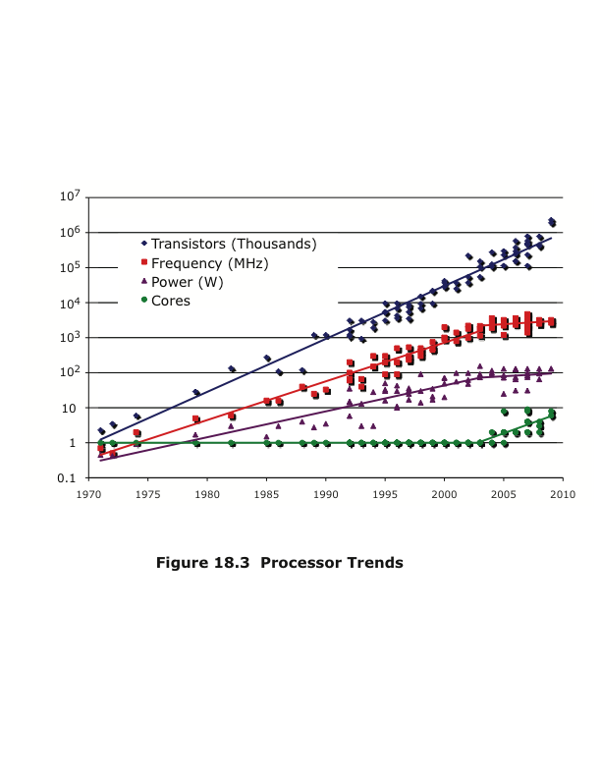
Processor Trends
Notes:
To maintain the trend of higher performance as the number of transistors per chip rise, designers have resorted to more elaborate processor designs (pipelining, super- scalar, SMT) and to high clock frequencies. Unfortunately, power requirements have grown exponentially as chip density and clock frequency have risen. This is shown in the Figure 18.3, which repeats Figure 2.11.

Slide 10
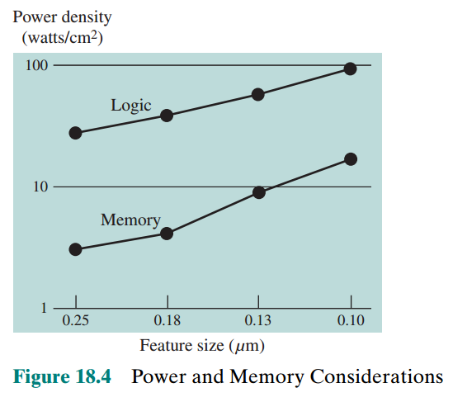
Power
Memory
Notes:
One way to control power density is to use more of the chip area for cache memory. Memory transistors are smaller and have a power density an order of magnitude lower than that of logic (see Figure 18.4). Further, as chip transistor density has increased, the percentage of chip area devoted to memory has grown, and is now well over half the chip area.

Slide 11
Power Consumption
By 2015 we can expect to see microprocessor chips with about 100 billion transistors on a 300 mm² die (base)
Assuming that about 50-60% of the chip area is devoted to memory, the chip will support cache memory of about 100 MB and leave over 1 billion transistors available for logic
How to use all those logic transistors is a key design issue
Pollack’s Rule
States that performance increase is roughly proportional to square root of increase in complexity
Notes:
By 2015, we can expect to see microprocessor chips with about 100 billion transistors on a 300 mm² die. Assuming about 50–60% of the chip area is devoted to memory, the chip will support cache memory of about 100 MB and leave over 1 billion transistors available for logic.
How to use all those logic transistors is a key design issue. As discussed earlier in this section, there are limits to the effective use of such techniques as superscalar
and SMT. In general terms, the experience of recent decades has been encapsulated in a rule of thumb known as Pollack’s rule [POLL99], which states that performance increase is roughly proportional to square root of increase in complexity. In other words, if you double the logic in a processor core, then it delivers only 40% more performance. In principle, the use of multiple cores has the potential to provide near-linear performance improvement with the increase in the number of cores.
Power considerations provide another motive for moving toward a multicore organization. Because the chip has such a huge amount of cache memory, it becomes unlikely that any one thread of execution can effectively use all that memory. Even with SMT, you are multithreading in a relatively limited fashion and cannot therefore fully exploit a gigantic cache, whereas a number of relatively independent threads or processes has a greater opportunity to take full advantage of the cache memory.

Slide 12
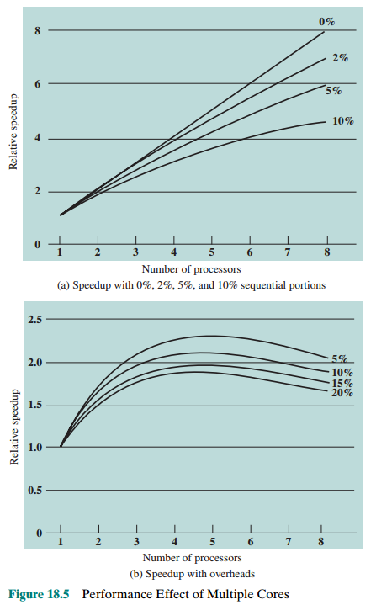
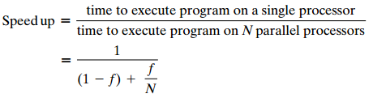
18.2- Software Performance Issues Performance Effect of Multiple Cores
f
f
Amdahl’s law
f: frequency, N: number of CPU
Notes:
The potential performance benefits of a multicore organization depend on the ability to effectively exploit the parallel resources available to the application. Let us focus first on a single application running on a multicore system.
The law assumes a program in which a fraction (1 – f ) of the execution time involves code that is inherently serial and a fraction f that involves code that is infinitely parallelizable with no scheduling overhead.
This law appears to make the prospect of a multicore organization attractive. But as Figure 18.5a shows, even a small amount of serial code has a noticeable impact. If only 10% of the code is inherently serial (f = 0.9), running the program on a multi- core system with 8 processors yields a performance gain of only a factor of 4.7. In addition, software typically incurs overhead as a result of communication and distribution of work among multiple processors and as a result of cache coherence overhead. This results in a curve where performance peaks and then begins to degrade because of the increased burden of the overhead of using multiple processors (e.g., coordination and OS management). Figure 18.5b, from [MCDO05], is a representative example.

Slide 13
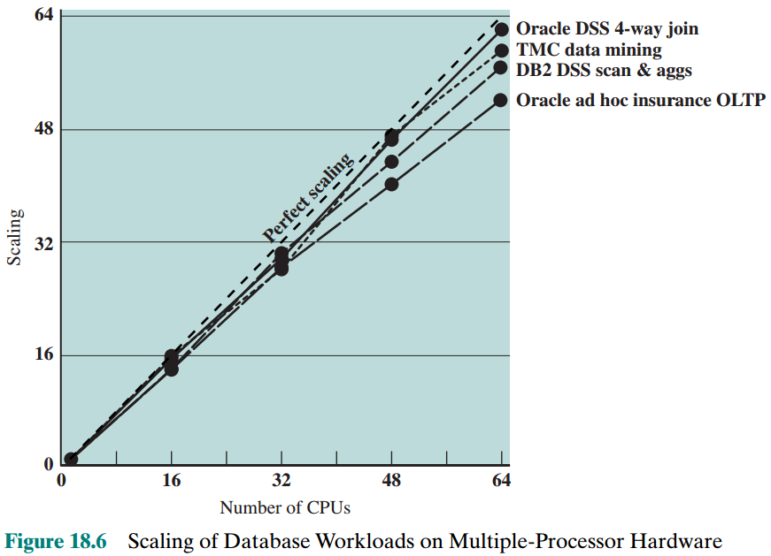
Scaling of Database Workloads on Multiple-Processor hardware
Database management systems and database applications are one area in which multicore systems can be used effectively. Many kinds of servers can also effectively use the parallel multicore organization, because servers typically handle numerous relatively independent transactions in parallel.
Notes:
However, software engineers have been addressing this problem and there are numerous applications in which it is possible to effectively exploit a multicore sys- tem. [MCDO05] analyzes the effectiveness of multicore systems on a set of database applications, in which great attention was paid to reducing the serial fraction within hardware architectures, operating systems, middleware, and the database application software. Figure 18.6 shows the result. As this example shows, database management systems and database applications are one area in which multicore systems can be used effectively. Many kinds of servers can also effectively use the parallel multicore organization, because servers typically handle numerous relatively independent transactions in parallel.

Slide 14
Effective Applications for Multicore Processors
Multi-threaded native applications
Characterized by having a small number of highly threaded processes
Lotus Domino, Siebel CRM (Customer Relationship Manager)
Multi-process applications
Characterized by the presence of many single-threaded processes
Oracle, SAP, PeopleSoft
Java applications
Java Virtual Machine is a multi-threaded process that provides scheduling and memory management for Java applications
Sun’s Java Application Server, BEA’s Weblogic, IBM Websphere, Tomcat
Multi-instance applications
One application running multiple times
If multiple application instances require some degree of isolation, virtualization technology can be used to provide each of them with its own separate and secure environment
Notes:
Multi-threaded Native application: ứng dụng đa luồng chạy trên máy đơn
Multi-provess application: ứng dụng nhiều chương trình đơn luồng. Hàm main là một luồng.
Java applications: Các ứng dụng viết bằng Java vì Java là công nghệ chạy theo cơ chế thống dịch → Chậm hơn so với công nghệ khác.
Multi-instance applicationsa: Ứng dụng chạy nhiều bản trong cùng 1 thời điểm.
In addition to general-purpose server software, a number of classes of applications benefit directly from the ability to scale throughput with the number of cores. [MCDO06] lists the following examples:
Multithreaded native applications: Multithreaded applications are characterized by having a small number of highly threaded processes. Examples of threaded applications include Lotus Domino or Siebel CRM (Customer Relationship Manager).
Multiprocess applications: Multiprocess applications are characterized by the presence of many single-threaded processes. Examples of multi-process applications include the Oracle database, SAP, and PeopleSoft.
Java applications: Java applications embrace threading in a fundamental way. Not only does the Java language greatly facilitate multithreaded applications, but the Java Virtual Machine is a multithreaded process that provides scheduling and memory management for Java applications. Java applications that can benefit directly from multicore resources include application servers such as Sun’s Java Application Server, BEA’s Weblogic, IBM’s Websphere, and the open-source Tomcat application server. All applications that use a Java 2 Platform, Enterprise Edition (J2EE platform) application server can immediately benefit from multicore technology.
• Multi-instance applications: Even if an individual application does not scale to take advantage of a large number of threads, it is still possible to gain from multicore architecture by running multiple instances of the application in parallel. If multiple application instances require some degree of isolation, virtualization technology (for the hardware of the operating system) can be used to provide each of them with its own separate and secure environment.

Slide 15
18.3- Multicore Organization
At a top level of description, the main variables in a multicore organization are as follows:
The number of core processors on the chip
The number of levels of cache memory
The amount of cache memory that is shared

Slide 16
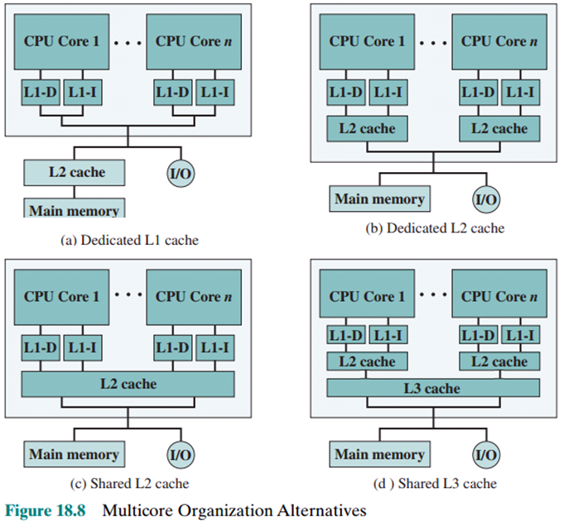
Multicore Organization …
D-cache: cache storing data
I-cache: cache storing instructions
Intel Core Duo
Intel Core i7

Slide 17
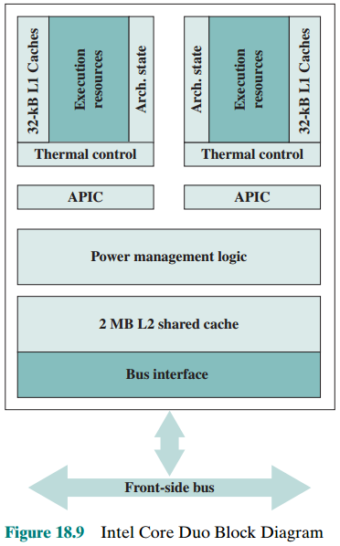
13.4- Intel x86 Multicore Organization
APIC: Advanced Programmable Interrupt Controller
Thermal Control: Mạch kiểm soát nhiệt
Power Management Logic: mạch quản lý năng lượng
Arch.: Architecture
Intel Core Duo
Notes:
Execution Resources: ALU
Architecture state : Bộ phận giám sát trạng thái thục thi
Thermal control: Bộ phận giám sát nhiệt độ giúp bảo vệ quá nhiệt
APIC: Bộ phận điều khiển ngắt
Power Mangement Logic: Mạch điều khiển tiết kiệm điện năng

Slide 18
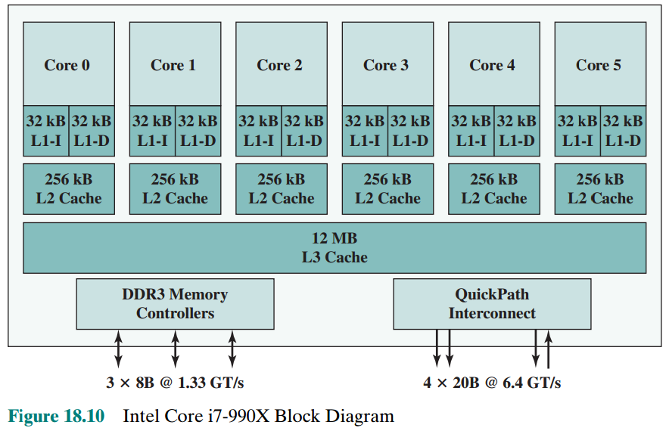
Intel Core I7-990X Organization

Slide 19
Summary
Multicore
Computers
Chapter 18
Hardware performance issues
Increase in parallelism and complexity
Power consumption
Software performance issues
Software on multicore
Multicore organization
Intel x86 multicore organization
Intel Core Duo
Intel Core i7-990X
Notes:
Chapter 18 summary.

