Slide 1


Banking Transactional
Analysis
1

Slide 2

Agenda
Problem Statement
Approach
Data Overview
Project Workflow
Exploratory Data Analysis
Key Insights
Recommendation
Dashboard Preview

Slide 3

Problem Statement

Slide 4
Problem Statement
A lack of deep analytical insights into customer banking patterns hinders the ability to personalize services and optimize profitability. This project leverages transactional datasets to identify key drivers of financial decisions, aiming to refine marketing strategies and improve customer satisfaction through data-driven segmentation.
What’s the Business Question?
What are the defining characteristics and behavioral trends of the bank's key customer segments, and how do these patterns influence overall financial engagement?
How does the distribution of transactions across various channels reflect changing consumer preferences, and where are the greatest opportunities to optimize channel costs while maintaining loyalty?
What are the primary factors driving revenue across different product categories (Mortgage, Loan, Credit Card), and how can the bank optimize its cross-selling strategies?

Slide 5
Approach

Slide 6

Approach – Two phase solution
Exploratory Data Analysis
Interactive Dashboard
1
2
Deep dive into income demographics, customer scores, and transaction fee impacts
Build a live view for business Users to self serve insights
Surface trend, outliers & relationships
Enable granular ad-hoc slicing by transaction amount segment, channel, and financial product

Slide 7
Project Workflow

Slide 8
Project Workflow
De
Data Loading & Initial Exploration
Define Business Objective
De
1
1
Load into VS Code for initial profiling and data understanding using Python.
1
Understand the core problem and expected business outcomes.
2
Dashboarding & Recommendations
De
De
Exploratory Data Analysis (EDA)
1
4
Build Power BI dashboard and present strategic findings.
1
3
Visualize trends, compare performance, and extract key insights.

Slide 9
Exploratory Data Analysis

Slide 10
EDA: Step‑by‑Step Process
Import Libraries
Load Data
Initial Exploration
Pre-processing & Cleaning
Feature Engineering
EDA & Visualization
Key Insights

Slide 11
Data Overview
Transaction ID: Unique identifier for each transaction
Customer ID: Unique identifier for each customer
Transaction Date: Date the transaction occurred
Transaction Type: Type of transaction (e.g., deposit, withdrawal, transfer, card payment, fees)
Amount: Monetary value of the transaction
Product Category: Category of financial products related to the transaction
Product Subcategory: Product category
Branch City: City where the transaction took place or branch located there
Branch Lat: Branch macro
Branch Longitude: Longitude of the branch
Channel: Channel where the transaction was executed (e.g., at a tea shop, ATM, mobile phone)
Currency: Currency used in the transaction
Credit Card Fees: Fees incurred from using a credit card
Insurance Fees: Fees related to insurance in the transaction
Late Payment Amount: Amount charged by the payment processing device
Customer Score: Credit score or internal rating Customer Segment
Monthly Income: Customer's monthly income
CustomerSegment: Customer's income segment
Recommendation: Product or offer produced for the customer

Slide 12
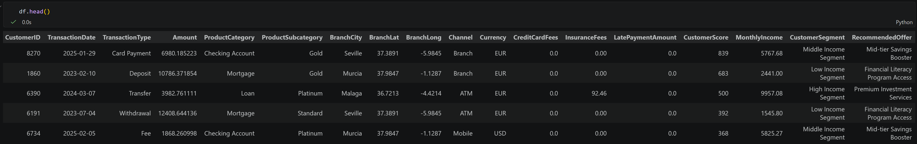
Data Categorization
Identifiers: Transaction ID, Customer ID.
Spatio – Temporal: TransactionDate, Branch City, Lat/Long.
Proffiling: Customer Score, Monthly Income, Customer Segment, Recommendations.
Financials: Amount, Fees (Credit/Insurance), Latepayment, Currency.
Behaviors/Channel: TransactionType, Channel, ProductCategory.
Data Inspection

Slide 13
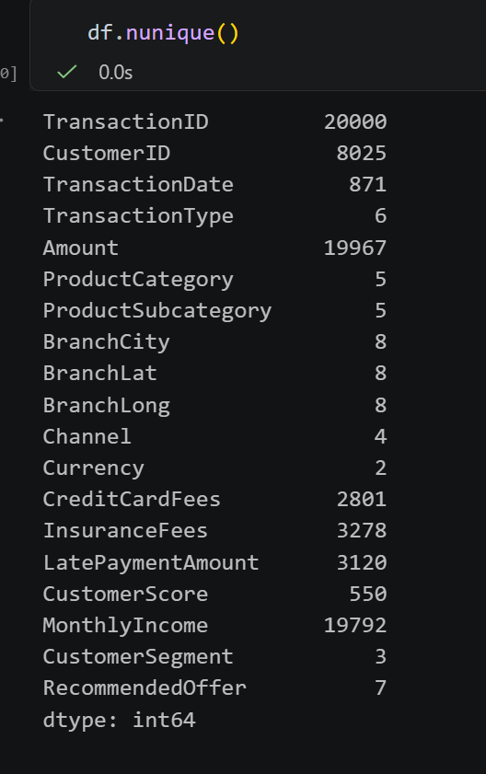
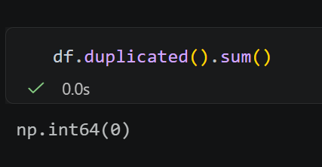
Data Inspection
CustomerID (8,025): Out of 20,000 transactions, there are only 8,025 unique customers.
BranchCity (8): The transactions are limited to 8 cities, which matches the 8 unique coordinates (BranchLat/BranchLong). This confirms a localized geographic scope.

Slide 14
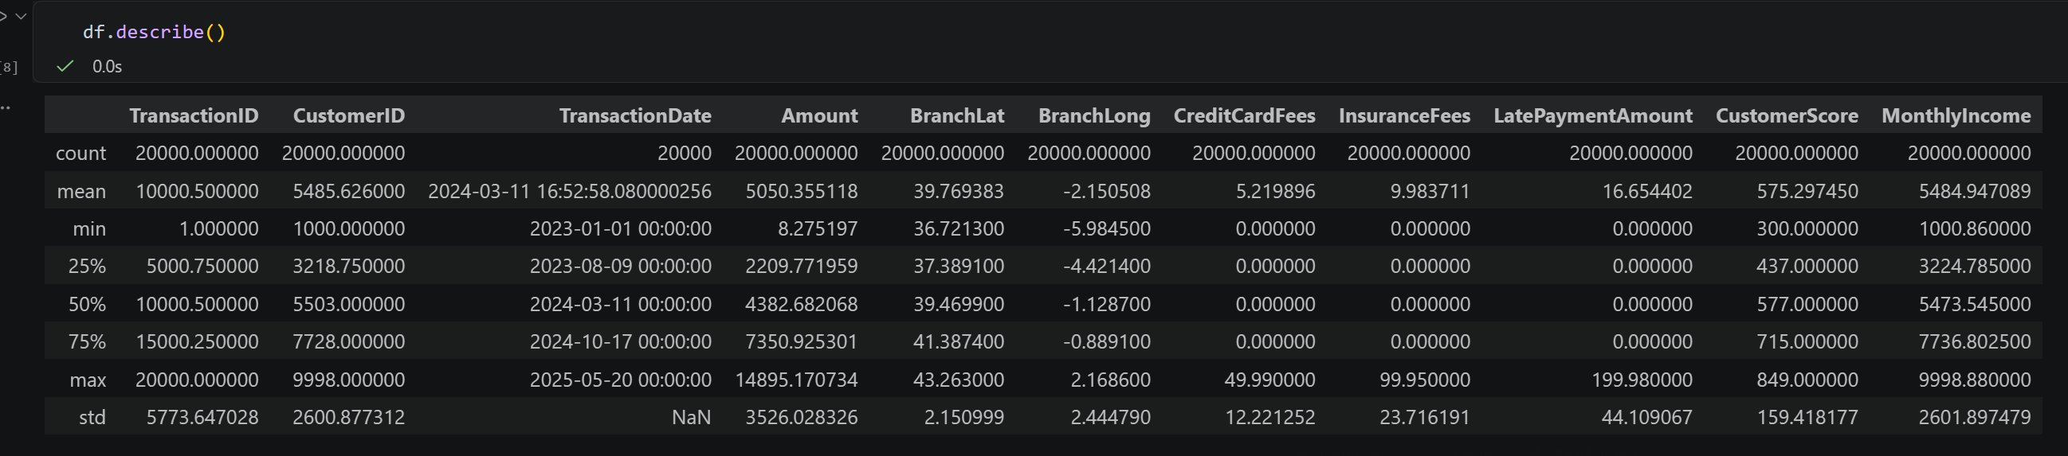
Data Inspection
All numerric columns show a count of 20,000, indicating there are no missing values in these specific features.
The TransactionDate spans from January 1st 2023, to May 20th 2025, Providing over two years of data for trend analysis.
Transaction Amount: The average transaction is 5,050, but there is significant variance (std = 3,526), with values ranging from a minimum of 8.27 to a maximum of 14,895.
Fee structure: For CreditCardFees, InsuranceFees, and LatePaymentAmount, at least 75% of the data points are 0.00 ➔ These fees are not applied to every transaction. They likely represent specific revenue drivers from a niche segment of users.
Monthly Income: Incomes range from 1,000 to 9,998. The proximity of the mean (5,484.95) to the median (5,473.54) indicates a balanced income distribution among the sampled customers.
The BranchLat and BranchLong variables show very low standard deviations (approx. 2.15 and 2.44). This suggests that the transactions are concentrated within a specific geographic region rather than being globally or nationally dispersed.

Slide 15
Descriptive and Statistic – Transaction Level
All numerric columns show a count of 20,000, indicating there are no missing values in these specific features.
The TransactionDate spans from January 1st 2023, to May 20th 2025, Providing over two years of data for trend analysis.
Transaction Amount: The average transaction is 5,050, but there is significant variance (std = 3,526), with values ranging from a minimum of 8.27 to a maximum of 14,895.
Fee structure: For CreditCardFees, InsuranceFees, and LatePaymentAmount, at least 75% of the data points are 0.00 ➔ These fees are not applied to every transaction. They likely represent specific revenue drivers from a niche segment of users.
Monthly Income: Incomes range from 1,000 to 9,998. The proximity of the mean (5,484.95) to the median (5,473.54) indicates a balanced income distribution among the sampled customers.
The BranchLat and BranchLong variables show very low standard deviations (approx. 2.15 and 2.44). This suggests that the transactions are concentrated within a specific geographic region rather than being globally or nationally dispersed.

Slide 16
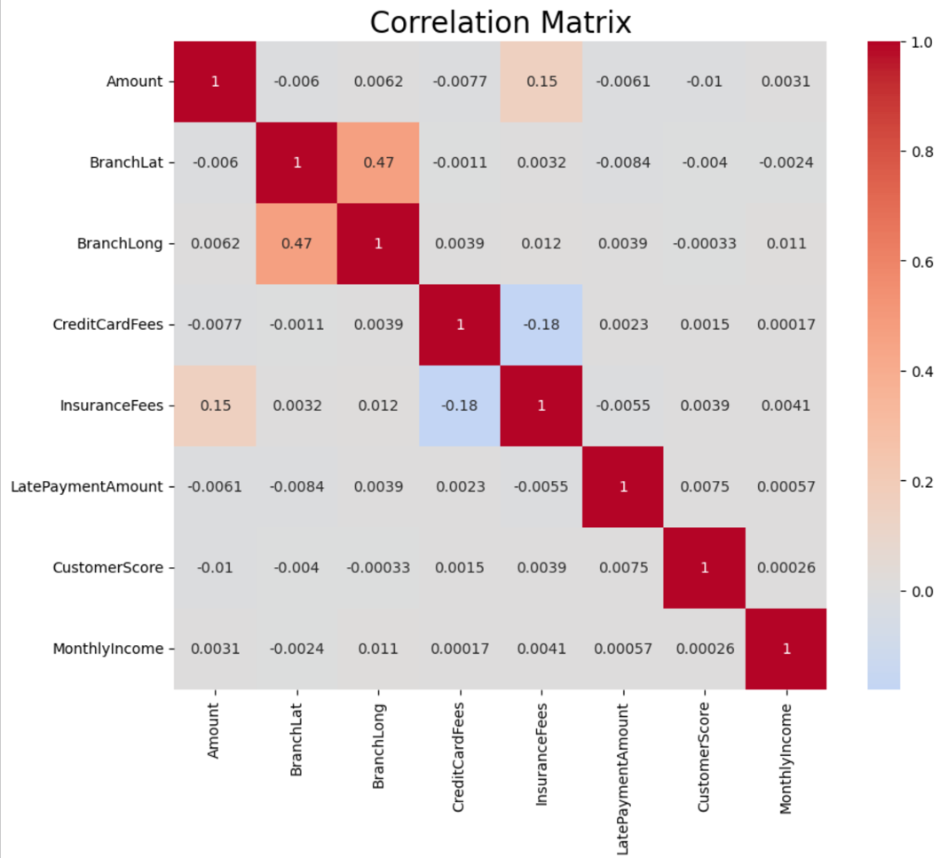
Unvariate Analysis – Transaction Level
Credit & Income Independence: A critical finding is the near-zero correlation between MonthlyIncome and CustomerScore. Higher income does not guarantee better credit behavior in this dataset. This allows the bank to decouple risk management from product scale offering high-limit products to high-income users while maintaining strict risk controls for those with low scores.
Late Payment Amount vs. Monthly Income ($0.00): Late payment penalties occur among both wealthy and low-income earners.

Slide 17
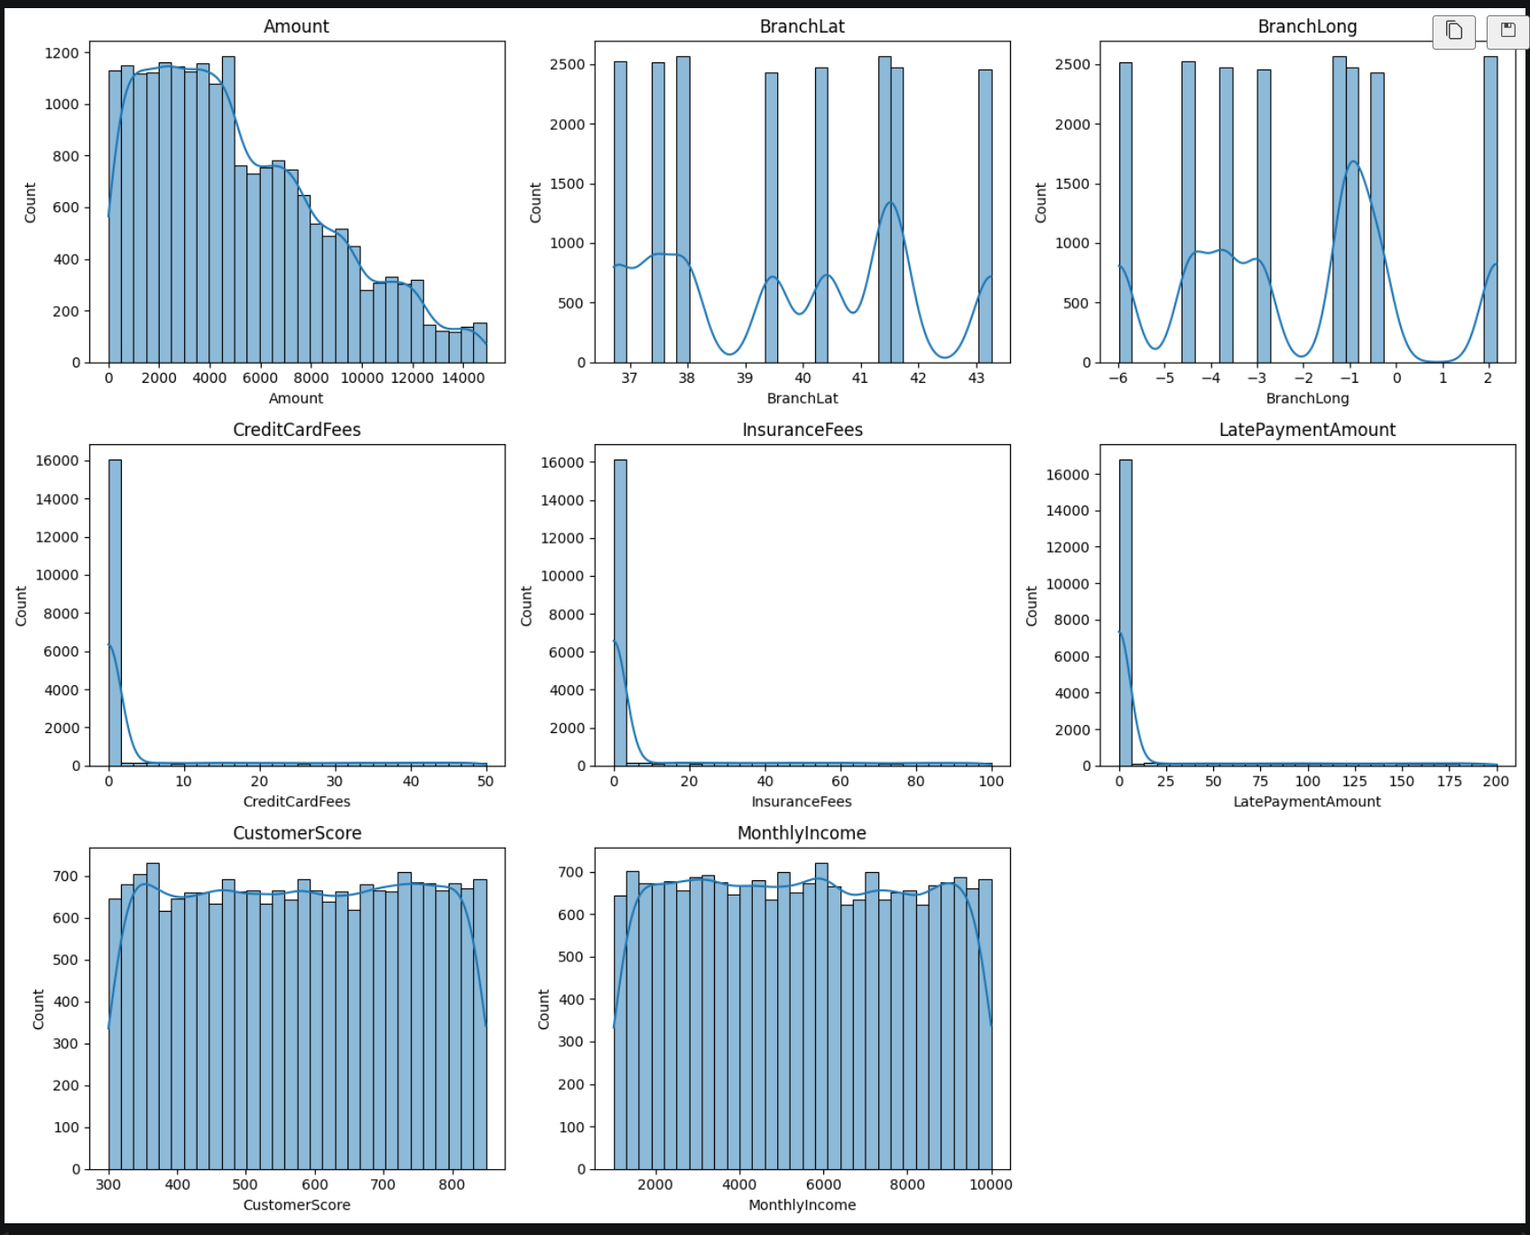
Bivariate Analysis – Transaction Level
Amount: Many transactions are small in value (a few hundred to a few thousand), and only a few are very large (over 10,000).
CreditCardFees, InsuranceFees, LatePaymentAmount: The majority of customers do not incur fees (0). Only a small group customers bear these fees. This is a group of customers that brings high profit margins but whose behavior needs to be carefully monitored.
Customer Score: The distribution is very balanced. The majority of customers have an average credit score (around 575). This indicates that the bank's risk is being managed at a stable level, not heavily skewed towards the bad debt group or the overly safe group.
Monthly Income: The distribution is relatively even and flat at the top. This shows that your customer base has incomes ranging from low to high, not extremely concentrated in one particular income group.

Slide 18
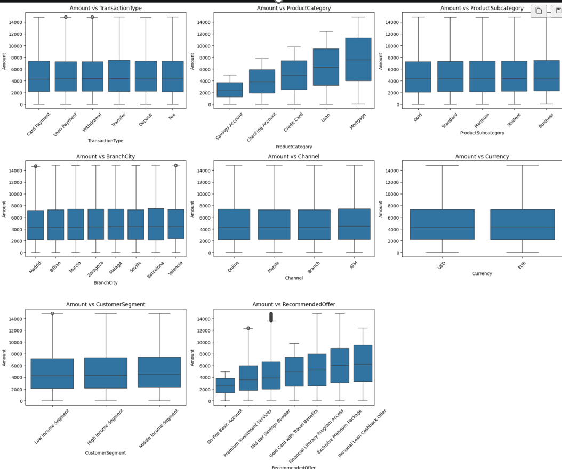
Unvariate Analysis – Transaction Level
Mortgage and Loan products exhibit the highest median transaction amounts and the widest interquartile ranges (IQR). Conversely, Savings Account transactions are significantly smaller and more clustered. Large capital movements are concentrated in debt-related products. To increase the bank's total transaction volume, marketing efforts should prioritize these high-value categories.
There is a clear upward progression in transaction amounts across the offers. The Exclusive Platinum Package is associated with the highest amounts, while the No-Fee Basic Account correlates with the lowest.
Customers are as comfortable moving large sums via Mobile or Online as they are at a Physical Branch. This supports a "Digital-First" strategy to reduce operational costs at branches without losing transaction volume.

Slide 19
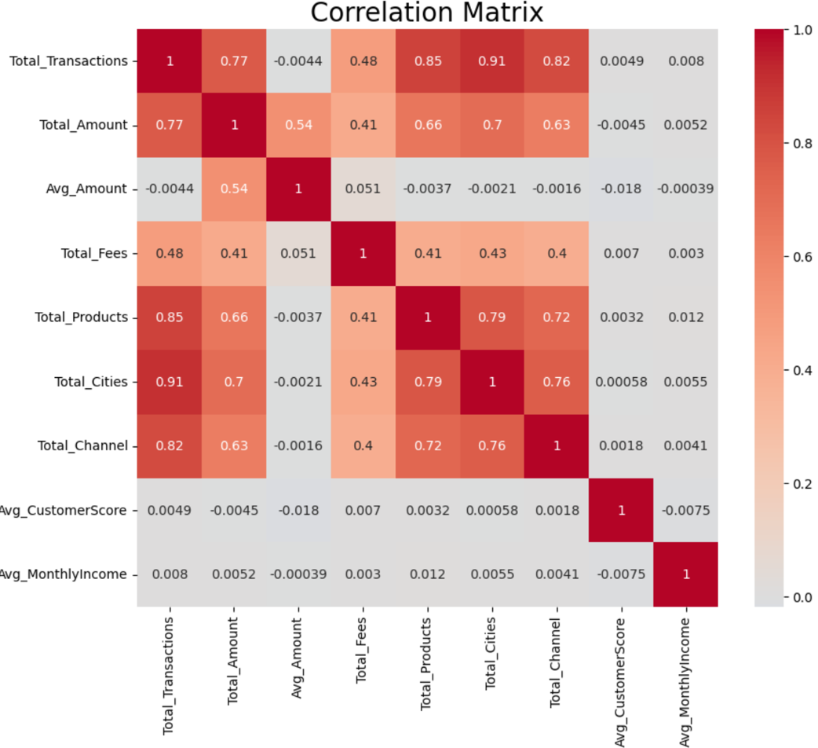
Unvariate Analysis – Customer Level
Engagement customer: if the customer uses more channels, they use more products and transact in more cities.
Total transactions vs total amount: Total spending volume is driven primarily by frequency, not necessarily by the size of individual transactions. The more often a customer uses the bank, the higher their total lifetime value.
Total transactions vs total fees: This suggests that fee revenue is also dependent on specific behaviors (like late payments or insurance purchases) rather than just raw volume.

Slide 20
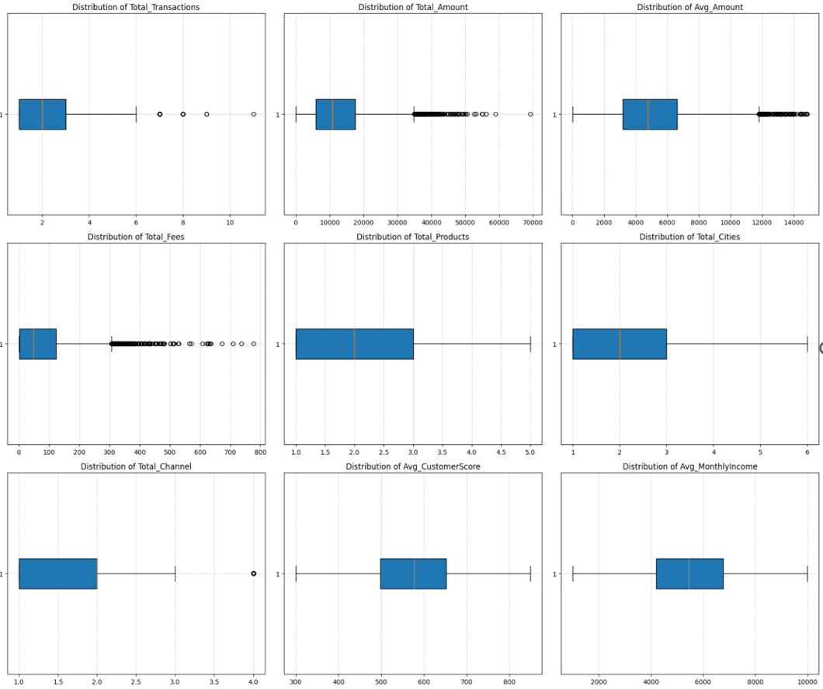
Unvariate Analysis – Customer Level
Total Transactions: The median is 2 transactions, with most customers falling between 1 and 3. However, there are significant outliers reaching up to 11. These outliers represent your "Power Users."
Product & City Reach: Most customers use 2 products and visit 2 cities. The spread for Total_Products is very tight, suggesting that the bank successfully moves customers past a single-product relationship quickly.
Total Channels: The median is 2 channels, but there is a clear outlier at 4. This represents the small elite group of "True Omnichannel" customers who use every available touchpoint.
Total Amount: The data shows a massive concentration at the lower end (median ~$10k) but a very long tail of outliers extending beyond $60k.
Total Fees: This chart is the most skewed. The median is low, but the outliers are numerous and reach up to $776

Slide 21

Charts & Insights

Slide 22
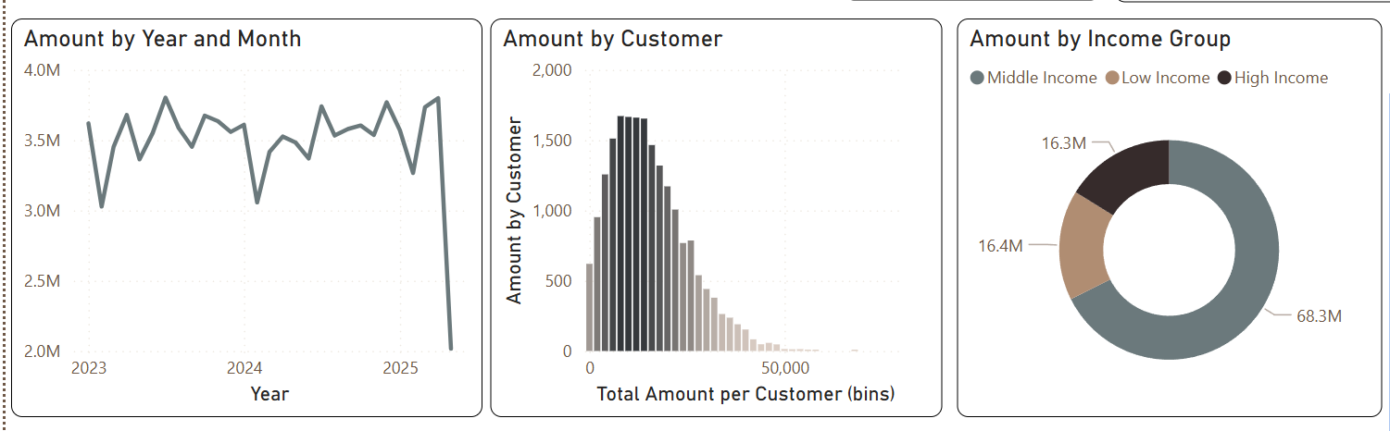
Overview
Overall Business Performance
Monthly transaction amounts remain relatively stable throughout the observed, fluctuating between approximately 3.1M and 3.8M.
Transaction Amounts are right-skewed, indicating that most customers contribute relatively small transaction values, while a small group of high-value customers generates a disproportionate share of the total amount.
This suggest the presence of high-value customer segments that should be prioritize for retention.
Middle Income customer contribute the largest share of transaction value (68.3M), accounting for roughly two-thirds of the total transaction amount.
High Income and Low Income customers contribute similar transaction volumes, highlighting the importance of the middle income segment to overall business performance.

Slide 23
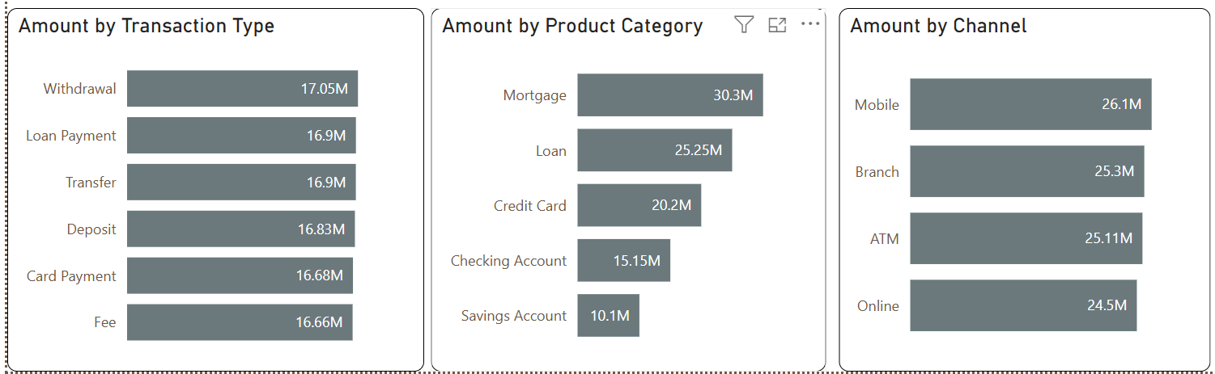
Overview
Mortage is the highest – performing product category(30.3M), followed by Loan (25.3M) and Credit Card (20.2M).
Saving and checking accounts generate lower transaction values, reflecting their primary role as deposit products rather high value transaction products.
Transaction values are evenly distributed across all transaction types, with no single type dominating the portfolio.
‘This balanced distribution indicates diversified customer banking activities across deposits, withdrawals, transfers, loan payments, card payments, and fees.
Mobile banking records the highest transaction value (26.1M), followed closely by Branch, ATM and Online Channels.
The relatively balanced distribution across channels suggests customers actively use multiple banking channels, while Mobile Banking has become the preferred transaction channel.

Slide 24
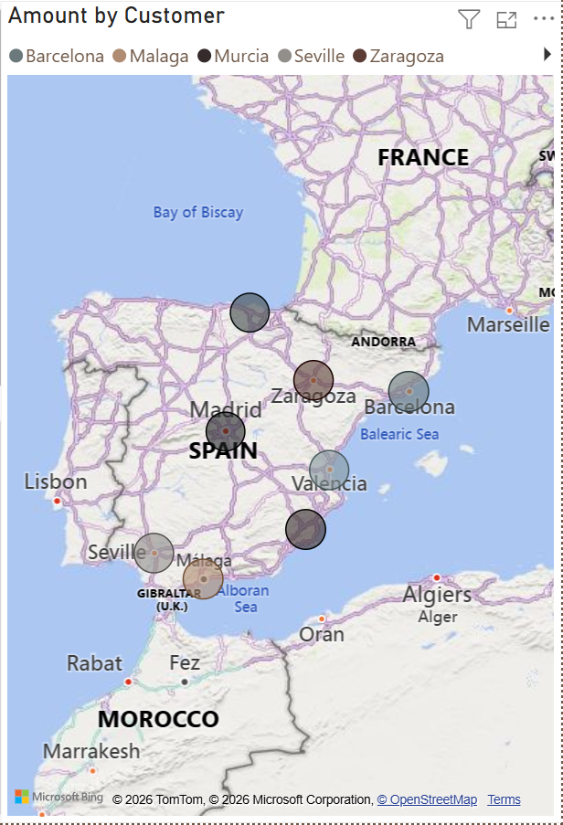
Overview
Transaction activities are spread across multiple cities, indicating a well-diversified customer base rather than dependence on a single geographic market.
Geographic analysis can further identify high-performing regions for targeted marketing and business expansion.

Slide 25
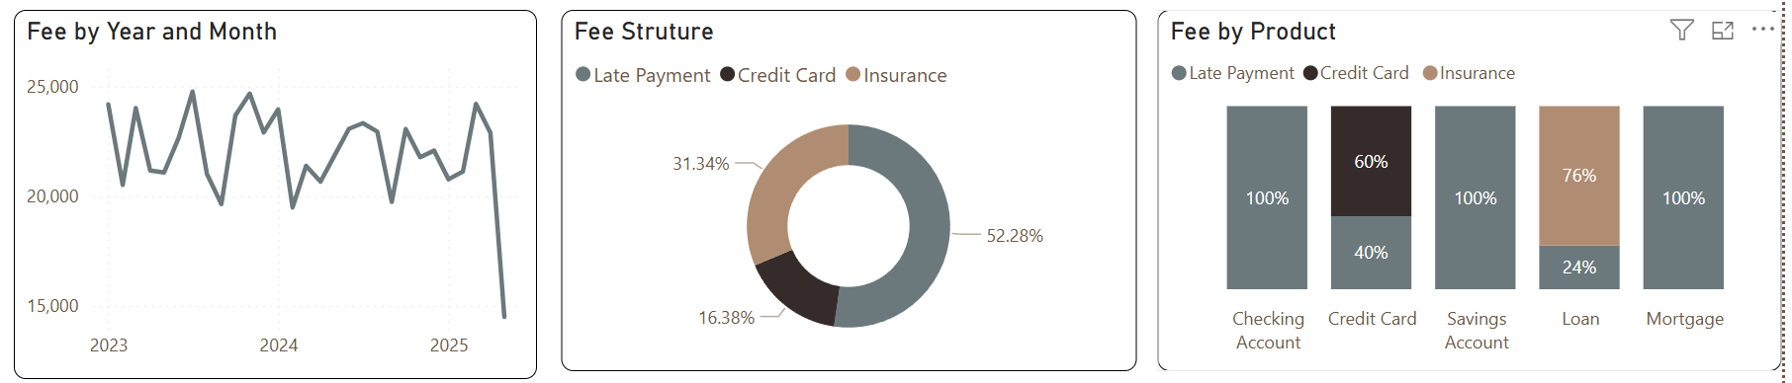
Fee Structure
Late Payment Fees contribute 52.28% of the total fee income, making them the primary source of revenue.
Insurance Fees account for 31.34%, while Credit Card Fees contribute only 16.38%.
The bank’s fee income is therefore highly dependent on penalty-related charges rather than service – based fees.
Checking account, savings account, and mortgage generate fees entirely from latepayment fees.
Late payment Fees suggesting that the bank relies heavily on penalty_based revenue, which may not be sustainable in the long term.

Slide 26
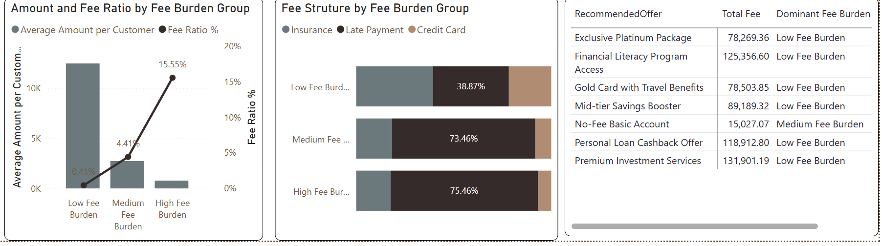
Fee Structure
Customer with high fee burden exhibit significantly higher fee ratios but lower transaction values, indicating a higher risk of customer dissactisfaction or churn.
Expanding service-based fee income, such as credit card services and insurance products, could diversify revenue sources and reduce dependence on penalty fees.
Personalized financial education, automatic payment reminders and fee-reduction incentives could help lower late payment fees while improving customer experience and long-term loyalty.

Slide 27
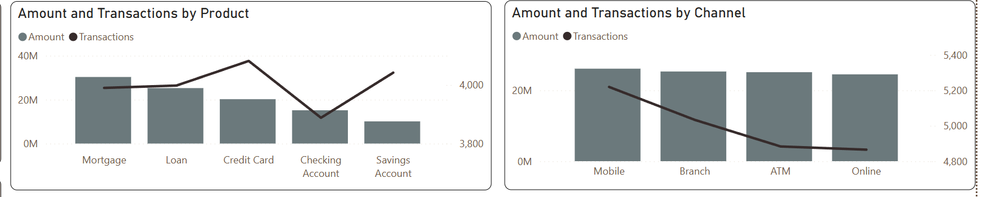
Customer Behavior And Multi-usage
Mortgage generates the highest transaction amount (30M), while credit card records the highest number of transactions.
Savings and Checking Accounts contribute lower transaction amounts, reflecting their role as fundamental banking products rather than high value financial services.
Credit cards demonstrate high customer activity despite generating a lower transaction value than Mortgage and Loan Products.
Mobiles Banking generates the highest transaction amount and transaction volume, confirming it as the primary customer interaction channel.
Branch, ATM and Online channels show relatively similar transaction values, suggesting customers actively use multiple banking channels rather than relying on a single platform.

Slide 28
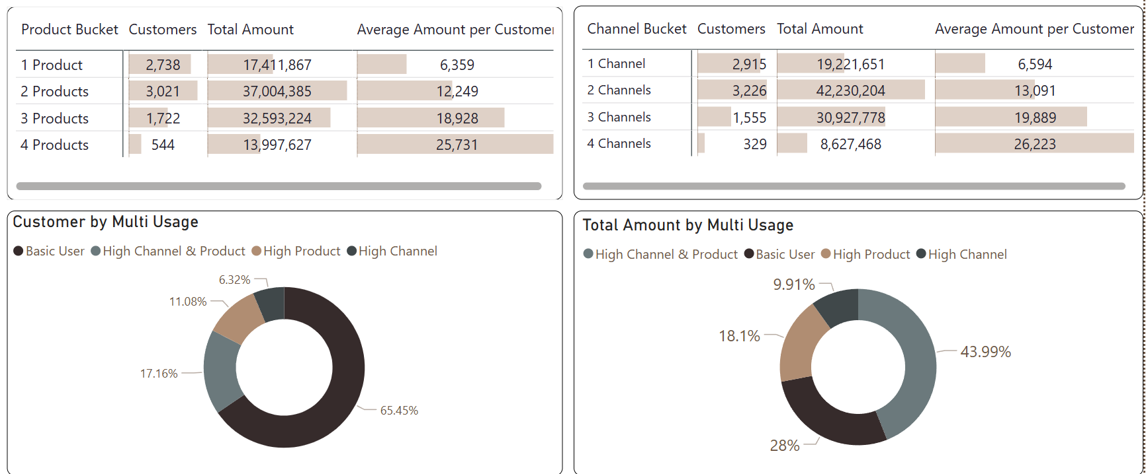
Customer Behavior And Multi-usage
Customers using two products and two channels represent the largest customer groups and contribute the highest total transaction amounts. More importantly, the average transaction amount per customer increases consistently as customers adopt additional products and channels, reaching 25.7K for four-product users and 26.2K for four-channel users.
Although Basic Users account for 65.45% of the customer base, they generate only 28% of the total transaction value, whereas High Channel & Product users represent just 17.16% of customers but contribute nearly 44% of the total transaction amount
These findings indicate that highly engaged customers deliver disproportionately greater business value, highlighting significant opportunities to increase customer lifetime value through cross-selling, omnichannel adoption, and personalized engagement strategies.

Slide 29
Key Insights

Slide 30


Key Insights
Stable Business Performance: The bank serves 8,025 customers with 20,000 transactions, generating over 101M in transaction value, while customer engagement remains relatively low at 2.49 transactions per customer.
Core Revenue Drivers: Mortgage is the highest-value product, Mobile Banking is the leading transaction channel, and Middle-Income customers contribute the largest share of total transaction value.
Fee Structure: Late Payment Fees account for 52.28% of total fee income, indicating a strong reliance on penalty-based revenue rather than value-added services.
Customer Engagement Matters: Customers using more products and channels consistently generate higher average transaction values, demonstrating a strong positive relationship between engagement and customer value.
High-Value Customer Segment: Although High Channel & Product users represent only 17.16% of customers, they contribute 43.99% of the total transaction amount, making them the bank's most valuable customer segment.
Growth Opportunity: The large Basic User segment (65.45% of customers) presents significant opportunities for cross-selling, omnichannel adoption, and personalized marketing to increase customer lifetime value and drive sustainable business growth.

Slide 31
Recommendations

Slide 32

Recommendations
Increase customer engagement by encouraging Basic Users to adopt additional banking products and channels through personalized cross-selling and bundled financial packages.
Strengthen digital banking adoption, particularly Mobile Banking, by enhancing user experience and introducing exclusive digital promotions to increase transaction frequency.
Reduce reliance on Late Payment Fees by implementing payment reminders, auto-payment services, and financial education programs to improve customer satisfaction while maintaining sustainable revenue growth.
Prioritize high-value customers by offering personalized rewards, premium services, and loyalty programs to retain customers with high product and channel usage.
Expand value-added fee-based services, such as insurance, investment, and premium credit card offerings, to diversify fee income beyond penalty-related charges.
Leverage customer segmentation to design targeted marketing campaigns, improving product adoption, customer lifetime value, and long-term profitability.

Slide 33
Dashboard Preview

Slide 34
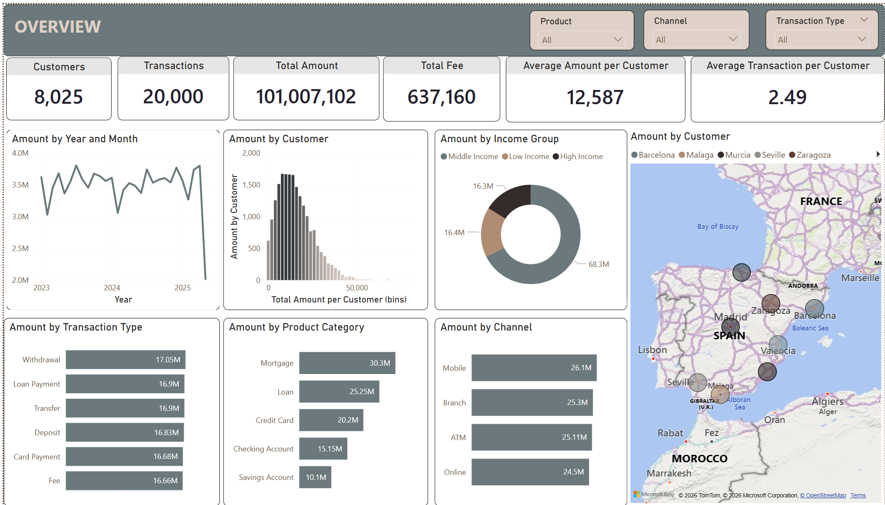
Page 1 –Overview

Slide 35
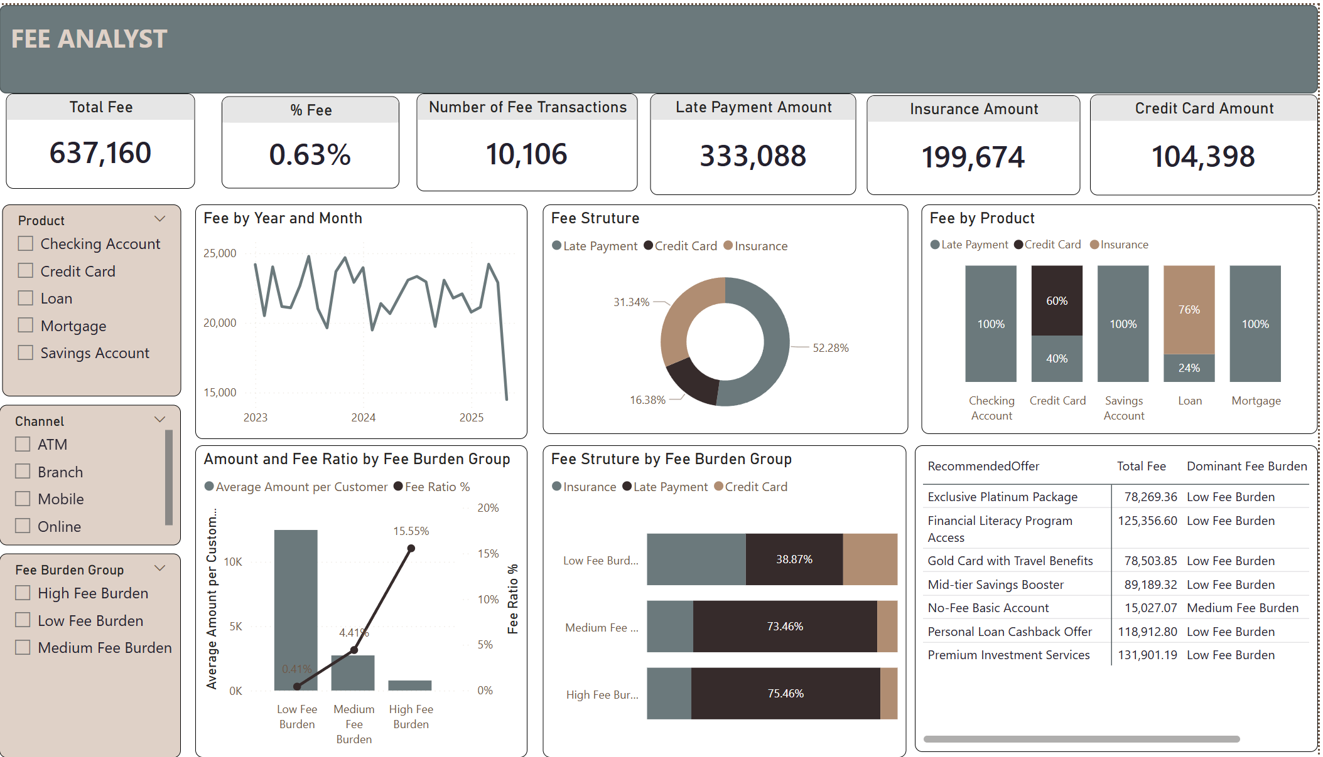
Page 2 – Fee Analyst

Slide 36
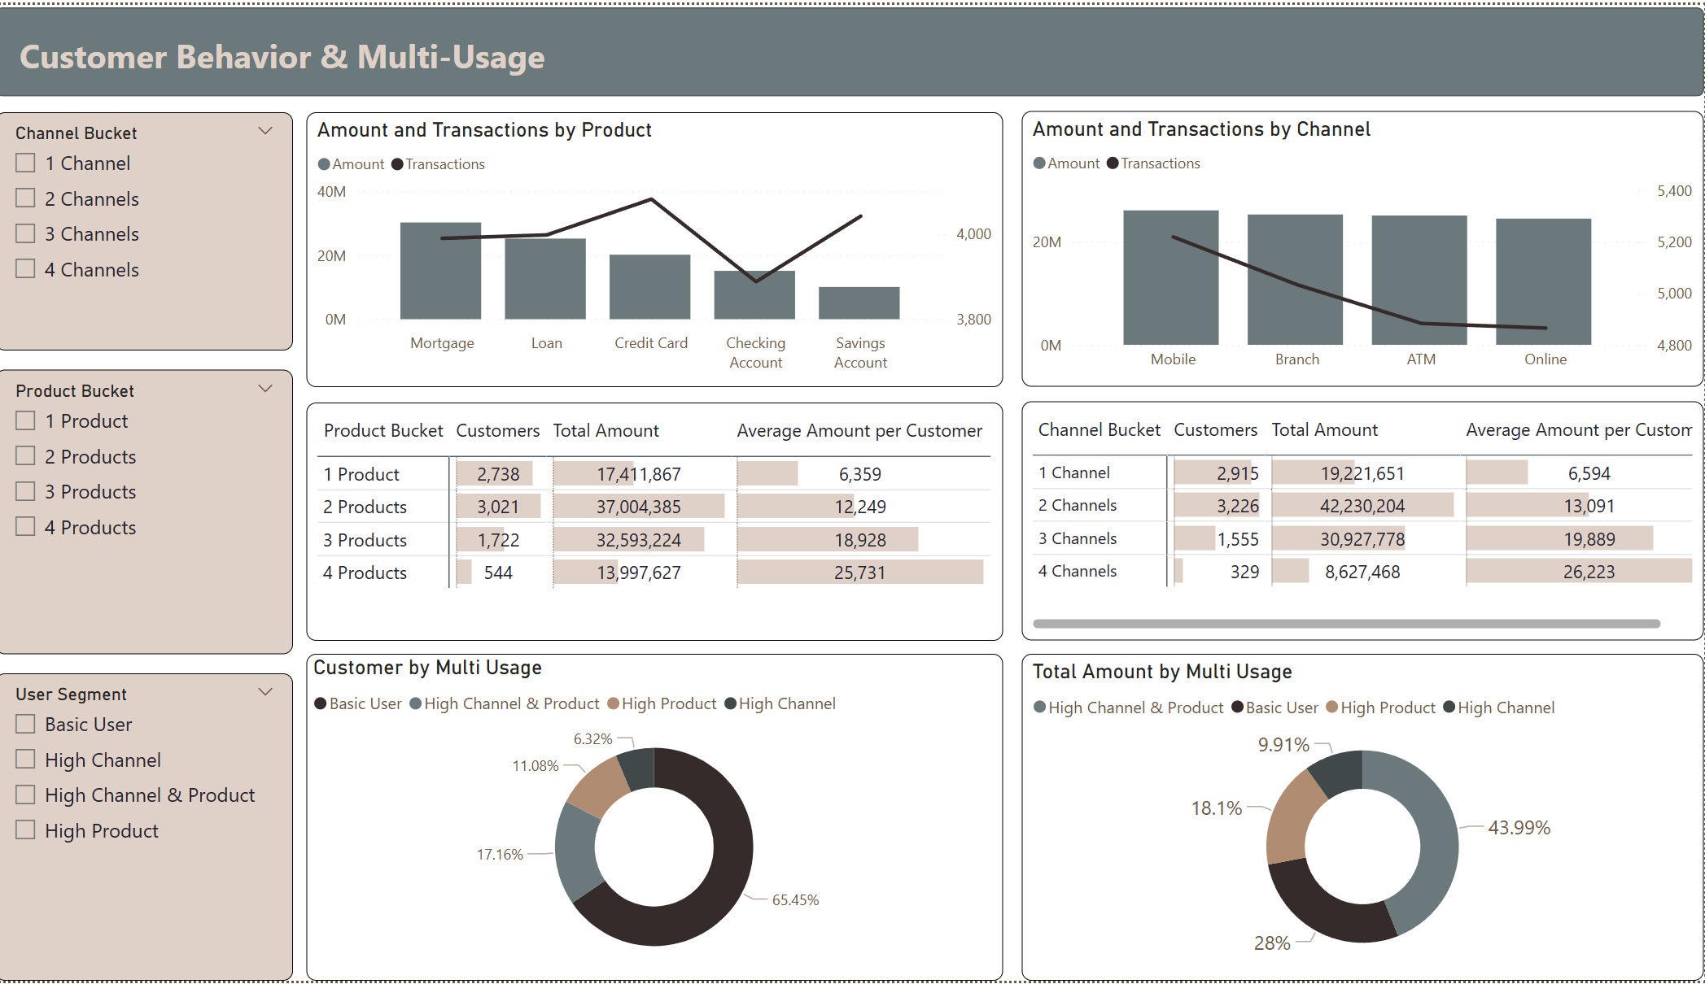
Page 3 - Customer Behavior & Multi-Usage

Slide 37

Thank You

