Slide 1
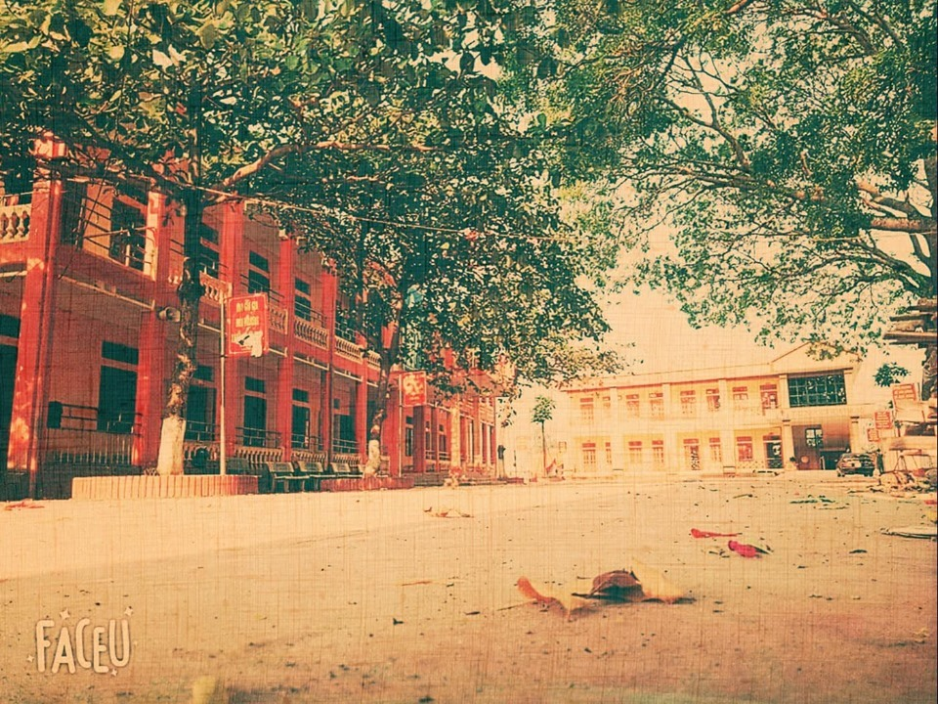
PARALLAX
S L I D E P O W P O I N T

Slide 2


BTQ GROUP
Animation Motion

