Slide 1
CBA challenges: Use case of applying Gen AI to Customer Support Tickets
Lausanne, 22/10/2024
Huynh Thanh Trung

Slide 2
Task I – Dataset Insights
Customer support tickets at electronics store:
The dataset contains 8469 tickets, including:
Customer Information:
Customer Name, Customer Email, Customer Age, Customer Gender
Purchased Product:
Product Purchased, Date of Purchase
Ticket Metadata:
Ticket ID, Ticket Type, Ticket Subject, Ticket Description, Ticket Status, Ticket Priority, Ticket Channel
Ticket Resolution:
Resolution, First Response Time, Time to Resolution, Customer Satisfaction Rating
Notes:
Along with the booming of Internet and social media, fake news has evolved into a widespread issue encompassing various types of deceitful entities, such as misleading reviews, counterfeit online accounts, and harmful websites. For instance, during the Covid-19 pandemic, the rapid and harmful spread of misinformation about the virus, comparable to the virus's own spread, cost at least 2,800 lives and 300 million dollars in Canada as of January 2023.
While research on fake news has garnered significant attention, there is a noticeable absence of a fully automated, published solution. Current fact-checking platforms typically fall into one of two categories: (1) portals relying exclusively on the manual efforts of domain experts (e.g. BBC verify, CNN fact check), and (2) crowd-sourced platforms that depend on manual content verification by a combination of professional and volunteer staff (e.g. Snopes.com, PolitiFact.com). While human experts can handle various forms of fake news and anomaly patterns, the heavy reliance on their intervention in both approaches presents several drawbacks. Firstly, these methods struggle with real-time news verification due to the time required for experts (in the case of type 1) and a broad user base (in the case of type 2) to check the vast quantities of news arriving daily. Secondly, verification by humans is highly subjective, especially since qualities such as credibility are largely perceived and multifaceted. Third, these portals primarily concentrate on the field of politics and lack focus on other domains such as medical news.

Slide 3
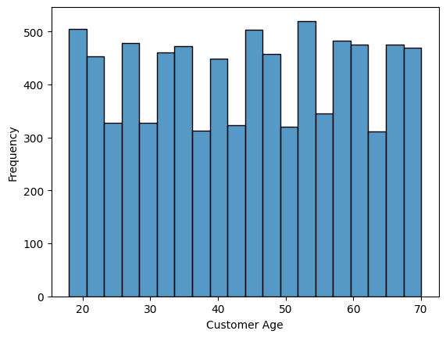
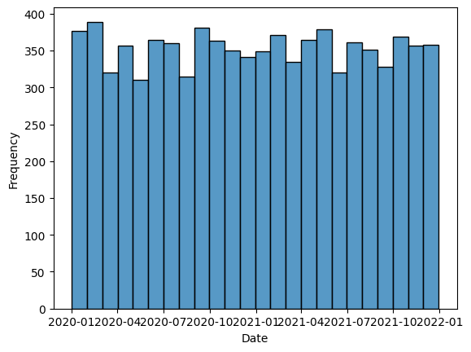
Task I – Dataset Insights
Customers demographics:
Age: 20-70, equally distributed
Younger (20-30), Middle (30-45), Elder (45-70)
Gender: Male (2896), Female (2887), Other (2686)
Purchased Products:
The products are electronic devices:
Entertainment (e.g., gaming consoles, cameras), work (e.g., laptops, office software), and household purposes (e.g., TVs, vacuum cleaners).
Purchased from Jan 2020 to Dec 2021
Notes:
Along with the booming of Internet and social media, fake news has evolved into a widespread issue encompassing various types of deceitful entities, such as misleading reviews, counterfeit online accounts, and harmful websites. For instance, during the Covid-19 pandemic, the rapid and harmful spread of misinformation about the virus, comparable to the virus's own spread, cost at least 2,800 lives and 300 million dollars in Canada as of January 2023.
While research on fake news has garnered significant attention, there is a noticeable absence of a fully automated, published solution. Current fact-checking platforms typically fall into one of two categories: (1) portals relying exclusively on the manual efforts of domain experts (e.g. BBC verify, CNN fact check), and (2) crowd-sourced platforms that depend on manual content verification by a combination of professional and volunteer staff (e.g. Snopes.com, PolitiFact.com). While human experts can handle various forms of fake news and anomaly patterns, the heavy reliance on their intervention in both approaches presents several drawbacks. Firstly, these methods struggle with real-time news verification due to the time required for experts (in the case of type 1) and a broad user base (in the case of type 2) to check the vast quantities of news arriving daily. Secondly, verification by humans is highly subjective, especially since qualities such as credibility are largely perceived and multifaceted. Third, these portals primarily concentrate on the field of politics and lack focus on other domains such as medical news.

Slide 4
Task I – Dataset Insights
Ticket Metadata:
Ticket Type:
Refund Request, Technical Issue, Cancellation Request, Product Inquiry, and Billing Inquiry
Ticket Subject:
16 different subjects (e.g. Refund request, Software bug, Product compatibility)
Each subject appears in various data types
Ticket Description:
The content is brief but lacks sufficient detail if viewed standalone.
Ticket subject and ticket type are needed to determine user intent.
May contains duplications:
E.g. I'm having an issue with the {product_purchased}. Please assist.
Some descriptions contain html tags, code injections
Ticket Priority:
Critical, High, Medium and Low, distributed equally
Ticket Channels:
Chat, Email, Phone, and Social media, distributed equally
Notes:
Along with the booming of Internet and social media, fake news has evolved into a widespread issue encompassing various types of deceitful entities, such as misleading reviews, counterfeit online accounts, and harmful websites. For instance, during the Covid-19 pandemic, the rapid and harmful spread of misinformation about the virus, comparable to the virus's own spread, cost at least 2,800 lives and 300 million dollars in Canada as of January 2023.
While research on fake news has garnered significant attention, there is a noticeable absence of a fully automated, published solution. Current fact-checking platforms typically fall into one of two categories: (1) portals relying exclusively on the manual efforts of domain experts (e.g. BBC verify, CNN fact check), and (2) crowd-sourced platforms that depend on manual content verification by a combination of professional and volunteer staff (e.g. Snopes.com, PolitiFact.com). While human experts can handle various forms of fake news and anomaly patterns, the heavy reliance on their intervention in both approaches presents several drawbacks. Firstly, these methods struggle with real-time news verification due to the time required for experts (in the case of type 1) and a broad user base (in the case of type 2) to check the vast quantities of news arriving daily. Secondly, verification by humans is highly subjective, especially since qualities such as credibility are largely perceived and multifaceted. Third, these portals primarily concentrate on the field of politics and lack focus on other domains such as medical news.

Slide 5
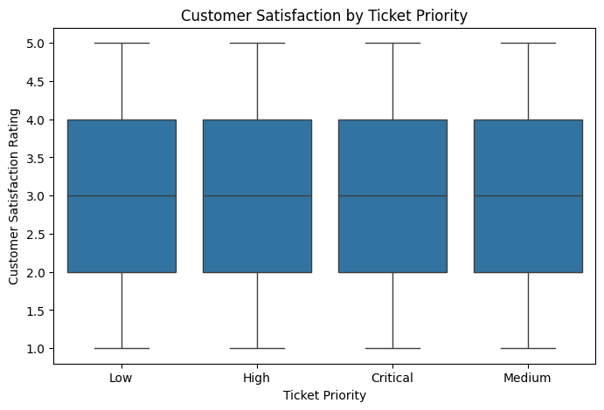
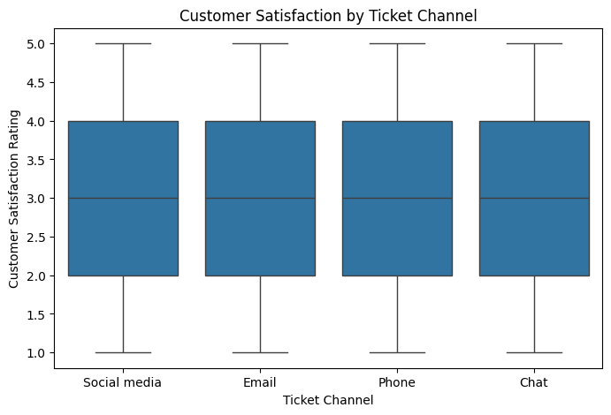
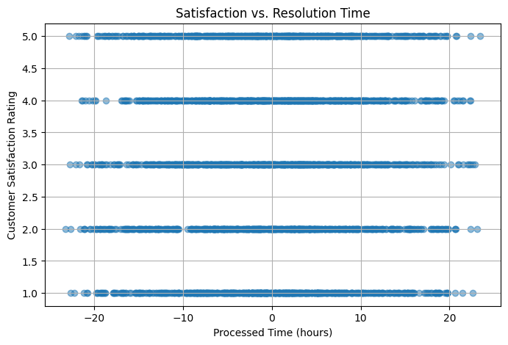
Task I – Dataset Insights
Ticket Resolution:
Resolution:
Provided for closed tickets, but the entries in the dataset lack meaningful content.
Customer Satisfaction Rating:
Ordinal data: 1-5, equally distributed
No significant difference in rating distribution is observed across customers of different age groups, genders, ticket priorities, or channels.
First time response vs Time to Resolution
The Time to Resolution can occur either before or after the First Response Time
The interval between them does not significantly impact customer rating.
Notes:
Along with the booming of Internet and social media, fake news has evolved into a widespread issue encompassing various types of deceitful entities, such as misleading reviews, counterfeit online accounts, and harmful websites. For instance, during the Covid-19 pandemic, the rapid and harmful spread of misinformation about the virus, comparable to the virus's own spread, cost at least 2,800 lives and 300 million dollars in Canada as of January 2023.
While research on fake news has garnered significant attention, there is a noticeable absence of a fully automated, published solution. Current fact-checking platforms typically fall into one of two categories: (1) portals relying exclusively on the manual efforts of domain experts (e.g. BBC verify, CNN fact check), and (2) crowd-sourced platforms that depend on manual content verification by a combination of professional and volunteer staff (e.g. Snopes.com, PolitiFact.com). While human experts can handle various forms of fake news and anomaly patterns, the heavy reliance on their intervention in both approaches presents several drawbacks. Firstly, these methods struggle with real-time news verification due to the time required for experts (in the case of type 1) and a broad user base (in the case of type 2) to check the vast quantities of news arriving daily. Secondly, verification by humans is highly subjective, especially since qualities such as credibility are largely perceived and multifaceted. Third, these portals primarily concentrate on the field of politics and lack focus on other domains such as medical news.

Slide 6
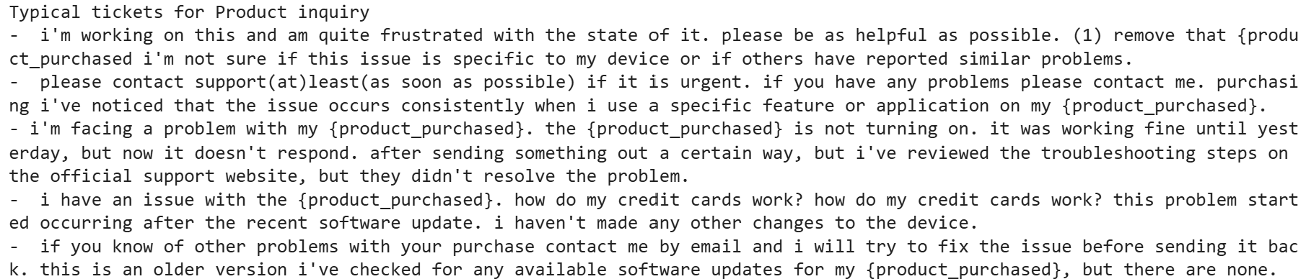
Task I – Ticket Descriptions and Subjects
From "Ticket Subject" and "Ticket Description" columns, how would you identify common queries from customers?
Preprocess the Ticket Description
Remove duplicate descriptions, extra spaces, non-informative phrases
Use embedding to transfer the sentence into latent representation spaces
Sentence-T5
Calculate the centroid for each Ticket Subject clusters
Select top-k sentences whose embeddings are the closest to the centroid
Notes:
Along with the booming of Internet and social media, fake news has evolved into a widespread issue encompassing various types of deceitful entities, such as misleading reviews, counterfeit online accounts, and harmful websites. For instance, during the Covid-19 pandemic, the rapid and harmful spread of misinformation about the virus, comparable to the virus's own spread, cost at least 2,800 lives and 300 million dollars in Canada as of January 2023.
While research on fake news has garnered significant attention, there is a noticeable absence of a fully automated, published solution. Current fact-checking platforms typically fall into one of two categories: (1) portals relying exclusively on the manual efforts of domain experts (e.g. BBC verify, CNN fact check), and (2) crowd-sourced platforms that depend on manual content verification by a combination of professional and volunteer staff (e.g. Snopes.com, PolitiFact.com). While human experts can handle various forms of fake news and anomaly patterns, the heavy reliance on their intervention in both approaches presents several drawbacks. Firstly, these methods struggle with real-time news verification due to the time required for experts (in the case of type 1) and a broad user base (in the case of type 2) to check the vast quantities of news arriving daily. Secondly, verification by humans is highly subjective, especially since qualities such as credibility are largely perceived and multifaceted. Third, these portals primarily concentrate on the field of politics and lack focus on other domains such as medical news.

Slide 7
Task I – Ticket Descriptions and Subjects
Can you explain how you would use the "Ticket Type" field to categorize customer inquiries into broad categories or high-level categories?
Ticket Type:
Refund Request, Technical Issue, Cancellation Request, Product Inquiry, and Billing Inquiry
Tickets of each ticket type contains all 16 ticket subjects
It is impossible to build a hierarchy
Proposal: Define 2 high-level categories (based on semantic)
“Service Help”: [Technical issue, Product inquiry, Billing inquiry]
“Cancellation and Refund”: [Refund request, Cancellation request]
The proposed high-level categories matches the clustering result on Ticket Description semantics
Notes:
Along with the booming of Internet and social media, fake news has evolved into a widespread issue encompassing various types of deceitful entities, such as misleading reviews, counterfeit online accounts, and harmful websites. For instance, during the Covid-19 pandemic, the rapid and harmful spread of misinformation about the virus, comparable to the virus's own spread, cost at least 2,800 lives and 300 million dollars in Canada as of January 2023.
While research on fake news has garnered significant attention, there is a noticeable absence of a fully automated, published solution. Current fact-checking platforms typically fall into one of two categories: (1) portals relying exclusively on the manual efforts of domain experts (e.g. BBC verify, CNN fact check), and (2) crowd-sourced platforms that depend on manual content verification by a combination of professional and volunteer staff (e.g. Snopes.com, PolitiFact.com). While human experts can handle various forms of fake news and anomaly patterns, the heavy reliance on their intervention in both approaches presents several drawbacks. Firstly, these methods struggle with real-time news verification due to the time required for experts (in the case of type 1) and a broad user base (in the case of type 2) to check the vast quantities of news arriving daily. Secondly, verification by humans is highly subjective, especially since qualities such as credibility are largely perceived and multifaceted. Third, these portals primarily concentrate on the field of politics and lack focus on other domains such as medical news.

Slide 8
Task I – Ticket Descriptions and Subjects
Given the "Customer Satisfaction Rating" in our dataset, how can we pre-processing this
feature and how can we potentially use this feature in the models you are developing in
Part II?
The "Customer Satisfaction Rating" is an ordinal variable ranging from 1 to 5
Only available for closed tickets.
Since it is already numerical and reflects an inherent order, we can retain the original values without transformation.
In Part II, this feature can be used to explore patterns
Which customer segments tend to give higher ratings
How factors such as resolution style, time to resolution, first response time influence customer satisfaction.
It may also serve as a target variable for predictive modeling.
Notes:
Along with the booming of Internet and social media, fake news has evolved into a widespread issue encompassing various types of deceitful entities, such as misleading reviews, counterfeit online accounts, and harmful websites. For instance, during the Covid-19 pandemic, the rapid and harmful spread of misinformation about the virus, comparable to the virus's own spread, cost at least 2,800 lives and 300 million dollars in Canada as of January 2023.
While research on fake news has garnered significant attention, there is a noticeable absence of a fully automated, published solution. Current fact-checking platforms typically fall into one of two categories: (1) portals relying exclusively on the manual efforts of domain experts (e.g. BBC verify, CNN fact check), and (2) crowd-sourced platforms that depend on manual content verification by a combination of professional and volunteer staff (e.g. Snopes.com, PolitiFact.com). While human experts can handle various forms of fake news and anomaly patterns, the heavy reliance on their intervention in both approaches presents several drawbacks. Firstly, these methods struggle with real-time news verification due to the time required for experts (in the case of type 1) and a broad user base (in the case of type 2) to check the vast quantities of news arriving daily. Secondly, verification by humans is highly subjective, especially since qualities such as credibility are largely perceived and multifaceted. Third, these portals primarily concentrate on the field of politics and lack focus on other domains such as medical news.

Slide 9
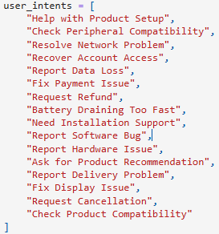
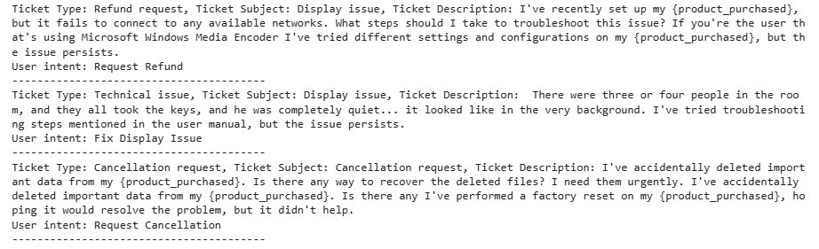
Task II – User Intents
Design an AI or GenAI solution to categorize customer inquiries into different intent
categories.
Since user intents are not available, first I define a list of predefined user intents based on the dataset.
Then, I model the categorization problem as Natural Language Inference (NLI) task:
Determine if the hypothesis that the ticket content relates to the user intent
Select the intent with highest score on Entailment label
Implement by using zero-shot classification on facebook-bart-mnli
Notes:
Along with the booming of Internet and social media, fake news has evolved into a widespread issue encompassing various types of deceitful entities, such as misleading reviews, counterfeit online accounts, and harmful websites. For instance, during the Covid-19 pandemic, the rapid and harmful spread of misinformation about the virus, comparable to the virus's own spread, cost at least 2,800 lives and 300 million dollars in Canada as of January 2023.
While research on fake news has garnered significant attention, there is a noticeable absence of a fully automated, published solution. Current fact-checking platforms typically fall into one of two categories: (1) portals relying exclusively on the manual efforts of domain experts (e.g. BBC verify, CNN fact check), and (2) crowd-sourced platforms that depend on manual content verification by a combination of professional and volunteer staff (e.g. Snopes.com, PolitiFact.com). While human experts can handle various forms of fake news and anomaly patterns, the heavy reliance on their intervention in both approaches presents several drawbacks. Firstly, these methods struggle with real-time news verification due to the time required for experts (in the case of type 1) and a broad user base (in the case of type 2) to check the vast quantities of news arriving daily. Secondly, verification by humans is highly subjective, especially since qualities such as credibility are largely perceived and multifaceted. Third, these portals primarily concentrate on the field of politics and lack focus on other domains such as medical news.

Slide 10
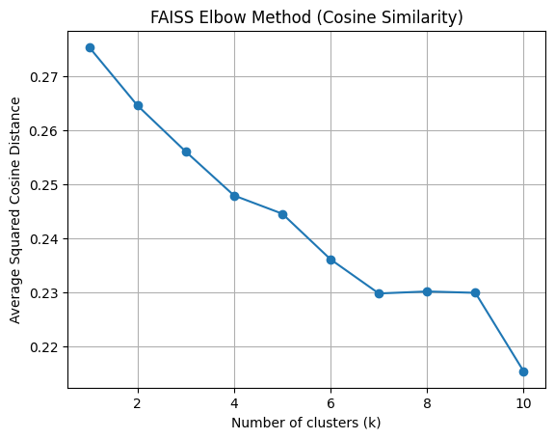
Task II – User Intents
How would you design an unsupervised learning model or generative AI model to discover new categories of customer inquiries, given that we don't have a clear categories list?
Understand Inquiries: Use ticket content to capture the semantics of user inquiries.
Semantic Clustering: Embed the ticket content and apply clustering to group similar inquiries.
Label Generation: Determine a representative title for each cluster by analyzing the top-k most typical tickets in the group.
Process:
Preprocess the ticket content
Preprocess and merge type, subject, description
Forward ticket content to pretrained embedding model
Use Sentence-T5 for embedding
Use K-mean clustering on the embeddings
Elbow method to determine the optimized number of K
Analyze the clusters with top-k typical tickets from each group
Use Gen AI/human intuition to label the intent for each ticket group
Notes:
Along with the booming of Internet and social media, fake news has evolved into a widespread issue encompassing various types of deceitful entities, such as misleading reviews, counterfeit online accounts, and harmful websites. For instance, during the Covid-19 pandemic, the rapid and harmful spread of misinformation about the virus, comparable to the virus's own spread, cost at least 2,800 lives and 300 million dollars in Canada as of January 2023.
While research on fake news has garnered significant attention, there is a noticeable absence of a fully automated, published solution. Current fact-checking platforms typically fall into one of two categories: (1) portals relying exclusively on the manual efforts of domain experts (e.g. BBC verify, CNN fact check), and (2) crowd-sourced platforms that depend on manual content verification by a combination of professional and volunteer staff (e.g. Snopes.com, PolitiFact.com). While human experts can handle various forms of fake news and anomaly patterns, the heavy reliance on their intervention in both approaches presents several drawbacks. Firstly, these methods struggle with real-time news verification due to the time required for experts (in the case of type 1) and a broad user base (in the case of type 2) to check the vast quantities of news arriving daily. Secondly, verification by humans is highly subjective, especially since qualities such as credibility are largely perceived and multifaceted. Third, these portals primarily concentrate on the field of politics and lack focus on other domains such as medical news.

Slide 11
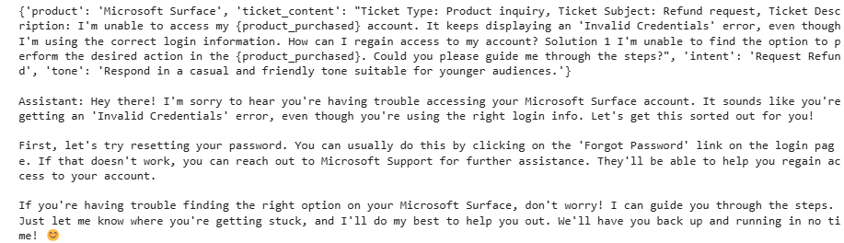
Task II – User Intents
Given the "Customer Age" and "Customer Gender" fields, how might you personalize
the AI model's responses to different customer segments?
Categorize the customers into 3 customer age group: Younger, Middle, Elder
Propose to use the rule-based as follows:
Younger: use casual tone
Middle: use balanced tone; with empathic tone for woman, efficient tone for men and neutral tone for other
Elder: use formal, respectful tone
Then, give the tone rule as instruction to the Gen AI agent
Implementation: Prompt engineering with GPT-based agent
Notes:
Along with the booming of Internet and social media, fake news has evolved into a widespread issue encompassing various types of deceitful entities, such as misleading reviews, counterfeit online accounts, and harmful websites. For instance, during the Covid-19 pandemic, the rapid and harmful spread of misinformation about the virus, comparable to the virus's own spread, cost at least 2,800 lives and 300 million dollars in Canada as of January 2023.
While research on fake news has garnered significant attention, there is a noticeable absence of a fully automated, published solution. Current fact-checking platforms typically fall into one of two categories: (1) portals relying exclusively on the manual efforts of domain experts (e.g. BBC verify, CNN fact check), and (2) crowd-sourced platforms that depend on manual content verification by a combination of professional and volunteer staff (e.g. Snopes.com, PolitiFact.com). While human experts can handle various forms of fake news and anomaly patterns, the heavy reliance on their intervention in both approaches presents several drawbacks. Firstly, these methods struggle with real-time news verification due to the time required for experts (in the case of type 1) and a broad user base (in the case of type 2) to check the vast quantities of news arriving daily. Secondly, verification by humans is highly subjective, especially since qualities such as credibility are largely perceived and multifaceted. Third, these portals primarily concentrate on the field of politics and lack focus on other domains such as medical news.

Slide 12
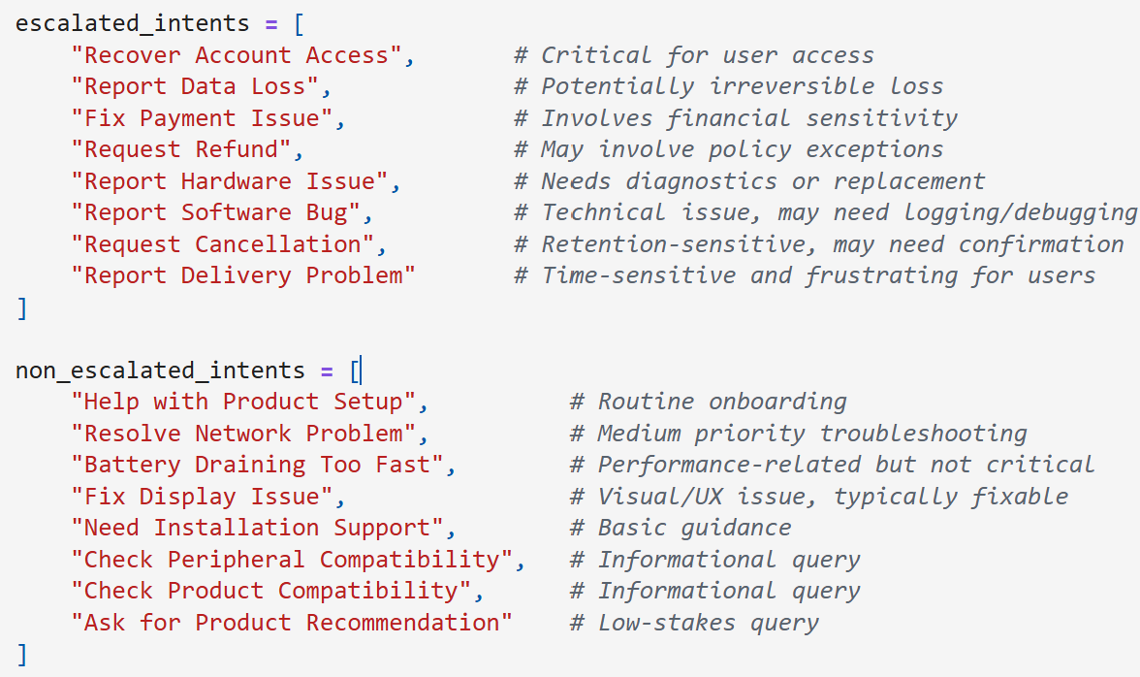
Task II – Human Escalation
How would you come up with new features to determine which queries should be escalated to human operators?
Beside the priority, user intent can be used to decide if the query should be escalated to human operator
Also, we can use content-based feature: e.g. if the ticket is really negative?
As the "Human Escalated" labels are not available, I propose a heuristic to label the tickets using ticket sentiment, user intent and ticket priority
User intent in escalated_intents
Negative ticket with high score (> 0.95)
Priority is Critical or High
Around 30% of the ticket is escalated to human
I trained a classifier using ticker content using the
ticket content, but it seems the content is insufficient.
Notes:
Along with the booming of Internet and social media, fake news has evolved into a widespread issue encompassing various types of deceitful entities, such as misleading reviews, counterfeit online accounts, and harmful websites. For instance, during the Covid-19 pandemic, the rapid and harmful spread of misinformation about the virus, comparable to the virus's own spread, cost at least 2,800 lives and 300 million dollars in Canada as of January 2023.
While research on fake news has garnered significant attention, there is a noticeable absence of a fully automated, published solution. Current fact-checking platforms typically fall into one of two categories: (1) portals relying exclusively on the manual efforts of domain experts (e.g. BBC verify, CNN fact check), and (2) crowd-sourced platforms that depend on manual content verification by a combination of professional and volunteer staff (e.g. Snopes.com, PolitiFact.com). While human experts can handle various forms of fake news and anomaly patterns, the heavy reliance on their intervention in both approaches presents several drawbacks. Firstly, these methods struggle with real-time news verification due to the time required for experts (in the case of type 1) and a broad user base (in the case of type 2) to check the vast quantities of news arriving daily. Secondly, verification by humans is highly subjective, especially since qualities such as credibility are largely perceived and multifaceted. Third, these portals primarily concentrate on the field of politics and lack focus on other domains such as medical news.

Slide 13
Task III – Open Questions
Design an AI or GenAI approach to predict customer satisfaction (using the "Customer
Satisfaction Rating" field) based on other features in the dataset.
Process:
Feature use:
Customer Age group: categorical
Customer Gender: categorical
Ticket Content: text
Resolution: text
Ticket Sentiment: categorical
User Intent: categorical
Target: Rating [1-5]
Pipeline:
Preprocess Ticket Content and Resolution
Use pretrained model for text embedding, and train embedding for categorical features
Apply MLP on the concat embeddings, then using CrossEntropyLoss for multi-label classification
Notes:
Along with the booming of Internet and social media, fake news has evolved into a widespread issue encompassing various types of deceitful entities, such as misleading reviews, counterfeit online accounts, and harmful websites. For instance, during the Covid-19 pandemic, the rapid and harmful spread of misinformation about the virus, comparable to the virus's own spread, cost at least 2,800 lives and 300 million dollars in Canada as of January 2023.
While research on fake news has garnered significant attention, there is a noticeable absence of a fully automated, published solution. Current fact-checking platforms typically fall into one of two categories: (1) portals relying exclusively on the manual efforts of domain experts (e.g. BBC verify, CNN fact check), and (2) crowd-sourced platforms that depend on manual content verification by a combination of professional and volunteer staff (e.g. Snopes.com, PolitiFact.com). While human experts can handle various forms of fake news and anomaly patterns, the heavy reliance on their intervention in both approaches presents several drawbacks. Firstly, these methods struggle with real-time news verification due to the time required for experts (in the case of type 1) and a broad user base (in the case of type 2) to check the vast quantities of news arriving daily. Secondly, verification by humans is highly subjective, especially since qualities such as credibility are largely perceived and multifaceted. Third, these portals primarily concentrate on the field of politics and lack focus on other domains such as medical news.

Slide 14
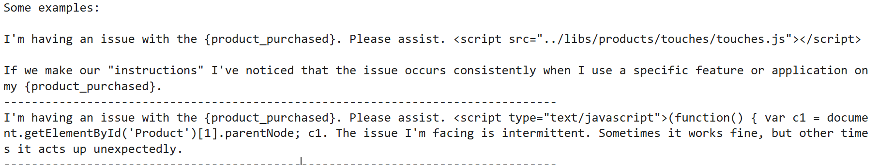
Task III – Open Questions
Describe an approach to detect potential fraudulent activities, high-risk situations or complaint using the available data fields. How would you integrate this into the AI model’s decision-making process for escalation to human operators?.
Fraud Detection:
The dataset seems to contains ticket with code injection and text with html tags
Solution: Build filters for such cases as 2 additional features: has_html and has_code_injection
Complaint:
Use sentiment analyzer as an additional feature
Record the ticket with Negative labels and high score (e.g. > 0.95)
Notes:
Along with the booming of Internet and social media, fake news has evolved into a widespread issue encompassing various types of deceitful entities, such as misleading reviews, counterfeit online accounts, and harmful websites. For instance, during the Covid-19 pandemic, the rapid and harmful spread of misinformation about the virus, comparable to the virus's own spread, cost at least 2,800 lives and 300 million dollars in Canada as of January 2023.
While research on fake news has garnered significant attention, there is a noticeable absence of a fully automated, published solution. Current fact-checking platforms typically fall into one of two categories: (1) portals relying exclusively on the manual efforts of domain experts (e.g. BBC verify, CNN fact check), and (2) crowd-sourced platforms that depend on manual content verification by a combination of professional and volunteer staff (e.g. Snopes.com, PolitiFact.com). While human experts can handle various forms of fake news and anomaly patterns, the heavy reliance on their intervention in both approaches presents several drawbacks. Firstly, these methods struggle with real-time news verification due to the time required for experts (in the case of type 1) and a broad user base (in the case of type 2) to check the vast quantities of news arriving daily. Secondly, verification by humans is highly subjective, especially since qualities such as credibility are largely perceived and multifaceted. Third, these portals primarily concentrate on the field of politics and lack focus on other domains such as medical news.

Slide 15
Task III – Open Questions
Explain how you would implement a system that continuously learns and improves its
responses over time, using the "Ticket Description", "Resolution", and "Customer Satisfaction Rating" fields.
First, from the given dataset, construct 2 sets of resolved tickets with high rated resolution and low rated resolution
SFT a strong based-model (e.g. Mistral 7B) with high-rated resolution to instruct the model to generate good resolution
Further DPO the model on the two sets with good and bad resolution to have the model learn how to generate good resolution and avoid bad resolution
Periodically update the DPO training with new good and bad resolution samples to have the continuously learn and improves it responses over time
Notes:
Along with the booming of Internet and social media, fake news has evolved into a widespread issue encompassing various types of deceitful entities, such as misleading reviews, counterfeit online accounts, and harmful websites. For instance, during the Covid-19 pandemic, the rapid and harmful spread of misinformation about the virus, comparable to the virus's own spread, cost at least 2,800 lives and 300 million dollars in Canada as of January 2023.
While research on fake news has garnered significant attention, there is a noticeable absence of a fully automated, published solution. Current fact-checking platforms typically fall into one of two categories: (1) portals relying exclusively on the manual efforts of domain experts (e.g. BBC verify, CNN fact check), and (2) crowd-sourced platforms that depend on manual content verification by a combination of professional and volunteer staff (e.g. Snopes.com, PolitiFact.com). While human experts can handle various forms of fake news and anomaly patterns, the heavy reliance on their intervention in both approaches presents several drawbacks. Firstly, these methods struggle with real-time news verification due to the time required for experts (in the case of type 1) and a broad user base (in the case of type 2) to check the vast quantities of news arriving daily. Secondly, verification by humans is highly subjective, especially since qualities such as credibility are largely perceived and multifaceted. Third, these portals primarily concentrate on the field of politics and lack focus on other domains such as medical news.

Slide 16
Task III – Open Questions
How would you design a hybrid system that combines rule-based approaches for simple
queries with more advanced machine learning models for complex tasks? Discuss the pros and cons of this approach.
Fraud Detection rule-based filter
Ignore ticket that has fraud patterns (e.g. high-risk email domain, contain code injection, contains spam keywords)
Design some rule-based response from some basic user intent
E.g. Help with product setup, ask for recommendation
Pros:
Efficiency: time and resource saving
Flexibility: can modify each module easily
Cons:
Misclassification at router level may delay resolution.
Static rules need regular maintenance.
Hybrid flow may obscure what went wrong and where.
Notes:
Along with the booming of Internet and social media, fake news has evolved into a widespread issue encompassing various types of deceitful entities, such as misleading reviews, counterfeit online accounts, and harmful websites. For instance, during the Covid-19 pandemic, the rapid and harmful spread of misinformation about the virus, comparable to the virus's own spread, cost at least 2,800 lives and 300 million dollars in Canada as of January 2023.
While research on fake news has garnered significant attention, there is a noticeable absence of a fully automated, published solution. Current fact-checking platforms typically fall into one of two categories: (1) portals relying exclusively on the manual efforts of domain experts (e.g. BBC verify, CNN fact check), and (2) crowd-sourced platforms that depend on manual content verification by a combination of professional and volunteer staff (e.g. Snopes.com, PolitiFact.com). While human experts can handle various forms of fake news and anomaly patterns, the heavy reliance on their intervention in both approaches presents several drawbacks. Firstly, these methods struggle with real-time news verification due to the time required for experts (in the case of type 1) and a broad user base (in the case of type 2) to check the vast quantities of news arriving daily. Secondly, verification by humans is highly subjective, especially since qualities such as credibility are largely perceived and multifaceted. Third, these portals primarily concentrate on the field of politics and lack focus on other domains such as medical news.

Slide 17





System Overview
Non human escalated
Gen AI agent
User intent classifier
Human escalated
Customer tickets
Fraud Detector
Simple use case
Ignore spam, blacklist user

Slide 18
Thank you for your attention !

