Slide 1
E-Plugin

Slide 2
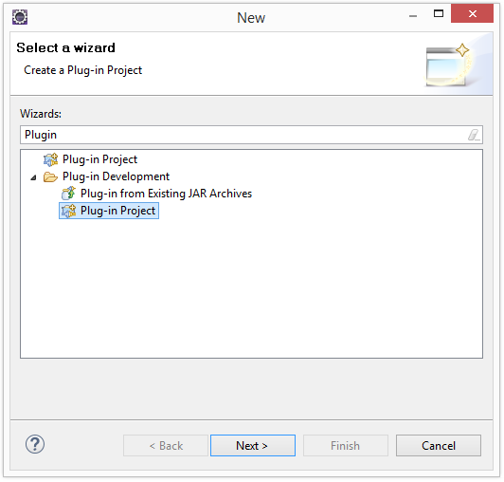
1. Create

Slide 3
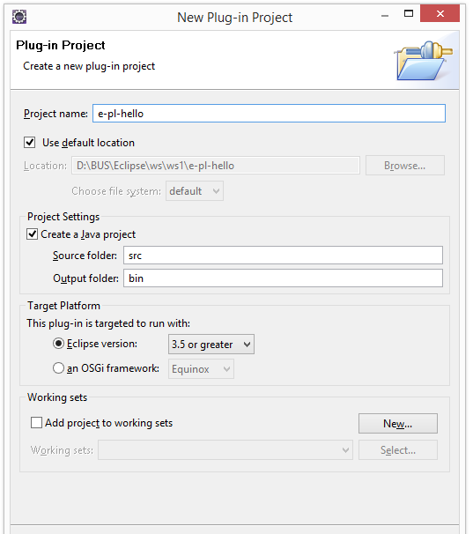
1. Create

Slide 4
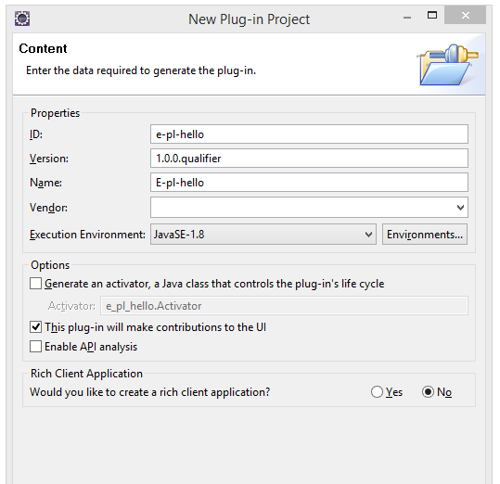
1. Create

Slide 5
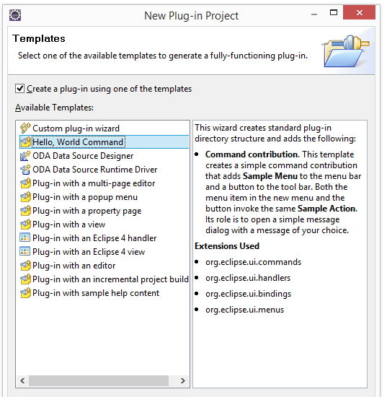
1. Create

Slide 6
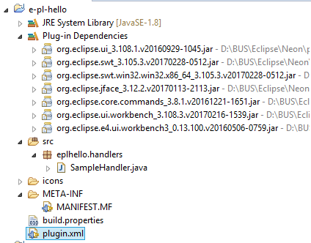
1. Create

Slide 7
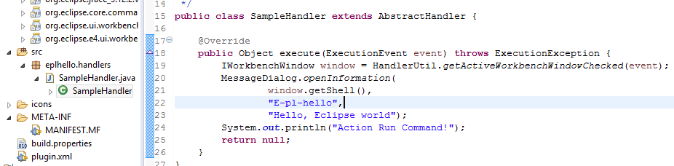
1. Create

Slide 8
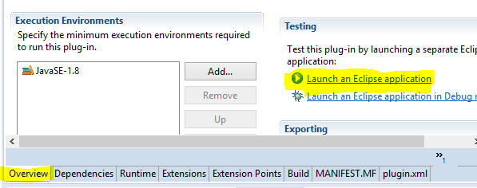

2. Run

Slide 9
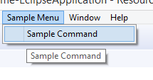
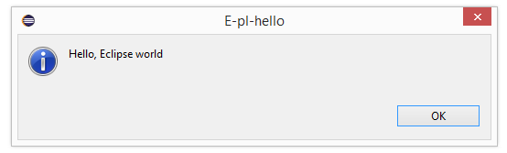
2. Run
Eclipse open new window

Slide 10
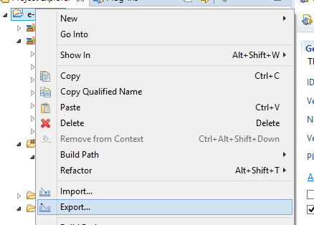
3. Export Plugin

Slide 11
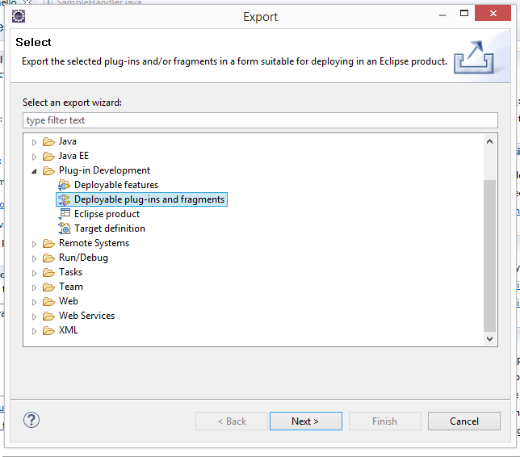
3. Export Plugin

Slide 12
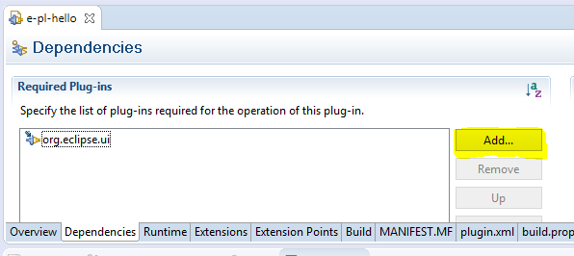
II 1. Add Dependences

Slide 13
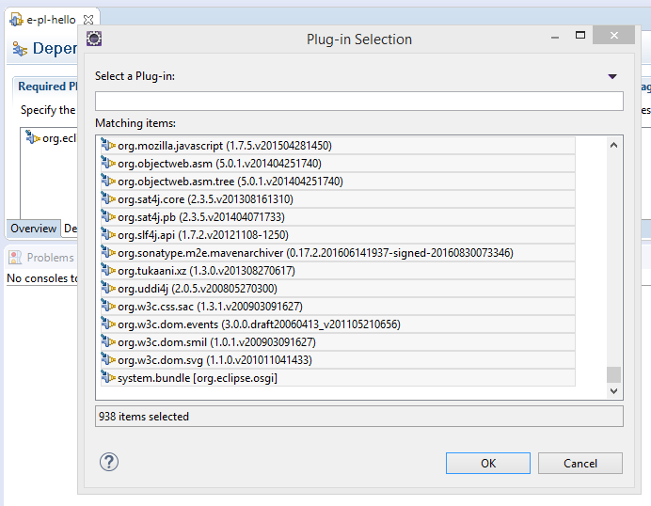
II 1. Add Dependences

Slide 14
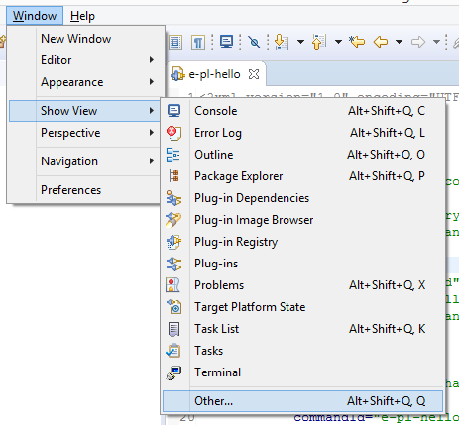
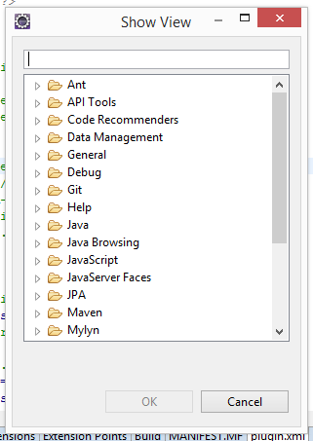
II 2. Views (Show view)

Slide 15
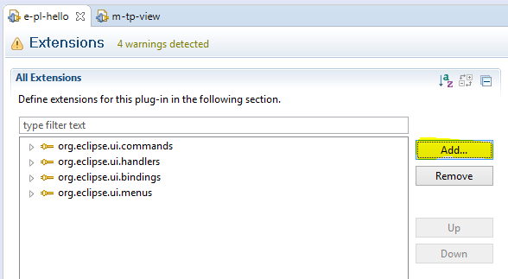
II 2. Views (Show view)

Slide 16
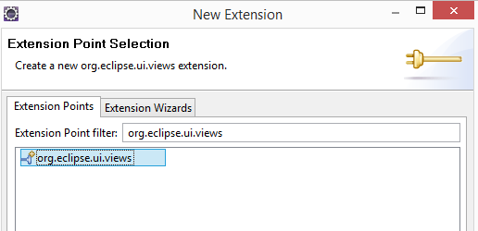
II 2. Views (Show view)

Slide 17
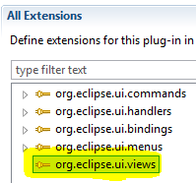
II 2. Views (Show view)

Slide 18
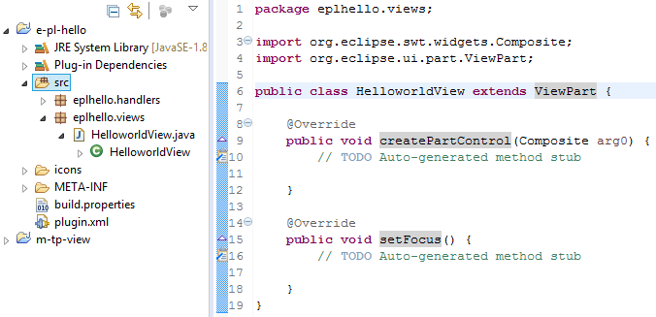
II 2. Views (Show view)

Slide 19
II 2. Views (Show view)
<extension
point="org.eclipse.ui.views">
<category
name="Hello World"
id="e-pl-hello.viewa.category">
</category>
<view
name="Hello World"
icon="icons/sample.gif"
category="e-pl-hello.viewa.category"
class="eplhello.views.HelloworldView"
id="e-pl-hello.views.HelloWorldView">
</view>
</extension>

Slide 20
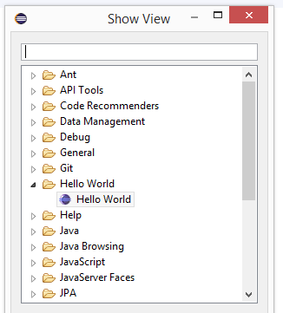
II 2. Views (Show view)
Run plugin:

Slide 21
II 3. ToolBars (Menu ToolBars)

Slide 22
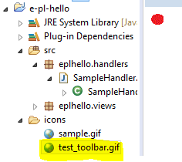
II 3. ToolBars (Menu ToolBars)

Slide 23
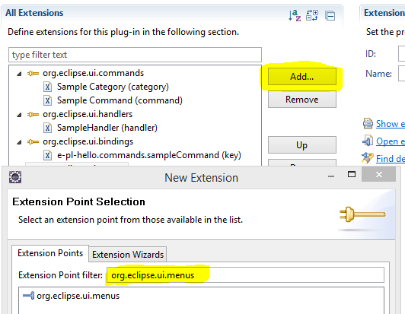
II 3. ToolBars (Menu ToolBars)
Add extension Menus if not exists.

Slide 24
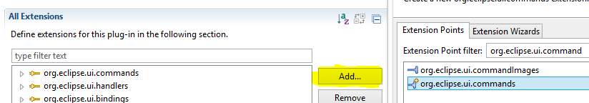
II 3. ToolBar (Menu ToolBars)
Add new Command Handler for toolbar
-- Add Command

Slide 25
II 3. ToolBar (Menu ToolBars)
Add new Command Handler for toolbar
-- Add Command
<extension
point="org.eclipse.ui.commands">
<category
name="Sample Category"
id="e-pl-hello.commands.category">
</category>
<command
name="Toolbar Command"
categoryId="e-pl-hello.commands.category"
id="e-pl-hello.commands.toolbarCommand">
</command>

Slide 26
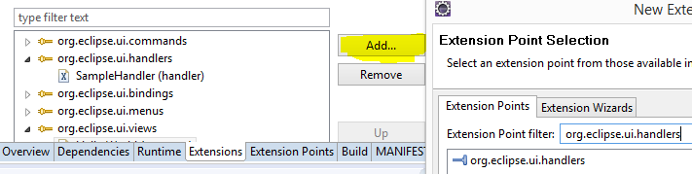
II 3. ToolBar (Menu ToolBars)
Add new Command Handler for toolbar
-- Add Handler

Slide 27
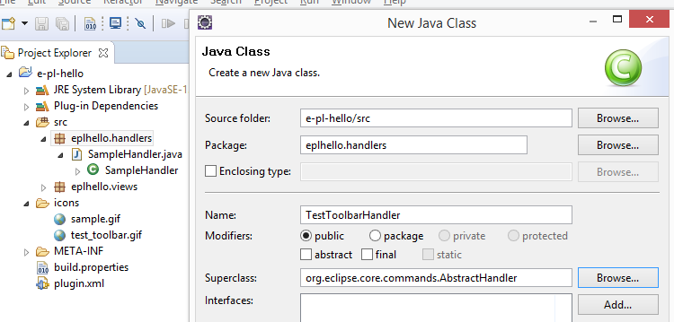
II 3. ToolBar (Menu ToolBars)
Add new Command Handler for toolbar
-- Add Handler

Slide 28
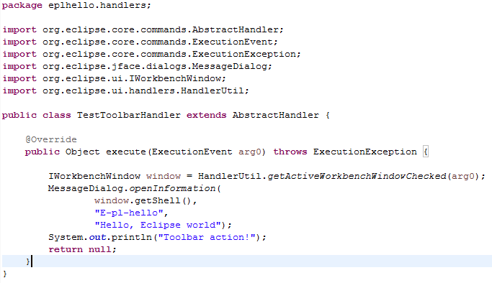
II 3. ToolBar (Menu ToolBars)
Add new Command Handler for toolbar
-- Add Handler

Slide 29
II 3. ToolBar (Menu ToolBars)
Add new Command Handler for toolbar
-- Add Handler
<extension
point="org.eclipse.ui.handlers">
<handler
commandId="e-pl-hello.commands.toolbarCommand"
class="eplhello.handlers.TestToolbarHandler">
</handler>

Slide 30
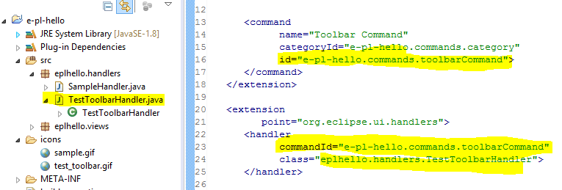
II 3. ToolBar (Menu ToolBars)
Add new Command Handler for toolbar
-- Add Handler

Slide 31
II 3. ToolBar (Menu ToolBars)
Add Menu ToolBars in plugin.xml
<extension
point="org.eclipse.ui.menus">
<menuContribution
locationURI="toolbar:org.eclipse.ui.main.toolbar?after=additions">
<toolbar
id="e-pl-hello.toolbars.helloToolbar">
<command
commandId="e-pl-hello.commands.toolbarCommand"
icon="icons/test_toolbar.gif"
tooltip="Say hello world"
id="e-pl-hello.toolbars.toolbarCommand">
</command>
</toolbar>
</menuContribution>

Slide 32
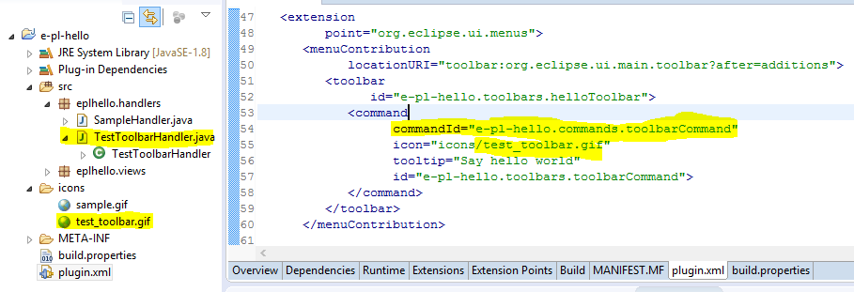
II 3. ToolBar (Menu ToolBars)
Add Menu ToolBars in plugin.xml

Slide 33
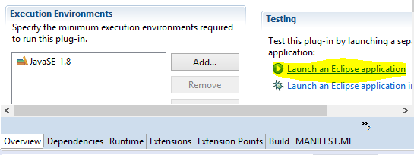
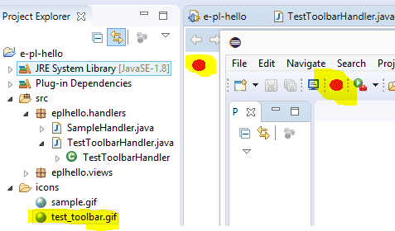
II 3. ToolBar (Menu ToolBars)
Run plugin:

Slide 34
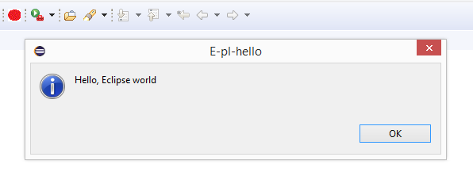
II 3. ToolBar (Menu ToolBars)
Run plugin:
Click:

Slide 35
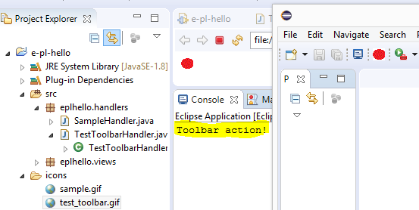
II 3. ToolBar (Menu ToolBars)
Run plugin:
Click OK:

Slide 36
II 4. Preferences
Eclipse Preference basics
http://www.eclipse.org/articles/article.php?file=Article-Preferences/article.html
http://www.vogella.com/tutorials/EclipsePreferences/article.html
The Eclipse platform supports preferences for persisting data between application restarts. Preferences are stored as key / value pairs. The key is an arbitrary String. The value can be a boolean, String, int or another primitive type

Slide 37
II 4. Preferences
Storage of the preferences
http://www.eclipse.org/articles/article.php?file=Article-Preferences/article.html
http://www.vogella.com/tutorials/EclipsePreferences/article.html
Eclipse stores the preferences in the workspace of your application in the .metadata/.plugins/org.eclipse.core.runtime/.settings/directory in the <nodePath>.prefs file.

Slide 38
II 4. Preferences
Get value Storage of the preferences
http://www.eclipse.org/articles/article.php?file=Article-Preferences/article.html
http://www.vogella.com/tutorials/EclipsePreferences/article.html
// We access the instanceScope
Preferences preferences = InstanceScope.INSTANCE
.getNode("com.eclipse.preferences.test");
Preferences sub1 = preferences.node("node1");
Preferences sub2 = preferences.node("node2");
sub1.put("h1", "Hello");
sub1.put("h2", "Hello1");
sub2.put("h1", "Hello2");
try {
// forces the application to save the preferences
preferences.flush();
} catch (BackingStoreException e) {
e.printStackTrace();
}
}

Slide 39
II 4. Preferences
Access Preferences in different plug-ins
http://www.eclipse.org/articles/article.php?file=Article-Preferences/article.html
http://www.vogella.com/tutorials/EclipsePreferences/article.html
You can access preferences in other plug-ins via the PreferenceService service.
String text = Platform.getPreferencesService().getString("org.eclipse.core.resources", "version", "", null);

Slide 40
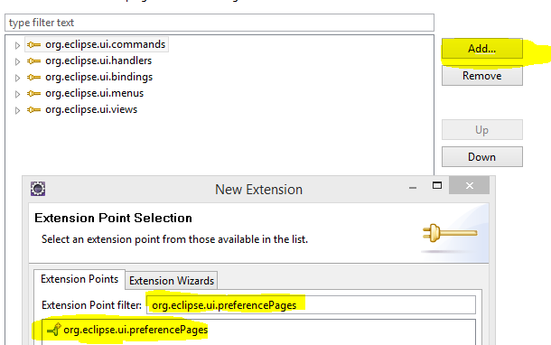
II 4. Preferences
Add Preferences
http://www.eclipse.org/articles/article.php?file=Article-Preferences/article.html
http://www.vogella.com/tutorials/EclipsePreferences/article.html

Slide 41
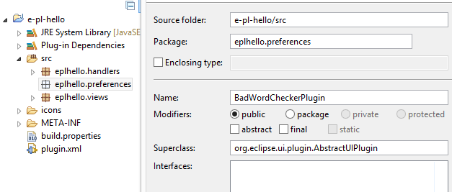
II 4. Preferences
Add Preferences
http://www.eclipse.org/articles/article.php?file=Article-Preferences/article.html

Slide 42
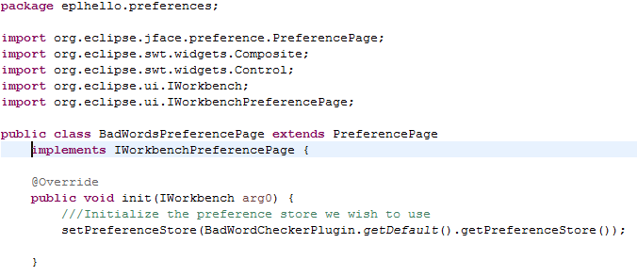
II 4. Preferences
Add Preferences
http://www.eclipse.org/articles/article.php?file=Article-Preferences/article.html

Slide 43
II 4. Preferences
Defining Preference Pages in plugin.xml
http://www.eclipse.org/articles/article.php?file=Article-Preferences/article.html
<extension point="org.eclipse.ui.preferencePages“ >
<page id="BadWordsPreferencePage"
name="Bad Words"
class="eplhello.preferences.BadWordsPreferencePage">
</page>
<page id="BadWordsColorPreferencePage"
name="Colors"
class="eplhello.preferences.BadWordsColorPreferencePage"
category="BadWordsPreferencePage">
</page>
</extension>

