Slide 1

Angular2
Getting Start
Author:
TU Tran
Skype: tranthanhtu83

Slide 2

Scope of video
Understand how the angular app look like
Create and navigate between pages
Get data form remote source and display on UI
TU Tran

Slide 3
Resources
Sample code: https://github.com/thanhtuit27/angular2_gettingstart
Angular: https://angular.io/
Visual code: https://code.visualstudio.com
Slides: http://www.slideshare.net/TuTran10/angular2-getstart-62750184
TU Tran

Slide 4
Angular 2
Overview
Config & bootstrap Angular
Route & component
Data binding
Service & REST (Http)
Common directive & pipes
TU Tran

Slide 5
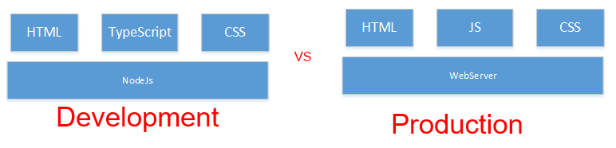
Overview
TU Tran

Slide 6
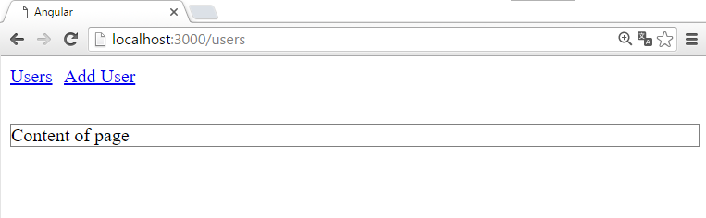
Config & bootstrap Angular
TU Tran

Slide 7
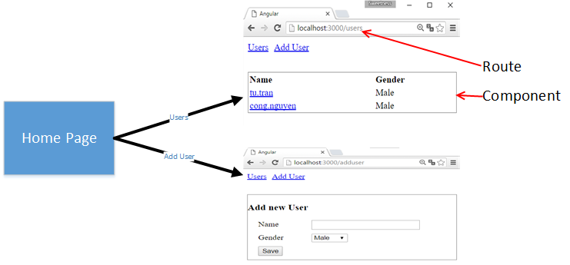
Route & Component
TU Tran
Notes:
Route with param

Slide 8
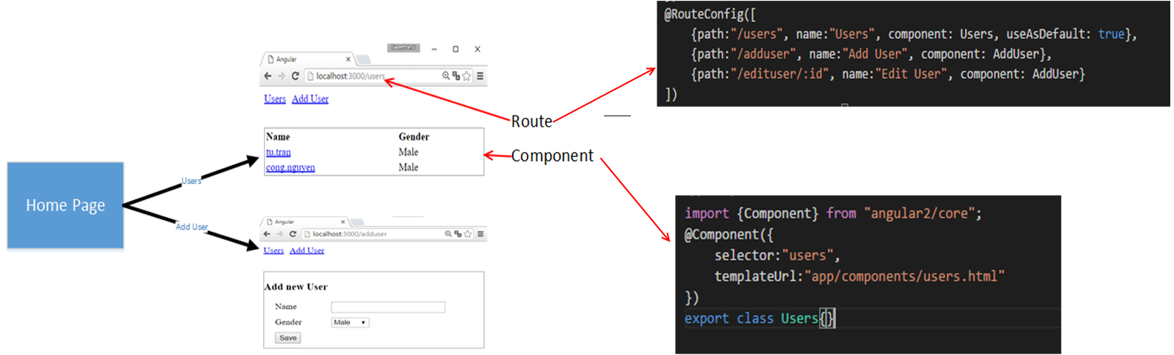
Route & Component
TU Tran
Notes:
Route with param

Slide 9
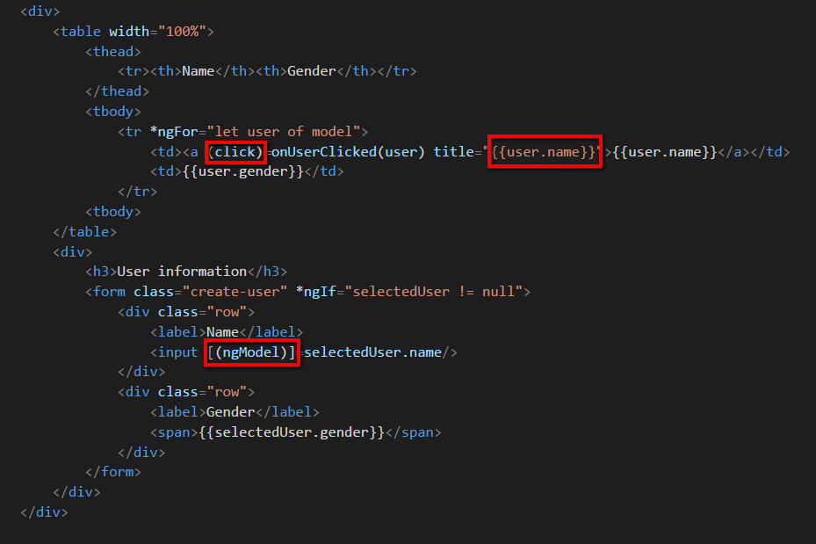
Data binding
TU Tran

Slide 10
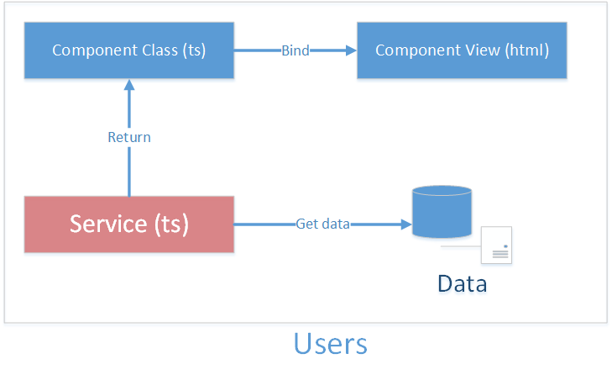
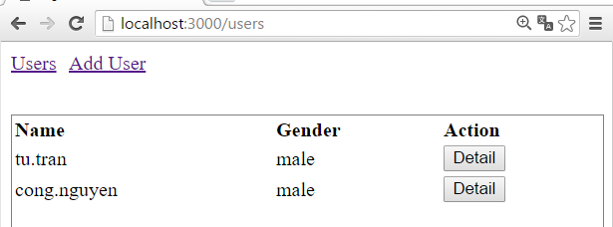
Service
TU Tran

Slide 11
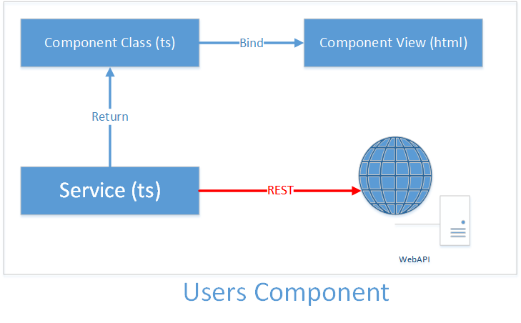
HTTP
TU Tran

Slide 12
Directive
Component Directive
Attribute Directive
Structural Directive
TU Tran

Slide 13
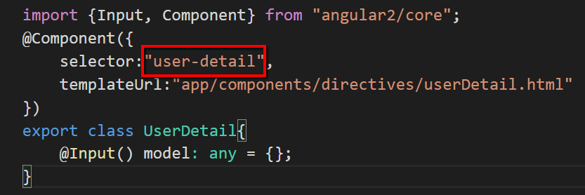
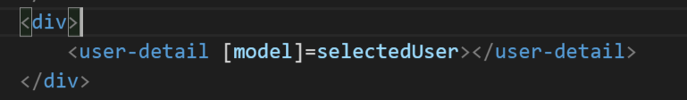
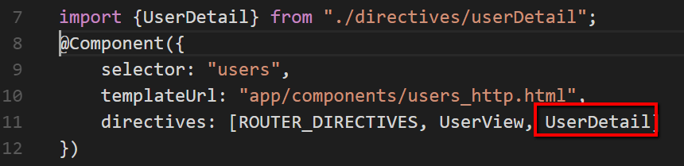
Component Directive
TU Tran

Slide 14
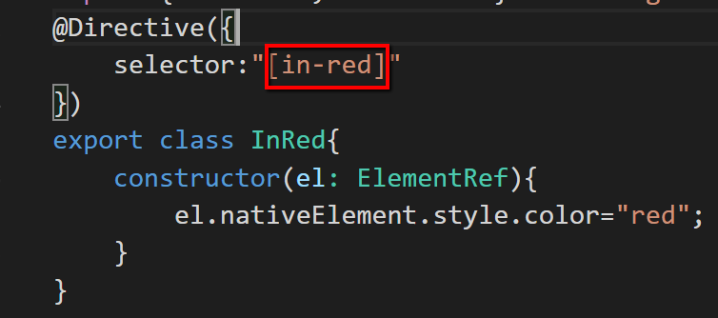
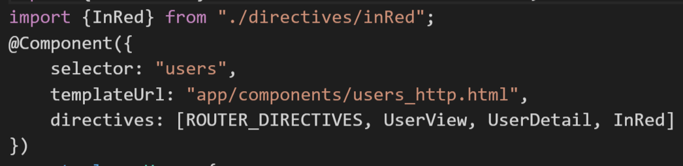
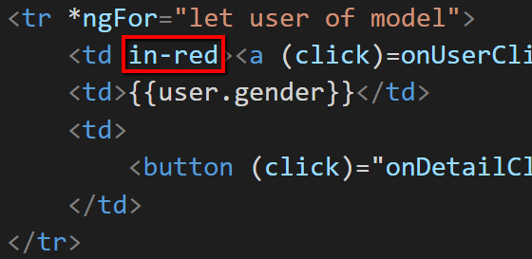
Attribute Directive
TU Tran

Slide 15
Structural Directive
A Structural directive changes the DOM layout by adding and removing DOM elements. We've seen three of the built-in structural directives in other chapters: ngIf, ngSwitch and ngFor.
TU Tran

Slide 16
Thank You
TU Tran

