Slide 1

Angular2
Getting Start
Author:
TU Tran
Skype: tranthanhtu83

Slide 2

Resources
Sample code: https://github.com/thanhtuit27/angular2_gettingstart
Angular: https://angular.io/
Visual code: https://code.visualstudio.com
Slides: http://www.slideshare.net/TuTran10/angular2-getstart-62750184
TU Tran

Slide 3
Angular 2
Overview
Config & bootstrap Angular
Route & component
Data binding
Service & REST (Http)
Common directive & pipes
TU Tran

Slide 4
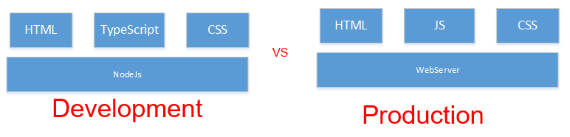
Overview
TU Tran

Slide 5
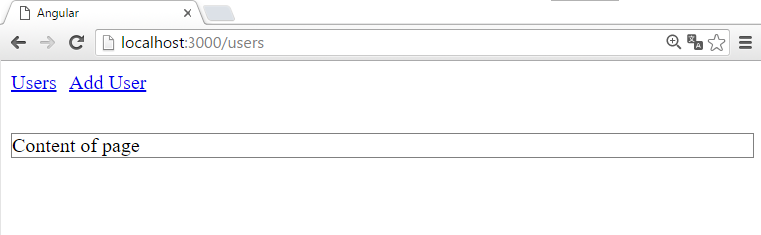
Config & bootstrap Angular
TU Tran

Slide 6
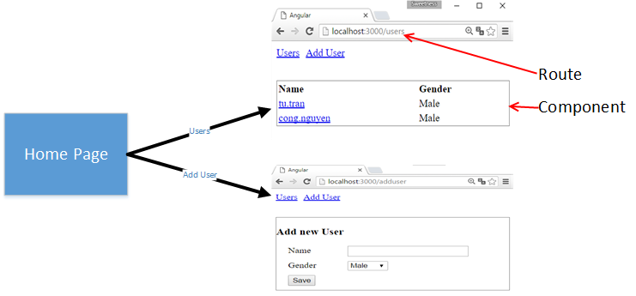
Route & Component
TU Tran
Notes:
Route with param

Slide 7
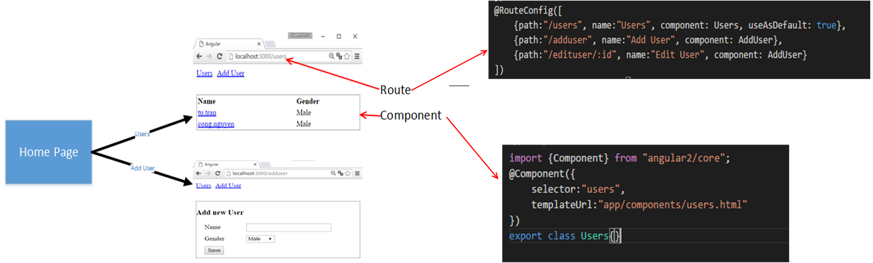
Route & Component
TU Tran
Notes:
Route with param

Slide 8
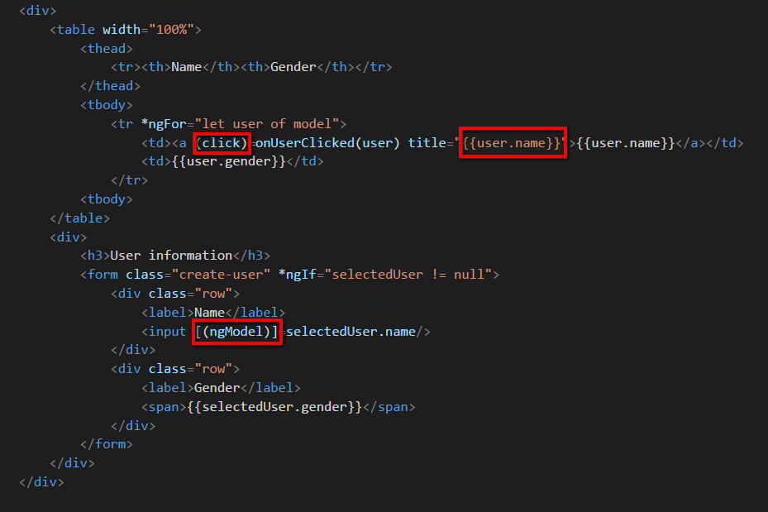
Data binding
TU Tran

Slide 9
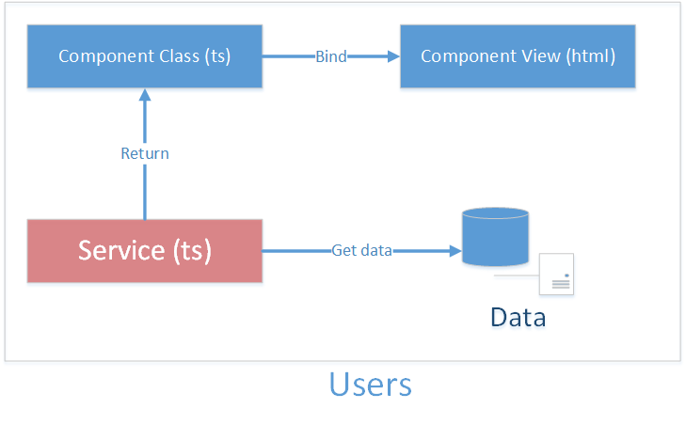
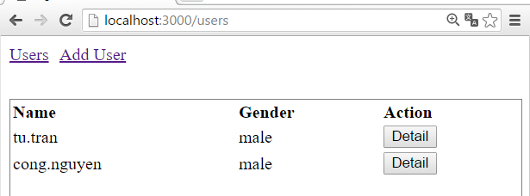
Service
TU Tran

Slide 10
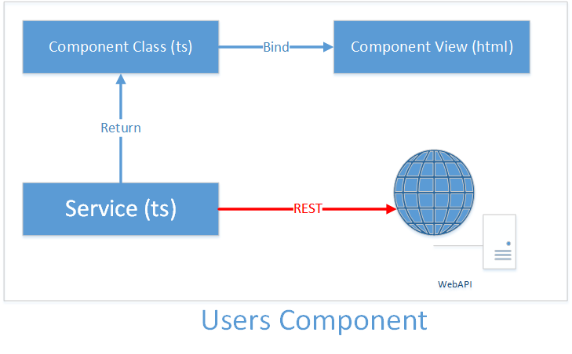
HTTP
TU Tran

Slide 11
Directive
Component Directive
Attribute Directive
Structural Directive
TU Tran

Slide 12
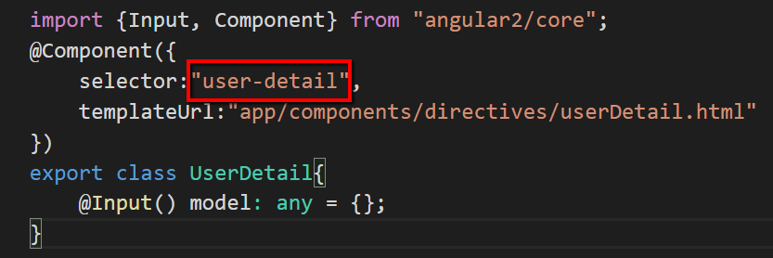
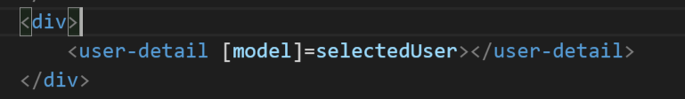
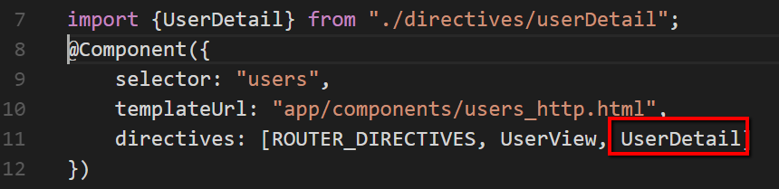
Component Directive
TU Tran

Slide 13
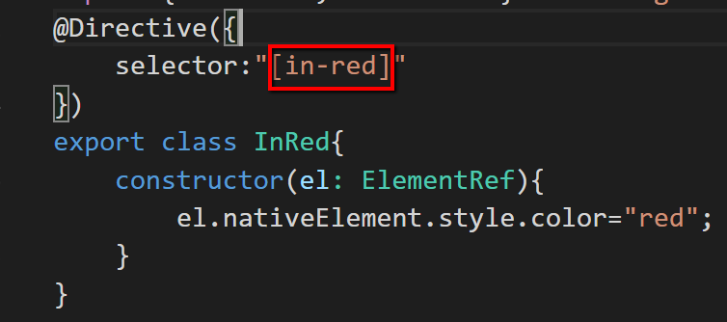
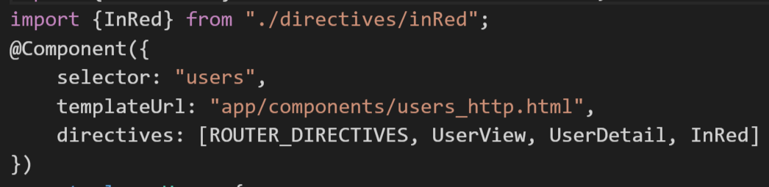
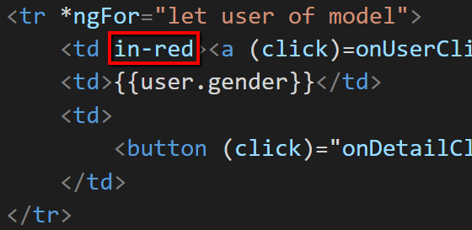
Attribute Directive
TU Tran

Slide 14
Structural Directive
A Structural directive changes the DOM layout by adding and removing DOM elements. We've seen three of the built-in structural directives in other chapters: ngIf, ngSwitch and ngFor.
TU Tran

Slide 15
Thank You
TU Tran

