Slide 1
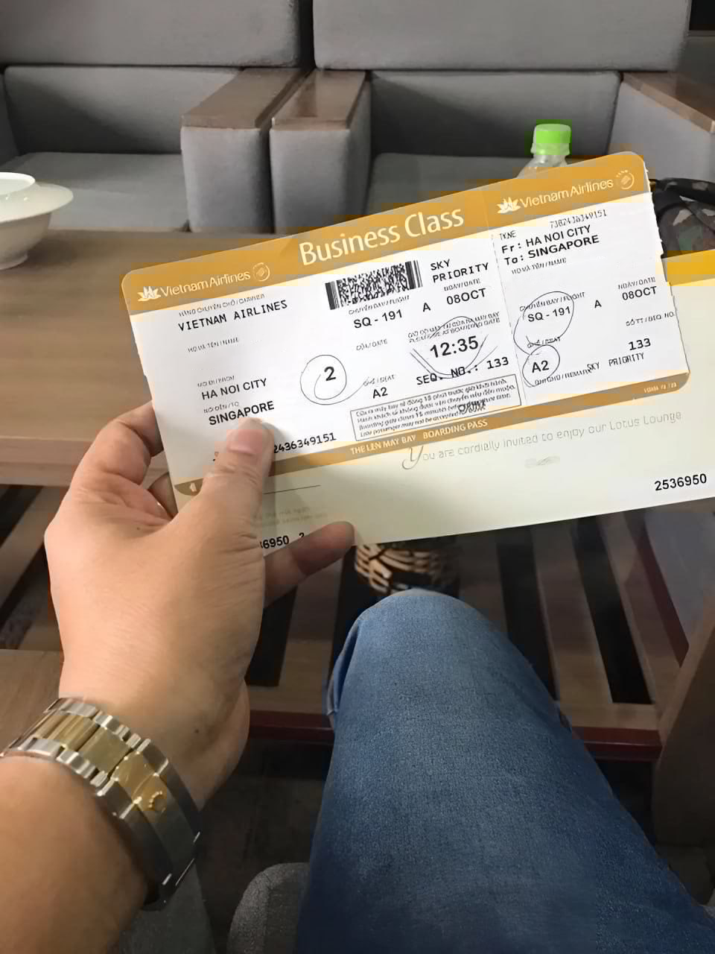
PHILONG/HO MR
PHILONG/HO MR

