Slide 1
MPP Project Presentation
LIBRARY MANAGEMENT
APPLICATION
615718 - Thanh Tung Le
615684 - Dang Tu Nguyen
615724 - Thanh Dung Nguyen

Slide 2
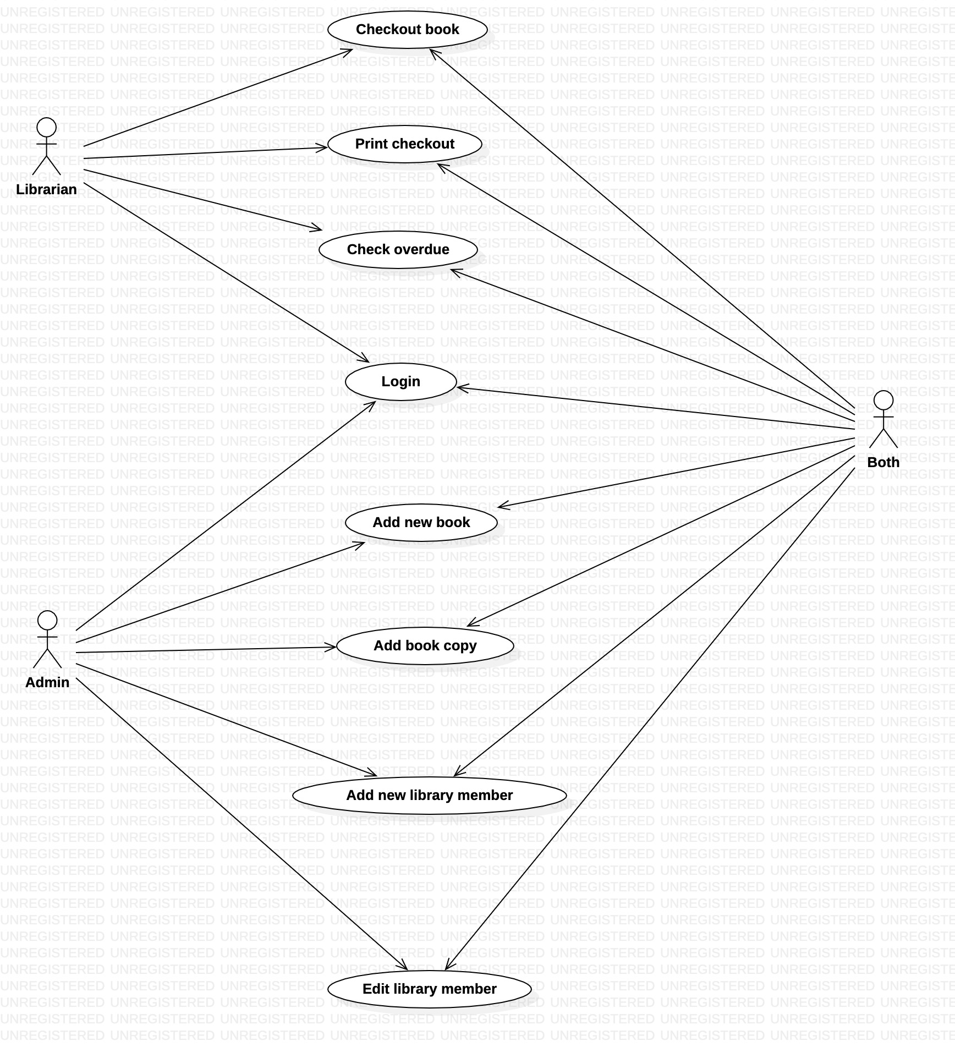
Use
Case
Diagram

Slide 3
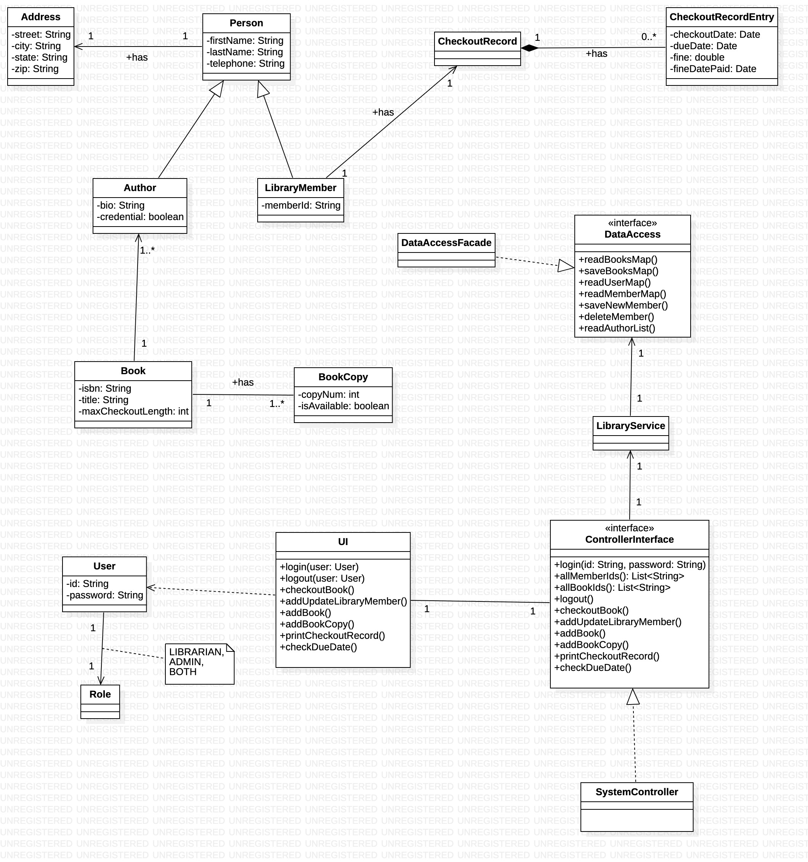
Class
Diagram

Slide 4
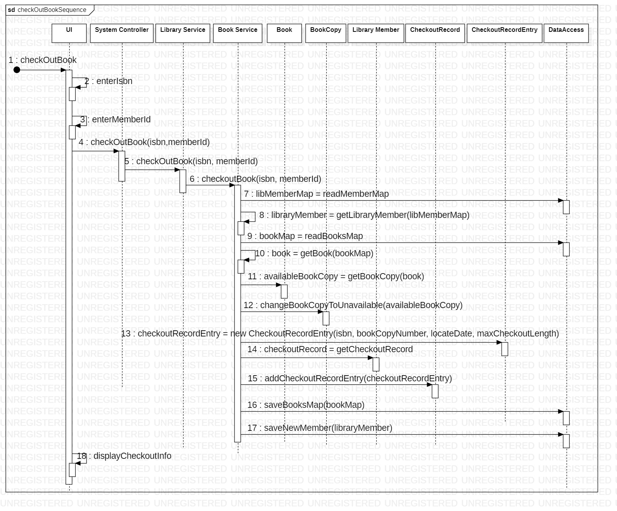
Sequence Diagram
– Checkout Book

Slide 5
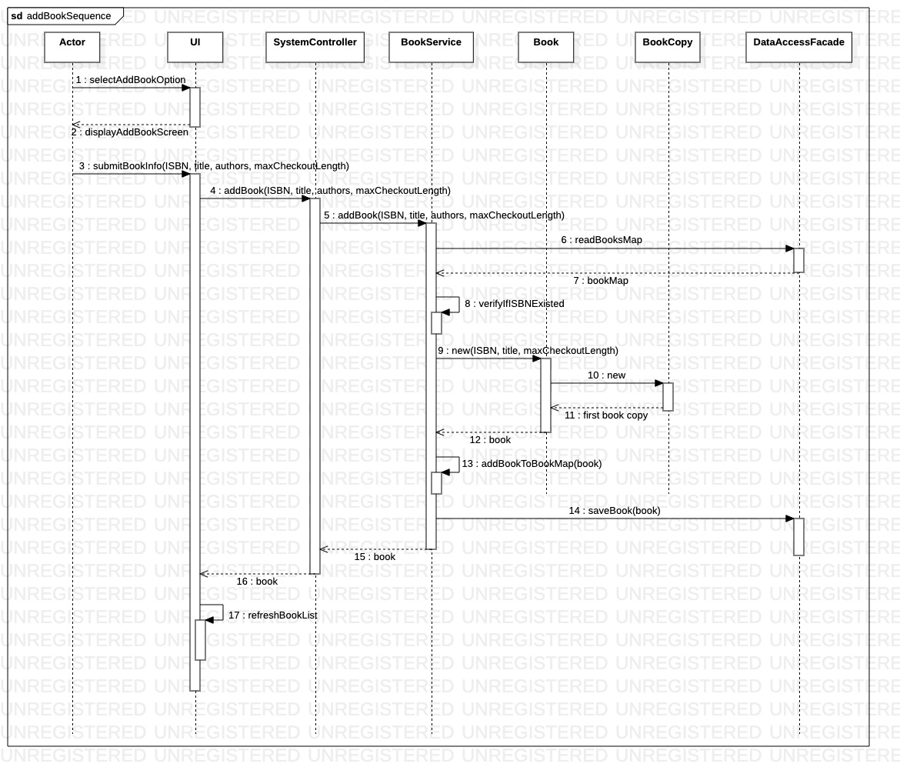
Sequence Diagram
–
Add Book

Slide 6
Validation Rules
ISBN: xx-xxxxx
Member ID: Number
Telephone Number: Number
First Name, Last Name: No empty, alphabet characters
Address
  Street: No empty
  City: No empty
  State: No empty
  Zip Code: No empty, 5-digits number

Slide 7
Connecting the Parts of Knowledge
With the Wholeness of Knowledge
My team is made up of different individuals with different strengths and personalities. But we have a strong bond and work together towards the common goal that is the final product of the project. It is the result of the practice of solidarity.
Likewise, a direct experience of the underlying reality of all manifest creation and our relationship with all of nature is a result of our practice of Transcendental Meditation.

Slide 8
Thank You

