Slide 1

Translation machine with Transformer
KOREAN - VIETNAMESE

Slide 2





Define the Problem
problem
problem
Overseas students in Korea

Slide 3
Define the Problem
Currently, the number of Vietnamese people learning and studying Korean is increasing at a breakneck speed.
When learning Korean, they often encounter Korean, especially Korean for daily activities and TOPIK Korean proficiency test.

Slide 4




Define the Problem
translate
translate

Slide 5
Define the Problem
Whenever difficult or incomprehensible Korean sentences appear, they often use translation software such as Google Translate or Papago.
Google Translate and Papago are two translation software that produce very good results and are used a lot by Vietnamese people.

Slide 6






Define the Problem
translate
translate

Slide 7
Define the Problem
Especially when translating sentences appearing in the topik test, because the Korean language proficiency test contains many complex sentences in terms of grammar and vocabulary, there are many cases in which the two machine translation software above produce The results are not good.
We translated on real data and the results were quite low, only less than 65% of the results were understandable.

Slide 8















Problem solving
Translate machine

Slide 9







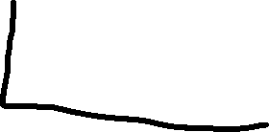



Implementation Steps
Data collect
Data preprocessing
Pretrain&Finetune
Deploy model

Slide 10
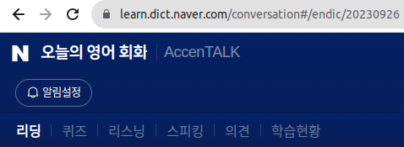








Data collect
2 students
Korean language major
Read
Crawl Data
Translate

Slide 11
Data Preprocessing
There is not much need to process at this stage because the data is quite clean.
Simple steps will be done using regex.

Slide 12
Data collect
Our plan is to collect 13,722 data pairs of Korean-Vietnamese sentences
3650 data were crawled from 'Naver 오늘의 영어 회화' from 2017/12/31~2023/08/31, this is a proven data source of very good quality and extremely clean.
4725 data focus on vocabulary that appears in Topik exam questions.
2004 data focus on gramma that appears in daily korean language.
The remaining 3343 data were taken from all published exam questions and translated by me and 2 students majoring in Korean language.

Slide 13

Pretrain&Finetune
After research, we decided to use the model facebook/m2m100_418M which is provided by facebook and can be loaded directly on Hugging Face.
We decided to use this model because it fits our goals and especially with the problem we encountered of low resources.
Some other reasons for us to choose model m2m100_418M is because after my model has a relatively light output of about 1.8gb and the results are better than other models like bart, mt5 and so on.

Slide 14








Evaluate
Evaluate
1000 pairs of sentences

Slide 15
Evaluate
We will evaluate the above dataset using the trained data and 1000 sentences from other sources such as topik textbooks in schools, sentences appearing on 'Naver 오늘의 영어 회화' appearing after 2023/10/01 ,...
Why use trained data for evaluation?
The reason is very simple, most people who review to prepare for the Topik exam practice using the published Topik exam questions, and what they need is to translate the sentences that appear in these Topik exam questions!
After training, we verified with BLEU score of 55 points and bert-score of 0.94. This is an acceptable result.

Slide 16





Deploy and Users
Groups in Facebook
Korean language center in Viet Nam
Korean language Extra class

Slide 17
Deploy and Users
After deploying the model, as mentioned above, the need for Korean-Vietnamese translation is huge and we can find the above users anywhere as long as the model works well.
The most potential places are Korean language learning groups on Facebook, followed by Korean language teaching centers and finally Korean language extra classes.

Slide 18
The model will be run for 1 week to collect data from users and analyze.

Slide 19
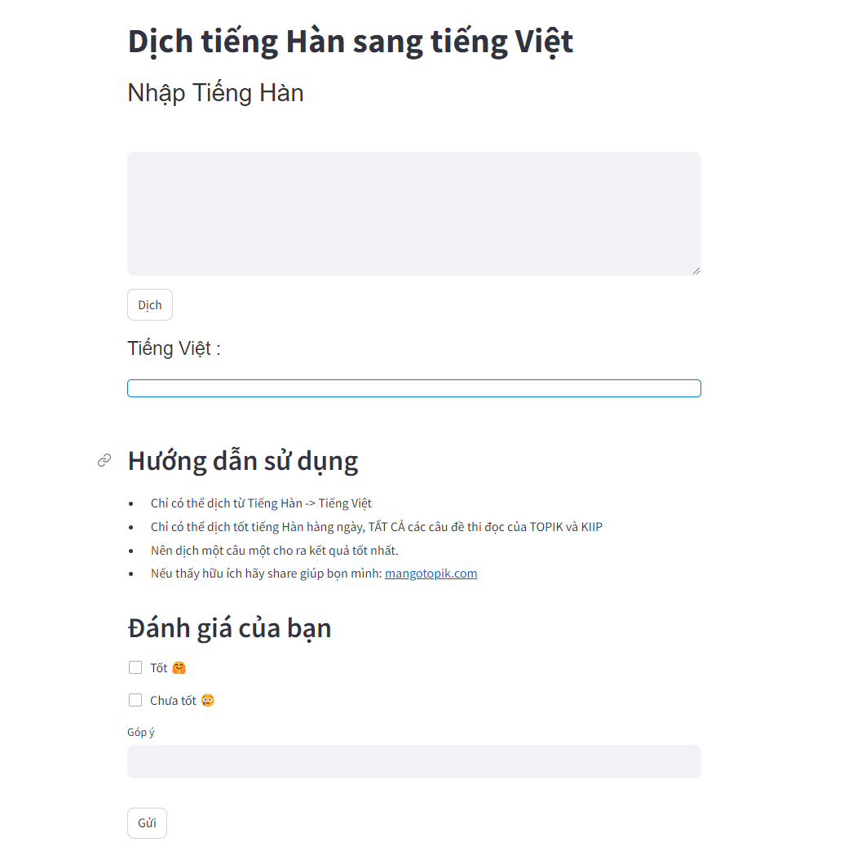
Website after deploy

