Slide 1
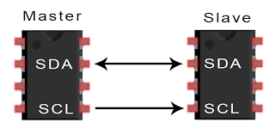
ECE 560 Assertion Based Verification
VERIFICATION OF THE I2C COMMUNICATION PROTOCOL
Kumar Durga Manohar Karna Nivedita Boyina Srikar Varma Datla Pooja Satpute
Electrical and Computer Engineering Department Maseeh College of Engineering and Computer Science

Slide 2
Contents
Introduction
I2C communication protocol
Bit Field Mapping for I2C
START and STOP conditions in I2C
Timing Diagrams
Block Diagram of Implemented Design
Dynamic Simulation Results
Formal Verification using AEP and FXP apps
Assertions & Assumptions for I2C master and I2C slave
Challenges
Team Contributions & Conclusion
References

Slide 3
Introduction
Project Overview: This project focuses on verifying the functionality of the I2C (Inter Integrated Circuit) communication protocol using assertion-based techniques in SystemVerilog. I2C is widely used for low-speed, short distance communication between integrated circuits in embedded systems.
Objective: To implement assertion-based verification of the I2C communication protocol using SystemVerilog, ensuring correct data transfer, timing, and error handling between master and slave devices.
Tools Used: Siemens – Mentor Questa Synopsys-VC Formal EDA Playground

Slide 4
I2C Communication Protocol
I2C (Inter-Integrated Circuit) is a two-wire serial communication protocol used in embedded systems that supports short distance communications with bitwise data transfer.
I2C follows Master-Slave hierarchy and uses only two wires to transfer date between the devices.
SDA (Serial Data) – The line for the master and Slave to send and receive data(bidirectional).
SCL (Serial Clock) – The line that carries the clock signal to synchronize data transfer between devices on the bus.
I2C assists data transfer between multiple master and multiple slave devices.

Slide 5
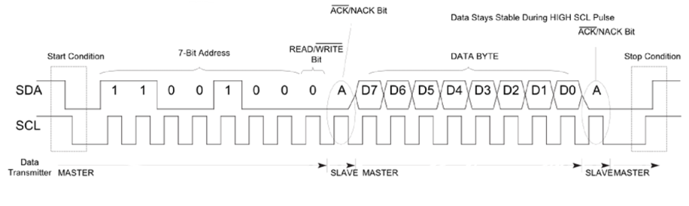
Bit Field Mapping for I2C
Address bits : A 7-bit sequence used to uniquely identify a slave device on the I2C bus.
Read/Write bits: A bit sent by the Master device is sending or requesting data from slave
ACK/NACK bits : A bit sent by the receiver to confirm the successful data transfer
Data bits : An 8-bi sequence carrying data transmitting between master and slave devices

Slide 6
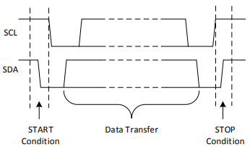
START and STOP conditions in I2C
START Condition -The SDA line switches from a high voltage level to a low voltage level before the SCL line switches from high to low.
STOP Condition - The SDA line switches from a low voltage level to a high voltage level after the SCL line switches from low to high.

Slide 7
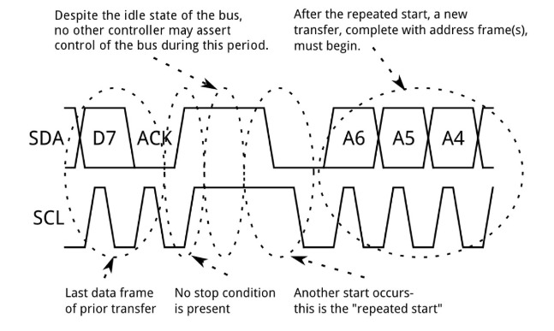
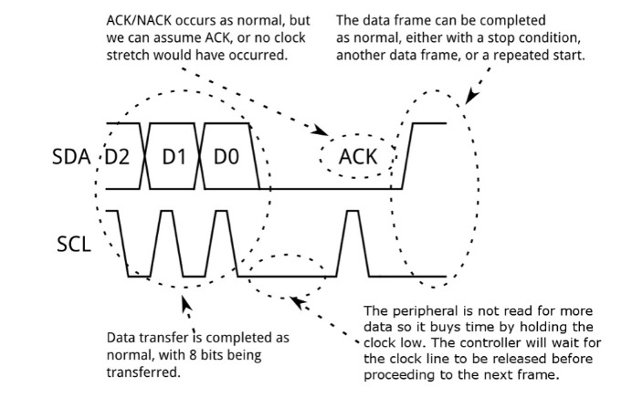
Timing Diagrams of I2C

Slide 8
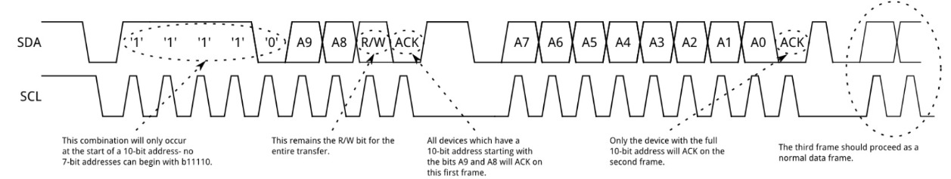
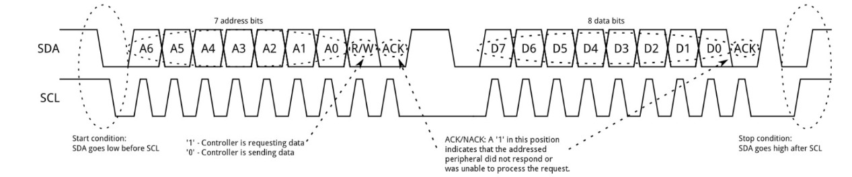
Timing Diagrams of I2C

Slide 9
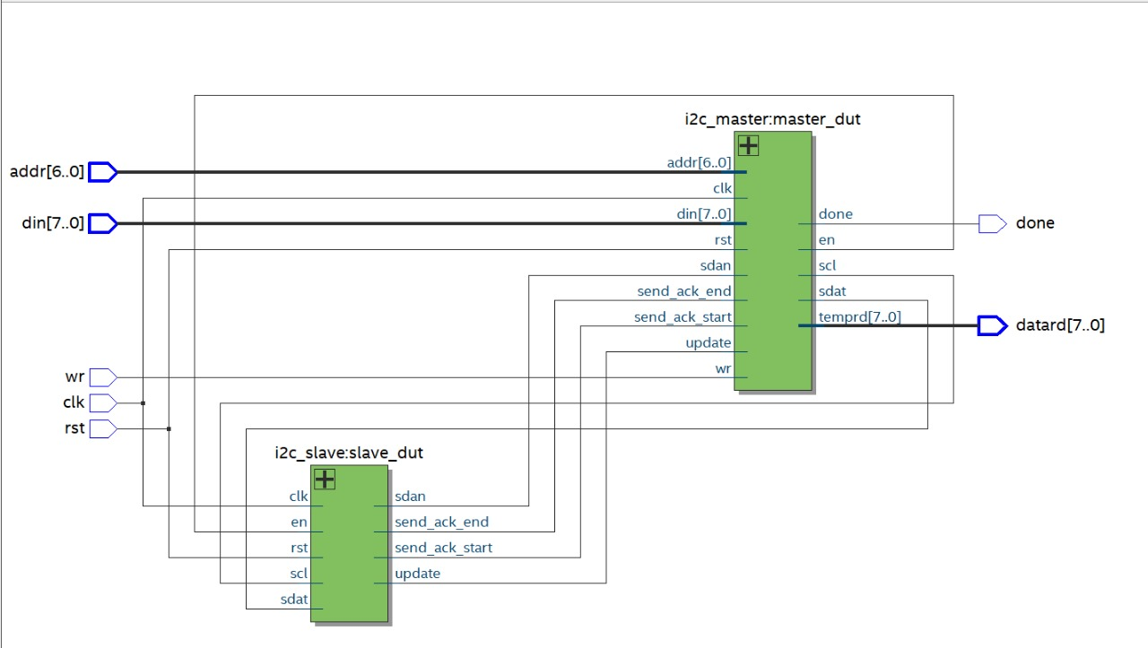
Block Diagram

Slide 10
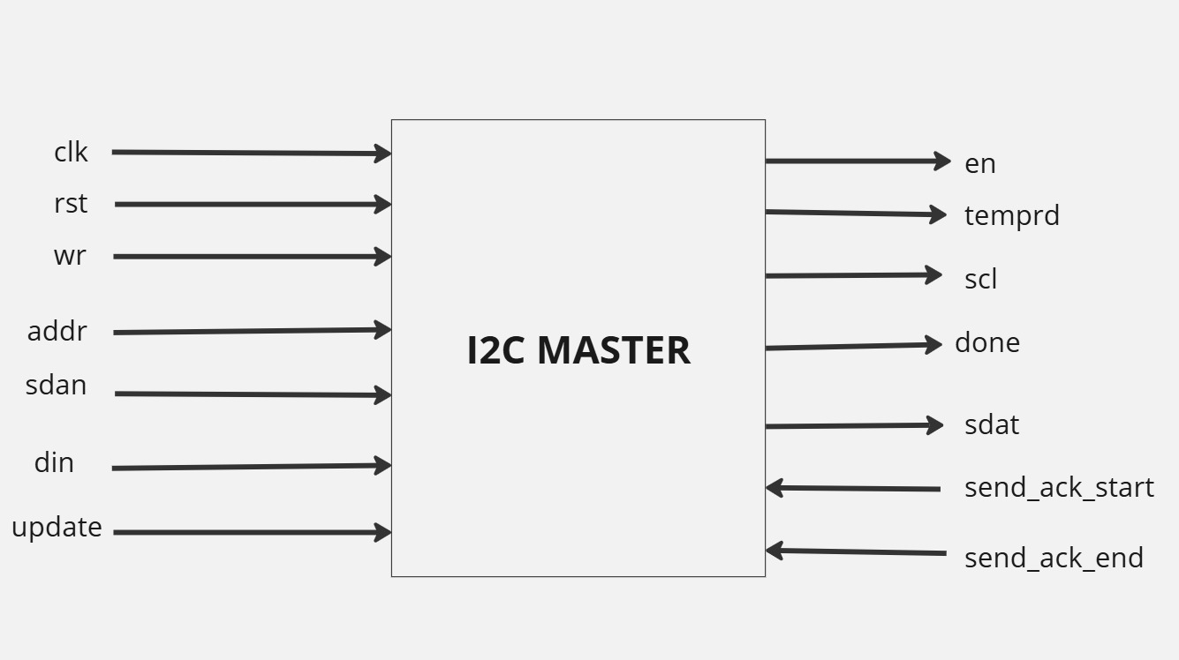
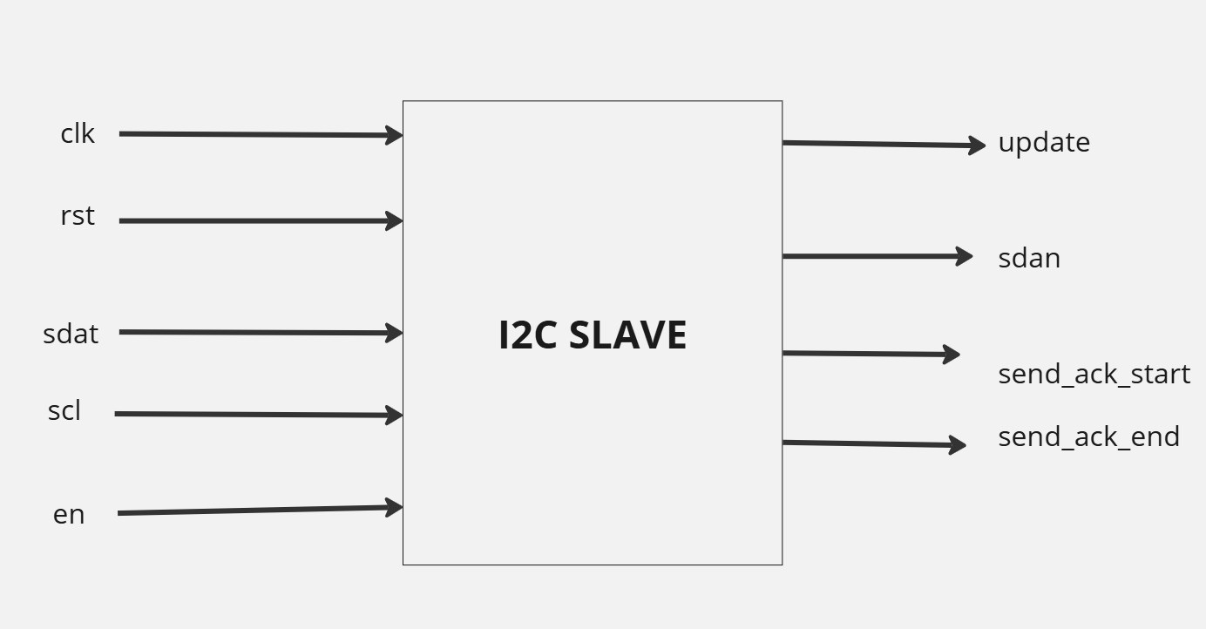
Block Diagram

Slide 11
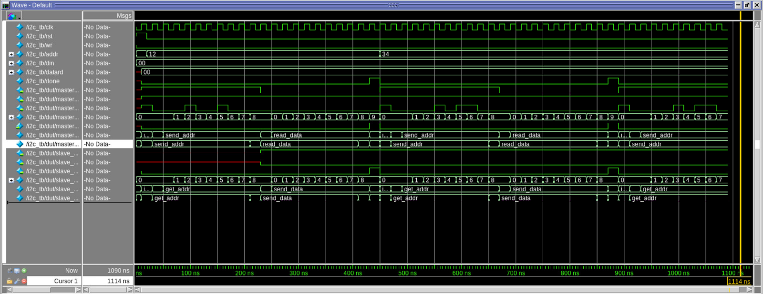
Dynamic Simulation Results
Fig: I2C read operation waveform

Slide 12
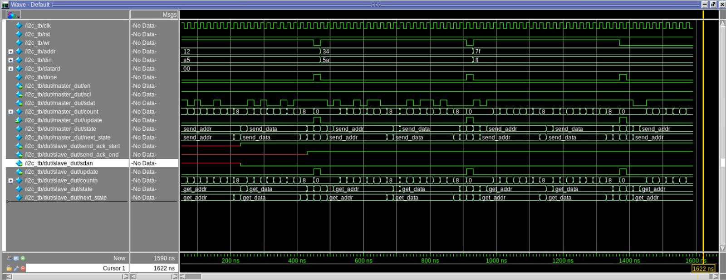
Dynamic Simulation Results
Fig: I2C write operation waveform

Slide 13
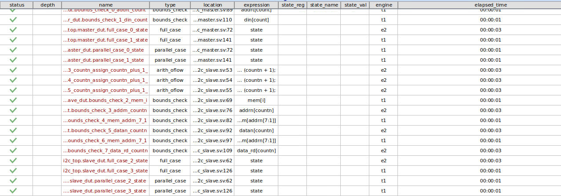
Formal Verification with AEP app

Slide 14
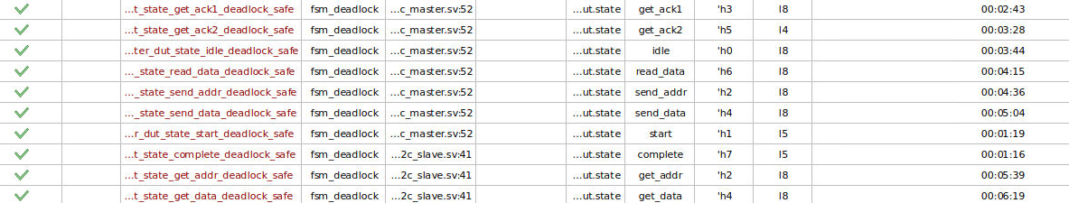
Formal Verification with AEP app

Slide 15
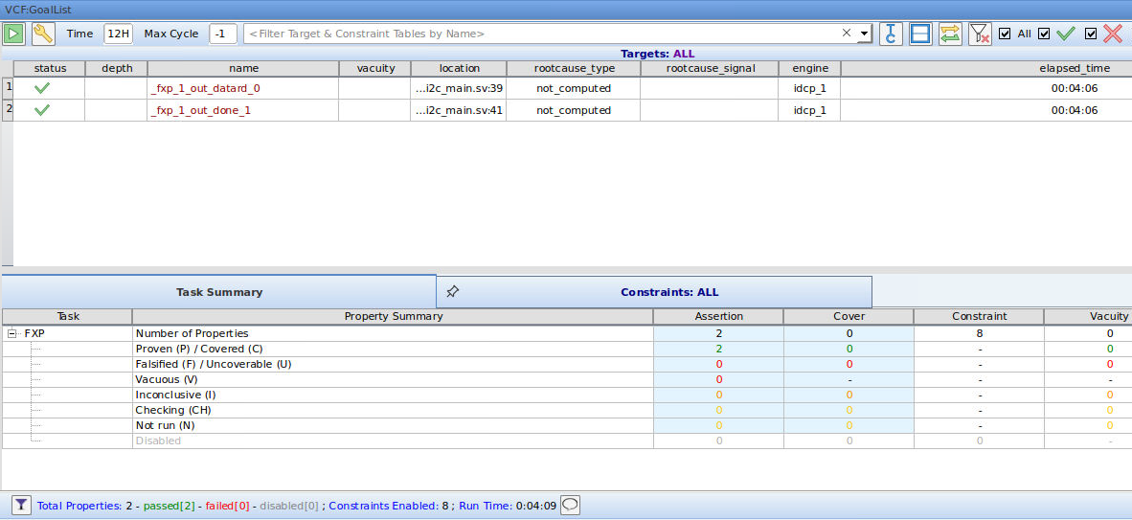
Formal Verification with FXP app

Slide 16
Assertions for I2C master
PROPERTY | DESCRIPTION
P1 | Ensures transition from idle to start for proper protocol initiation.
P2 | Verifies transition from start to send_addr after the start condition.
P3 | Confirms transition from send_addr to get_ack1 after address transmission.
P4 | Ensures state remains send_addr until address transmission completes.
P5 | Verifies transition from get_ack1 to send_data for a write operation.
P6 | Verifies transition from get_ack1 to read_data for a read operation.
P7 | Ensures transition from send_data to get_ack2 after data transmission.
P8 | Confirms state remains send_data until all data is transmitted.
P9 | Verifies transition from get_ack2 to complete after acknowledgment.
P10 | Ensures state remains get_ack2 if acknowledgment is not received.
P11 | Confirms transition from read_data to complete after data read.
P12 | Ensures state remains read_data until all data is read.
P13 | Verifies transition from complete to idle when update is high.
P14 | Ensures state remains complete until the update signal is high.
p15 | Confirms the sdat line is high in the idle state.

Slide 17
Assertions for I2C slave
PROPERTY | DESCRIPTION
P1 | Ensures transition from idle to start for proper protocol initiation.
P2 | Ensures transition from start to get_addr when a start condition is detected.
P3 | Ensures the state remains get_addr while the address bits are being received (count ≤ 7).
P4 | Ensures transition from get_addr to send_ack1 after all address bits are received (count > 7).
P5 | Ensures transition from send_ack1 to get_data when enabled (en signal is high).
P6 | Ensures transition from send_ack1 to send_data when disabled (en signal is low).
P7 | Ensures transition from get_data to send_ack2 after all data bits are received (count > 7).
P8 | Ensures transition from send_ack2 to complete after sending the acknowledgment.
P9 | Ensures the state remains send_data while data bits are being sent (count ≤ 7).
P10 | Ensures transition from send_data to complete after all data bits are sent (count > 7).
P11 | Ensures transition from complete to idle for resetting the transaction.
P12 | Ensures the update signal is active only when the slave is in the complete state.

Slide 18
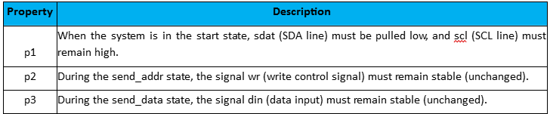
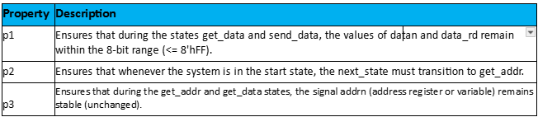
Assumptions for I2C Master and Slave
Assumptions for I2C master
Assumptions for I2C Slave

Slide 19
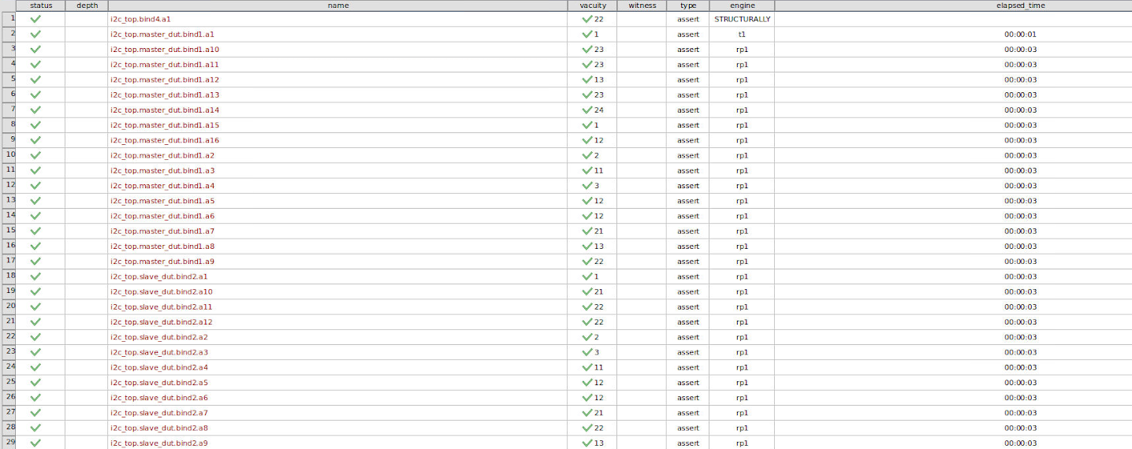
Assertions for I2C Master and Slave
All the assertions passed successfully

Slide 20
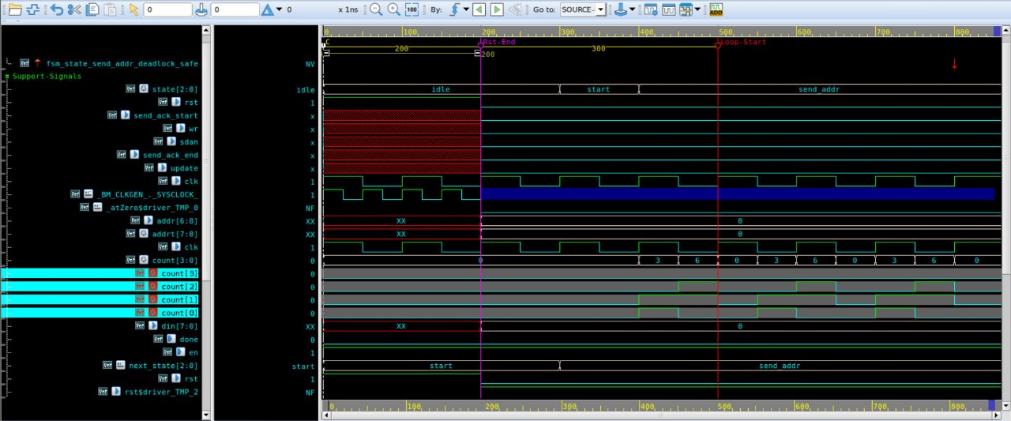
Bug injection and its root cause
Count updates inside the combinational block In the send_addr state, the assignment count = count + 4’b0001, is performed in a combinational block. Then uncontrolled loops occurred in send_addr of master and get_addr of slave.
CEX traces in I2C master

Slide 21
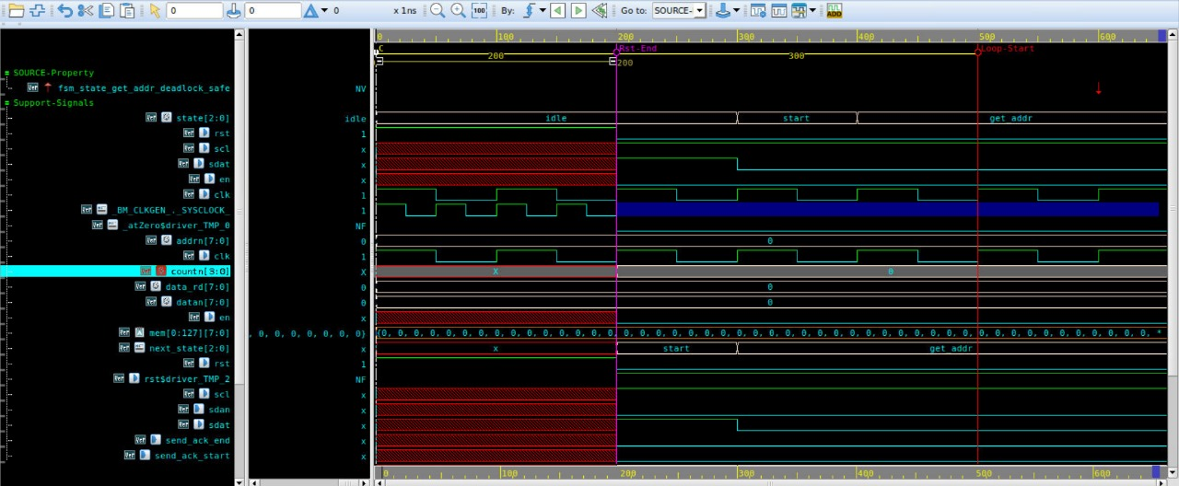
Bug injection and its root cause
Count updates inside the combinational block In the send_addr state, the assignment count = count + 4’b0001, is performed in a combinational block. Then uncontrolled loops occurred in send_addr of master and get_addr of slave.
CEX traces in I2C slave

Slide 22
Challenges
Synchronizations Issues Achieving proper coordination between SDA and SCL signals was challenging due to timing mismatches during simulation.
Debugging Assertion Failures Pinpointing the exact cause of assertion failures required analyzing multiple signals and state transitions in detail.
Formal Verification Complexity Managing state explosion and resource constraints during formal verification required optimizing the properties and design hierarchy.
State Transition Errors Validating seamless transitions between states required careful design and debugging.

Slide 23
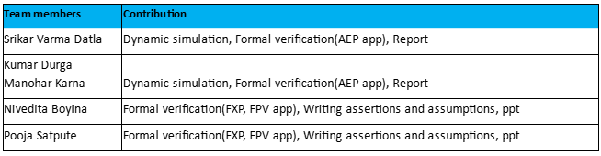
Contribution of Team Members & Conclusion
Conclusion
The project successfully implemented and verified the I2C communication protocol using SystemVerilog. Assertions ensured correctness, formal verification enhanced reliability, and simulations validated functionality, showcasing the robustness of our design for real-world embedded system applications.

Slide 24
References
A Basic Guide to I2C – Texas Instruments https://www.ti.com/lit/pdf/sbaa565#:~:text=I2C%20is%20a%20two%2Dwire,and%20receive%20commands%20and%20data.
I2C Protocol Verification –EDA Playground https://www.edaplayground.com/x/rSCn
CummingsSNUG2016SV_SVA_Best_Practices - http://www.sunburstdesign.com/papers/CummingsSNUG2016SV_SVA_Best_Practices.pdf
Verification Academy – Siemens https://verificationacademy.com/topics/assertions/
ECE 560 Professor Venkatesh Patil Lecture Slides
Mohamed Ghonim Tutorial for Synopsys VC Formal Tutorials
ChatGPT, Perplexity AI

Slide 25
End of Presentation
Thank you!

