Slide 1
Unit 9.
Recursive descent parsing

Slide 2
Characteristics
Used to parse LL(1) language
Can be extended for parsing LL(k) grammars, but algorithms are complicated
Parsing non LL(k) grammars can cause infinite loops

Slide 3
Recursive-descent parsing
A top-down parsing method
The term descent refers to the direction in which the parse tree is traversed (or built).
Use a set of mutually recursive procedures (one procedure for each nonterminal symbol)
  Start the parsing process by calling the procedure that corresponds to the start symbol
  Each production becomes one clause in procedure
We consider a special type of recursive-descent parsing called predictive parsing
  Use a lookahead symbol to decide which production to use

Slide 4
Recursive Descent Parsing
For every BNF rule (production) of the form
<phrase1> → E
the parser defines a function to parse phrase1 whose body is to parse the rule E
void compilePhrase1( )
{ /* parse the rule E */ }
Where E consists of a sequence of non-terminal and terminal symbols
Requires no left recursion in the grammar.

Slide 5
Parsing a rule
A sequence of non-terminal and terminal symbols,
Y₁ Y₂ Y₃ … Y_{n}
is recognized by parsing each symbol in turn
For each non-terminal symbol, Y, call the corresponding parse function compileY
For each terminal symbol, y, call a function
eat(y)
that will check if y is the next symbol in the source program
  The terminal symbols are the token types from the lexical analyzer
  If the variable currentsymbol always contains the next token:
  eat(y):
  if (currentsymbol == y)
  then getNextToken()
  else SyntaxError()

Slide 6
Simple parse function example
Suppose that there was a grammar rule
Prog ::= KW_PROGRAM Ident SB_SEMICOLON Block SB_PERIOD
Then:
void compileProgram(void)
{
eat(KW_PROGRAM);
eat(TK_IDENT);
eat(SB_SEMICOLON);
compileBlock();
eat(SB_PERIOD);
}

Slide 7
Look-Ahead
In general, one non-terminal may have more than one production, so more than one function should be written to parse that non-terminal.
Instead, we insist that we can decide which rule to parse just by looking ahead one symbol in the input
BasicType ::= KW_INTEGER | KW_CHAR
Then compileBasicType can have the form
switch (lookAhead->tokenType) {
case KW_INTEGER:
eat(KW_INTEGER);
break;
case KW_CHAR:
eat(KW_CHAR);
break;
default:
error(ERR_INVALIDBASICTYPE, lookAhead->lineNo, lookAhead->colNo);
break;
}
}

Slide 8
KPL Parser
Can be built using BNF rules or syntax diagrams
Use syntax diagrams: consists of 13 functions, each function for a syntax diagram
Use BNF rules: consist of approximate 50 functions, each function for a variable (non-terminal symbol)

Slide 9
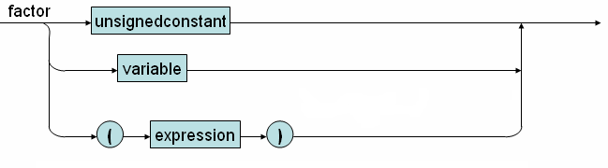
Compile factor function
void compileFactor(void) {
switch (lookAhead->tokenType) {
case TK_NUMBER:
eat(TK_NUMBER);
break;
case TK_CHAR:
eat(TK_CHAR);
break;
case TK_IDENT:
eat(TK_IDENT);
switch (lookAhead->tokenType) {
case SB_LSEL:
compileIndexes();
break;
case SB_LPAR:
compileArguments();
break;
default: break;
}
break;
case SB_LPAR:
eat(SB_LPAR);
compileExpression();
eat(SB_RPAR);
break;
default:
error(ERR_INVALIDFACTOR, lookAhead->lineNo, lookAhead->colNo);
}
}

Slide 10
compileTerm function (Use BNF)
Rules for term
82) Term ::= Factor Term2
83) Term2 ::= SB_TIMES Factor Term2
84) Term2 ::= SB_SLASH Factor Term2
85) Term2 ::= ε

Slide 11
compileTerm and compileTerm2 functions
// check the FOLLOW set
case SB_PLUS:
case SB_MINUS:
case KW_TO:
case KW_DO:
case SB_RPAR:
case SB_COMMA:
case SB_EQ:
case SB_NEQ:
case SB_LE:
case SB_LT:
case SB_GE:
case SB_GT:
case SB_RSEL:
case SB_SEMICOLON:
case KW_END:
case KW_ELSE:
case KW_THEN:
break;
default:
error(ERR_INVALIDTERM, lookAhead->lineNo, lookAhead->colNo);
}
}
void compileTerm(void) {
compileFactor();
compileTerm2();
}
void compileTerm2(void) {
switch (lookAhead->tokenType) {
case SB_TIMES:
eat(SB_TIMES);
compileFactor();
compileTerm2();
break;
case SB_SLASH:
eat(SB_SLASH);
compileFactor();
compileTerm2();
break;

Slide 12
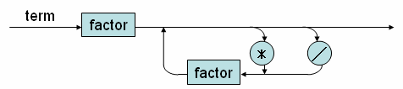
CompileTerm function (Use SD)
void compileTerm(void)
{
compileFactor();
while(lookAhead->tokenType== SB_TIMES || lookAhead->tokenType == SB_SLASH)
{switch (lookAhead->tokenType)
{
case SB_TIMES:
eat(SB_TIMES);
compileFactor();
break;
case SB_SLASH:
eat(SB_SLASH);
break;
}
}
}

Slide 13
Statement
49) Statement ::= AssignSt
50) Statement ::= CallSt
51) Statement ::= GroupSt
52) Statement ::= IfSt
53) Statement ::= WhileSt
54) Statement ::= ForSt
55) Statement ::= ε

Slide 14
compileStatement function (using BNF)
void compileStatement(void) {
switch (lookAhead->tokenType) {
case TK_IDENT:
compileAssignSt();
break;
case KW_CALL:
compileCallSt();
break;
case KW_BEGIN:
compileGroupSt();
break;
case KW_IF:
compileIfSt();
break;
case KW_WHILE:
compileWhileSt();
break;
case KW_FOR:
compileForSt();
break;
// EmptySt needs to check FOLLOW tokens
case SB_SEMICOLON:
case KW_END:
case KW_ELSE:
break;
// Error occurs
default:
error(ERR_INVALIDSTATEMENT, lookAhead->lineNo, lookAhead->colNo);
break;
}
}

Slide 15
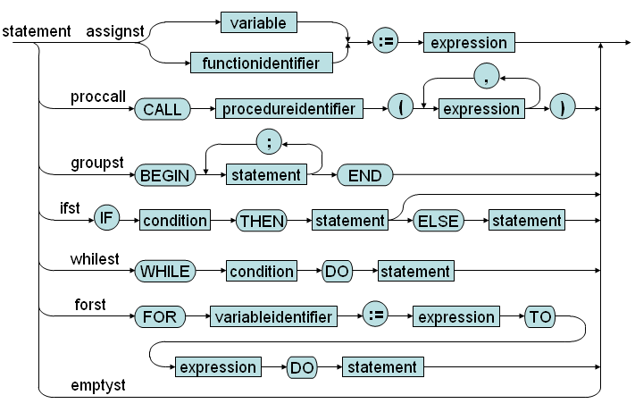
Syntax diagram for statement

Slide 16
compileStatement function (using SD)
void compileStatement(void) {
switch (lookAhead->tokenType) {
case TK_IDENT:
eat(TK_IDENT);
while (lookAhead->tokenType==SB_LSEL)
{eat(SB_LSEL);
compileExpression();
eat(SB_RSEL); }
eat(SB_ASSIGN);
compileExpression();
break;
case KW_CALL:
eat(KW_CALL);
eat(TK_IDENT);
if (lookAhead->tokenType== SB_LPAR)
eat(SB_LPAR);
compileExpression();
while (lookAhead->tokenType== SB_COMMA)
{eat (SB_COMMA);
compileExpression();}
eat(SB_RPAR);
// Check FOLLOW set …………….
break;
case KW_BEGIN:……
break;
case KW_IF:……..
break;
case KW_WHILE:………
break;
case KW_FOR:……….
break;
// EmptySt needs to check FOLLOW tokens
case SB_SEMICOLON:
case KW_END:
case KW_ELSE:
break;
// Error occurs
default:
error(ERR_INVALIDSTATEMENT, lookAhead->lineNo, lookAhead->colNo);
break;
}
}

