Slide 1
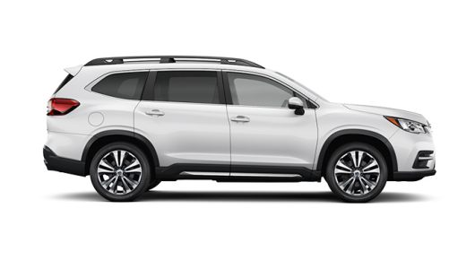
Car Management System
Team 5

Slide 2
Agenda
Team members
Problem statement
Use case diagram
Architecture analysis
Use case analysis
Search Car
Search Dealer
Save Favorite Car
Q&A

Slide 3
Team members
Nu Anh Thu, Truong
Thanh Tuyen, Le
Thi Nhat Van, Le

Slide 4
Problem statement
Connections between buyers and dealers.
Offers services that help consumers looking for cars from a dealer for purchase
Manage dealers’ information and help to verify their profiles.
Dealers can manage their cars information

Slide 5
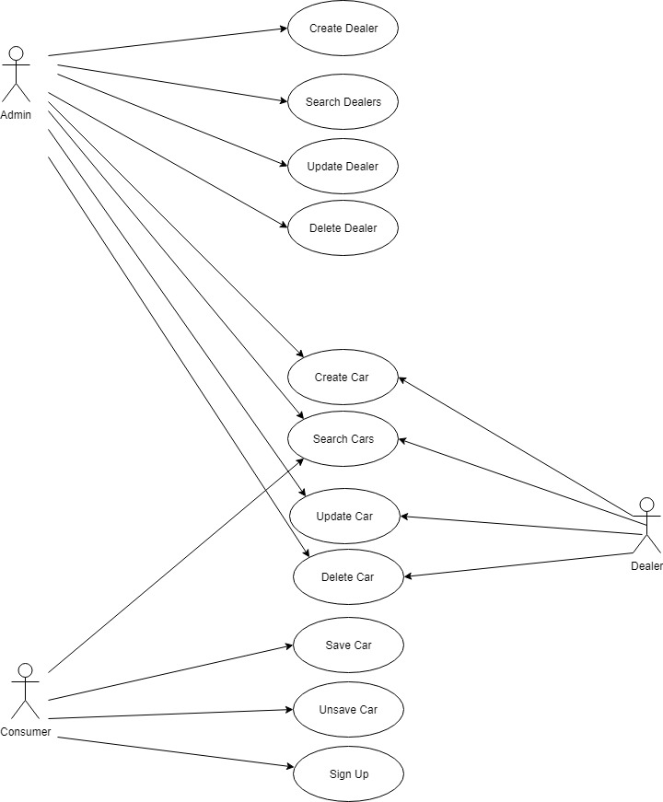
Use case diagram

Slide 6
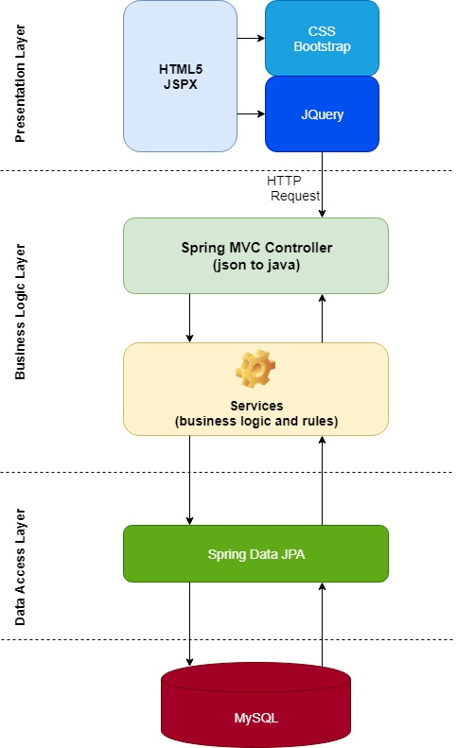
Architecture Analysis

Slide 7
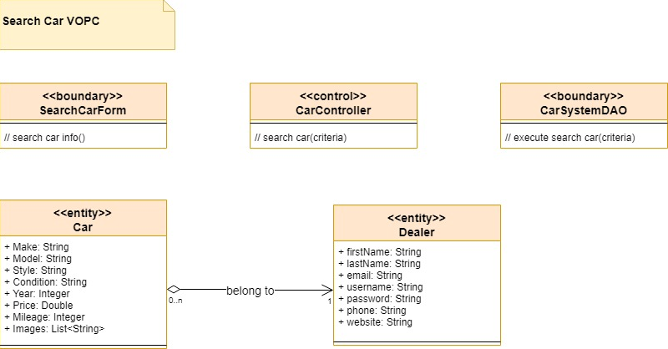
Use case – Search car

Slide 8
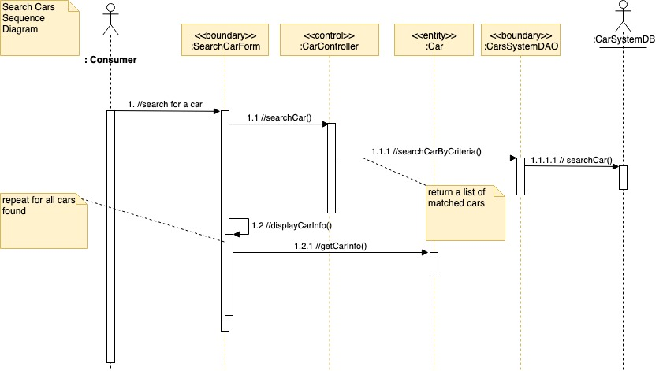
Use case – Search car

Slide 9
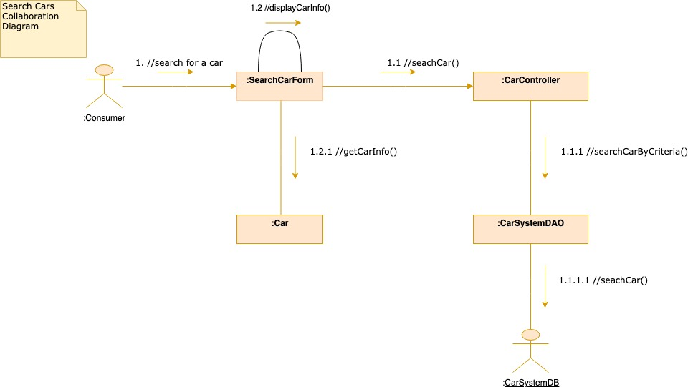
Use case – Search car

Slide 10
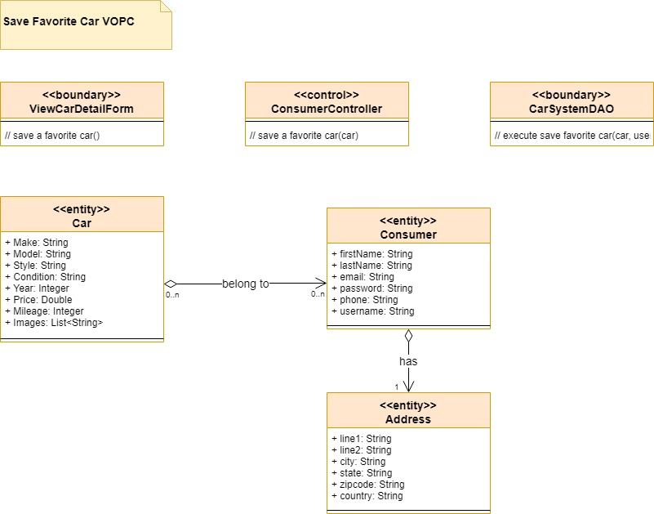
Use case - Save Favorite Car

Slide 11
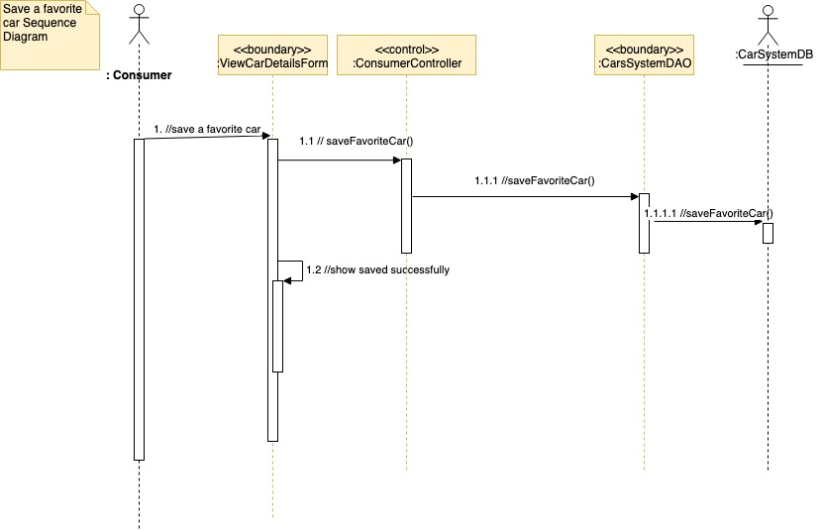
Use case - Save Favorite Car

Slide 12
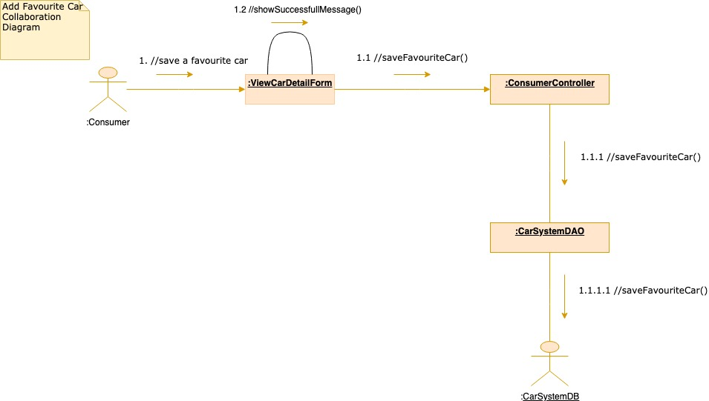
Use case - Save Favorite Car

Slide 13
Q&A

Slide 14
Thank you

